Slide 1
Progress on the IGU’s Triennium Strategic Plan
Coordination Committee
March-May 2017 Update
Mel Ydreos – Executive Director, Public Affairs and
Chair, Coordination Committee
Rod Rinholm – Acting Chair, Coordination Committee
Anette Sorum Nordal – Secretary, Coordination Committee
Terence Thorn – Sr. Advisor, USA Presidency

Slide 2
Agenda
General IGU Updates
Update on the Triennium Strategic Objectives
WGC 2018 Progress and Committee Guidelines
Committee Reports
Upcoming Events
  CC Meeting – Muscat, Oman
  IGRC2017 – Rio de Janeiro, Brazil
  Safety Summit – Washington DC, USA

Slide 3
General IGU Updates

Slide 4

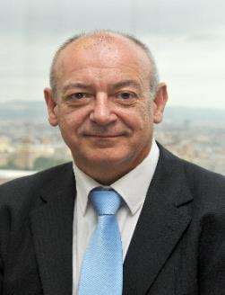



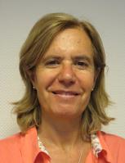
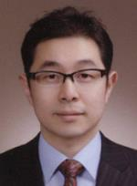
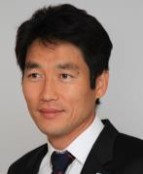

IGU Secretariat from November 1 2016
Secretary General
Luis Bertrán
IGU Director
Rafael Huarte
Chief Advisor
Antonia Fernández Corrales
Executive Assistant
Luisa Peris
Advisor
Hyunchang Kim
Senior Advisor
Taeksang Kwon
Coordination Committee Secretary/Information
Consultant
Anette Sørum Nordal

Slide 5
Update on the
Triennium Strategic Objectives

Slide 6
IGU Strategic Direction 2015-2018 Triennium
AREAS OF TRIENNIUM STRATEGIC FOCUS
Access Markets Social License
TRIENNIUM OBJECTIVES
Grow the global gas
market share
Key decision, policy makers and global agencies accept gas as an ally for their global/regional/local development and growth
Credible global Voice of Gas by being an advocate towards political, technical and economic progress of the gas industry
Support and facilitate innovation and industry best practices while delivering member value
TRIENNIUM GOALS
Effectively differentiate gas from the other fossil fuels
Advocate policies that support the greater use of gas including the key role in mitigating climate change and improving air quality
Advocate for the removal of market barriers that would result in greater use of gas
Effectively operationalize MOU’s with Strategic Partners
Engage in major events/opportunities to raise support for natural gas
Become active in relevant and important evolving developments
Increase profile of IGU reports, visitors to the Global Gas Portal and LinkedIn
Become relevant to key international journalists
Deliver an outstanding IGRC & WGC 2018
Effective communications and access to IGU’s leadership
Integrated Triennial work plan
Global focus; Regional impact
Increase member engagement in IGU related activities
Strive for “100”

Slide 7



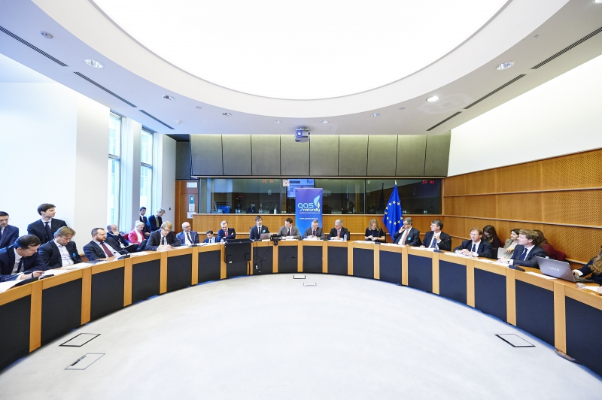

Grow the Global Gas Market Share
IGU/IEF Ministerial Gas Forum held in December 2016 in New Delhi, India. Report on Gas for Growth issued for the event.
Keeping focus on clean air: Released 2nd Edition IGU report on Urban Air Quality end-2016 and 3rd edition coming end-2017
Participated at Gas Week 2016 in Strasburg late November
IEA-IGU methane workshop held in Paris, February 2017 and another planned for March 2017 in Berlin, Germany

Slide 8




Gas Accepted as an Ally
Strategic Communications and Outreach Calendar developed further. This ensures better engagement in major events/opportunites to raise support for natural gas
Tatiana Khanberg engaged to assist Mel on advocacy an communications activities.
Strategic Partnerships Approach: Working to better link the work of the committees with IGU´s work with strategic partners.
Participating to the G20 Energy Sustainability Group also under the German Presidency. Releasing report on Gas in Marine Transport in relation to meeting end March.
IGU Diplomatic Gas Forums held in Amsterdam, Oslo & Washington D.C. in 2016. Planning events for 2017

Slide 9

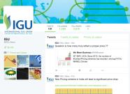


Credible Global Voice of Gas
Refreshed portal to be released in April 2017
New strategy for social media developed:
LinkedIn followers growing organically, targeted efforts to increase followers
Continued presence on twitter: @IGU_News with over 2200 followers
Continuing to reach out and build relationships with the major global media outlets and journalists.
Strong progress on the organization of WGC 2018 with input from the National Organizing Committee, host partners and the Financial Advisory Board

Slide 10





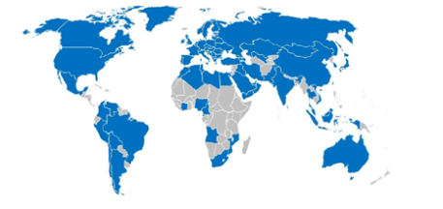
Deliver Member Value
Update of Facts and Figures section at www.igu.org
Policy positions will also be posted on the portal.
Preparing Technology & Efficiency report. To be released October 2017
New versions of IGU World LNG Report and IGU Wholesale Gas Price report coming in April and May
Continue to host Regional member outreach meetings
Ongoing project to develop the IGU Marketing Plan
Barbara Jinks contracted to assist the project

Slide 11
WGC 2018 Progress and Committee Guidelines

Slide 12
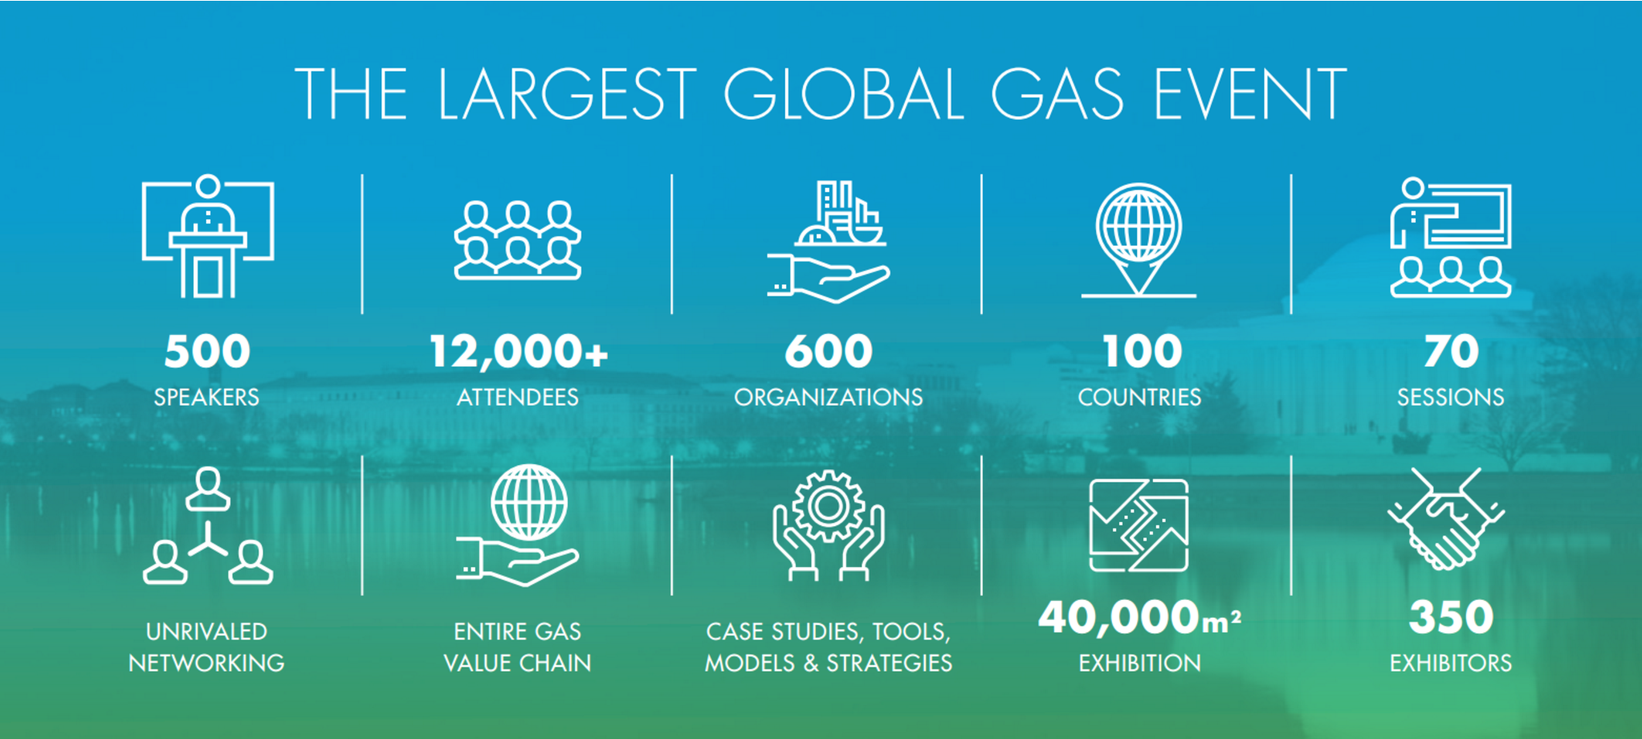
Update on WGC 2018 Programme

Slide 13
WGC 2018 Status Report
Exhibition – 80% of space allocated
  Numerous specialized pavilions
Sponsorship – Hosts/Principals/Diamonds confirmed
Conference
  Keynote sessions
  Luncheon sessions
  Current Issues Debates sessions
  Industry Insights Sessions – Call for Papers Launch
  Technical and Innovation Center – conducted on floor of exhibit hall
Engagement with outside audiences
  Diplomatic Corps
  Washington, DC based policy makers
  Customer Groups
  Regulatory Authorities
  Financial Community
  LPG
  Young Professionals
  STEM
Ongoing and Upcoming Marketing Activities wgc2018.com
  Newsletters, global events, USA events, CWC events

Slide 14
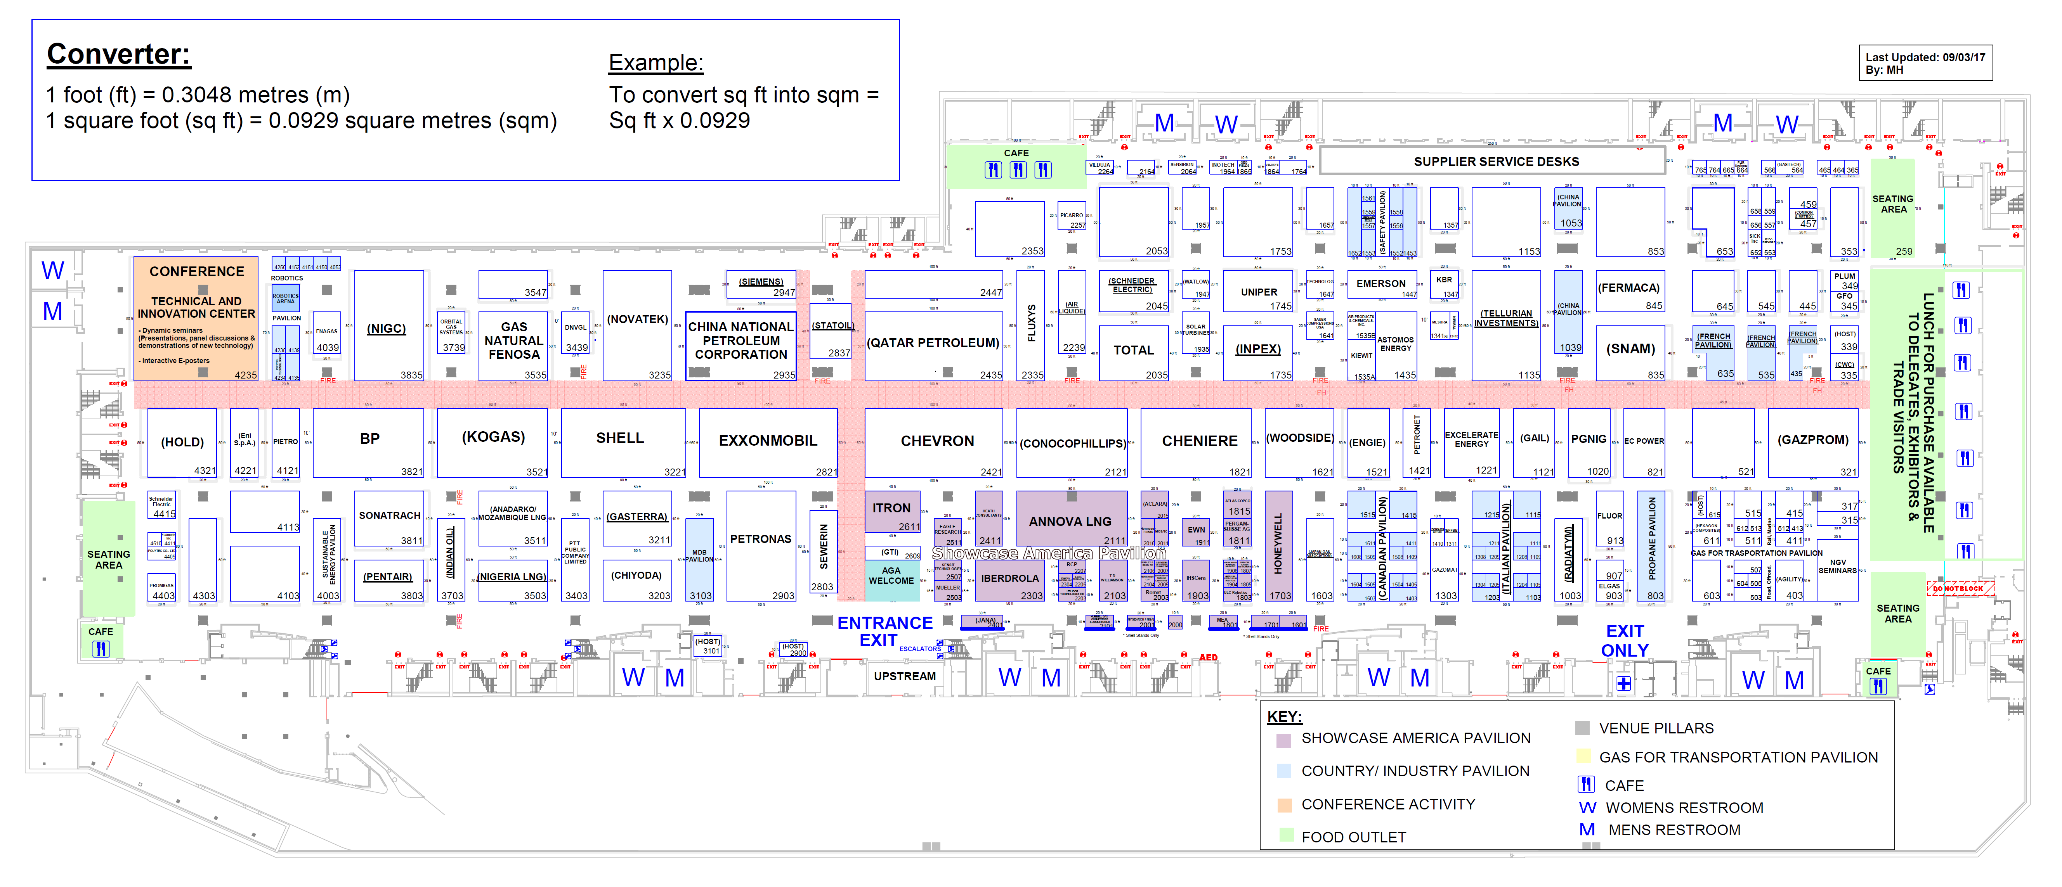
Exhibition Floorplan

Slide 15
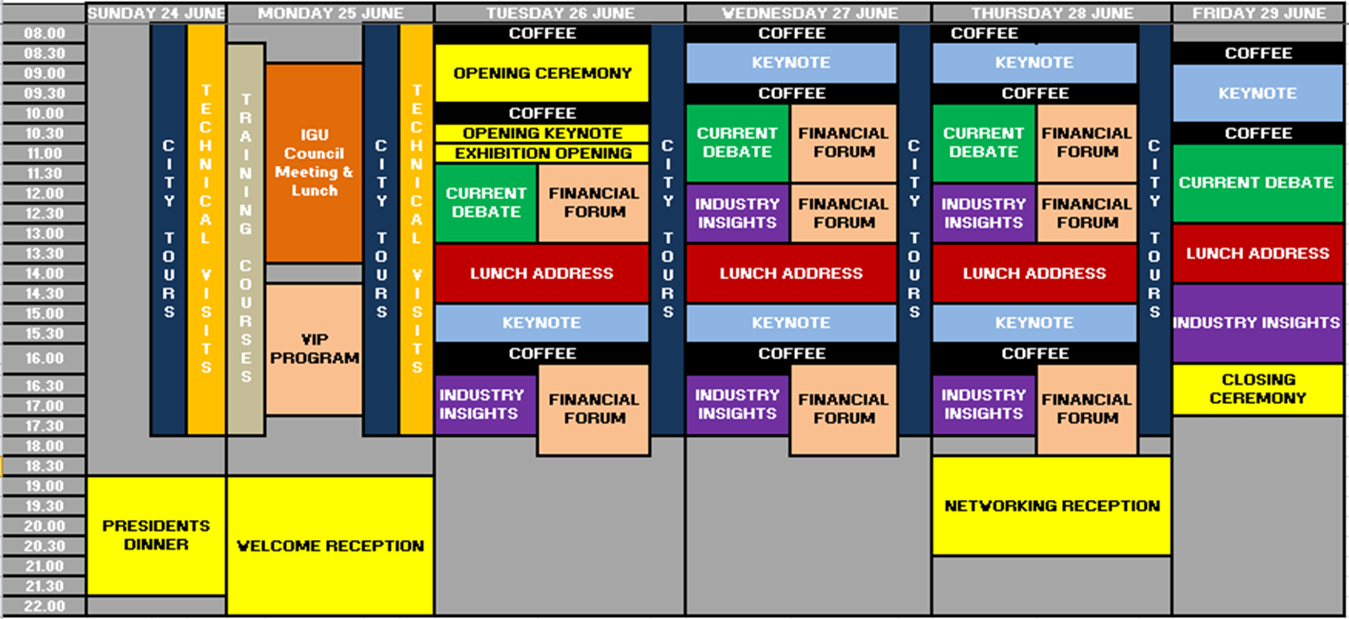
PROGRAM OVERVIEW
NB: Timings subject to change

Slide 16
Call for papers key dates
Feb – May 2016 | Spring Meetings: Committees are to familiarise themselves with these guidelines. Begin initial thoughts on sessions and topics
Oct 2016 | Fall Meetings: Committees to put forward a preliminary list of topics to be included in the Call for Papers
Dec 1, 2016 | Committees to confirm Session Titles
Feb 2017 | CWC to prepare guidelines for call for paper submission
Apr 5, 2017 | Call for Papers Launch
Sept 1, 2017 | Call for Papers Closes
Fall 2017 CC Meeting | Paper selection process to be discussed (after Oct 1, 2017)
Oct 1 – Nov 10, 2017 | Paper Reviewing
Nov 27, 2017 | Author Notification
Mar 9, 2018 | Author Final Paper Deadline

Slide 17
Committee Sessions at WGC2018
68 sessions currently defined by committees and task forces
  Industry Insight Sessions
  Technical and Innovation Center (TIC) Sessions
Adding session descriptions and specific CfP topics
Opportunity for additional TIC sessions based on Call for Papers results

Slide 18
M&C Committee Sessions at WGC2018
Three industry insight sessions currently planned
Potential for Technical & Innovation Center Session?
  Innovative best practices in gas industry marketing and communications
Contribution to Current Issue Debate session
  Global Alternative Futures for Natural Gas
  Public Perception Matters
Next step will be to finalize session description and specific Call for Papers topics
Number of sessions may be modified based on the review of the Call for Papers results in fall 2017

Slide 19
Awards at WGC2018
Nominees and selections in parallel with Call for Papers
  Global Gas Industry Award
    Awarded at WGC since 2008
    Objective of contributing to the progress of the gas industry through promoting innovation and sustainability
    Theme for 2018: The Role of Natural Gas in enhancing the quality of life, today and in the future
    Winner given monetary award, WGC2018 registration and expense coverage
  IGU Innovation Awards
    New award series defined and selected by Research Development and Innovation (RD&I) Committee
    Showcases the latest available technologies furthering the continued growth of the global gas industry

Slide 20
Innovation Awards
Showcases the next big innovations in natural gas
Administered by RD&I Committee
Awards offered in 10 categories
  Exploration and Production (E&P)
  Liquefied Natural Gas (LNG)
  Transmission, Processing and Storage
  Gas Distribution
  Domestic Utilization
Winners will present and receive certificates in dedicated Technical and Innovation Center sessions
Website and conference application will highlight winner’s equipment or innovative processes
  Commercial and Industrial Utilization
  Transportation Driven by Gas
  Digital and Smart Solutions
  Gas and Renewables
  Emissions Detection and Mitigation

Slide 21
Committee Reports
Expectation that each committee will publish a summary report of activities over the triennium
  Summarizes the primary results and insights
  All committee and task force summary reports will be online on IGU website and also aggregated in a compendium for WGC
  Structure and format for committee summaries from CC
Topic specific reports will also be produced for individual study groups as appropriate
  e.g., World LNG Report, Gas Price Report, other..
  Format from IGU and US Presidency similar to case study reports
Editing assistance and oversight available from M&C Committee
Content can also be targeted for IGU Newsletter, website, other channels

Slide 22
Upcoming meetings

Slide 23
Schedule of CC, EXC & Council meetings
IGU meetings 2015-2018 Triennium | Meeting periods and places | Coordination Committee meetings | Executive Committee and Council meetings | Council workshop
2017 | 28-30 March, Muscat, Oman | 28 March | 29 March
 | 24-26 October, Tokyo, Japan | 24 October | 25 October | 26 October
2018 | 17-19 April, Cairo, Egypt | 17 April | 18 April
 | 25-29 June, Washington D.C., USA WGC2018 | 24 June |  | 25 June

Slide 24

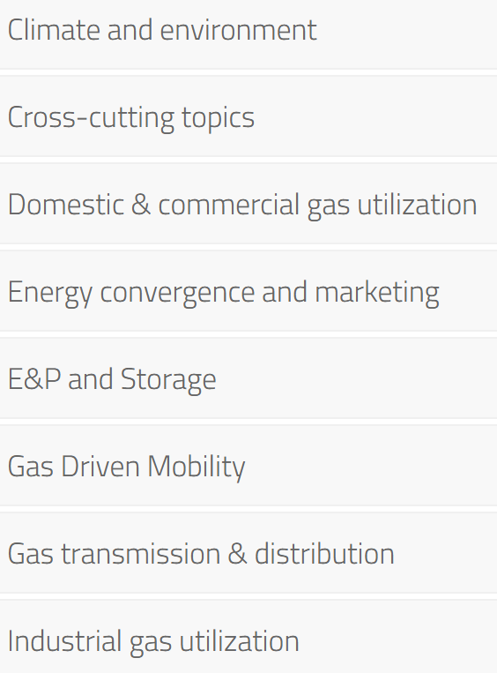
Conference Topics
International Gas Union Research Conference (IGRC)
  One of three primary events for IGU
Plenary sessions
  Natural Gas and Renewable Energy
  Innovations in the Gas Value Chain
  The Brazilian Gas Industry
436 approved papers and presentations
Exhibition
Targeting 500+ attendees
May 24-26 2017

Slide 25
IGU Safety Summit – November 6-7, 2017
Will be held in Washington, DC at the Omni Shoreham Hotel
Will be followed by AGA’s 11th annual Safety Leadership Summit, for those interested in staying for this separate program
The theme of the event is “Improving the Safety of Natural Gas Across the Globe”
Presentations focused on employee safety, contractor safety, public safety, and infrastructure safety/integrity
Program is intended for industry leaders across the world to share ideas and leading practices on enhancing safety.

