Slide 1
Model 2030-2040
Monthly flexibility need analysis

Slide 2
EU Gas consumption to decrease, flexibility questionable
Key trends:
Electrification (HPs, EVs, industry)
More intermittent generation
Insulation and other efficiency measures
Decarbonization

Slide 3
Power demand to increase, to be matched with renewables
The charts present two different scenarios
Equinor (Walls) - current trends, economic growth remains the key driver, energy transition that is slowly accelerating, but does not reach climate targets
Ember (Stated policies) - pathway aligned with stated national policies until 2035 (afterwards trajectory of zero emissions in the power sector at least cost by 2050 due to a lack of detail in official plans)
We consider Walls scenario more likely and we will use it to demonstrate our approach, however in the sensitivity analysis we will discuss various options
In Walls scenario Power demand to grow by 10% by 2030 (+266 TWh) and 18% by 2040 (+491 TWh)
Decline in fossil sources (-675 TWh by 2040) to be offset by
Growth in intermittent sources (+953 TWh by 2040) – what about their seasonal profile?

Slide 4
Supply: seasonal Swing being provided by gas, nuclear & coal
Current annual power consumption (& power supply): 2,777 TWh (2022)
We have applied 2017-2022 monthly profile on annual net electricity generation in 2022 as shown in the chart
Wind & solar can supplement each other smoothening the monthly pattern (using ratio 2.3:1 due to load factors of 24% & 11% respectively
Others of 172 TWh include bioenergy, geothermal, ocean, etc.
Seasonal swing (Oct-Mar vs Apr-Sep) of 189 TWh delivered mostly by gas (60 TWh), nuclear (48 TWh) and coal (47 TWh)
In the future seasonality will change (mainly due to heat pumps and electric vehicles)

Slide 5
DEMAND: HP penetration to affect Seasonal pattern
Electric vehicles (EVs) assumptions
Current penetration and consumption (2022): 6 mil. EVs (14 TWh)
2030/2040: 35/140 mil. EVs
Annual mileage: 11,300 km/car (2022) +23% in 2030/2040)
Avg. consumption: 0.2 kWh/km
Rather complex seasonality as mileage peaks in Sum while battery drain in Win
Heat pumps (HPs) assumptions
Consumption in 2022: 134 TWh
Number of units 2022: 20 mil. HPs of which 90% is used for space heating
Number of units 2030 / 2040: 40 mil. (Fit for 55) / 60 mil. (own assumption)
Highly seasonal consumption
To be further discussed in detail
Other power demand
By 2040 EVs to grow by 1770% (375 TWh), HPs by 200% (268 TWh), the remainder drops by 6% (153 TWh) to be consistent with Equinor Walls
We have applied 2022 monthly profile on this remainder demand
Overall seasonal pattern will be more pronounced in 2030+, mainly due to HP

Slide 6
In 2030/40 more power balancing will be needed
Seasonal demand swing will increase due to rising share of heat pumps:
189 TWh (6.8 % of annual) in 2022
283 TWh (9.3 %) in 2030
358 TWh (11 %) in 2040
All the sources apart from coal and gas are shown with the same seasonal pattern as in 2022 respecting the forecasted growth of each individual source
Coal+gas are used for balancing in our model. Their total share will decline notably from 35% in 2022 (983 TWh) to 10% in 2040 (330 TWh).
Seasonal pattern for coal+gas will be much more prominent

Slide 7
Heating demand
We have split gas consumption into three segments:
Gas to Power (89 bcm)
Flat consumption (summer demand excluding GtP) which is mostly industrial demand (177 bcm)
Remaining seasonal consumption - most of it being space heating (126 bcm)
Seasonal demand is well correlated with Heating Degree Days (HDDs)
HDDs are calculated as T_{m} ≤ 15°C Then [HDD = ∑_{i}(18°C - T^{i}_{m})] Else [HDD = 0]
We have used historical HDDs in calculating HP demand in connection with their varying efficiency
HDDs as shown in the chart are based on daily data and weighted across 10 European countries by volume of consumption (also national data are weighted this way)

Slide 8
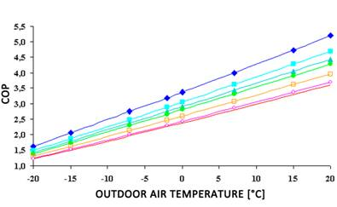
Heat Pumps: Number of units to double by 2030
Existing stock (2022) of HPs used for space heating is 18 mil. (90% of 20 mil. shown in the chart)
This represents 13.7% share of heating market (in terms of number of buildings) and 5.1% share of power demand (134 TWh)
HP heating consumption of 134 TWh has been quantified as:
Current residential consumption: 95 TWh (81 TWh sourced from Eurostat for 2021 + 17% increase in HP stock in 2022)
We assume the same share of HPs on heating demand in non-residential sector
Average efficiency of HPs is modelled at 340% (ranging from 150% at -20 °C to 440% at 20 °C assuming heating medium temperature (Tw) of 43 °C as illustrated in the chart) resulting from our calculations with historical daily data
Seasonal profile utilizes HDDs. Due to varying efficiency the seasonality is slightly more pronounced than that of HDDs
HP heating consumption to increase in 2030 and 2040 to 268 and 403 TWh respectively, representing 8.8% and 12.3% share of the yearly power demand.
Heat Pump Efficiency Across Temperature
Source: REHVA Federation of European Heating, Ventilation and Air Conditioning Associations

Slide 9
Building stock will be better insulated and with more HPs
Building stock: quality
Although there is 18 mil. HPs used for space heating in 2022, for this analysis (normalized buildings) we consider normalized figure of 23 mil. and also assume that HPs are used only in insulated buildings
We assume 20% (34 mil.) of normalized buildings are well insulated (and 23 mil. of them have HPs). The remaining 11 mil. will have HPs installed by 2040.
Increased share of well-insulated buildings will come either from replacement (1% p.a. mentioned above) and renovation (1% p.a. by 2030 & 1.5% p.a. in 2030-2040)
RePowerEU target is 2.1% p.a. in 2030 (medium & deep renovation)
We estimate 32% energy saving resulting from insulating of a building (as an average of two sources mentioning 21% and 44%)

Slide 10
Seasonal profile to be more prominent
Annual gas consumption with seasonal element is assumed to decrease by 19.4% by 2030 and 47.5% by 2040
The decrease of seasonal swing will be much less dramatic: by 5.5% by 2030 and 16.9% by 2040
Decreasing need for seasonal swing in the heating segment will be partly offset by GtP segment

Slide 11
Scenarios for power generation: Monthly profiles
Base case:
20/40/60 mil. HPs
2%/2.5% replacement + renovation
6/35/140 mil. Evs
Higher share of solar on power supply results in higher swing (see the table)
S/W swing in TWh
Scenario | Eq - Walls | Ember - St. pol. | IEA - St. pol.
2022 | 1,190
2030 | 1,125 | 1,166 | 1,243
Share of solar | 10% | 15% | 19%
Share of wind | 24% | 32% | 30%
2040 | 989 | 1,187
The more rewewables installed – the greater need for flexibility from gas (storage)

Slide 12
Thank you for your attention

Slide 13
WE Focus on 2 segments of gas consumption: Heating & GtP
Scope: EU27
Annual gas consumption (2019-2022): 4,321 TWh ~ 393 bcm (using 11 kWh/m3) can be split into
Gas to Power (GtP)
Heating
Other (non-seasonal, mainly industry)
Year 2023 shows signs of demand decrease of which a significant part wil be permanent – not reflected yet [TO DO]
Only GtP and Heating are volatile / seasonal, therefore we focus only on these

Slide 14
Coal/Gas switching: Coal diminishing, gas for flexibility
From calculated coal+gas power generation (top right chart) we assign volume to coal based on the pace of planned phase-out (as shown below) compared to current generation
Gas gets the remainder, which might be slightly conservative assumption (see Q2 in the bottom right chart)
Under certain scenarios coal+gas can turn negative - then hydro is curtailed first in our model

Slide 15
HP sensitivity
HP in mil. units
Scenario | Slow | Base | Rapid
2022 |  | 20
2030 | 34 | 40 | 50
2040 | 44 | 60 | 100
S/W swing in TWh
Scenario | Slow | Base | Rapid
2022 | 1,190
2030 | 1,105 | 1,125 | 1,158
2040 | 922 | 989 | 1,114

Slide 16
Insulation Sensitivity
Replacement + renovation+ p.a. (%)
Scenario | Slow | Base | Rapid
2022 | x | x
2030 | 1.6% (0.8/0.8) | 2.0% (1.0/1.0) | 2.7% (1.2/1.5)
 |  |  | 3.3% (1.2/2.1)
 |  | 2.5% (1.0/1.5)
2040 | 1.6% (0.8/0.8)
S/W swing in TWh
Scenario | Slow | Base | Rapid
2022 | 1,190
2030 | 1,138 | 1,125 | 1,102
2040 | 1,039 | 989 | 933

Slide 17
EV sensitivity
EV in mil. units
Scenario | Slow | Base | Rapid
2022 |  | 6
2030 | 25 | 35 | 50
2040 | 90 | 140 | 170
S/W swing in TWh
Scenario | Slow | Base | Rapid
2022 | 1,190
2030 | 1,128 | 1,125 | 1,121
2040 | 940 | 989 | 995

Slide 18
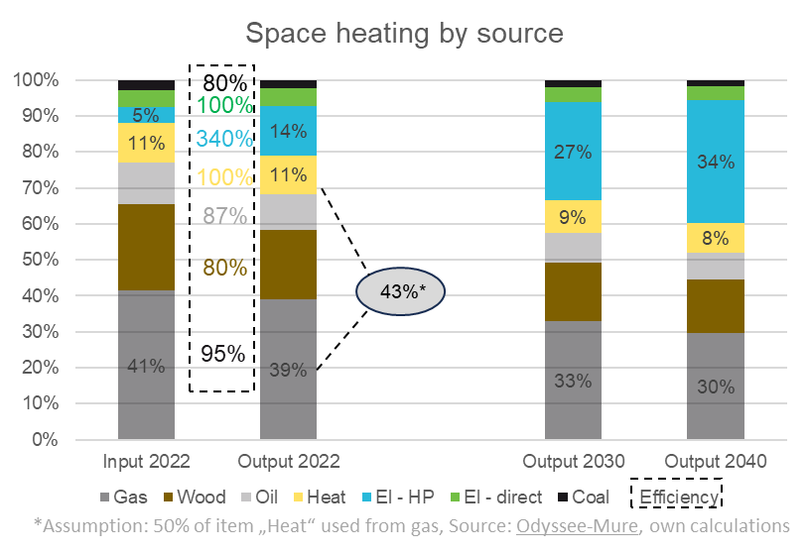
Gas for Space Heating
Space heating demand
There are fundamentally three ways how space heating demand for gas will decrease in the years to come:
Fuel switching to HP
Better insulation
Climate and behavioral changes - not reflected yet [TO DO]
The overall effect on seasonal demand will be a decline by 17.1% by 2030 and 37.7% by 2040
Fuel switching to HP
Increased penetration of HPs will pressure gas market share from 44% (2022) to 37% in 2030 and 34% in 2040 (we assume HPs will be replacing all the other sources proportionally)
[TO DO: prioritise oil/coal to HP switching]
Better insulation
Annually 2.0% or 2.5% (up to vs. after 2030) of building stock will be newly built or newly renovated, resulting into 36% and 61% of buildings well insulated in 2030 and 2040 respectively (up from 20% in 2022)
Great part of these replacements / renovations will be connected with HP installation, thus the overall effect will be combined
[TO DO: allocate gas demand replacement to various factors]

Slide 19
Scenarios for power generation: assumptions & Annual
We present here three scenarios for power generation
Equinor (Walls) fits the best given the current trajectory of renewables
RePowerEU target for wind+solar share in 2030 is 55%
Scenario | Actual (2022) | Equinor (Walls) | IEA (Stated policies) | Ember (Stated policies)
Power demand in TWh (2030/2040) | 2,777 | 3,043 / 3,268 | 3,256 / n.a. | 3,000 / 4,359
Wind+Solar share (2030/2040) | 23% | 34% / 48% | 49% / n.a. | 47% / 72%
CO2 emissions reduction (1990 vs 2022 or 2050) | 27% | 81% | 76% | 100%

Slide 20
Sensitivity scenarios (using Walls for power generation)
We model three scenarios in the sensitivity analysis (Base scenario was described so far in the presentation)
In all of them Equinor (Walls) is used for power generation segment
Scenario | 2022 | Slow | Base | Rapid
HP in mil. units (2030/2040) | 20 | 34 / 44 | 40 / 60 | 50 / 100
Replacement + renovation p.a. (%) (2030/2040) |  | 1.6%/1.6% | 2%/2.5% | 2.7%/3.3%
of which (insulation/replacement) |  | (0.8/0.8) | (1/1)/(1/1.5) | (1.2/1.5)/(1.2/2.1)
EV in mil. units (2030/2040) | 6 | 25/90 | 35/140 | 50/170

Slide 21
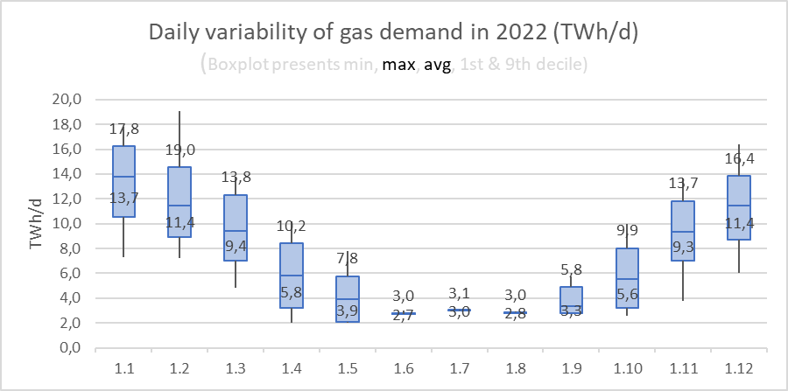
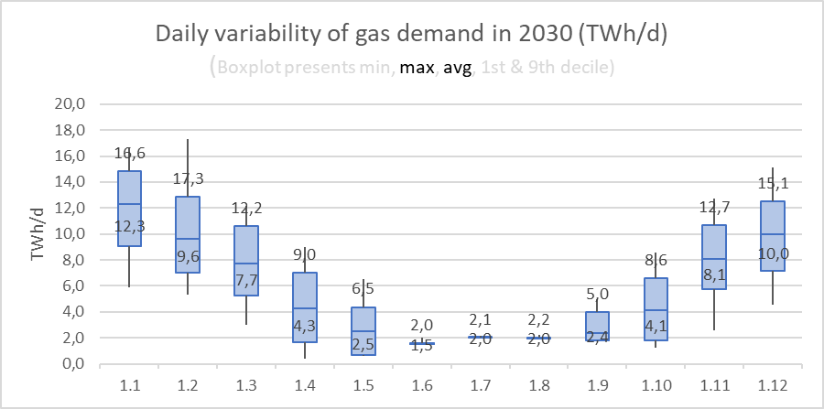
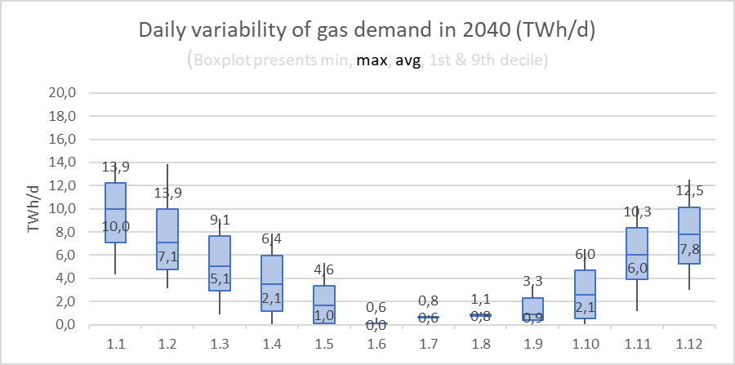
Daily variability of gas demand

Slide 22
Backup
Scenarios to 2030 | 2022 | Fit for 55 | RePowerEU | Base
HP in mil. units 2030 | 20 | 40 | 41.5 | 40
of which (medium&deep renovation) | <0.8% | 1.9% | 2.1% | 0.8%
Installed wind capacity in GW | 204 | 469 | 510 | 342
Installed solar PV capacity in GW | 207 | 530 | 592 | 330

Slide 23
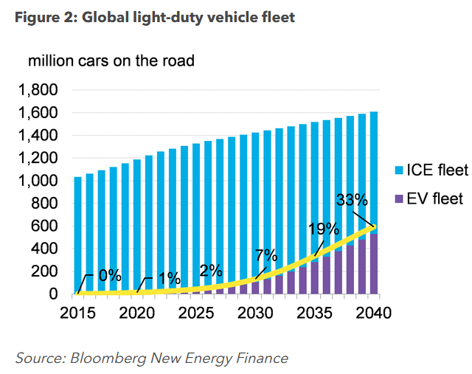
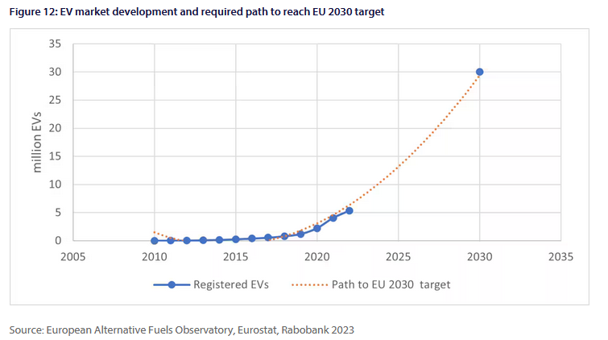
BACKUP
Electric vehicles (EVs)
2022: 6 mil. Evs (https://alternative-fuels-observatory.ec.europa.eu/transport-mode/road/european-union-eu27)
2030: 35 mil. Evs (More specifically, EU road passenger transport must reach 30m electric vehicles by 2030, close to six times more than the 5.3m registered today https://www.rabobank.com/knowledge/d011340306-the-takeoff-of-the-passenger-electric-vehicle-market-a-pathway-toward-the-eus-2030-e-mobility-targets, https://www.consultancy.eu/news/5766/europes-electric-vehicles-fleet-to-reach-40-million-by-2030)
2040: 140 mil. Evs (https://www.iea.org/data-and-statistics/charts/global-ev-stock-by-mode-in-the-sustainable-development-scenario-2020-2030, https://www.iea.org/data-and-statistics/charts/electric-vehicle-fleet-in-2040-in-the-future-is-electric-and-new-policies-scenarios , The deployment of electric vehicles (EVs) is expected to quadruple over 2031-2040 (GIE))
Avg. consumption: 0.2 kWh/km (https://ev-database.org/cheatsheet/energy-consumption-electric-car)
Annual mileage: 11,300 km/car (2022) +23% in 2030/2040) (Change in distance travelled by car | ODYSSEE-MURE , https://ev-database.org/cheatsheet/energy-consumption-electric-car)
Kms peak in Sum, battery drain in Win (Range test: How far can electric cars go in winter? | What Car?)

Slide 24
backup
Heat pumps (HPs)
2022: 20 mil. HPs (90% used for space heating, EHPA market report 2023)
2030/2040: 40/50 mil. (RePowerEU & Fit for 55, 90% used for space heating, ATMO 2022)
Insulation
replacement rate of 1% p.a. (https://www.knaufinsulation.com/news/insulating-all-europes-residential-buildings-can-cut-energy-demand-for-space-heating-by-44)
Insulation rate of 0,8% p.a. (1% of 136 mil. (not insulated buildings)) How-to-stay-warm-and-save-energy_final-report(2).pdf
Savings via insulation: 32% (avg. Calc. From Measuring the Returns to Home Insulation and BPIE)
Building stock
131 mil. buildings in EU (119/12) https://www.rics.org/news-insights/energy-efficiency-of-the-building-stock-in-the-eu
3:1 in square meters (EC Technical reports)

