Slide 1
IGU Storage Committee Meeting
Daniel Golja
Energy Institute Hrvoje Požar
Croatia
Paris, April 10-12, 2024

Slide 2
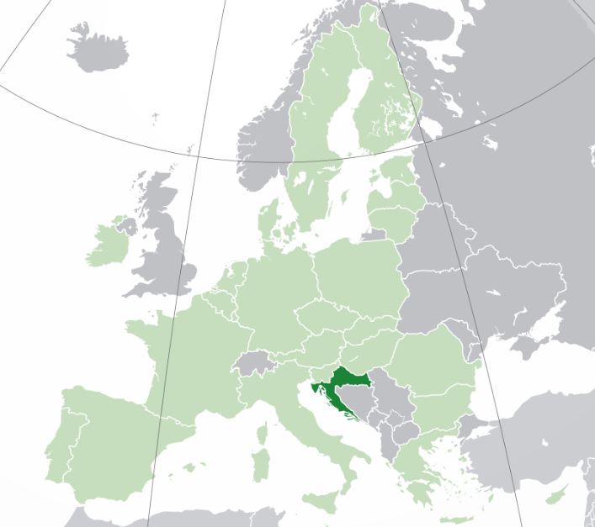
Intro
Croatia
Population: 3.87 million
Gas consumption: ≈2.8 bcm/a
Gas production: ≈0.8 bcm/a
Gas IP: with Slovenia, and Hungary
LNG terminal: 1
UGS: 1
2
Notes:
Population (Census 2021)
Consumption up to 3 bcm, 2.8 bcm on average, slightly above 2.5 in 2022
Production (gas fields in the Adriatic Sea, and onshore in the northern part of Croatia) - 745 mcm in 2022 – 29% of consumption covered

Slide 3
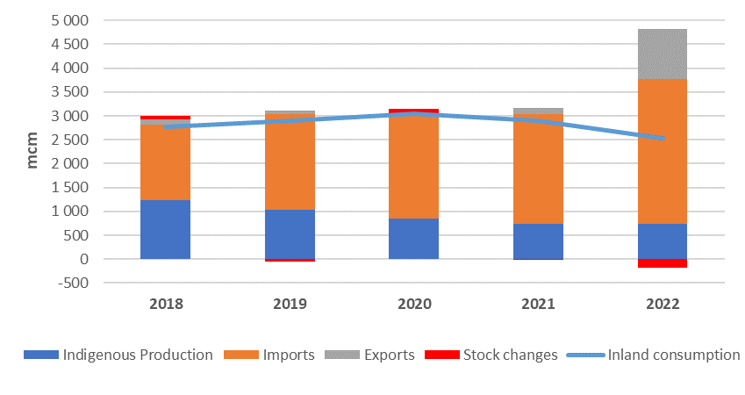
Natural gas energy balance
742 %
Export 2022/2021
Source: Energy in Croatia 2022, Annual Energy Report
3
Notes:
Domestic gas production decreases over the years, imports increases, and gas consumption is relatively stable.
It can be noticed that the export of natural gas increased significantly in 2022. This is due to the switch in gas supply that occurred due to the geopolitical situation. Namely, gas is now supplied via LNG terminal and there is some amount of gas that transits from the LNG terminal towards Slovenia, and Hungary.

Slide 4
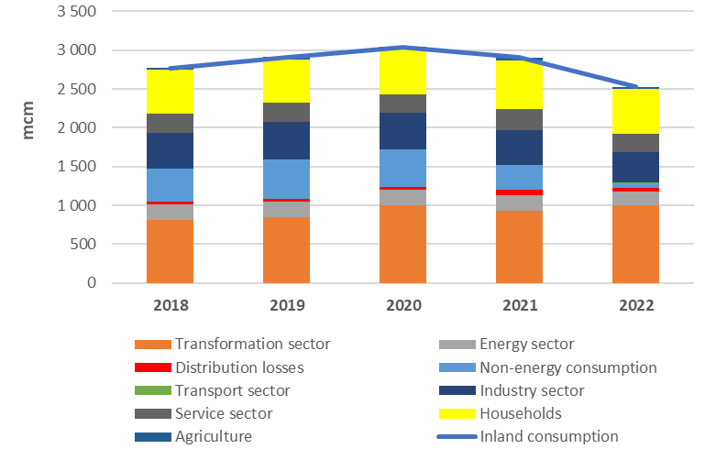
Natural gas consumption
-12.9 %
Natural gas consumption 2022/2021
Source: Energy in Croatia 2022, Annual Energy Report
4
Notes:
In 2022, there was about a 13 percent decrease in gas consumption (mostly driven by the decrease in gas consumption in refineries, and in the petrochemical industry (due to high prices of natural gas).
Croatian fertilizer factory is the biggest single user of natural gas (consumption of up to 500 mcm of gas per year, while in 2022 the consumption was only about 62 mcm, which is 81% less than in 2021, or about 88% less than in 2020.

Slide 5
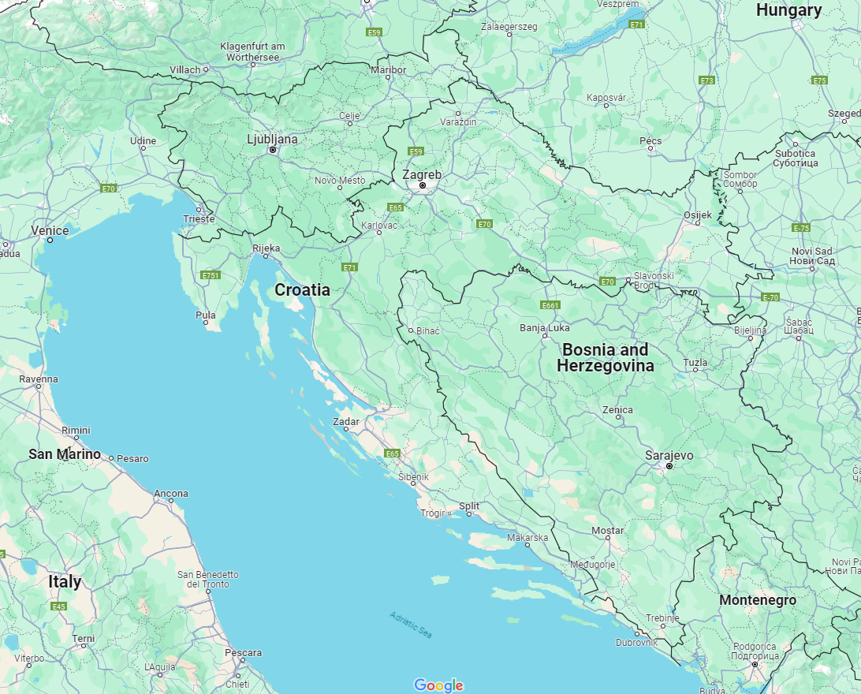
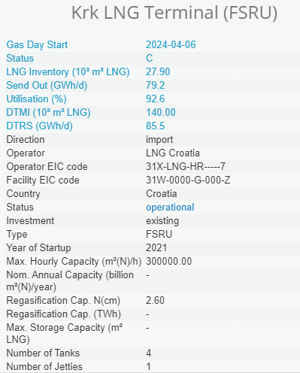
Krk LNG Terminal
5
Notes:
In terms of gas supply, most of the gas in Croatia today comes in the form of LNG via LNG terminal.

Slide 6
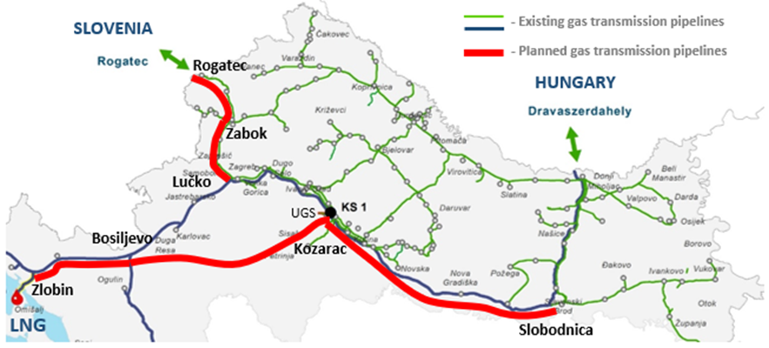
Krk LNG Terminal
Commissioned 01/01/2021
Regasification capacity: initial 2.6 bcm, increased to 2.9 bcm in April 2022 (limited by the maximum capacity of the gas pipeline system)
On August 18, 2022, the Croatian government adopted a Decision to increase the SoS by the construction of the gas transmission pipeline Zlobin-Bosiljevo (155 M€) and increasing the capacity of the LNG terminal to 6.1 bcm (25 M€)
6
Notes:
The technical capacity now is 338 000 m3/h or 2.9 bcm/y – bottleneck in the TS.
To fully utilize the expanded capacity of the terminal, and to enable higher quantities of gas from the terminal to be transported toward neighboring countries, new transmission pipelines are needed (presented in red lines).

Slide 7
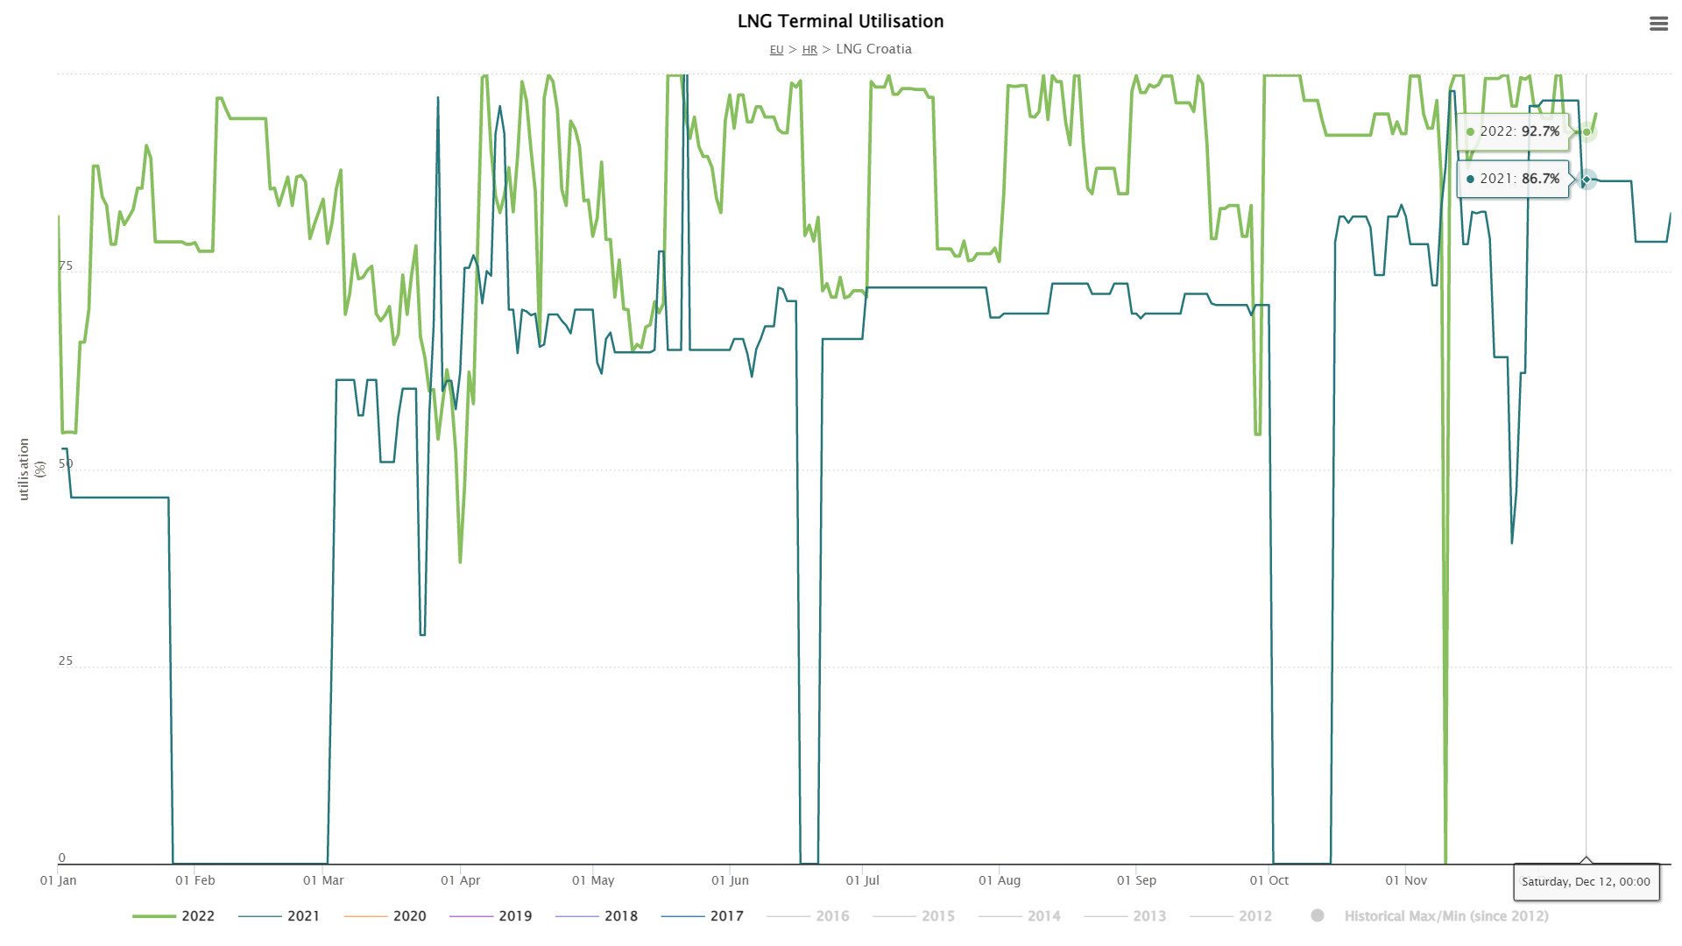
LNG
Krk LNG Terminal Utilisation
7
Notes:
Capacity is sold out until 2034?

Slide 8
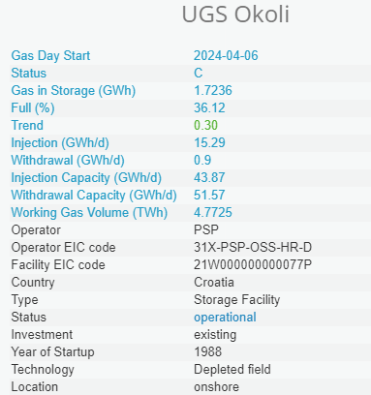
Existing UGS
8
Notes:
UGS is located in central Croatia, about 50 km SE from Zagreb.
Depleted field, commissioned in 1988
WGW: 438 mcm
Injection: 180 000 m3/h (4.32 mcm/day)
Withdrawal: 240 000 m3/h (5.76 mcm/day)
Pressure (entry/exit at the connection point to the transmission system): 25 to 45 bar

Slide 9
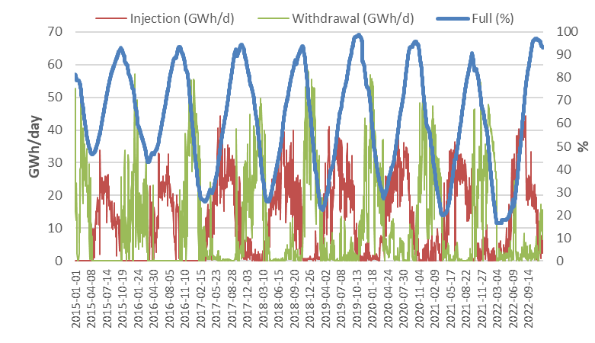
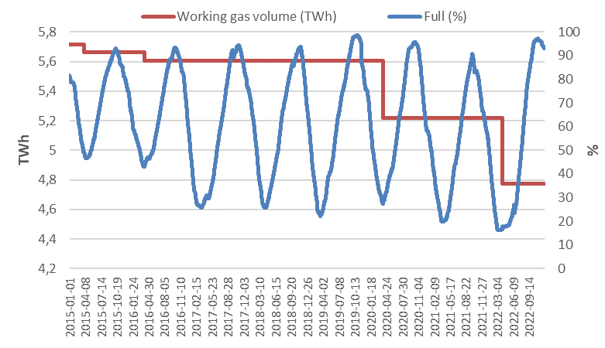
Existing UGS Data
WGW: 4.77 TWh
9
Notes:
Here are the data for injection, withdrawal, and the occupancy of the gas storage in the period from 2015 …
As you can see from the curves, this storage is used as seasonal storage – The injection phase is from the 1st of April till the end of September (+/-30 days), while the withdrawal phase is from the 1st of October till the end of March.
So, currently, it is in the injection phase, and it’s 37% full (08.04.2024).
Also, we can see that the WGW of the storage decreased.
The problem is that due to the natural and geological characteristics of the depleted field, the output capacity of the storage rapidly decreases after about half of the gas volume is withdrawn. This is why it is not possible to withdraw sufficient gas quantities during the high gas demand. Effectively, only about 350 mcm of gas are available each year.
That is why it has been decided to build a new gas storage facility in Grubišno Polje, which will have a small volume but a large output capacity, thus enabling the coverage of peak gas demand.

Slide 10
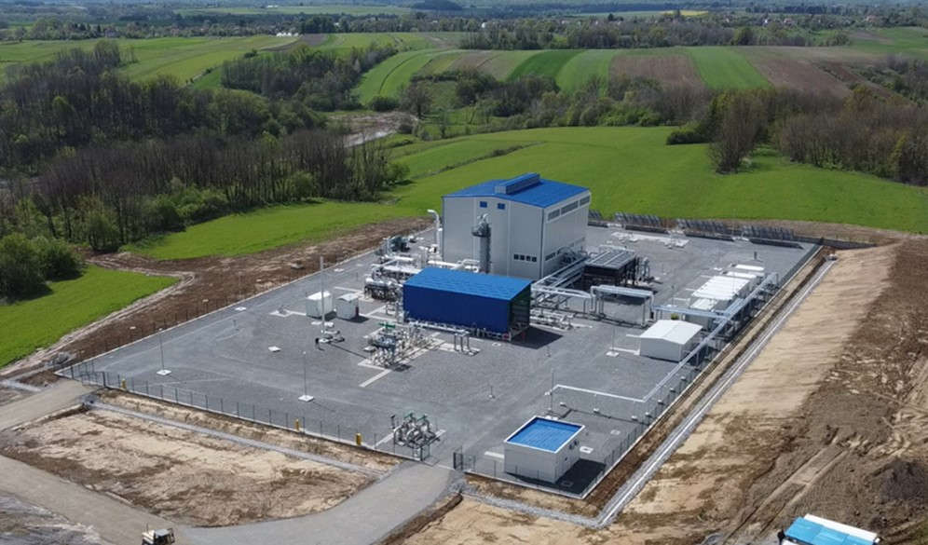
New UGS Grubišno Polje
1st phase: exploitation of the reservoir gas (≈32.6 M€)
2nd phase: conversion of the gas field into UGS (≈33.2 M€)
WGW: 60 – 100 mcm
Max Injection: 70,000 m³/h
Max Withdrawal: 100,000 m³/h
New gas station
Existing UGS
New UGS (planned for 2027)
10
Notes:
The new UGS is located about 85 km east (aerial distance) from Zagreb, and about 50 km from the existing gas storage.
This is a gas field with about 200 mcm of gas, of which about 150 mcm can be extracted. However, reservoir gas contains about 18% nitrogen, which was very challenging, and production never started.
Technical documentation was prepared, the necessary permits were obtained and construction works started in February 2022. Until July 2023, the gas station with a compressor station was built, as well as the connection pipelines to the gas transmission network, and the exploitation phase started. This phase is expected to last 3 to 4 years.
The 2nd phase of the project is expected to start this year. It includes the development of up to 8 new wells and the extension of the gas station.
In the end, it is expected that storage will have a WGW of 60 -100 mcm, which is about 20% more gas storage volume compared to the existing gas storage.
Injection and withdrawal will be about 40% higher.

Slide 11
EIHP - Selected gas projects/references
Study on the implementation of the new Regulation (EU) 994/2010 concerning measures to safeguard security of gas supply in the Energy Community (ECS, 2013)
Implementation of the system of measurement and calculation of gas transport in energy units (Plinacro, 2013)
Consulting services for the preparation of the LNG terminal project for co-financing from the Connecting Europe Facility program (Plinacro, 2014)
Gas Development Master Plan for Montenegro (COWI IPF Consortium, 2015)
Gas Master Plan for Albania (COWI IPF Consortium, 2016)
Technical Support for Eastern Europe Natural Gas Partnership (USAID/USEA, 2017)
Optimization of the Regional Gas System to Reach Lowest Cost Maximum Diversification of Gas Supply for Target Year 2040 (USAID/USEA, 2018)
11

Slide 12
EIHP - Selected gas projects/references
Support for Improvement of Methodology for Gas Distribution Grid Tariffs in Ukraine (ECS, 2018)
Bosnia and Herzegovina Southern Gas Interconnector Feasibility Study (EBRD, 2020)
Albania, Dumrea UGS Feasibility Study (Egis, 2020)
Three Seas Initiative + 1 (Aegean Sea) Market Integration Study (USAID/USEA, 2020)
Feasibility analysis of the incorporation of the Croatia gas exchange (CROPEX, 2022)
North Macedonia - Kosovo Gas Interconnection Feasibility study (Egis, 2021)
Kosovo Gas Development Plan and Regulatory Framework Review and Assistance (Egis, 2022)
Potential of hydrogen production, biomethane production, and geological storage of CO₂ for decarbonization of gas transmission system (Plinacro, 2022)
Projections of Natural Gas Annual and Peak Demand in Georgia Through 2050 (USAID/USEA, 2023)
12

Slide 13
Thank you for your attention

