Slide 1
Market for Underground storage in Germany
What are the challenges from “Service” point of view
Dr. Amer ABDEL HAQ
UGS GmbH
Germany

Slide 2
1.1 With a share of 56.0%, the electricity generated
and fed into the grid in 2023 came mainly from
renewable energy sources.
Which Markets?
1- Market For Gas
From (A) Pipeline to (Z) End Consumers
2- Market For Services and Technologies
Equipment
Classical Storage Market
Engineering
Personal
1.2 German Government booked all possible spaces
of underground storage to guarantee security
of supply
1.3 Gas storage operators are safe in terms
of financial Planning.
1.4 Gas storages in Germany are relatively new
1.5 Gas storages in Germany are sufficient
at the time being
1.6 No urgent need for big scale investment
1.7 H2-Storage is being developed but only in
pilot-format

Slide 3
2.1 Main producers of storage equipment are no more
Existing in Germany (Haliburton Baker Hughes) if not
totally then partially
2.2 No sufficient storage projects are needed
(green field projects)
2.3 Switching to Hydrogen-Products
2.4 Geothermal Market is extremely increasing
2.5 Lack of qualified workers
(43.1% of firms reported suffering from a shortage
of qualified workers)
2.6 No good prospects for the future (student numbers
are dramatically decreasing)
2.7 Inflation (2020:0,5% - 2021: 3,5% - 2022:7%
2023:6% in total 17%)
Which Market
1- Market For Gas
From (A) Pipeline to (Z) End Consumers
2- Market For Services and Technologies
Equipment
Classical Storage Market
Engineering
Personal

Slide 4
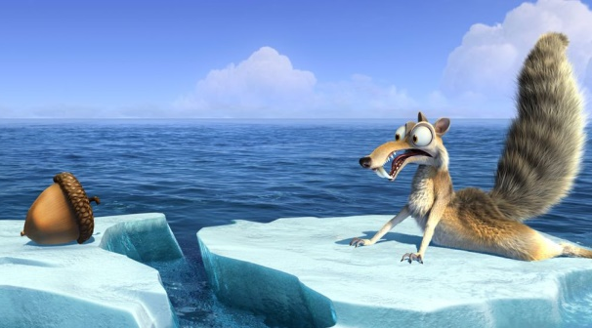
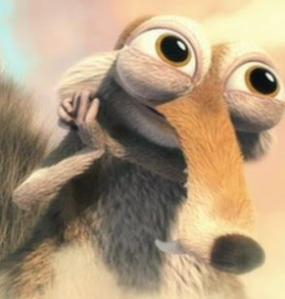
§
Challenges
Work restrictions
Sick leave
Enormous expenses
Feasibility studies/pilot projects
Infrastructure
Funding and politics
Follow up development
Knowledge/Investment
Infrastructure
Change management
Armed conflict in UA
Armed conflict(s) in ME
Political upheavals and armed conflict(s) in NA
Global warming/Climate change

Slide 5
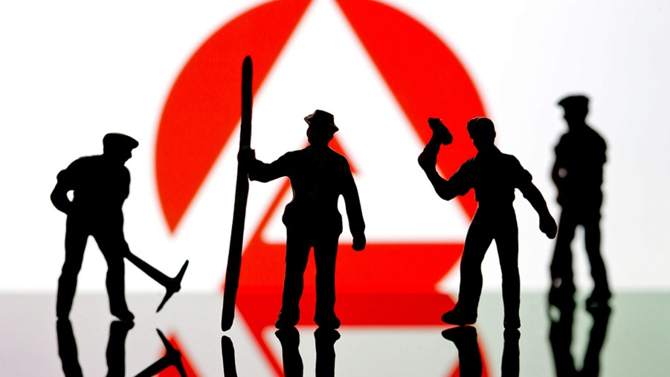
Moving to Germany as a skilled worker
THE Challenge
https://www.auswaertiges-amt.de/en/skilled-worker-immigration/2304796

Slide 6
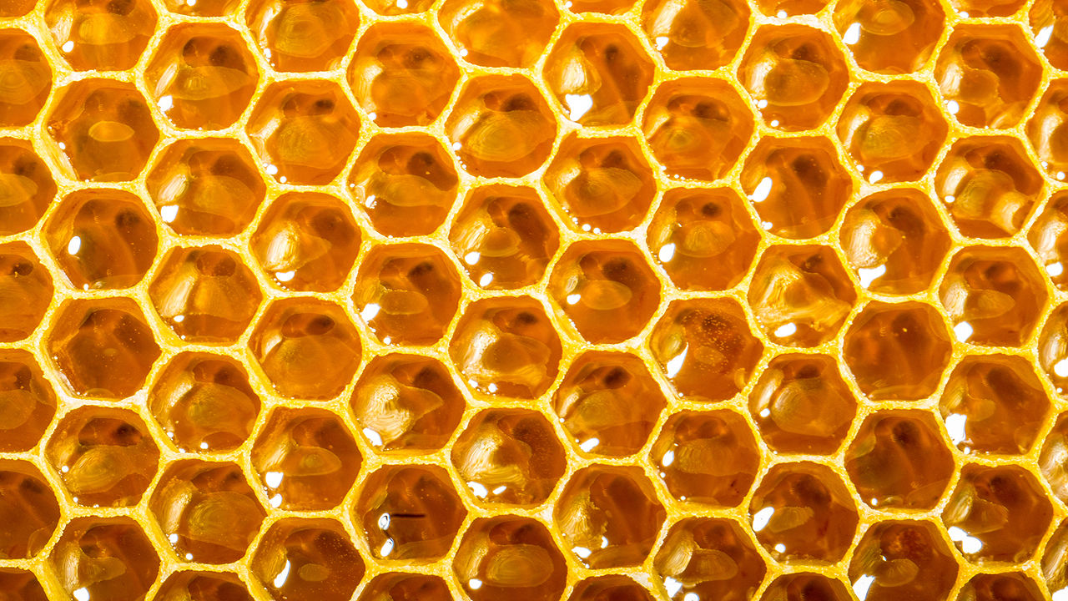
THE Challenge
2 mm
$$E_{kin} \overset{⇔}{into} E_{th}$$
25°C to 40°C

Slide 7
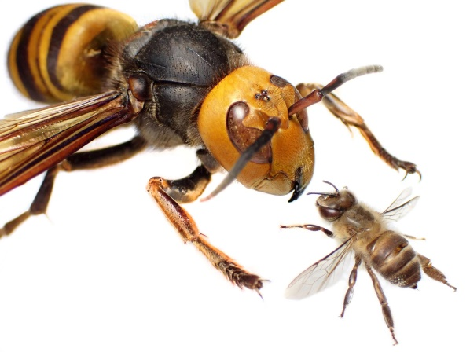
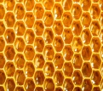
THE Challenge
Homeoffice
Work life balance
Headhunters
Claiming a navigation system
HH
Labour union
20% Honey increase
WizWizWiz.HydrogenHoney.bees

Slide 8
Conclusion
To be honest!
I don`t know.
I don`t know how to solve this very big problem and in which business form we should exist in the future!
What is about your opinion????? Please .

