Slide 1
Commercial dispatching synergies
Radovan Predajňa

Slide 2
NAFTA in Europe
SK / CZ / AT / HU / UA / DE / GB

Slide 3
NAFTA
UGS operations in Europe
SK / CZ / AT / DE / GB

Slide 4
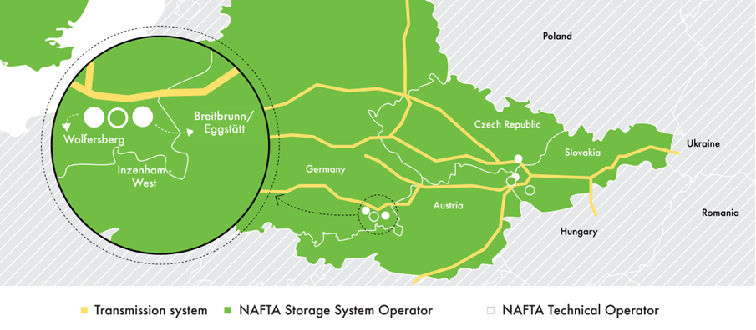
NAFTA
UGS operations in Europe
SK / CZ / AT / DE

Slide 5
NAFTA / Look into the past (10 years ago year 2014)
DEA/NAFTA Speicher
Inzenham – West (DE)
WGV 4.8 TWh
POZAGAS
Slovakia
WGV 6.9 TWh
SPP-STORAGE
Czech Republic
WGV 6.9 TWh
NAFTA
Slovakia
WGV 29.5 TWh
No own Commercial dispatching (provided by Bayernets)
Only 2 clients
Only 2 contracts
No Supplementary services
Own Commercial dispatching
Excel databases
Less than 10 clients
Less than 20 contracts
Providing of Supplementary services
No Commercial dispatching
Only one client
Only one contract
No Supplementary services
Distribution system gas network balancing purpose only
Own Commercial dispatching
NAFTA IT system
More than 10 clients
More than 20 contracts
Providing of Supplementary services

Slide 6
NAFTA / Current situation in 2024
NAFTA Speicher
Inzenham – West (DE)
WGV 4.8 TWh
POZAGAS
Slovakia
WGV 6.9 TWh
SPP-STORAGE
Czech Republic
WGV 6.9 TWh
NAFTA
Slovakia
WGV 29.5 TWh
Commercial dispatching by NAFTA
NAFTA IT system
More than 5 clients
More than 10 contracts
Providing of the Supplementary services
Commercial dispatching by NAFTA
NAFTA IT system
More than 10 clients
More than 20 contracts
Providing of Supplementary services
Commercial dispatching by NAFTA
2 clients
2 contracts
No Supplementary services
Connection to the network and software implementation in 1/2025
Own Commercial dispatching
NAFTA IT system
More than 20 clients
More than 35 contracts
Providing of Supplementary services

Slide 7
NAFTA / Legal analysis of providing commercial dispatching services from NAFTA to other SSOs
Reasons: Increasing effectivity and reliability of operations
Before merging: Legal analysis according to Slovak and EU legislation
SSO
Commercial dispatching
Publishes tenders
Sells the capacity
Sells Additional and Supplementary services
Final customer invocing
Sets up company pricing policy
Sets up contracts (WGV, rates, curves)
Matching procedures
Allocation processes
Generates reports
REMIT reporting
Result of the analysis:
NAFTA and other SSOs operate as separate legal entities, therefore, Commercial dispatching services need to be provided based on a contract.
Commercial dispatching of NAFTA only works with those data of other SSOs which are essential for the dispatcher’s work.
All sales (standard services, additional services, etc.) must be executed or offered by the SSO itself, cannot be done by the Commercial dispatching of NAFTA.
NAFTA and other SSOs are not allowed to exchange commercial, pricing and other relevant information through joint Commercial dispatching.

Slide 8
Commercial dispatchers are not allowed to provide any commercially sensitive information about the storages to other parties.
Commercial dispatching needs to ensure that the relevant information is not shared or exploited in any other way.

Slide 9
NAFTA acquires:
UGS Breitbrunn,
UGS Inzenham-West,
UGS Wolfersberg
ISOD is replacing the 12 years old IS yCapacity Dispatcher
Nafta provides ISOD for Pozagas
NAFTA
Milestones in connection with the Commercial dispatching
ISOD – Information System of Commercial dispatching
3/2018
2/2019
2/2021
3/2021
6/2023
4/2025
NAFTA provides commercial dispatching for Inzenham-West (including ISOD)
NAFTA is developing ISOD for SPP-S. Shall be in production in 2025
NAFTA provides commercial dispatching for Pozagas

Slide 10
4 storage sites
4 different countries
5% of EU storage capacity

Slide 11
One Commercial dispatcher
rules them all ...

Slide 12
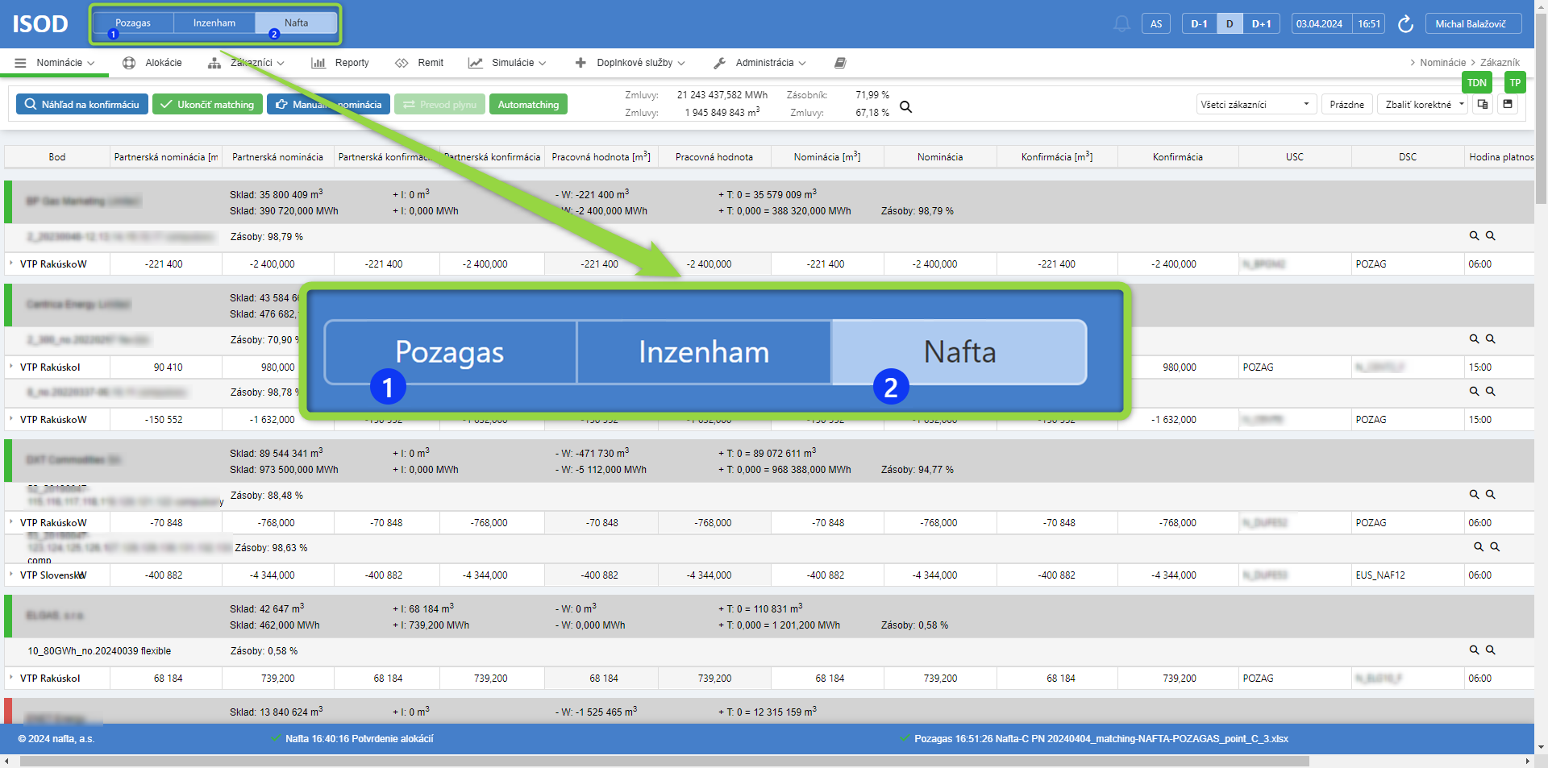
ISOD
Information System of Commercial dispatching

Slide 13
NAFTA / ISOD: Not just the matching software for SSO
Nominations
Allocations
Customers
Reports
REMIT
Simulations
Supplementary services
Administration
An innovative tool that can predict the stock level in the storage based on various scenarios.

Slide 16
www.nafta.sk

