Slide 1
ESGN Pilot Development
PILAR FIELD
IGU Introduction
April 2024

Slide 2
ORIGEM ENERGIA ESGN TEAM
CHRIS GAVIN – Head of Gas Storage
Petroleum Engineer with 14 years of experience in depleted-reservoir gas storage
DANIELLE CARMO – UGS Project Manager
Petroleum Engineer with 12 years of industry experience in offshore drilling, project management and production operations.
LIVIA FERNANDES – Wells Engineer
Petroleum Engineer with 12 years of industry experience in drilling, research and software applications.

Slide 3
ORIGEM ENERGIA - Introduction
Origem Energia – Hub Alagoas (https://youtu.be/wmVLpAq-4Fk?si=IWeNOkKnCc7HvJJp)
Length – 4min 22sec

Slide 4
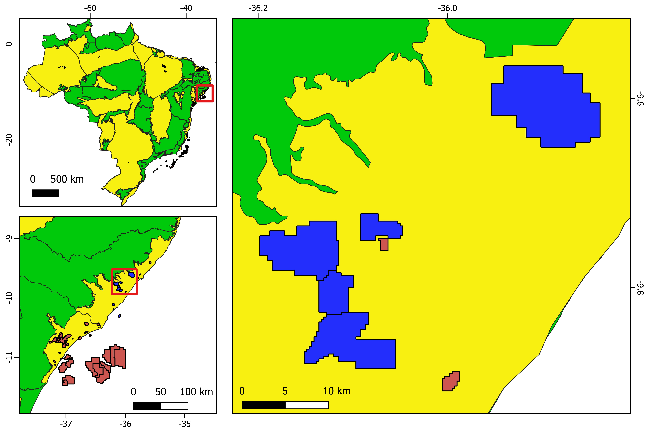
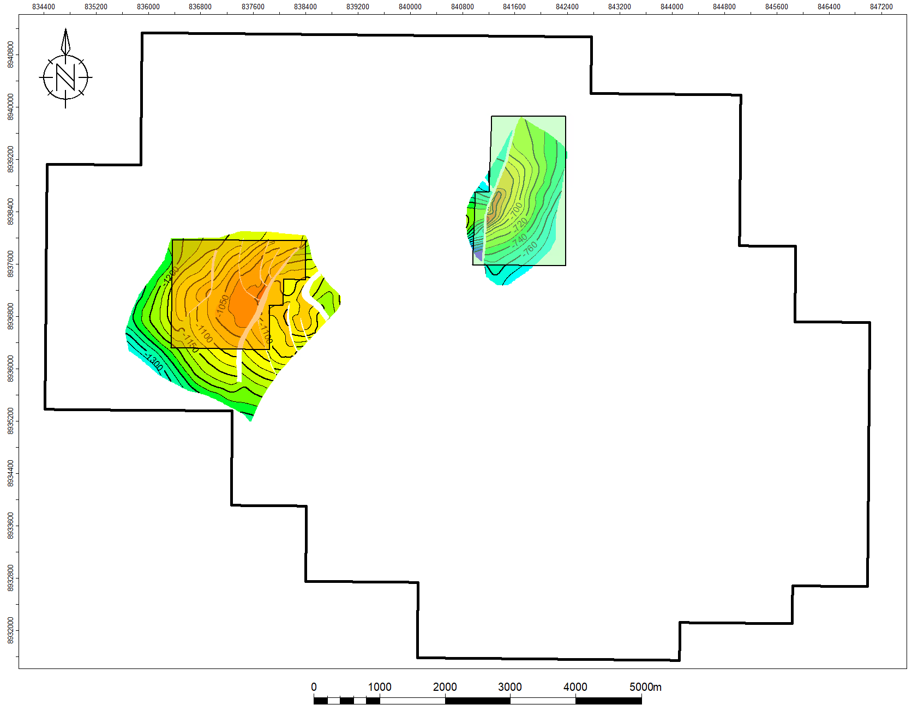
Origem Producing Fields
PILAR FIELD
NORTHEAST PILAR
PILAR
SOUTHWEST PILAR
ORIGEM ENERGIA PILOT ESGN Project Areas
4
Notes:
Adicionar os gráficos de produção e injeção e mapa de localização.

Slide 5
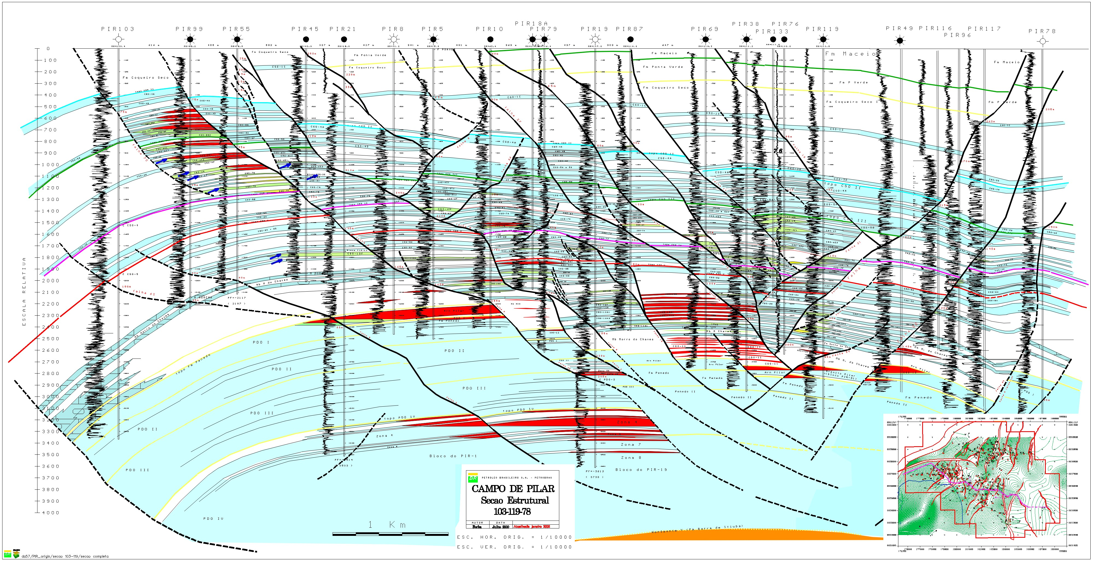
Southwest Pilar Project Area
X-SECTION (SW PILAR)

Slide 6
Southwest Pilar Project Area
Pilot ESGN Development (CSO-6H & 6I)
Future ESGN Potential (CSO-12 )
Future ESGN Potential (Penedo Formation )
X-SECTION (SW PILAR)

Slide 7
IDEAL SETTING FOR ESGN PILOT DEVELOPMENT
Gas reinjection system utilized by previous operator for secondary recovery will be retrofitted for Pilot ESGN Operation (compression and flowlines already in place)
Gas reinjection activity results in decreased incremental base gas requirements
Relatively young infrastructure – discovery well was drilled in 1981, gas reinjection infrastructure installed in early 1990s.
Abundant well count in the two project area = numerous opportunities to utilize existing wellbores for Injection/Withdrawal or Observation use = minimum drilling activity.
Reservoir compartmentalization provides optimal project scalability
The Pilar Plant, which features one of the largest gas processing facilities in NE Brazil, is adjacent to the main N-S pipeline in Brasil, with the pipeline interconnect and compressor station literally next door.

Slide 8
ORIGEM ENERGIA – Company Values
Origem Energia is transforming Alagoas (https://youtu.be/WdP5aQp1uIc?si=daHCcqYQ7N_5Eu_C)
Length – 9min 35sec

Slide 9
THANK YOU FOR YOUR TIME!!

