Slide 1
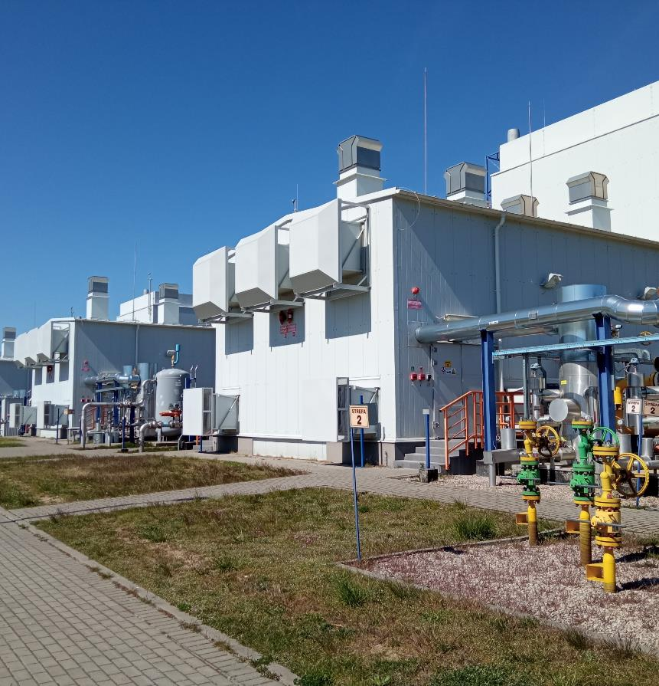
Noise emission reduction project in UGS Kosakowo
Sławomir Skwarczyński
Paris, April 2024

Slide 2

About the project
Noise emission issues
the social party
local authorities
Legal reqirements
The main aim of the project was to reduce noise emission by the installation of UGS Kosakowo, especially for low frequency emission.
Implementation of the designed solutions resulted in significant environmental impact and improvement of acoustic comfort for neighbouring residents within the range of UGS influence.

Slide 3
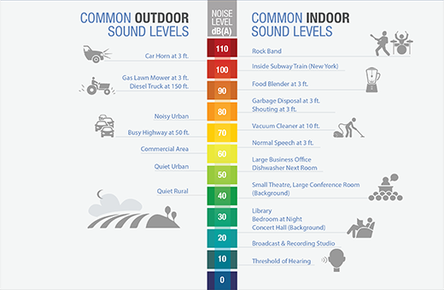
Why we did it
Allowed noise levels:
Type of area | Day | Night
Residential area (single-family housing) | 50 dBA | 40 dBA
Residential area (multi-family housing) | 55 dBA | 45 dBA

Slide 4
Project overview
Vibrodiagnostic analysys
Identification of the problem
2019/20
I Stage
Limiting of noise in main emitters
Accredited measurements
Acoustic camera measurements
Analysis of the results
2021/22
II Stage
Limiting of noise in secondary emitters, including low frequency sources
Accredited measurements
Analysis of the results
2023/24
Step-by-step approach to get best results with limited resources

Slide 5
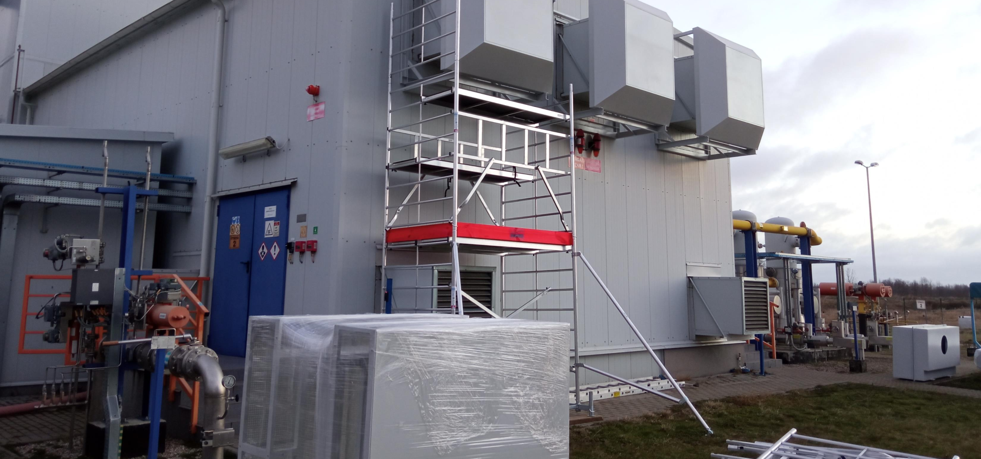
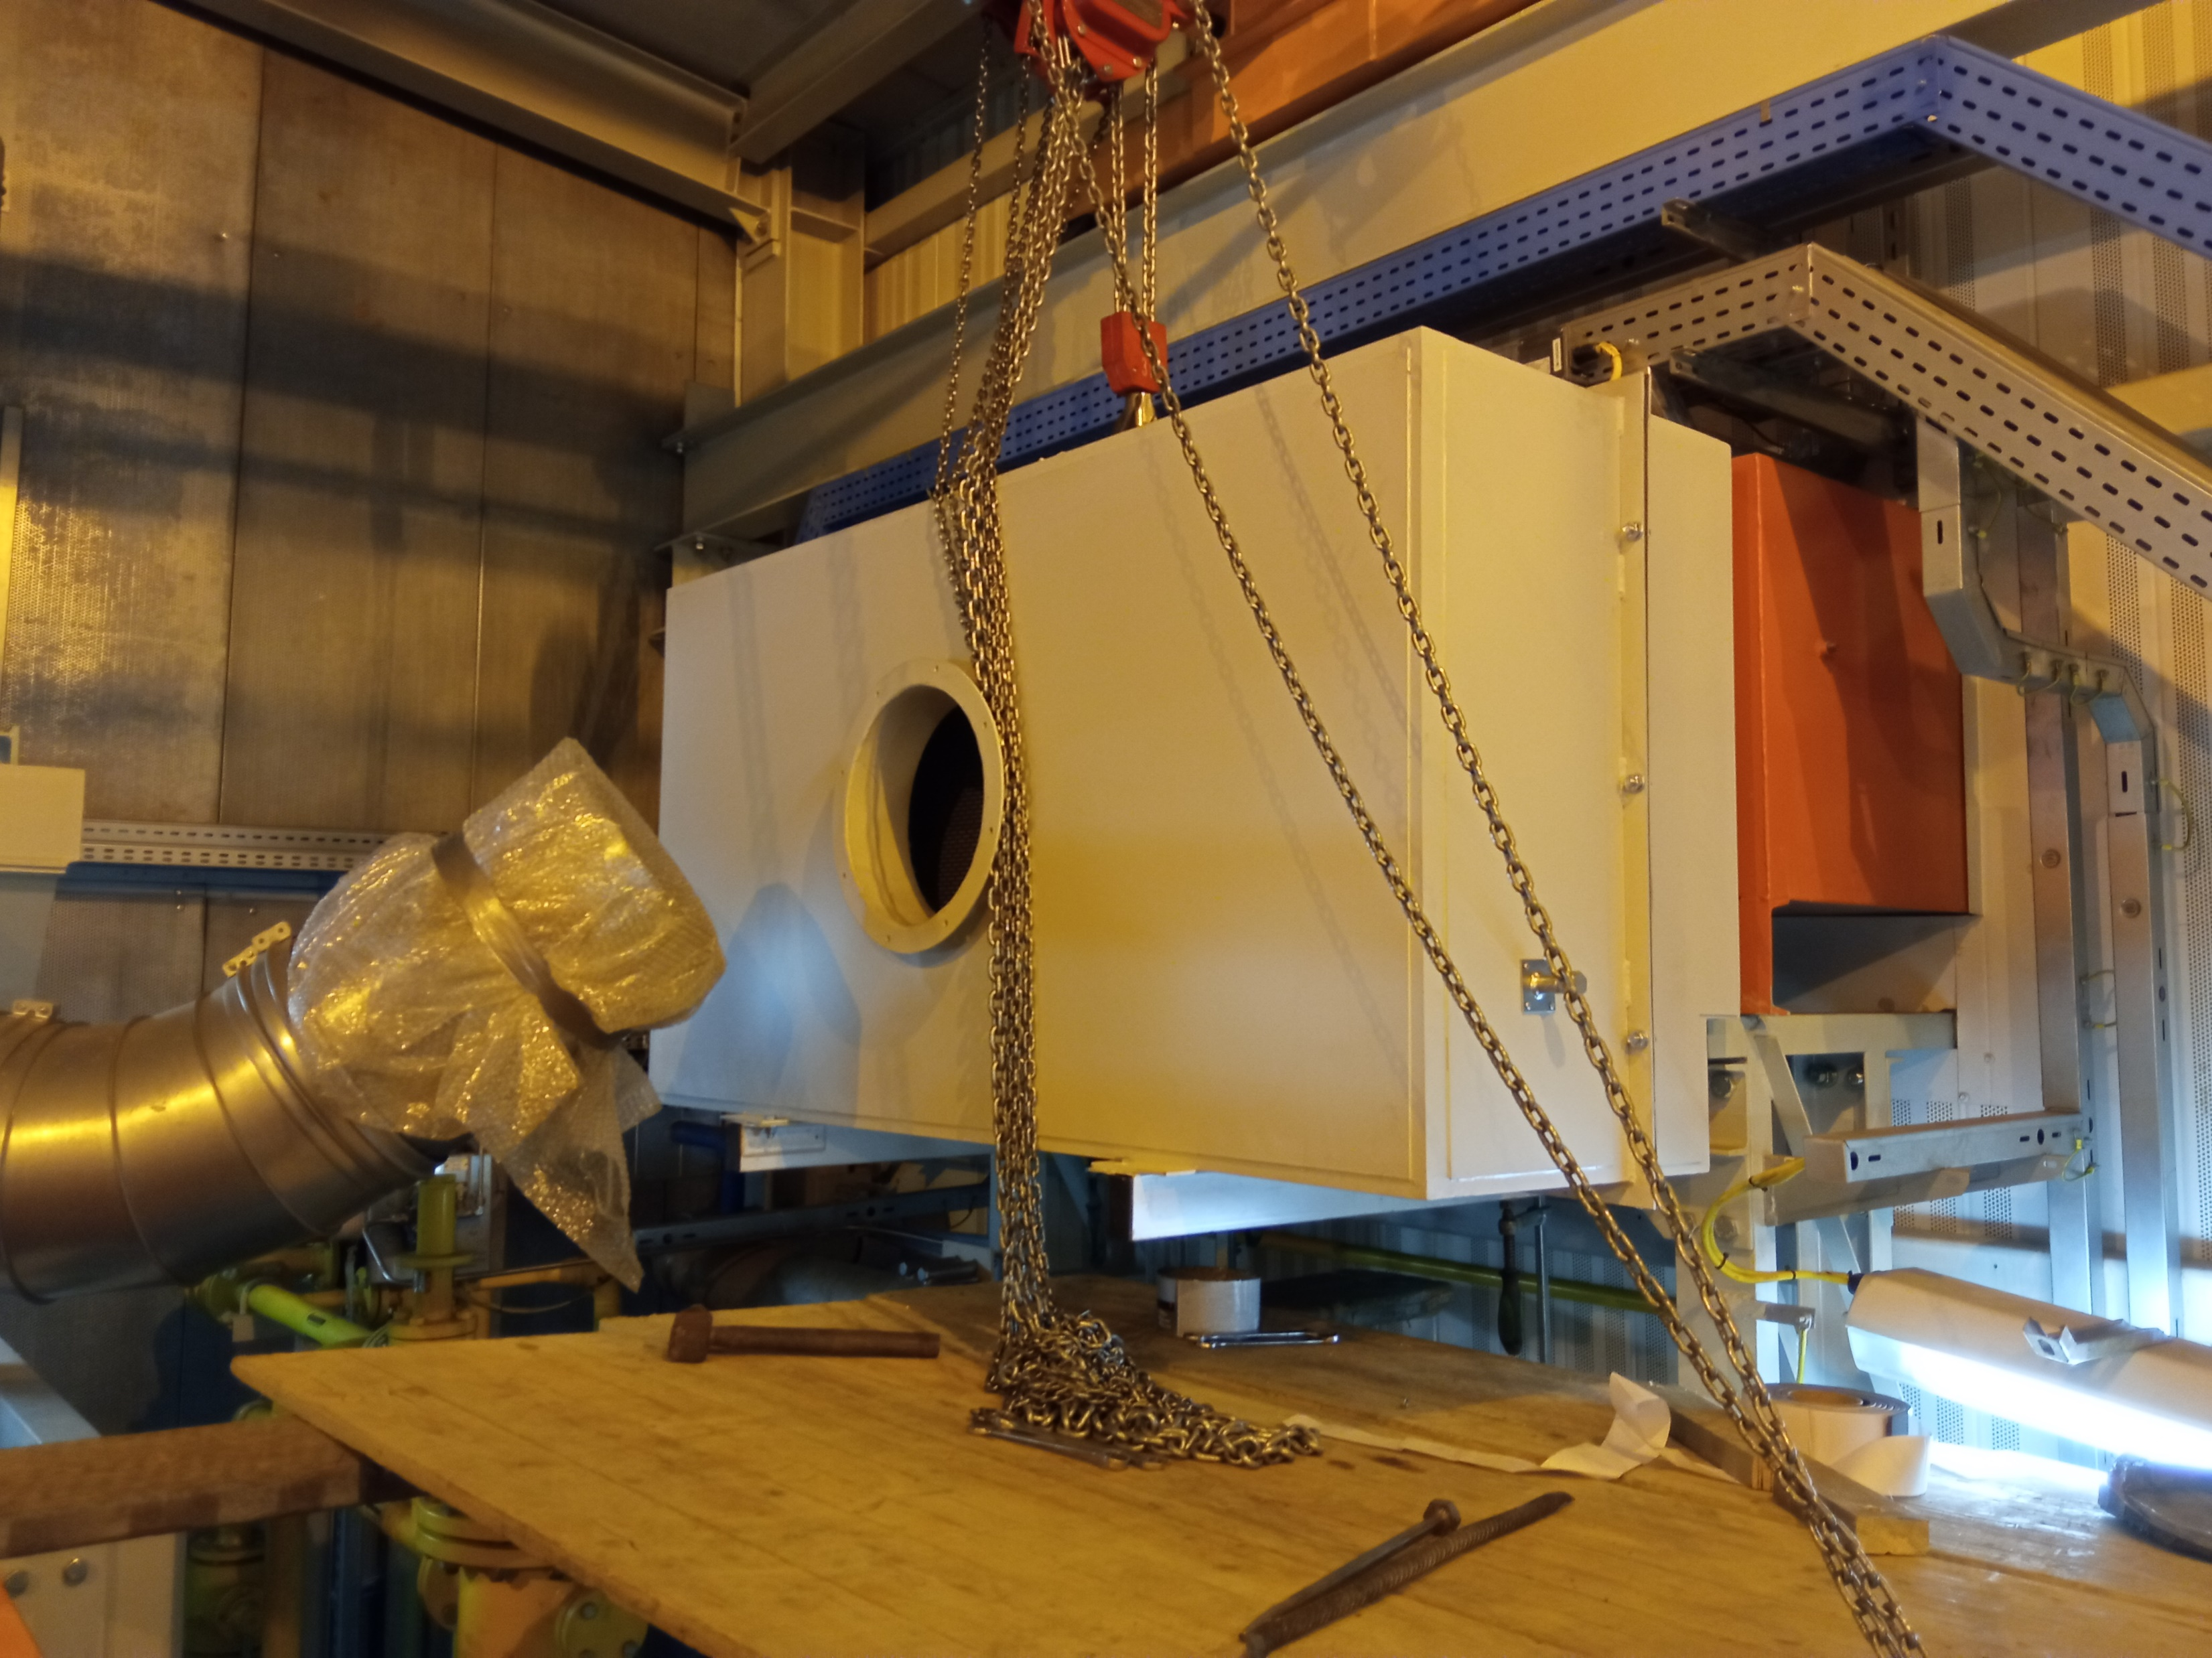
I Stage
– implemented solutions:
Silencers of ventilation air intake – 20 pcs.
Silencers of air supply fans intake – 12 pcs.
Entrance doors to compressor building – 8 pcs.
Insulation of technological installation – 8 pcs.
Silencers of air intake to gas engine’s turbines – 8 pcs.

Slide 6
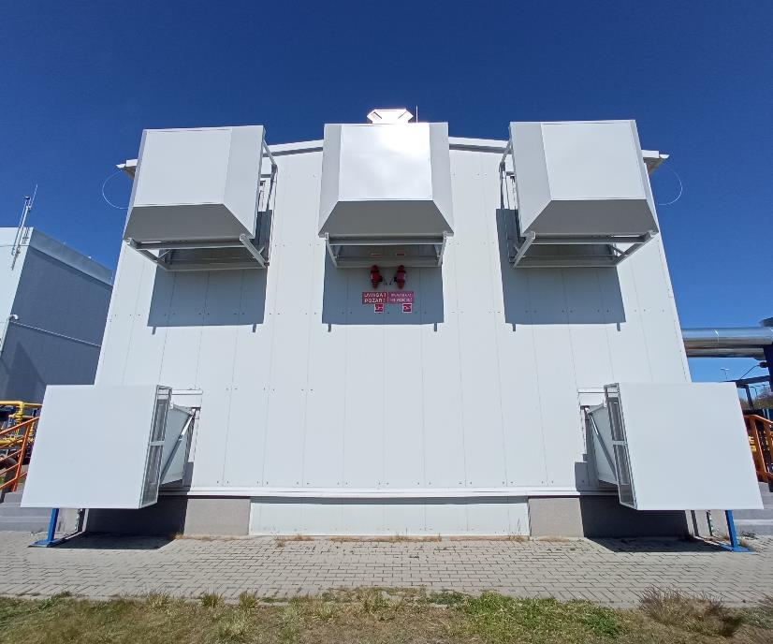
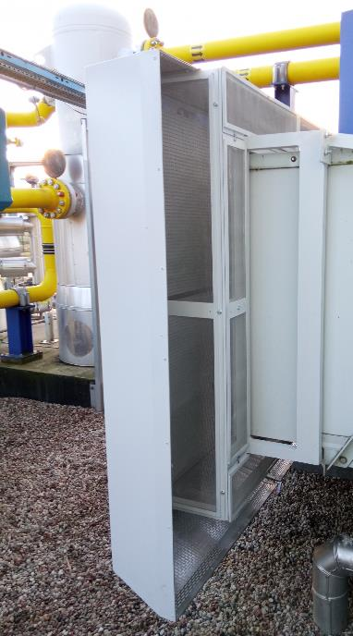
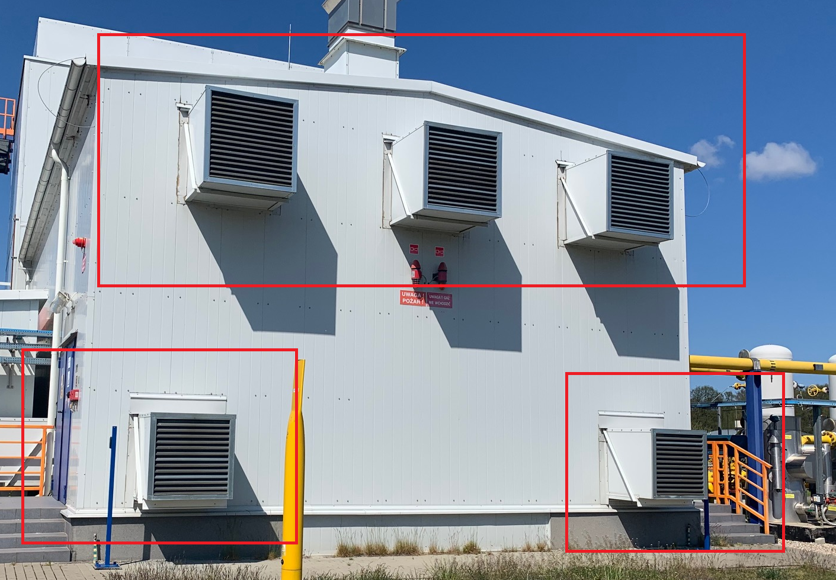
Intake of ventilation air
Gravity ventilation intake 73dB/A 68dB/A reduction: 5dB/A
Fan intake 84dB/A 68dB/A reduction: 16dB/A

Slide 7
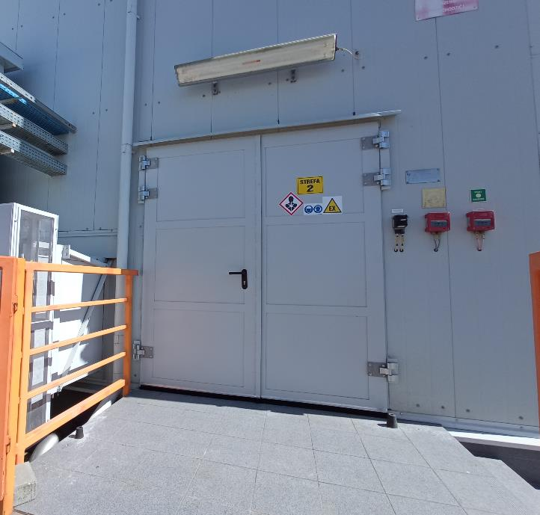
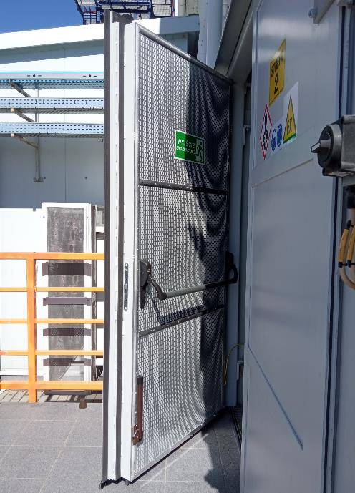
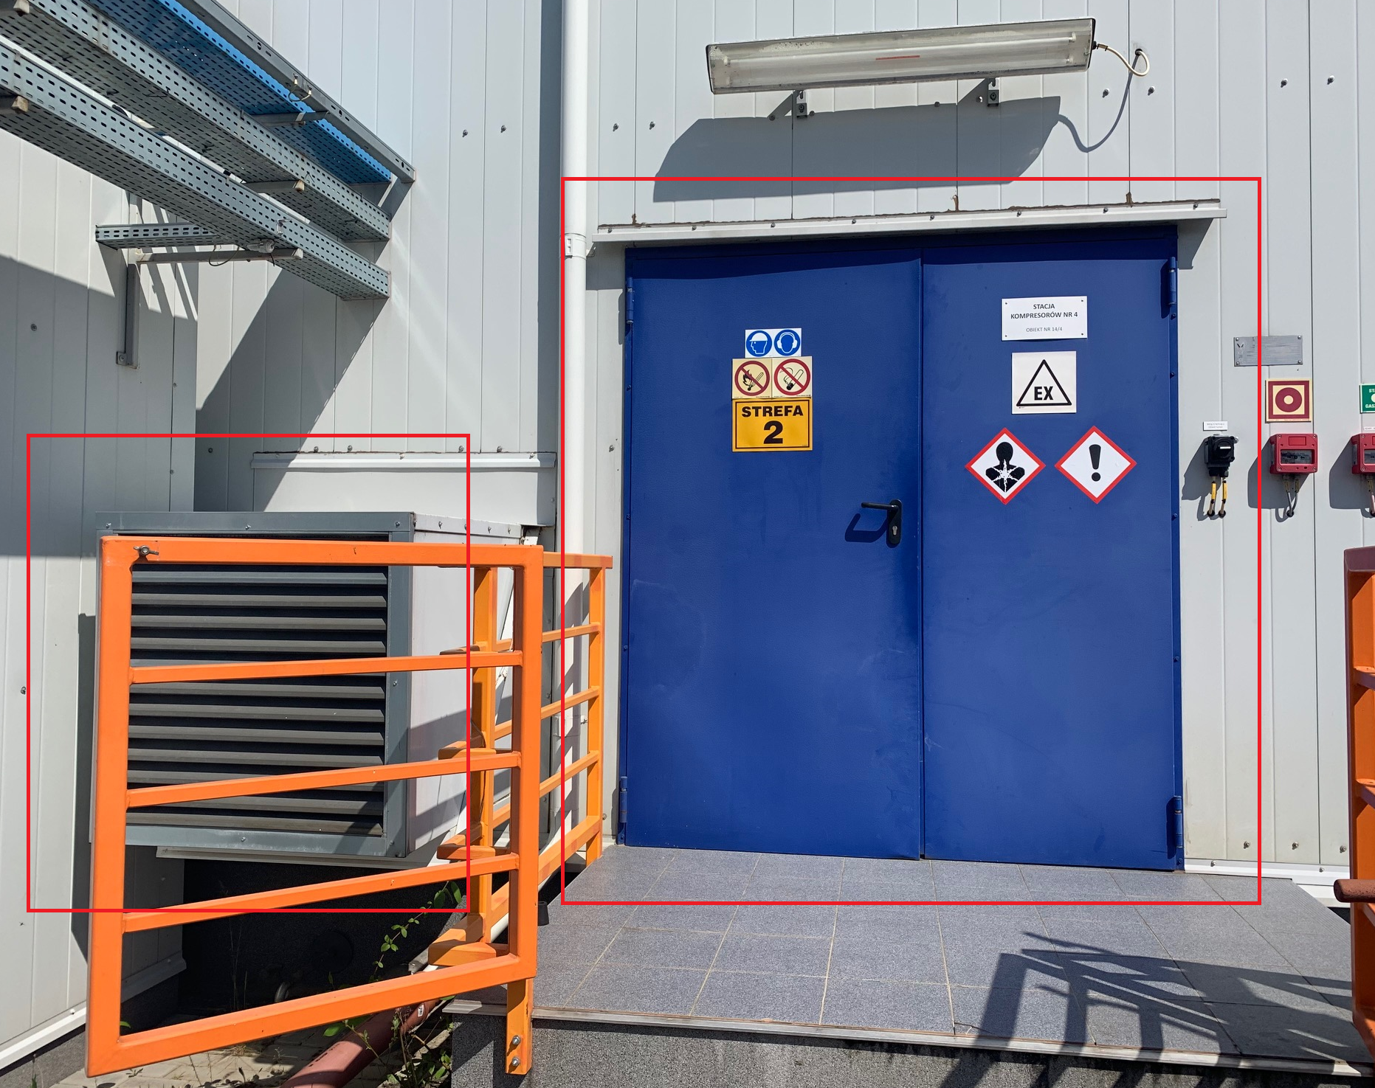
Entrance door
79dB/A 63dB/A reduction: 16dB/A

Slide 8
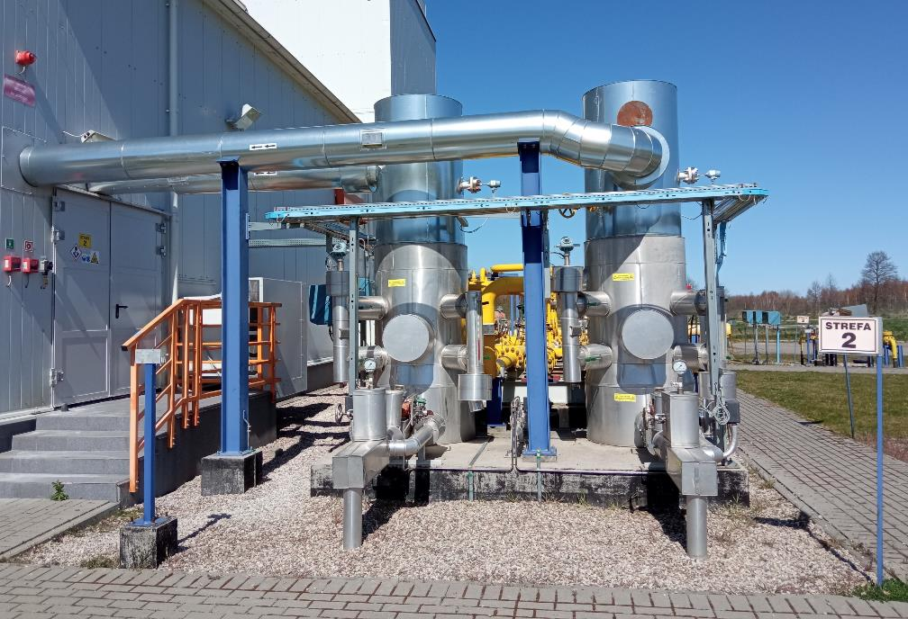
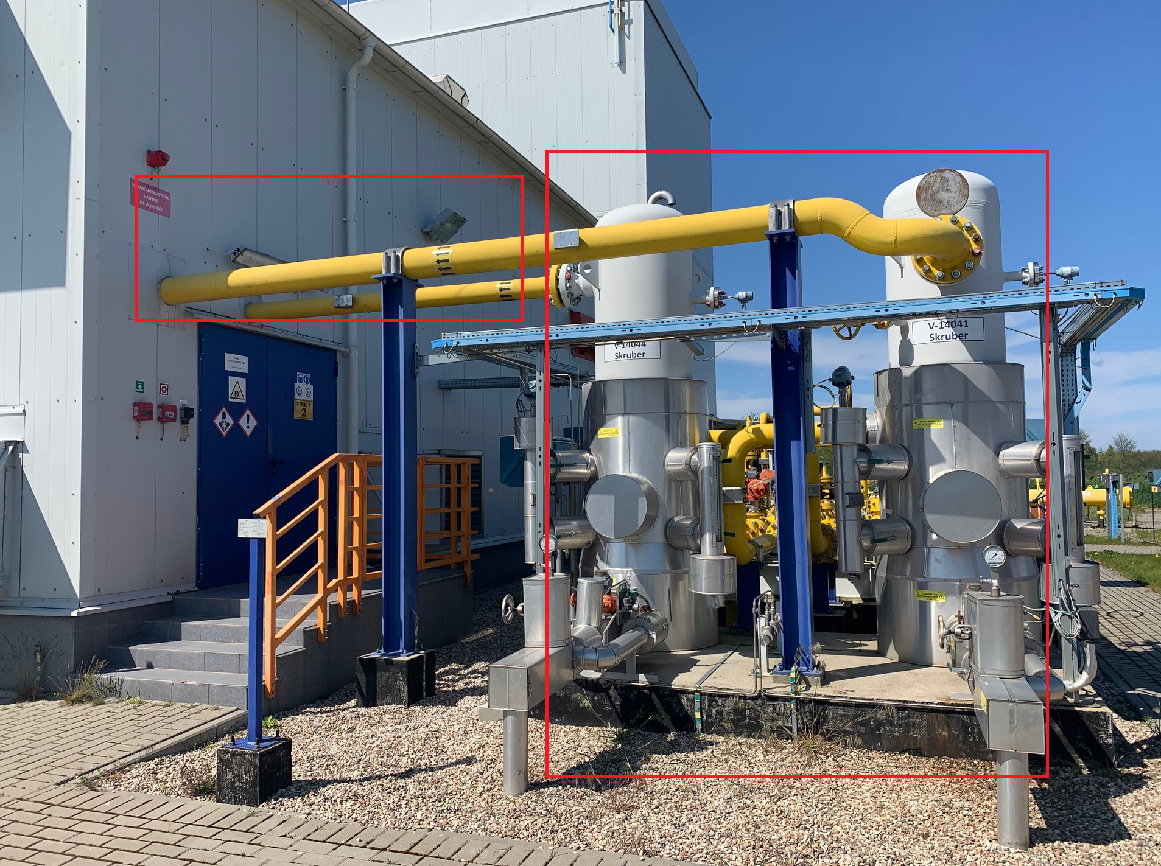
Scrubber installation with piping
80 dB/A 67 dB/A reduction: 13 dB/A

Slide 9
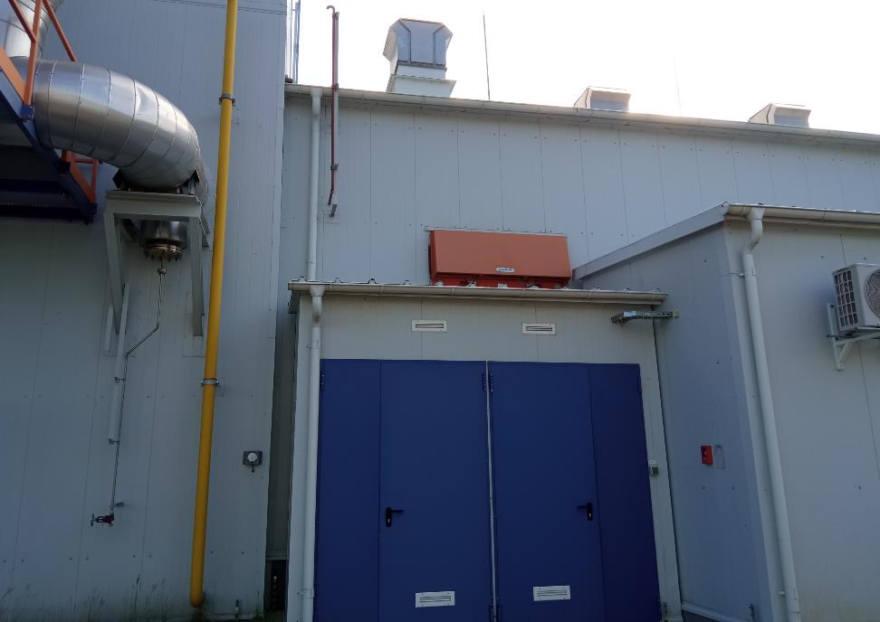
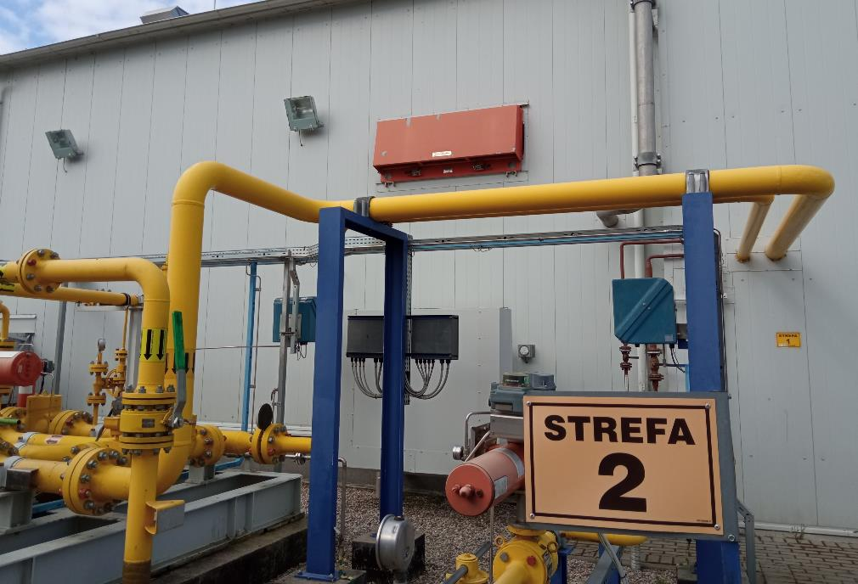
Silencers of air intake to gas engine’s turbines
96 dB/A 73 dB/A reduction: 23 dB/A

Slide 10
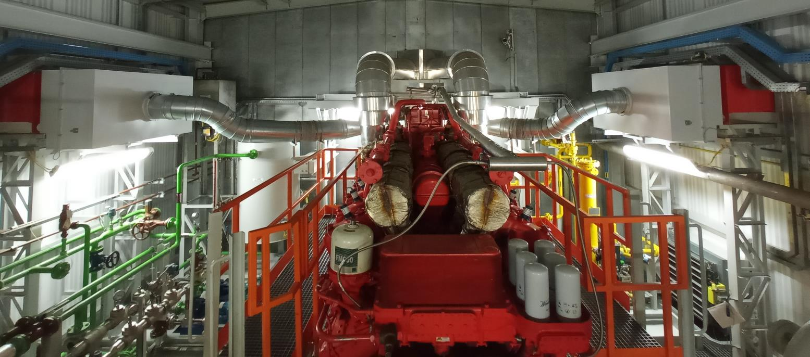
Silencers of air intake to gas engine’s turbines

Slide 11
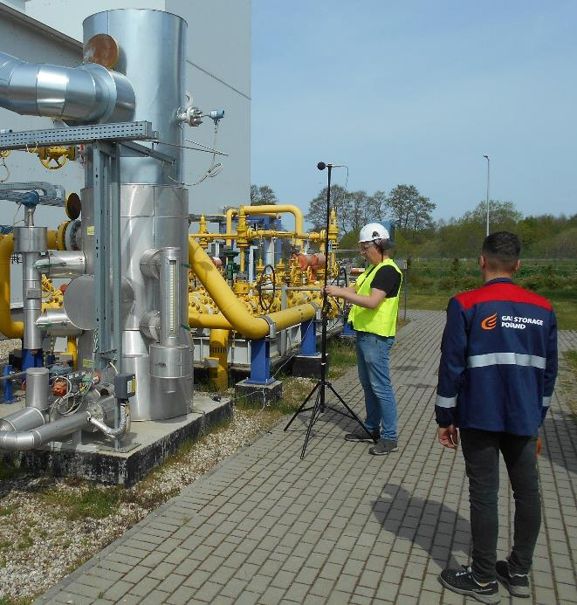
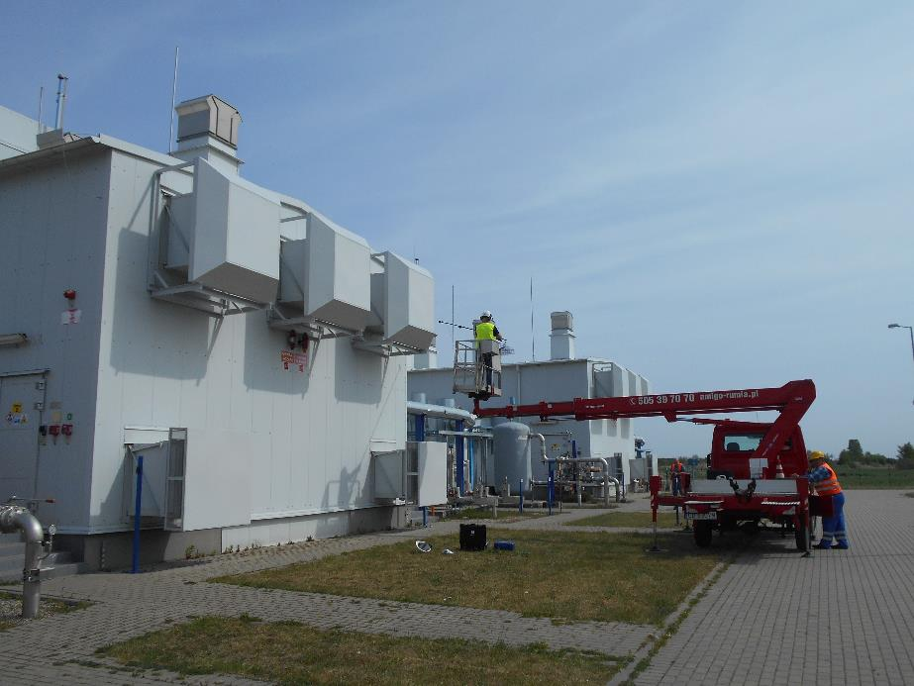
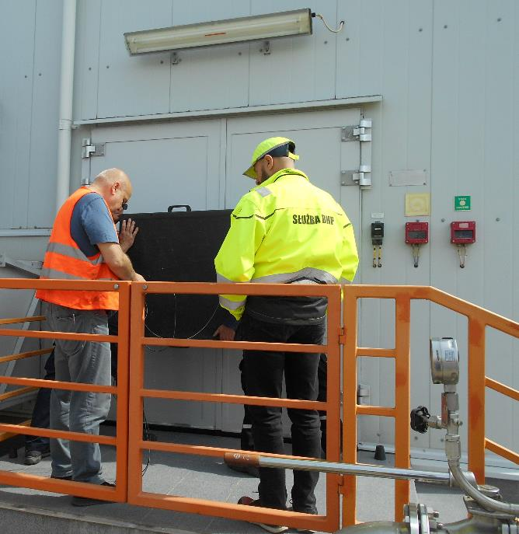
Accredited noise measurements after I stage

Slide 12
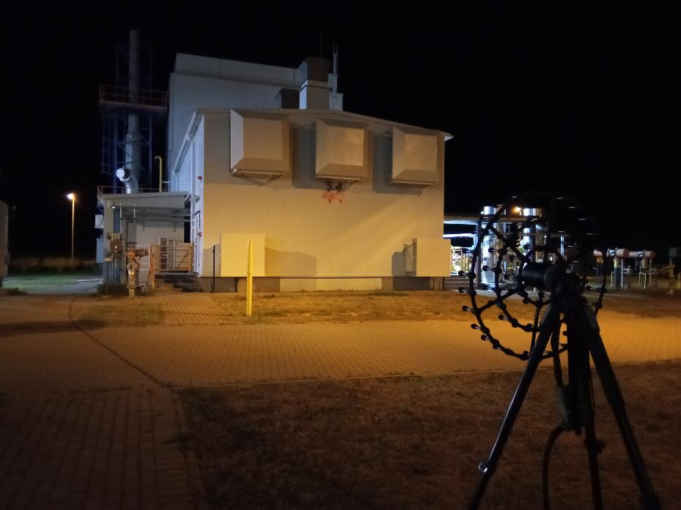
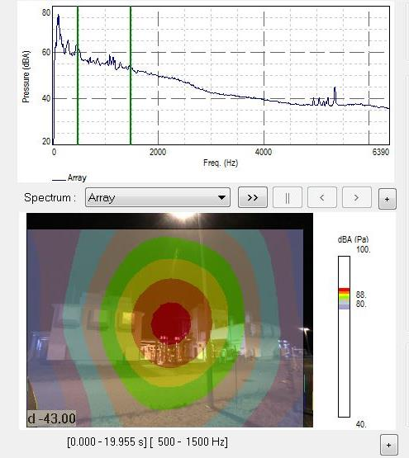
Mode in bandwidth 63 and 125Hz
(stack)
Acoustic camera measurements after I Stage
Mode of acoustic emission at low frequency

Slide 13
I Stage – summary
Required efficiency of all implemented noise reduction measures have been achieved
Significant reduction of noise level on-site and in the UGS surrounding
Analysis of the accredited measurements allowed to show low frequency noise issue
Additional emitters to work on during II Stage have been selected – exhaust stacks of gas engines 4 psc.

Slide 14
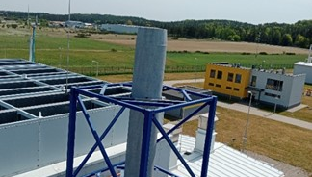
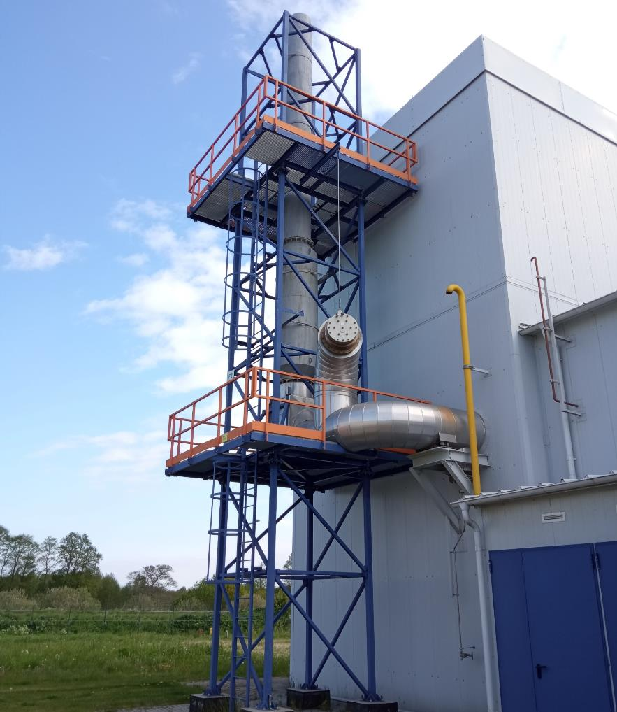
II Stage:
Main Focus on low frequency noise emission reduction from other emiters.
Exhaust stacks – two directions of noise emission through the outlet and blow-off flap.

Slide 15
Goals
To reach adequate acoustic conditions it was required to cut the noise emission from exhaust stacks by at least 14,0 dB/A.
Main focus were 63 and 125 Hz bands, which are responsible for low frequency noise transmission
Acoustic pressure level L [dB/A]
Octave band center frequencies [Hz]

Slide 16
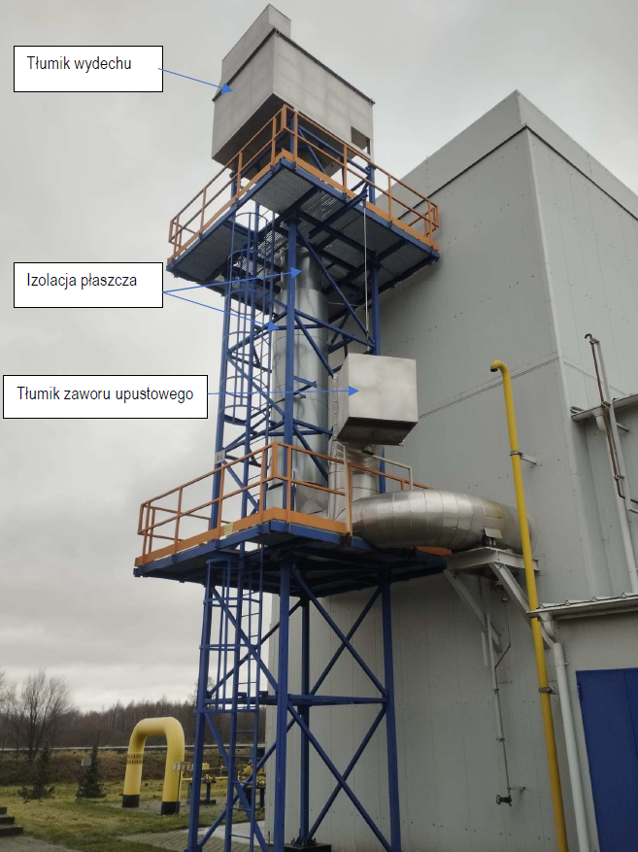
II stage – implemented solutions
Silencer on the outlet
Silencers on the gas engine exhaust gases stack outlet – 4 psc.
Noise reduction level 18,6 dB/A 95,5 → 76,8 dB/A
Silencers on blow-off flaps – 4 pcs.
Noise reduction level 15,4 dB/A 82,1 → 66,7 dB/A
Exchange of acoustic insulation of stack – 4 pcs.
Noise reduction level 15,8 dB/A 79,4 → 63,6 dB/A
Insulation of stack
Silencer on the blow-off flap

Slide 17
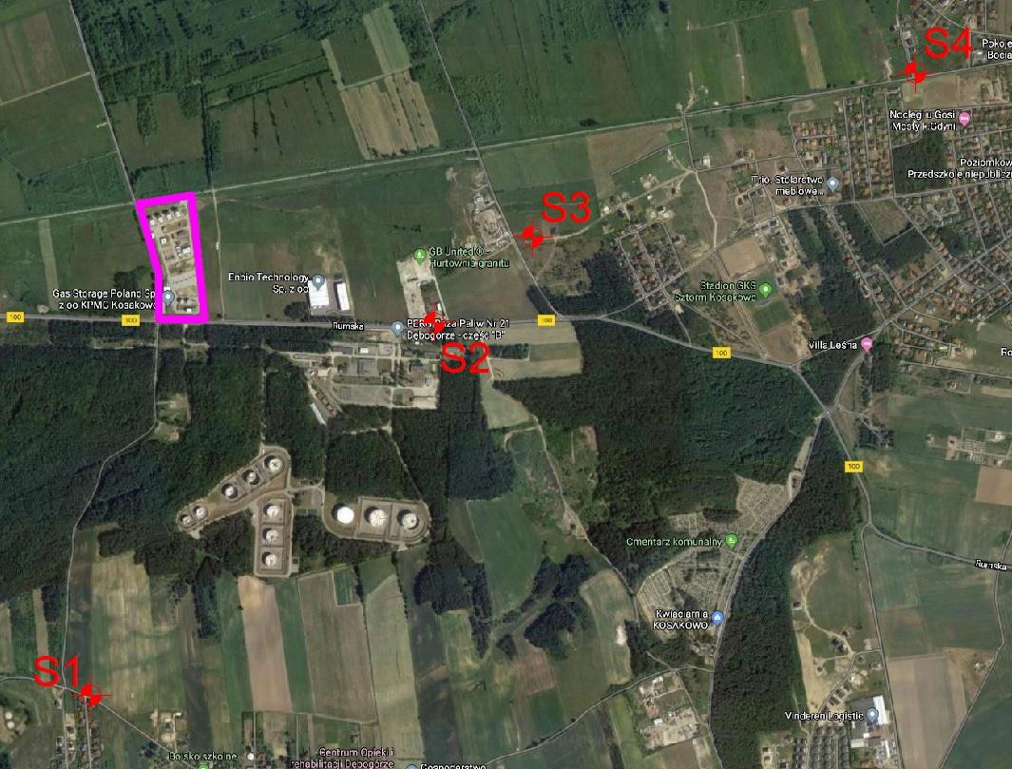
Accredited noise level measurements after II Stage
Measurement results
Day | Night
33-42 dB/A | 32-33 dB/A
Background noise level
N/A (due to traffic noise) | 31,6 dB/A
Based on the performed measurements and calculations it has been confirmed that on all measurement points around UGS Kosakowo both, during the day and night while running 3 compressor units at full capacity, noise level was within allowed limits.

Slide 18
II Stage – summary
Noise reduction level was higher than expected for all emitters
Low frequency noise at residential areas in Kosakowo were significantly reduced
Accredited measurements results and analysis based on those results confirmed that the impact of UGS Kosakowo installations on acoustic environment of residential areas is within allowed limits
II Stage implementation period - 12 months

Slide 19

Q&A

