Slide 2
Insights on H₂ velocity in wells
Mejda AZABOU, Ph.D., Salt Cavern Engineer, Storengy
IGU Storage Committee Meeting 10 - 12 April 2024

Slide 3
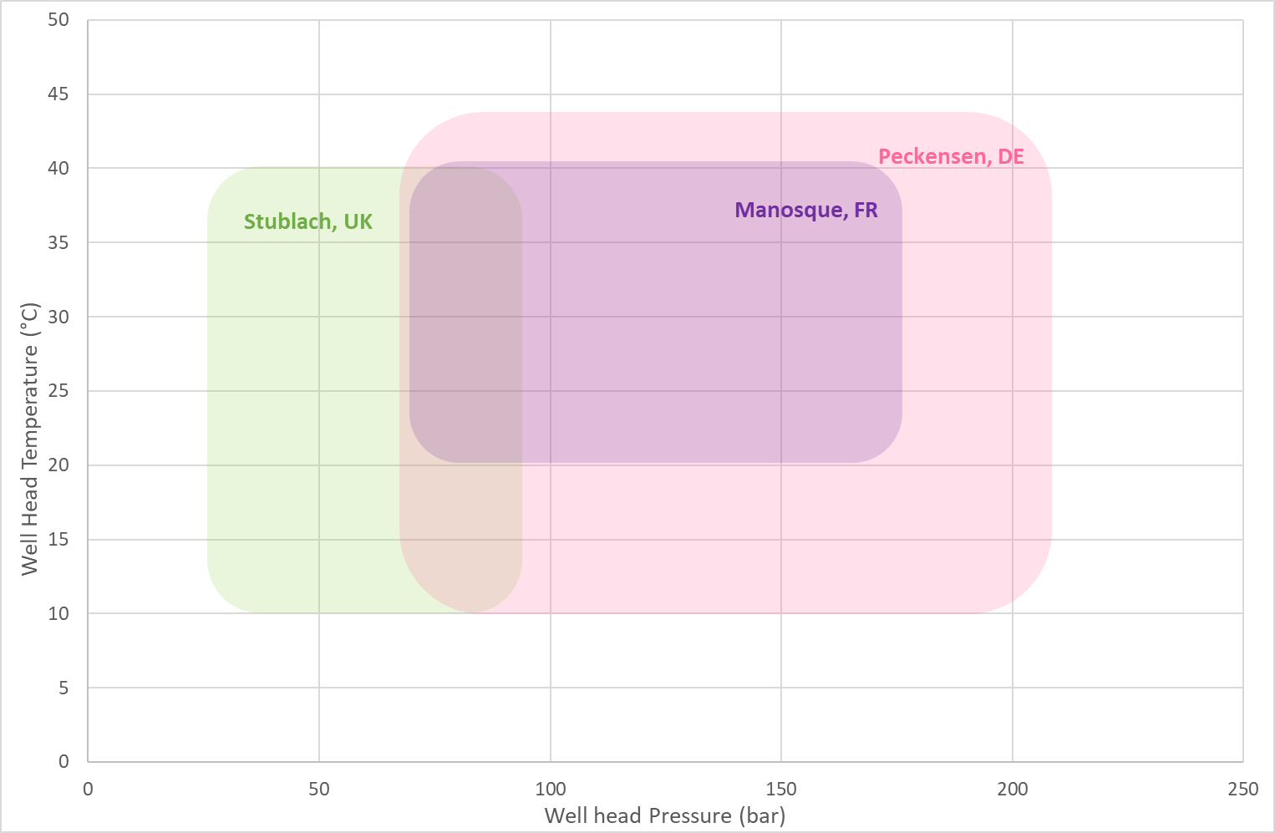
Scope of the study
Focus on salt caverns wells, simple regular linear tubing:
30 bar < P < 250 bar ; 10°C < T < 50°C
Study based on a literature review + operation history of Storengy gas storage sites

Slide 4
Natural gas: current practice, state of the art
What’s the current maximum velocity for natural gas ?
→ 15 m/s, 20 m/s, 14 m/s and 12 m/s
How was this limit established ?
→Not known precisely, but the main aspects taken into accounts are:
Erosion risk
External noise
Flow induced vibrations
Flow induced pulsations
Technical-economical aspects

Slide 5
In order to establish H₂ maximum velocity
Erosion
API RP 14E (identical to ISO-137032003-03)
Pick-up velocity
DNV-RP-O501
Flow induced vibrations
Wall pressure fluctuations (Von Karman Institute for fluid dynamics)
Energy Institute Guidelines (EIG)
Flow induced pulsations
Energy Institute Guidelines (EIG)
External Noise

Slide 6
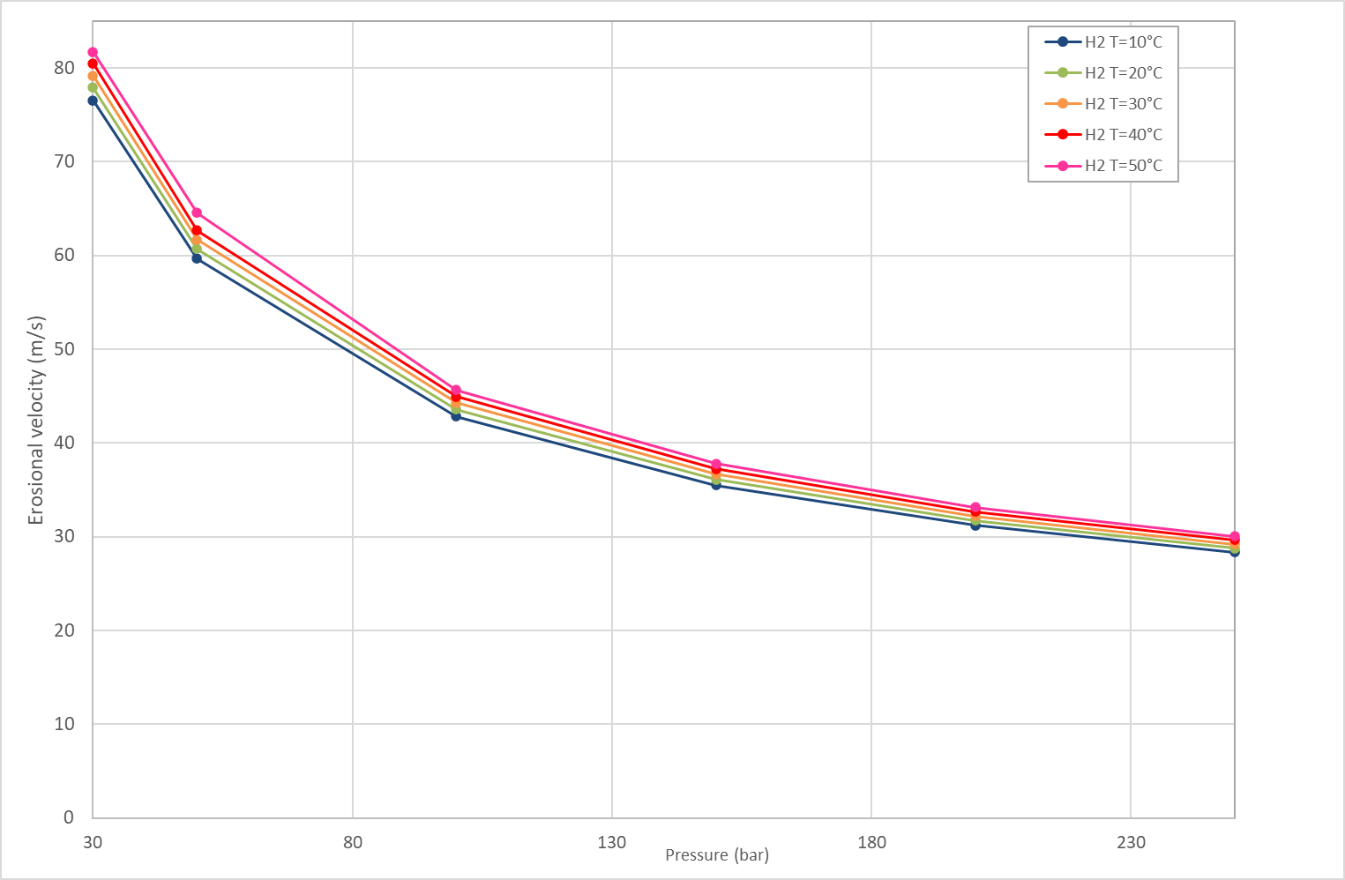
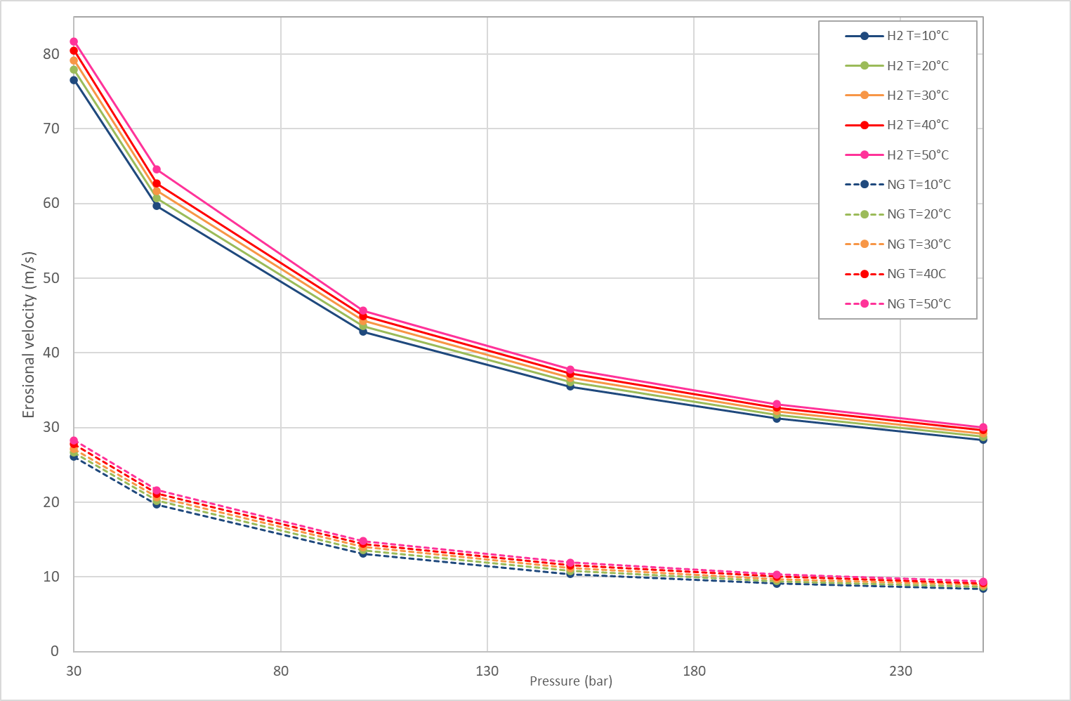
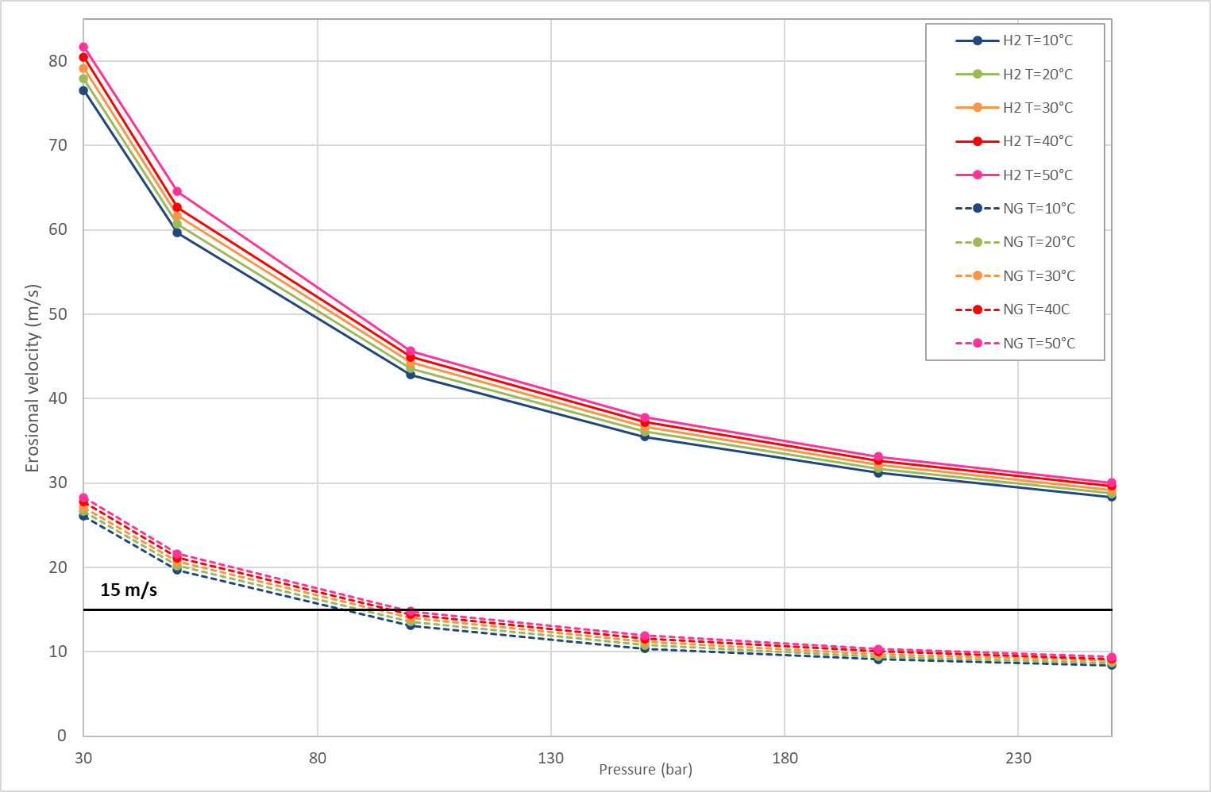
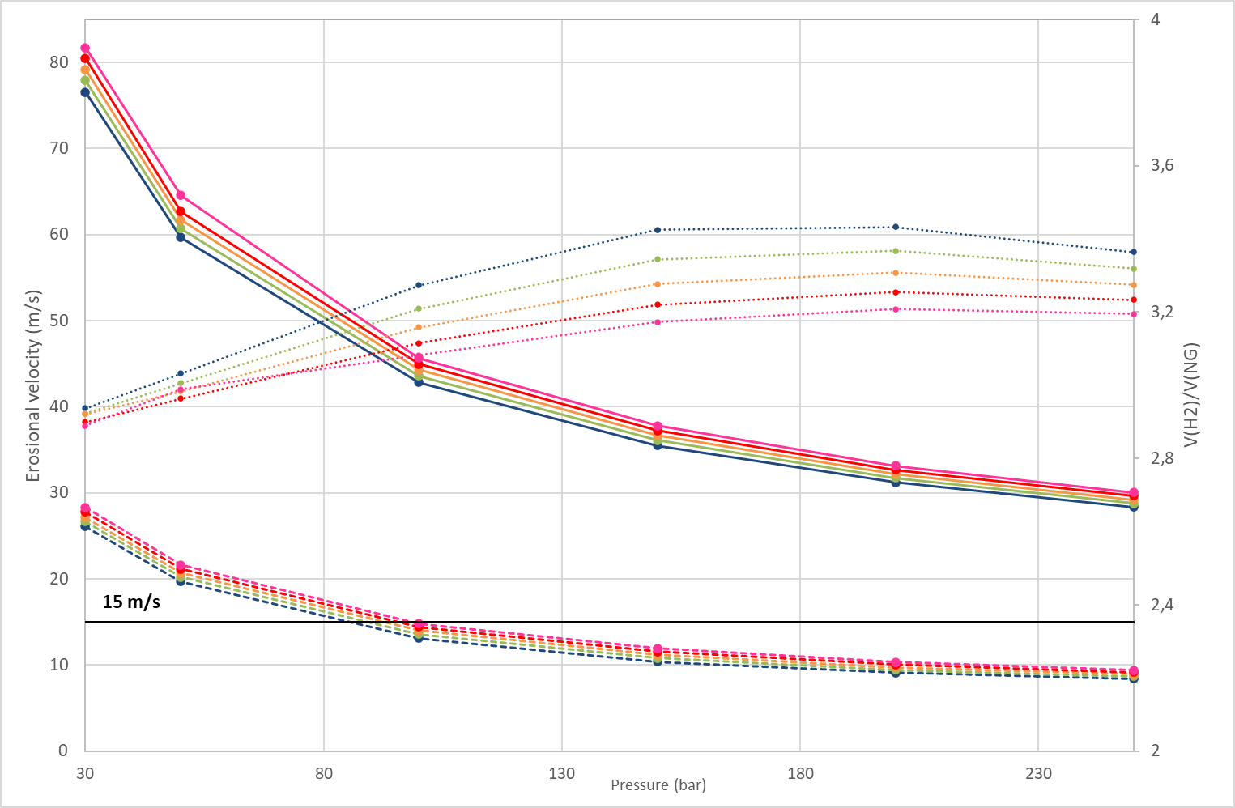
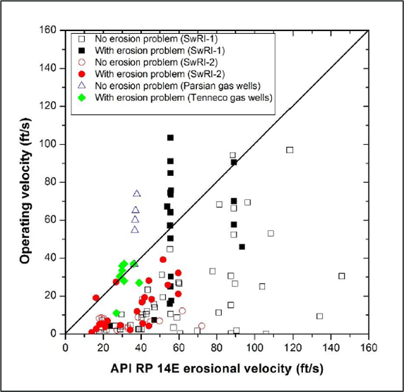
Erosion: API RP 14E / ISO-137032003-03
ρ * V² = C
Empirical equation, no solid particles, no corrosive agents ( H₂S or CO₂)
The erosional velocity depends on the gas density which, in turn, depends on the pressure.
Defining one maximum velocity over a large range of pressure is extremely conservative.
Need to define a maximum velocity by pressure ranges.
The API RP 14E = ISO-137032003-03, widely utilized but also criticized : unknown origin, limitations, inadequacy to predict erosion…

Slide 7
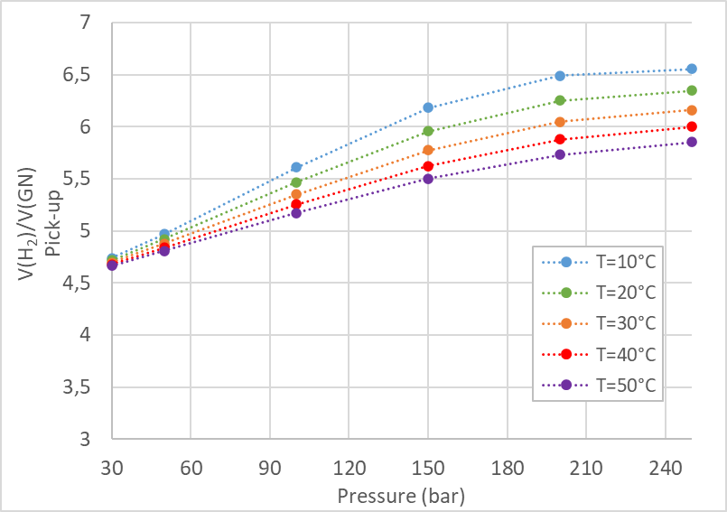
Erosion: Pick-up velocity
The pick-up velocity $V$ of a gas flowing inside a pipe of diameter $D$, is the minimum speed sufficient to move a layer of solid particles of mean diameter $dp$ and density $ρp$, initially at rest.
$\frac{V}{\sqrt{gd_{p}}}=0.0428∗{Re}_{p}^{0.175}∗{\left(\frac{D}{d_{p}}\right)}^{0.25}∗$ ${\left(\frac{ρ_{p}}{ρ_{gas}}\right)}^{0.75}$
$${Re}_{p}=\frac{d_{p}∗V∗ρ_{gas}}{μ_{gas}}$$
(Empirical model of Cabrejos & Klinzing, Von Karman Institute of Fluid Dynamics)
→ Depending on the pressure, H₂ can flow 4.6 to 6.5 times faster than natural gas without increasing the risk of erosion.

Slide 8
Erosion: DNV-RP-O501
Directives on “how to operate safely and cost effectively manage the consequences of sand produced from the oil and gas reservoirs through production wells, flowlines and processing facilities” & “Erosive wear in piping systems”
If no solid particles: 70 to 80 m/s
In presence of solid particles, for linear pipes:
$$E_{L}=Φ_{M−p}∗\frac{K∗v^{n}∗F_{α}}{ρ_{pipe }∗A_{pipe}}$$
→ $\frac{Φ_{M−p}(H_{2})}{Φ_{M−p}(NG)}={\left(\frac{v\left(NG\right)}{v\left(H_{2}\right)}\right)}^{n}, n=2,6$
If V(H₂) is 3 to 4 times greater than V(GN), erosion risk will increase 20 to 40 times.
X Too conservative and non consistent with Pick-up velocity and API RP 14E.

Slide 9
Flow induced vibrations : wall pressure fluctuations
Turbulent flow boundary → wall pressure fluctuation → vibrations
(empirical model, Goody model: Von Karman Institute of Fluid Dynamics)
Reynolds number ($R_{e}=\frac{V∗ρ∗L}{μ}$) is the main driving parameter
(DNV Energy Systems. GERG Energy Capacity Study. Energy capacity related effects of repurposing
natural gas pipelines for hydrogen or hydrogen blends. Flow and Fuel Advisory.
Groningen : DNV Energy Systems, 2022. 228024-FFA 22-1838 Rev.2)
→ low/no risk of vibration if H2 velocity is 3 to 4 times greater than NG
Pressure (bar) | V(H2)/V(NG) | Re(H2)/Re(GN)
4 | 3,081 | 0,465
8 | 3,114 | 0,465
16 | 3,183 | 0,467
30 | 3,309 | 0,469
40 | 3,403 | 0,475
60 | 3,596 | 0,496
85 | 3,842 | 0,520
120 | 4,149 | 0,557
150 | 4,326 | 0,697
250 | 4,279 | 0,943

Slide 10
Conclusions and recommended maximum velocity
Establish maximum velocities by pressure ranges rather than a potentially extremely conservative unique value.
Recommended H₂ velocities in wells, based on the most conservative erosion assessment method:
Elements on the maximum H₂ velocity in wells → complete with a study focused on surface facilities + thermomechanical study.
Most norms were initially established for oil & gas industry.
Pressure | Maximum velocity H₂ (m/s) | PC(H₂)/PC(NG) (if V(NG)=15 m/s)
30 to 100 bar | 42 | 0,68 to 0,85
100 to 150 bar | 35 | 0,52 to 0,57
150 to 200 bar | 30 | 0,44 to 0,52
200 to 250 bar | 28 | 0,41 to 0,43
Pressure | Maximum velocity H₂ (m/s)
30 to 100 bar | 42
100 to 150 bar | 35
150 to 200 bar | 30
200 to 250 bar | 28

Slide 11
Thank you !

