Slide 2
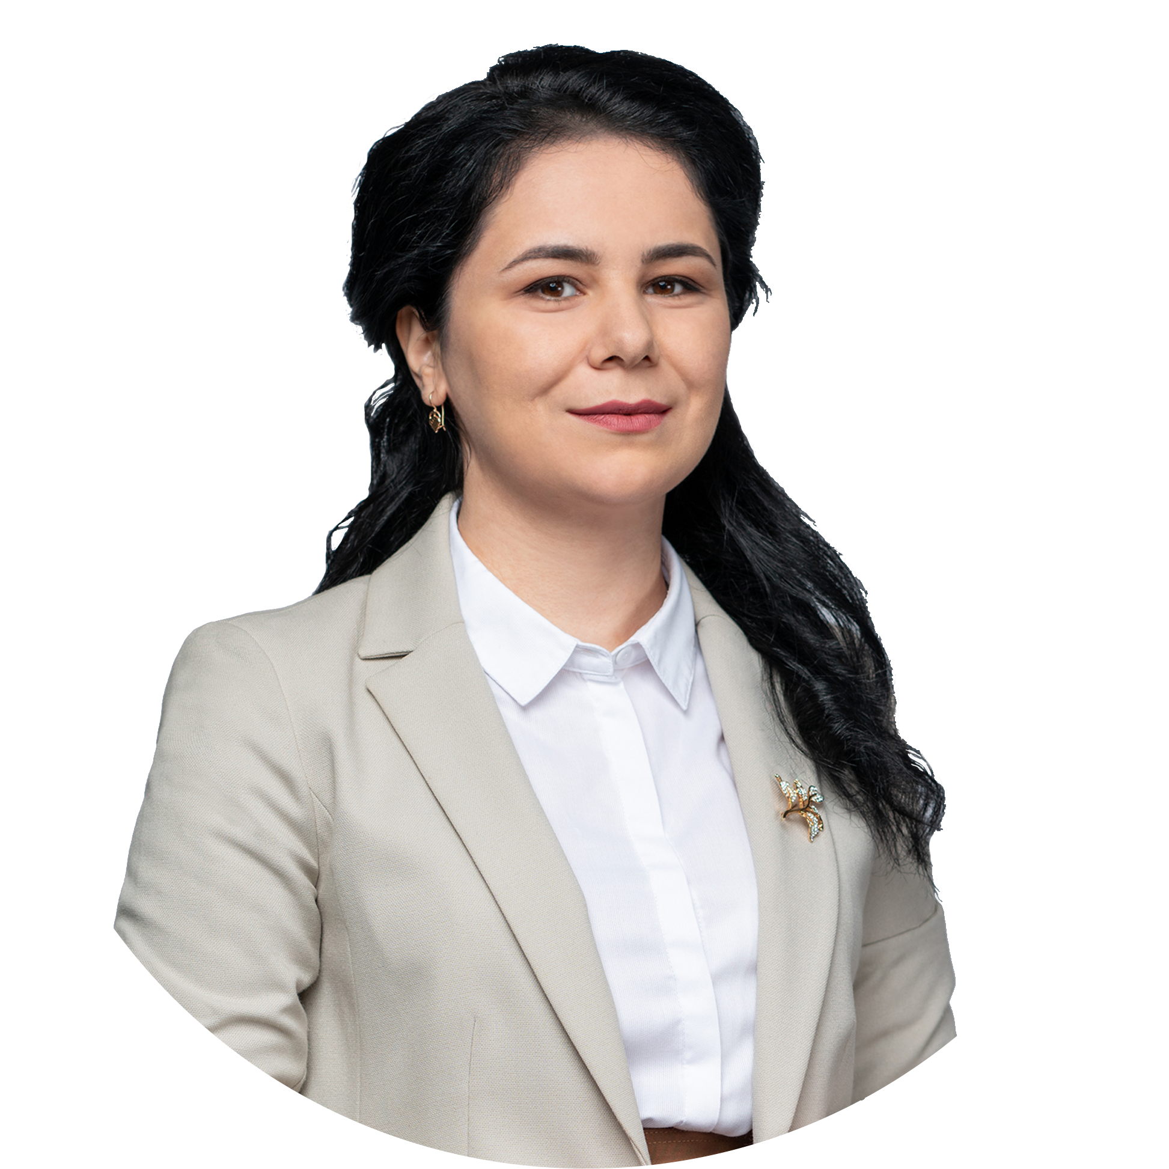

Slide 3
Ukrainian SSO is regulated by the
National Energy and Utilities Regulatory Commition (NEURC)
Storage Activity Regulation
Access to Services Regulation
Tariff Regulation
Gas Storage Code
adopted NEURC 30.09.2015
Latest update 03.04.2024
Standard Storage Agreement
adopted NEURC 30.09.2015
Latest update 03.04.2024
Tariffs for natural gas storage (injection, withdrawal) services
adopted NEURC 30.06.2022

Slide 4
bcm
310
30
.95
1 300
overall working gas volume
1 920
1 500
1 900
420
1 000
400
2 150
700
17 050
2 300
25.3
overall working gas volume near Europe
bcm
10
bcm
working gas volume
offered to non-residents
1 230
Aquifer
Depleted gas field
Out of control

Slide 5
Annual
Seasonal
Monthly
Daily
Firm – 60%
Conditionally firm – 30%
Interruptible – 10%
mcm/d
Firm import capacities to Ukraine
54
mcm/d
Interruptible import capacities to Ukraine
113
mcm/d
Firm export capacities from Ukraine
200+
CWR: gas storage for 1095 days w/o payment of taxes/customs duties
Short-haul: access to gas storage facilities at discounted tariffs to GTS IPs
Constructions, reconstructions and repairs of oil & gas pipelines and ground equipment
Repairs & maintenance of gas compressor stations and other gas installations
Expert & technical inspections of gas industry facilities
R&D institute of gas transportation
UA storage facilities
Entry/exit points

Slide 6
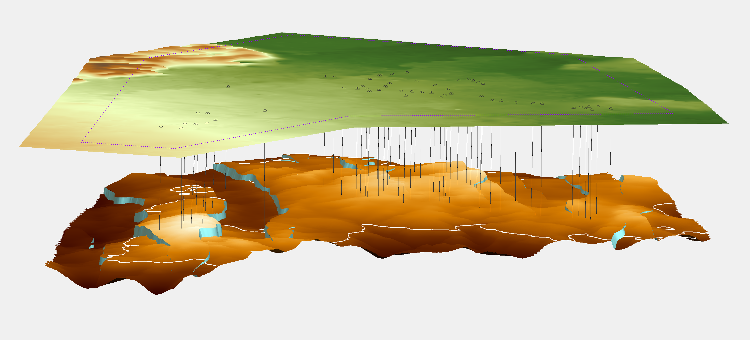
Filling | Withdrawal mcm/day | Injection mcm/day
100% | 230 | 188
50% | 170 | 203
30% | 122 | 222
10% | 60 | 213
INDUSTRIAL ZONE
ground facilities
Largest gas storage area ≈ 42ha
Smallest gas storage area ≈ 5 ha
COMPRESSOR
UNITS
COMPRESSOR
CAPACITY
WELLS
Total — 1365
TOTAL
WE USE
INJECTION
STORAGE LAYER
where gas is stored, outlined (white line)
WITHDRAWAL
GAS TURBINE DRIVEN
GAS ENGINE DRIVEN

Slide 7
10 facilities = 1 virtual storage facility
In case of one UGS facility outage, gas can be withdrawn from another UGS to confirm nomination
Up to 5 connections to GTS
UGS classified as critical infrastructure with relevant treatment (ADS+UA Armed Forces)
Based on the Ukrainian Legislation (the General Staff of the Armed Forces of Ukraine Protocol)
Emergency back-up power supply at each UGS facility
Fuel reserve for at least 10 days
UGS equipment is additionally protected with special constructions
Developed emergency response plans
Including emergency response to surface equipment damage as a result of attacks
Physical tests for maximum withdrawal capacity for each UGS facility
March 2024
Emergency response drills
1 274 during the last 2 years
Stress-test scenarios for 2023/2024
Verified and confirmed by the independent international auditor Simone Research Group
Natural protection
Up to 2000 meters – depths of gas deployment in dense rock

Slide 8
Stress-test scenarios 2023/2024: | Stress-test scenarios 2024/2025:
Up to 2.5 bcm Cold/Mild winter 8 scenarios including 0 transit Critical infrastructure damage scenarios | Up to 5 bcm Cold/Severe winter 8 scenarios including 0 transit Even tougher critical infrastructure damage scenarios
Ukrtransgaz inputs:
Storages technical characteristics
UGS volume allocation
Gas withdrawal capacity for each UGS
Alternative modes of gas withdrawal
Participating in independent technical review (Prague, March 18-20)

Slide 9
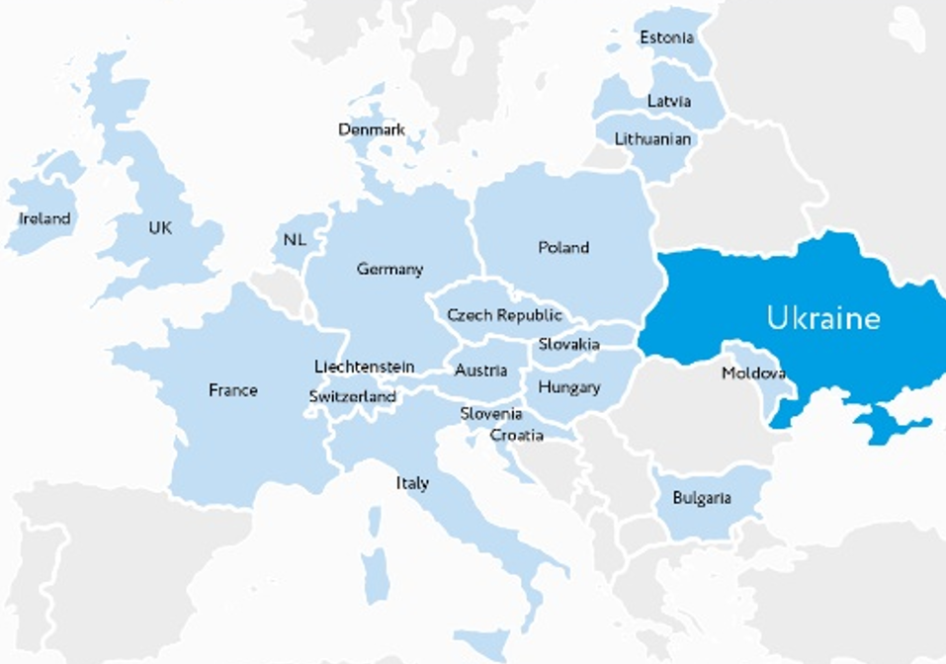
non-residents
170
+36%
in 2023
41
residents
1117
+13%
in 2023
37
32
COUNTRIES
3.3
bcm
Injected in CWR
in 2023

Slide 10
Resolution of the NEURC No. 656 dated 30th June 2022
euro
1.8
MWh
euro
euro
euro
0.86
MWh
0.04
MWh
0.90
MWh
injection
storage fee
for a month
withdrawal
INJECTION FEE
ƒ = 243.52 UAH* x 1.2(VAT) x COEFFICIENT / (FX**) / 10.595 (GCV)
STORAGE FEE
(WORKING GAS VOLUME)
 | Annual | Monthly | Day Ahead
Injection | 1.0 | 1.1 | 1.2
Storage
Withdrawal
ƒ = (1 month) = n-days x 0.4 UAH* x 1.2(VAT) x COEFFICIENT/ (FX**) / 10.595 (GCV)
WITHDRAWAL FEE
ƒ = 253.03 UAH* x 1.2(VAT) x COEFFICIENT / (FX**) / 10.595 (GCV)
* Tariff for 1 000 $m^{3}$/day
** FX — Foreign exchange. The indicator depends on the UAH/EUR exchange rate

Slide 11
Commercial efficiency
Certified in accordance with the EU regulations
Surplus of storage capacities offered to non-resident
customers
16% increase in Customer Portfolio in 2023
1st time ever at the E-World with own booth in 2024
Competitive pricing
Fixed tariff until April 2025
Lowest storage tariff in Europe
No capacity auctions
Digitalization
Tailor made I-Platform for customers
launched in 2020
Full I-Platform migration to SAP S/4 HANA in
energy units (project in progress)
Flexible Services
Storage (injection/withdrawal)
Latest update in service portfolio April 3, 2024
CWR, CWR+short-haul
Service branches
Energy Community
assessment note

Slide 12
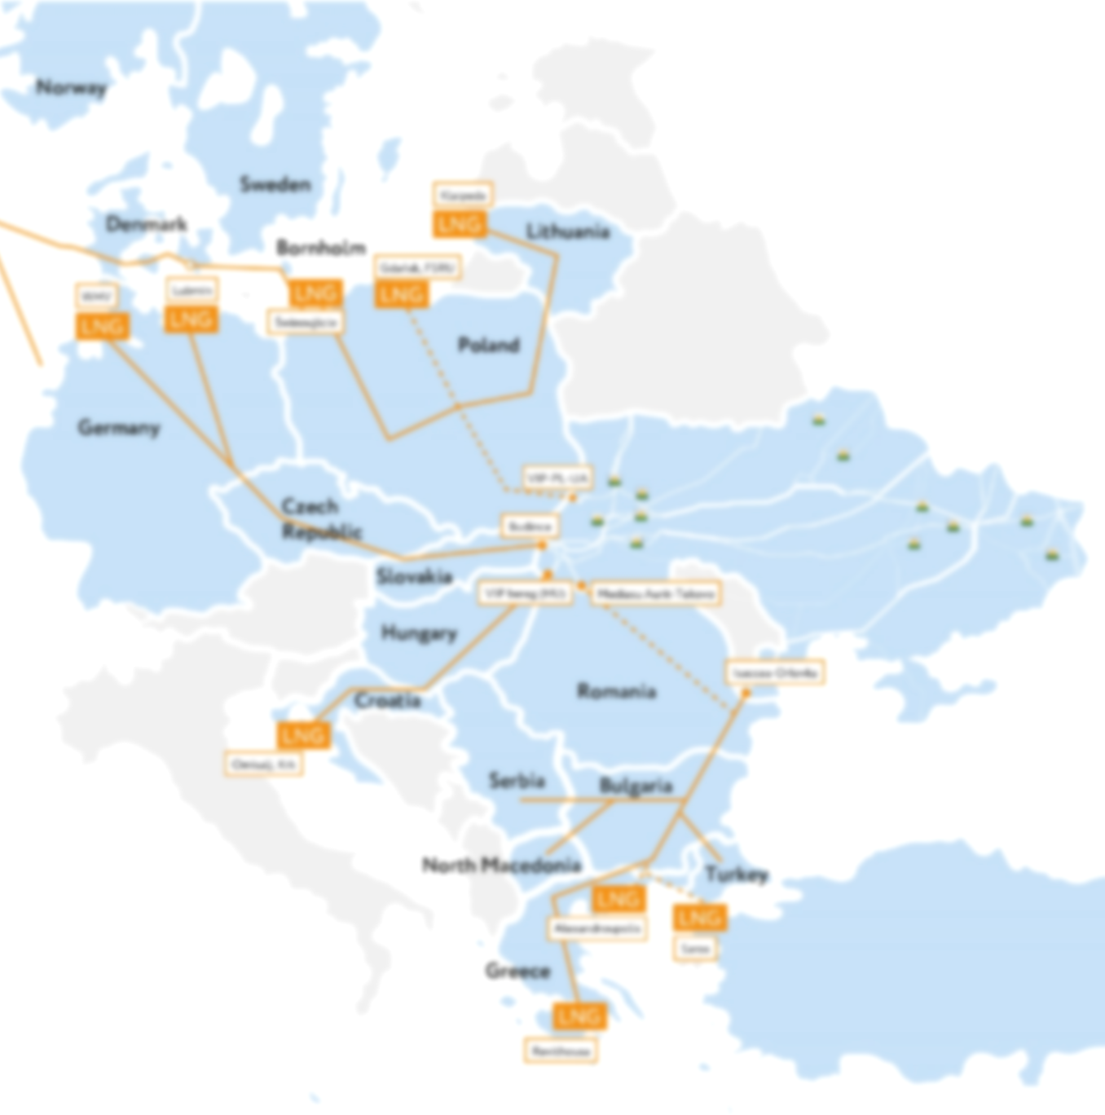
2024…
SSO UA AS A PART OF EU ENERGY BALANCE
…in progress
Improving Service Portfolio
Regulatory updates for biomethane storage
Migration to SAP S/4 HANA
Switching to ENERGY UNITS
2022 - 2023
CERTIFIED & RELIABLE SSO
2020 - 2022
CUSTOMER-ORIENTED SSO
Сertified in accordance
with EU regulations
Сustomer Portfolio expanded
I-Platform updated
Commercial function set up
Non-Resident Customer Portfolio built
I-Platform launched
2020
UNBUNDLING

Slide 13
100%
59%
EU Partner
EU SSO
nomination
UA SSO
nomination
11%
10
working gas volume
offered to non-residents
bcm
0%
* data taken from agsi.gie.eu 05.04.2024

