Slide 1
Storage Committee Collaboration Hub
Paris,2024

Slide 2
1
Collaboration hub
2
How to connect to Collaboration hub
3
4
5
6

Slide 3
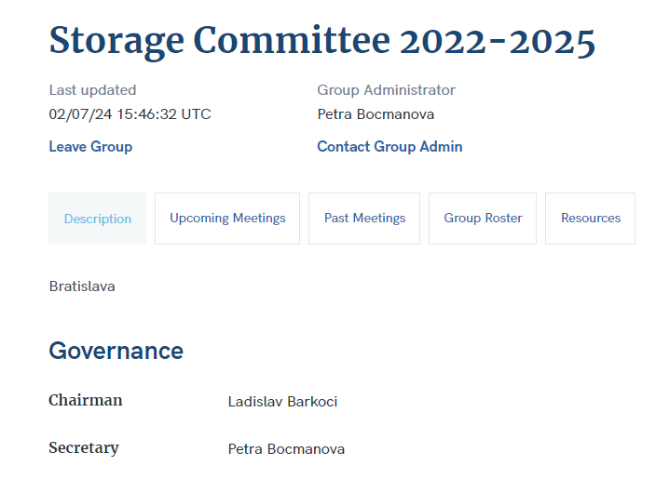
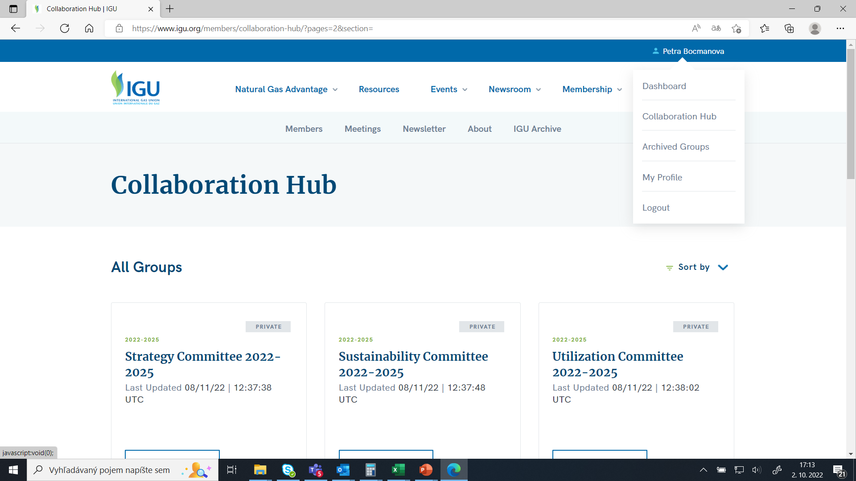
Collaboration hub
Our own space on IGU web site
Publish content
Organize meetings
Share documents
Share contact details of our members

Slide 4
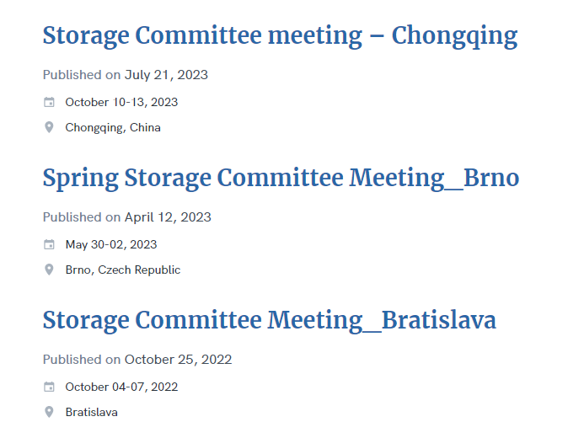
All minutes and presentations stored on collaboration hub
Presentations Storage Committee Meeting_Paris will be added soon

Slide 5
How to connect to Collaboration hub
1
IGU website
2
Create account
3
Collaboration hub
4
5
6

Slide 6
STEP 1
Visit the IGU website
Click on the link below
https://www.igu.org/

Slide 7
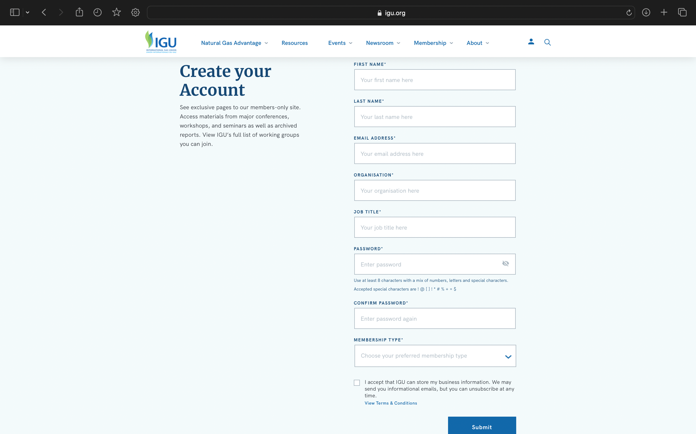
STEP 2
Submit registration

Slide 8
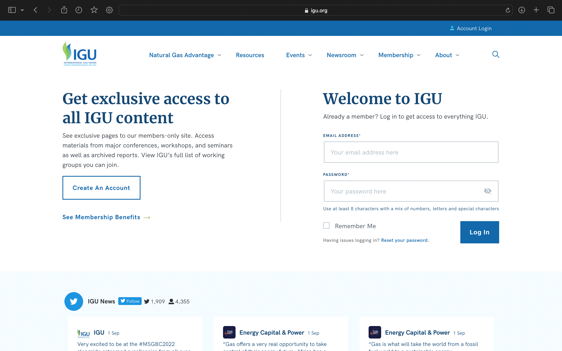
STEP 2
Create an Account
Click on the link below:
https://www.igu.org/members/login/

Slide 9
STEP 3
Find Storage Committee Collaboration Hub

Slide 10
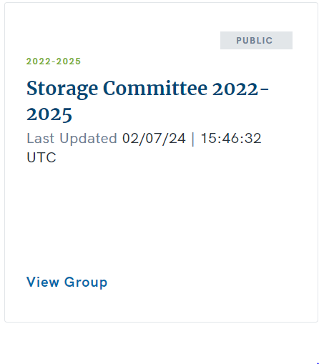
STEP 3
Send request to join group
After your request is sent to us, we will approve it, and you will become a part of this hub, enabling you to download the presentations.

