Slide 2
Project Défi H2
Sponsor : Damien RAVAUD
Project Manager : Nicolas GAU
« Défi » as a challenge for Storengy
We have to build everything with this new gas

Slide 3
Objective - Défi H2 project
The operator Storengy France must be able to:
Operate and maintain, with the high safety level, Hypster's facilities (surface installation) to meet the needs of hydrogen cycling in EZ53 and hydrogen production by electrolysis
Hydrogen Pilot STorage for large Ecosystem Replication

Slide 4
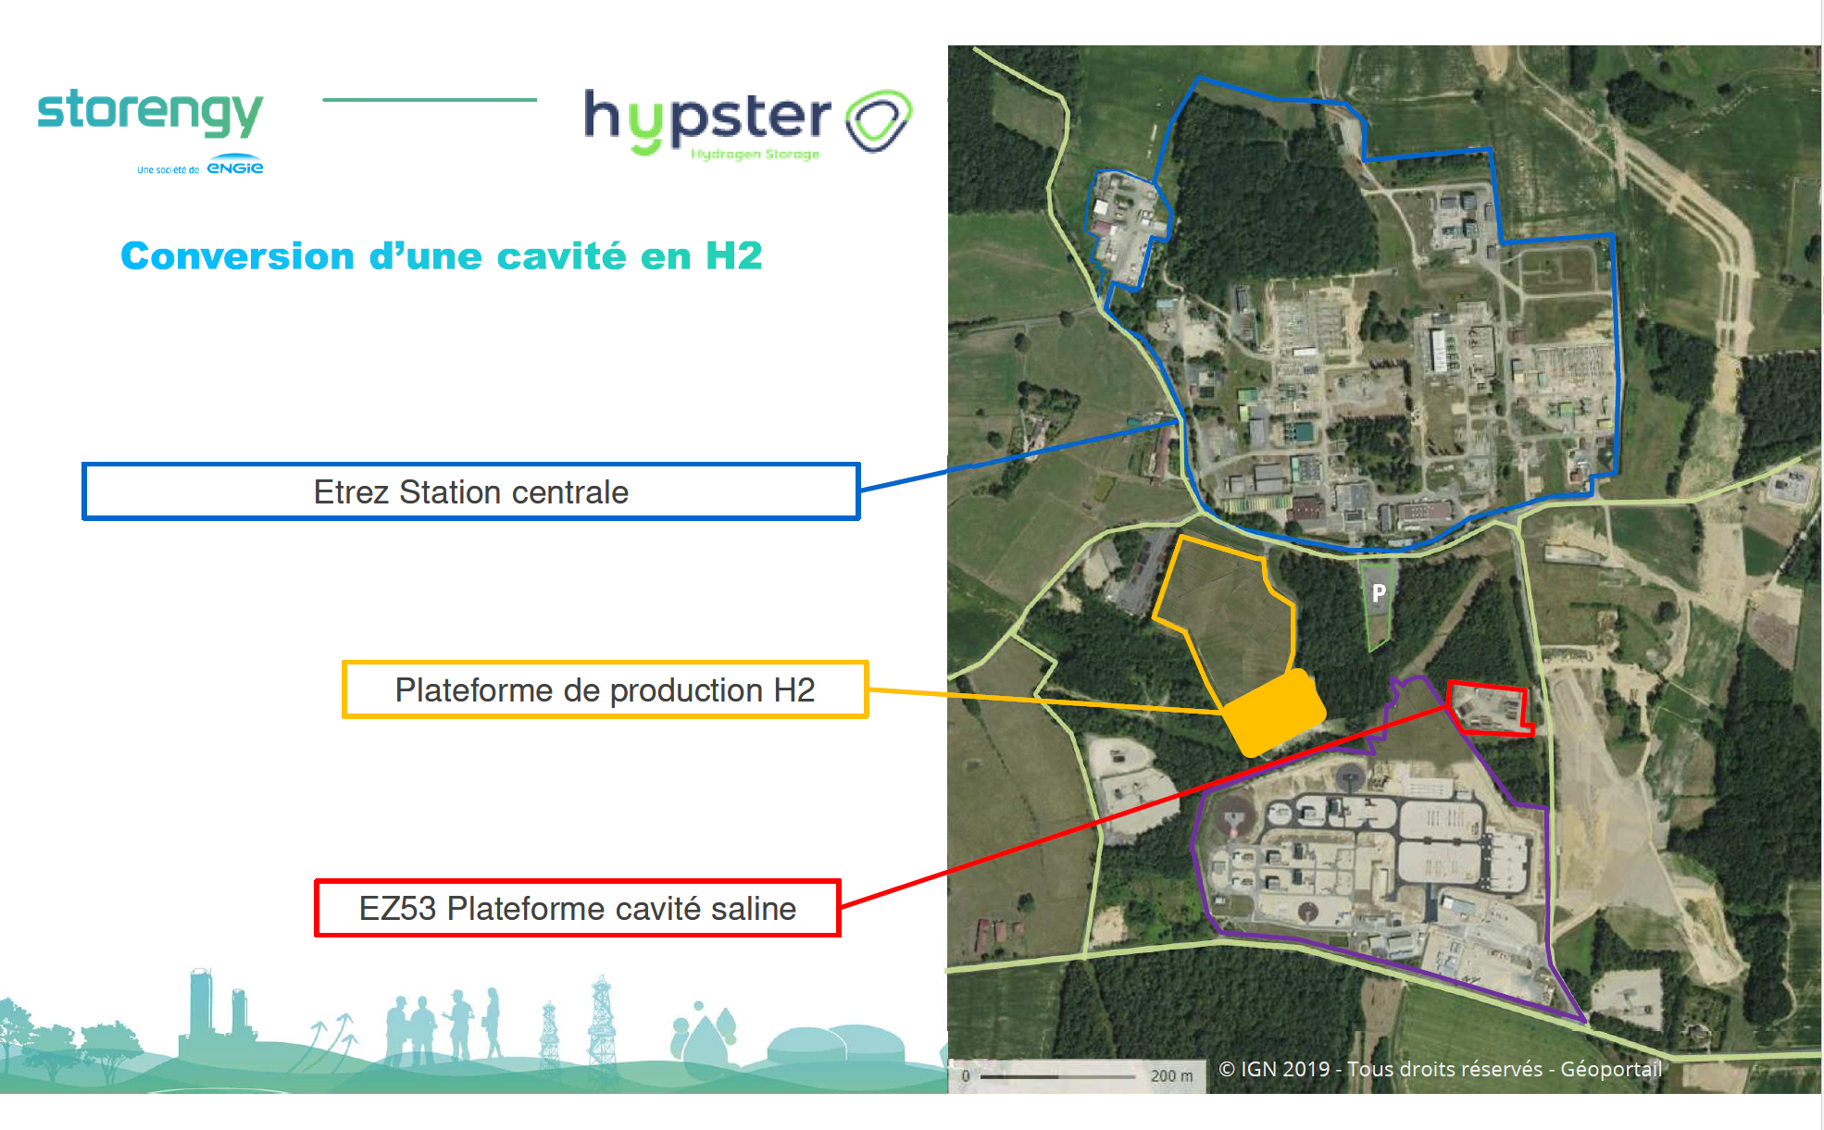
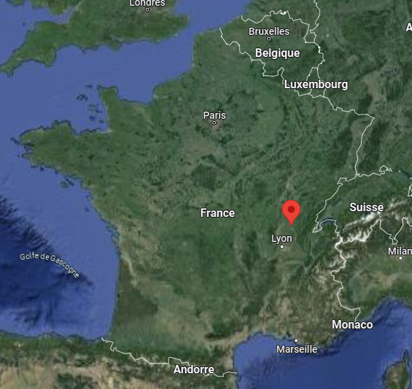
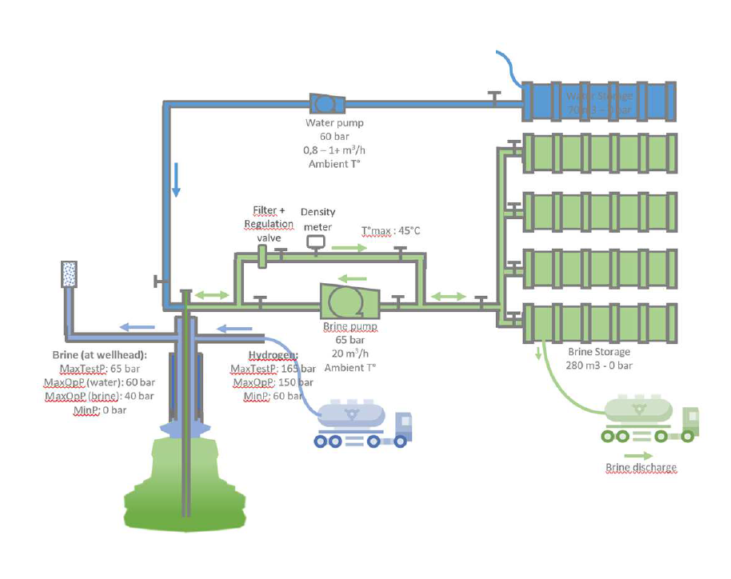
Just few words of Hypster project
Key figures :
Location : Etrez
H2 Production :
Power : 1MW (electrolyser PEM)
Production : 400 kg/j
H2 Storage Pilot :
3 t max
Natural Gas Site
H2 production
H2 Storage
1 – Test with an avalaible cavern EZ53:
Nitrogen leak test (ok) and Hydrogen (23/04 to June)
Cycling test (june → sept/oct)
2 – H2 Production : July for commissioning
Electrolyser
Compressor
Tube trailer Platform

Slide 5
What is new for operators ?
New trainings :
Training 1 for operational workers: 1 day with ½d H2 risks information & ½d H2 practice
Training 2 for non operational workers : ½d with H2 risks information
New authorization (qualification title) with 2 levels :
Training 1 + assessment with Experquiz tool
Training 2 + assessment with Experquiz tool
New safety management documents for operations :
Integration of H2 risks in our Prevention Plan, work order, fire/spark permit (use of specific tool), …

Slide 6
What is new for operators ?
All connected object (watch, smartphone,…) not allowed on process zone and storage platform
Work clothes : high visibility, anti flame propagation and anti static)
Gas detector
%LFL H2, O2, H2S, CO
According to risk analyses, use of thermal camera
Antistatic safety shoes
(ESD certification)

Slide 7
What is new for operators ?
Operations rules :
Isolate equipment → nitrogen inerting → ready for maintenance
Package (electolyser, compressor) : risk with confined space
Monitor the O₂ cell because the risk of anoxia may be present if nitrogen inerting is carried out automatically upon detection of a leak in the package
Let the package doors open during all the operation

Slide 8
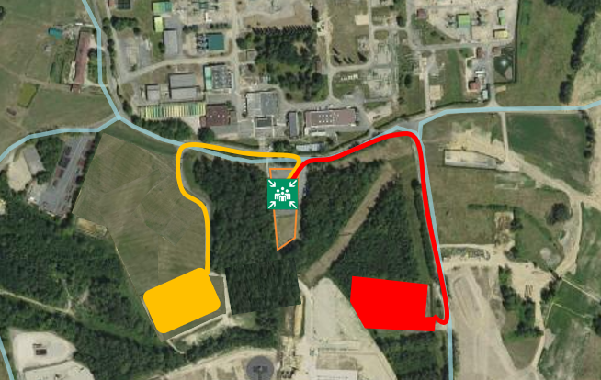
What is new for operators ?
Emergency Plan adapted with the integration of new H2 installations (perimeter) and in coordination with other operators close to our site (new risks scenarios)
H2 leak detection : Stop operation → evacuation site → inform supervision room
Stop operations in case of storm alert (specific subscription for weather information, already used for Natural Gas site)
Site evacuation
OU
Alarm evacuation site
→ Reach the meeting point ←

Slide 9
Thank you for your attention

