Slide 1
The fundamental role of underground storage in ensuring security of supply
Storage Committee meeting Group3
10 - 12 April 2024, Paris, France

Slide 2
Where do we stand? Is underground storage recognized for all the values it generates for society? Is there an awareness of its key role in contribution to supply of security?

Slide 3
— Underground storage generates a number of values, of which only the arbitrage value is recognized by the market —
RECOGNIZED BY THE MARKET
ARBITRAGE VALUE
SYSTEM VALUE
OPTIMAL VALUE OF STORAGE
INSURANCE VALUE
TARGETED
INTERVENTION
REQUIRED
KICK-START VALUE
ENVIRONMENTAL VALUE

Slide 4
— Underground storage generates a number of values, of which only the arbitrage value is recognized by the market —
RECOGNIZED BY THE MARKET
ARBITRAGE VALUE
SYSTEM VALUE
OPTIMAL VALUE OF STORAGE
INSURANCE VALUE
TARGETED
INTERVENTION
REQUIRED
KICK-START VALUE
ENVIRONMENTAL VALUE

Slide 5
1. The underground storage stands out as the primary asset for alleviating the impacts of an energy crisis or preventing a new one
2. The unbreakable link between SoS and gas storage
3. The insurance value requires a comprehensive approach encompassing the entire energy system and involving a collective dimension

Slide 6
The underground storage stands out as the primary asset for alleviating the impacts of an energy crisis or preventing a new one
1
The most reliable option for providing a secure physical supply source close to demand centers
The sizing of storage capacities has been carried out by optimizing the entire gas system
Underground storage offering a notable advantage in addressing and mitigating the stress on the system
Underground storage characterized by its large capacities and long-term duration, compared to alternative storage technologies

Slide 7
Underground storage is the most reliable option
Providing a secure physical supply source close to demand centers
Securing firm capacities, even for potentially substantial amounts of gas volume
within record delivery times

Slide 8
The sizing of storage capacities carried out by optimizing the entire gas system
Gas storage lowers the cost of transmission pipelines
There is no substitute for underground storage to meet these extreme events.

Slide 9
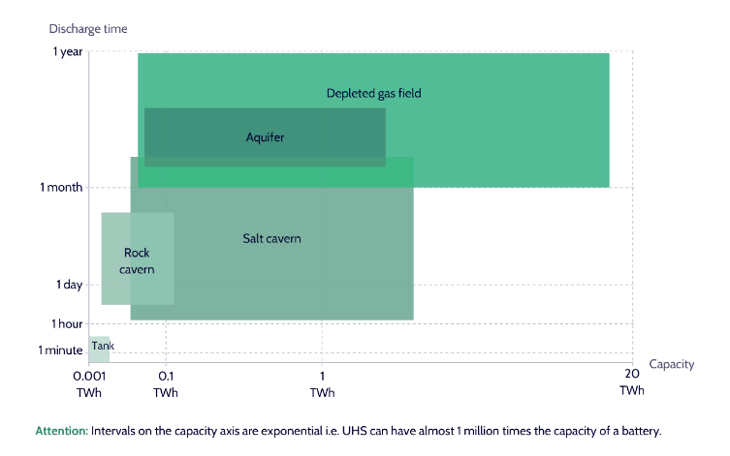
Comparison of UHS types in terms of capacity and discharge time (flexibility type)
Markets relying on this asset have a significant advantage in addressing and mitigating the stress on the system,
becoming as such the guardian of a balanced market, ensuring their citizens continuity of supply and price stability
Source: Guidehouse (2024) ON BEHALF OF HEART FOR EUROPE

Slide 10
The unbreakable link between SoS and gas storage
2
This link becoming apparent during times of crisis
The gas storage paradox - The tension stems from the need for gas storage amid challenges in fully demonstrating its value

Slide 11
This link becoming apparent during times of crisis
Illustration of economics of seasonal modulation – summer vs winter
Under market mechanisms, merchant revenues are driven by the summer-winter spreads.
Consumers receive a net benefit from gas storage as demand in winter is greater than demand in summer
The "insurance value" of storage lies in its ability to provide a reliable, flexible, and resilient energy infrastructure over the long term
Source: FTI Compass (2018)

Slide 12
The gas storage paradox
High summer-winter spreads
or short-term volatility
Risk of supply
Not sufficient
storage capacity
Symptoms of a “stressed”gas system
No long-term vision
Low summer-winter spreads
or low price volatility
Security of supply
Adequate
storage capacity
Optimised gas system
Long-term vision

Slide 13
The insurance value requires a comprehensive approach encompassing the entire energy system and involving a collective dimension
3
The low probability of events happening may result in minimizing their impact
Society as a whole aims to protect itself against risk, especially within the field of energy Since underground storage capabilities cannot be replaced, targeted intervention must not be disregarded

Slide 14
The low probability of events happening may result in minimizing their impact
The low probability of events happening may result in minimizing their impact, as risk exposure fluctuates over time.
Society as a whole is focused on ensuring a sustained commitment to relatively stable and low prices over the long term.
Fortunately, certain governments in various regions of the world have begun taking steps to complement the price signals unveiled by the market.

Slide 15
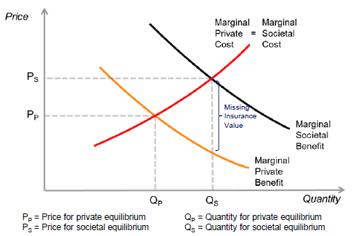
Society as a whole aims to protect itself against risk, especially within the field of energy
The market failure in insurance value
society puts a greater value on the benefit of storage (MSB) than the shippers (MPB). So left to its own devices, the market could require less storage (Qp) thant society would want (Qs).
Interventions are then necessary to ensure that society's storage capacity aligns with the optimal level, which may differ from the level retained by the market.
This gap is theoretically called „missing insurance value”.
Source: Poyry (2017)

