Slide 1
April 2024
14:30-14:00
Report: The role of underground hydrogen storage in Europe
H2eart for Europe

Slide 2
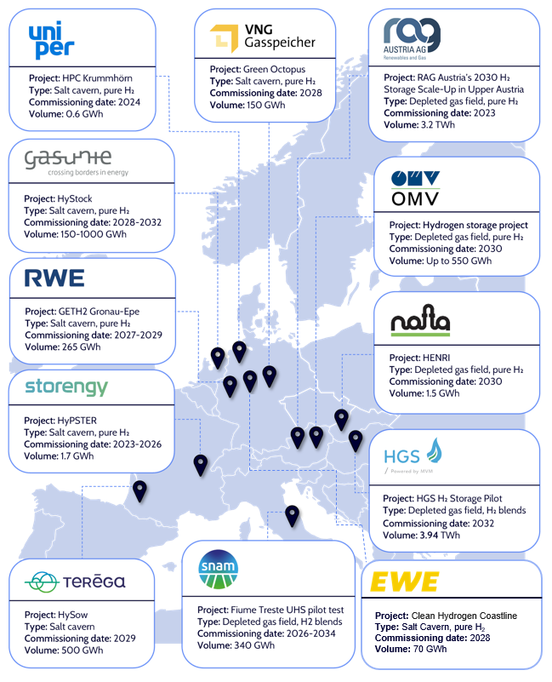
CEO-led alliance of leading SSOs in Europe
Launched in Brussels in January 2024 with Maroš Šefčovič, H2eart for Europe is a CEO-led Underground Hydrogen Storage Alliance, currently composed of 12 major European Storage System Operators.
We are committed to deliver UHS as a clean energy storage solution which can unlock hydrogen as a flexibility vector.
Key role of Underground Hydrogen Storage in the EU
We demonstrated UHS’s important role in Europe’s energy transition, by reducing the overall cost of the energy system, supporting the balancing of the energy system (short and long term) and helping the development of renewable energy sources.
More info here!
April 2024

Slide 3
Underground Hydrogen Storage can bridge the flexibility gap.
With the increase of share of intermittently produced renewable energy sources (RES) in the energy mix, we need to ensure a stable energy supply and RES must be coupled with clean energy storage options, providing the necessary flexibility.
Underground Hydrogen Storage (UHS) is a scalable solution that unlocks hydrogen
as a flexibility vector and depending on the technologies and cycling rate, varying
timescales for short- to long-term storage are possible.
The project pipeline of 9TWh by 2030 reflects the strong commitment to UHS technology by the energy sector. However, there is a strong necessity for project acceleration considering the predicted need of 45TWh and the actual gap of 36TWh of storage by 2030.
Narrowing this 36 TWh storage gap would require between 18 and 36 billion euros in investment. Policy makers must take action now to ensure a smooth roll-out of RES and the achievement of critical decarbonisation targets.
Targeted policy measures are needed and may take the shape of a dedicated EU Hydrogen Storage Strategy, granting hydrogen storage the attention needed for a successful and efficient scale-up.
April 2024
Notes:
Working toward REPowerEU and Fitfor55 is simply non negotiable
This wil call for the development of massive storage option, not only for seasonal activities. The traditional use of Underground storage.
But, and this is the first finding… we need clean energy storage option
Many options are available (and we’ll detail that after) but only one has a wide range of reach, and this is the second finding… UHS can do it all
The members of this alliance haven’t stand still, they are already developing project. Is it enough? No, as, and this is the third finding, we have a major gap to fill…
The commitment of our members make narrowing the gap a accessible but we’ll need also support… in terms of investment of course
But also, and this is the fifth finding, in terms of targeted policy measures…

Slide 4
Presentation overview
1. Future-proofing the energy system with underground hydrogen storage
2. Development of underground hydrogen storage assets
3. Trajectory of underground hydrogen storage developments: 2030 and beyond
4. Conclusion and policy overview
Front page of “The role of underground hydrogen storage in Europe”
April 2024

Slide 5
The current ramp-up of renewables causes urgent flexibility needs…
… making clean energy storage solutions of the essence.
April 2024
.
Notes:
Working toward REPowerEU and Fitfor55 is simply non negotiable

Slide 6
1.
Future-proofing the energy system with underground hydrogen storage
Unlocking a resilient and decarbonised Europe has various challenges.
The management of volatile electricity production and similarly volatile demand lies at the heart of the flexibility challenge in the power sector.
April 2024
Notes:
Renewable energy sources increase flexibility needs

Slide 7
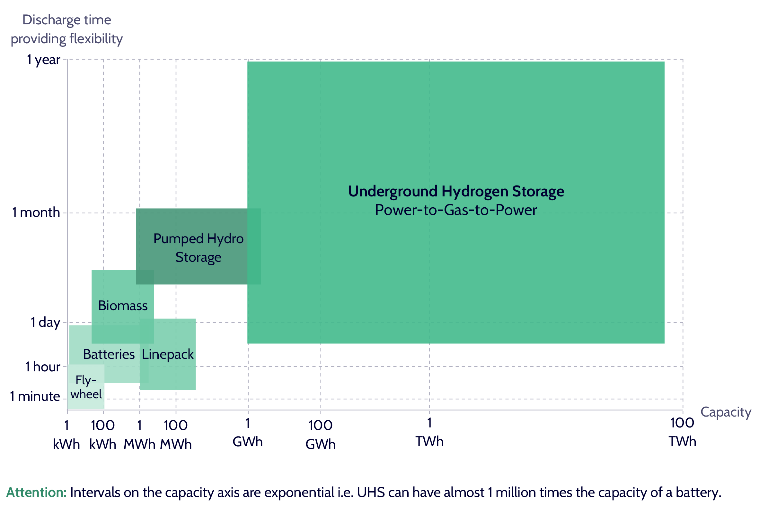
1.
Future-proofing the energy system with underground hydrogen storage
Flexibility needs of the future energy system will increase over time, and UHS is a uniquely versatile storage solution which can provide flexibility tailored to a wide range of use cases simultaneously. Other flexibility solutions are limited in capacity and discharge time.
Synergies between UHS and PtGtP technologies allow for a universal approach to flexibility, seamlessly spanning long-term, mid-term, and short-term storage requirements in the evolving landscape of decarbonised energy systems
Figure: Comparison of flexibility solutions in terms of discharge time in which they provide the according capacity
April 2024
Notes:
- Flexibility needs will increase with more intermittent renewable and phase out of dispatchable, fossil fuels.
- UHS is the sole solution to the increasing flexibility challenge in the energy system, functioning as a connection between the future decarbonised power and gas networks.

Slide 8
1.
Future-proofing the energy system with underground hydrogen storage
Key takeaways of part 1.
Supports flexibility needs of the future energy system and provides an essential link between the power sector and the hydrogen economy.
Providing short to long term flexibility needs and large capacities, underground hydrogen storage is the sole techno-economically viable technology available
UHS unlocks benefits along the entire value chain and foster the development of RES
April 2024
Notes:
1. future energy system reliant on volatile electricity production of RES and demand fluctuations is in utmost need of flexible dispatchable backup, currently not yet provided.
2. UHS in combination with PtGtP mechanisms can provide the necessary high flexibility needs whilst offering an incomparable scale of volume
3. By implementing large-scale storage into an integrated energy system, investment and operational cost can be reduced whilst increasing the RES content in the energy mix, leading to lower emissions for a sustainable future.

Slide 9
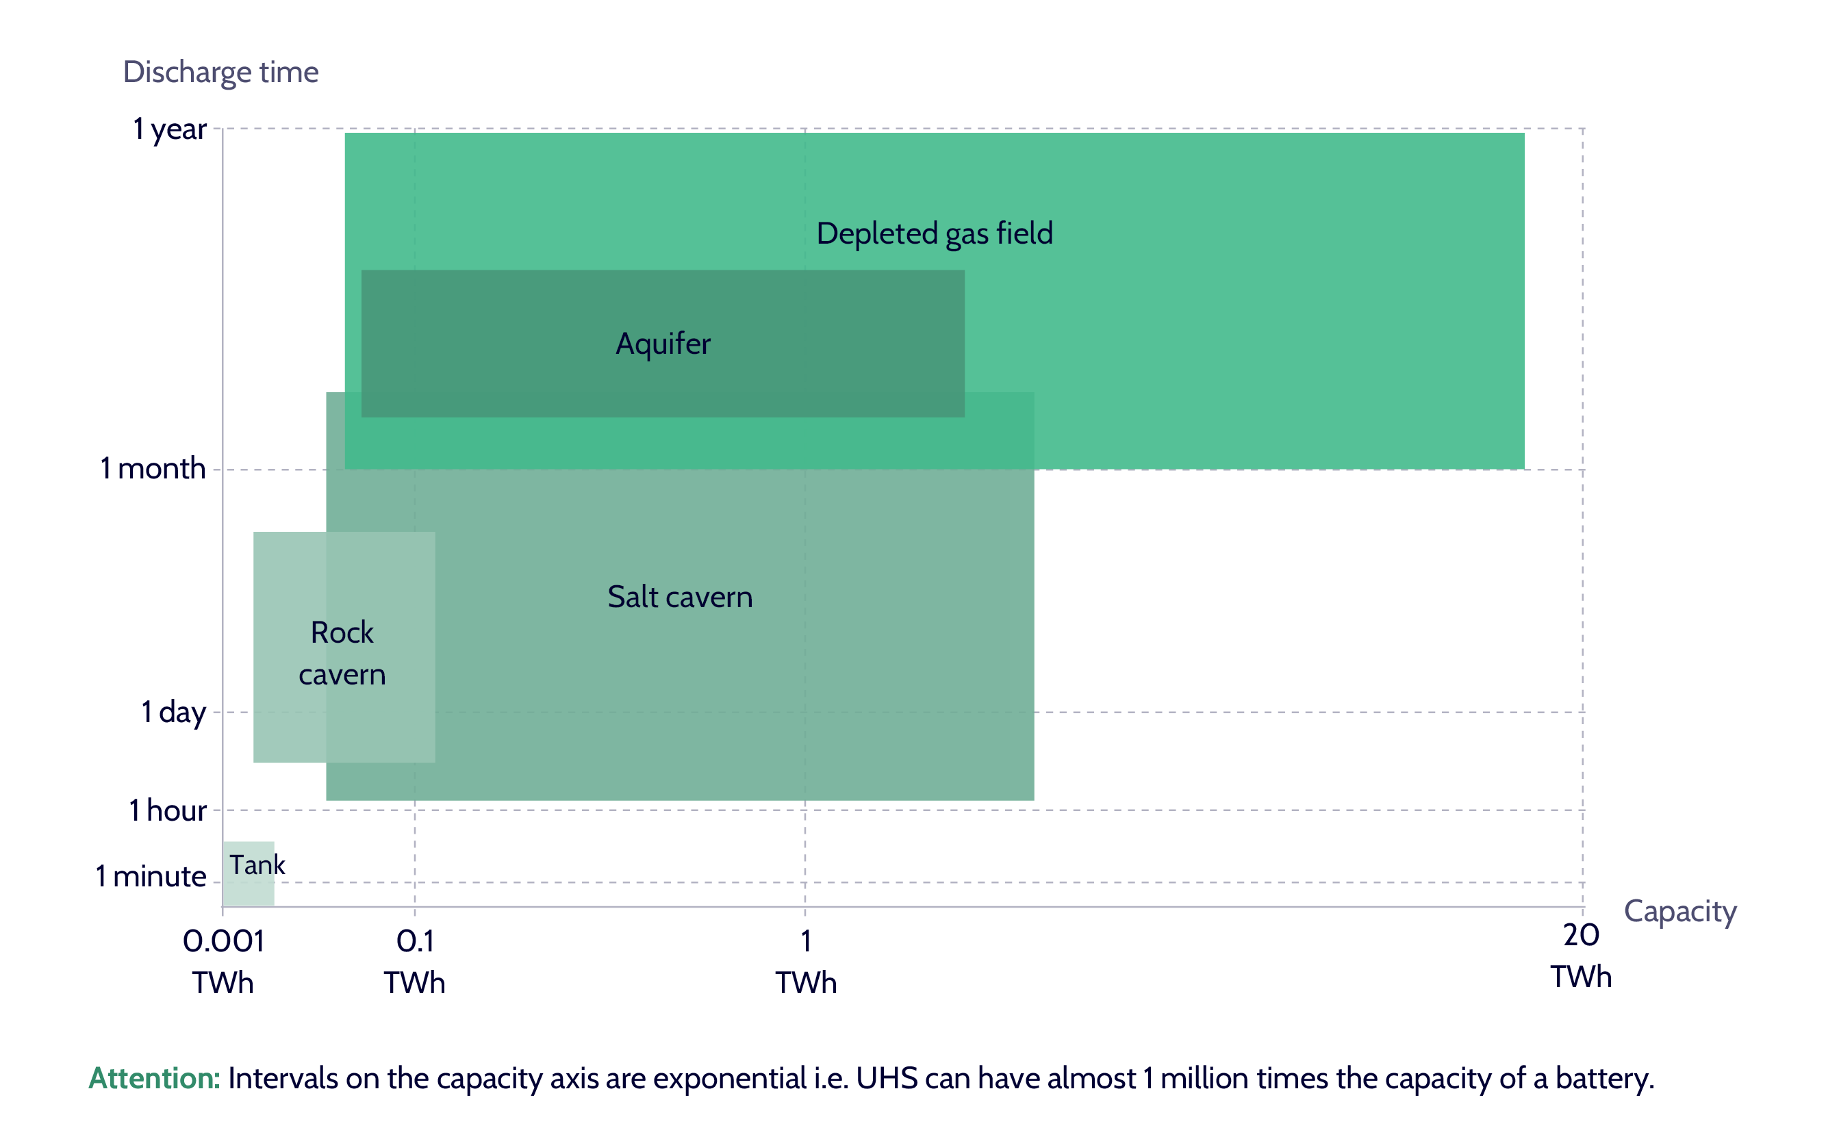
2.
Development of underground hydrogen storage assets
All storage types are needed to achieve system benefits.
Technology readiness ensures swift development, e.g. by thoroughly testing sites and making site-specific adjustments.
Many projects are currently carried out to further investigate and analyse necessary changes in plant design and lay-out.
Figure: Comparison of UHS types in terms of capacity and discharge time (flexibility type)
April 2024
Notes:
Salt caverns: enclosed underground cavity, capable of various cycles per year – unique characteristics, agile contributors to peak shaving and fulfilling hourly storage needs. – constrained per region, mostly available to Northern/Central-European countries.
Depleted gas fields: Typically undergrowing only one or two annual cycles – Large volumes and well-established understanding for operation. Storing hydrogen differs from one field to another, more research needs to be done on this topic.

Slide 10
2.
Development of underground hydrogen storage assets
Figure: Potential setup of UHS to serve the full flexibility range by efficient well placement to increase withdrawal and injection rates
Examples of key parameters for operation of storage assets are storage volume, injection and withdrawal rates.
Netting of customer requests reduces the need for storage, allowing for more flexibility to react to fluctuating supply and demand conditions
Different operational modes of UHS allow for different cycle types and enable meeting flexibility needs.
Note: All technologies can be utilised for various flexibility ranges. Drawings are not representative of true size.
April 2024
Notes:
Talk about the different flexibility needs and how they could be realised with different operational modes (e.g. cluster mode, multiple storage next to each other to inject and withdraw separated shortly in time).

Slide 11
2.
Development of underground hydrogen storage assets
Key takeaways of part 2.
To unlock all benefits of UHS and leverage synergies, various technological UHS solutions must work together.
Rapid kick-off of UHS development whilst ensuring high safety standards is of utmost importance.
Building on decades of experience and leveraging existing infrastructure shortens development timelines and investment needs.
April 2024
Notes:
All storage types have their individual advantages whilst being simultaneously constrained by either geographical or technical properties. When connected via pan-European infrastructure, all advantages can be leveraged, and boundaries overcome.
SSOs have the technical experience to develop status-quo gas storage infrastructure, enabling hydrogen storage assets to utilise their full potential in flexibility provision whilst also being aware of possible never faced safety precautions
UHS is a scalable technology as existing underground gas storage can be repurposed for the use of hydrogen, reducing development time and consequently ensuring a faster achievement of benefits.

Slide 12
3.
Trajectory of underground hydrogen storage developments: 2030 and beyond
Storage projects are already being developed across Europe with 9.1 TWh of pure-hydrogen storage capacity in the pipeline for 2030.
Around 45 TWh of storage would be required to tap into the benefits for the energy system, resulting in a gap of 36 TWh in 2030.
45TWh : as per the GIE study (https://www.gie.eu/press/new-gie-study-reveals-an-urgent-need-for-targeted-policy-intervention-to-fulfill-european-underground-hydrogen-storage-requirements/)
Figure: Actual UHS sites in operation in 2030 (left) and gap with required storage volume to tap into the benefits for the energy system (right)
April 2024

Slide 13
3.
Narrowing the storage gap requires investments
The Storage gap results in between 18-36 b€ additional investments within this decade.
To narrow this gap and develop UHS assets, a regulatory framework and public support will be key.
Access to EU and national financing instruments must be facilitated.
Figure: Underground hydrogen storage gap (left) and related investment needs based on optimistic, average and conservative case, corresponding to 500, 750 and 1000 €/MWh (right)
April 2024

Slide 14
3.
Trajectory of underground hydrogen storage developments: 2030 and beyond
Key takeaways of part 3.
There is a large gap between planned hydrogen projects and needed storage volumes for the benefit of the EU energy system.
This storage gap means there is a need for €18-36 billion in additional investment by 2030, and this gap is only expected to increase towards 2040 and 2050.
Narrowing the storage gap requires a clear and transparent regulatory framework to facilitate investment decisions. Public financial support is needed from the EU and national funds.
April 2024
Notes:
In 2030, this gap is predicted to measure 36 TWh. By 2040 and 2050 this gap will have increased significantly due to large uncertainties in the market regarding the development of underground hydrogen storage projects
These large investments, typical for large infrastructure projects, are needed to unlock all previously mentioned benefits for both the electricity system and the hydrogen ecosystem e.g. efficient integration of renewables and a stable supply of hydrogen.
Storage developers need the right (financial) support to scale up assets and develop more mature and suitable projects.

Slide 15
4.
Conclusion and policy overview
Key takeaways of part 4.
Policy makers must act now to ensure a smooth roll-out of RES and the achievement of critical decarbonisation targets.
UHS at scale will significantly contribute to the stability & decarbonisation of future energy systems.
European hydrogen and RES targets are significant, and their achievement critically hinges on relevant supporting infrastructure, and related targeted policymaking.
A clear and stable regulatory framework – possibly in the form of a dedicated UHS Strategy – will be required as soon as possible to enable the scale-up of UHS.
The large gap between actual planned projects and required storage capacity by 2030 and 2040 highlights the need for a hydrogen storage volumes target.
April 2024
Notes:
by creating a stable supply of hydrogen for end users and enabling a flexible back-up power production via PtGtP to variably produced renewables.
The EHB is already well underway, showing the critical impact of policymaking. Similarly, UHS needs significant efforts from policymakers and key acors from the hydrogen value chain to unlock UHS’ full potential and to implement UHS at scale.
Delays due to long permitting processes must be minimised to ensure the swift development of the hydrogen storage business case. Stable investment conditions, remuneration models, incentives to develop assets and de-risking measures are essential.
A storage target would stimulate actors across the value chain to action, recognise UHS as a key technology for the future energy system and show commitment from EU policymakers.

Slide 16
Next step for coming months:
Preliminary Table of Content
Chapter 1: Policy & Regulation
Gas package: Addressing impact of this legislative package on UHS in Europe
Chapter 2: Economics
Business models: Assessing operational models, valuation of storage, including reducing curtailment and mitigation of grid congestion
Funding instruments: Availability & relevancy for UHS projects (e.g. H2 auctions, Innovation Fund, PCI)
Chapter 3: Implementation
Planning, design & operation: including technical feasibility of UHS technologies, based on pilot projects of our members.
Construction & permitting: Increasing speed of deployment, one-stop-shop principle
We will deliver the strategic roadmap of Underground Hydrogen Storage in Europe, assessing our members’ initiatives and proposing EU-level changes to accelerate the development of UHS.
The development of a dedicated European Underground Hydrogen Storage Strategy
April 2024

Slide 17
The H2eart for Europe website is live
h2eart.eu

Slide 18
March 2024

Slide 19
1.
Future-proofing the energy system with underground hydrogen storage
How UHS accelerates the integration of energy systems
KICK-START VALUE
FOR H₂ SUPPLY
SYSTEM VALUE
FOR H₂ - TRANSPORT
ENVIRONMENTAL VALUE
FOR OFFTAKERS
April 2024
Notes:
Kick-start value: Overcoming chicken-and-egg problem – using excess electricity as hydrogen to not curtail, so efficient buildout of RES capacities, while balancing supply and demand of electricity and hydrogen.
System value: Efficient use of Electrolyzers - Reduces overall need for expansion of energy infrastructure – creates a reliable and resilient system with increased security of supply as back-up fuel.
Environmental value: Reach climate targets with the cheapest possible hydrogen – reducing carbon footprint of end-users by transitioning away from fossil hydrogen faster.

Slide 20
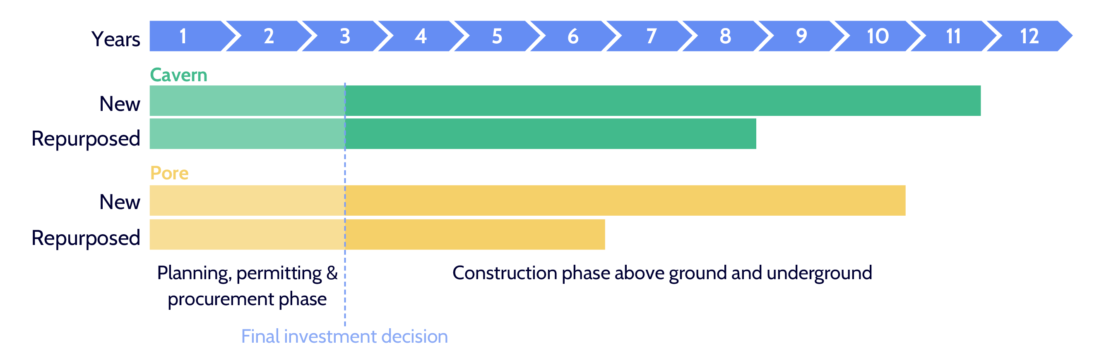
2.
Development of underground hydrogen storage assets
Typical development timelines of underground hydrogen storage are substantial.
Acceleration in the regulatory framework is key to accelerate the overall development process (e.g. permitting procedures).
April 2024
Notes:
Development timelines are long, and for these infrastructure asset, planning ahead will be key.

