Slide 1

WELL PERFORMANCE MANAGEMENT
Peter Šafár, NAFTA a.s.
2023.10.11

Slide 2
INTRODUCTION
UGS MODEL IN NAFTA
RESULTS INTERPRETATION
NEXT STEPS
APPLICATION OF UGS MODEL IN OTHER STORAGES

Slide 3
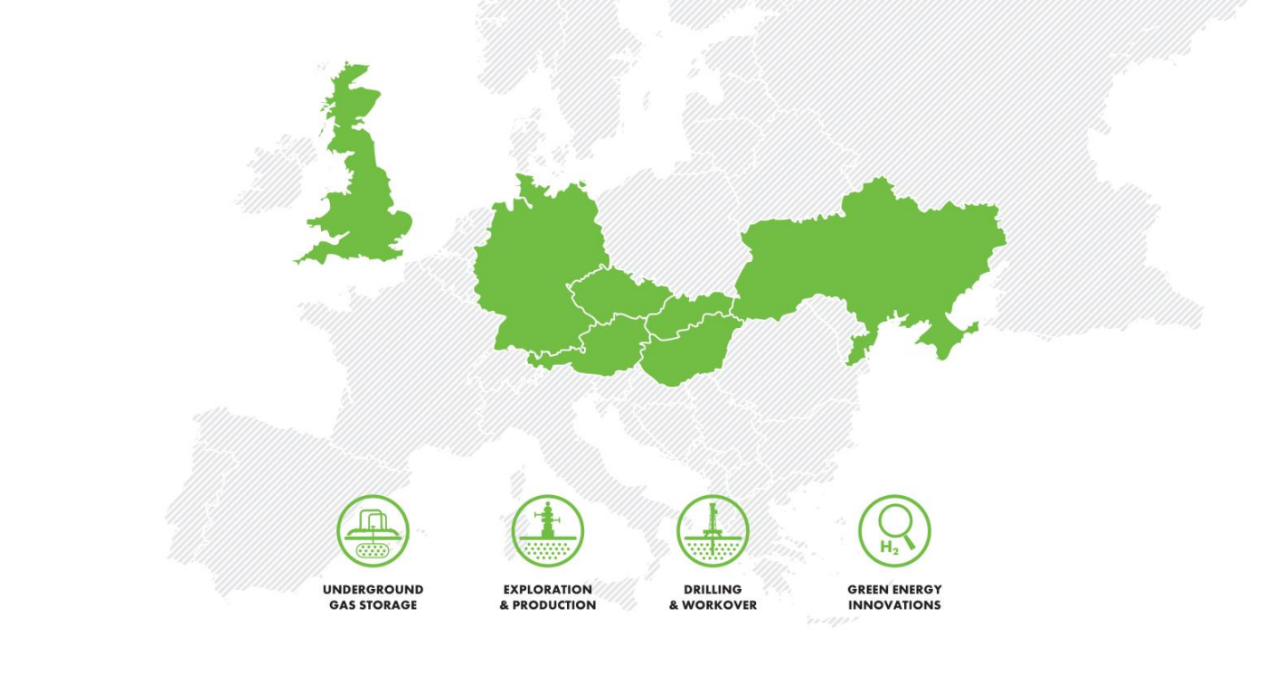
  INTRODUCTION
NAFTA a.s.
The 6th largest Operator of Natural Gas Storages in Europe
Storage capacity: 64 TWh
Value in flexibility
  Technical
  Commercial
  Position in the Markets
Intention to develop all these areas
Next expansion

Slide 4
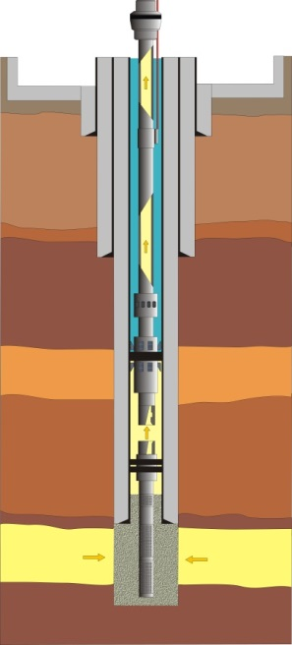
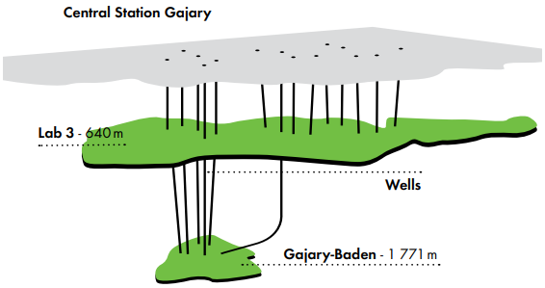
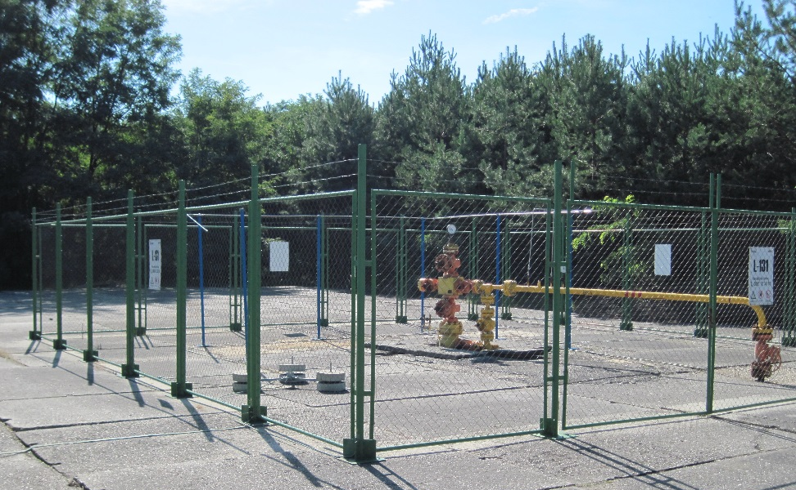
  GAS STORAGE WELL
UGS Facilities are critical part of the gas infrastructure
Gas storage wells
  Connection between reservoir and sufrace technology
  Injection and Withdrawal of natural gas

Slide 5

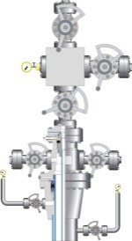
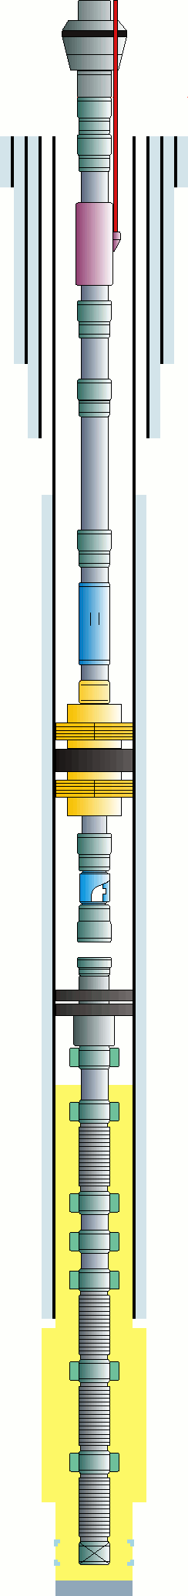
  THEORETICAL Qc VS PHYSICAL Qm GAS RATE
Wellhead
142 BARa
0.6 mil Sm3/d
VLP
Data from Wellhead
Static Pressure
Dynamic Pressure
Flowrate
Temperature
IPR
151 BARa
153 BARa

Slide 6
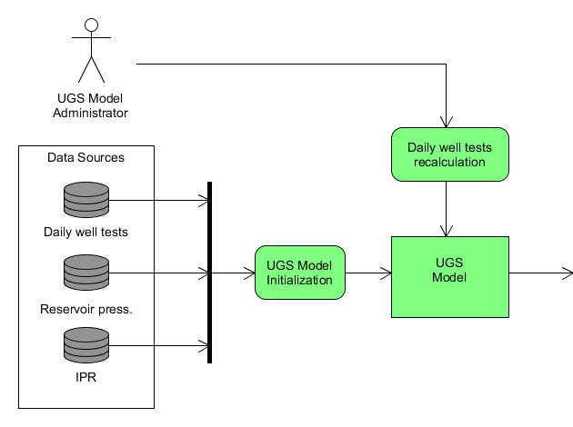
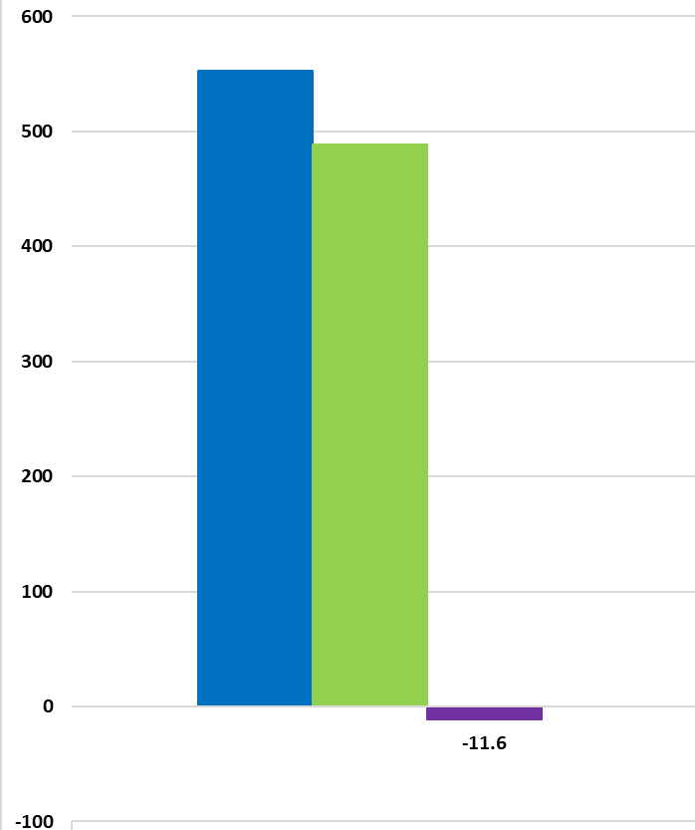
  THEORETICAL FLOWRATE CALCULATION
Theoretical flowrate
Actual flowrate
Difference %
For our largest UGS reservoir 8th Panonian we evaluate more than 35 000 test samples per year

Slide 7
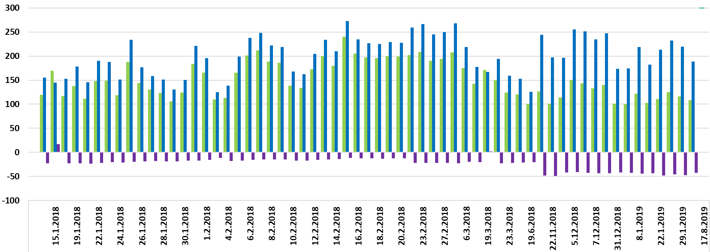
  8. PANON – RESULTS SET
Well SUC029
Worsening well performance, further actions needed

Slide 8
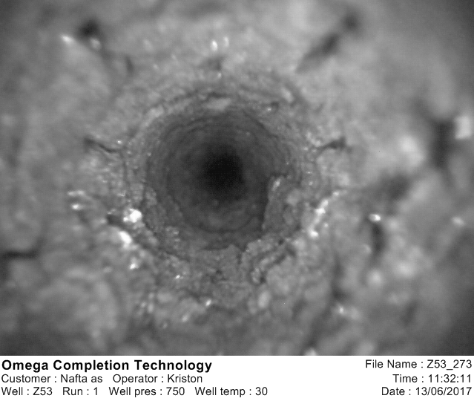
  DOWNHOLE CAMERA SURVEY
Scale formation inside downhole equipment including screen

Slide 9


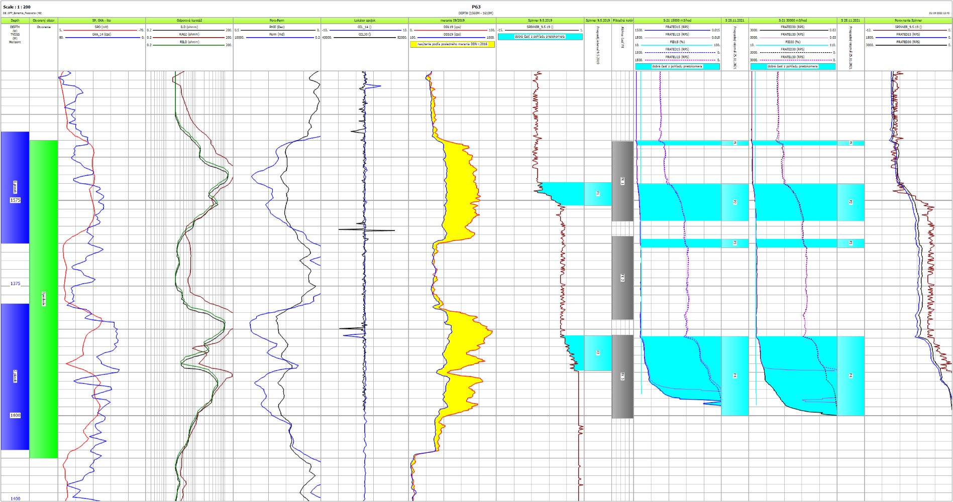
  SPINNER SURVEY & CONSULTATION
1.
2.
3.
4.
5.
Lower measured flowrate as was expected
Results are consulted with Reservoir Engineers to confirm decrease in performance

Slide 10
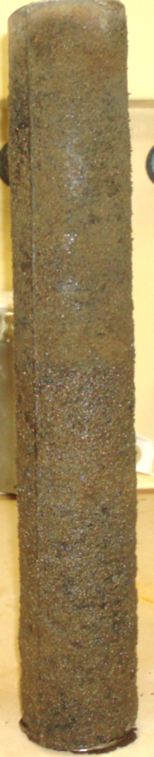

  WELL ACIDIZING
Screen from the well SUC024
Screens installed in 1996
Half of the screens‘ sample submerged into RETAKYS ®
After 6 hrs. full removal of scaling
After acidizing
Lab Test

Slide 11
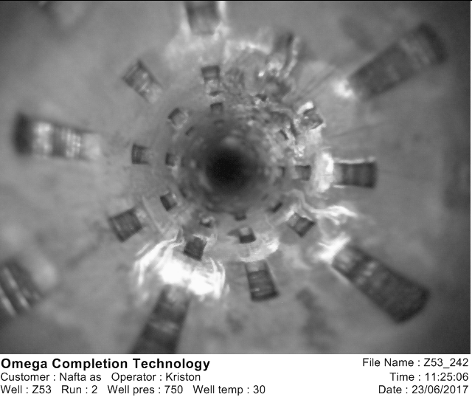
  RESULTS AFTER WELL ACIDIZATION
Before Well Acidizing
After Well Acidizing
1.
2.
3.
4.
5.
1.
2.
3.
4.
5.

Slide 12
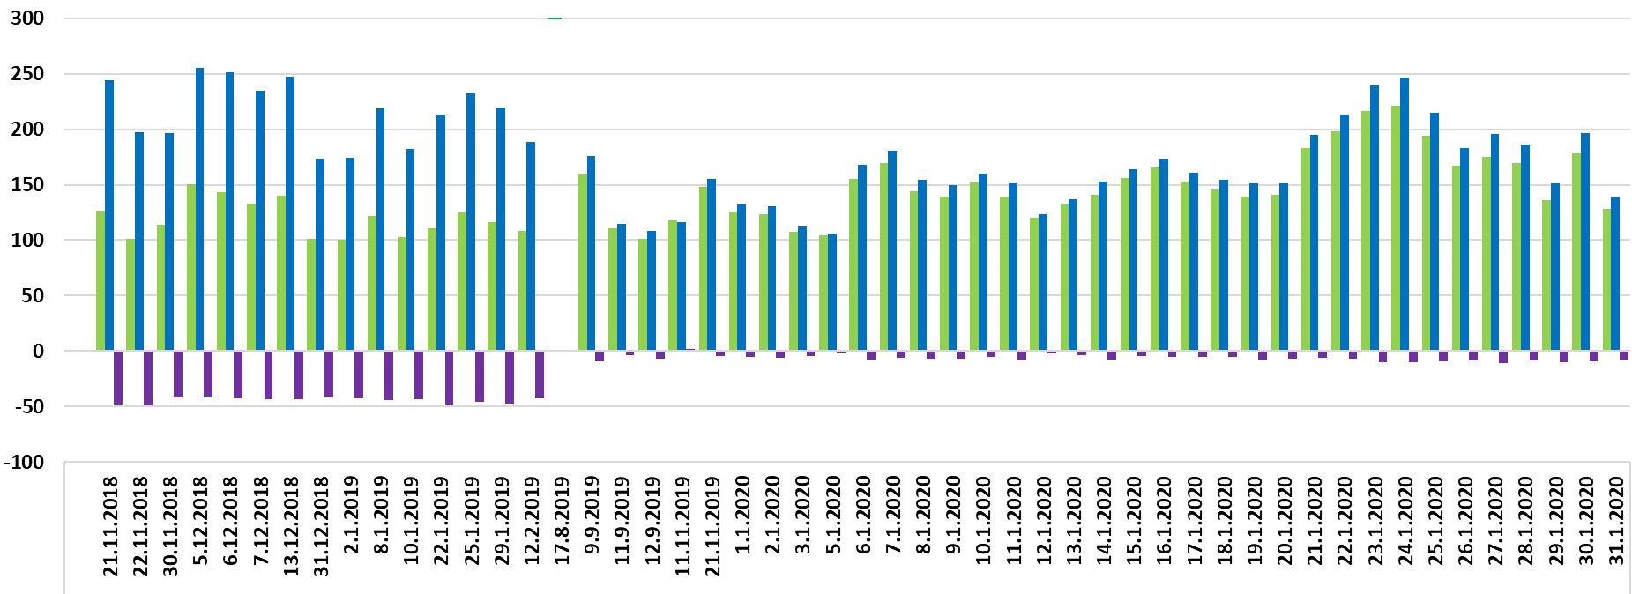
  PERFORMANCE TEST MONITORING RESULTS
Before Well Acidizing
After Well Acidizing
Well SUC029
Confirmed well performance improvement

Slide 13
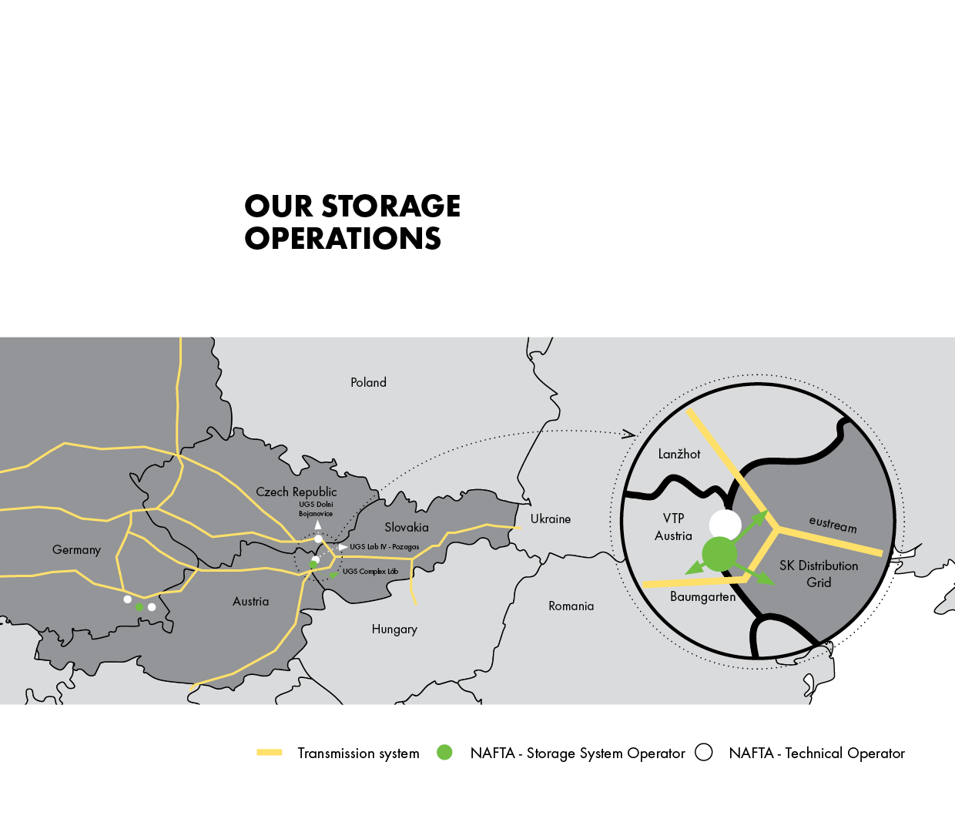
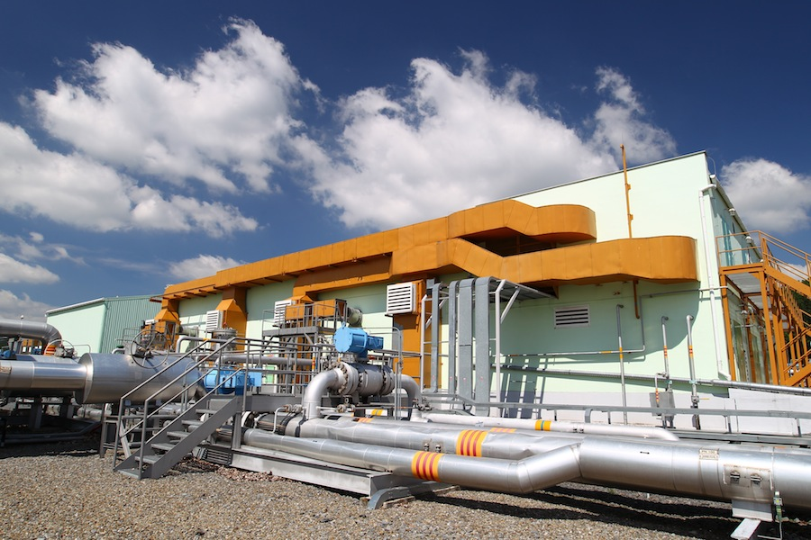
  APPLICATION TO OTHER GAS STORAGES
UGS Dolní Bojanovice

Slide 14
  NEW RESERVOIRS, NEW CHALLANGES
 | UGS DOLNI BOJANOVICE |  | PILOT PROJECT
Reservoir | Main Object | Lenses | 8th Panonian
Permeability | 1-2000 mD | 1-2630 mD | 1-5000 mD
Porosity | 1-33 % | 10-36 % | 5-35 %
Number of Gas Wells | 15 | 5 | 96
Working Gas Volume | 463 mil. m³ | 120 mil. m³ | 1715 mil. m³
Different parameters of reservoirs require different approach of data gathering
Customisation of wells monitoring needed

Slide 15
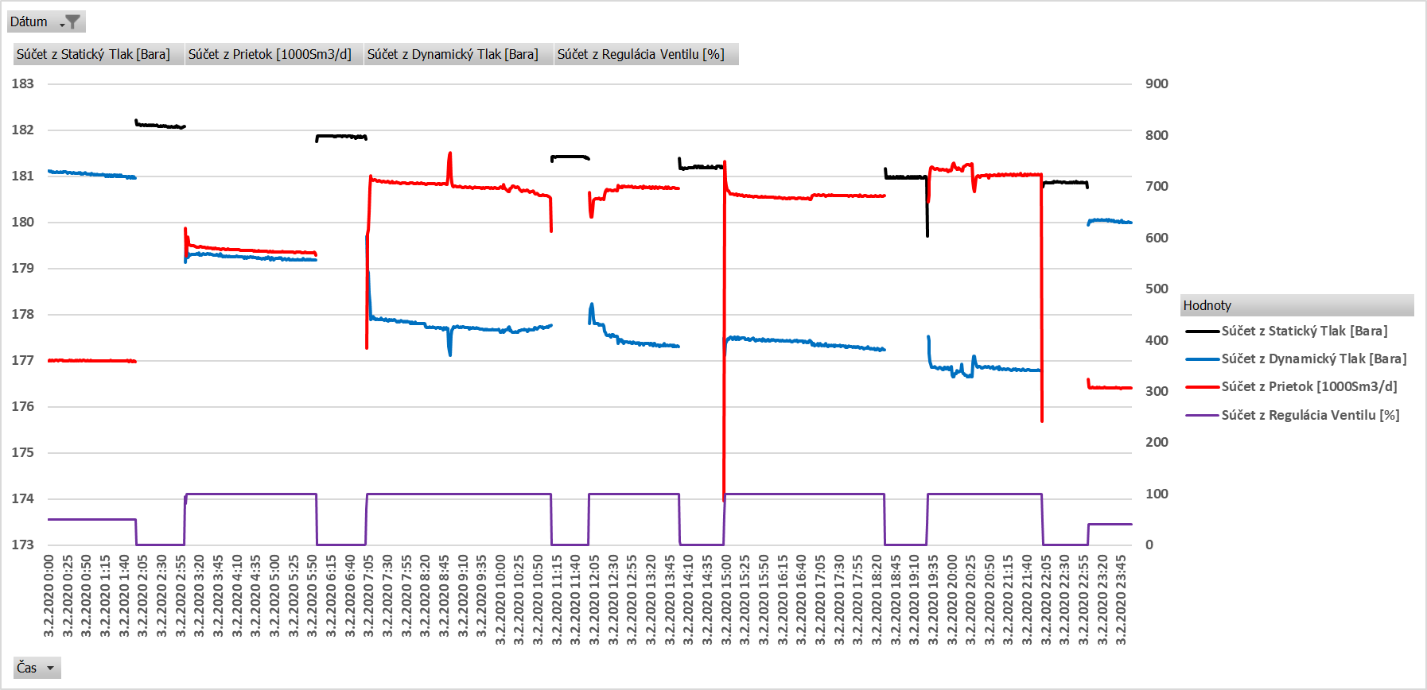
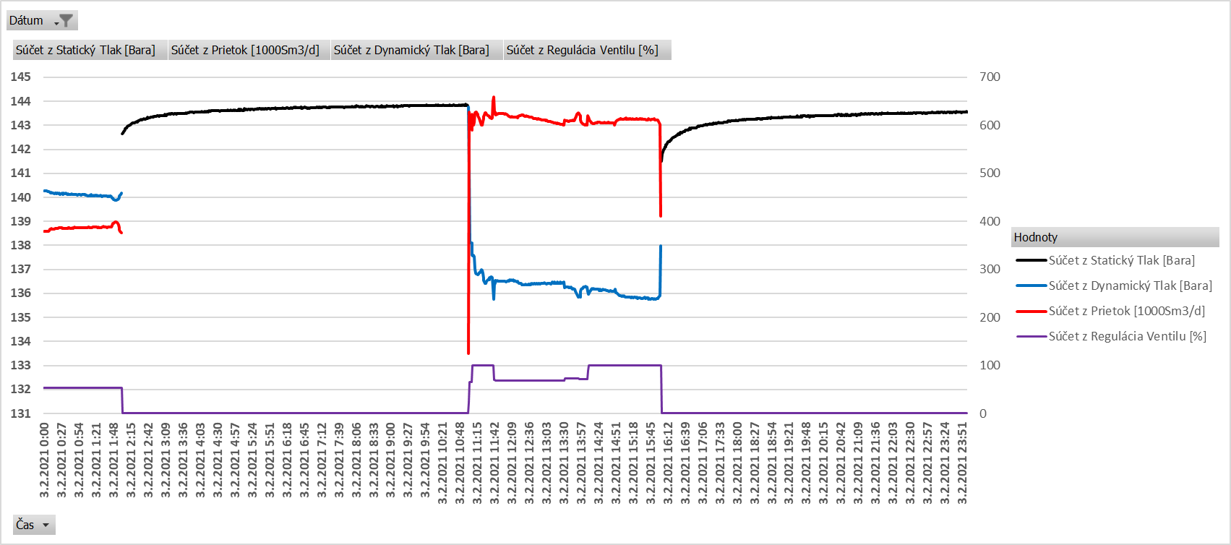
Short stabilization time
after shut in
  PRESSURE STABILISATION
Well P63
Stabilised pressures are esential for testing
Each Well has different stabilisation times
Pressures taken from narrow time range yield more precise results
Well P65
Static Pressure
Dynamic Pressure
Long stabilization time
after shut in
Flowrate
Valve Position

Slide 16
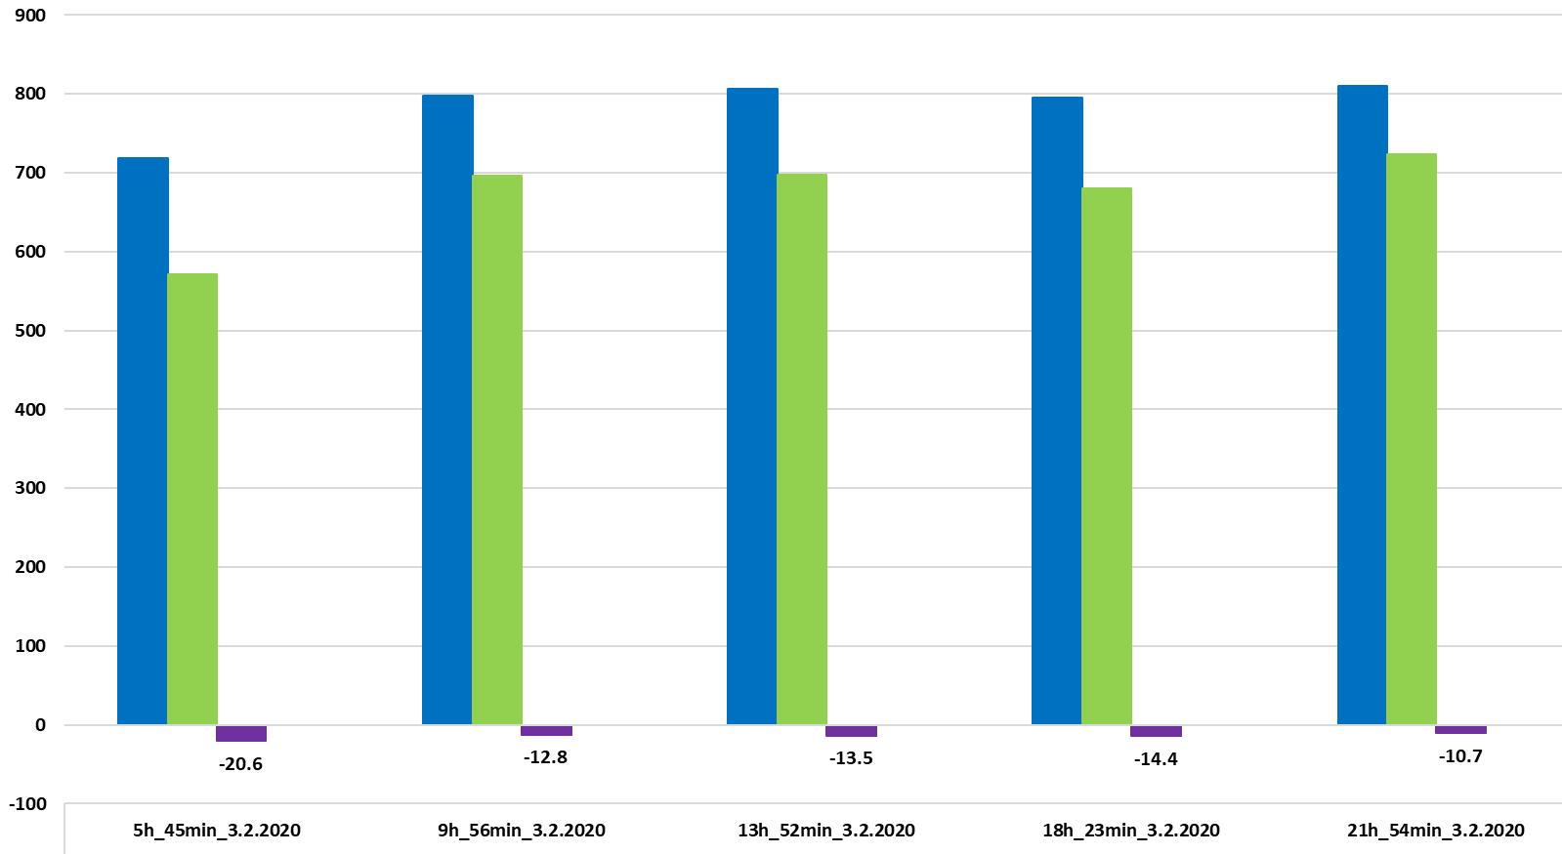
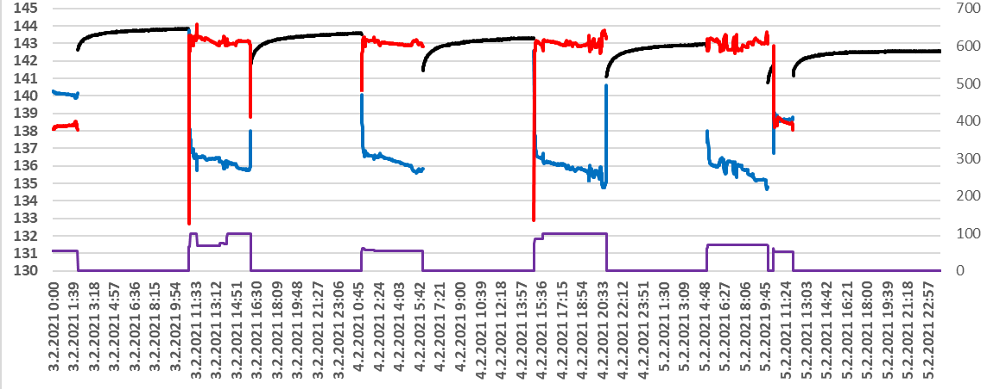
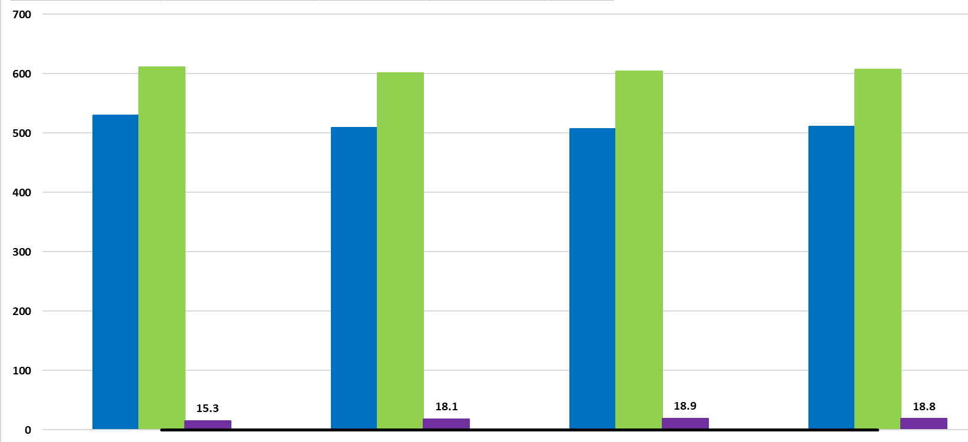
Well P63
Well P65

Slide 17
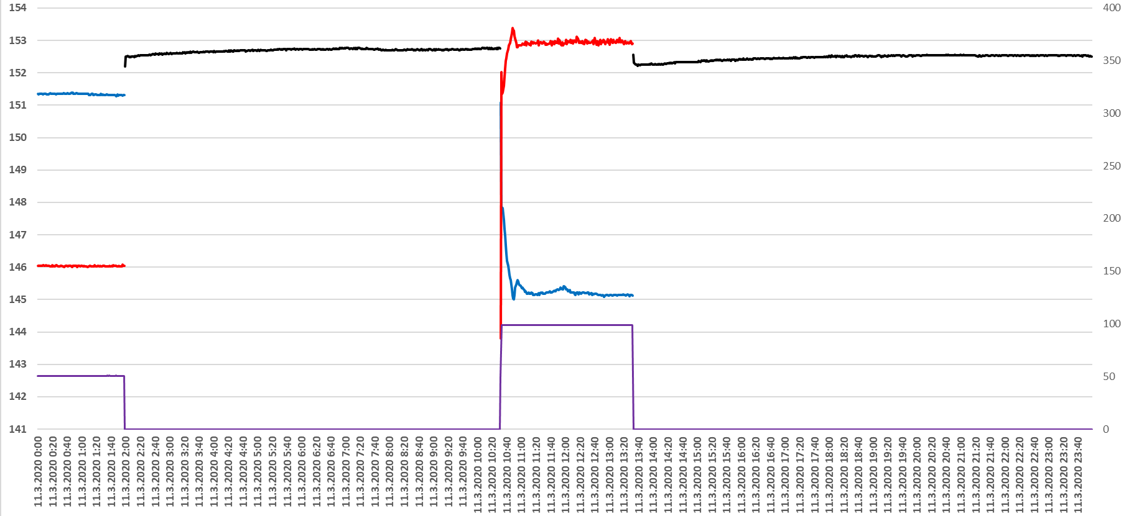
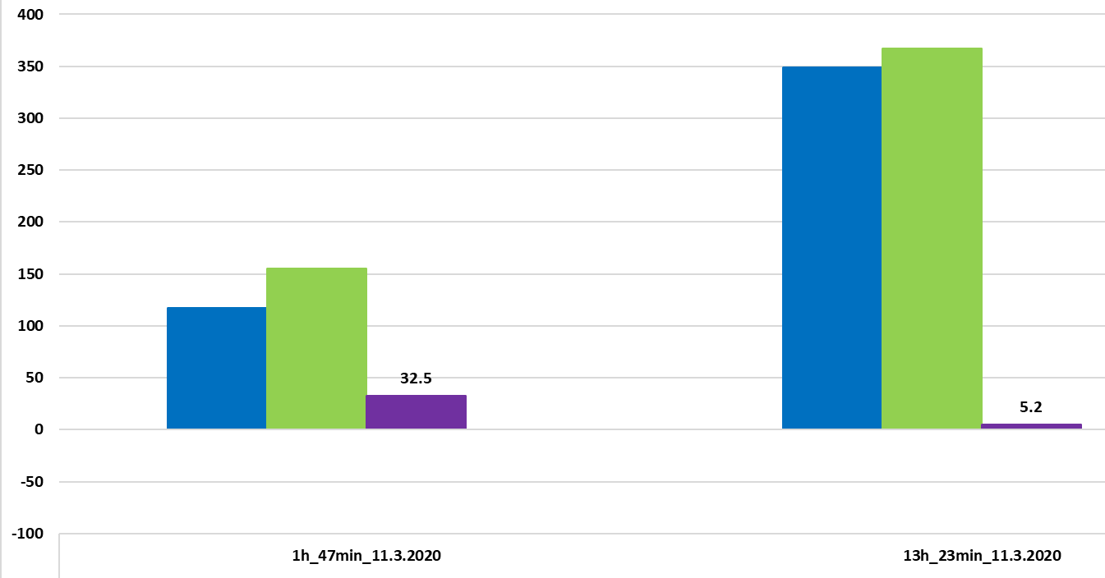
  GAS FLOWRATE
Well P113
Important selection of constant representative flowrates
Low flowrates - bigger differences
Higher flowrates – more precise results
High flowrates are limited due to risk of well equipment damage or damage to perforation interval
Well tests yield more precise results when reservoir is full due to potential of higher flowrates at the start of withdrawal season than at the end of season
Impact of different flowrates on model differences

Slide 18
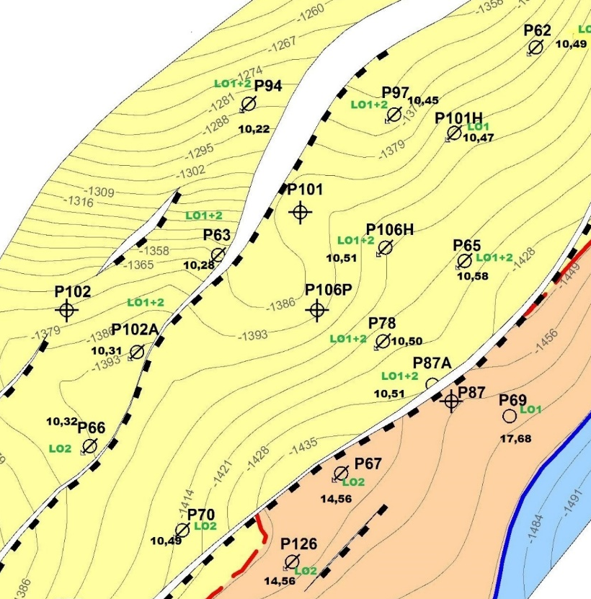
  WELL COMMUNICATION
Well boreholes in close proximity influence each other gas flowrates - cause additional differences in well test results
During well test, potential influencing wells needs to be shut in

Slide 19
  SCHEDULE FOR TESTING
Well | Shut in time | Running time | Requested rate
P63 | 1 hr | 3 hrs | 700 000 m³/d
P101H | 1.5 hrs | 5 hrs | 900 000 m³/d
P65 | 9 hrs | 5 hrs | 650 000 m³/d
... | ... | .. | ...
Only one well is tested at a time
Test consists of multiple shut in and running sequences to acquire more representative data
Test schedule is consulted with Gas Storage Operations Management to match customer requests

Slide 20
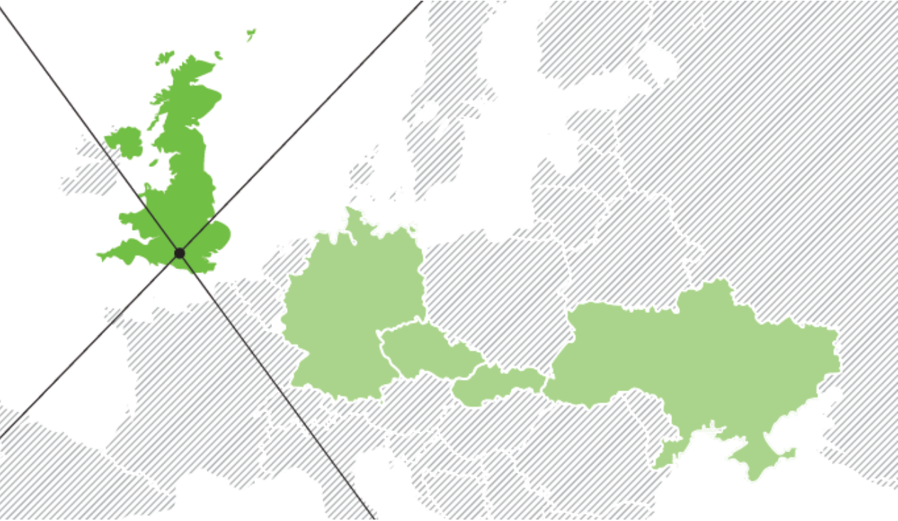
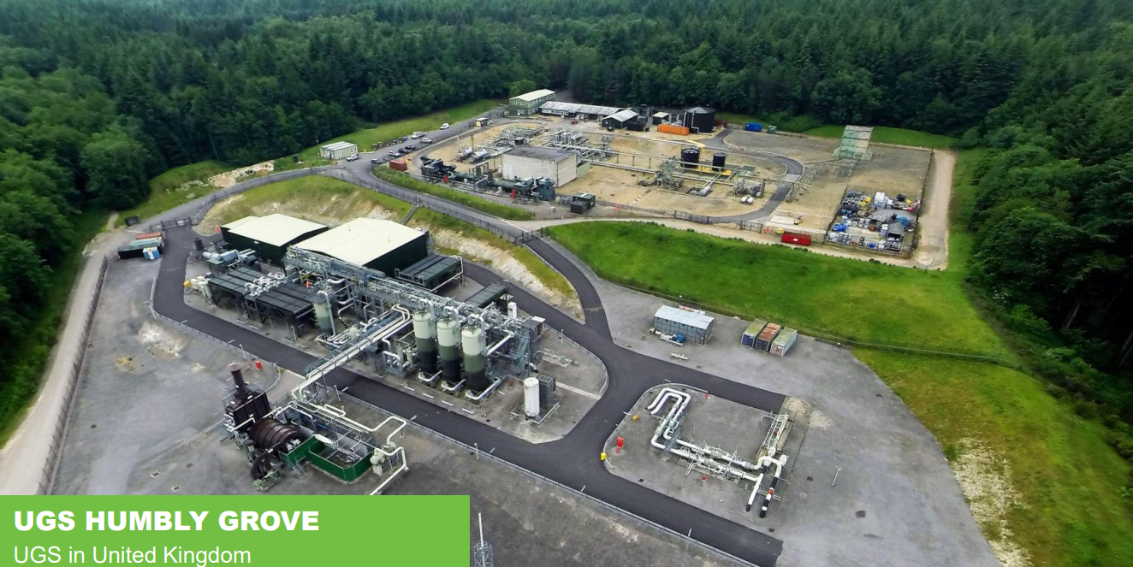
  FUTURE PLANS FOR NEXT GAS STORAGE
Humbly Grove Energy
Gas Storage facility in UK
Plan to start WPM by the end of 2023

