Slide 1
The Progress and Outlook of Natural Gas Development in Petrochina
Research Institute of Petroleum Exploration & Development, PetroChina
GUO Zhi
2023.10

Slide 2
Contents
S1: Progress of global NG development
S2: Progress of NG development in China
S3: Progress and challenge of NG development in PetroChina
S4: Outlook of NG development in China and PetroChina

Slide 3
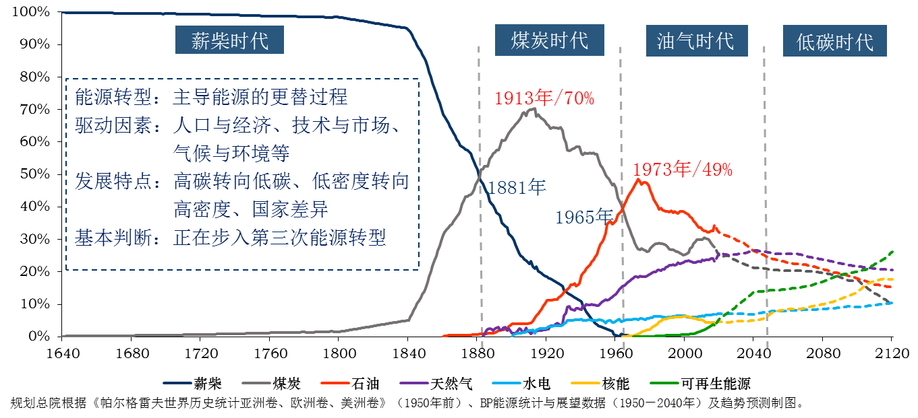
S1. Progress of global NG development
1. Gloabal energy consumption is currently undergoing its third transformation, transitioning torwards a diversified, green and sustainable energy system
As a clean and low-carbon energy, natural gas will play a key role in the third energy transformation. It is projected that the global share of NG in primary energy consumption will remain above 20% by 2035 (currently 24%) , which is the smallest decline among fossil fuels.
Traditional Biomass
Coal
Oil & Gas
Low Carbon / Net Zero
Traditional Biomass
Coal
Oil
Gas
Hydro
NUR
Renewable
Source:”International Historical Statistics”, BP：Statistical Review of World Energy 2021

Slide 4
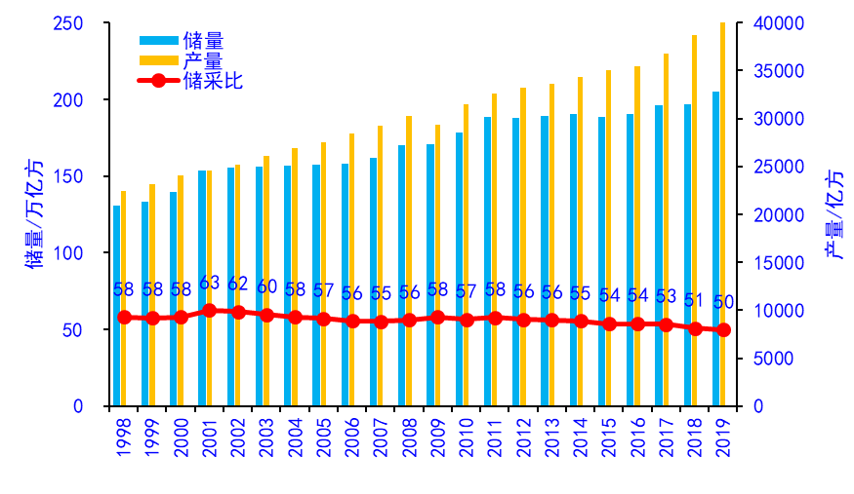
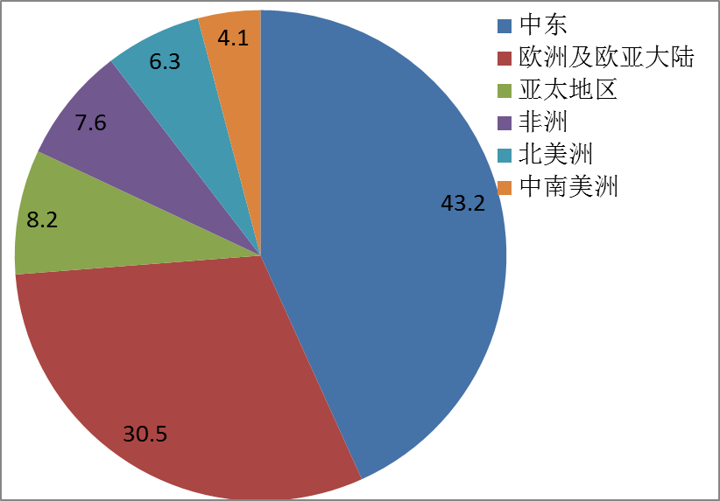
2. Global reserves and production of NG keep growing steadily, but their distribution is uneven across different regions
In 2022, global NG production was 4.25 tcm, with an average annual growth rate of 2.3% over the past decade
The gloabal residual recoverable proven reserves of NG reached about 188 tcm by 2020, with an average annual growth rate of about 1.7% over the past decade
The residual recoverable reserves mainly distribute in the Middle East, Eurasia, Asia-Pacific and America, accounting for over 80%
Middle East
Eurasia
Asia-Pacific
Africa
North America
Central and South America
Reserves
Production
Reserve/production ratio
Reserves / tcm
Production / 0.1bcm
Reserve/production ratio
2020
Global NG production, reserves and reserve/production ratio
（BP Statistics）
Regional distribution of global recoverable NG reserves
（BP Statistics）

Slide 5
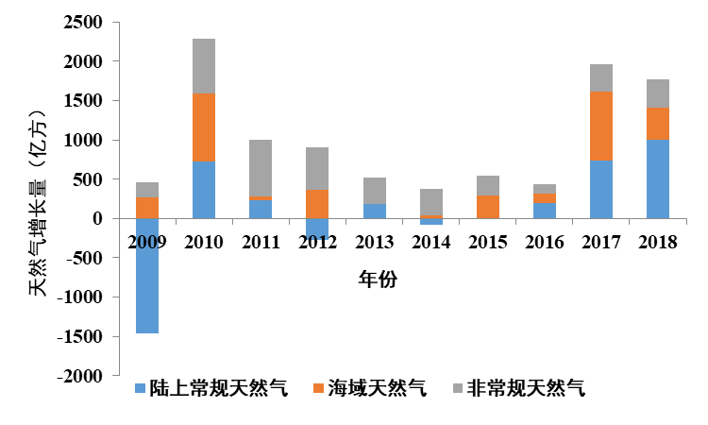
3. Unconventional gas production increases rapidly and will become one of the main source of natural gas supply in the future
Over the past decade, unconventional gas production experienced a rapid growth. In 2022, the global unconventional gas production reached 1.03 tcm, accounting for 24.2%.
The growth of unconventional gas production mainly consists of shale gas and tight gas from the US and China. In 2022, the US produced about 800 bcm of shale gas, while China produced 24 bcm of shale gas and 62 bcm of tight gas
NG productionincrement (bcm)
Onshore conventional gas
Offshore gas
Unconventional gas
Composition of global NG production increment

Slide 6
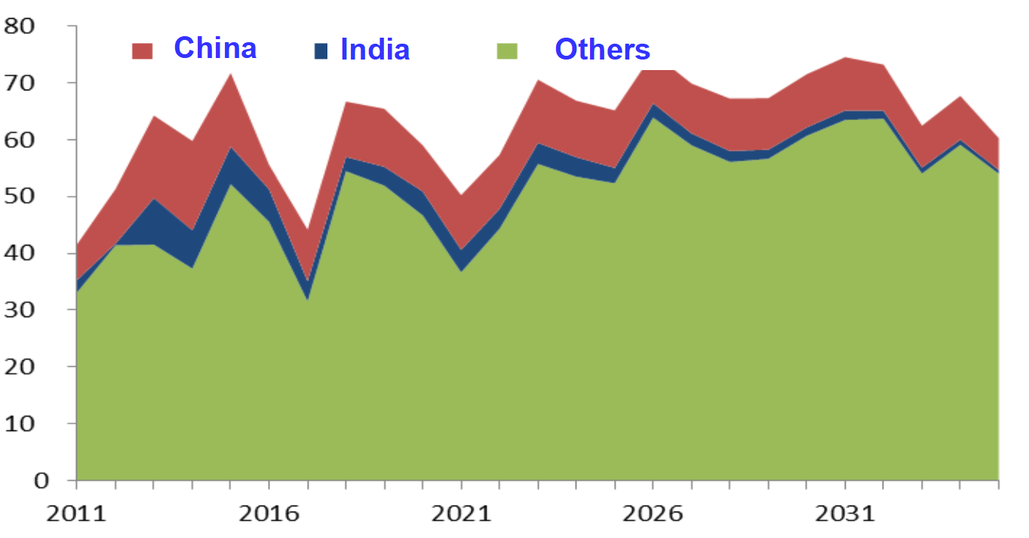
4. The global NG industry is currently experiencing a prosperous era, driven by the continuous growth of demand for NG
Developed countries in Europe and America have giant markets, sound facilities, and stable demand, but geopolitical conflicts pose significant challenges to NG supply.
Countries in the Asia Pacific exhibit robust demand for NG , and NG consumption will continue to grow over the next 15-20 years.
The annual increment of golbal NG consumption
Forecast of global NG consumption
(IEA, PetroChina)
 | Annual NG consumption / bcm
 | 2020 | 2025 | 2030 | 2035
China | 324 | 441 | 550 | 600
India | 111 | 128 | 138 | 148
Total World | 4000 | 4800 | 5700 | 6300
NG consumption increment (bcm)

Slide 7
Contents
S1: Progress of global NG development
S2: Progress of NG development in China
S3: Progress and challenge of NG development in PetroChina
S4: Outlook of NG development in China and PetroChina

Slide 8
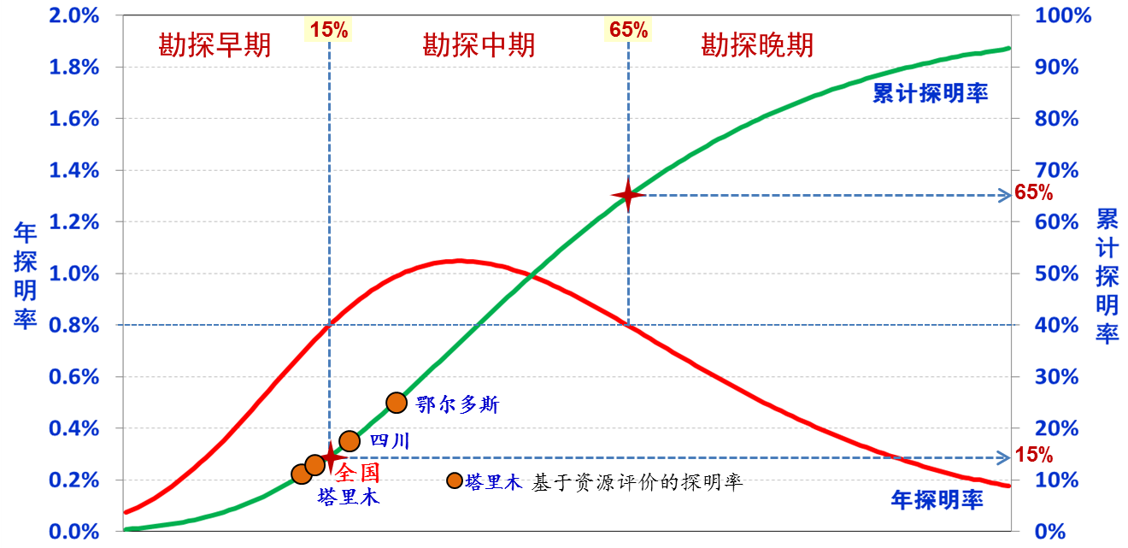
S2. Progress of NG development in China
1. China possesses abundant NG resources, with a low proven rate and huge potential
China's NG resources are 172 tcm, and the NG exploration is currently at an early to middle stages, with a proven rate less than 20%.
China's recoverable resources of unconventional gas are 33.1 tcm, which approach that of the US.
Early stage of
exploration
Middle stage of
exploration
Late stage of
exploration
US
China
Cumulative
proven rate
(Units: tcm)
Annual incremental proven rate
Cumulative proven rate
Annual incremental
proven rate
Ordos Basin
Sichuan Basin
Averag in China
Conventional gas
Shale gas
Tight gas
Tarim Basin
Comparison of recoverable NG resources between China and the US
Proven rate and exploration stage of three major basins in China
Notes:
Abundant resources are the basis for sustained growth of natural gas production in China

Slide 9
2. The growth of NG reserves remained robust in past few decades, but reserves with poor property contributed to the majority
Since 2000, China's average annual incremental proven reserves of NG reach 734 bcm, with unconventional gas and ultra deep gas account for the majority
By the end of 2022, China's cumulative proven reserves are 19 tcm: 9.11 tcm of conventional gas (53%), 5.40 bcm of tight gas (32%), 1.81 tcm of shale gas (11%), and 0.73 tcm of coalbed methane (4%)
Incremental proven reserves (bcm)
Annual incremental proven reserves of NG in PetroChina and China

Slide 10
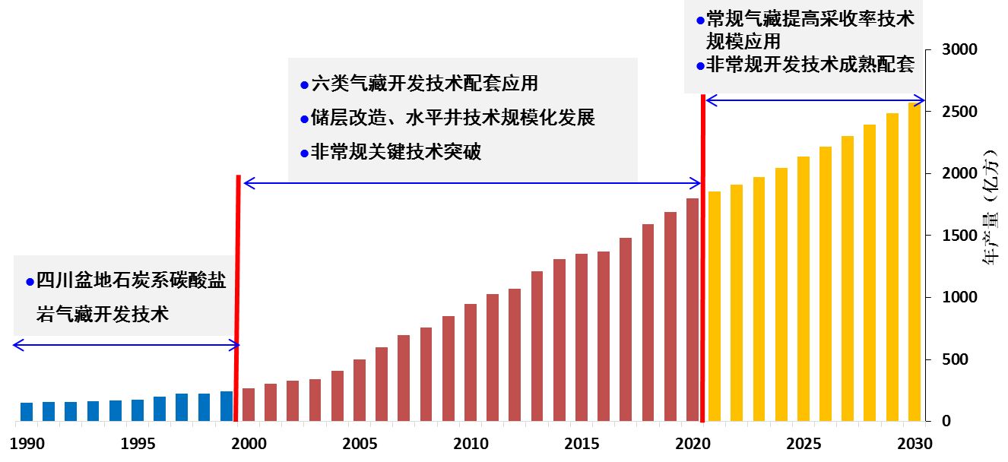
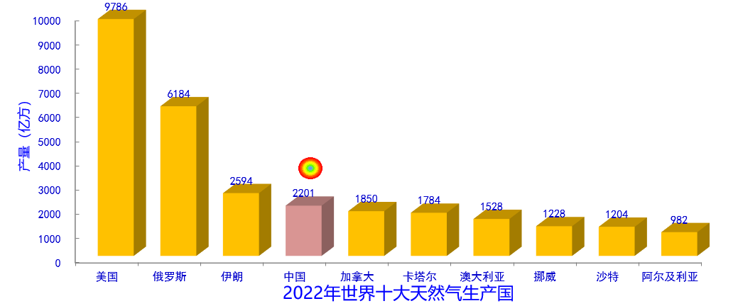
3. Rapid expansion of NG production in China, ranked the 4th in the world
Since 2000, China's natural gas production has grown rapidly, with an average annual growth rate of 10.4%. In 2022, it reached 220.1 bcm (PetroChina 145.5 bcm)
Four major natural gas production bases in Ordos Basin, Tarim Basin, Sichuan Basin, and offshore areas have been established
EGR of conventional gas
Scale and commercial application of unconventional gas development technologies
Development technology of 6 types of gas reserviors
Hydralic fracturing and Horizontal well
Development of unconventional gas
Annual NG production
Development technology of carboniferous carbonate gas reserviors in Sichuan Basin
US
Russia
Iran
China
Canada
Qatar
Australia
Norway
Suadi
Arabia
Algeria
The world's top ten NG producers in 2020
Annual NG production in China

Slide 11
4. NG consumption continues to increase, and its external dependence rate is controlled within an appropriate range
In 2022, China’s NG consumption was 364.6 bcm (372.6 bcm in 2021), with an external dependence rate of 40.2% (44.1% in 2021).
Compared with 2018, although NG consumption increased by 86 bcm in 2022, the external dependence rate decreased from 43.6% to 40.2%.
Production (bcm)
Consumption (bcm)
Imports (bcm)
External dependence rate (%)
external dependence rate (%)
NG consumption, Production and imports (bcm)
China’s annual NG consumption，production and imports（National Bureau of Statistics）

Slide 12
5. Natural gas development promotes energy structure transformation
Compared with other major economies, the proportion of NG in primary energy consumption in China is relatively low (China 8.9%, World average 24.5%)
The proportion of NG in primary energy consumption has doubled over the past decade, increasing from 4% to 8.9%. NG consumption has experienced a nearly fourfold growth, rising from 95.8 bcm to 364.6 bcm.
Consumption
Proportion
Consumption (bcm)
Proportion (%)
The proportion of NG in primary energy consumption in China
Notes:
Showing a great potential for further growth

Slide 13
Contents
S1: Progress of global NG development
S2: Progress of NG development in China
S3: Progress and challenge of NG development in PetroChina
S4: Outlook of NG development in China and PetroChina

Slide 14
S3.1 Progress of NG development in PetroChina
1. PetroChina's NG production experienced significant growth over the past few decades
Initial stage (1949-1977) : NG business of PetroChina began to develop in Sichuan, NG production exceeding 10 bcm in 1977
Slow growth stage (1977-2001) : 1977 to 2001, mainly conventional gas, and production slowly increased by 20 bcm
Rapid growth stage (2001- ) : NG production experienced a significant surge, rising from 20.6 bcm in 2001 to 145.5 bcm in 2022
Exceeding 20 bcm in 2001
Exceeding 50 bcm in 2005
Exceeding 70 bcm in 2010
Exceeding 80 bcm in 2013
Exceeding 90 bcm in 2014
Exceeding 100 bcm in 2017
Exceeding 110 bcm in 2019
Exceeding 130 bcm in 2020
Rapid growth stage
Production (bcm)
Initial stage
Slow growth stage
Small and medium sized gas fields in Sichuan Basin , Sichuan-Chongqing gas pipeline network
Conventional gas, Jingbian Gas field, Shanxi-Beijing gas pipeline
Development of large gas fields including Kela-2、Sulige、Longwangmiao; Shanxi-Beijing gas pipeline, West-East natural gas transmission
PetroChina's annual NG production

Slide 15
Over the past 2 decades, PetroChina's NG production accounted for more than 2/3 of China's total. The proportion, dispite experiencing a slight decline in recent years, is anticipated to remain above 60% in the future.
250
PetroChina’S Production
Production of other companies
Proportion of PetroChina’s production in China
200
150
Production (bcm)
Proportion (%)
100
50
Composition of NG production in China from 2000 to 2022

Slide 16
2. Over the past decade, PetroChina's conventional gas production increased gradually, while unconventional gas experienced a significant expansion
Conventional gas: 18.3 bcm in 2000, 80.6 bcm in 2022
Tight gas: 0.5 bcm in 2004, 43 bcm in 2022
Shale gas: 0.02 bcm in 2012, 13.9 bcm in 2022
coalbed methane: 0.01 bcm in 2008, 3 bcm in 2022
Conventional gas
Tight gas
Shale gas
Coalbed gas
Production (bcm)
Composition of NG production in PetroChina

Slide 17
3. Development technologies for 8 types of gas reservoirs have been progressively established
High pressure gas reservoir development technology (Kela-2 and keshen gas fields)
Carbonate gas reservior development technology (Longwangmiao gas field)
Tight gas reservior development technology
(Sulige gas field)
unconsolidated sandstone gas reservior development technology (Sebei gas field)
Volcanic gas reservoir development technology (Xushen gas fields)
Condensate gas reservior development technology (Yaha gas field)
Shale gas reservior development technology (Changning gas field)
coalbed methane reservior development technology (Qinshui gas field)
2000-2022:
High pressure gas reservoir,
tight gas reservoir, shale gas, condensate gas reservior reservoir, coalbed methane reservior
年产量（亿方）
Production (bcm)
1980-2000:
Dissolved gas production increases,
Carbonate gas reservior
development in Jingbian gas field
1950-1970:
Carbonate gas reservior
development technology in Sichuan Basin
Growth of NG production of PetroChina and corresponding technological progress

Slide 18
4. Three major NG basin and nine major gas fields have been developed in PetroChina
The 3 major NG development basins, Changqing, Southwest and Tarim, produce 120 bcm of NG in 2022, accounting for 82.5%, and each of them has an annual production capacity of over 30 bcm
The 9 major gas fields including Sulige, Anyue and Keshen produce 91.5 bcm of NG in 2022, accounting for 62.9%, and each of them has an annual production capacity of 5 bcm
Production of 9 major gas fields of PetroChina
Development Basin | Gas Field | Production in 2020 （bcm） | Proportion in PetroChina（%）
Changqing | Sulige | 30.5 | 21.0
 | JInbian | 7.6 | 5.2
 | Yulin | 5.2 | 3.6
Southwest | Anyue | 15.3 | 10.5
 | Changning | 5.6 | 3.8
Tarim | Keshen | 9.8 | 6.7
 | Kela2 | 5.9 | 4.1
 | Bozi-Dabei | 6.9 | 4.5
Qinghai | Sebei | 5 | 3.4
Sum |  | 91.5 | 62.9
Changqing Oilfiled Company
Southwest Oil&Gasfield Company
Production (bcm)
Tarim Oilfield Company
Other affiliates of PetroChina
Proportion of 3
companies in
PetroChina
Production of 3 major NG development basin of PetroChina

Slide 19
5. Sulige gas field has become one of the world's top 10 largest gas fields
Sulige gas field produced 30.7 bcm of NG in 2022, becoming the only super gas field in China with an annual production of more than 30 bcm and ranked the 10th largest gas field in the world
NG Production of the world's top 10 largest gas fields
State | Company | The starting year of commercial development | Production（bcm）
Iran | South Pars | 2002 | 230.5
Russia | Gazprom | 2001 | 91.7
Russia | Gazprom | 1983 | 64.7
United Arab Emirates | ADNOC | 1981 | 64.3
Algeria | Sonatrach | 1961 | 44.9
Norway | Statoil ASA | 1995 | 35.8
US | Antero Resources | - | 34.7
Oman | Petroleum Development Oman | 1979 | 31.3
Russia | YUKOS | 2017 | 31.1
China | Sulige, PetroChina | 2007 | 30.7

Slide 20
S3.2 Challenge of NG development in PetroChina
1. Ultra deep gas reservoirs and unconventional gas reservoirs accounted for the most incremental proven gas reserves in PetroChina over the past decade
From 2011 to 2022, the incremental proven reserves in PetroChina is about 6 tcm, with ultra deep and unconventional gas reserves accounting for more than 90%
It is estimated that 4.5 tcm of gas reserves will be proven from 2021 to 2025 (ultra deep gas reserves accounting for 20% and unconventional gas reserves accounting for 74% )
Tight gas
reservior
Utra eep
gas
reservoir
Shale gas
reservoir
Others
Shale gas
reservior
Tight gas
reservior
Reserves (bcm)
Ultra deep gas
reservoir
Others
Composition of annual incremental proven reserves in PetroChina
Estimation of incremental proven reserves in PetroChina from 2021 to 2025

Slide 21
2. PetroChian have drilled large amount of gas wells but the productivity of gas wells is relatively low
By 2019, PetroChina has drilled 21,500 gas wells, and the average daily production of gas wells decreased from 28,000 m³/d in 2010 to 16,100 m³/d in 2019
16,518 gas wells have been driiled for developing tight gas and shale gas, accounting for 61% of the total, and the proportion will further increase
Number of
gas wells
Overall daily
production
Average daily
production of
gas wells
Excluding CBM wells
Decline trend of gas well production in PetroChina
Notes:
The low production and high proportion of tight gas and shale gas wells determine the low average production of gas wells in PetroChina

Slide 22
3. Production decline of gas fields is progressively intensifying, necessitating enhancements in technology and measures to ensure production stability.
PetroChina possesses 23 gas fields with an average annual production capacity of over 1 bcm
9 fields are in the production decline period and the end of stable production period, with 25.1 bcm of production in 2020, accounting for 19.5% of the total. (Kela 2, Dina 2, Sebei)
8 gas fields have been developed to compensate for the decline, with 49.1 bcm of production in 2020
Gas fields in decline period and at the end of stable production
Gas fields to
compensate for
the decline
Gas fields to
increase the
overall production
289
Production (bcm)
491
251
Composition of NG production in PetroChina

Slide 23
4. High cost of unconventional gas development
The development cost of shale gas (1171-1400 RMB/1000m³) and coalbed methane (1432-2000 RMB/1000m³) is much higher than the average of gas reserviors in PetroChina
The proportion of unconventional gas production is steadily rising, posing challenges to the profit and scale of NG development in PetroChina.
Coalbed methane
Shale gas
TIght gas
472
23
Development cost (bcm)
Production (bcm)
116
333
Average
TIght gas
Shale gas
Coalbed methane
Estimation of unconventional gas production in PetroChina
Development cost of gas reservoirs in PetroChina (2019)

Slide 24
5. Some key technologies rely on imports, restricting the development effeciency
Key tools including Geosteering technology rely on imports
The technology of “one-trip drilling” of super-long horizontal well is still not commercialized
Lack of large fracturing truck and infinite-stage segmental fracturing technology
Current PDC drill bit fails to meet the
requirement of “one-trp drilling”
Comparison of key development parameters of shale gas in China and the US
Parameters | US | PetroChina | Comparison
Thickness | 15~20 m | 10~15 m | Similar
Number of Wells drilled per rig per year | 25~40 | 3~4 | 8~10 times
Length of horizontal section | 2200 m | 1500 m | 1.5 times
Footage of “one trip drilling” | 2500 m | 250 m | 10 times
drilling rate of horizontal section | 1000~1500 m/d | 30~50 m/d | 30 times
fracturing stages | 7~8 Clusters/Segement，Cluster spacing 5~6 m | 3~5Clusters/Segement，Cluster spacing10~15 m | Similar
EUR of single gas well | 300~500 mcm | 90~120 mcm | 3~4 times

Slide 25
Contents
S1: Progress of global NG development
S2: Progress of NG development in China
S3: Progress and challenge of NG development in PetroChina
S4: Outlook of NG development in China and PetroChina

Slide 26
S4 Outlook of NG development in China and PetroChina
1. PetroChina possesses abundant gas resources, and its reserve/production ratio is still high
In the past five years, SEC reserves have basically stabilized at more than 2 tcm
The SEC reserves/production ratio is 14 and the incremental recoverable reserves/production ratio of 1.7 in 2022
Incremental
recoverable reserves
250
Production
SEC reserves
Incremental recoverable
reserves/production ratio
200
Reserves/production ratio
150
SEC reserves (bcm)
Reserve/production ratio
Economically incremental recoverable
reserves/production ratio
Economically incremental recoverable reserves (bcm)
Production (bcm)
100
50
SEC reserve/production ratio of PetroChina
Incremental recoverable reserves/production
ratio of PetroChina
Notes:
, indicating that PetroChina's NG production still possesses great potential for further expansion

Slide 27
2. NG production of PetroChina will continue to increase in next few decades
The production of NG is projected to reach 165 bcm in 2025, followed by a further increase to 200 bcm in 2035 before stabilizing
Conventional gas production is projected to rise from 84.6 bcm, while its share is expected ot decline from 61% to 48%
Unconventional gas production will increase from 59.9 bcm to 104.5 bcm, with its share increasing from 39% to 52%
Conventional
gas
Tight gas
Shale gas
Coalbed methane
200
180
4
165
4
3
31
50
23
Production (bcm)
53
54
51
88
92
92
Estimation of NG production of PetroChina from 2022 to 2035

Slide 28
Steady growth in conventional gas and rapid expansion in unconventional gas in next few decades.
It is expected that the NG production will peak at 340 bcm around 2035 and will remain stable until 2050
The breakthrough of deep coalbed methane and the discovery of other types of gas reserves will contibute to a further increase in production
Production (bcm)
Estimation of NG production in China
Notes:
With the technology advancement and innovative management practices, the natural gas industry has experienced remarkable progress recent years and will continue the trend of "steady growth in conventional gas and rapid expansion in unconventional gas" in next few decades.

Slide 29
3. NG development will be closely integrated with renewable energy, playing a pivotal role in China's ongoing transformation of energy structure.
Natural gas consumption will continue to grow rapidly in China until 2035, propelled by the goal of "carbon emission reduction".
From 2035 to 2060, natural gas consumption will remain stable in China, driven by the strategy of “synergetic development of renewable energy and natural gas".
Consumption of primary energy (tce)
Share of primary energy
Coal
Oil
Natural gas
Non-fossil feul
Carbon emission
Prediction ofenergy consumption, energy structure, and Carbon emission

Slide 30
Conclusion
The acceleration of China's energy transformation has brought unprecedented opportunities for NG development, but it also faces challenges such as resources deterioration, inceasing difficulty in stabilizing production of mature gas fields, and unprofitable development of unconventional gas. Therefore, It is imperative to continuously promote scientific and technological innovation, promote efficient and extensive exploration, stablize production of mature gas fields, commercially develop new areas, and strive for high-quality and sustainable development of NG.

Slide 31
Thank You!

