Slide 1
Underground Storage in China
-R&D Projects，State quo and Progress
IGU Storage Committee Meeting
10 – 13 October 2023
Chongqing, China

Slide 2
Outline
1. Underground Gas Storage
2. Underground Hydrogen Storage
3. Carbon capture and storage
4. Compressed Air Energy Storage

Slide 3
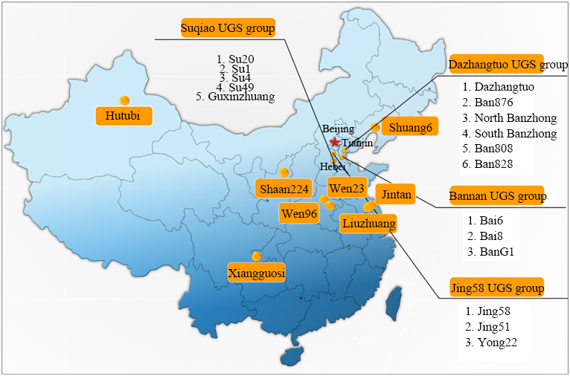
1. UGS in China
Initiated at the end of the 20th century, UGS in China is now entering the stage of rapid development.
Key facts:
Number of sites： 25
in depleted gas field: 22
in salt cavern: 3
Working Gas Volume ：~19 bcm
Peak Withdrawal Rate：~20 mcm/day
First depleted gas field：2000 （Dazhangtuo）
First salt cavern：2007 （Jintan）
Company: CNPC, Sinopec, Pipechina, Towngas,etc.
UGS sites in China

Slide 4
1. UGS in China
Coal-gas switching will widen the gap between natural gas demand and supply and accelerate UGS development.
800
Chemical industry
Transportation
Power generation
Industrial fuel
City gas
600
400
200
2017
2020
2030
2035
Gas consumption estimation in China（Source: CPPEI, 2017）
In 2022, gas consumption is 336 bcm，40.2% depended on imported gas
In 2035, gas consumption is estimated to exceed 600 bcm，UGS demand will around 80-100 bcm

Slide 5

1. UGS in China
CNPC issued “2019-2030 UGS construction planning scheme” in 2018 to establish 6 gas storage centers with potential working gas capacity exceeding 60 bcm.
Gas import from Central Asia
Imported Russian gas
Northeast UGS center
(130×10⁸ m³)
Northwest UGS center
(120×10⁸ m³)
Mid-west UGS center
(150×10⁸ m³)
North UGS center
(70×10⁸ m³)
Southwest UGS center
(130×10⁸ m³)
Imported LNG
Pipeline established and being established
Planned pipeline
UGS
LNG station
Mid-east UGS center
(70×10⁸ m³)
Gas import from Burma

Slide 6
1. UGS in China
Future trends: In 5 years, the number of storages will reach 65, with the total WGV of 40 bcm
UGS development trends for next 5 years
General Info about UGS construction plan
Operator | Under construction |  | Planned
 | Number | Designed WGV （bcm） | Number | Designed WGV （bcm）
CNPC | 11 | 135.6 | 9 | 107.1
Sinopec | 12 | 25.2 | 4 | 7.3
PipeChina | 4 | 37.5 | 8 | 99.8
Other | 2 | 20.9
Total | 29 | 219.2 | 21 | 214.2

Slide 7
Outline
1. Underground Gas Storage
2. Underground Hydrogen Storage
3. Carbon capture and storage
4. Compressed Air Energy Storage

Slide 8
2. UHS in China
Background:
China is the largest producer and consumer of hydrogen in the world. Since 2010, China has increased its hydrogen production by 6.8% per year to reach 33 million tons in 2020. Today, hydrogen produced by coal gasification makes up more than 60% of the supply, hydrogen produced from SMR represents 20% of the supply, 18% as a by-product of industrial processes, while less than 1% is “green”.
Until recently, the shift from grey to green hydrogen has not been at the center of China’s energy agenda.This changed with President Xi’s announcement on 22 September 2020 that China would peak its emissions by 2030 and reach carbon neutrality by 2060 and develop a 1+N framework to support achieving them.
The transition to green and blue hydrogen production has since been high on China’s policy agenda. Several green hydrogen projects are currently being developed, in particular in Inner Mongolia and Xinjiang, supported by major state-owned energy enterprises such as CNPC, Sinopec. In the newly released 2021-2035 hydrogen plan, China aims to produce 0.1-0.2 MT green hydrogen annually by 2025 and to significantly improve the portion of green hydrogen in its energy consumption by 2025. Blue hydrogen technologies, i.e., fossil-based hydrogen production with CCUS, are still in the early stages of development, but are expected to mature by 2030 and play an important role in China’s path to carbon neutrality.

Slide 9
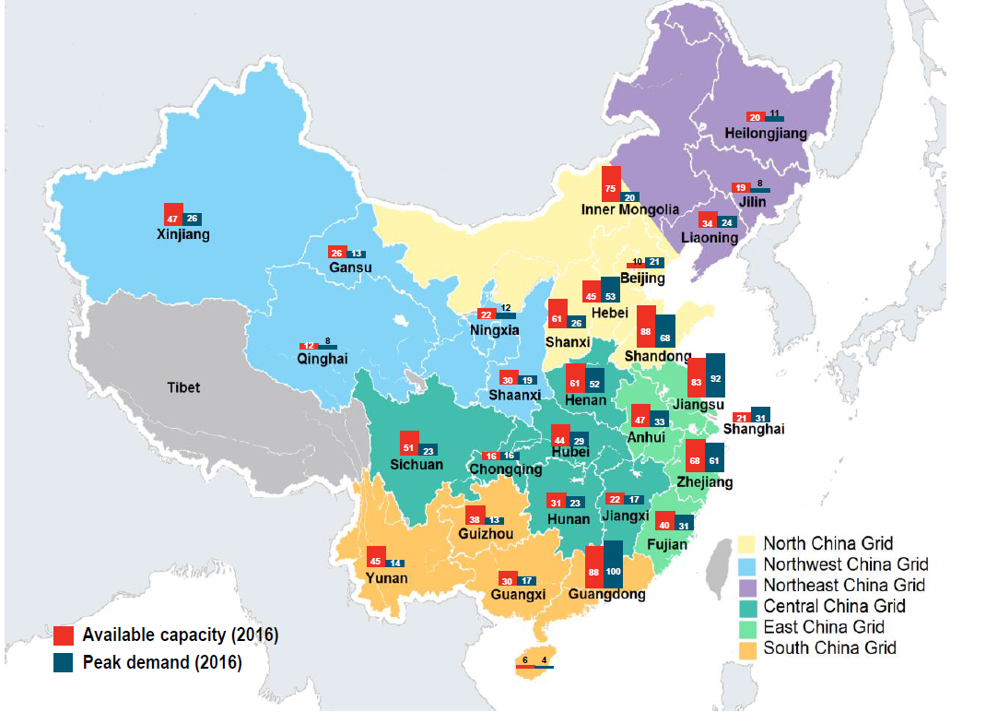

2. UHS in China
Background:
Current challenges in China’s power market——Oversupply is prominent issue for many provinces
China has the largest power generation fleet in the world, with 1,614GW of installed capacity by 2016, of which over two thirds was built in the last decade. The national power oversupply was 35%.
Most of the provinces facing severe over-capacity are located inland, notably Xinjiang, Gansu,Sichuan, and Yunnan, where renewableresources (wind, solar, and hydro) are the most abundant.

Slide 10
2. UHS in China
China’s geographical mismatch between resources and load centers
Over 70% of China’s large-scale wind and solar projects have been installed in the resource-rich northern regions featuring low electricity demand and low export capacity.
Due to an excess of electricity supply over local demand, resource-rich northern regions have to export their renewable and thermal electricity to other regions.
However, the construction of inter-regional transmission capacity in China has consistently lagged behind the growth of generation assets.
A lack of transmission lines to export electricity from the renewable energy mega-bases has been the major cause of renewables curtailment in the past.

Slide 11
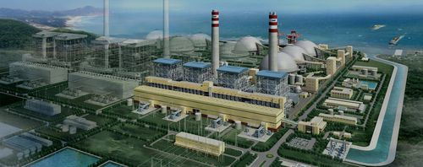
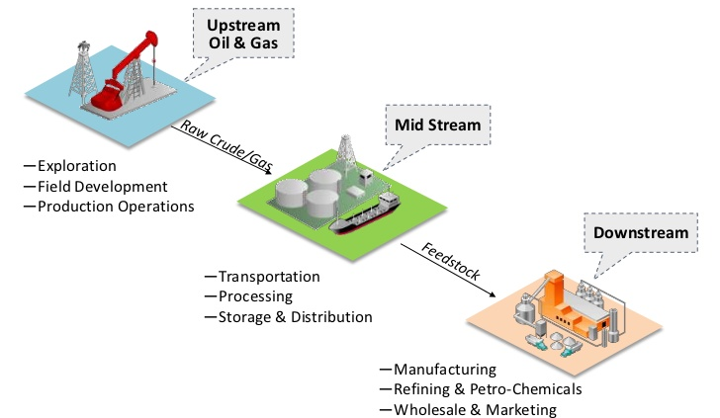
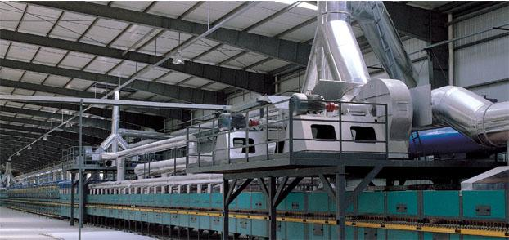
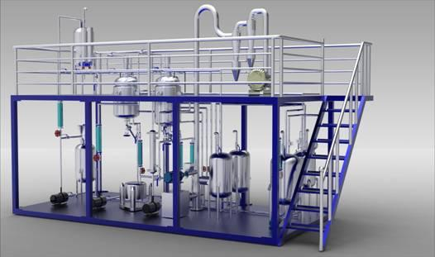
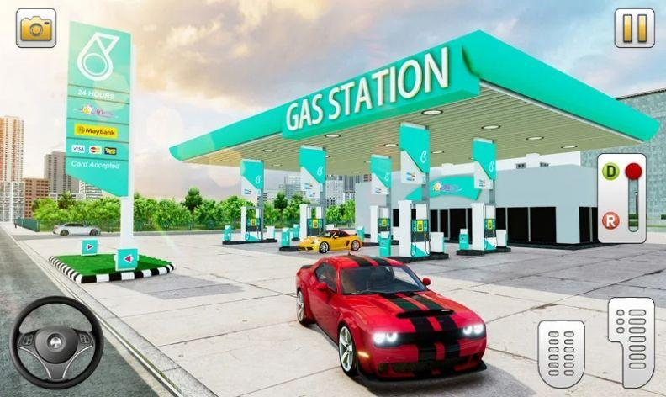
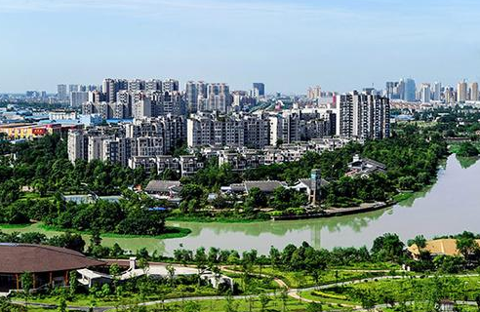
2. UHS in China
UHS Values:

Slide 12
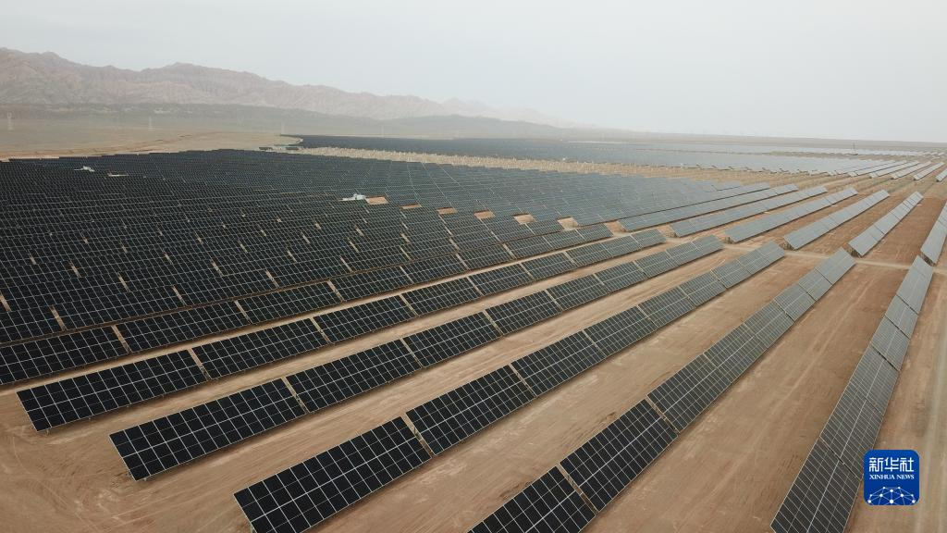
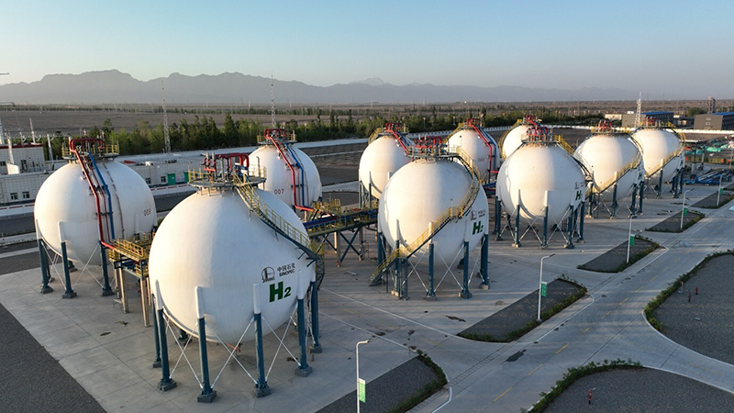
2. UHS in China
Sinopec Xinjiang Kuqa Green Hydrogen Pilot Project:
Key facts: the largest solar-to-hydrogen project in China
Commission: 2023
H2 production: ~20,000 tons per year (PEM)
H2 storage: 210,000 m³
H2 transport: 28,000m³/h

Slide 13
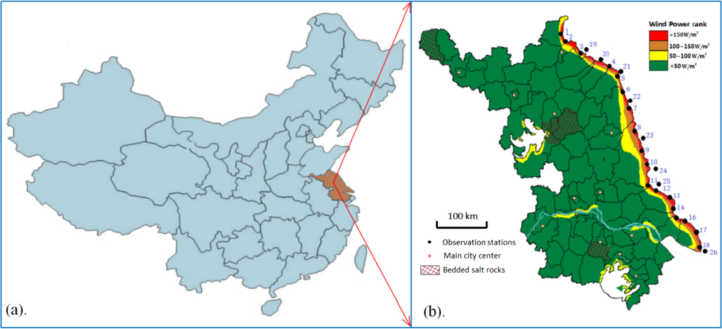
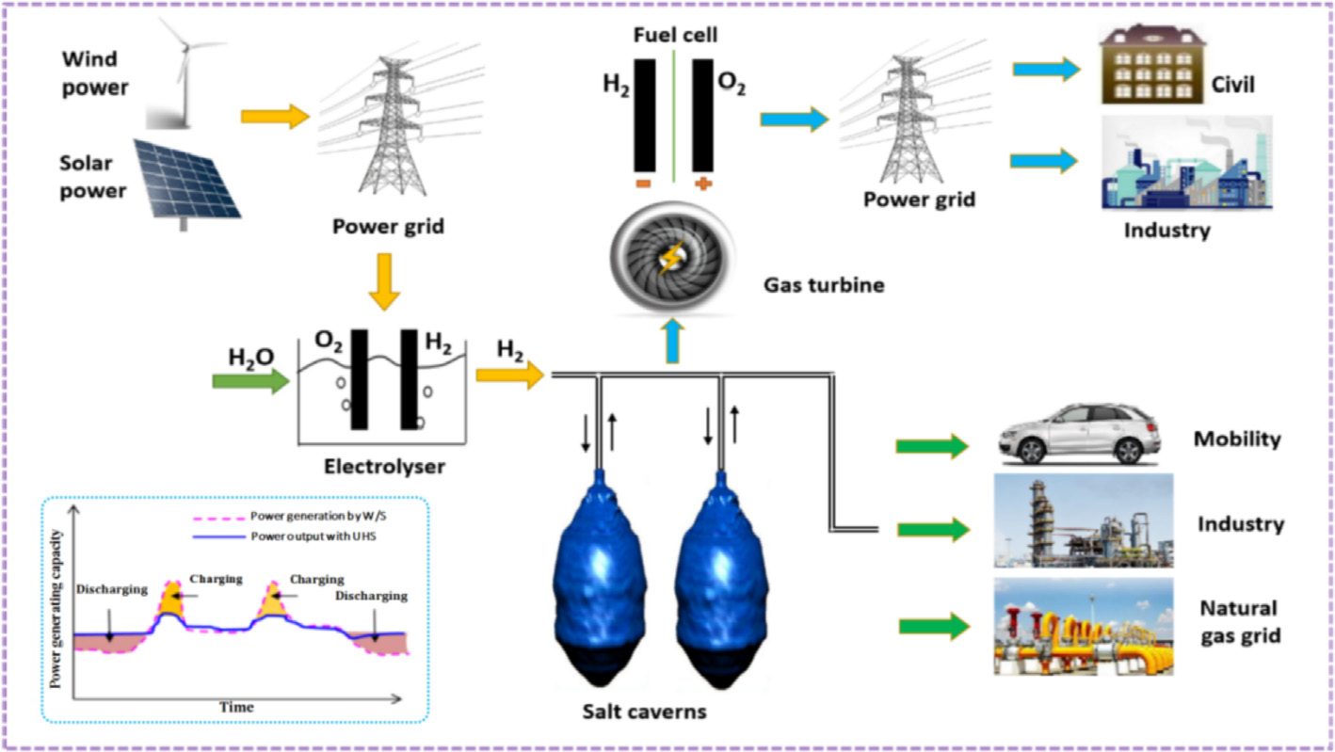
2. UHS in China
Jintan Salt Cavern UHS Pilot Project
Key facts:
Current Status: Feasibility Study
Location: Jiangsu Province
H2 production : 40000Nm³/h(PEM)
Salt Cavern: 3 caverns (~200,000m³ each )
Total Gas: ~86mcm

Slide 14
Outline
1. Underground Gas Storage
2. Underground Hydrogen Storage
3. Carbon capture and storage
4. Compressed Air Energy Storage

Slide 15
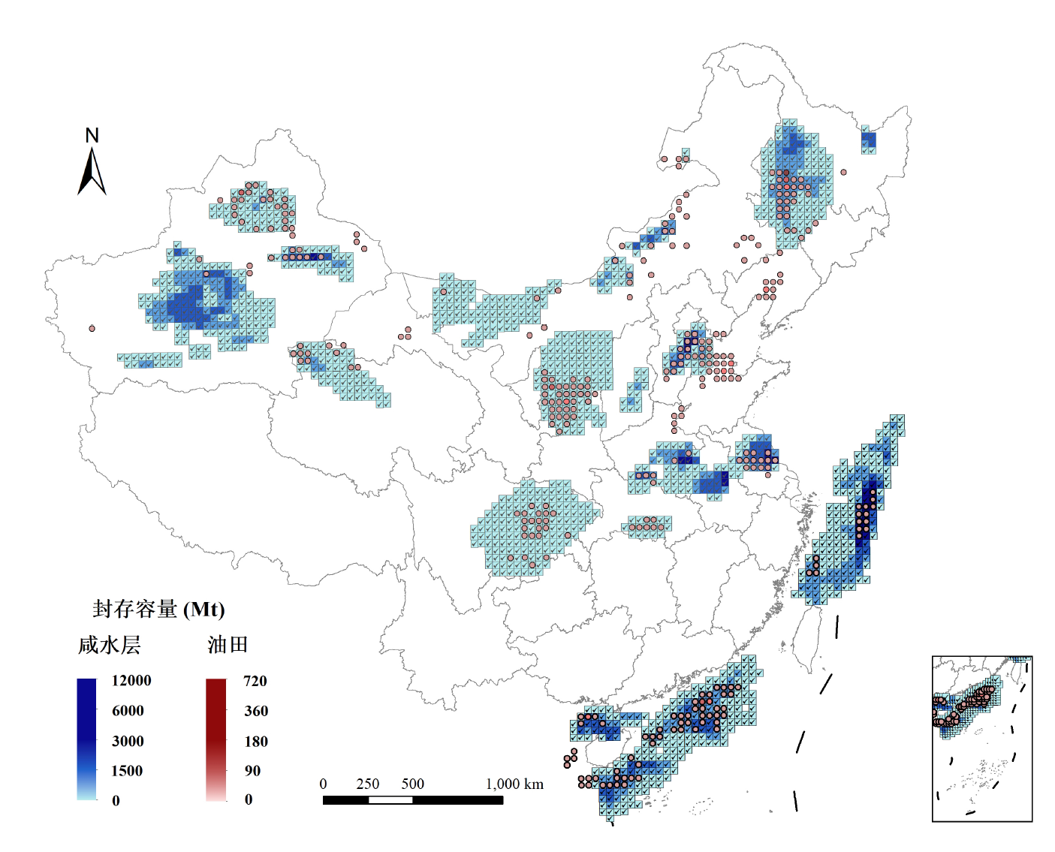



3. CCS in China
China's theoretical CO2 geological storage capacity is approximately 1.21 to 4.13 trillion tons, mainly including saline aquifers, oil and gas fields and other geological structures
Proven reserve of the oil fields can store approximately 20 billion tons of CO2
Proven reserve of the gas fields can store approximately about 15 billion tons of CO2
The storage capacity of deep saline aquifers is approximately 0.16 to 2.42 trillion tons

Slide 16
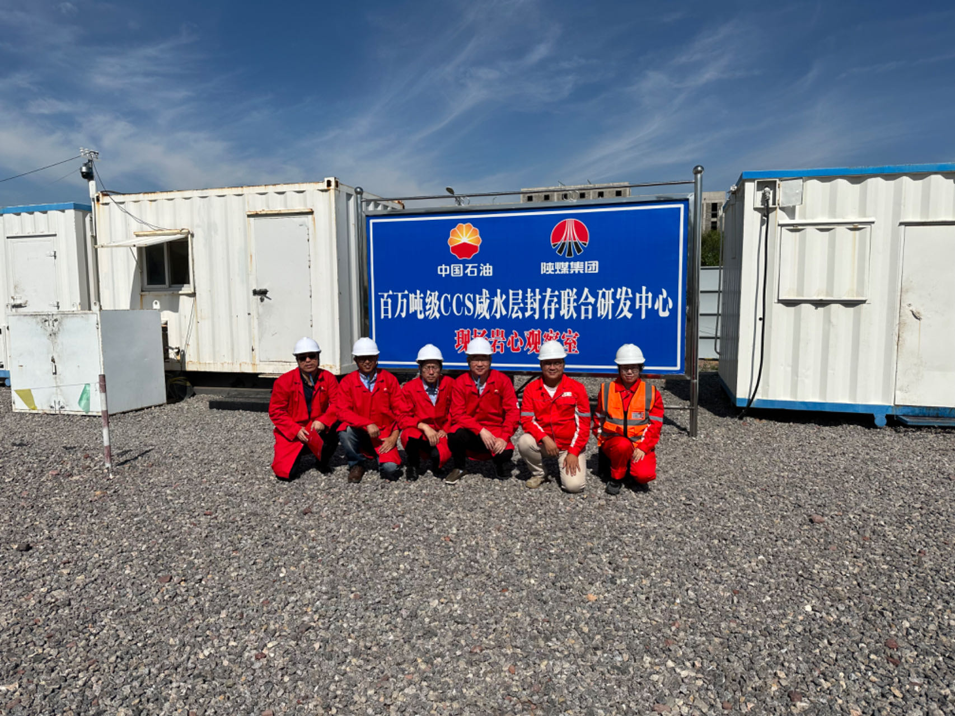
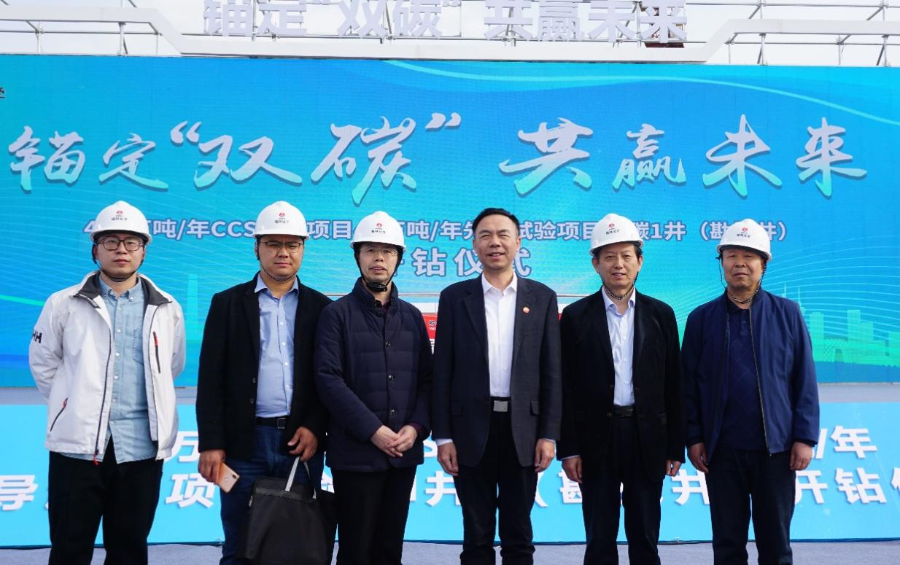
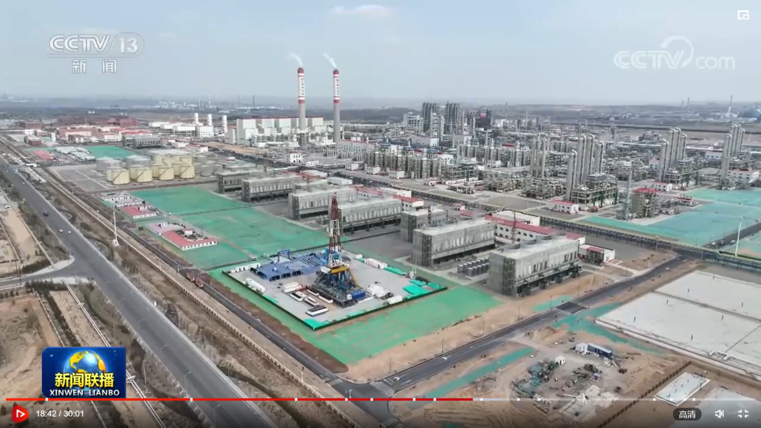
3. CCS in China
Pilot Project: Shannxi Yulin CCS
Key facts
Commission: 2023
Geological horizon：aquifer mainly
Depth range: 2000-2600m
Phase I scale: 4 vertical wells
Overall storage scale：4 million tons per year

Slide 17
Outline
1. Underground Gas Storage
2. Underground Hydrogen Storage
3. Carbon capture and storage
4. Compressed Air Energy Storage

Slide 18
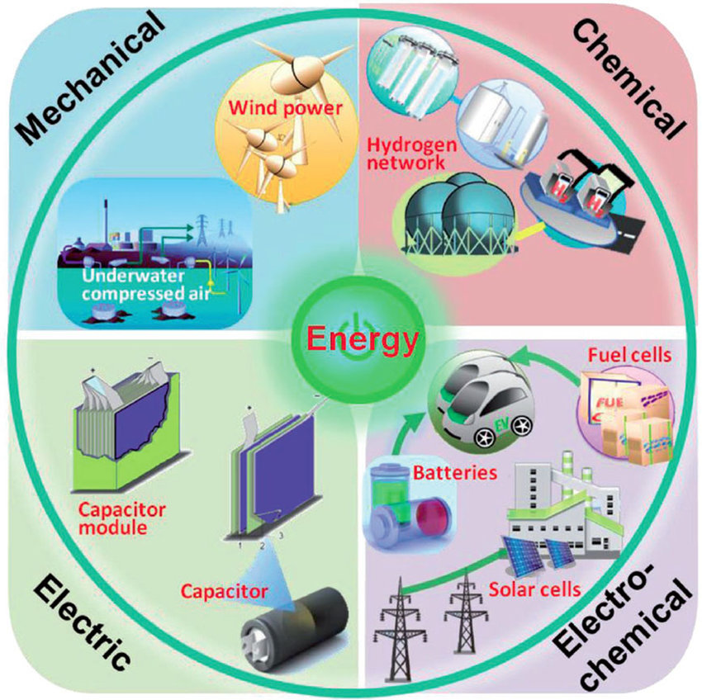
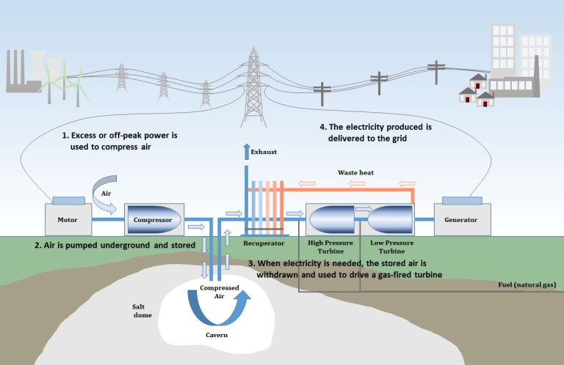
Future Trends
UGS function will be extended in renewable energy projects, e.g., as large-scale energy storage facility.
Due to intermittency of solar and wind, energy storage facility is indispensable
Compressed air energy storage, coordinated with hydrogen production and gas-fired power station, is an economical and efficient measure applied to renewable power plant
Classification of energy storage technology
Schematic diagram of CAES

Slide 19
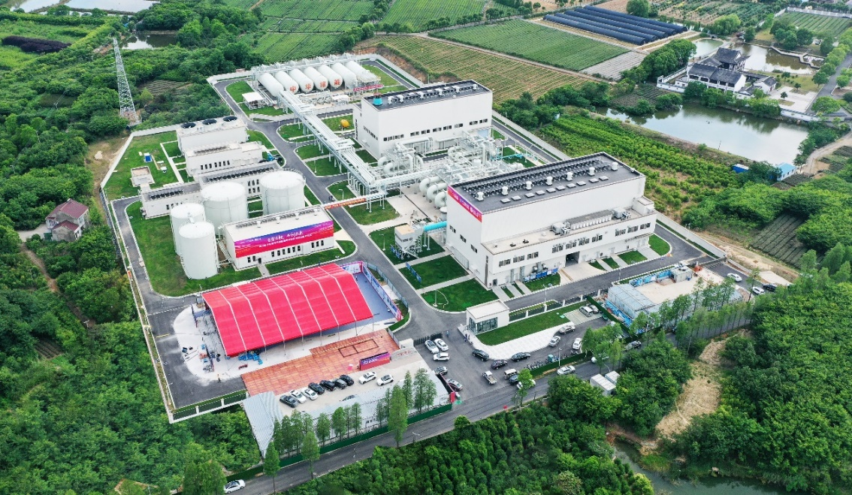
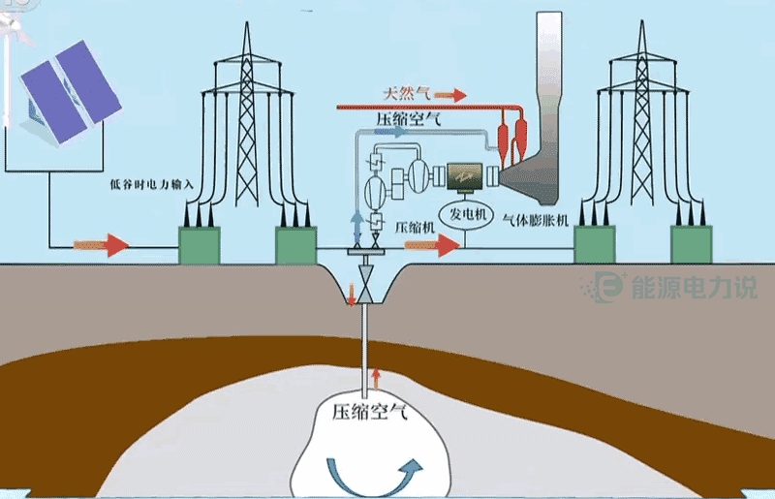
4. CAES in China
First CAES Project in China——Jintan CAES
Key facts
Commission: 2021
Power Generating Capacity: 60 MW
Storage Capacity: 300MWh/day
Round trip efficiency: ~60%
Geometrical volume of the salt cavern:~200,000m³
Pressure Range: 12-14MPa

Slide 20
Thank You!

