Slide 1
Technology Innovation and Energy Transition of CNPC
11th October, 2023

Slide 2
Contents
About CNPC
Technology Innovation of CNPC
Energy Transition of CNPC
About RIPED

Slide 3


1. About CNPC
China National Petroleum Corporation (CNPC) is an integrated international energy company covering oil, gas & new energies, refining, chemicals, marketing & new materials, support & services, as well as capital & finance etc.
Company Strategies
One of China's main oil and gas producers and suppliers
Ranking 3rd among the world's top 50 oil companies
Ranking 2nd on Fortune Global 500
Resources
Market
Internationalization
Innovation
Green and Low-carbon

Slide 4

1. About CNPC
2022 Business Overview——Exploration & Development of Oil & Gas
Crude oil production
Crude oil equity production
105
77.04
million tons
million tons
Domestic
Overseas
Natural gas production
Nature gas equity production
145.5
31.75
billion cubic meters
trillion cubic meters

Slide 5
1. About CNPC
2022 Business Overview - New Energy Business
Hydrogen: The total production capacity being 3,000 tons/year. 23 hydrogen refueling stations have been built.
Geothermal: The total area for geothermal heating being 25 million square meters. This has allowed for an annual reduction of 570,000 tons of standard coal use.
Wind and Solar Power: The cumulative installed capacity now exceeds 1.4 million kilowatts.
First Offshore Solar Power Project Connected to the Grid of CNPC:
The project has an installed capacity of 18.7 megawatts and can generate an average of 27.5 million kilowatt-hours annually. Compared to thermal power, it can reduce carbon dioxide emissions by 22,000 tons per year.

Slide 6
Contents
About CNPC
Technology Innovation of CNPC
Energy Transition of CNPC
About RIPED

Slide 7
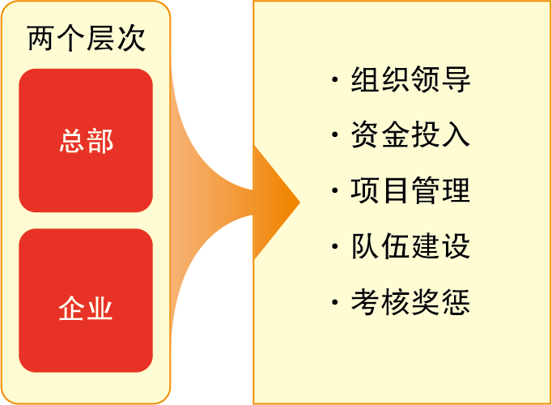
2. Technology Innovation of CNPC
A Unity with Three-level Management: Organizational Structure for S&T Innovation
A Unified Whole
Unified strategic planning
Unified system design
Unified project advancement
Unified business coordination
S&T and information leadership group of CNPC
S&T management department
Technology committees
S&T management departments of specialized subsidiaries
Specialized committees
Three-level management
Organizational Leadership
Financial Investment
Project Management
Team Building
Performance Evaluation and Incentives
Headquarters
S&T management departments of affiliated research institutes
S&T management departments of regional companies/specialized companies
Specialized companies
Enterprises
Research institutes of regional companies

Slide 8
2.Technology Innovation of CNPC
Technology Innovation System
Technology Innovation System of CNPC
Organizational
system
R&D system
Platform system
Support system
Talent cultivation and
incentive policies
S&T investment and
cooperation
S&T system and
information platform
Headquarters
Level
Research institutes
Research on Foundational, advanced, and commonly applicable key technologies
Key laboratories
8⁺⁵
Local
Level
Featured technology
centers of regional
company research
institutes
Featured technology
R&D Production
technology support
Pilot
(test) bases

Slide 9
2. Technology Innovation of CNPC
Technology Innovation System - Organizational Structure
As of 2022, there are 4,721 research staff directly employed by the research institutes of CNPC, accounting for 20.2% of the total research staff across all three levels of research organizations.
Research Institute of Petroleum Exploration &Development
Planning Institute
Economic and Technical Research Institute
Materials Engineering Research Institute
Engineering Technology Research Institute
Petrochemical Research Institute
Safety and Environmental Protection Research Institute
Kunlun Digital Technology Co., Ltd.
Shenzhen New Energy Research Institute
Houston Technology Research Center
Shanghai New Materials Research Institute
Japan New Materials Research Institute
Dubai Research Institute
8⁺⁵
research institutes

Slide 10
2. Technology Innovation of CNPC
Technology Innovation System - R&D System
Based on the level of S&T maturity, the system is divided into three levels and ten directions or focus areas.Totally 50 science and technology projects are deployed to support various business units.
No. | Project type | Exploration | Development | Refining | Chemicals | Storage and transportation | Overseas | Engineering technology | Safety, environmental protection and energy and water saving | Unconventional and New Energy | Decision support | Total
1 | Foundational and disruptive technologies | 2 | 2 | 1 | 1 |  |  | 3 |  | 1 |  | 10
2 | Technical breakthroughs and experimentation | 4 | 5 | 4 | 4 | 3 |  | 4 |  | 1 |  | 25
3 | Supporting promotion and industrialization | 2 | 2 | 1 | 1 |  | 3 | 3 | 2 |  | 1 | 15
Total |  | 8 | 9 | 6 | 6 | 3 | 3 | 10 | 2 | 2 | 1 | 50

Slide 11
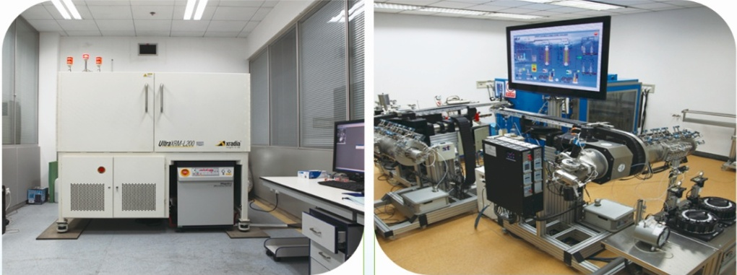
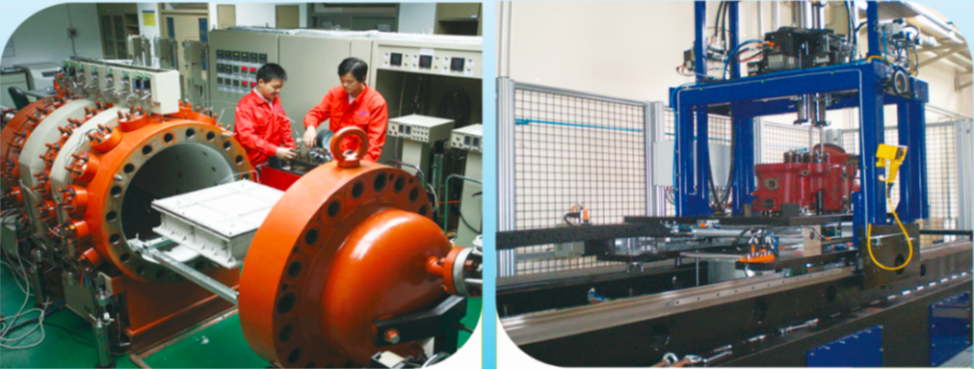
2. Technology Innovation of CNPC
Technology Innovation System – Platform System
Since 2006, CNPC has invested over 3 billion yuan to establish 55 key laboratories and test bases covering the entire upstream, midstream, and downstream business chains. It is the central enterprise with the highest number of national-level R&D platforms (16), holding a dominant position in the national petroleum S&T innovation system.

Slide 12
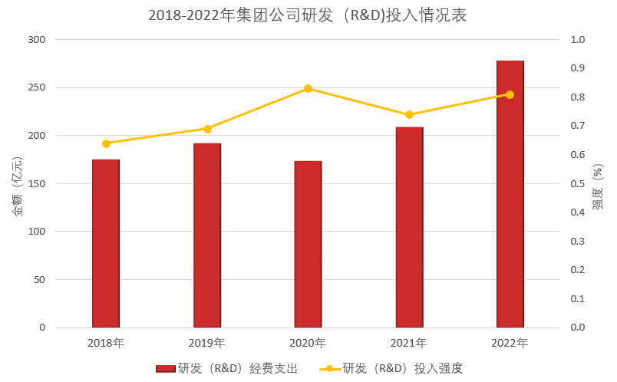
2. Technology Innovation of CNPC
Technology Innovation System - Support System
A comprehensive S&T support system has been established that includes stable investment, well-developed institutional frameworks, and team-building efforts. The environment for S&T innovation continues to improve.
R&D Investment of CNPC from 2018-2022
In 2022, the actual expenditure reaching 27.74 billion yuan, up 33% over the previous year. Calculated based on a total revenue of 3.4011 trillion yuan, the R&D investment intensity stands at 0.8%.
Amount(100 million RMB)
Intensity
R&D Expenditure
R&D Investment Intensity

Slide 13


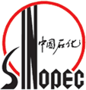



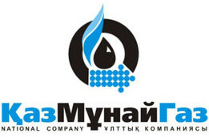



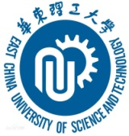
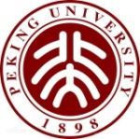




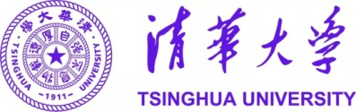




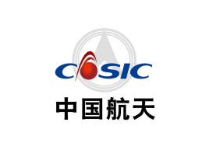







2. Technology Innovation of CNPC
Collaboration and Sharing

Slide 14
Contents
About CNPC
Technology Innovation of CNPC
Energy Transition of CNPC
About RIPED

Slide 15
3. Energy Transition of CNPC
In 2022, CNPC incorporated green and low-carbon initiatives into its development strategy. It has laid out a three-step overall scheme for green and low-carbon transitional development “Clean Substitution, Strategic Succession and Green Transition”. CNPC has explicitly identified new energy as its core business area moving forward.
Three-step overall scheme for green and low-carbon transitional development
Clean Substitution
2021—2025
Strategic Succession
2026—2035
Transition
2036—2050

Slide 16
3. Energy Transition of CNPC
Formulated a special plan for the development of new energy and new business, promoting corporate transition into a comprehensive energy company of "oil, gas, thermal power, and hydrogen".
Crude Oil
Natural Gas
Geo-thermal
Green Power
Hydrogen
Facilitate exploration and development
Steady production increase
Develop natural gas as a priority
Increase at a large scale
Medium and deep geothermal development
Hot dry rock power generation
Integrated development of wind-solar gas-electricity
Centralized and distributed synchronization
Transportation sector, refinery by-product hydrogen
Gradual transition to blue and green hydrogen
gas
oil

Slide 17
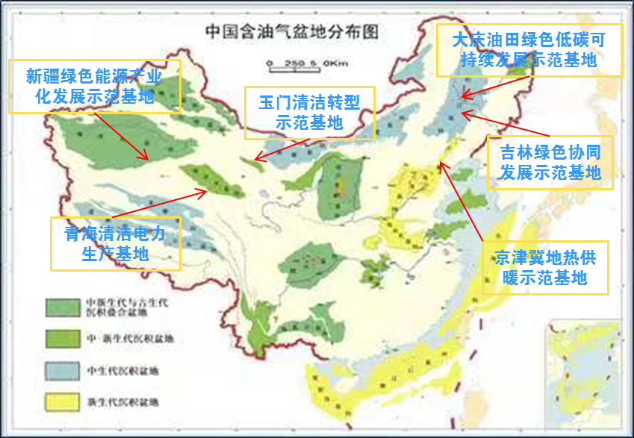
3. Energy Transition of CNPC
Six New Energy Bases
Distribution of oil-bearing basins in China
Daqing Oilfield Green & Low-carbon Sustainable Development Demonstration Base
Beijing-Tianjin-Hebei Geothermal Heating Demonstration Base
Daqing Oilfield Green & Low-carbon Sustainable Development Demonstration Base
Jilin Green Collaborative Development Demonstration Base
Qinghai Green Power Production Base
Yumen Clean Transformation Demonstration Base
Xinjiang Green Energy Industrialization Development Demonstration Base
Xinjiang Green Energy Industrialization Development Demonstration Base
Yumen Clean Transformation Demonstration Base
Jilin Green Collaborative Development Demonstration Base
Daqing Oilfield green low-carbon sustainable development demonstration base
Qinghai Green Power Production Base
Beijing-Tianjin-Hebei Geothermal Heating Demonstration Base
Mesozoic-Cenozoic and Paleozoic superposed sedimentary basin
Mesozoic-Cenozoic sedimentary basin
Mesozoic sedimentary basin
Cenozoic sedimentary basin

Slide 18

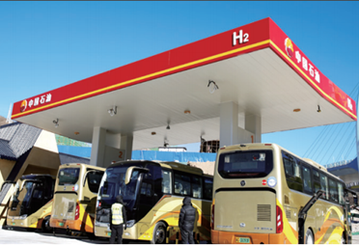
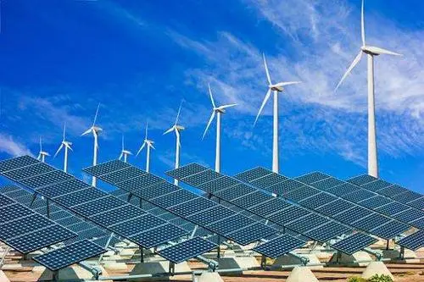
3. Energy Transition of CNPC
2050 Targets
Key Supplier of Clean Energy
Green & Low-carbon / Net Zero Development
Total energy production and supply doubled
Low-carbon / Net Zero energy: 80%
Heat, Wind, solar Power, and hydrogen : 50%
Build into China’s largest geothermal company
Clean power installation capacity among Top 10 in China
A leading Company in Hydrogen business in China
Carbon neutrality Model Company

Slide 19
Contents
About CNPC
Technology Innovation of CNPC
Energy Transition of CNPC
About RIPED

Slide 20
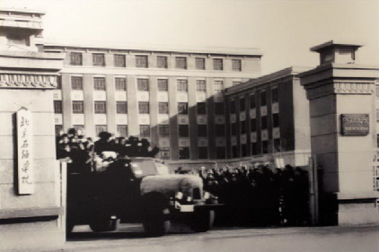
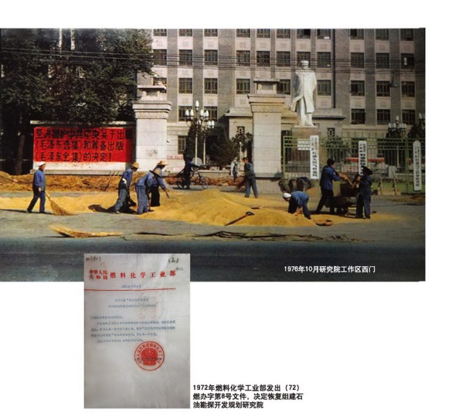
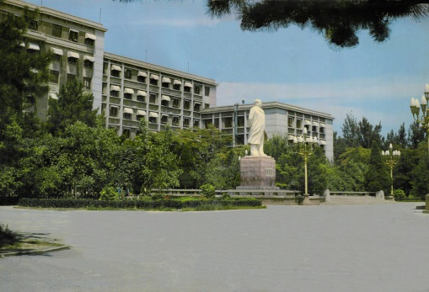
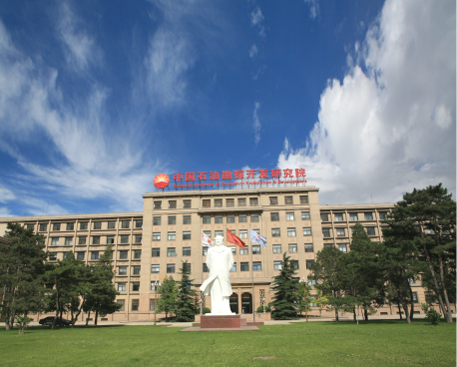
4. About RIPED
Development History
RIPED was established in 1958. Alongside the start, construction, and rapid development of China's petroleum industry, the Research Institute has gone through four phases of development. It has now become a domestic first-class and internationally renowned comprehensive research institution for oil, gas, and new energy.
Petroleum Science Research Institute (Upstream + Refining & Chemical) of the Petroleum department
Petroleum Exploration and Development Planning Research Institute Of the Combustion & Chemical Department / Petrochemical Department
Institute of Petroleum Exploration and Development of the Research Petroleum Department/Parent Company
Research Institute of Petroleum Exploration and Development (RIPED) of the CNPC
1958
1972
1978
1999

Slide 21
4. About RIPED
Role, Responsibilities, and Business Layout
“One think tank and three centers” of CNPC's global upstream business
Six Business Areas
Strategic Decision-Making Think Tank
Oil and Gas Exploration
Oil and Gas Field Development
Oil and Gas Production Engineering
High-Level
Scientific Talent
Development Center
Unconventional and New Energy
Major Theory and Technology R&D Center
Technology Support
and Service Center
Information and Decision Support
Graduate Education and Technical Training

Slide 22
4. About RIPED
RIPED
Dispatched Discipline Inspection Team
Office
Department of R&D
Department of Finance
Department of HR
Administrative Departments (9)
Department of Corporate Culture
Department of IT Management
Department of QHSE
Department of Legal Affairs
Department of International Affairs
NWGI （7）
HIPG （5）
Shenzhen New Energy Research Institute
Information and research support departments (4)
Scientific research departments（HQ）(32)
Logistics support departments (4)
Strategic planning
O&G exploration
Field development
Engineering
Unconventional O&G and New Energy
Overseas
Comprehensive Service Center （ Office of Construction Management ）
Department of Retiree Affairs（ Department of Public Utilities）
Management Center of Langfang Science and Technology Park
RIPED Petroleum Technology Corporation (Beijing)
Department of AI Research
Department of IT
Department of Archives
Training Center
Department of Energy Strategy
*Department of Global Resource Strategy
*Department of Overseas Strategy
*Department of Domestic Resource Strategy
* Department of Domestic Oil Development
* Department of Domestic Gas Development
* Department of New Energy Development
* Department of Upstream Technology Development Strategy
* Department of IT
Department of Petroleum Exploration
Department of Resource Evaluation & Planning
Central Laboratory of Geological Sciences
Department of Geophysical Technology
Department of Well Logging Technology
* Department of Tarim Basin E&P
*Department of Qaidam Basin E&P
Department of Oil Field Development
Department of EOR
Department of Heavy Oil Recovery
Department of Tight Oil Development
Department of Gas Field Development
Department of Underground Storage
* Department of Junggar Basin Development
* Dubai Project Department
* Abu Dhabi Project Department
Department of Production Engineering
Department of Intelligent Control and Equipment
Department of Fracturing
Department of Oilfield Chemicals
Cost Center
E&P Engineering Supervisory Center
* Department of Ordos Basin E&P
Department of Unconventional O&G
Department of New Energy
Department of Technical Standards
*Department of Sichuan Basin E&P
Overseas Comprehensive Office
Department of O&G Resource Exploration
Department of O&G Development Planning
Department of Overseas New Ventures Assessment
Department of Central Asia & Russia E&P
Department of Middle East E&P
Department of Africa E&P
Department of America E&P
Department of Asia-Pacific E&P
Department of Well Construction Engineering
Department of Production Operations
Note: The departments marked with * are supported by corresponding research departments

Slide 23
4. About RIPED
Talent Team
Current Staff: 2767 people, among which 2,153 are at the headquarters (Beijing + Langfang Parks), 381 at the Northwest Branch (NWGI), and 233 at the Hangzhou Research Institute of Geology (HIPG). Professional and Technical Staff: 2,175 people, including 4 current academicians, 179 senior engineers, and 2,067 with a Master's degree or higher, overall exhibiting high educational levels, high professional titles, and high quality.
Age distribution of employees
Distribution of employees by departments

Slide 24
4. About RIPED
Research Conditions
3 National Key Laboratories
21 corporate-level key laboratories/R&D centers
600 large and medium-sized experimental device (sets) and 60 iconic device (sets)
Laboratory Name | Representative Technologies | Construction Year | Approving Authority | Acceptance Year
National Key Laboratory for Enhanced Oil Recovery | Intelligent Water Flooding, Green Chemical Flooding, Thermal Recovery of Heavy Oil, CCUS-EOR | 2008 | Ministry of Science and Technology | 2010
National Energy Shale Gas R&D (Experimental) Center | Shale Gas Content Testing, Microscopic Characterization, Hydraulic Fracturing Large Physical Model | 2010 | National Energy Administration | 2019
National Energy Tight Oil and Gas R&D Center | Multidimensional and Multi-scale Reservoir Characterization, Diagenesis Modeling, Oil and Gas Aggregation Modeling | 2014 | National Energy Administration | 2019

