Slide 1
Material selection on H2 ready well infrastructures
IGU –UGS Committee meeting
Chongqing 11th-13th Octobre 2023

Slide 2
Test results on cements
Repurposing of current asset to H2-GN blends

Slide 3
Test results on cements
Testa Pozzo
Cement is classified as a»primary barrier» according Well intgrity management practice because:
It is directly in contact with hydrocarbons
restore the integrity of the caprock behind the casing
But also prevent flows through annular space between casing and wellbore
Tubo Guida
Valvola di sicurezza
Casing Superficiale
Tubing
di iniezione
erogazione
gas
Studies on cement behaviour are as fundamental as studies on steell HE
Casing intermedio e di produzione
Packer
Roccia di copertura
Filtri
Gravel Pack
Giacimento

Slide 4
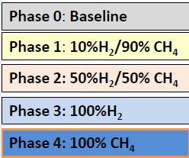
Cements H2 test results (SPE-214423-MS Snam- Stratum –Loeben univ.)
“ An Interdisciplinary Approach to Investigate the Cement Integrity for Underground Hydrogen Storage Wells”
3 Types of cements tested :
API class A
API class G
Special cement blend
H2 behaves like an inherts into the cement and any significant change was detectet in its properties

Slide 5
Cements results 2

Slide 6
Cements results 3

Slide 7
Cements results 4

Slide 8
Repurposing current UGS well stock to H2-GN blend
Testa Pozzo
Mean age of our well stock is more than 30 years: repurposing is a very important topic in terms of strategy, investment planning
Tricky topic: for hundreds of well, it needs to know
Well history
Detailed list of materials utilised
What has been going in and out for decades
Tubing casing corrosion(?)
Is there any third party company that can certify a well can be repurposed?
Tubo Guida
Valvola di sicurezza
Casing Superficiale
Tubing
di iniezione
erogazione
gas
Casing intermedio e di produzione
Packer
Roccia di copertura
Filtri
Gravel Pack
Giacimento

Slide 9
Snam strategy for asset repurposing up to 10%H2-NG blend
WIMS
Certification of well integrity management system (WIMS) according to ISO 16530 from an external certification body
Material testing
Complete testing on materials rtrieved from old wells (valves , casing, elastomers)
Field assessment
Site specific well assessement in order to verify all information about materials are available

Slide 10
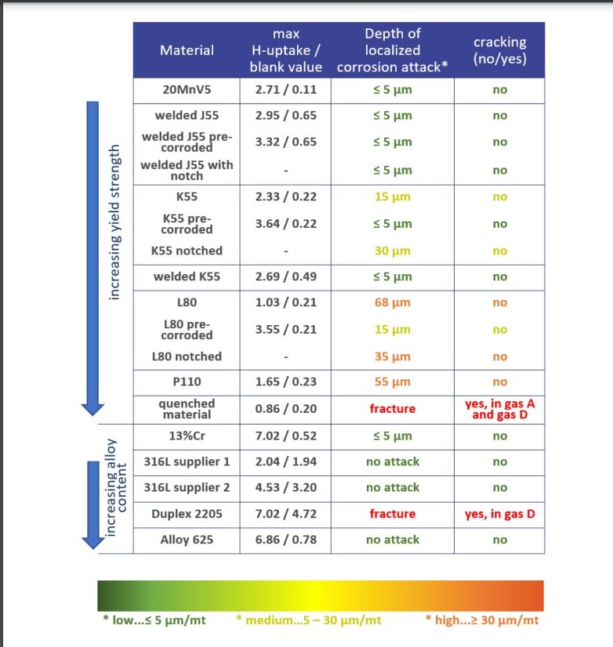
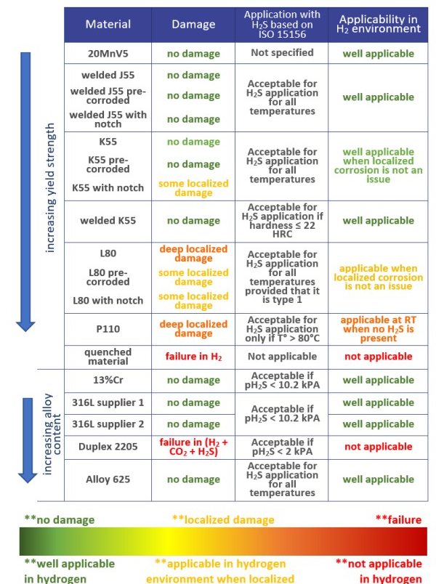
Repurposing current UGS well stock to H2-GN blend: test on new materials can be used for old wells?
Focus on J55 (most diffused materials on production tubing in Italy) and P110 (present on ancillary completion equipment).
From Hystories released information
Resource: Hystories_D4.6-0-Summary-report-on-all-investigated-steels.pdf
Mechanic test =CLT constant load test
Hydrogen pressure = 100 and 120 bar
Environment: with and without
1%H2S, 13% CO2, brine
Room temperature
Positive results for almost all tested materials

Slide 11
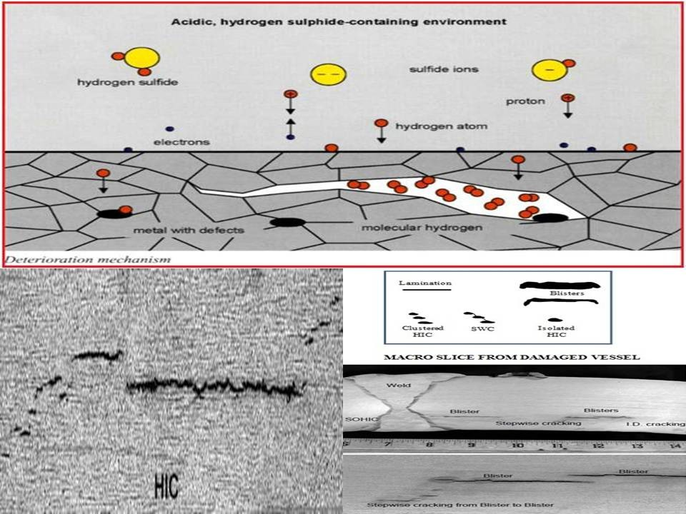
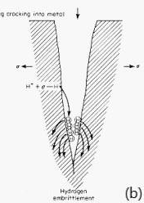
Repurposing current UGS well stock to H2-GN blend: test on new materials can be used for old wells?
P110 : usable at room temperature without H2S, but the test at RT (with H2S) was positive.
J55 : applicable, but ISO 15156-2 clause 8 highlights HIC problems at RT (minor issues on new pipes but on 30 years old pipe ?)
HIC
Main impurity that enhancing HE are sulphur inclusions and shape of steel microstructure.
Unfortunately P110 J55 idientify material classes and chemically composition is not very well detailed.
Control of impurity like sulphur in steel farm has drastically improved through years: P110 produced in ’70s probably would fail the test proposed in Hystories
HSC or SSC
Well Repurpsing requires a deep knowledge of our well stock, and very good data traceability.

