Slide 1
European energy market overview
IGU Storage Committee meeting
Chongqing, 12th October 2023.

Slide 2
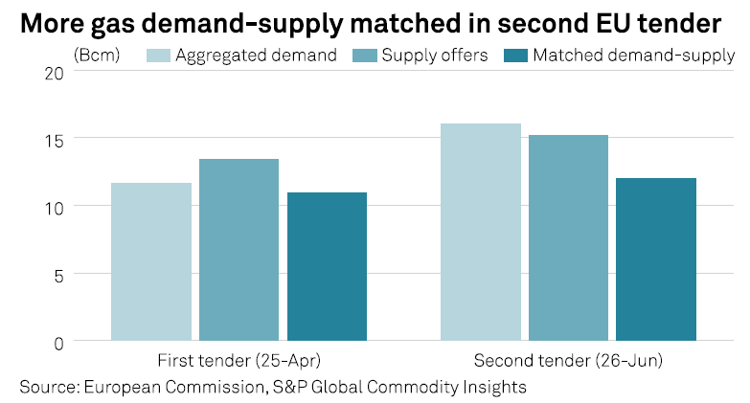
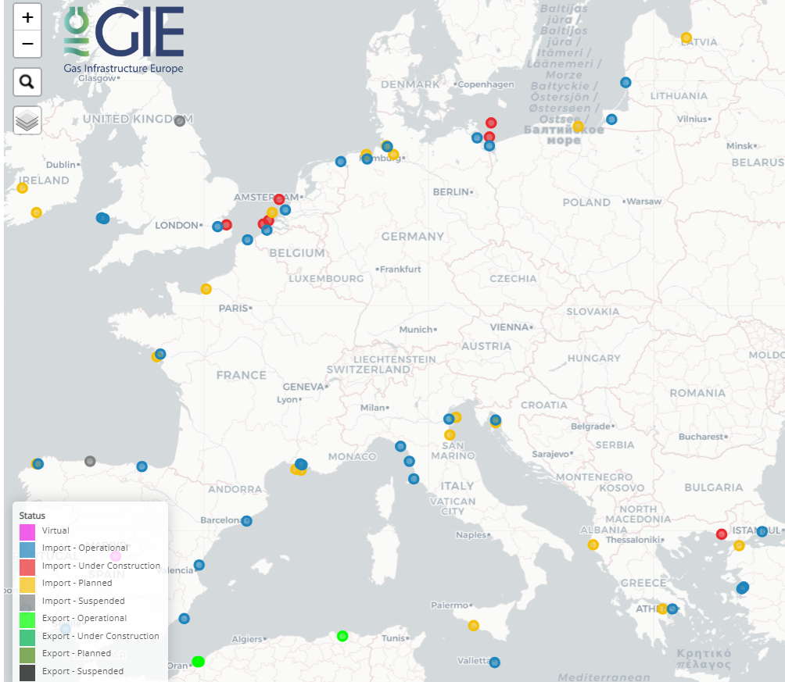
European energy market overview I Nora Liszkai HGS
Zooming in – market dynamics of the European Union
European politics
EU Goals and strategy
Gas market dynamics in 2022 vs. 2023
Latest legislative measures
Review of SoS Regulation
Save gas for a safe winter
Solidarity Regulation
RePowerEU
Fit for 55
Energy prices
Russian-Ukrainian war
Supply diversification
Energy saving
#AggregateEU
Certification
Filling level for storage facilities until 2025
Filling trajectories/ Control points
90% filling target
Solidarity
Transparency
2

Slide 3
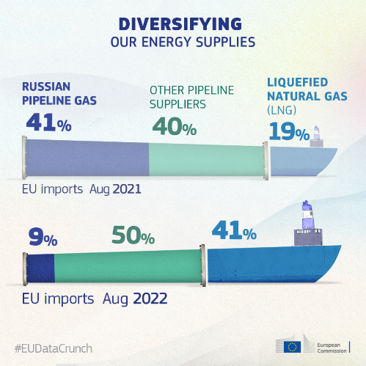
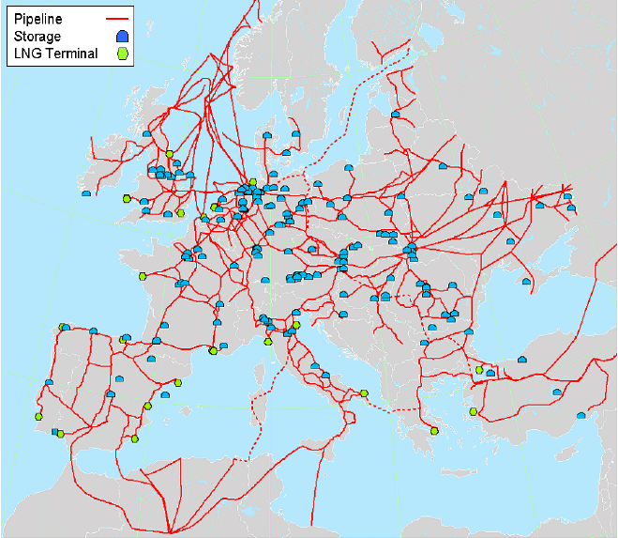
European energy market overview I Nora Liszkai HGS
Recent changes in European gas imports
bcm
Other pipeline sources
LNG
Sources: IEA, EC & HGS
OECD Europe: | Austria; Belgium; Czech Republic; Denmark; Estonia; Finland; France; Germany; Greece;
 | Hungary; Iceland; Ireland; Italy; Latvia; Lithuania; Luxembourg; Netherlands; Norway;
 | Poland;Portugal; Slovak Republic; Slovenia; Spain; Sweden; Switzerland; Türkiye; UK
EU markets
LNG
Storage
H₂

Slide 4
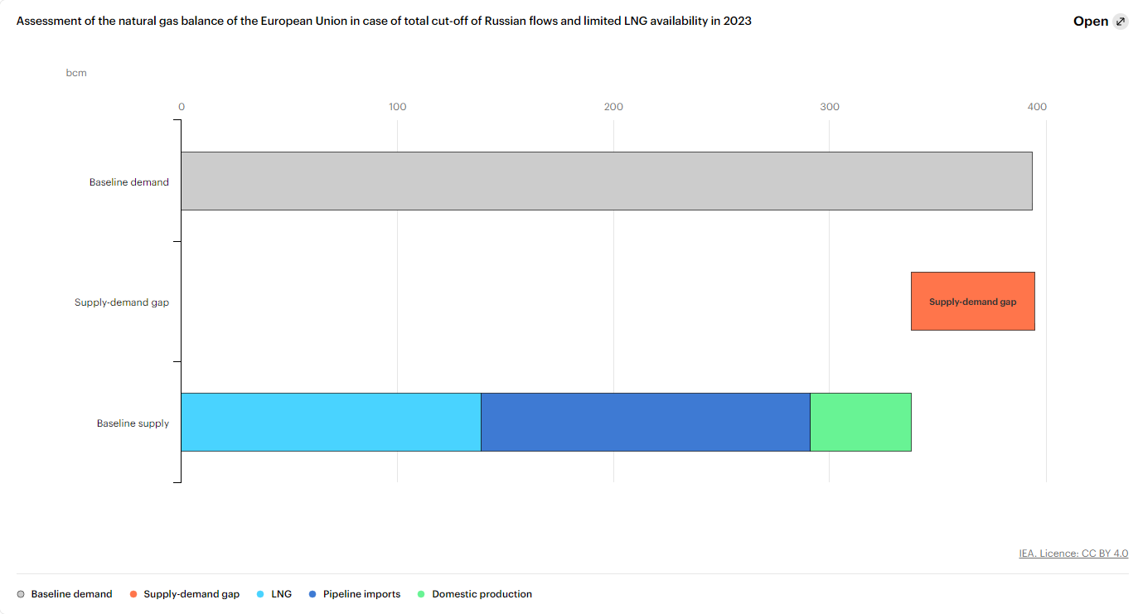
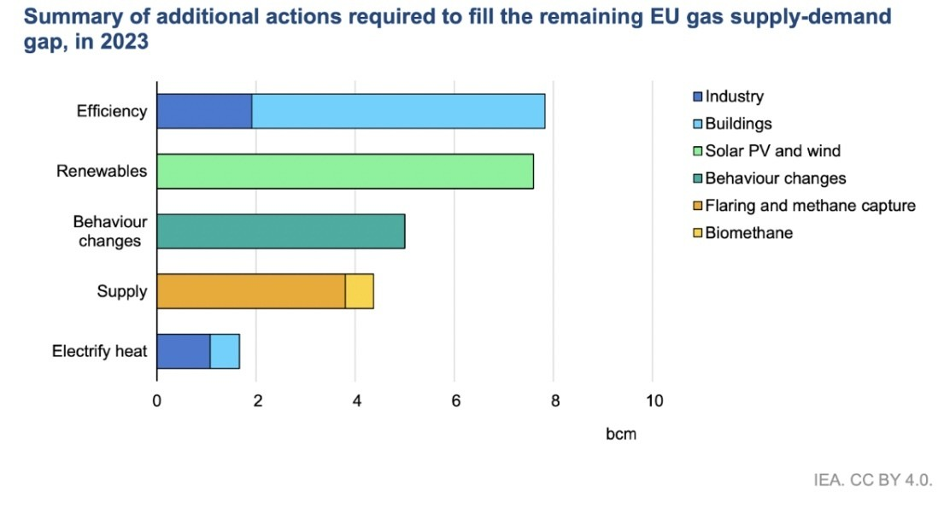
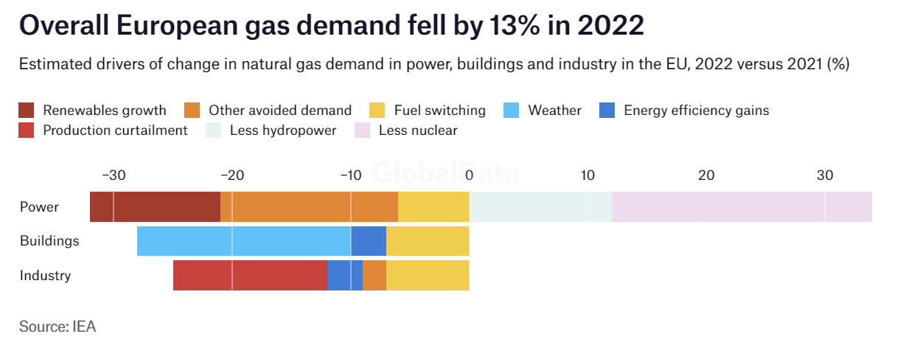
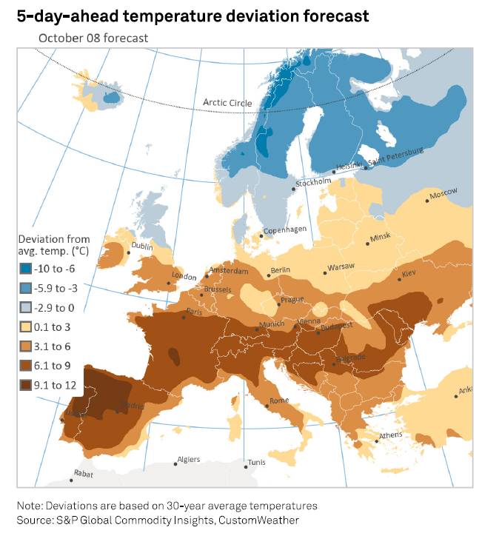
European energy market overview I Nora Liszkai HGS
Recommended measures to avoid gas shortages in the EU
Demand
Supply
Challenges for SSOs
Behaviour
Weather
Biomethane
EU markets
LNG
Storage
H₂
Source: IEA, Bruegel

Slide 5
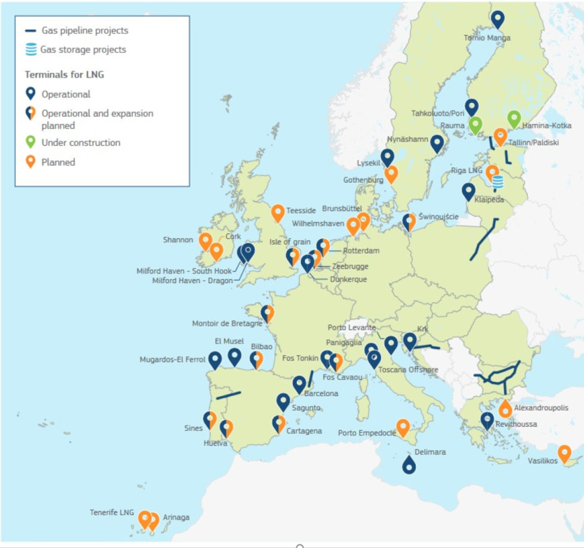
European energy market overview I Nora Liszkai HGS
LNG boom in the EU
The EU increased LNG imports to cut its dependence on Russian gas by at least 155 bcm before 2030
29 operational LNG terminals, 33 LNG import terminal projects that are currently under construction or in the planning stage
Europe still relies on Russia for about 12% of its LNG imports in 2022
EU financed LNG project which focuses on further evolution of the global LNG market: LNGNet
Risk of oversupply needs to be considered alongside with scaling up the efficiency measures
EU markets
LNG
Storage
H₂
Capacity to boom from 270 bcm to 400 bcm by 2030
Sources: IEEFA, EC, ALSI

Slide 6
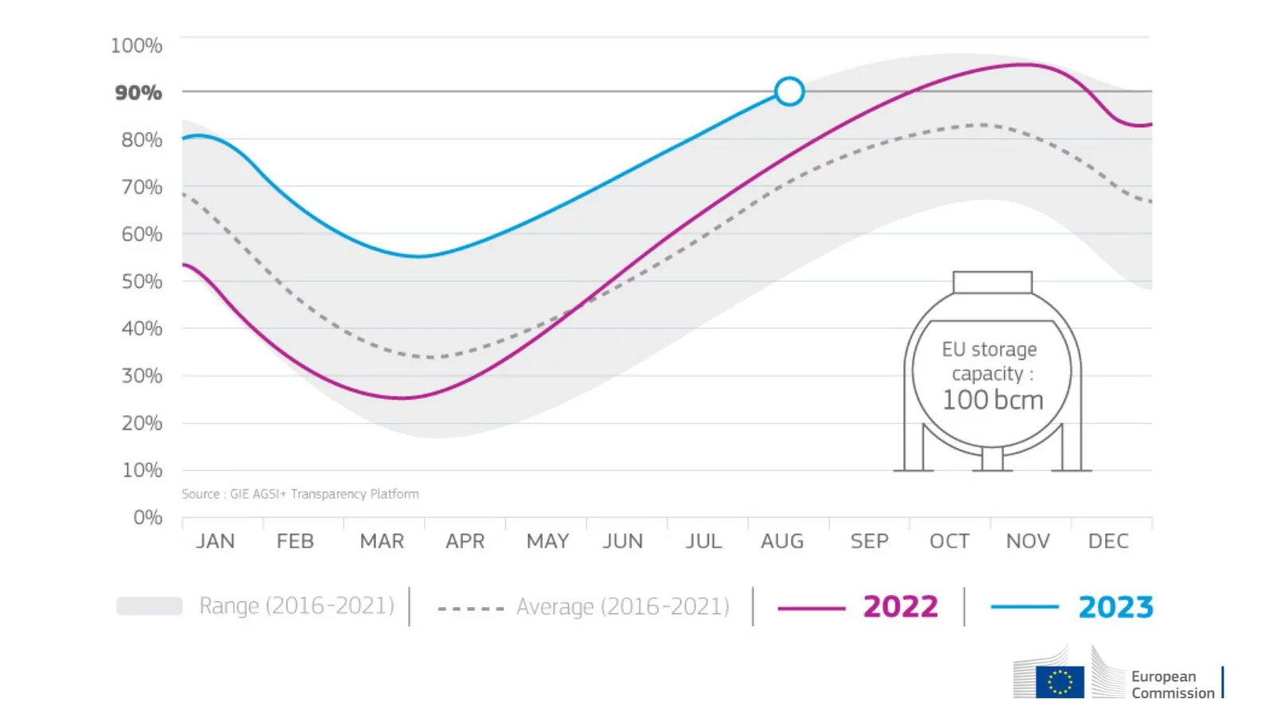
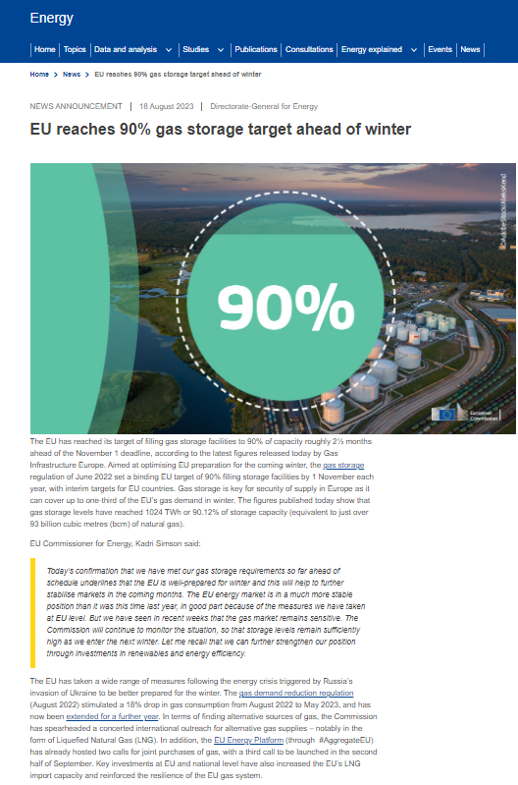
European energy market overview I Nora Liszkai HGS
Gas storage updates
Overview of winter 2022/2023
Market changes & emergency regulations
A record-breaking 70 bcm was needed
Mild winter
Heating season in Europe ended well: over 55% full
Gas prices on EU exchanges have been falling since the beginning of 2023
Towards winter of 2023/2024 and beyond
Maintain cohesion and solidarity
Extension of filling obligations after 2025
full storage facilities provide a buffer to the gas grid
This relaxes imports constraints
The EU has reached its target of filling gas storage facilities to 90% ahead of the November 2023.
EU markets
LNG
Storage
H₂

Slide 7
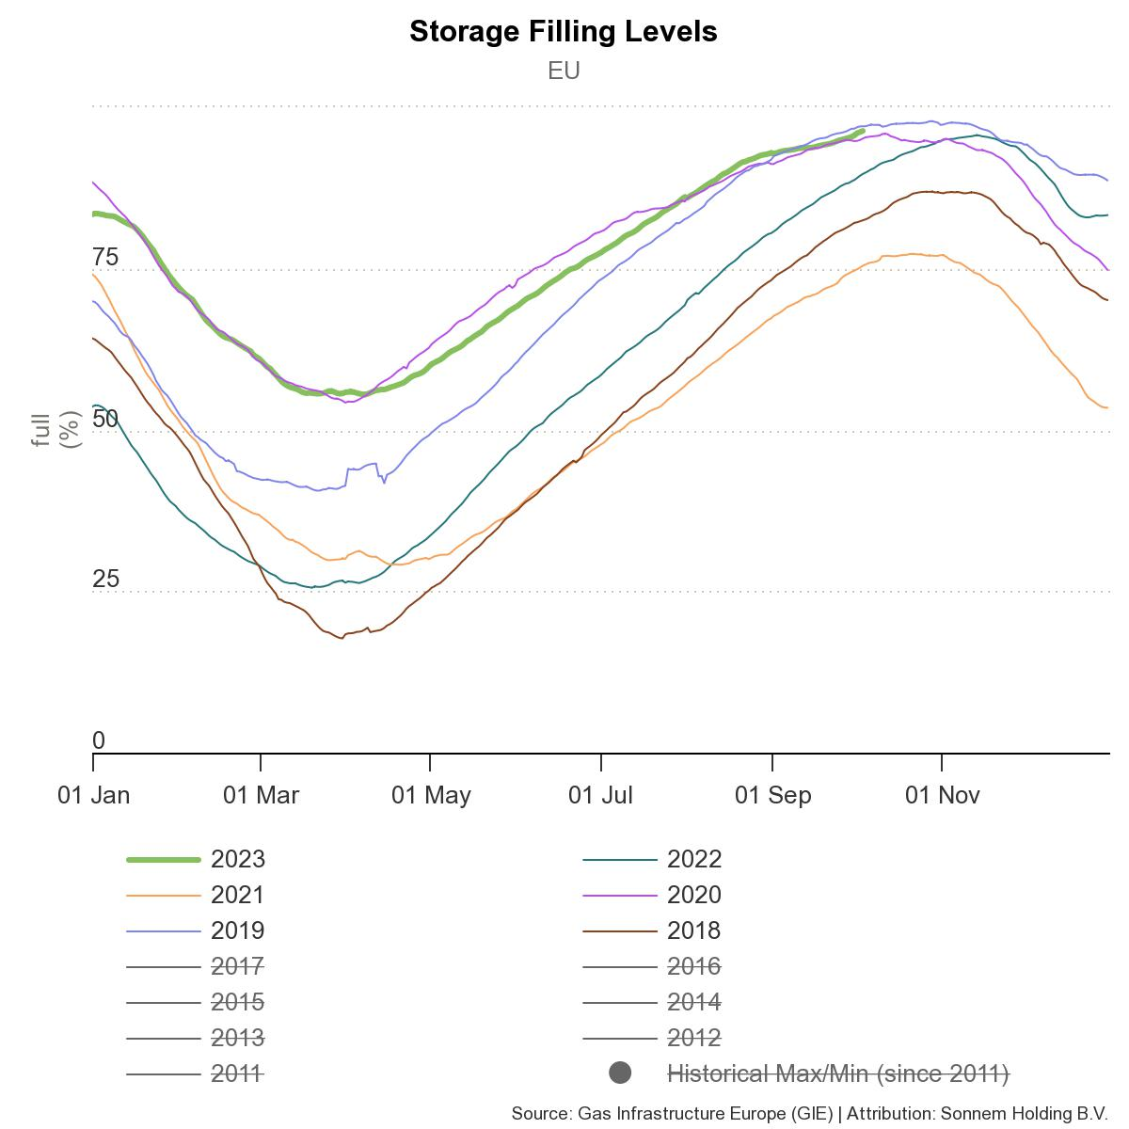
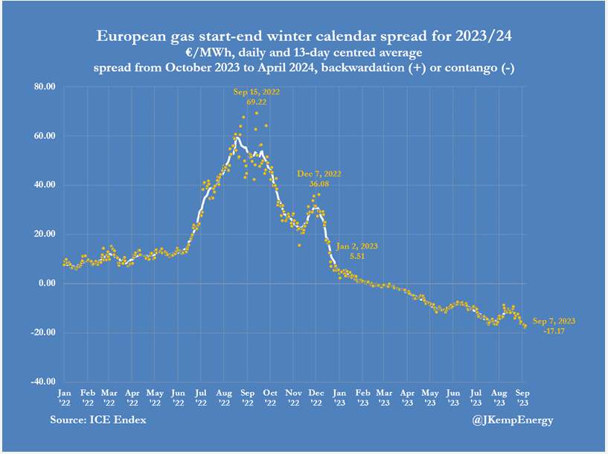
European energy market overview I Nora Liszkai HGS
Filling levels and market dynamics
EU markets
LNG
Storage
H₂
Sources: GIE AGSI, John Kemp Reuters

Slide 8
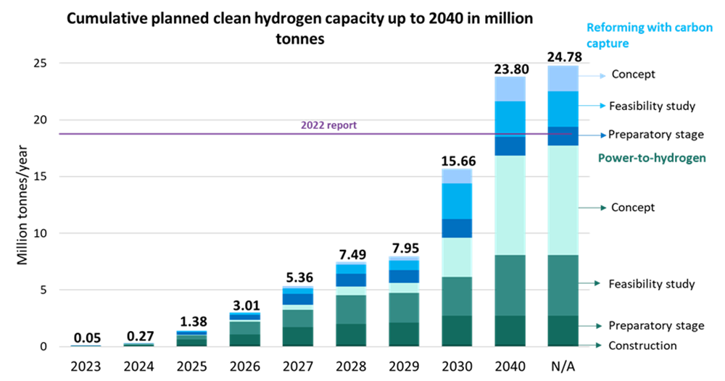
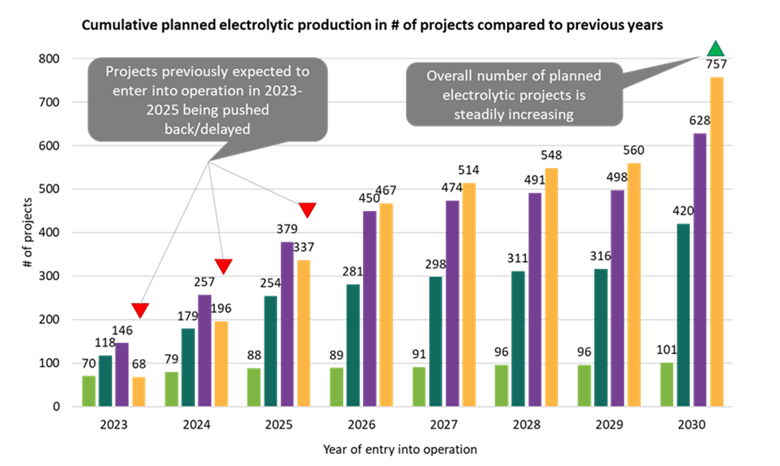
European energy market overview I Nora Liszkai HGS
European Clean Hydrogen Monitor 2023
Hydrogen production capacity remained stable for 2022 at around 11.5 Mt
While power-to-hydrogen/water electrolytic capacity rose by 23% to 228 MW by September 2023 compared to December 2022, it represents only 0.3% of the total production capacity.
At this rate, total installed capacity would barely reach 1 GW by 2030 compared to the ~100 GW needed to produce the 10 Mt envisaged by RePowerEU
EU markets
LNG
Storage
H2

Slide 9
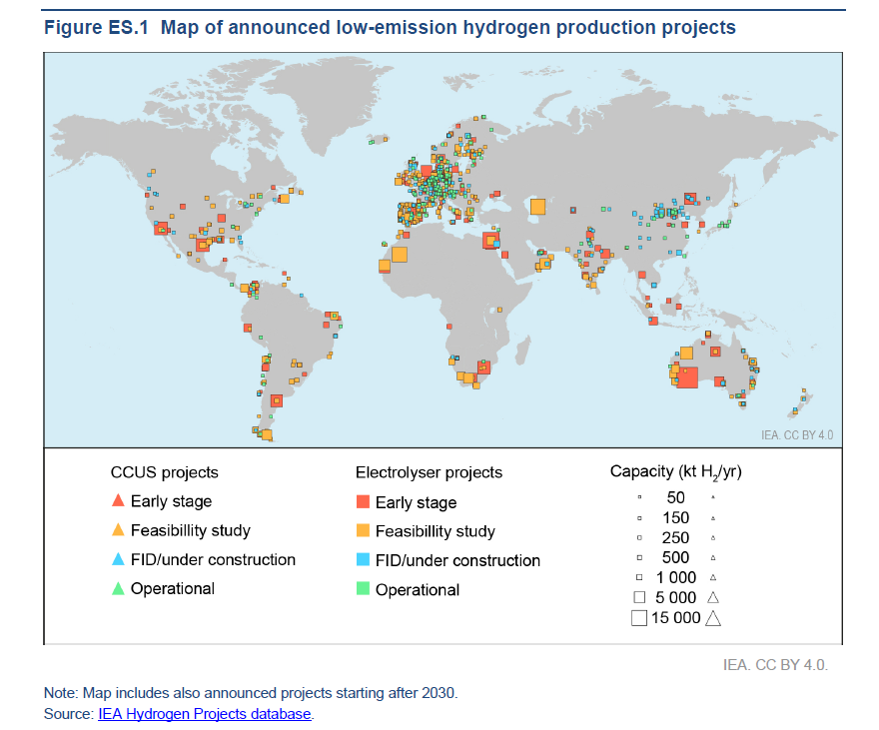
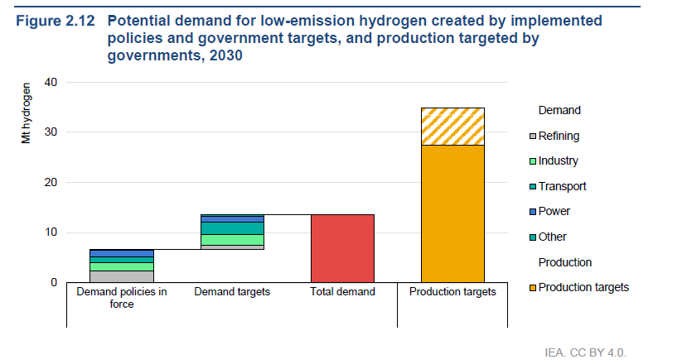
European energy market overview I Nora Liszkai HGS
Zooming out – IEA Global Hydrogen review 2023
Focus on demand creation for low-emission hydrogen
The potential production by 2030 from announced projects is 50% larger than it was in 2022, but only 4% of this potential production has FID
Electrolyser manufacturers have announced ambitious expansion plans: 14 GW of manufacturing capacity are available today, half of which is in China
Global hydrogen use reached 95 Mt in 2022
Demand remains concentrated: Low-emission hydrogen is being taken up slowly in existing applications (0.7%)
EU markets
LNG
Storage
H2

Slide 10
Nora Liszkai
Lead strategic expert
liszkain@mfgt.hu

