Slide 1
Information from CC
Storage Committee Meeting
Chongqing
2023.10.12

Slide 2
1
CC Updates
2
Introduction of Call for Abstract
3
Introduction of WGC2025

Slide 3
CC Updates
1

Slide 4
Members Recruitment
*As of September 20, 2023
Unit | Number of member | Increment | Number of Country
E&P | 28 | 3 | 17
Storage | 43 | 8 | 21
Transmission | 40 | - | 22
Distribution | 49 | 2 | 24
Utilisation | 36 | - | 19
Sustainability | 49 | 2 | 25
Strategy | 56 | 2 | 24
Gas Markets | 47 | - | 22
LNG | 74 | - | 29
Marketing & Communications | 30 | - | 19
R&D and Innovation | 58 | - | 24
TFS | 12 | - | 8
TFN | 21 | - | 10
TFD | 17 | - | 7
Total | 560 | 17
The sum of Chairs, Vice Chairs and Secretaries is 38, not included in the table.

Slide 5
Analysis of Committee/TF Members
From 44 Countries
Top 6 | (>20)
China | 78
Thailand | 47
Poland | 43
Brazil | 31
Colombia | 24
France | 21
Male | Female
409 | 151

Slide 6
CC Participation in Committee/TF Meetings
Carbon Neutrality Taskforce-Oct. 6, online
Strategy Committee-Oct.11-13, Beijing
LNG Committee-Oct. 10-13, Shanghai
Storage Committee-Oct.10-13, Chongqing

Slide 7
Communication with Secretariat
Meeting with FED
Met with FED 3 times in September, Beijing. FED provided suggestions of Call for Abstract and feedbacks from Committees.
Meeting with Senior Advisor
Met with Senior Advisor online. Senior Advisor provided suggestions on daily work.

Slide 8
Introduction of Call for Abstract
2

Slide 9
Overall
The abstracts should be submitted via the online platform.
The abstracts should be no longer than 500 words (in English only) with no more than 1 picture.
Once their abstracts were accepted, authors will be given the opportunity to present at WGC2025 and will be required to submit a Full Paper relating to their Abstract.
The Full Paper should be no longer than 20,000 words and submitted in English only.
The presenting authors will be asked to submit a Powerpoint Presentation to be presented at the conference.

Slide 10
Timeline of CfA (to be approved)
Items | Start Date | End Date | Status
CfA Guidelines Discussion | Sep. 12, 2023 | Sep.12, 2023 | Started
Submit the list of reviewers to NOC | Sep. 12, 2023 | Nov. 30, 2023 | Started
Submit the list of moderators to NOC | Sep. 12, 2023 | Dec. 31, 2024 | Started
CfA Guidelines Approval | Oct. 16, 2023 | Oct. 16, 2023 | Waiting
Call for Abstract | Nov. 20, 2023 | May 30, 2024 | Launching Soon
Abstracts review | May 30, 2024 | Jul. 30, 2024
Author notification | Jun. 1, 2024 | Jul. 30, 2024
Paper collection | Jun. 1, 2024 | Oct. 30, 2024
Speaker management (Confirmation) | Nov. 1, 2024 | Jan. 30, 2025
Presentation management | Nov. 1, 2024 | Mar. 30, 2025
WGC2025 | May 19, 2025 | May 23, 2025

Slide 11
Timeline
Start-up discussion
CC Lima meeting
2022.10
Set tasks of Perth Phase
CC Brussels meeting
2023.4
CfA Themes Finalise
Perth meeting
2023.10
Session Topics Confirmation
End of 2024
Paper Collection
2024.6.1-10.30
Awards finalise
2025
Project Plan (ETF)
CC Virtual meeting 2023.1
CfA Survey Result and discussion
CC Virtual meeting
2023.9
CfA
2023.11.20-2024.5.30
Speaker Confirmation
2024.11.1-2025.1.30
WGC2025
Beijing
2025.5

Slide 12
Themes
Theme 1 | Advancing technologies from E&P to utilisation | New technologies deployed/under study within the whole industry chain, including but not limit to CC(U)S, EOR, unconventional gas, LNG, transmission, distribution and utilisation innovation.
Theme 2 | Supply, demand, market and prices | Global/regional supply/demand structure, gas pricing mechanism, impacts on gas price, etc.
Theme 3 | New scenarios for gas utilisation | New patterns for gas utilisation in household, heavy transport, coupling with renewables and power sector etc.
Theme 4 | Gas marketing and promotion under the new context | lessons learned from other industry, shaping the status of gas in the outside world, conveying positive messages , etc.
Theme 5 | New momentum for LNG | Carbon neutrality trends impact and opportunities for LNG, decarbonisation of LNG value chain
Theme 6 | Digital transformation | Best practices of digital transformation within the value chain. Digital technologies can help to enhance efficiency, cut costs, improve quality of service, and contribute to a low carbon economy.
Theme 7 | New gases promoting energy transition | Adoption of new gases (renewable methane, hydrogen, biogas, etc.) in energy mix. The role of the gases in energy transition and achieving climate ambition.
Theme 8 | The role of gas in achieving SDGs | Case studies of the role of gas in realising UN SDGs, including poverty alleviation, zero hunger, etc.
Theme 9 | Methane emission reduction | Monitoring, reporting, verification. Best practices and roadmap of methane reduction.
*Committees and Task Forces are encouraged to take the lead in some themes, joint efforts are also welcome.

Slide 13
Awards
Awards are incentives to attract more attention and participation to CfA and WGC2025, also a remarkable recognition of innovations and insights.
Tier1: IGU Global Gas Awards
1 winner
Theme: "Energising a Sustainable Future" same as WGC2025
Tier2: WGC2025 Regional Awards
5 (TBC) winners from different continent.
Be aligned with TWP--attach importance to regions.
Tier3: WGC2025 Industry Awards
9 (TBC, maybe same as the number of themes) winners based on the outcome of Call for Abstract.

Slide 14
CfA and Session Topics
Alignments on the themes are a keep-going task for CC depending on the quality and quantity of abstracts submitted. Industry Insight will be a 90min session and Technology Innovation will be a 45min session. The quantity of II and TI is 36+14.
Mechanism:
Monthly update from CfA online systems.
Decision on CfA extension to be made before May 30, 2024.
CC discussion and decision on Session topics after Call for Abstract ends. (June or October 2024 TBC)
Final adjustments based on speakers' participation before January 30, 2025 (TBC)

Slide 15
Introduction of WGC2025
3

Slide 16
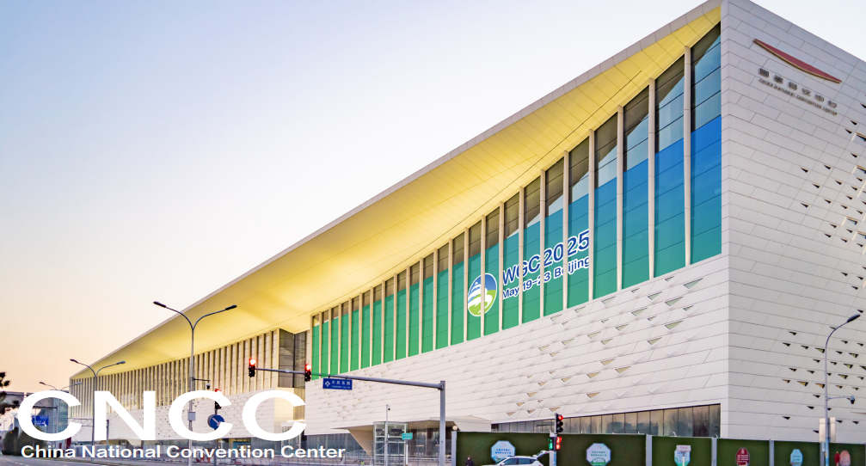
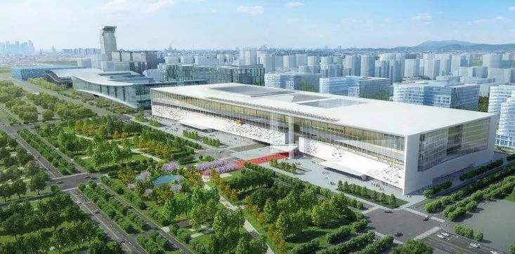
Date and Venue
WGC2025 will be held in Beijing on May19-23, 2025. The venue will be China National Convention Centre (CNCC) Phase II, which ranked the first among the World’s Most Anticipated Under-construction Exhibition Venues of 2022. CNCC phase II will be physically ready in 2024, with the size of 460m*150m*45m, three floors above the ground and two floors under.

Slide 17
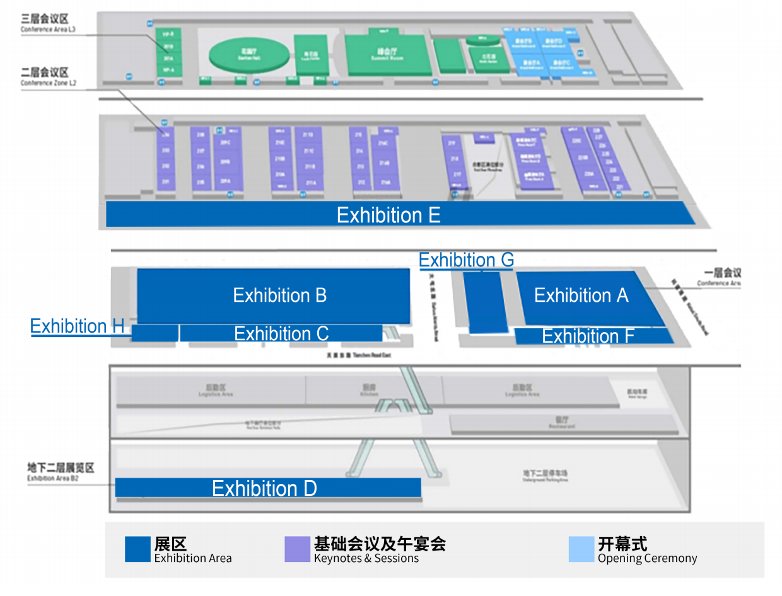
Venue
We have a 5-floors-venue for exhibitions, conferences and other social events, the area include:
auditorium with 5,000 (maximum) capacity
15+ concurrent sessions
18,000+ (Exhibition A+B+C+E) net square metres
other additional space(Exhition DFH)

Slide 18
Conference
The conference part will mainly be held at the second floor, which has a total of:
16 medium-sized meeting rooms, each with an area of over 400㎡
23 small-sized meeting rooms, ranging from 100 to 210㎡
10 VIP rooms

Slide 19
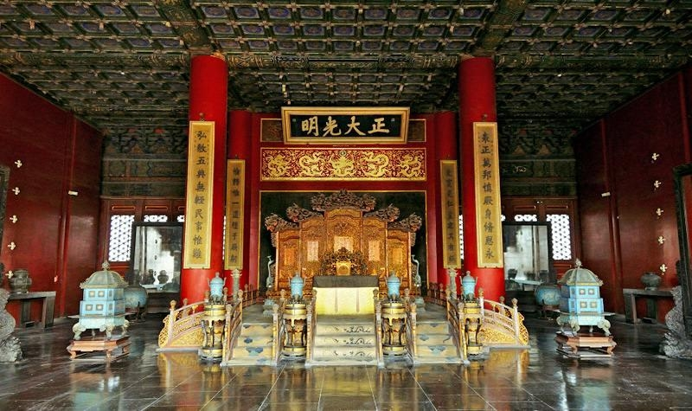
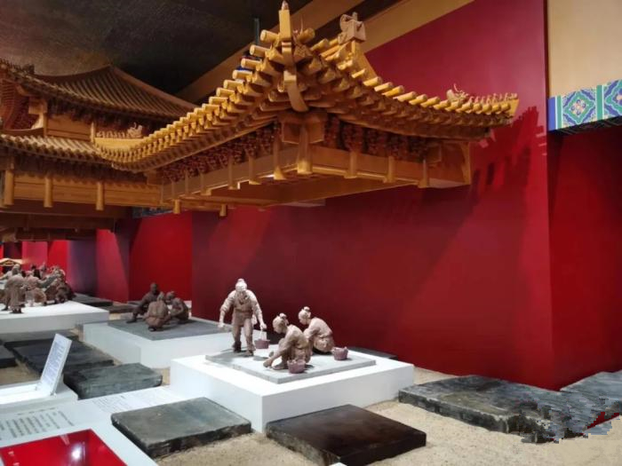
Social function
We also have an 8,000㎡ rooftop garden with a retractable roof on the third floor, various social events such as receptions and cocktail parties can be held here, which will provide an enhanced networking experience for attendees. The building materials of the 3F Roof garden were made with the same firing craftsmanship with the bricks used in the Forbidden City.

Slide 20
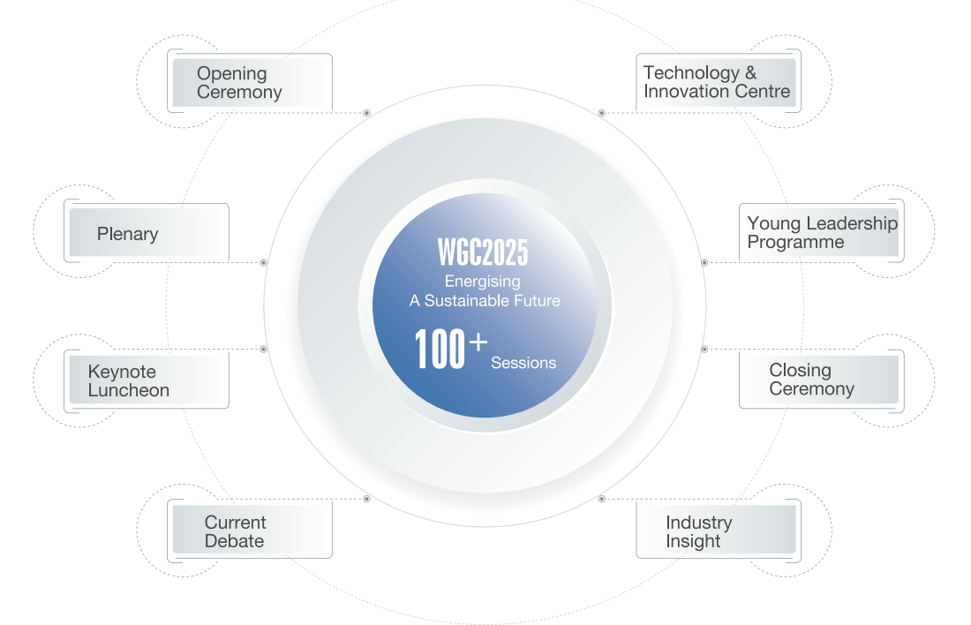
Session types
Around 100 sessions in different formats will be held, including:
Opening Ceremony
Plenary
Keynote Luncheon
Current Debate
Industry Insight
Technology & Innovation Centre
Young Leadership Programme
Closing Ceremony

Slide 21
Themes
Discussion are centred on:
One core theme:
Energising A Sustainable Future
Seven keynotes:
Policy and Macro-environment
Energy Transition
Technology Innovation
Regional Gas Development
Energy and Finance
LNG and Trade
Gas Utilisation
Energising A Sustainable Future
Policy and Macro-environment
Energy Transition
Technology Innovation
Regional Gas Development
Energy and Finance
LNG and Trade
Gas Utilisation

Slide 22
Speakers
You will meet 600+ top-notch speakers from the industry, including:
ministers and government officials
CEOs and business leaders from top energy companies
renowned experts and scholars
industry association leaders
representatives of global organisations
……

Slide 23
Exhibitors
You will meet 360+ global gas and energy exhibitors, which cover almost all of the world's TOP 50 energy companies, including:
oil and gas companies
integrated energy companies
energy service companies
other service providers

Slide 24
Exhibitors from previous WGCs

Slide 25
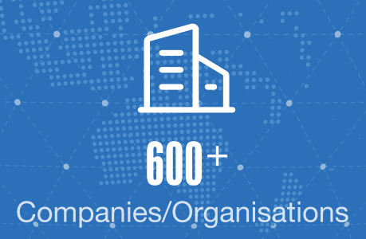
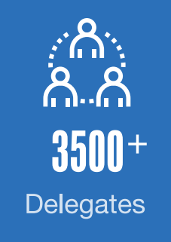
Delegates
You will meet 3,500+ delegates from 70+ countries and 600+ companies or organisations, covering the entire gas value chain.
Meet global senior technical, commercial and strategic executives.
The delegate registration is expected to start in May, 2024.

Slide 26
Highlights
Showcase cutting-edge technology & innovation
Advance with the trend
Engage with Stakeholders
Consolidate leadership position
Expand social network
Exchange industry insights
PLATFORM

