Slide 1
Transparency obligations: success story of a joint transparency platform of AGSI

Slide 2
Transparency obligations
1
2
AGSI transparency platform
Success story
3
4
5
6

Slide 3
Transparency obligations
1

Slide 4
Transparency obligations
1 of the fundamental principles of EU energy law for storages:
resulting in a set of
transparent and non-discriminatory access to storages
TRANSPARENCY OBLIGATIONS

Slide 5
Transparency obligations
from non-biding rules of GGPSSO
into binding legislation e.g.:
Regulation (EC) No 715/2009 of the European parliament and of the Council on conditions for access to the natural gas transmission networks
Regulation (EU) No 1227/2011 of the European parliament and of the Council on wholesale energy market integrity and transparency
Council regulation (EU) 2022/2576 enhancing solidarity through better coordination of gas purchases, reliable price benchmarks and exchanges of gas across borders

Slide 6
Transparency obligations
obligations are vague e.g.:
make relevant information public
in particular data on the use and availability of services
in a time-frame compatible with storage facility users’ reasonable commercial needs
information on contracted and available storage capacities on a numerical basis on a regular and rolling basis and in a user-friendly standardized manner
in a meaningful, quantifiably clear and easily accessible way and on a non-discriminatory basis
subject to the monitoring of such publication by the national regulatory authority.

Slide 7
Transparency obligations
WHAT?
HOW?
HOW OFTEN?
NRA?
JOINT APPROACH
AGSI platform

Slide 8
AGSI transparency platform
3

Slide 9
AGSI transparency platform
https://agsi.gie.eu
Storage data covers all the countries of EU

Slide 10
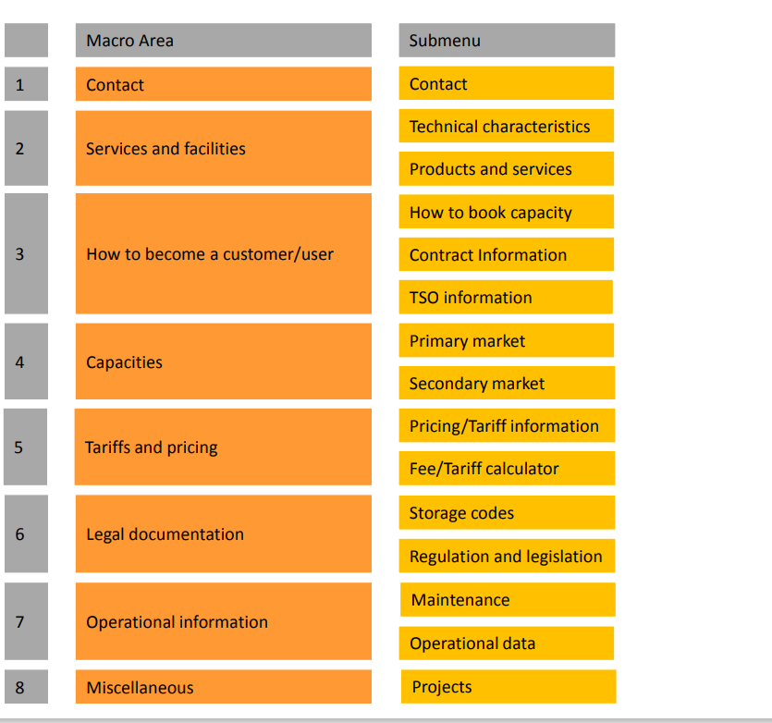
AGSI transparency platform
Transparency template already from 2013

Slide 11
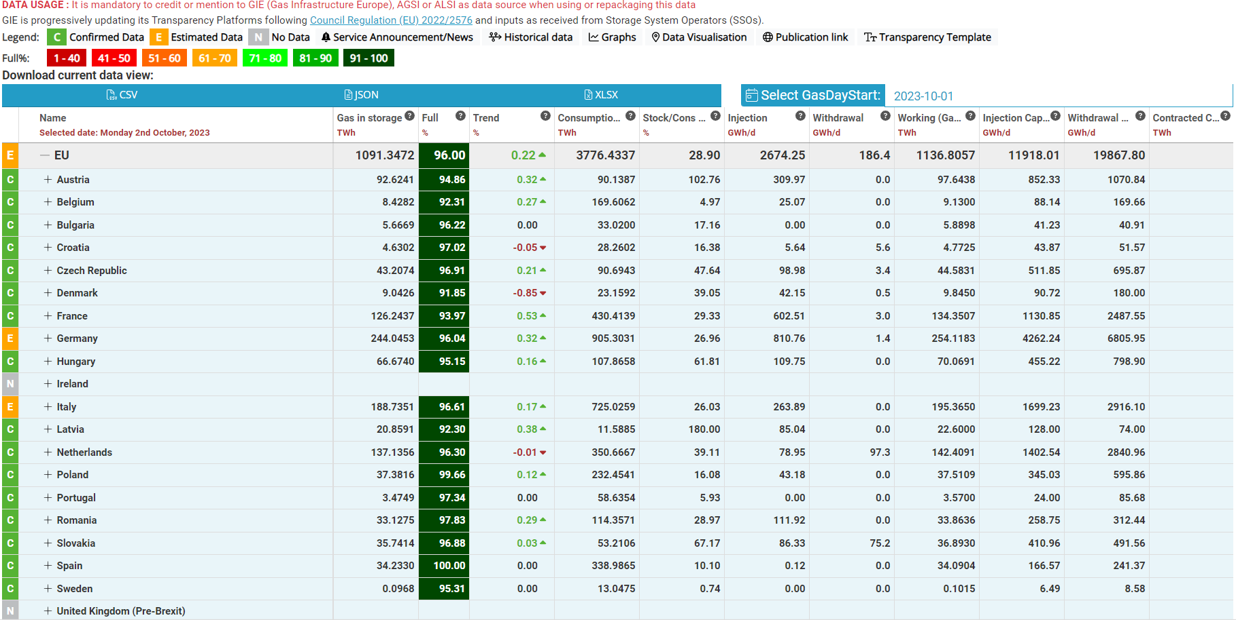
AGSI transparency platform

Slide 12
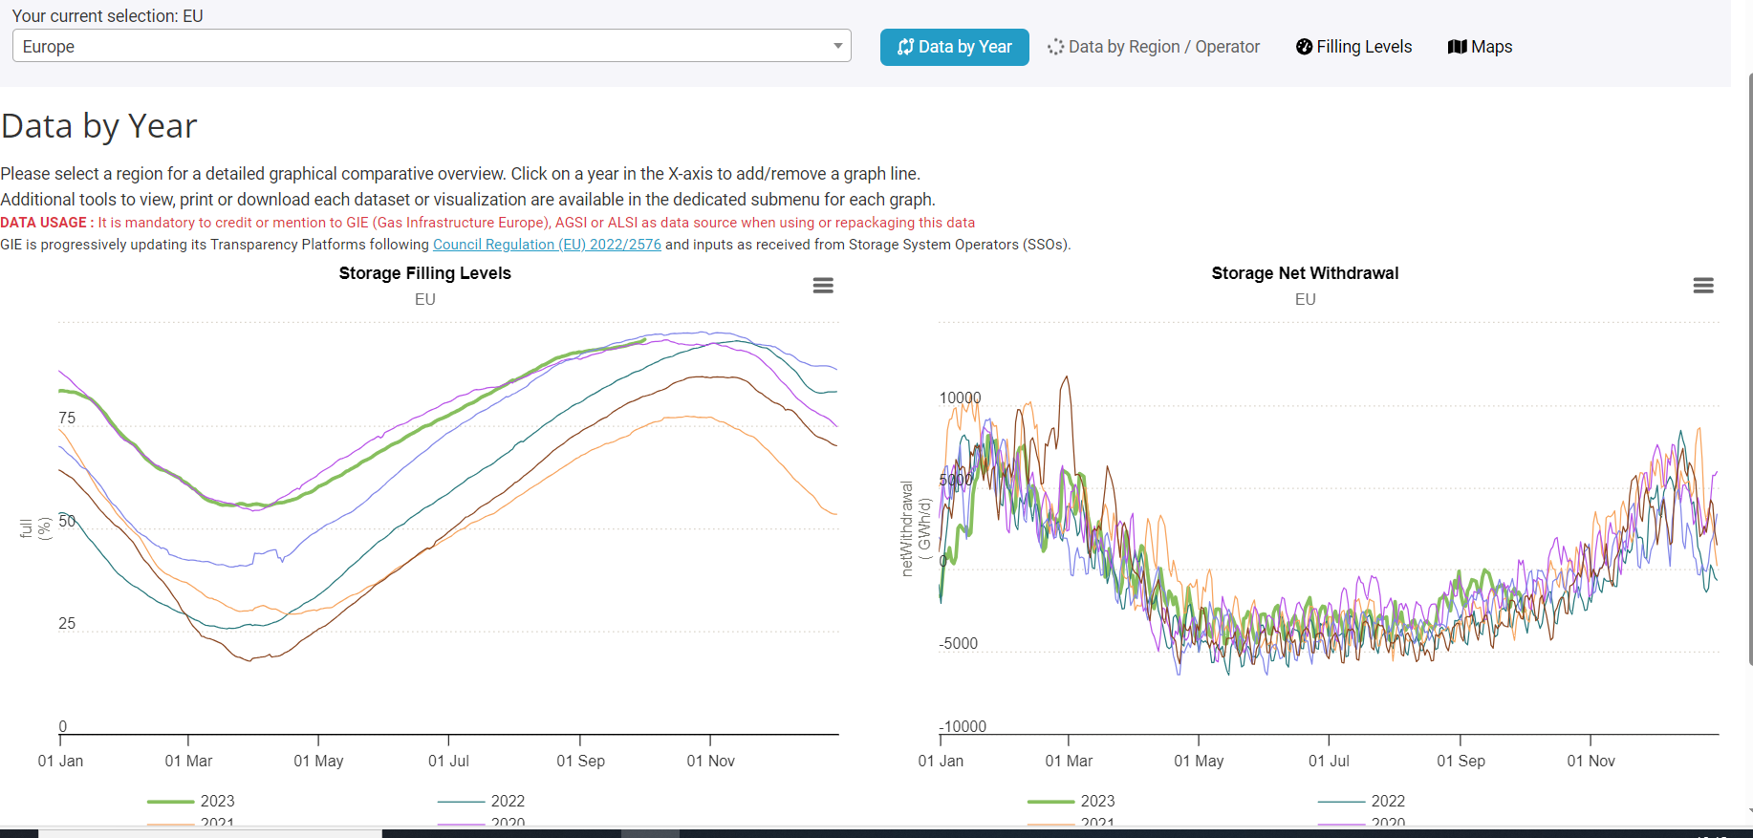
AGSI transparency platform

Slide 13
Success story
3

Slide 14
Success story
Council regulation (EU) 2022/2576:
„By 28 February 2023, LNG facility operators and gas storage facility operators shall publish all the information required by Article 19 of Regulation (EC) No 715/2009 on a European LNG Transparency Platform and a European Storage Transparency platform, respectively, in a transparent and user-friendly manner. Regulatory authorities may request those operators to make public any additional information relevant for system users.“
requirements on storage filling levels spike of 18,479 active users/1 day
AGSI traffic +212% vs 2022 May 2023 : ~6235 users/day – global

