Slide 1
NAFTAs IPCEI project – Project Henri
1.6.2023

Slide 2
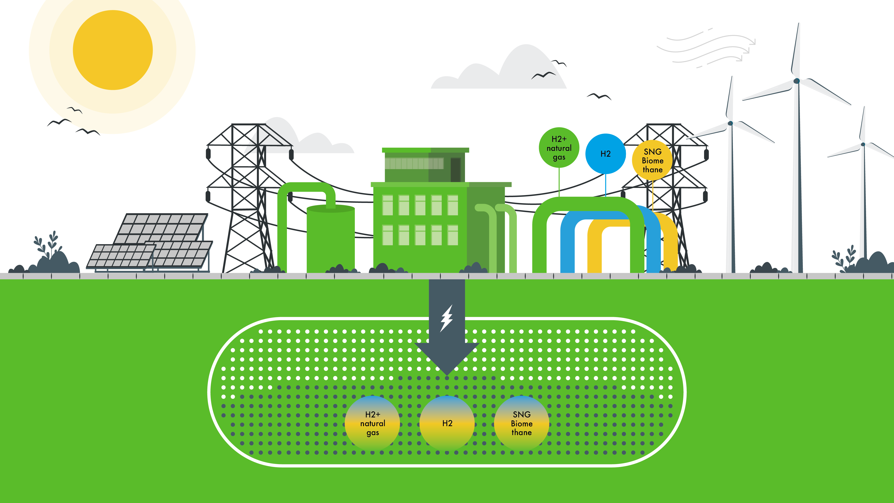
ENERGY storage – a centerPiece of the future energy system
STORAGE

Slide 3
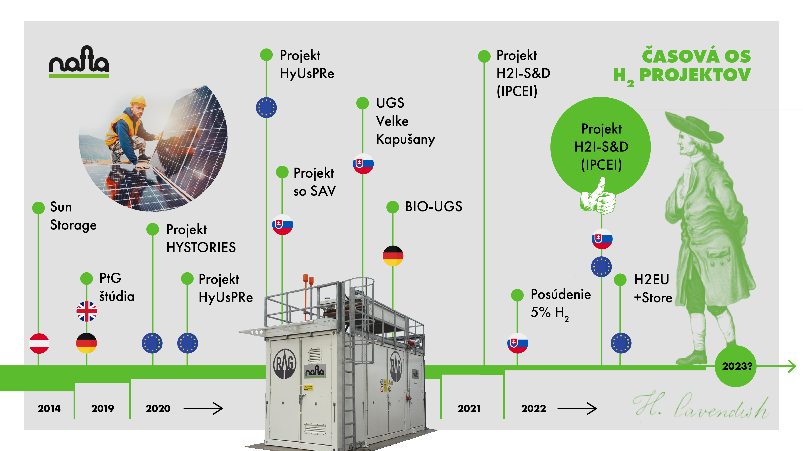
NAFTAS hydrogen timeline

Slide 4
Project henri introduction
First Slovak Hydrogen IPCEI project („Important Project of Common European Interest“) – Hy2Tech wave
Evaluation by EC started 9/2021 finished 8/2022
Project started 11/2022 and will finish 12/2029 (2. phase)
Fist general assembly of the Hy2Tech & Hy2Use (3/2023) - Berlin

Slide 5
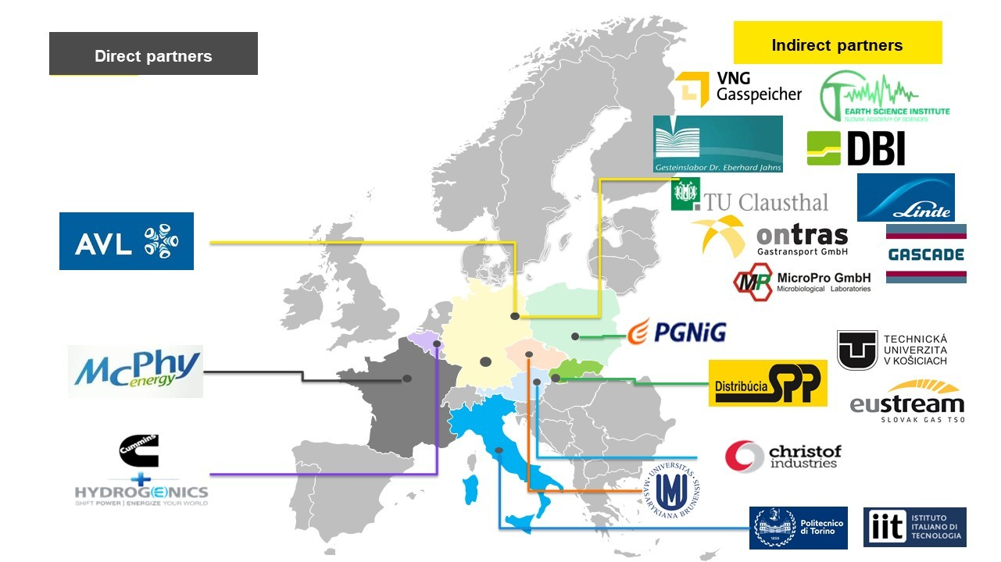
Project Henri
Definition of methodology for reservoir assessment
Identification of suitable structure for storing of H₂ in Slovakia
Based on R&D phase definition the max suitable H₂ storing concentration
Pilot technology for confirmation the research at real condition

Slide 6
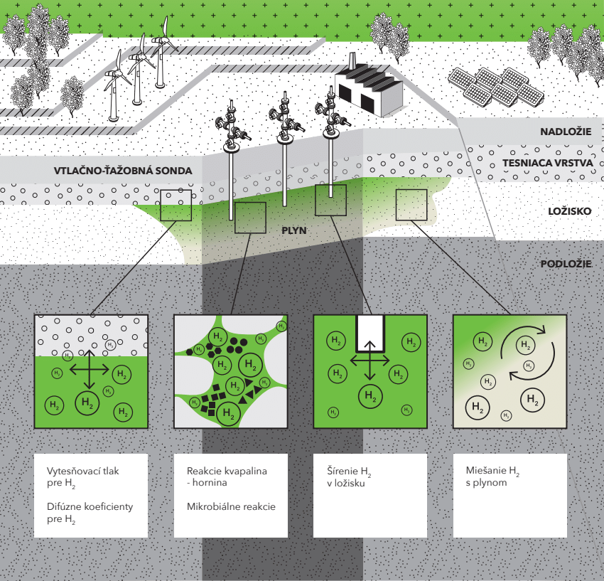
Project H2I-S&D
Project Duration: 2022 – 2029 (based on call)
R&D phase
FID phase
Laboratory experiments
Geochemical interaction
Microbial interaction
Testing of materials
Modelling of the reservoir
Building the technology for H₂ production and related storing technology
Testing the H₂ purification technology

Slide 7
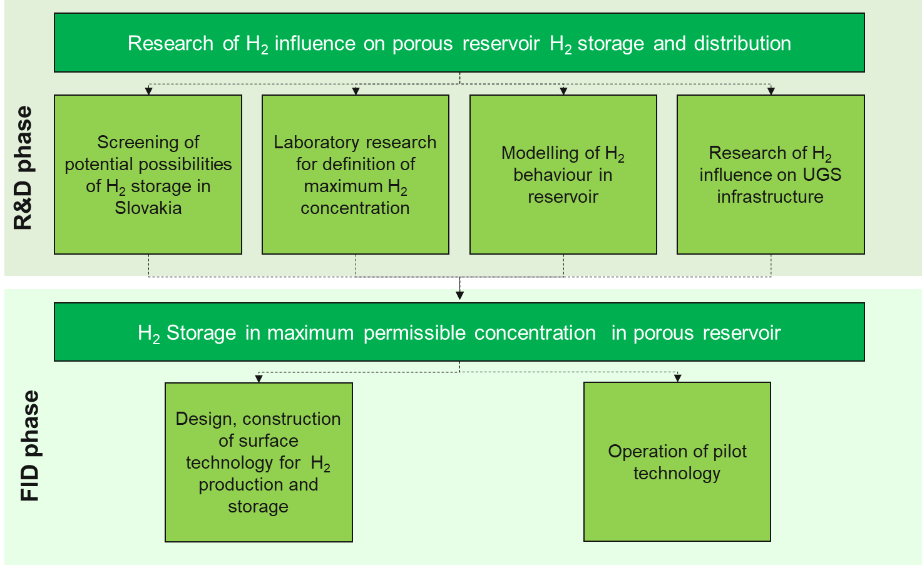
Project H2I-S&D Working packages

Slide 8
Screaning of potential possibilities of H2 storage in Slovakia
Development of methodology for reservoirs assessment
Preselected structures for laboratory experiments
Database and map will be created

Slide 9
Laboratory experiments
Testing of reservoir rock:
Storage and exposure of core samples to hydrogen at different % of H2
Petrographical characterization
Gas permeability and water permeability measurement
Composition of gas and water phase measurement
Different pressure, temperature, water salinity
Different pressure, temperature, water salinity
Testing of cap rock:
Threshold pressure measurement for H2
H2 diffusion coefficient measurement
Test at several hydrogen concentration

Slide 10
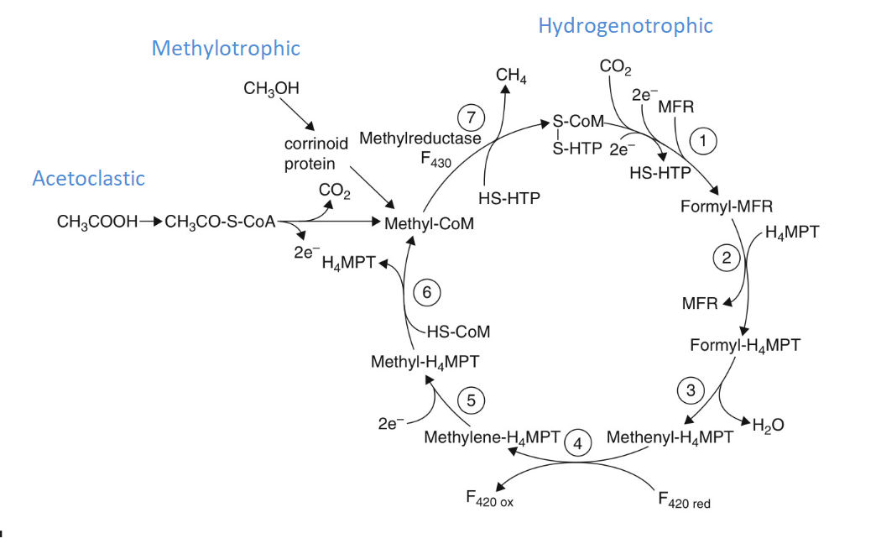
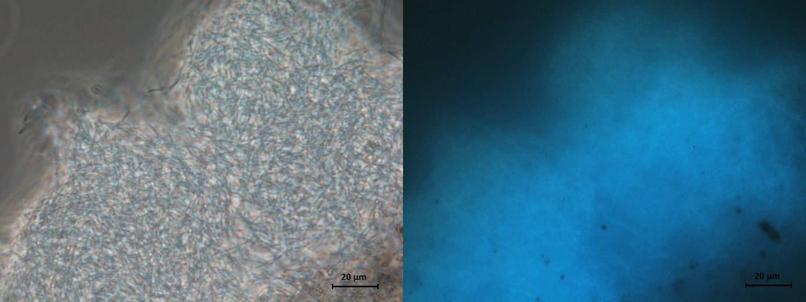
Laboratory experiments
Microbial activity
Identification of bacteria / archaea presented in reservoir
Simulating the reservoir condition to define microbial reaction which will occur
Tests will be done at original reservoir water samples
pH measurements, composition of gas and water phase
Initial and maximum microbial density
Cell number before and after experiment
Test will be done at several H2 concentration

Slide 11
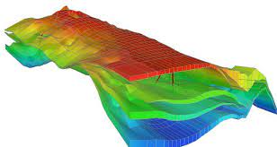
Modelling of h2 behaviour
Geochemical model will be created
H2 impact to reservoir rock
H2 impact to Cap rock
Reaction with reservoir fluid
Microbiology
Model will predict the H2 behaviour in the reservoir - will be verified during the FID phase

Slide 12
Research of H2 influence to UGS
Material testing
Testing of steels and sealing materials
At real storage condition (worst condition) – temperature, pressure, methanol, hydrocarbons, wet gas etc...
Description of the test is in discussion
Cement testing
Measurement of gas permeability
Microscopic investigations
X ray diffraction and Energy dispersive X ray spectroscopy
Test at several H2 concentration and different conditions (pressure, temperature, salinity)

Slide 13
Outcomes from R&D
Selected structure for 2. phase of the project (FID phase)
Defined performance parameters of selected structure:
WGV
Injection / withdrawal rate
H2 concentration etc.
Model simulating H2 behaviour
Design of the surface facility for 2. phase of the project

Slide 14
FID phase

Slide 15
Thank you
Contact:
Roman Zavada
Head of Innovation Unit
roman.zavada@naft.sk

