Slide 1
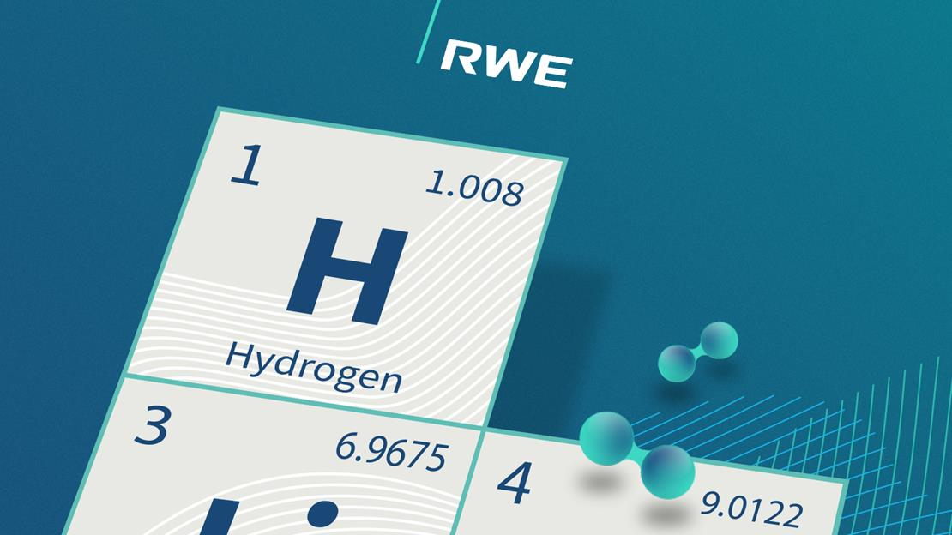
H2 Readiness
RWE Gas Storage CZ, s.r.o.
Petr Goluch

Slide 2
Task and goals
Surface technology, well completion and reservoir need to be assessed in terms of materials and processes. And finance.
Assessed H2 content in NG*
2 %
10 %
20 %
50 %
98 %
4 main areas
Materials
Processes
Reservoir
Legislation
Means of assessment
Literature research
OEM’s consultations
In-house process calculations and know/how
Tests, research, cooperation
* hereinafter H2 content in % mol.
Stránka 2
Pilot UGS: Dolní Dunajovice - analogical to other storages

Slide 3
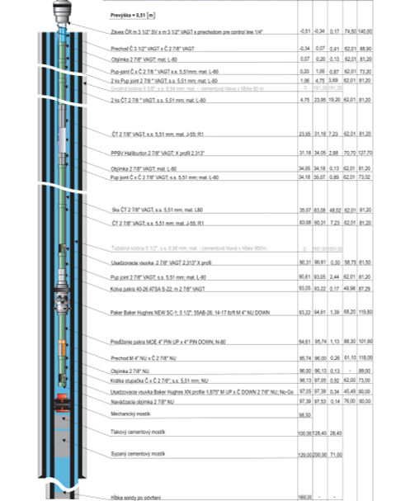
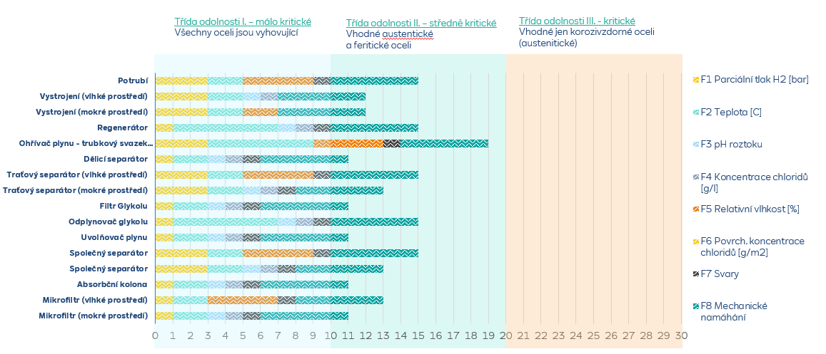
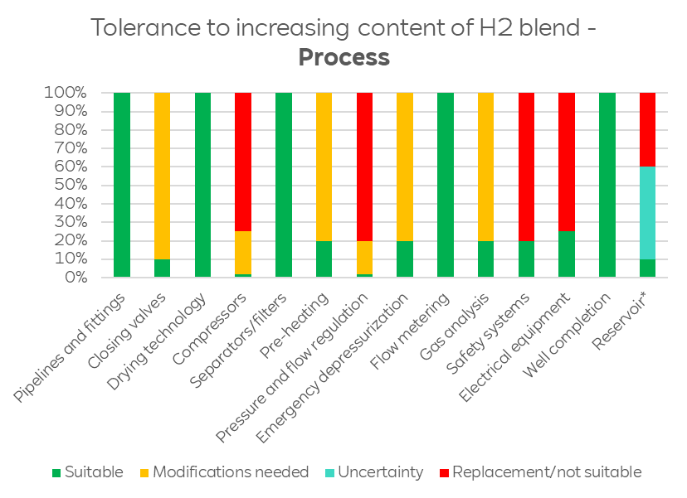
Technical readiness
Technical readiness: materials, processes and reservoir determine % of H2 also in economical point of view
Materials
Assessment of materials for tolerance of H2/blend environment, including influence of specific chemical substances as mining water, TEG..
hydrogen embrittlement of steel materials
gaskets, sealing materials
Processes
Assessment of key processes as
gas compression
dehydration
metering, regulation, heat exchange
detection systems, emergency depressurization
Reservior, wells
Assessment of
reservior and well integrity
geochemical interactions
change of GIP/WGV (volumetric/energetic)
reservoir methanation

Slide 4
Legislation readiness
Hydrogen legislation: 2-5 % probably permitted from 2025
Czech legislation | EU Legislation
H₂ currently missing in the legislation & not measured in the gas network Key legislation to be amended: Energy Act, Decree on Measuring, Mining Legislation Proposal to suggest probably max. 2% H₂ Approval & application not before 2023 | Proposal for EU Gas & H₂ Market Regulation: 1 October 2025 readiness for 5% H₂ Approval expected in 2023
Technical Standards
Czech standards for gas industry (ČSN, TPG) not yet solving H2 applications International standards exists (API, EIGA, ASME, DVGW)
Stránka 4

Slide 5
Planned and on-going tests
Tests to verify predictions and literature research results are being performed
Area | Item | Objectives | Goals | Status
Surface technology | Material testing | To test selected suspicious steel materials for H2 embrittlement in cooperation w. Chemical Institute in Prague and Academy of Science – laboratory and long-time autoclave testing | Verify selected steel materials and propose measures (lifetime, conditions) | On-going
Surface technology | Gasket testing | To conduct tests of gakets in laboratory conditions w. Chemical institute in Prague | Observe tightness of commonly used gaskets for mixture of NG+H2 | Finished
Reservoir | Field test at Dunajovice well | To conduct real test on Dunajovice so far unused lentil (now floaded). Pre-project: N2 test; then inject and cycle mixture NG+H2 (5-15%) | Observe behaviour of mixture NG+H2 in real conditions – tightness, microbiological methanation, influence on well completion | On-going (on NG)
Reservoir | Reservoir and H₂ geochemical interactions | To describe geochemical interactions based on laboratory experiments and geochemical modeling | To quantify H₂ losses due to geochemical interactions, To describe possible poro/perm changes | On-going
Well completion | Field test at Tvrdonice well | To conduct real test on Tvrdonice well being worked-over and plugged to be separated from reservoir | Observe influence of mixture NG+H2 in real conditions on well completion and its tightness (tubing, casing, cement, packer, SSSV, x-mass tree) | Permitted and on-going
Stránka 5

Slide 6
Summary
First results show that we can store certain % of H2* without excessive complications/modifications
H2 content
0 %
no adjustments needed
%
minor adjustmenst needed, reservoir risks hard to predict but most likely acceptable
%
geological risks increasing
20-25 %
break-even - some materials with unacceptable risk, technology to be replaced, some electrical equipment not meeting ATEX (>25%), increased geological risks
50 %
further increase of material and geological risks (replacement of surface technology, well completion?)
98 %
100 %
Storage facilities are analogical. Most differencies are in technology (compressors) and in geology is different (Lobodice – aquifer, Háje – cavern)
Stránka 6

Slide 7
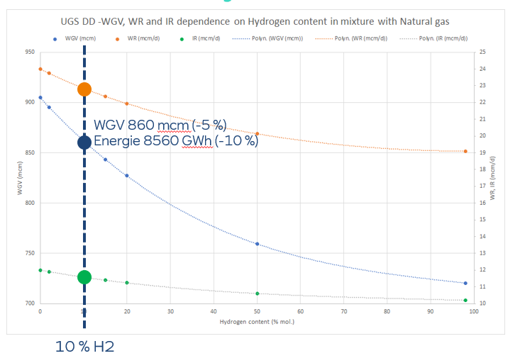
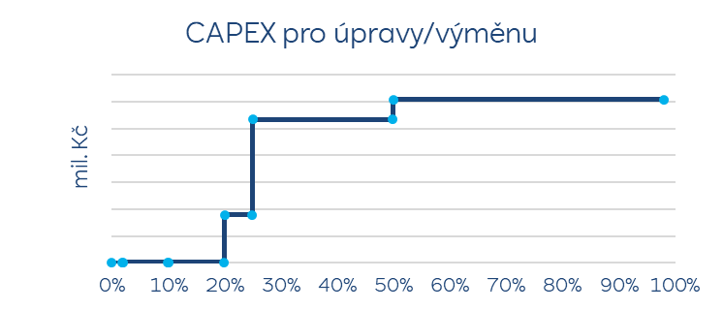
Summary
H2 will have impact on volumetric and energetic balance of UGS and impose necessary investments and costs
Volumetric and energetic balance: less volume and even less energy to be stored at currect conditions. Contrary to requirements for H2 Storage in governmental strategies
Example
CAPEX will extremely rise when reaching break-even point.
Revenues will decrease and costs likely to increase with current economical model for NG/H2 blend storage.
CAPEX
Example

Slide 8
Thank you for your attention.

