Slide 1
Energy storage initiatives at Hungarian gas Storage
IGU Spring Storage Committee Meeting
Brno, Czech Republic
30 May – 2 June 2023

Slide 2
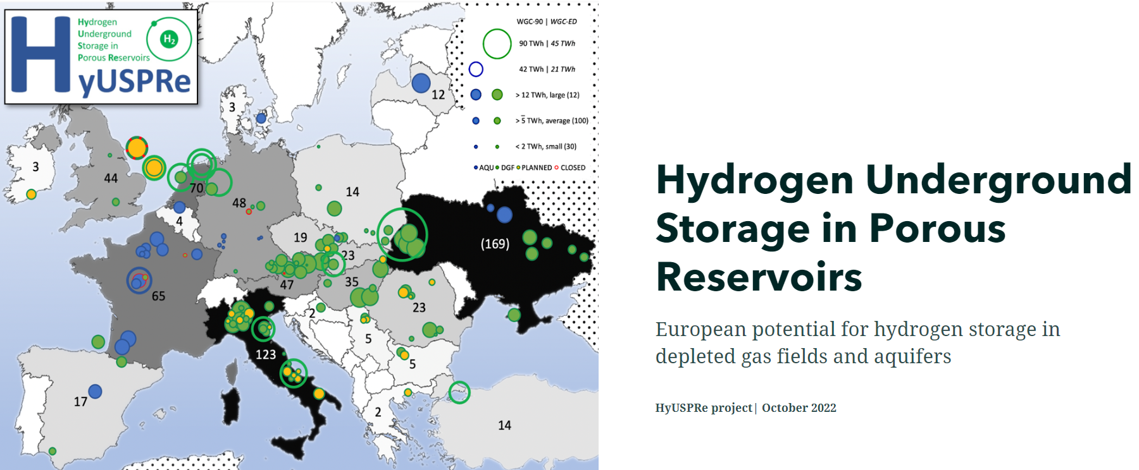
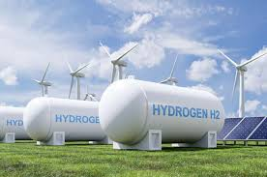
Energy storage initiatives I Nora Liszkai - HGS
HGS and its involvement in hydrogen
Main activities
Underground gas storage operations
Regulated activities (Mining authorities, Hungarian Energy Authority, Emergency management)
Flexibility services provider: Demand-supply balancing operations
4 gas storage sites in Hungary
Total of 4,4 bcm working gas capacity (HU gas consumption cca. 10 bcm/year)
Sole shareholder: MVM Energy (100% state owned company)
Hydrogen activities
+
After 2030
Large scale and seasonal electricity balancing
by underground storage of H₂
EUH₂STARS
Consortium led by RAG Austria AG
Application for funds under Horizon EU
Demonstrate underground hydrogen storage in depleted porous natural gas reservoirs
Hajdúszoboszló
Pusztaederics
Kardoskút
Zsana
2

Slide 3
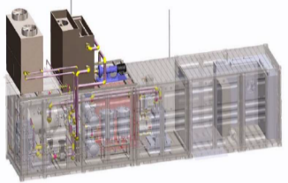
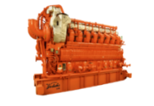
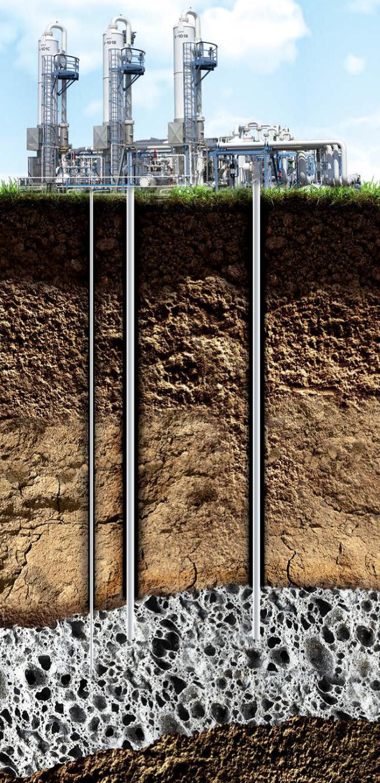
Energy storage initiatives I Nora Liszkai - HGS
Background of Aquamarine – Flagship project
Idea (2018-2019): to broaden storage services with hydrogen based energy storage
First step: Project Aquamarine - State support in 2020
Goals:
To test surface process system on hydrogen tolerance
by installing a H₂ production unit with all necessary auxiliaries and
By carrying out supportive research programmes
Timeframe:
Start: 1st February 2021.
Duration: 2 years
Budget:
Initial HUF 3 bn (~EUR 7.9 million)
State support: cca. 65%
Research partners: 4 Universities and R&D Center
INITIAL PLAN
PVs
Power plants
Wind turbines
Power grid
Electrolizer (2,5 MW)
H₂
O₂
Energy usage
1 Feb 2021 – 31 Jan 2023
Injection into the reservoir
2023-2025
As fuel in the compressors
Injection into the transmission system

Slide 4
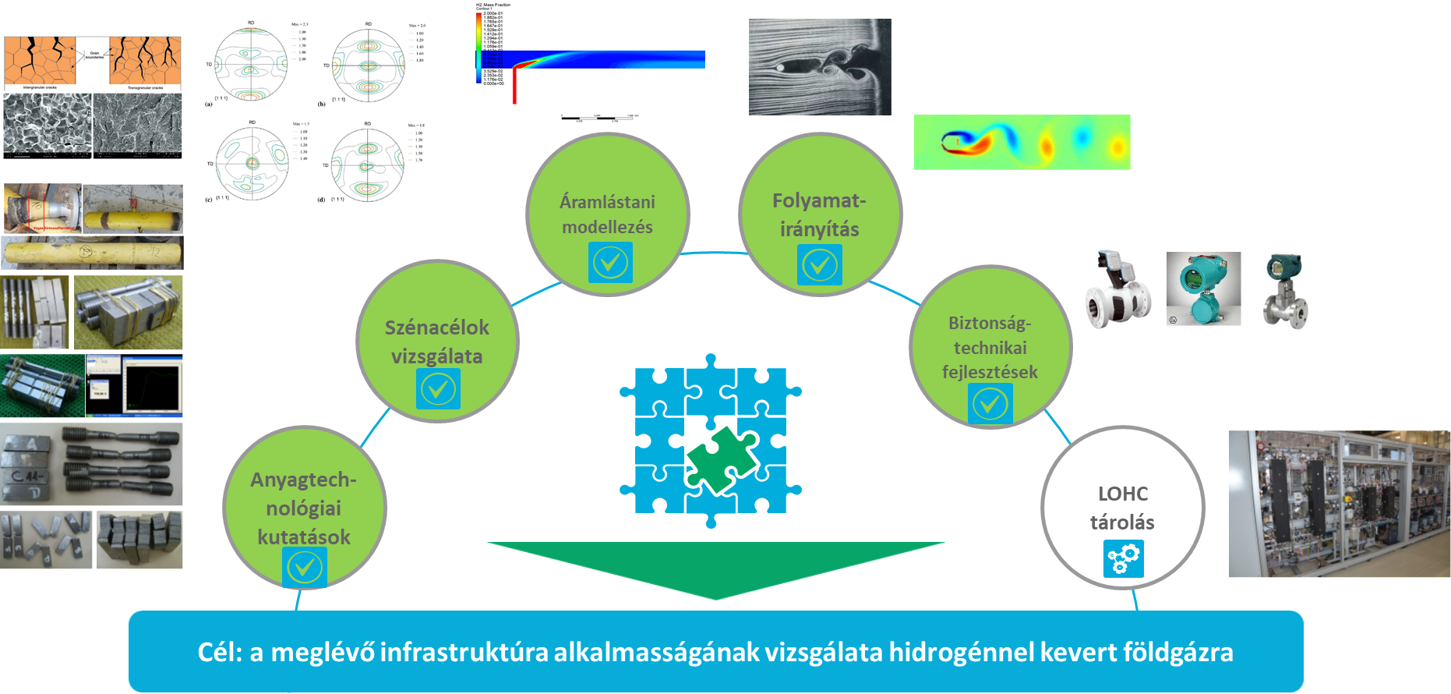
Energy storage initiatives I Nora Liszkai - HGS
Research Programme
Hydrody-namic modelling
Process controll
Testing of carbon steels
Safety & technical improve-ments
Research of materials
LOHC storage
Aim: analyzing existing infrastructure’s tolerance against H₂ and methane blend

Slide 5
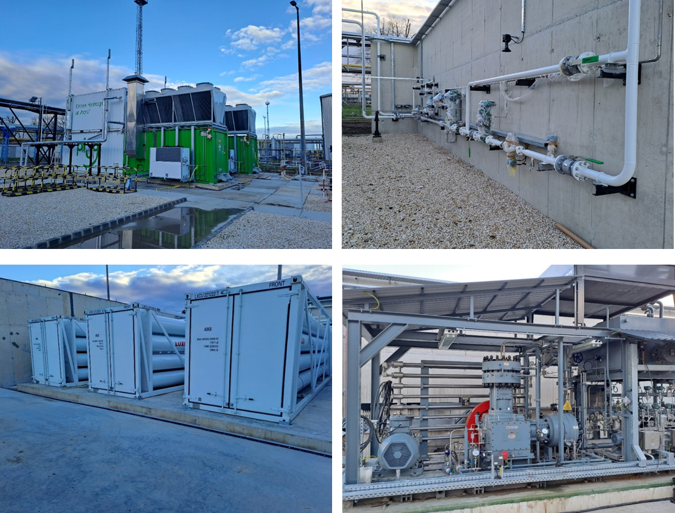
Energy storage initiatives I Nora Liszkai - HGS
As of today
Construction
H₂ production test phase until: 31st July 2023 - max. 400m³/h
Current activities: commsissioning of main& auxiliary equipment, functional tests, final tightness tests before operation
Agreement for joining MVM Partner’s balancing center is ongoing
Extras:
Tanker truck filling facility
Contract with Messer as offtaker of H₂
Additional services ready for sale
Cost overrun compared to 2020 spring cost expectations: ~93%

Slide 6
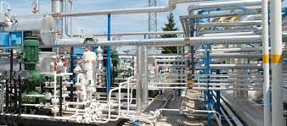
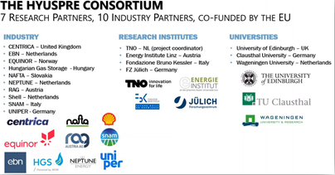
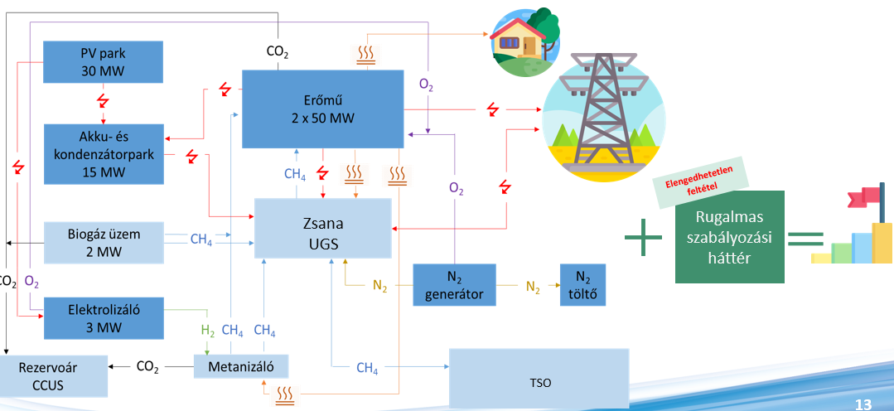
Energy storage initiatives I Nora Liszkai - HGS
Accomplishing our mid-term strategy
Gas storage
Aquamarine
Aquamarine +
Flexibility
Optimalisation
Security of supply
HyUS-PRE
2 MW electrolyser
R&D
Pilot / Flagship project
+
LOHC technology
SEASONAL ENERGY STORAGE
+
Compressor control technology
EUH₂Stars
+
Coating processes
RRF Projects
+
R&D and Training center
Consortia with the lead of RAG Austria AG
Horizont EU – Funding
TRL 8 demonstration project for large scale hydrogen storage in porous reservoirs
Proejcts to establish complex energy storage

Slide 7
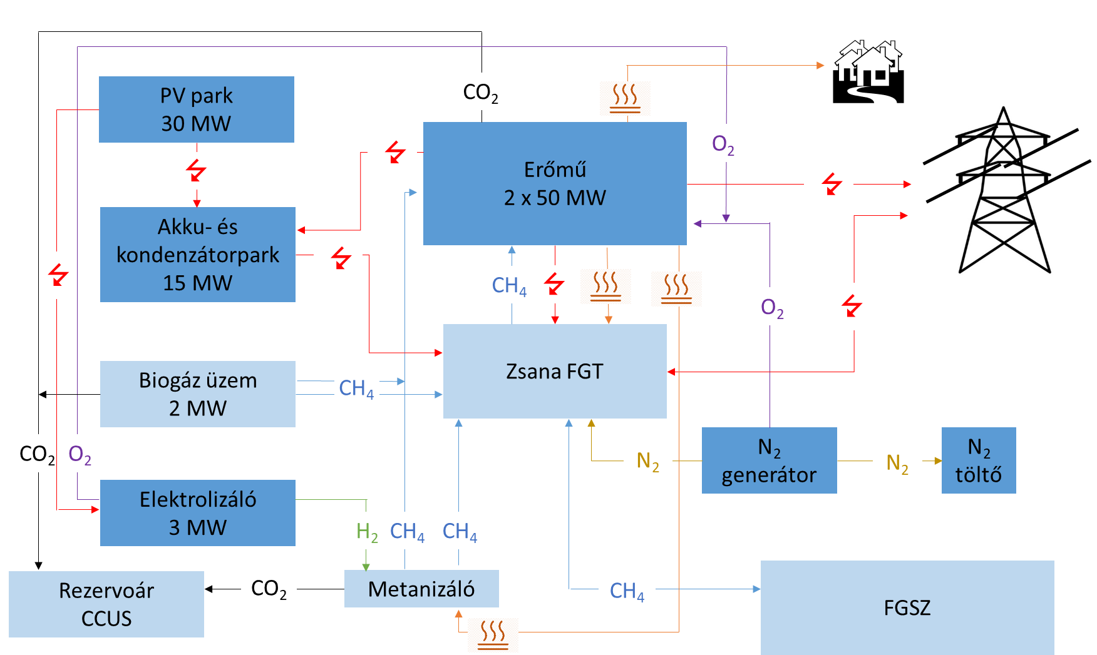
Energy storage initiatives I Nora Liszkai - HGS
The future - Innovative solutions for a complex energy community
Complex pilot energy community with the utilisation and storage of renewable energy at one of our underground gas storage site (Zsana) which could be a base of the wide-spread application of such an innovative energy storage solution
Power plant
2 x 50 MW
Accu and condenser park
15 MW
UGS
Biogas facility
2 MW
N₂ generator
N₂ charger
Electrolyser
2.5 MW
Reservoir CCUS
Methanisation

Slide 8
Key role of underground hydrogen storage I Nora Liszkai
Thank you for your attention!

