Slide 1
Latest news in EU CH4 emission regulation, impact on UGSs
2023.06.01

Slide 2
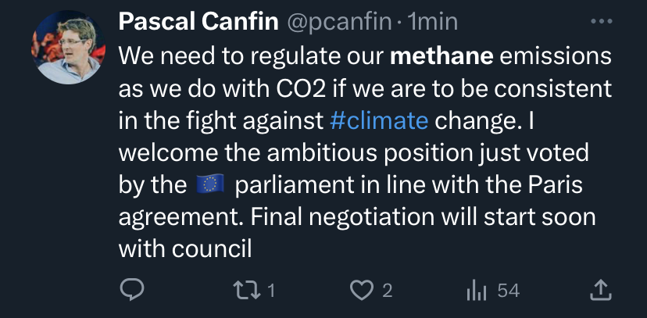
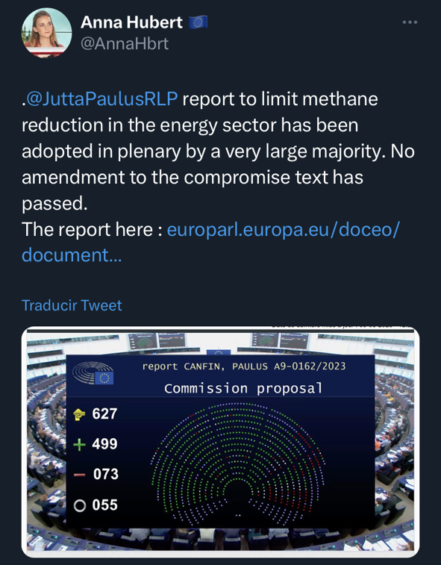
New CH₄ emission regulation was approved by EU Parliament on 10/5/2023
Results of the Parliament vote: 499 in favor, 79 against and 55 abstentions.
No amendments from the EPP passed
Press release from the EU Parliament
After the vote the rapporteur, Jutta Paulus (Group of the Greens/European Free Alliance, DE) said: "Today's vote is a commitment to more climate protection and energy sovereignty in Europe. Without ambitious measures to reduce methane emissions, Europe will miss its climate targets and valuable energy will continue to be wasted. We call for ambitious and stringent methane reduction measures. In the energy sector, three quarters of methane emissions can be avoided through simple measures and without large investments. As Europe imports more than 80% of the fossil fuels it burns, is essential to expand the scope to energy imports."

Slide 3
New CH₄ emission regulation was approved by EU Parliament on 10/5/2023
From the press:
  Lawmakers defeated an effort by a clutch of conservative MEPs to weaken the Parliament’s stance.
  Tighter rules for monitoring emissions, as well as more stringent leak detection and repair (LDAR) requirements to tackle leaky fossil fuel infrastructure.
  The Parliament also asked the Commission to come up with a framework to ensure exporting countries have to abide by similar rules.
  This bill will be the bloc’s first legislation, while countries such as Canada, the United States or Nigeria already have frameworks in place. Companies in the U.S., the other Global Methane Pledge founder, will have to pay for excessive methane emissions from next year, for example.
  Targeting the energy sector is relatively cheap and easy compared to tackling agriculture — which is responsible for more than half of EU methane emissions — or waste, responsible for about a quarter.

Slide 4
1
Measurement, reporting, verification
2
Leak detection and repair
3
Venting and flaring
4
Cost estimation

Slide 5
Measurement, reporting, verification
1

Slide 6
Measurement, reporting, verification (Article 12)
Collection of methane emission data across whole gas chain and EU countries MRV (measuring, reporting, verification) is implemented. It should be done according OGMP 2. methodology.
Competent authorities of each member state should perform inspections the first inspection should be completed 18 21 months after the date of entry into force of the Regulation
Reporting and methodology must be checked by independent and accredited verifiers
Data on methane emissions will be accessed to IMEO (International Methane Emissions Observatory)
Operators should submitt their methane emission data report on operated assets:
  calculated based on generic emission factors for each source latest 18 10 months after the date of entry into force of the Regulation,
  based on source level measurement and specific emission factors latest 24 12 months after the date of entry into force of the Regulation,
  based on source level measurement complemented by site level measurement latest 36 months after the date of entry into force of the Regulation

Slide 7
Leak detection and repair
2

Slide 8
New EU regulation on CH4 emission implementations
Leak detection and repair (LDAR) approach is implemented by the Regulation
Operators shall submit a LDAR programme to the competent authorities latest 6 months after the date of entry into force of the Regulation
Operators shall carry out LDAR survey according LDAR programme latest 12 9 months after the date of entry into force of the Regulation
  Aboveground components: 17 g/h, every 2 months, at the level of each source
  Aboveground components: 50 ppm or 1 g/h, every 4 months, at the contact of each source
  Underground components: 500 ppm or 5 g/h, every 5 months
Operators shall repair or replace all components found to be emitting of methane at standard temperature and pressure in 30 5 days for a 1st attempt, then in 30 days with proper explanation to the Authority. In case of the leaky equipment requires downtime or due to other mentioned serious issues it should be repaired within one year.
Post repair inspection is required in 30 days after repair and report must be elaborated

Slide 9
Venting and flaring
3

Slide 10
Venting and flaring
venting and flaring is allowed only in given situations (further details ref. Article 15):
  in case of an emergency or malfunction; and
  during normal operations of pneumatic devices and pumps, dry gas seals, compressors, atmospheric pressure storage tanks, or other components designed to vent, provided that the equipment meets all the specified equipment standards established pursuant to paragraph 5b, and is properly maintained and regularly inspected to minimise methane losses
  during gauging or sampling a storage tank or other low-pressure vessel
  during loading out liquids from a storage tank or other low-pressure vessel to a transport vehicle in compliance with applicable standards
  during repair, maintenance, testprocedures and decommissioning,including blowing down and depressurizing equipment to perform repair and maintenance
operators shall vent only where flaring is not technically feasible
  due to lack of flammability, inability tosustain a flame, safety concerns, when the environmental or climate impact of mitigation measures is higher than the benefit, or when it risks endangering safety of operations or personnel. In such a situation, as part of the reporting obligations operators shall demonstrate to the competent authorities the necessity to opt for venting instead of flaring

Slide 11
Venting and flaring
where non-emitting alternative equipment is available to the equipment that vents, it shall replace that equipment by 31 December 2026!
flaring shall only be allowed where either re-injection, utilisation on-site, gas processing, or dispatch of the methane to a market are not feasible for reasons other than economic considerations.
  Venting and flaring reporting, Operators shall notify the competent authorities of venting and flaring events no later than 48 hours:
  caused by an emergency or a malfunction; or
  lasting a total of 8 hours or more within a 24 hour period from a single event
Controlled flaring that occurs during shutdowns shall be reported in the annual report.
Flares must be checked monthly

Slide 12
Cost estimation
4

Slide 13
Costs estimation of increased LDAR survey freqencies at source level
In April 2022 and in Feb 2023 company The Sniffers was ordered to quantify fugitive CH₄ emissions at the biggest UGS Dolni Dunajovice (38 000€)
After OGI Flir camera qualitative screening of whole above ground facility high flow sampler was used for quantification of detected leaks. It required bagging of the relevant part of thechnology (armatures, flange connections, …).
Doing this every 2 months externally: 38 000 x 6 = 228 000 €/y, 1 368 000 €/y for our 6 UGS roughly
This is just for LDAR survey, costs of repair are not included…

Slide 14
Abatement costs example from DSO
Example of a valve leaking in a low pressure valve station (source: Gasunie)
Leak size: 17 g/h
Annual leak: 150 kg ~ 4,200 kgCO2eq
Similar to the impact of 2 European household‘s annual gas consumption
In 50 years, the total emission would be 7,5 tCH4
Repair costs: 500,000 € (management, engineering and supervision, permitting, materials, construction, management of surroundings and the (societal) costs of emissions caused by the repair or replacement)
Abatement costs: 67,000 €/tCH4
Societal cost¹: 3,500 €/tCH4
¹From EC's Impact Assessment
14

Slide 15
Penalties
Member States shall lay down the rules on penalties applicable to infringements of the provisions of EU CH₄ emission regulation and shall take all measures necessary to ensure that they are implemented.
Member States shall notify the rules on penalties to the Commission by 12 months from the date of entry into force of the Regulation

Slide 16
Further steps
Try to influence result from Trialogue
2-4 pager/position paper to react on EU regulation addopted by EU parliament will be prepared
Influence the Council on national level on individual basis
Trialogue will not be started during Swedish EU presidency more likely Spanish
Expected EU Regulation entry into force mid of 2024

Slide 17
Further comments
Remarks (position papers, change proposals) from industry via GIE/Marcogaz/Eurogas/GERG/Entsog to CH₄ emission regulation were not reflected by EU Parliament and Commission
Some non profitable organizations and some service providers has/had full control on EU regulation prescriptive shape
IGU was totally absent in that process and no Voice of gas was heard
The Intention and commitment of CH₄ emission decreasing from industry was shown just foccus on real emission decreasing instead of administrative and economical burden behind this Regulation

Slide 18
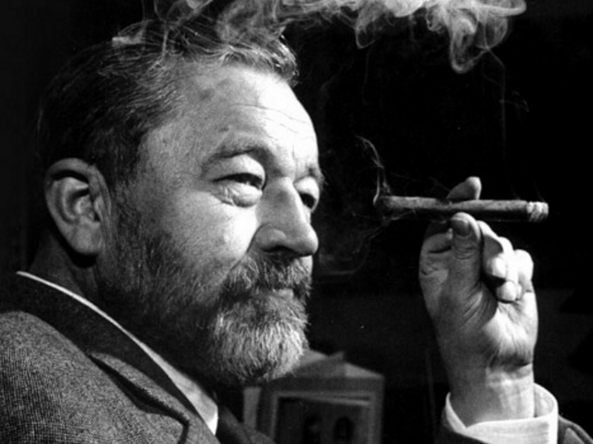
We must fight against stupidity but we will never win…
Jan Werich

