Slide 1
reducing natural gas emissions at nafta
Lukáš Andelek

Slide 2
why reduce emissions?
  Legislation – fulfillment of the new EU regulation after entry into force,
  Ecological effect – elimination of greenhouse gas emissions,
  Increased operational safety – elimination of natural gas venting as a dangerous substance,
  Economical effect – operation without gas losses.

Slide 3
Milestones
2010
expansion of data collection of natural gas emissions
2010s
refining the measurement methodology, analyzing the sources
2018
discussions of emission reduction systems
2020-21
two independent studies have been done
2021-22
implementation of N2 purge system on two compressor units
2022
basic design documentation for capturing system for three units
2023
FID for capturing system
2024
implementation of the emissions capture project

Slide 4
Main sources of emissions
Main sources of natural gas emissions in compressors
Depressurization
Purging of the compressor
Seal gas venting
Gas starter
The compressor units as the biggest source of natural gas emissiens
Average emissions by source (2015-2022)

Slide 5
Milestones
2010
expansion of data collection of natural gas emissions
2010s
refining the measurement methodology, analyzing the sources
2018
discussions of emission reduction systems
2020-21
two independent studies have been done
2021-22
implementation of N2 purge system on two compressor units
2022
basic design documentation for capturing system for three units
2023
FID for capturing system
2024
implementation of the emissions capture project

Slide 6
How can we prevent the necessity of purging?

Slide 7
Compressor emissions

Slide 8
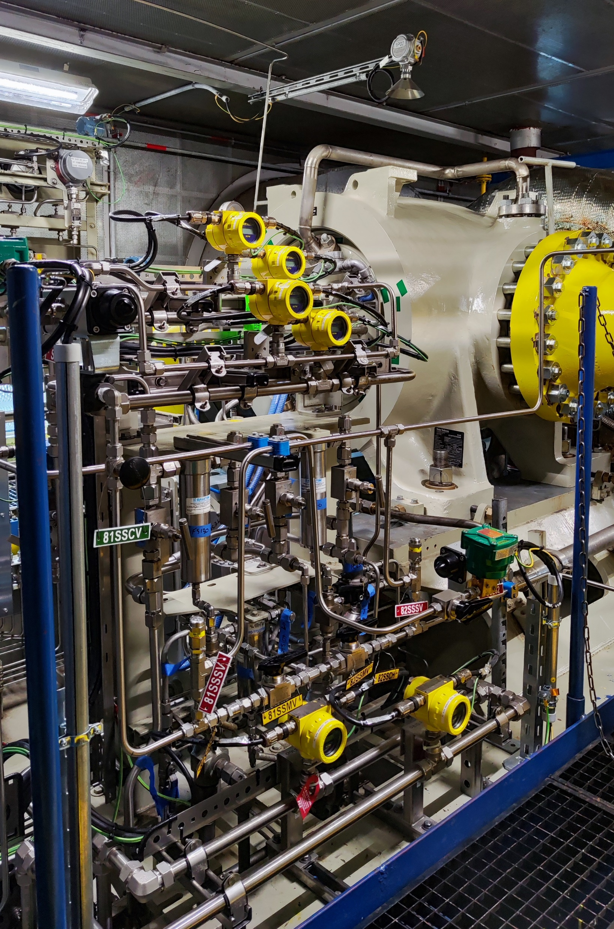
Project description
Challenges
How to prevent the possibility of an explosive atmosphere inside of the compressor?
How to operate this system reliable and safely?
Tasks
Depressurization to a required overpressure
Subtitute natural gas with inert gas
Keep stable overpressure inside the compressor case
Depressurization in case of emergency
SW/HW implementation

Slide 9
n2 purge
Summary
Elimination natural gas emissions during the start-up
Identification of possible leaking valves
Pressurized hold for months
Compressor is protected against corrosion
Gained know-how

Slide 10
Milestones
2010
expansion of data collection of natural gas emissions
2010s
refining the measurement methodology, analyzing the sources
2018
discussions of emission reduction systems
2020-21
two independent studies have been done
2021-22
implementation of N2 purge system on two compressor units
2022
basic design documentation for capturing system for three units
2023
FID for capturing system
2024
implementation of the emissions capture project

Slide 11
How can we prevent all vented emissions?

Slide 12
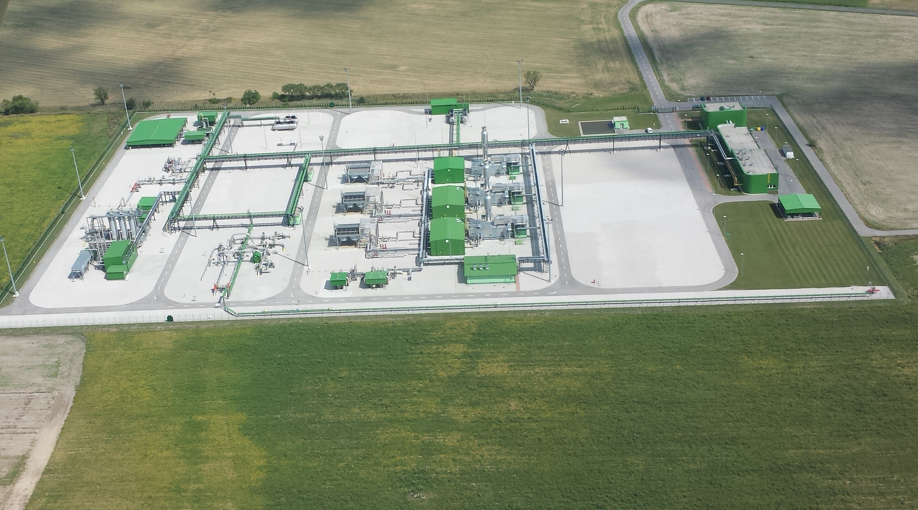
Central Area of UGS Gajary – báden (CAG)

Slide 13
Capturing system in CAG
Challenges
How to capture the emissions from two sources and prevent the necessity of purging?
How to implement this system for three compressor units (five compressors in total)?
Depressurization time, safety, variability, ...
Tasks
Prevent the necessity of the purging
Depressurization without emissions
Capturing the dry gas seal vents
Variability and safety of the system operation

Slide 14
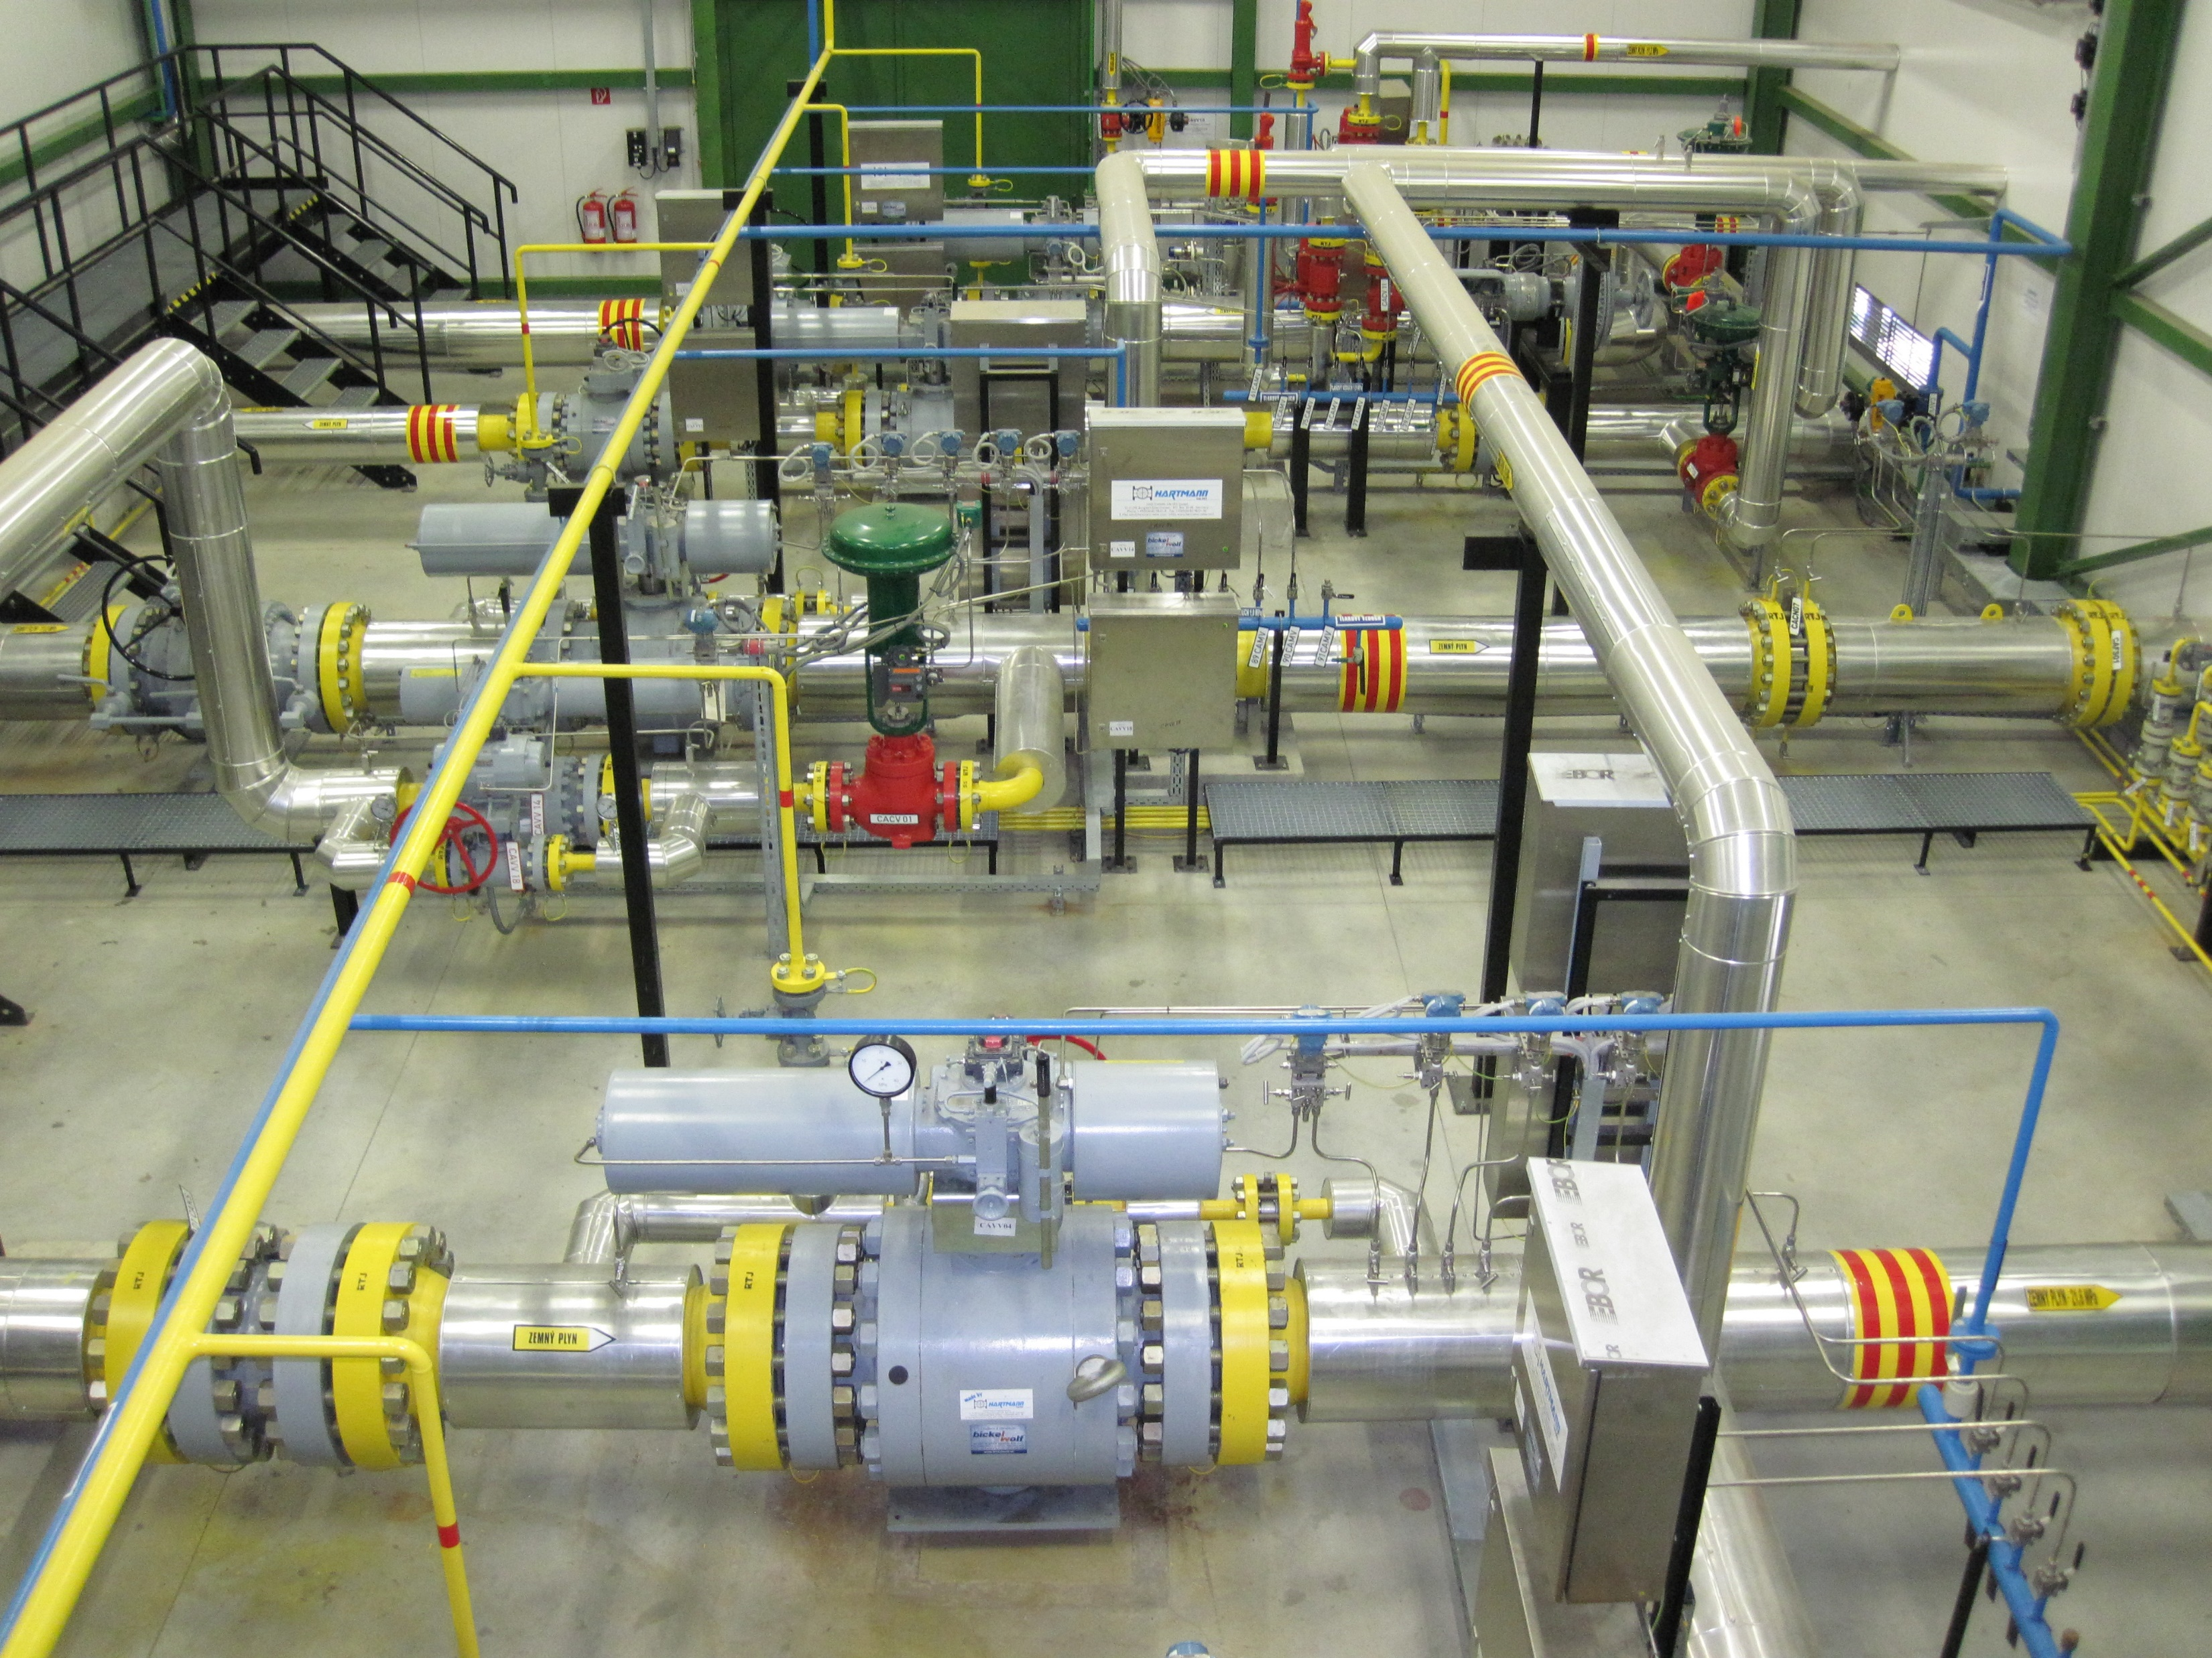
Capturing system in CAG
Operation procedure
Stopping the compressor unit
Releasing into suction collector without recompression system
Depressurizing the compressor circuit to low pressure by recompression system
Injecting nitrogen and venting to maintain overpressure
Start-up without purging
Capturing the DGS vents during the operation

Slide 15
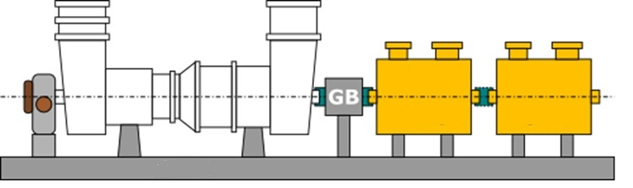
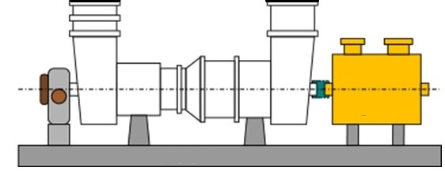
Principal scheme
TKG1
Release (w/o rec. system)
Accumulation tank
Pressure reduction and treatment
Compressor
TKG2
Depressurization of compressors
Suction collector
TKG3
Dry gas seal vents
Control system

Slide 16
Capturing system devices

Slide 17
Capturing system in CAG
Summary
Manufacturer verified solution
Pilot project for other compressor units
Gained know-how
Zero emissions emitted by compressors after implementation

Slide 18
Implementation in upcoming projects
Compressor fleet renewal
  Two 5 MW compressor units with capturing system will be installed
  Compressor units will be driven by electric motors
Capturing system for the central station
  Capturing of the compressors emissions
  Capturing emissions during the maintanence works
  Capturing emissions during the servicing activities
  Capturing off gases

Slide 19
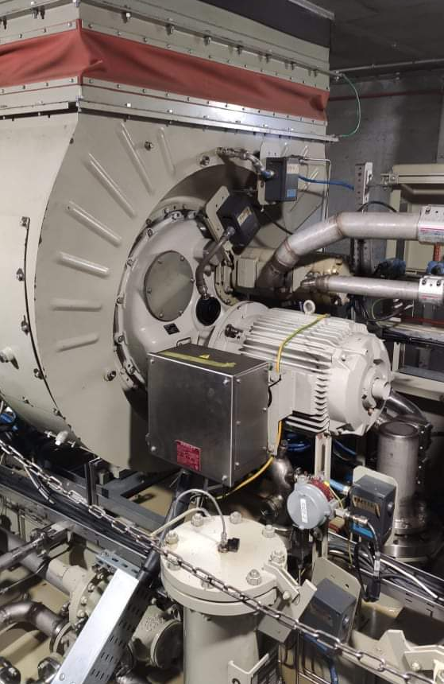
Start system upgrade
Replacement of the pneumatic gas starters with an electric starter motors
Zero natural gas emissions during compressor unit start-up
Quieter and more reliable unit starting
Replacement during the overhauls of the gas turbines

Slide 20
Thank you

