Slide 1
Reconstruction of Gas Preheating and Dehydration Technologies, Energy Savings at UGS Tvrdonice
Libor Čapla, Lukáš Kopal
31st May 2023, IGU UGS Comitte Spring Meeting

Slide 2
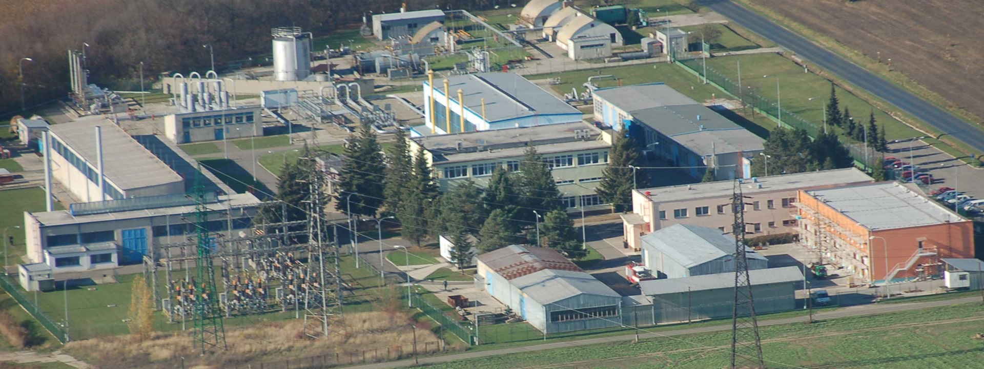
Short history summary
Gas extraction began in 1959 with peak in 1969 (114,5 mcm/y);
UGS Tvedonice 1st construction stage started 1971;
Trial operation starts 1973;
1st construction stage finished 1975, 1 compressor unit, 38 operating wells;
2nd construction stage starts 1980: 2 gathering stations, +2 compressor units;
3rd construction stage 2004 – 2005: safety and reliability;
2007 → 9th to 11th sarmatian reservoir connection project started;
2015 → Triple project preparation started.

Slide 3
UGS Tvrdonice basic facts
UGS facility construction started in 1971 and in 1973 it became operational.
Working gas volume was 525 mcm, cushion gas volume was 623.2 mcm, reservoir pressure range is 7.0 – 15.4 MPa, actual max withdrawal rate was 8.2 mcm/day, injection capacity was 8.5 mcm/day in 2018. *
There has been drilled 366 wells in oil and gas field Hrusky, 113 are owned by iGS, 68 are operated as injection/withdrawal UGS wells up to date.
UGS has 6 gathering stations, 3 compressors used for injection and it is connected into TSO 2 x DN500 PN63 pipeline for injection, 1 x DN700 for only withdrawal and DN1000 PN75 for injection and withdrawal. Transfer pressure range is 4.5-6.1 MPa.
* reference temperature 15 °C, reference pressure 101,325 kPa.

Slide 4
UGS Tvrdonice, central plant – original state

Slide 5
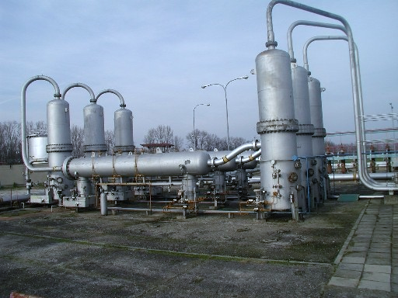
UGS Tvrdonice original dehydration units status
There were 3 horizontal DN 500 PN 63 dehydration lines installed since 1973, producer and supplier – DSD Gas und Tankanlagenbau GmbH.
Each line consisted of inlet liquid separator, absorber with wire pillows and TEG separator. No TEG continuous discharge was installed there.
Maximal output of one line was 3 mcm/day.
The maximal output of three lines was 9.0 mcm/day but UGS Tvrdonice maximal withdrawal rate was 8.0 mcm/day.
Injection of TEG was done by 3 inlets/column in amount of 300-1300 kg/h/column based on pump output. Every unit had its own TEG regenerator.
Although it was operated without any significant problems its age caused corrosion effects on seal elements and flanges. Therefore official testing pressure 96 bar could not been reached during last pressure test, only 75 bar test pressure was successfully applied. Revision technician opinion was the dehydration columns do not pass next pressure tests without problems and operational pressure limitations.

Slide 6
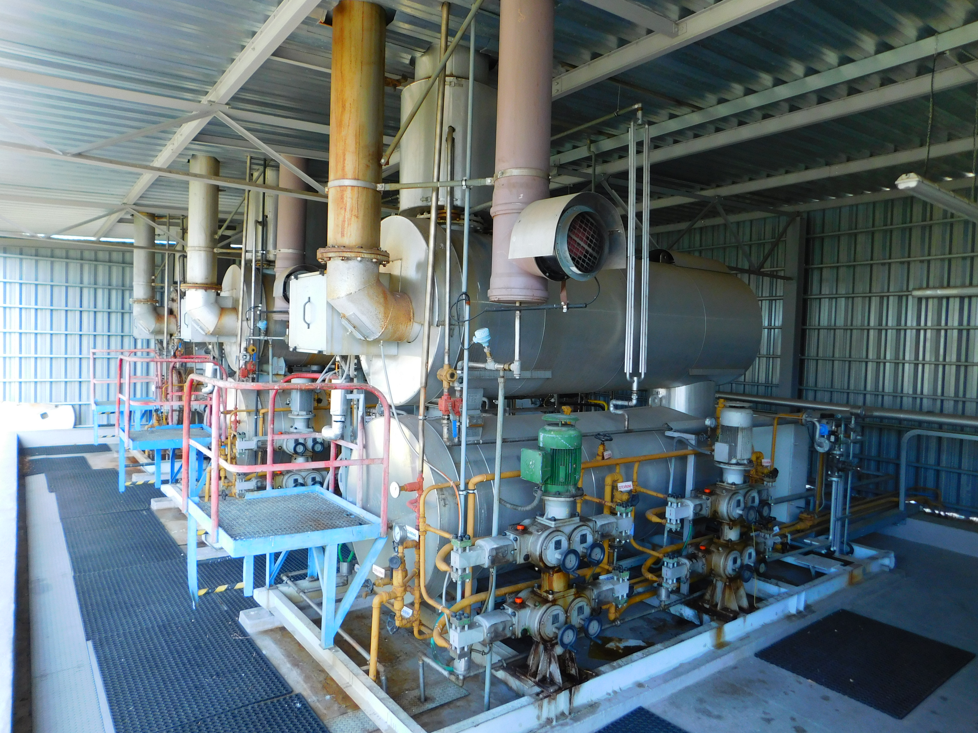
UGS Tvrdonice original TEG regenerators status
There were 3 TEG renerators installed since 1973, producer and supplier – DSD Gas und Tankanlagenbau GmbH.
Problems with utillization of sour gases as heat source.
Worn out technology.
Insufficient for increase of WR esp. TEG pumps.

Slide 7
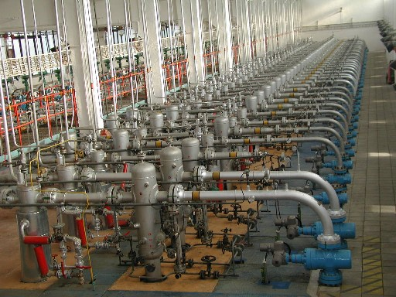
UGS Tvrdonice original steam gas preheating exchangers
There were 40 steam gas heat exchangers installed since 1973, producer and supplier – DSD Gas und Tankanlagenbau GmbH. Heat exchangers were pressure vessels (36 x DN 250 (h = 2.1 m), PN 140 and 4 x DN 300 (h = 1.5 m), PN160) with internal piping.
Gas preheating was done by heat exchanger on each metering line downstream the gas/liquid separator and upstream the orifice flow metering, flow and pressure regulation.
Worn out technology, several leaks occured every season UGS Tvrdonice operation had to be stopped due to gas leak into the heat exchangers steam system for usually 1 day. Repair costs were 20,000 EUR/year. 30 pcs. of heat exchangers were still not repaired.
Insufficient for actual Qmax of the wells and GS.
Designed for 1 stage pressure reduction.

Slide 8
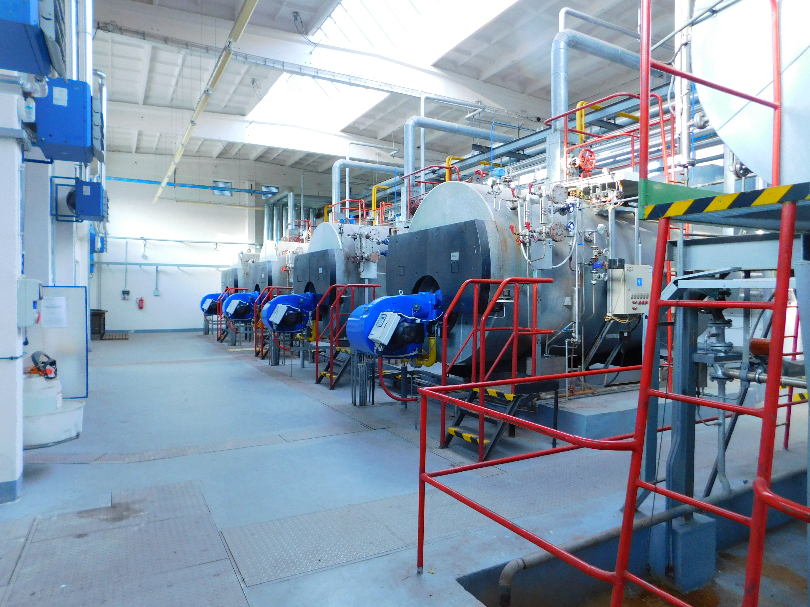
UGS Tvrdonice steam boilers system original status
Due to higher delta P on regulating valves at separation hall and temperature decrease due to JT effect esp. at the beginning of withdrawal season there was need for sufficient gas preheating before it enters to dehydration units at temperature 15 °C.
Steam boiler room contained 4 steam boilers (each with 2.9 MW power), water treatment compartment,… Usually 2 boilers were in operation in Nov-Feb and 1 boiler was in operation in October, March and April.
Steam boilers contained internal piping which have been exchanging totally approximately every 8 years. Maintenance costs for steam boiler room were 20,000 EUR/year + 5,000 EUR/year for water treatment costs.
Steam boilers consume up to 0,24 mcm of natural gas/month.
Due to aggressiveness of steam, water treatment is necessary but still corrosion of boilers is in progress during years of operation.

Slide 9
Replacement of steam boilers by hot water system and 1 CHP unit + 2 stages gas pressure reduction

Slide 10
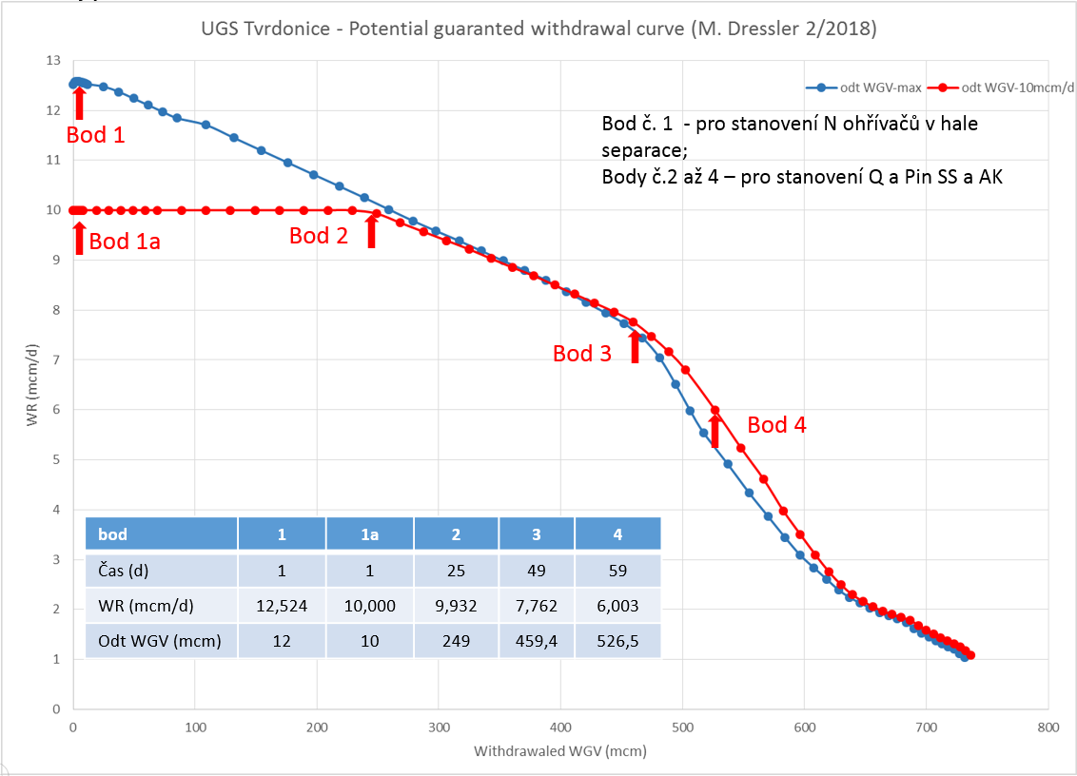
Withdrawal curve operating points modeling – part 1

Slide 11
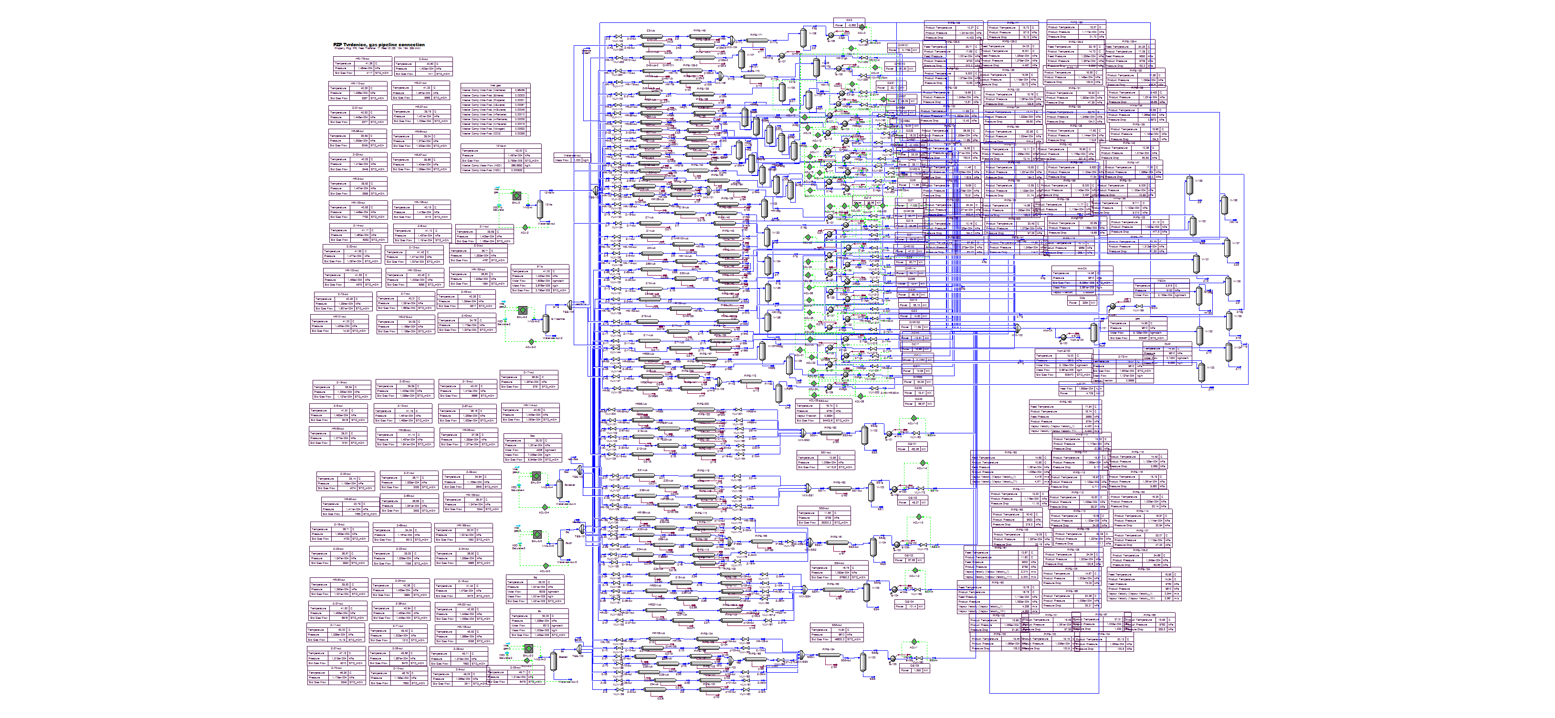
Process Flow Diagram – OP1

Slide 12
Steam boilers system reconstruction assumptions
Hot water boilers system efficiency could be 90 % in comparison of 70 % efficiency of steam boilers system. Total natural gas consumption of water gas boilers will be 20 % lower than steam boilers in this case.
Hot water boilers system will have lower OPEXs against steam boilers OPEXs.
Hot water boilers system is more reliable and it has lower tendency to accidents in comparison with steam boilers and steam heaters.
Much easier to prepare media for hot water heating in comparison with steam heating, where raw water treatment and condensate requires chemical dosing and monitoring the composition of the water supply, drainage, swapping condensate feed pump with a higher discharge pressure, etc.
Heat losses in the steam distribution system are higher than losses in hot water distribution system.
Hot water distribution system is simpler and does not contain condensate drains in each steam/gas heat exchanger.
Hot water system will not require following needs for existing state of steam boiler system:
  water discharge approval - every 5 years
  analysis of wastewater and technological water (sampling) - every 2 month
Based on that reasons we recommended to replace steam heating system by hot water system.

Slide 13
2 stages gas pressure reduction option assumptions
Based on calculation results boiler power for 2 stage pressure reduction is 4.1 MW + 1 MW has to be add for heating of operating halls - mainly compressor hall when service works are performed.
2.4 MW of boiler power could be saved in a case of 2 stages pressure regulation in a case of 1 °C UGS outlet temperature
At the gas inlet to dehydration columns it is necessary to reach temperature 15°C. In this case max. operating pressure of the dehydration columns could be increased up to 9.4 MPa.
To solve inconvenient technical condition of existing horizontal dehydration units it is possible to use 2 or 3 UGS Dolní Dunajovice original dehydration columns (PN 100).
Inspection of the 3 used columns has to be done in the project beginning.
3 UGS DD used columns with no modification could be applied with max. gas flow rate 10.8 mcm/d.
Based on quote from ATEKO 12 mcm/day could be achieved if we use only 2 reconstructed columns from DD (bubble cup trays replacement by structured packing) for 3.9 mil. CZK/column.
Downstream dehydration gas must be heated up before pressure reduction up to 6 MPa (transfer pressure) and must reach temperature on fiscal metering above 0°C using second stage of preheating.

Slide 14
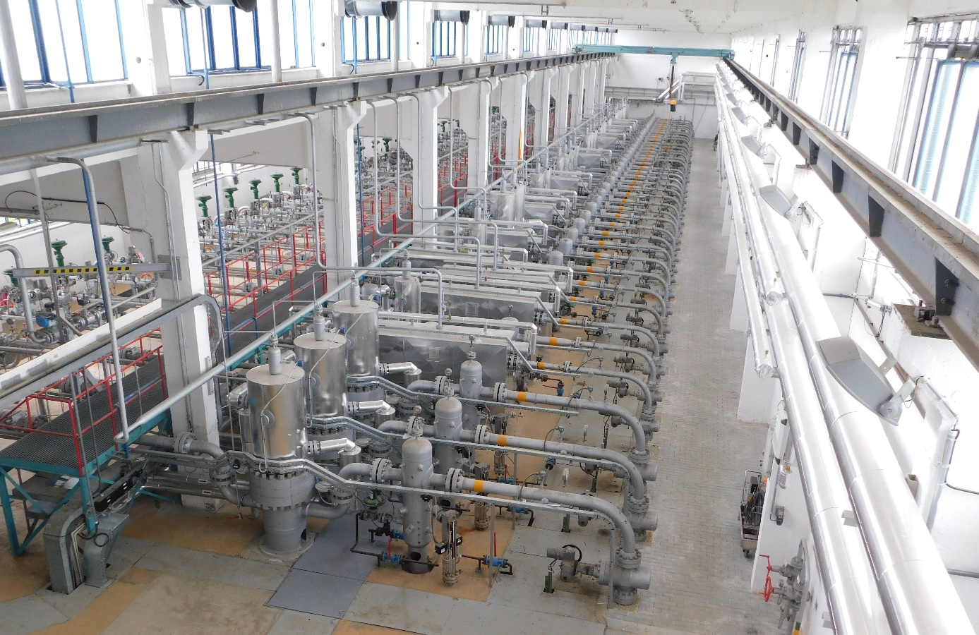
Project realisation 2018-2021: Heat Exchangers
Heat exchangers purchase and installation:
2 pcs max. power 1200 kW/pcs, type No.1
6 pcs max. power 200 kW/pcs, type No. 2
20 pcs max. power 80 kW/pcs, type No.3
13 pcs max. power 33 kW/pcs, type no. 4

Slide 15
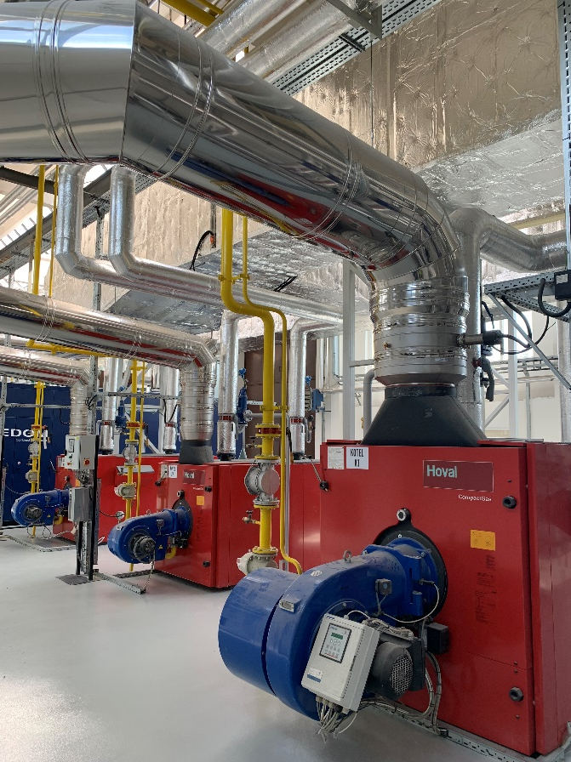
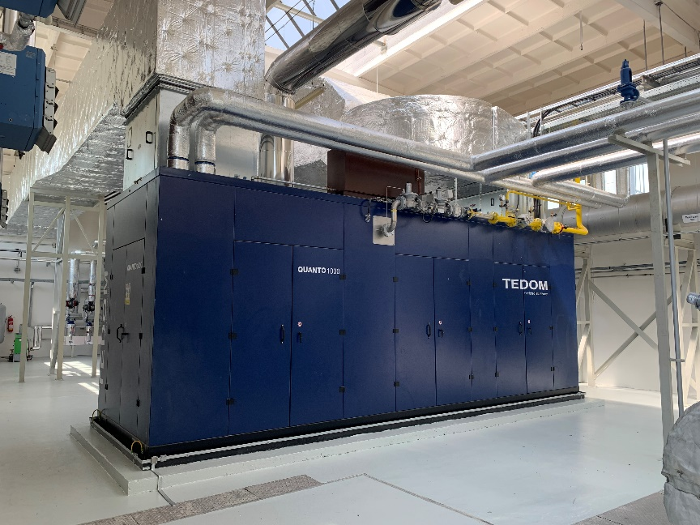
Project realisation 2018-2021: Gas Boilers, CHP
CHP and three gas bolilers purchase and installation:
1 CHP unit TEDOM, Quanto 1000, max. el. power 999 kW, thermal power 1.1 MW
Gas boiler HOVAL, 1 x 2 MW, 2 x 1 MW

Slide 16
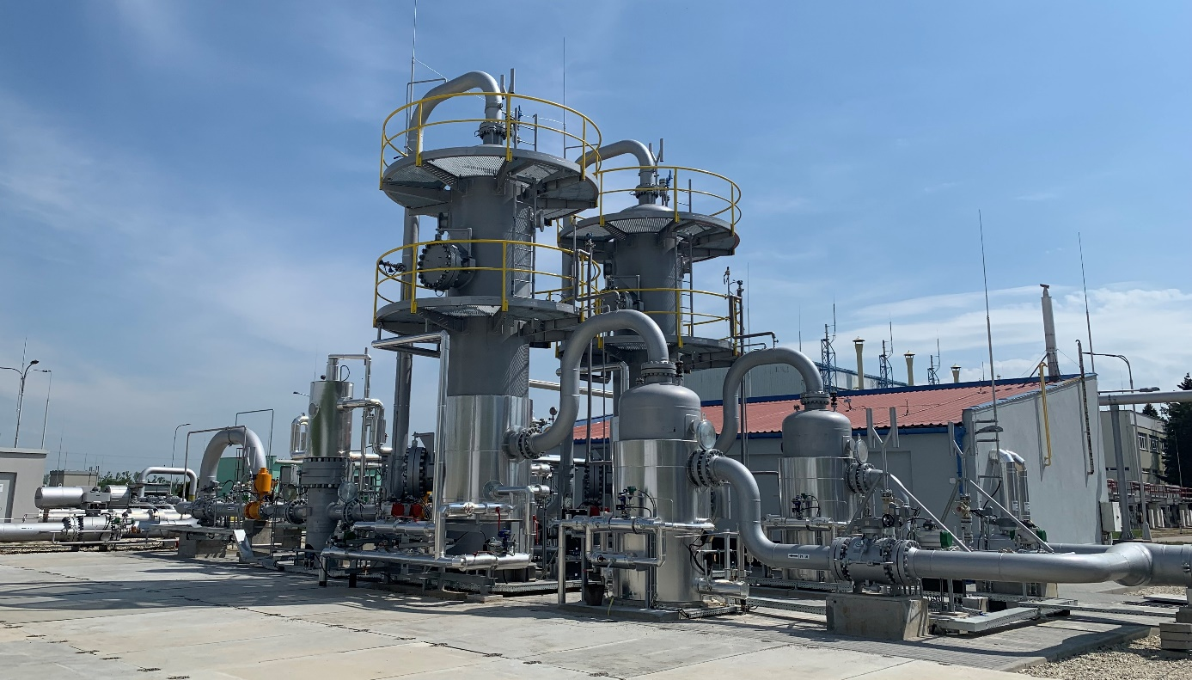
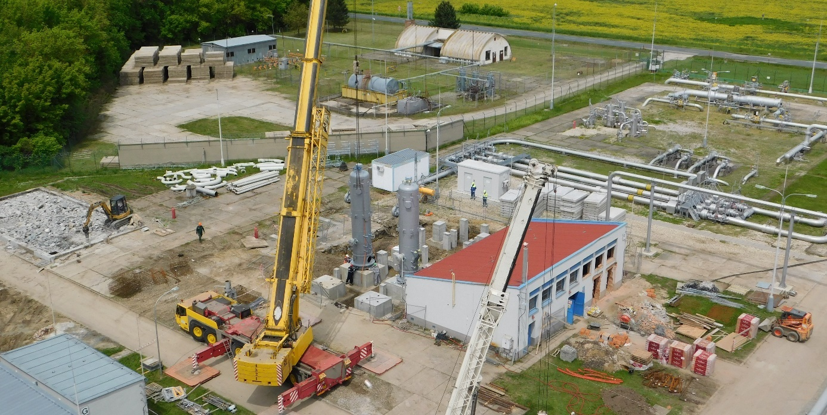
Project realisation 2018-2021: Dehydration Columns
2 x Dehydration units → ATEKO

Slide 17
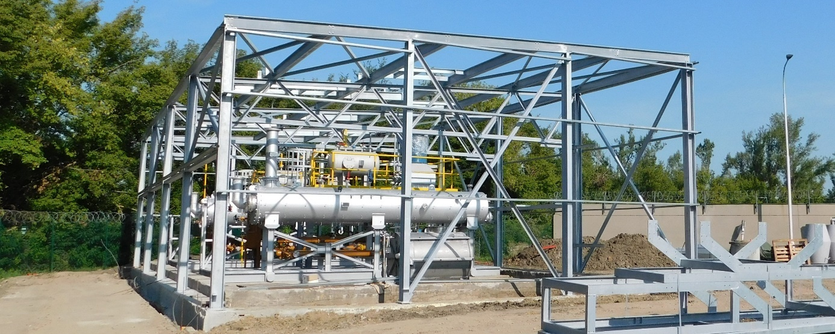
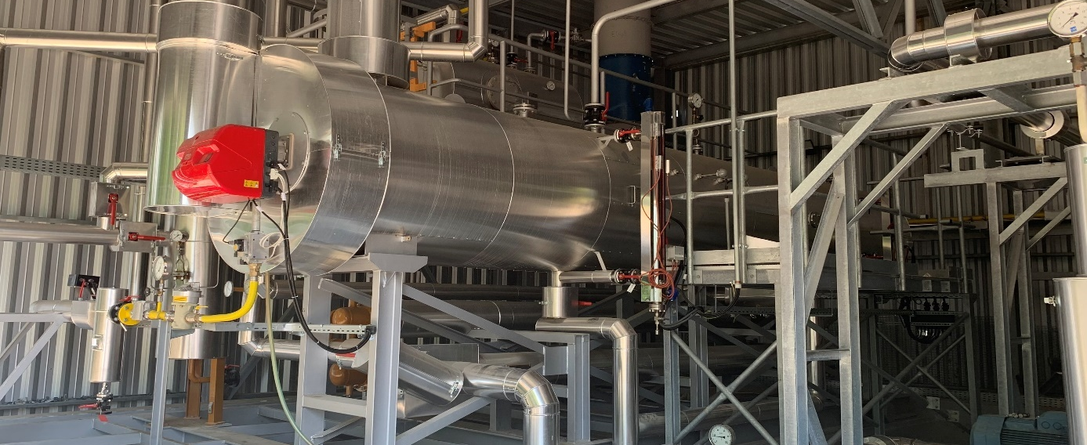
Project realisation 2018-2021: TEG regenerators
2 x TEG Regeneration units → ATEKO

Slide 18
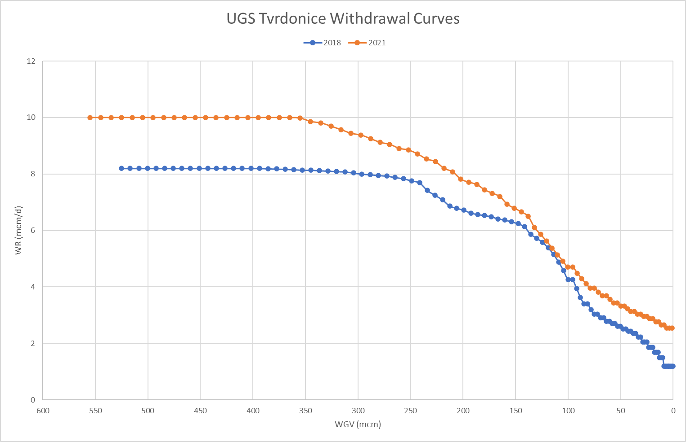
Conclusions
CAPEX: 8.3 mil. EUR;
Withdrawal rate increases from 8.2 to 10.0 mcm/d;
Natural Gas consumption decreased by 40 %;
In connection with this also CO₂, CO and NO_{x} emissions decreased by 40 %;
Fuel gas: saving of 285,000 m³/year→ financial saving 276,000 EUR/year;
2021/2022: CHP produced 329 MWh electric energy, with fuel gas consumption 92,841 m³ NG. Financial profit was 25,000 EUR;
2022/2023: CHP produced 2 GWh electric energy, fuel gas consumption 500,397 m³ NG. Financial profit was 164,000 EUR.
Economic benefit seems to be higher than we proposed during project evaluation time from the point of new energy market conditions situation view.

Slide 19
Thank you for your attention

