Slide 2
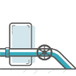

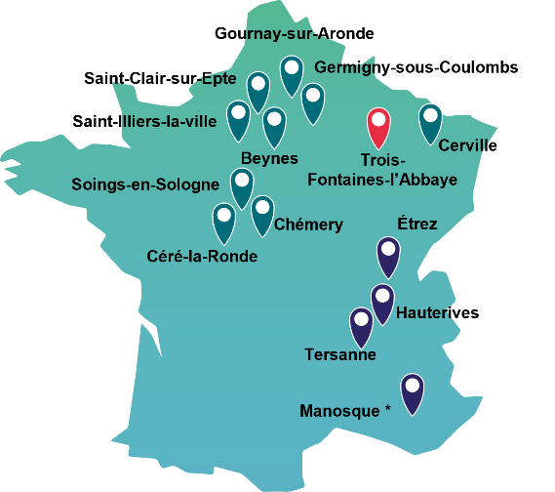
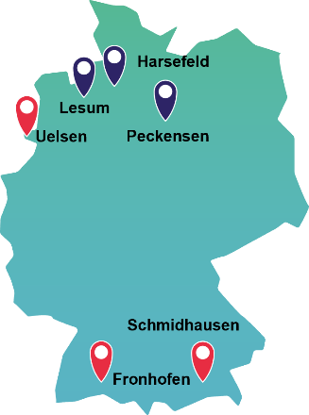



Storengy CH4 storage facilities
  France
  Germany
  United Kingdom
The sites of Soings-en-Sologne, Trois-Fontaines-l'Abbaye and Saint-Clair-sur-Epte are in reduced activity.
* 50% stake in Géométhane and operation of the site
Aquifers
Salt caverns
Depleted fields

Slide 3
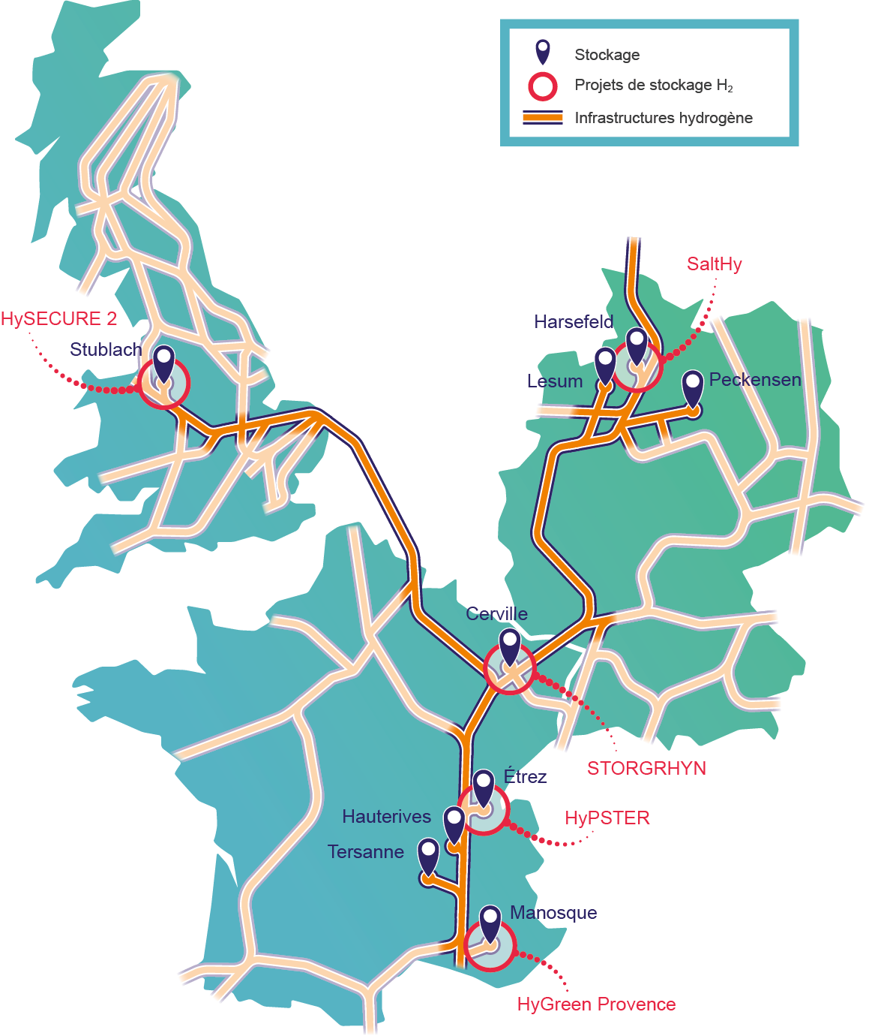
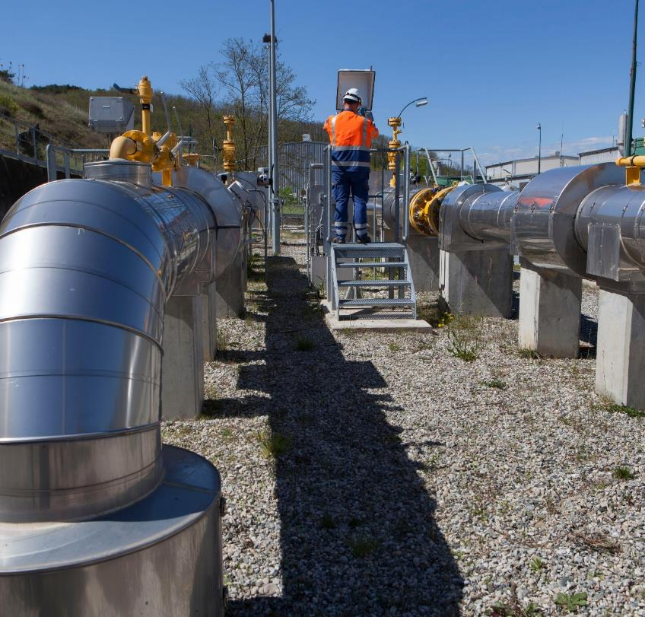
Our ambition :
A European leader in underground hydrogen storage

Slide 4
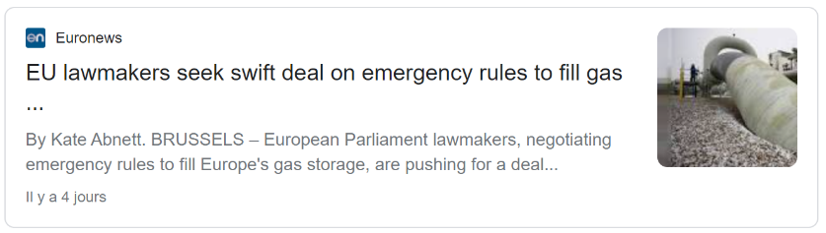

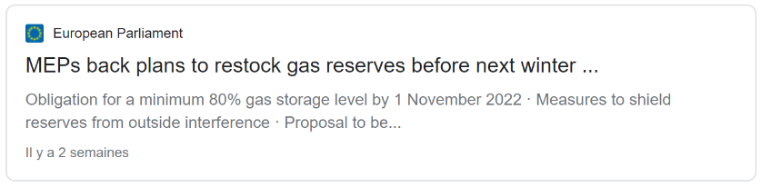

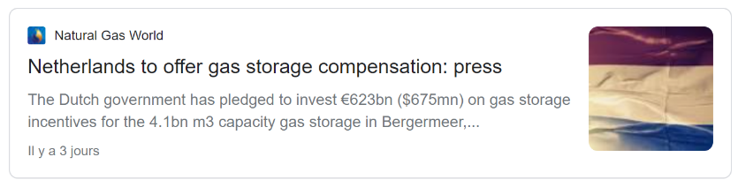
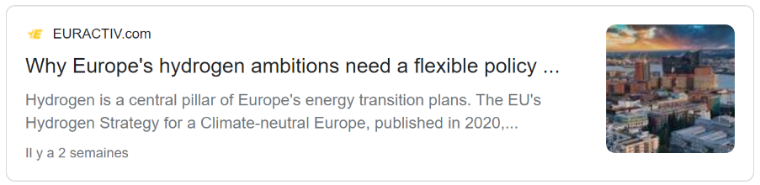
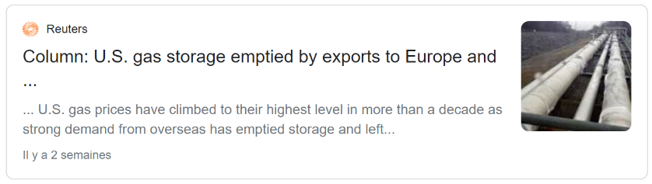
...

Slide 5
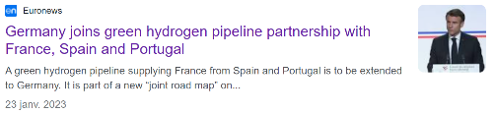
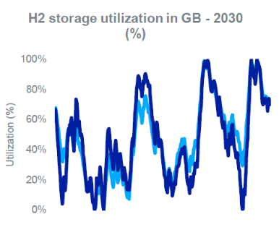




Large-scale H2 infrastructures business case grows stronger by the day
1
2
3
Strong political push since January
Hydrogen storage identified as priority to achieve most climate neutral strategies
Hydrogen storage key to meet future EU regulation criterias
“Meeting the UK’s Net Zero targets requires
2 TWh of H₂ storage to be available by 2030”
“German National Hydrogen strategy considers that to achieve climate-neutral energy system, it is essential to develop a network and storage infrastructure”
Storage high flexibility, scalability & large-scale volume is key to meet hourly correlation criteria in 2030

Slide 6
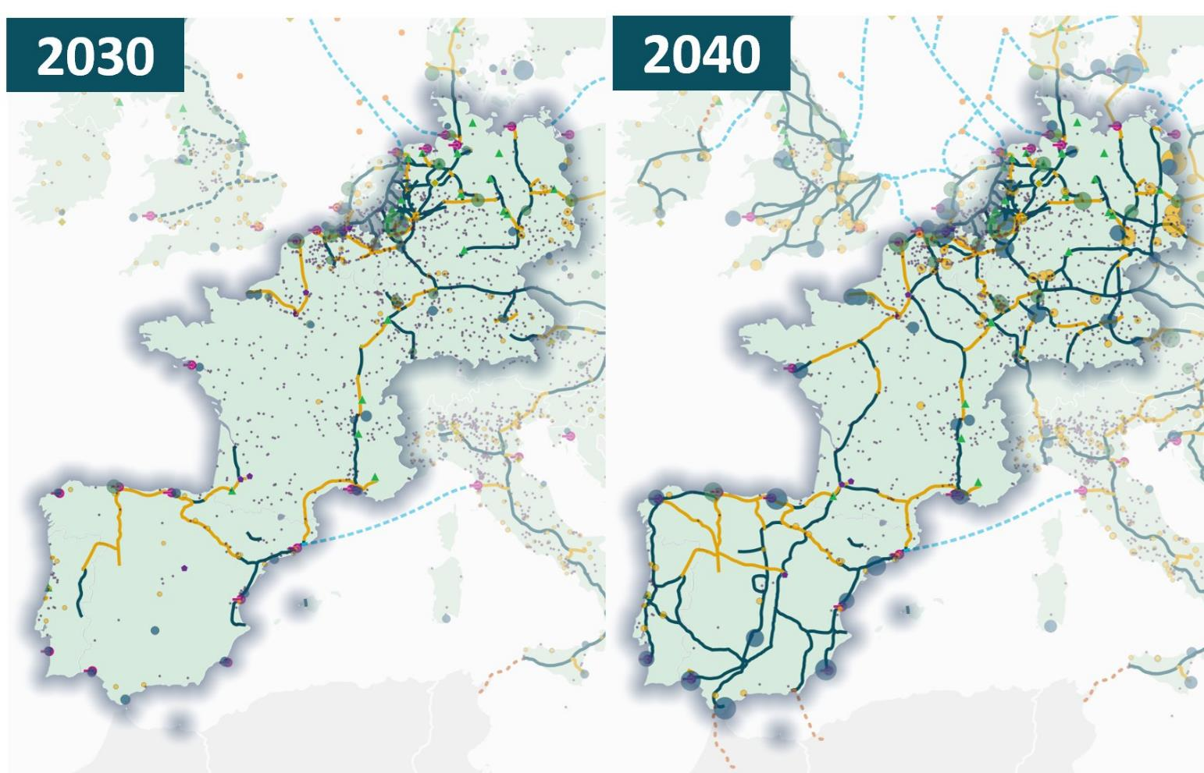

Slide 7

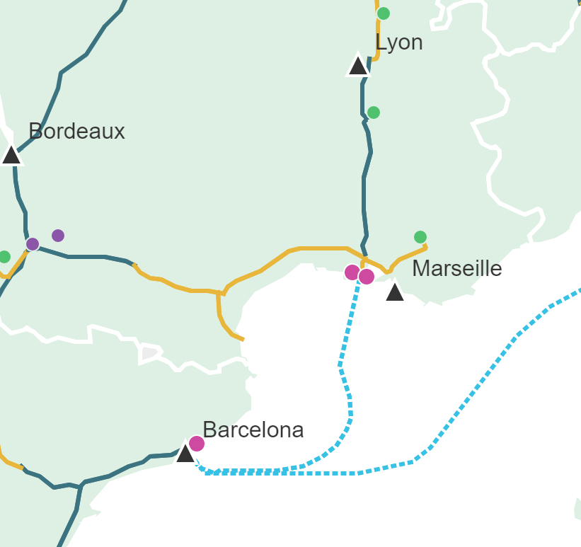
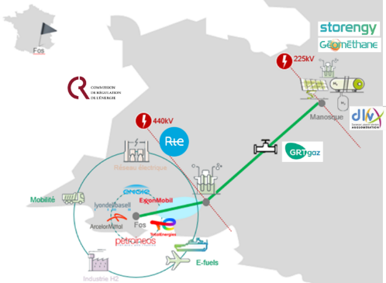



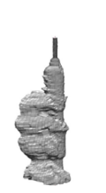


GEOH2 – underground hydrogen storage in the South of France
Key facts
Storage : 6000 tons in 2 existing salt caverns
Pipeline : 100 km
Demand : 85 kt/year green H2 by 2030
Production : 1 GW electrolysis by 2030
COD Storage : 2028
GEOH2
HY-FEN
Hynframed
GEOH2
Values
Green H2 cost : -25%
Continuous supply
Power grid congestion
RES-E curtailment : +38% H2 production
Environmental : -70% CO2 emissions
BarMar
GA & GB caverns
https://ehb.eu/page/european-hydrogen-backbone-maps
Source : ARTELYS, “Showcasing the pathways and values of Underground Hydrogen Storage”, 2023

Slide 8










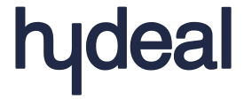




A growing interest from various market players
Large industrials
RES & H2 producers
Power grids
UHS to provide 24/7 supply & security of supply
UHS to decouple renewable electricity & hydrogen production from demand
UHS to offer power grid balancing services, reducing congestion and allowing greater RES production
18 players expressed strong interest for large-scale hydrogen storage during Geomethane Open Season in March, 2023
“Triggered by industrial clusters’ needs, H2 storage capacities will ultimately be driven by power sector flexibility requirements from 2030s onwards”

Slide 9
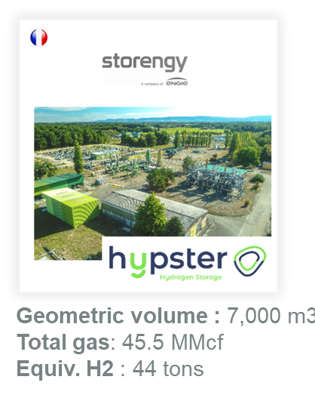
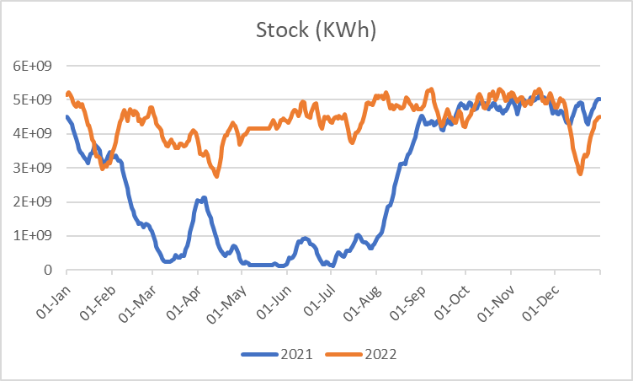
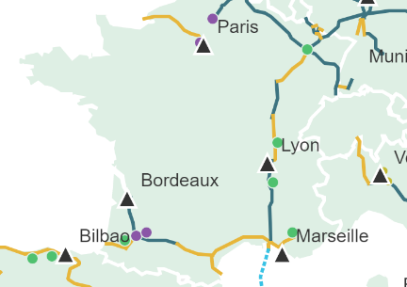
Case Study : natural gas fast-cycling storage
Highly flexible storage
4 cycles equivalent / year
Storage capacity evolution
over a year (TWh)
5 TWh
3 TWh
2 TWh
Classic seasonal storage
3 cycles equivalent / year
HYPSTER

Slide 10
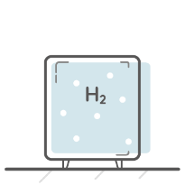

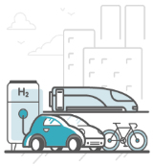




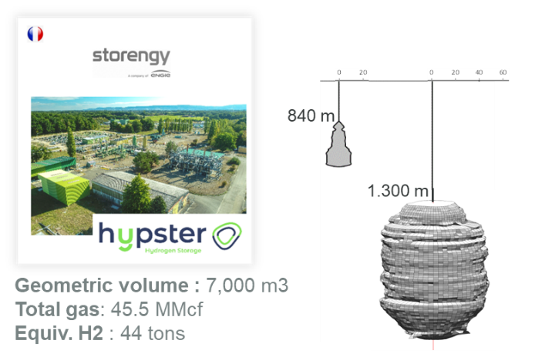
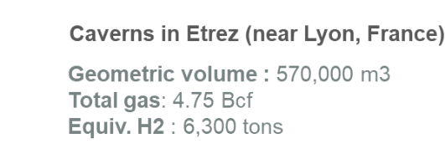
A world-first industrial scale UHS project
On-site renewable electricity production
(1,9 MW solar plant project)
On-site H₂ production
(1 MW electrolyzer)
H₂ supply chain
H₂ consumption
(industry, mobility…)
Electricity production
(Fuel Cell)
Electricity grid
Potential additional application (currently out of scope)

Slide 11











A world-first industrial scale UHS project
Consortium Partners
Hydrogen Pilot STorage for large Ecosystem Replication
H2 & Subsurface expertise
Location : Etrez gas storage site (France)
H2 production : 1 MW PEM electrolyzer
H2 storage capacity :
  3 tons at R&D stage
  44 tons in commercial phase (start in 2026)
Total budget : 13 M€
9 partners from 4 countries
5 M€ funding from Clean Hydrogen Partnership
Regulation & Safety
Objectives
Storage replication potential
Test industrial-scale renewable hydrogen production and storage in salt caverns.
Reach operational readiness for fast-cycling UHS thanks to 100 cycles performed in 3 months.
Illustrate UHS value at regional scale.
Assess technical & economical reproducibility of the process to other sites throughout Europe.
Technical and economic assessments
Bacteriology Purification
Communication
2021
2022
2023
2024 - 2025
2026
Commissioning full-scale commercial pilot
Coordination
Engineering studies
Construction of H₂ production and storage facilities
Commissioning Underground H₂ fast-cycling experiment
+ H₂ Production
Construction full-scale surface facilities + tube trailer loading dock
This project has received funding from the Fuel Cells and Hydrogen 2 Joint Undertaking (now Clean Hydrogen Partnership) under Grant Agreement No 101006751. This Joint Undertaking receives support from the European Union’s Horizon 2020 Research and Innovation programme, Hydrogen Europe and Hydrogen Europe Research.

Slide 12
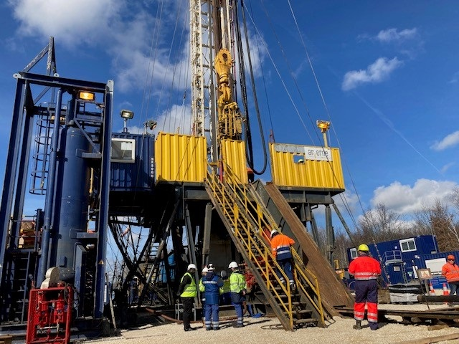
Agenda
April - Workover to install H2-ready completion
May – completion tested & operational
June - Installation of compressor & buffer tank
July - Installation of electrolyser
August - Preparation for cycling: brine tank, pump…
September - The first injection of H2 & project inauguration
November – cycling tests
February, 2024 – End of phase 1

Slide 13


