Slide 1
Hydrogen in Ireland
Summary – IGU DC meeting Lisbon 2023

Slide 2
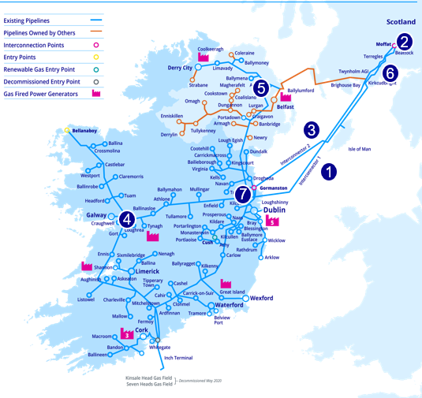
Gas Networks Ireland network

Slide 3
The gas network is central to Ireland’s energy system
Natural Gas accounts for 40% of direct energy used in heat.
32% of Irelands primary energy needs are met by Natural Gas.
49% of electricity is generated using Natural Gas.
Ireland Total Primary Energy Requirement (TPER) by Fuel source
Natural Gas in Ireland

Slide 4
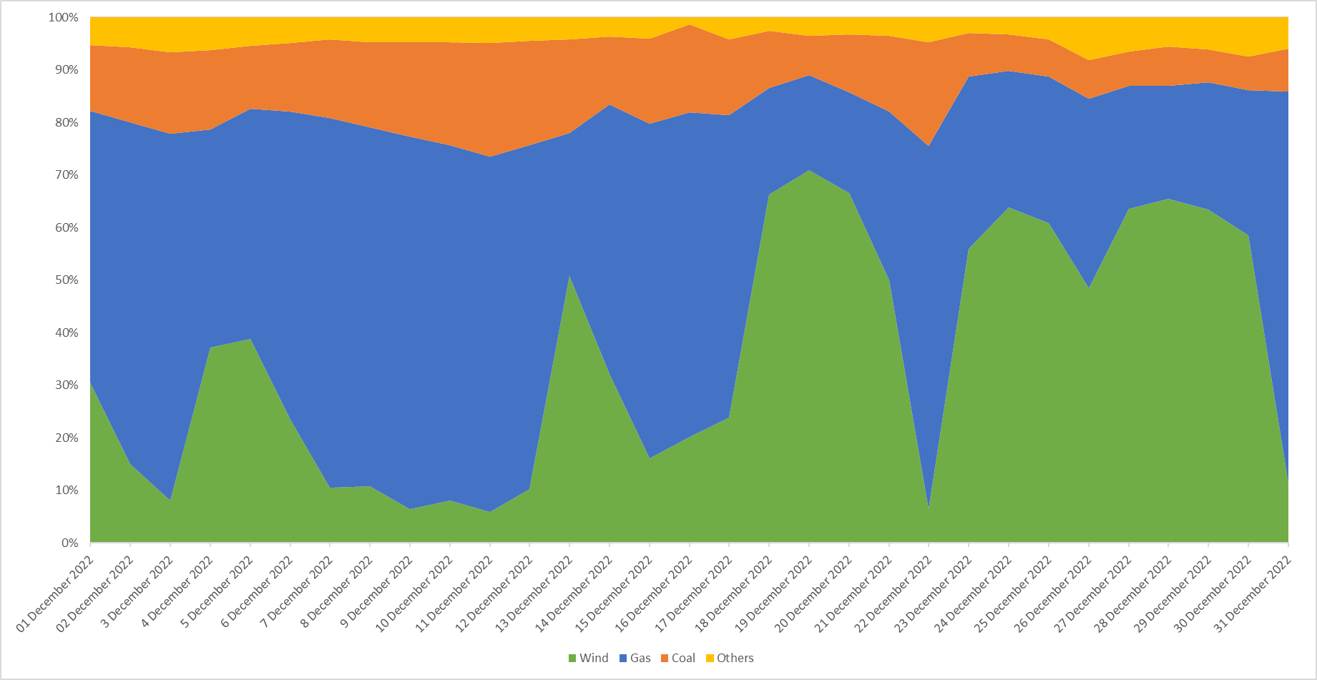
Fuel Mix in Power Generation – December 2022

Slide 5
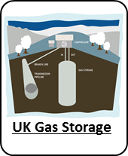
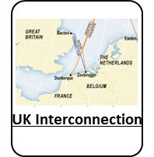
Ireland Gas Supply Sources
Indigenous gas production in west of Ireland
No gas storage since 2022
Single UK entry point to Ireland supplies 80% of demand, although the declining Corrib supply will bring this to more than 90% over the 10 year horizon.
UK has plans to introduce Hydrogen by 2025
c.75%
c.25%

Slide 6
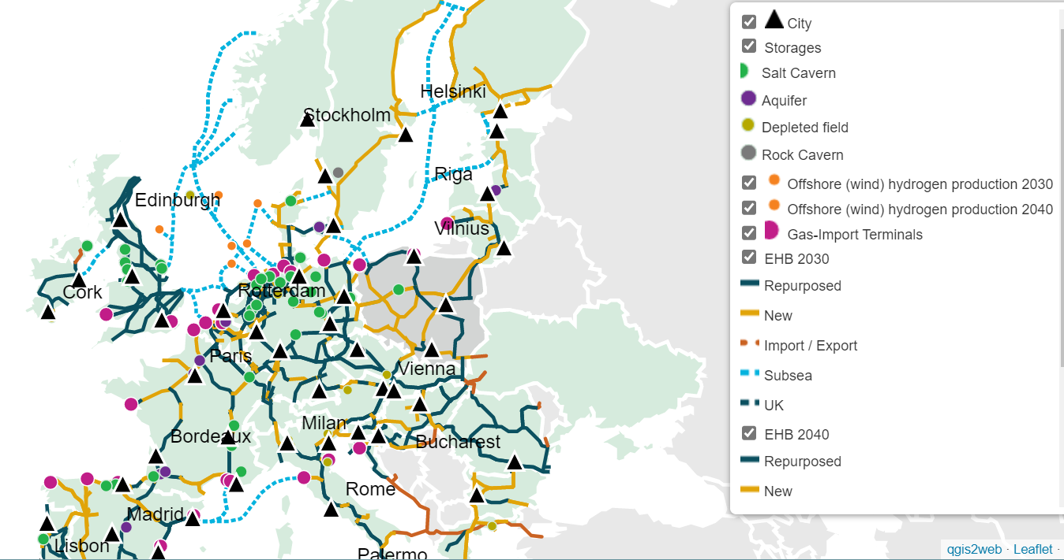
EU Hydrogen Backbone

Slide 7
Hydrogen Programme at GNI

Slide 8
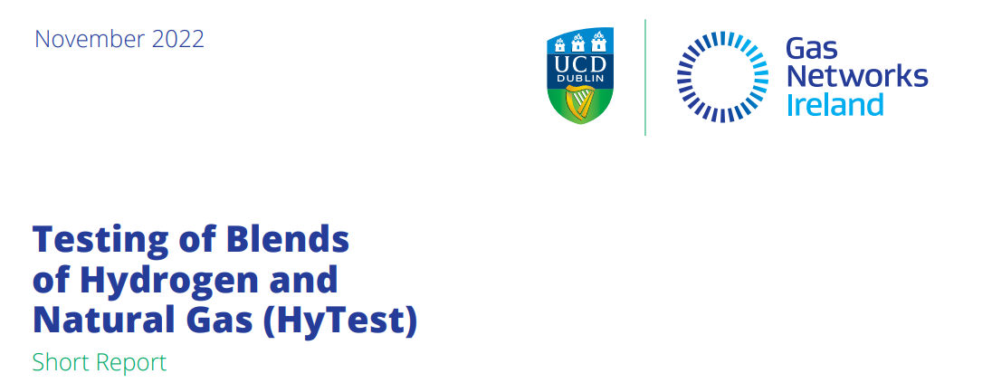
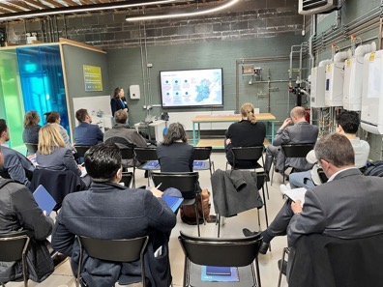
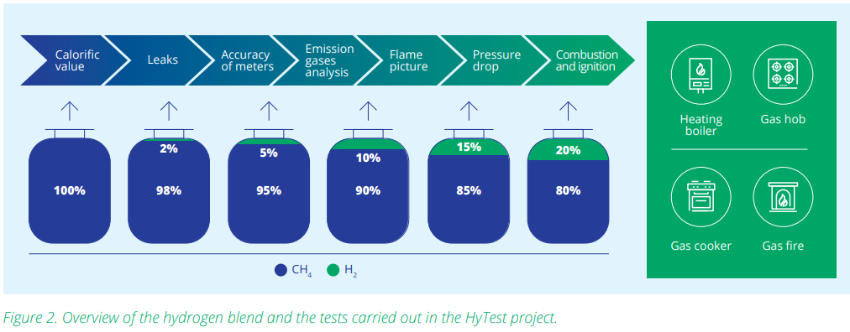
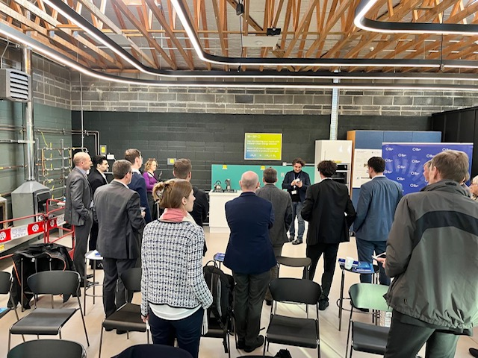
HyTest – testing Hydrogen blends - 2022 Testing of Blends of Hydrogen and Natural Gas (gasnetworks.ie)

Slide 9
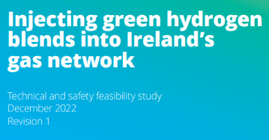
Hydrogen Network Assessment
Objectives:
1.To evaluate the potential impacts of
hydrogen and natural gas blends on
the gas network
2.To assess the impacts of hydrogen blends on current network operations and the integrity of the gas networks.
3.To determine the impacts of hydrogen
blends on downstream end-user appliances.
1.6 Next steps
Commence a pilot hydrogen blending project on the gas network
validate the safe operation of the network, end user appliances and equipment
complement technical studies and laboratory trials and enable the development required regulatory safety demonstrations
increase experience, awareness and confidence in hydrogen blending in an operational environment that can be scaled up

Slide 10
H2 – long-term scenario planning
2030
2040
2050
GNI TYNDP
sectoral emissions targets (5.7 TWh biomethane and ~5.4 TWh hydrogen)
EirGrid - 2.2 TWh biomethane, 0 TWh hydrogen for powergen 2030
EirGrid: Electricity final demand of 45.1 TWh
GNI’s Conversion Limited Model:
Fit for 55, REPowerEU

Slide 11
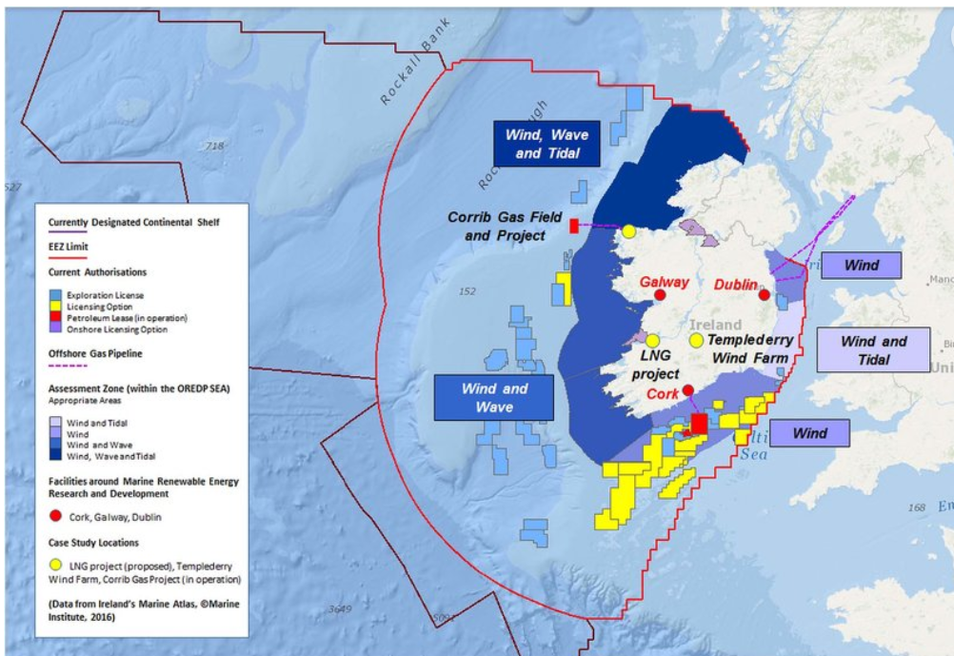
Ireland – offshore wind potential

Slide 12
Future Natural Gas/Hydrogen Network
H2-ready powergen
Clusters with 100% H2 production, storage & transport
H2 Blends to 20% in NG network
Transition to 100% H2 network connecting H2 clusters, in parallel with NG network
H2 export via EU H2 backbone

Slide 13
Thank You

