Slide 1
ROLE OF UNDERGROUND STORAGE IN A WORLD COMMITTED TO BEING CARBON NEUTRAL
IGU Storage Committee
Group 3

Slide 2
Role of underground storage in a world committed to being carbon neutral
Underground storage vital across all stages of the market development and the energy system as a whole
Policies for underground storage
From UGS to UHS

Slide 3
Topics to discuss Business Meeting Agenda
02
Underground storage vital across all stages of the market development and the energy system as a whole
Policies for underground storage
From UGS to UHS
01
02
03

Slide 4
Underground storage being vital across all stages of the market development and the energy system as a whole
Electricity system
Improving the flexibility
in a increasingly strained electricity network
Increasing role of underground storage
on a path to climate neutrality by 2050
Methane system
Responding to the current energy crisis
Supporting the promotion of renewable and low-carbon gases into the grid
Hydrogen system
Kick-starting the clean hydrogen ecosystem
Supporting the promotion of RES-E as well as low carbon hydrogen
Today
Underground gas storage
Underground hydrogen storage
4

Slide 5
An appropriate vision for the role of UGS and UHS
Early transition
Carbon neutrality
02.
System value
Insurance value
04.
Optimisation of the entire electricity and gas system while lowering the cost of gas production
Kick-start value
Facilitating the emergence of a decarbonized ecosystem
Env. value
Arbitrage value
03.
Mitigating the stress on the power grid while ensuring a better use of RES
Key elements to accommodate electrification
Insurance value
Promoting competition among market participants
Ability to make a better use of the cheapest energy technology sources in competitive markets
01.
Responding to market needs, at all times, with low carbon gases

Slide 6
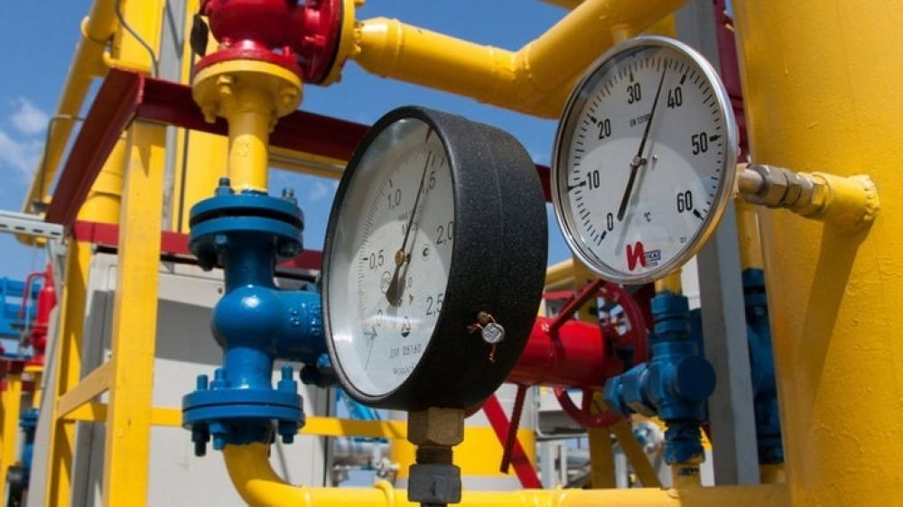
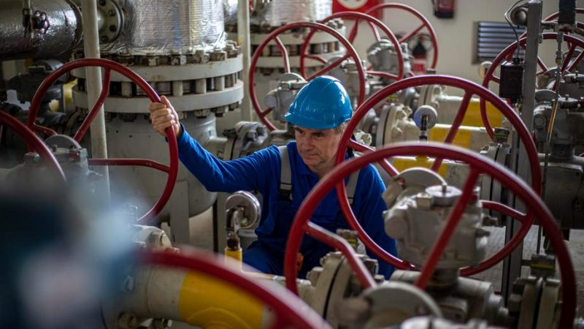
Increasing role of underground storage for SoS (Focus on the insurance value)
In Europe, UGS has attracted attention as one of the main instrument to mitigate the impact of the energy crisis
The first intervention
at EU level
Oct 18, 2022
Emergency package
(under two Regulations on 19 Dec 2022)
Market Correction Mechanism on wholesale gas price cap
Gas demand aggregation and joint purchasing platform
A new LNG price benchmark
Jul 26, 2022
Reduction in gas demand
(under a Regulation amendment)
Jun 27, 2022
New gas storage rules
(under a Regulation amendment)
May 18, 2022
REPowerEU package
The gas storage obligation is a typical security of supply measure which was needed even in a well-functioning and liberalized market because the market is not deemed to provide security of supply.

Slide 7
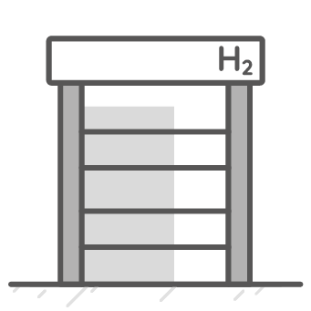
Even more pronounced role of underground storage in the future, kick-starting the H2 eco system
Renewable electrolysis system using electricity storage to store
Renewable electrolysis system using UHS to better use RES-deployment
Industrial user
Oversized RES capacity plant
Short electricity battery or via power grid (virtual storage)
UHS
Batteries in the electricity system
Enabling to store any excess of RES, resulting in lower LCOH compared to a case without batteries (higher utilization of the electrolyser)
Savings eroding over time as deeper penetration of RES further increases storage costs as electricity storage are not scalable
UHS enabling to store at large scale
Benefits increasing with RES deployment & electricity grid constraints
Resulting in lower LCOH than in the case with batteries (higher-scalability of storage

Slide 8
Topics to discuss Business Meeting Agenda
02
Underground storage vital across all stages of the market development and the energy system as a whole
Policies for underground storage
From UGS to UHS
01
02
03

Slide 9
Underground storage assets can unlock important benefits for the whole energy system, across multiple sources of value
Values to be assessed
in the modeling framework
Insurance value
Ability to provide security of supply where the degree to which production may be able to match demand is uncertain.
System value
Kick-start value
Ability to withdraw/inject energy into the system to reduce strain on the network and contribute to a more efficient energy system (i.e. by avoiding suboptimal over-investments).
Ability to smooth out the transition and incentivise optimal investment levels for production facilities. (optimal size in RES capacity)
Facilitating the emergence of a decarbonized ecosystem
Arbitrage value
Environmental value
Ability to make a better use of the cheapest energy sources in competitive markets, reducing the consumers’ exposition to the volatility of prices
Flexibility provided to increasingly base renewable & low carbon energy sources and avoid the dispatch of production / generation means with a larger carbon footprint.
Underground storage
GIE Artelys study, 2022

Slide 10
Large-scale storage widely seen as a key driver for the energy transition
In a an increasingly strained electricity network with oversized RES-E
Large-scale storage widely seen as a key enabler for the energy transition in a world where increased volatility of production and consumption profiles leads to higher uncertainty and flexibility needs
Vital for the energy system as a whole
Encompassing both the electricity and gas sectors given the strong interlinkages emerging between these sectors
01.
Mitigating the stress on the power grid while ensuring a better use of RES is a key element to accommodate electrification
Bulk energy shifting required
02.
Molecule-based system with the support of UHS to co-optimize the entire energy system
Driving forward the market development for clean & resilient energy sytem
03.
Adequacy assessment required
Holistic approach
An appropriate vision for the long steady role of storage
04.
Vital across all stages of the market development and the energy system as a whole

Slide 11
Identifying the appropriate UHS needs as well as a obtaining a clear and transparent vision
Interconnected projects to H2 pipeline development…
Missing gap
RES deployments
Sensitivity analysis
UHS announced projects by 2030
UHS project status
UHS needs baseline
by 2030 to comply
with REPoweEU
UHS announced projets by 2030
Main observation
Needs for UHS likely to exceed future flexibility offered by announced projects
Quantitative assessment
UHS targets to be defined
to be compliant with hydrogen demand
Gap filling mechanisms
Appropriate levers and actions to address the gap
Values to be assessed
in the modeling framework
Closing the gap

Slide 12
Topics to discuss Business Meeting Agenda
02
Underground storage vital across all stages of the market development and the energy system as a whole
Policies for underground storage
From UGS to UHS
01
02
03

Slide 13
Comparison of UGS and UHS over different timeframes
Production
Demand
UGS
UHS (electrolytic H2)
UGS
UHS
RES production variability
Constant over the different timescales (methane production and imports)
Hourly
(solar PV in particular)
Hourly
Daytime vs nighttime activities
(residential, tertiary)
Weekly
(wind power in particular)
Increasing mismatch between demand and supply patterns
S
D
Weekly
Weekday vs weekend activities
(residential, tertiary)
Seasonally
(hydro, wind and solar PV)
Seasonally
Thermosensitivity
(Mostly residential)
Network congestions

Slide 14
Additional drivers of flexibility needs, specific to electrolytic hydrogen
RES production variability
- Hourly (solar PV in Particular)
- Weekly (wind power in particular)
- Seasonal (hydro, wind and solar PV)
Network Congestions
Strict correlation
Bidding zone
UHS - key to meet criteria
Better use of RES
Securing the reduction of grid withdrawals in the power-grid
01
Fast cycling rate
Large-scale volumes
Scalability
High deployment of RES will require large-scale volume of storage
The benefits of electricity storage will erode over time as they are not scalable
02
Mature techno
UHS targets to comply with the fight against Climate change
UHS – Improving the competitiveness of RFNBO suppliers
Mature energy storage technologies
Challenge - scarcity
03

