Slide 1
IGU Storage Committee Meeting
Artelys study on
01 June 2023

Slide 2
in a nutshell

Slide 3
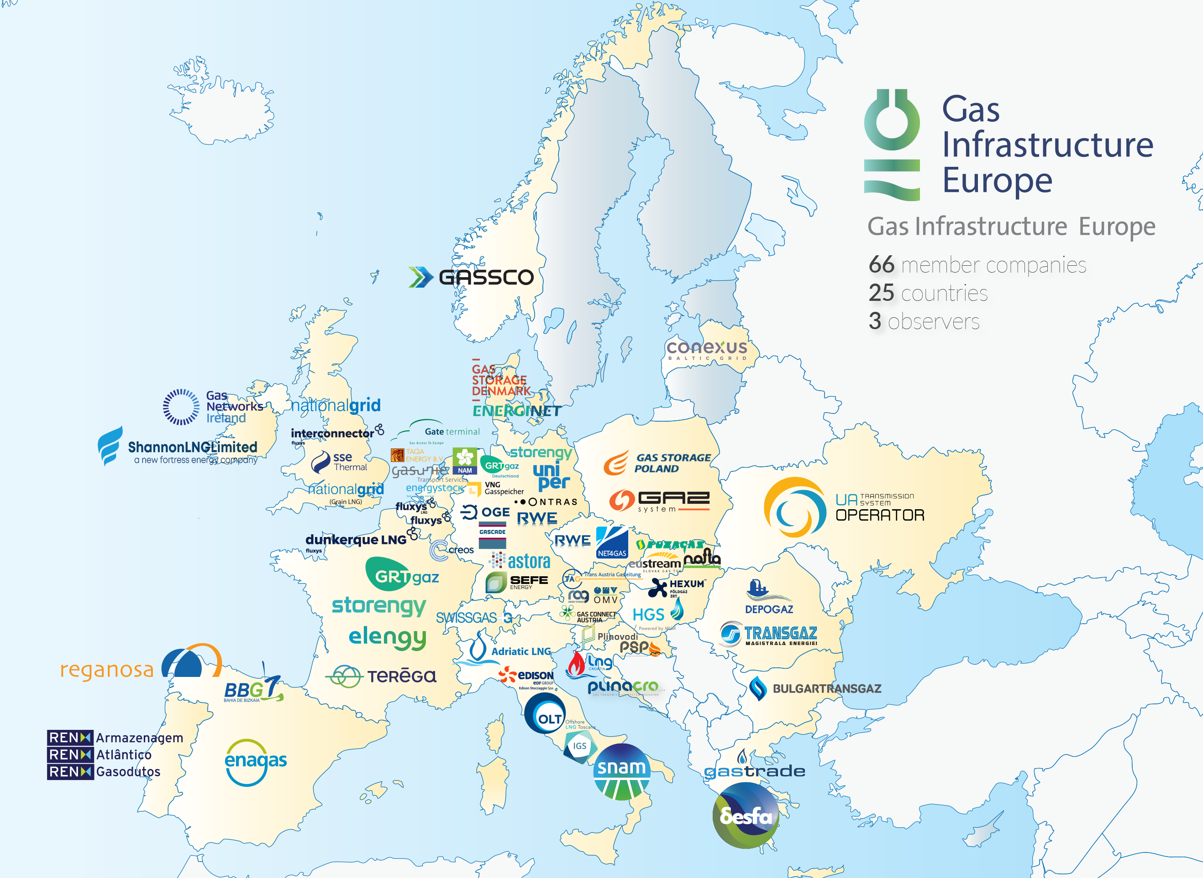

Slide 4
Values generated by UHS to be quantified in the modeling framework is the prerequisite to take actions!
Values generated by UHS
Avoiding high electricity prices/ high price volatility
Avoiding CO2 emissions
Avoiding RES (renewable electricity sources) curtailment
Avoiding system costs (not oversizing the network)
Better use of cheap RES source…

Slide 5
Showcasing the pathways
& values
of underground hydrogen storage

Slide 6
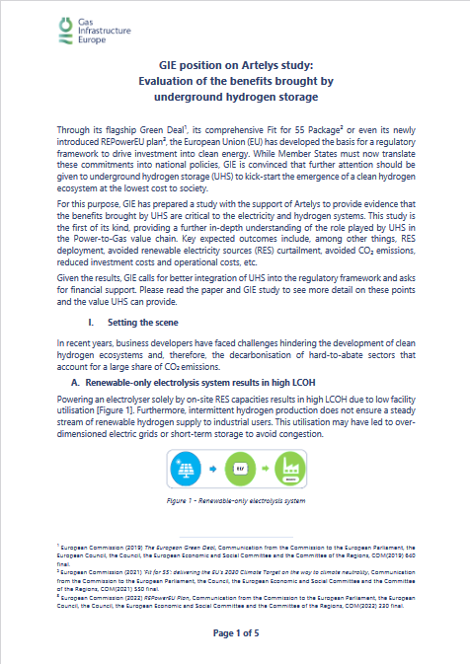
GIE, supported by Artelys, quantified the value of UHS
for the 1st time

Slide 7
Objective & approach
Values of hydrogen storage
Territorial use case
#1 | On-site green hydrogen production for industrial consumer
#2 | Hydrogen production from grid-connected electrolysis for thermosensitive consumer backed-up by an alternative supply option
#3 | Hydrogen production from grid-connected electrolysis for industrial consumer backed-up by an alternative supply option
#4 | On-site renewables for green hydrogen production and power injection/consumption into/from the grid
SYSTEM VALUE
KPI: total annualized costs
INSURANCE VALUE
Impact analysis of hydrogen storage
System dynamics (production, storage)
Generation/demand mix
Cost metrics (total, levelized, etc.)
Carbon emissions
Showcasing the values of hydrogen storage
Quantitative evolution of the benefits brought by hydrogen storage
Key messages on the values
KPIs: storage, flexibility, installed capacity
ARBITRAGE VALUE
KPIs: production cost, H₂ supply routes
KICK-START VALUE
KPIs: investments in renewable and electrolysers
ENVIRONMENTAL VALUE
KPIs: avoided CO₂ emissions and RES curtailment

Slide 8
Values generated by UHS in an integrated energy system
System
Arbitrage
Insurance
Environmental
Kick-start
Avoid over-investment in infrastructure elements across the entire energy system
Allow better use of the cheapest hydrogen sources in competitive markets
Ensure sufficient volumes and injection rates are available to end-uses subject to uncertain demand levels
Allow withdrawal of decarbonised electricity for H₂ production and limit RES curtailment
Allow to optimally size investments in RES capacity to comply with transition targets
Notes:
System value: By enabling a better dimensioning of the overall system, UHS helps avoid over-investment in other infrastructure elements, and thereby minimizing the overall cost of hydrogen production
Arbitrage value: By reducing the risk association with the intermittency of electrolytic hydrogen production, UHS enables to make better use of the cheapest hydrogen sources and to better exploit the synergies between hydrogen suppliers
Insurance value: By securing hydrogen supply, at a low cost, in situations of variable hydrogen demand (e.g. H2 turbines), UHS provides insurance to the hydrogen system and decreases the risk of scarcity and unserved energy in the electricity sector
Environmental value: By allowing the system to withdraw decarbonised electricity for hydrogen production, UHS helps avoid GHG emissions
Kick-start value: By reducing overall hydrogen costs and optimizing the size of RES capacity (including Power-to-Gas, wind onshore, solar, etc.), UHS enables to facilitate the emergence of a hydrogen ecosystem

Slide 9
Illustration with territorial use case 1
A SYSTEM WITHOUT UHS
A SYSTEM WITH UHS
Electricity generated based on Solar
Electricity generated based on dispatchable sources
Electricity generated based on Wind
Electricity supply
Hydrogen
supply
1
Not sufficient RES generation to power the electrolyser in order to meet the H2 demand (flat H2 demand)
Surplus RES generation curtailed
3
During low electricity price periods (high RES)
UHS enables to increase the electrolysis capacity and to produce more H2 than the instantaneous demand
During high electricity price periods (Low RES)
UHS discharges to meet the demand, enabling electrolysis to reduce its operation
2
4

Slide 10
Results of territorial use case 1
UHS reduces the hydrogen costs by 25%
UHS results in up to 38% more renewable H₂ in the mix
UHS is key to meeting compliance with transition targets and facilitating the emergence of hydrogen ecosystem
UHS reduces the average carbon emissions of H₂ by 70%

Slide 11
An appropriate vision
for the role of
large-scale storage

Slide 12
Thank you for your attention.
Stay tuned to decarbonisation & security of supply news
by following GIE on social media
gie_brussels_
@GIEBrussels gas-infrastructure-europe-gie-
www.gie.eu | gie@gie.eu | T +32 2 209 05 00 Avenue de Cortenbergh, 100 - 1000 Brussels - Belgium

