Slide 1
CC Information updates

Slide 2
Personnel

Slide 3
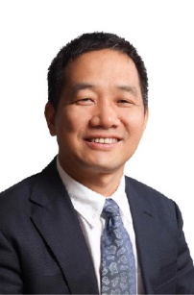
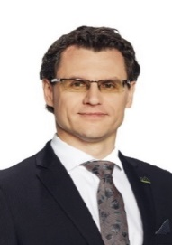
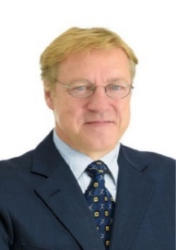
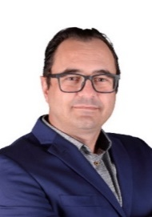
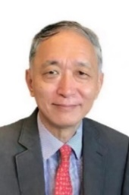
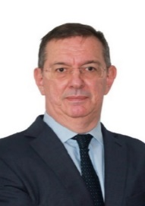
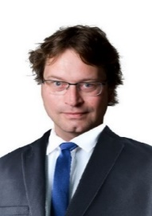
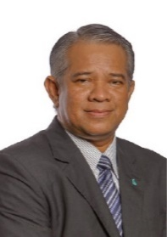
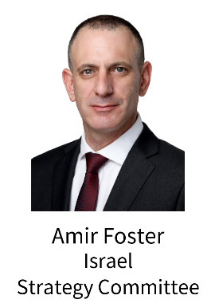
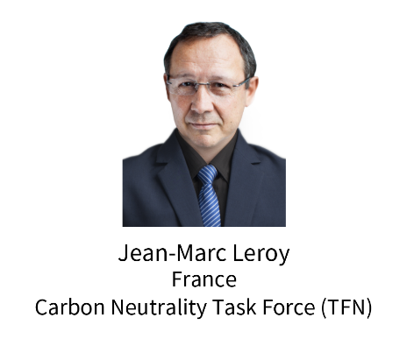
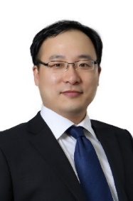
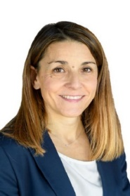
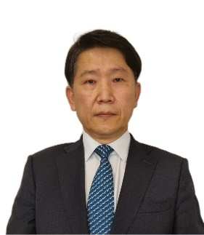
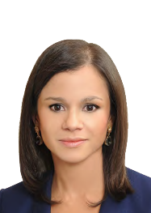
Chairs of Committees
Coordination Committee
Chairs of Task Forces
Maurizio Zangrandi
Italy
Transmission Committee
YANG Lei
China
CC Chair
Vittorio Musazzi
Italy
CC Vice Chair
Mohamed Fouad
Egypt
Marketing and Communications Committee
ZHU Kai
China
CC Secretary
Luz Stella Murgas Maya
Columbia
Strategic Communications and Outreach Task Force (TFS)
Jeong Wook Khang
Korea
LNG Committee

Slide 4
Results of Members Recruitment
Unit | Number of member | Number of Country
E&P | 26 | 15
Storage | 36 | 19
Transmission | 40 | 22
Distribution | 46 | 24
Utilisation | 36 | 18
Sustainability | 47 | 25
Strategy | 54 | 24
Gas Markets | 47 | 22
LNG | 74 | 29
Marketing & Communications | 30 | 19
R&D and Innovation | 58 | 24
TFS | 12 | 8
TFN | 21 | 10
TFD | 17 | 7
Total | 544

Slide 5
Analysis of Committee/TF Members
Male | Female
398 | 146
From 43 Countries
Top 6 | (>20)
China | 64
Thailand | 46
Poland | 41
Brazil | 31
Colombia | 24
France | 23
Thailand (46) and Ukraine (19) contributed more than a half of the increment since the CC Lima meeting (106).

Slide 6
Triennial Meetings Schedule (up to date)
Committee/TF | 2H 2022 |  | 1H 2023
E&P | Nov. 24 online, meeting documents shared | March 7, online, meeting documents shared | April 11, Brussels, Belgium & hybrid, meeting documents shared
Storage | Oct. 5-6 Bratislava, Slovakia, meeting documents shared |  | May 30 – June 2, Brno, Czech
Transmission | Sept. 27-29 Sicilia, Italy meeting documents shared |  | May 2 - 5，Kuala Lumpur, Malaysia, Meeting documents shared
Distribution | Nov. 9-11 Essen, Germany, meeting documents shared |  | April 4-6, Lisbon, Portugal, Meeting documents shared
Utilisation | Nov.3-5 Florianópolis/Santa Catarina/Brazil, meeting documents shared |  | May 17-19, Lisbon, Portugal
Sustainability | Oct. 10-11 Barcelona Spain, hybrid, meeting documents shared |  | March. 13-15，London, UK & hybrid, meeting documents shared, IGU Secretariat participated
Strategy | Nov. 22-24 Warsaw, Poland, meeting documents shared | 1.12 meeting with CC Chair, online | March 13-15, Tel-Aviv, Israel meeting documents shared
Gas Markets | Oct. 20 Online |  | May 15-17， Kuala Lumpur, Malaysia
LNG | Sept. 26 Online, meeting documents shared | Special meetings were organised by CNOOC team for the drafting of World LNG Report | March 28-30，Seoul, Korea, meeting documents shared
Mkt & Comm |  | March 24, online; meeting minutes shared | March 28, online，meeting minutes shared April 12, Akmal is replaced by Fouad
RDI | Sept. 20-22 Amsterdam, Netherlands & hybrid, meeting documents shared |  | March, 28 - 30，Cartagena, Colombia, hybrid, meeting documents shared，Rodney participated
TFN | Oct. 7 online, meeting documents shared |  | 3.21 online
TFD |  | 11.22 meeting with CC Chair, online 12.12 meeting with TFN Chair, online 12.22 meeting with TRACOM SG1, online | March 27, online, IGU-wide invitation
CC | July 20, online; Oct.25, Lima, Peru, | Jan. 12, online | April 12, Brussels

Slide 7
CC Meetings Analysis
CC meetings are enlarged to welcome Vice Chairs and Secretaries of Committees/TFs, and invite special guests such as TFs, EXCom members, IGU members, etc.
The engagement of IGU units in CC meetings remains high.
 | 20220720 kick off virtual | 20221025 Lima | 20230112 virtual | 20230412 Brussels
IGU Presidency, Secretariat and CC leaders | 10 | 13 | 6 | 13
Committees and Task Forces | 24 | 12 | 23 | 17
Invitees | 2 | 4 | 8 | 5
Sum | 36 | 29 | 37 | 35

Slide 8
CC Work Progress

Slide 9
CC Management on Committees/TFs
Organised brief meetings with all the Chairs of Committees/TFs.
Helped Marketing and Communications Committee select the Committee Secretary to ensure the Committee’s work move forward.
Supports Committees/TFs to build the multi-tiered management structure in order to reward the active members and stimulate the potential active members.
Supports and encourages Committees/TFs to externally release information and professional insights to amplify the IGU’s influence on the global energy debate.
Builds and shares the database of enlarged ‘CC family’ – resumes of CC Chairs, Vice Chairs, Secretaries – to enhance the social capital of CC.
Builds bridges between Committees/TFs and IGU Units and members.
Quick response to requests of Committees/TFs and IGU members.

Slide 10
CC Participation in Committee/TF Meetings
Provided 6 speeches (video) and 1 foreword to Committees/TFs meetings, attended virtual/physical Committee/TF meetings.
Encourages Committees/TFs to enlarge the access to their meetings for IGU members, EXCom members, RCs and even external stakeholders. Strategy Committee and TFD have made attempts.
Encourages the utilisation of IGU Portal – Group for information and materials sharing. 23 Admins have received training and half of the Committees upload documents.

Slide 11
CC Cooperation with the IGU Units
Meetings
Participated in the regional workshops organised during IGU meetings;
Committees cooperate with RCs, e.g. Strategy Committee invited Middle East RC to attend the Committee meeting;
Expanded CC meetings and Committee meetings, e.g. TFD organised an IGU-wide meeting;
Promoted joint researches, e.g. TFN, TFD, Transmission, RDI, Sustainability, Strategy, organised joint meetings to discuss common interests;
Committees organised meetings at the same time of local events to gain mutual benefits, e.g. Strategy Committee - Israeli Annual Energy Conference, Utilisation Committee - Lisbon Green Gas Summit;
Assisted IGU Secretariat participated in Committees’ meetings;
Reports
World LNG Report was drafted on schedule by CNOOC and LNG Committee with wider participation of IGU members;
Strategy Committee is making efforts in improving the Global Gas Wholesale Price Survey Report;
RD&I Committee is trying to expand the database for the Global Renewable Gas Report;
CC Chair participated in the review of Gas for Africa report.
Media
CC news release in the IGU Newsletters, exclusive interview of CC members for IGU Magazines.

Slide 12
CC for WGC2025 Preparation

Slide 13
WGC2025 Preparation
Participated in the designs of WGC2025 logos and the conference theme.
Designed the conference structure together with NOC.
Drafted themes of Plenary sessions and Current Debates sessions.
Directed the drafting of CfA Guidance through timeline control and content revision.
Motivated Committees/TFs to fulfill the tasks of preparation through organising special CC meetings, online surveys, cooperation with NOC, FED and PCEO.
Joined the‘Roadshow’ of Chinese Presidency team in China to invite industrial peers to participate in WGC2025.

Slide 14
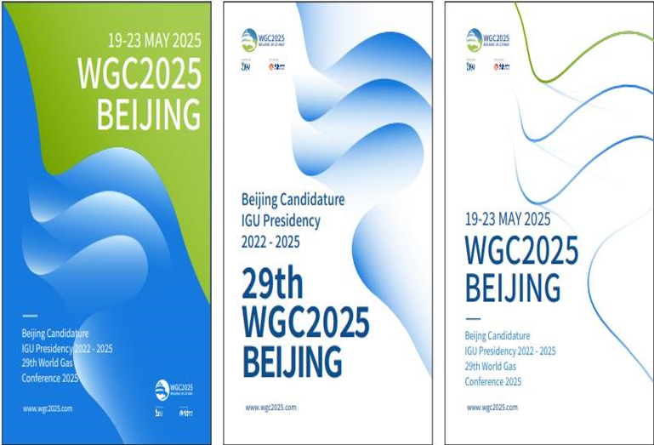
WGC2025 Logo

Slide 15
CC Tasks in Brussels Phase
1. Target audiences
Identify new areas of industry growth and the audience relevant to WGC2025;
Identify audiences under-represented at WGC2022 but important to industry and require development. (Rodney and Jason join)
To facilitate committee/TF members inclusion, PCEOs will provide a portal link where everyone can enter their feedback.
2. Framework and number of sessions and topics for WGC2025 Programme
Variables the NOC/CC will address in planning the framework and the number of sessions
No. of sessions allocated to Industry Insights (time, format flexibility and placement)
No. of speakers per session (including time for Q&A)
Innovations such as role of moderators, industry support, additional speakers

Slide 16
Results of Survey on New Audiences (7+2+1)
E&P: Robotics and Automation in the Upstream Gas Industry; AI applications in Exploration and Production; Modular Offshore Gas to Liquids technologies；Delegates from Africa and emerging markets；Representation from upstream service companies
Transmission: AI algorithms for operation and maintenance and digital twin of physical; New gases; Gas and electric power coupling； Data tech companies and suppliers； Start ups； Electric power companies；Search institutes/associations studying new gases to be dispatched via pipeline
Storage: Regulators, policy makers, Non-Governmental Organisations, big electricity producers (we want to attract attention on energy storage using renewable gases, these is the audience that needs to understand the benefits of such solution and how they can help it to grow), H2-Storage (lack of skilled workers).
RDI: Renewable and low-carbon gasses；innovative gas start-up companies.
Marketing and Communications: Power to X - energy transformation- the conversion of electricity into hydrogen, gas, fuels, ammonia and chemicals (Power-to-Hydrogen, Power-to-Gas, Power-to-Ammonia, Power-to-Liquids); Development of new system services: energy storage, gas blending, energy conversion/processing, management of gas/energy flows; Development of "green" fuels gaseous (biogas, biomethane); Hydrogen as a new fuel - development of regasification, expansion, electrolysis segment; The carbon neutral LNG market – how to reduce the carbon intensity of LNG production and shipping; Diversity in our industry- including share of women, young professionals • Preparations of our DSO and TSO networks for hydrogen; Tackling Methane emissions- developing common standards; Gas mobility and its future- for instance in Europe after 2035; Natural gas and LNG sector in Latin America. Offshore projects could enable further growth of this segment; CCUS. These projects are growing globally, and they will continue to grow exponentially. Some of these projects also involve natural gas or hydrogen; Green and blue hydrogen. Potential market and role of Latin American countries. • Sustainable mobility based on natural gas. Advances in Latin America towards the growth, measures, incentives, challenges, and opportunities of sustainable mobility with natural gas; The effects of subsidies worldwide on natural gas projects; Future participation of natural gas in the energy matrix as a fuel and as an input to produce blue hydrogen.

Slide 17
Results of Survey on New Audiences (7+2+1)
Sustainability: Renewable gases: biomethane and hydrogen, ESG Methane emissions and climate change. Regarding biomethane we should be more in contact with primary sector: agriculture, manure, waste treatment plants, landfills, etc. who are the ones who have the raw material for biomethane production. As well, we should be more in contact with power energy sector (electricity) trying to get sector coupling between electricity and gas.
Strategy: NGO related to climate and environmental issues; Influential entities in the field of ESG. (We need to find those bodies with whom we can hold a dialogue to \promote the positioning of natural gas in the ESG world) ; Stakeholders related to issues of security and energy security. (The goal is to create a connection between ESG, the development of the global gas industry, the effort to reduce the energy imbalance in the world, and the issue of global warming. Today, more than ever, these factors can be linked to the understanding that the development of natural gas infrastructure in the world is the key to reducing greenhouse gas emissions while strengthening global energy security. Other solutions are ineffective in the short term and not sustainable for long-term improvement in these issues.)
TFN: Agriculture, Waste management, e-methane and biomethane start-ups and research institutes
TFD: use digital technologies in mid and downstream of gas industry; green hydrogen will be interesting for delegates.
World LPG Association: Address how other molecules such as LPG can work 'further together' with natural gas to widen access to clean fuels. Also consider sectors such as shipping.

Slide 18
GROWTH & NEW AUDIENCES
Home market audience (provided by NOC)
Downstream gas companies
Gas infrastructure companies, such as shipbuilding, storge tanks, transmission pipeline, etc.
Renewable energies, such as wind, hydro, solar, etc.
Digitalization
Financial institutions
SELECT & PRIORITSE DELEGATE TARGET AUDIENCES INTO CATEGORIES

Slide 19
Number of Sessions (II+TI)
Responded
Suggested
Utilisation | 1. Industrial Gas Utilisation
3 | 2. Domestic and Commercial
 | 3. Natural Gas for Transport
Gas Markets | 1. Regional gas markets development
 | 2. Greening the gas markets
4 | 3. Impact of pandemics on gas markets
 | common topic: Global Gas Industry Differentiated Development and Best Practices Report
TFS 2 | A key platform to discuss and debate hotspot issues of the gas industry, support the development of the IGU position paper, provides inputs for the design and delivery of IGU Strategic Communications and Outreach Plans
 | II | TI
E&P | 2 | 1
Transmission | 4 | 2
Storage | 1 | 1
Strategy | 6 | 2
RD&I | 3 | 4
Sustainability | 3 | 1
Marketing & Communications | 3 | 2
LNG | 3 | 3
TFN | 1 | 1
TFD |  | 1
Distribution | 1 | 3
sum | 27 | 21
World LPG Association | 1 | 1

Slide 20
Potential special session to facilitate triennial results
Seek new opportunities for all Chairs to present the triennial results of their Committees/TFs in a special conference session.
New type of sessions allow special interest groups to express their gas advocacy voices, e.g. female leaders forum, gas + finance forum, gas nights, sponsor sessions.
SGs need to submit their triennial reports and the template was drafted.

Slide 21
CC Reminder
Tasks to be fulfilled in Perth Phase
May 2023 - August 2023
By June 16, the Committees propose topics (using insights from audiences and themes) to fit session structure. Then CC needs to coordinate the sessions and topics to avoid overlaps.
By Sept. 1, CC shares themes and topics with committees.
September 2023
By Sept.1, CC members will receive CfA Process & Strategy from NOC/PCEOs including timeline, evaluation and awards, software system design and promotional schedule.
Sept. 13? CC will organise a virtual meeting to discuss the results of the above-mentioned work.
October 2023 (Perth)
The WGC2025 Working Group including the CC members will:
Confirm the 4-day conference structure
Finalise objectives & structure and evaluation for awards
Approval of CfA strategy, process & timelines for the launch of CfA in November

