Slide 1



He-Integrity Test
Dr. Amer ABDEL-HAQ
UGS GmbH
A precise and safe way to prove the mechanical tightness
of (H2 and/or natural gas) storage caverns

Slide 2
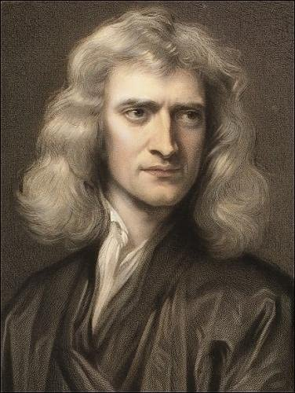


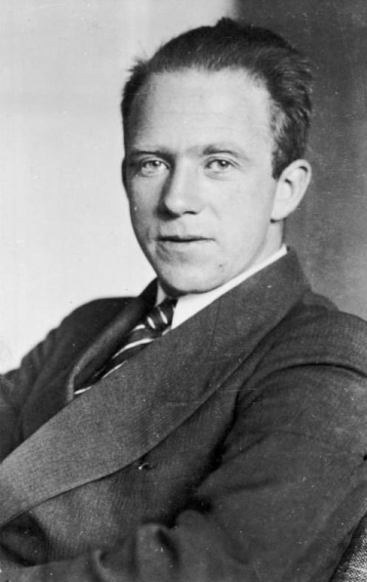
What is MIT at all?
Mechanical Integrity Test is a test to ensure that there is “no” significant leak in the well and the mechanical components of the well function in a way that is protective of human health and the environment.
m
3290error31874903
F
Mechanics
Uncertainty Principles
Sir Isaac Newton
Werner Heisenberg

Slide 3
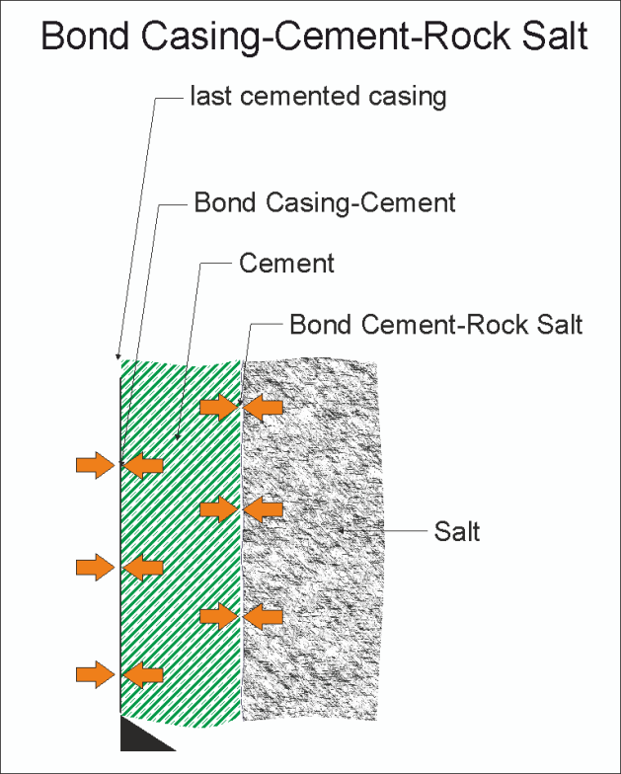
History
Conventional MIT
N2
2017
72h
NaCl
3

Slide 4
History and comparison
Conventional MIT
Innovative MIT
N2
2017
72h
NaCl

Slide 5
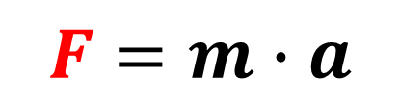
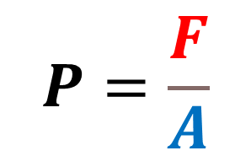
Basics of pressure
$$P=\frac{F}{A}$$
$$F=m∙a$$
F
F
A
A

Slide 6
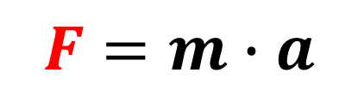

Basics of pressure
$$P=\frac{F}{A}$$
$$F=m∙a$$
F
F
A
A

Slide 7


Basics of pressure
$$P=\frac{F}{A}$$
$$F=m∙a$$
F
F
A
A

Slide 8
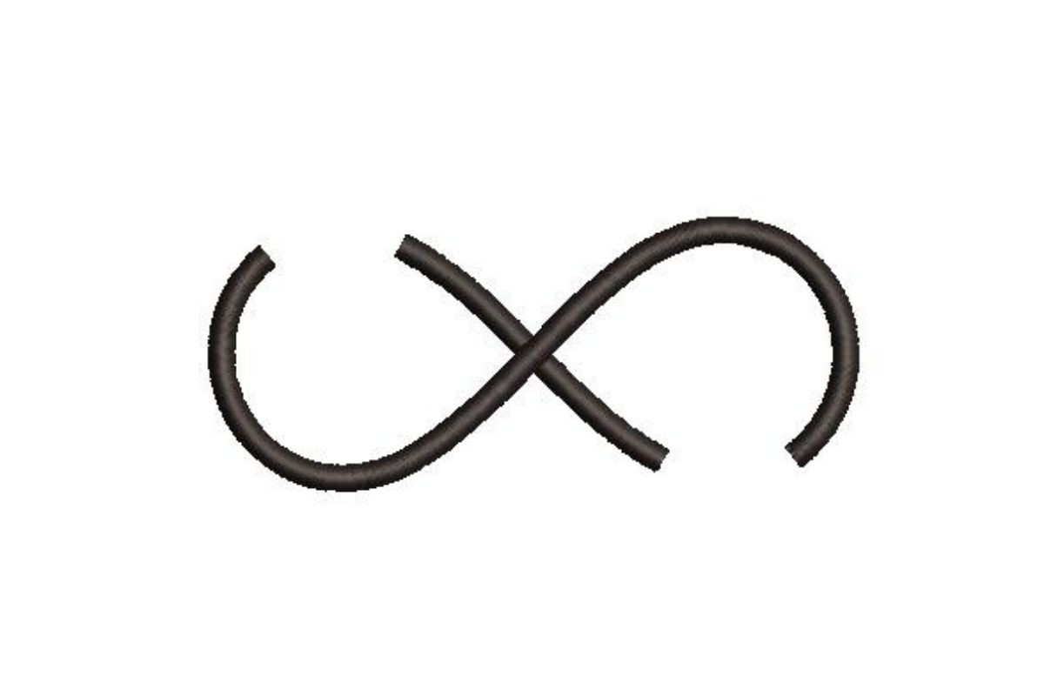
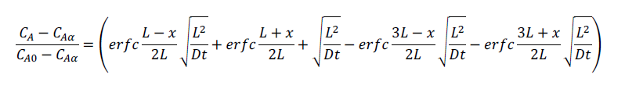
Diffusion
Diffusion is the net movement of molecules or atoms from a region of high
concentration to a region of low concentration as a result of random motion
of the molecules or atoms
Semi-infinite Body
[Relating to TAUTZ-1971-Leipzig]

Slide 9
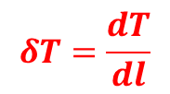
Convection
Convection is the movement caused within a fluid by the tendency of hotter
and Therefore, less dense material to rise, and colder, denser material to sink under the influence of gravity, which consequently results in transfer of heat.
$$δT=\frac{dT}{dl}$$
CFD - Computational Fluid Dynamics
Heat and Mass Transfer

Slide 10
The solution
Convection Cell

Slide 11
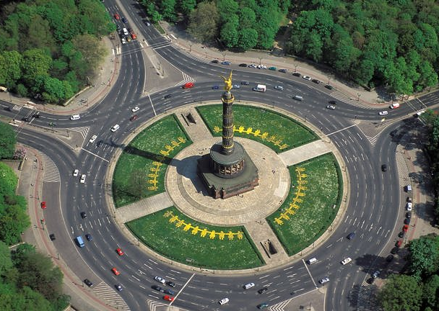
Convection
A
B
H
G
C
F
E
D

Slide 12


Convection
Berlin Wall/ Berliner Mauer

Slide 13
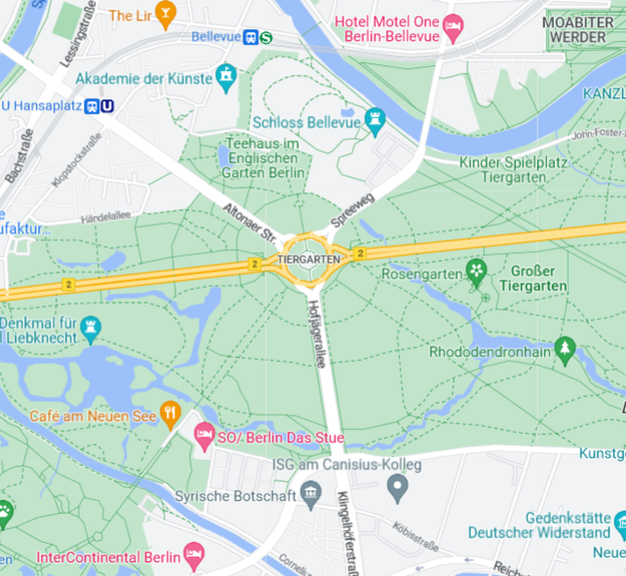

Convection
A
+20 min.
+30 min.
+15 min.
+20 min.
+20 min.
+30 min.
+15 min.
B
+20 min.

Slide 14


Convection
2 h
92 h

Slide 15
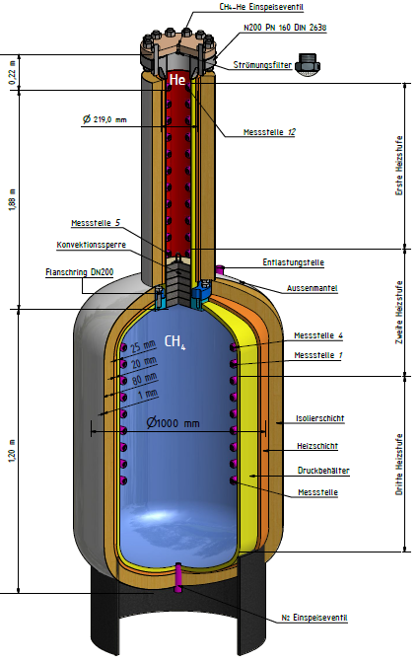
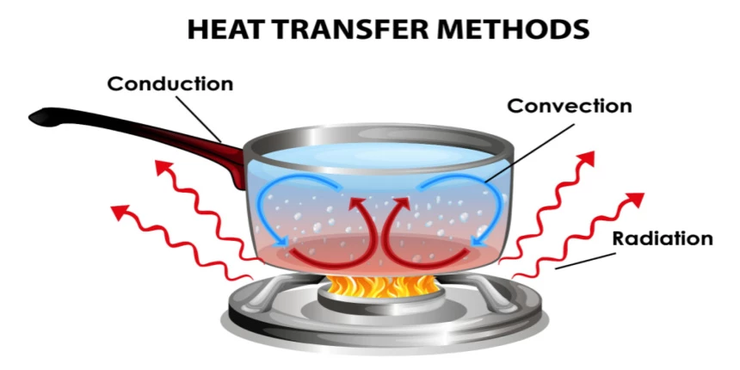
Analogy
A
∆U
B
E-systems
A
∆P
B
Fluid dynamics
Heat Transfer

Slide 16
Application
New requirements of the Mining Authorities in DE and in EU
Rising of new H2-storages (caverns)
Converting natural gas caverns to H2-caverns
What is still required to complete
the new method?
Test on real caverns
Building the convection Barrier
Financing

Slide 17


