Slide 1
Coordination Committee Meeting
Brussels, Belgium
2022.04.12

Slide 2
Meeting Agenda
Moderated by CC Chair
8: 30 – 9: 30 CC Meeting 1
Opening remarks by CC Chair (5 mins)
Message from IGU President (10mins)
CC Information updates by CC Secretary (25 mins）
LNG Committee Chair Replacement Introduction to members recruitment
Introduction to CC work results
Introduction to updated SCOA by Tatiana (20 mins)
9: 30 – 10 : 00 Coffee Break
10 : 00 - 12: 30 CC Meeting 2
Introduction to work progress of Committees and TFs (150 mins)
(Work plan implementation: research activities and periodical results, meeting results, flagship reports progress, multi-tiered external relations development)
12: 30 – 14: 00 CC Lunch
14: 00 – 15: 30 CC Meeting 3
Discussion: Sessions framework, topics, prizes, platform, tools, innovative ideas for WGC2025 CC Reminder

Slide 3
CC Meeting 1
Opening remarks by CC Chair
Message from IGU President
CC Information updates by CC Secretary
  LNG Committee Chair Replacement
  Introduction to members recruitment
  Introduction to CC work results
Introduction to updated SCOA by Tatiana

Slide 4
Opening Remarks

Slide 5
Message from IGU President

Slide 6
CC Information updates

Slide 7

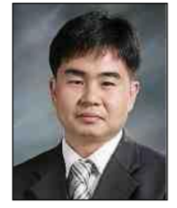
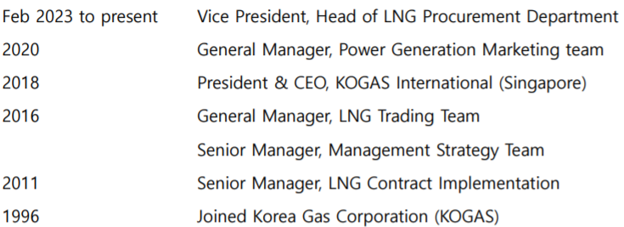
New LNG Committee Chair
EXC is asked to approve the appointment

Slide 8
New Transmission Committee Chair
Mr. Maurizio Zangrandi
Proposed replacement for Mr. Vittorio Musazzi, SNAM
EXC is asked to approve the appointment
2020-2022 Co-CEO, OLT (Offshore LNG Toscana)
2019 Chairman and CEO, Enura
2018 CEO, GNL Italia
SVP Transportation Network, SNAM
Head of Compression Station Department, SNAM
2007 Planning & Cost Control Head, SNAM

Slide 9
New Secretaries
Marketing and Communications Committee
Secretary: Richard Kvasnovsky (Executive Director of SPNZ/Slovak Gas and Oil Association)
TFD
Secretary: Xinwo Huang & Kun Liang (Tencent)

Slide 10
Results of Members Recruitment
Unit | Number of member | Number of Country
E&P | 25 | 15
Storage | 35 | 19
Transmission | 40 | 22
Distribution | 47 | 25
Utilisation | 36 | 18
Sustainability | 47 | 25
Strategy | 53 | 24
Gas Markets | 46 | 21
LNG | 73 | 29
Marketing & Communications | 30 | 19
R&D and Innovation | 58 | 24
TFS | 12 | 8
TFN | 21 | 10
TFD | 15 | 7
Total | 538

Slide 11
Analysis of Committee/TF Members
Male | Female
396 | 142
Thailand and Ukraine contributed most of the increment since the CC Lima meeting.

Slide 12
Committees/TFs Meetings Schedule (2023 1H)
E&P
Storage
Transmission | May 2 – 5，Kuala Lumpur, Malaysia
Distribution | April 4 – 6, Lisbon, Portugal
Utilisation | May 17 –19, Lisbon, Portugal
Sustainability | March 13 – 15, London, UK
Strategy | March 13 – 15, Tel-Aviv, Israel
Gas Markets | Week1, April, Malaysia
LNG | March 28 – 30, Seoul, Korea
Mkt & Comm | March 24, online
RDI | March 28 – 30, Cartagena, Colombia
TFN | March 21, online
TFD | March 27, online
* CC needs to keep a record of Committee meeting minutes and presented slides.

Slide 13
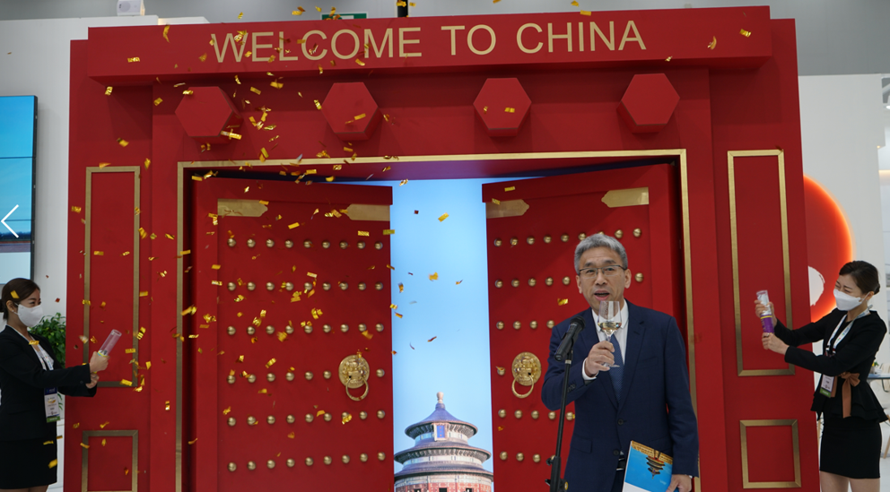
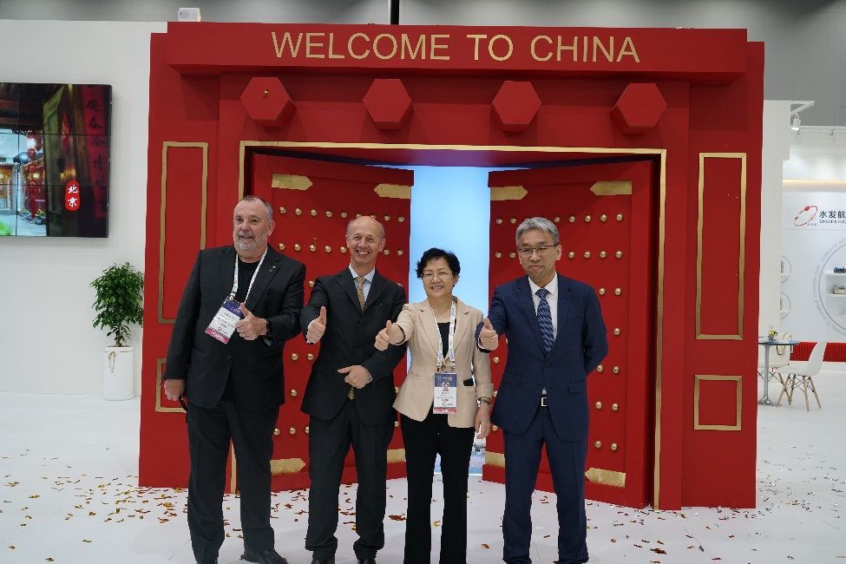
WGC2025 Launching Ceremony in Daegu

Slide 14
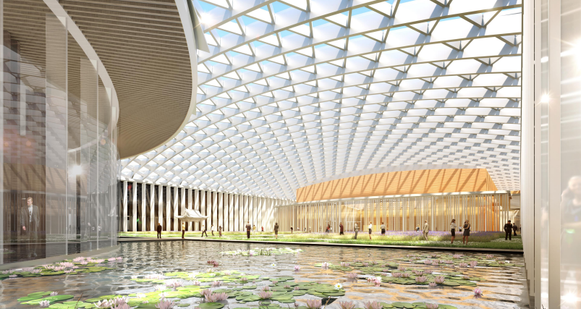

Indoor Scene of CNCC

Slide 15







WGC2025 Logo

Slide 16
WGC2025 Preparation —— Brussels Phase
BRUSSELS PHASE
DECEMBER 2022 (12.22) > FEBRUARY 2023 (02.23)
MARCH 2023 (03.23)
BRUSSELS 10-13 APRIL 2023
STRATEGIC MARKETING
PLAN TEMPLATE
Refer section 1
SELECT & PRIORITSE DELEGATE TARGET AUDIENCES INTO CATEGORIES
PAST AUDIENCE ANALYIS
TARGET AUDIENCE REPRORT
Combine potential target audiences for review in Brussels
MATCH TARGET AUDIENCE CATEGORIES TO CONFERENCE THEMES
GROWTH & NEW AUDIENCE ANALYIS
DELEGATE PRODUCT TEMPLATE
Framework for delegate product including pricing and inclusions.
Historical products from past events and innovative ideas, to match audiences
REVIEW DELEGATE PRODUCT
including pricing and inclusions (final approval Perth)
GROWTH & NEW AUDIENCE ANALYIS
CONFIRM CONFERENCE FRAMEWORK & CHINA PROTOCOLS
DETERMINE BRUSSELS ATTENDEES
Presidency, CC, IGU secretariat, WGC2028 NOC
CONFIRM CFA SESSION STRUCTURE & NUMBER OF SESSIONS
DRAFT CONFERENCE FRAMEWORK
Refer section 2
Populate the conference framework with session type
DELEGATE PRODUCT TEMPLATE
Framework for delegate product including pricing and inclusions.
Historical products from past events and innovative ideas, to match audiences
REVIEW CFA PROCESS & TIMELINE
PROPOSE NUMBER OF CFA SESSIONS REQUIRED
DETAIL ASSISTANCE REQUIRED FROM PCEOs
CONFERENCE FRAMEWORK & GUIDELINES
Refer section 3 for timetable of CFA
CFA speaker selection framework & timeline
CFA management guidelines
FINALISE TOPIC SELECTION PROCESS WITH CC
REVIEW OBJECTIVES & STRAEGY FOR AWARDS
RESPONSIBILITIES
CC
PCEOs
NOC
CONFIRM OBJECTIVES AND TIMETIME OF PERTH PHASE
ABOVE GATHER AS “WORKING GROUP”

Slide 17
CC Tasks in Brussels Phase
1. Target audiences
  Identify new areas of industry growth and the audience relevant to WGC2025;
  Identify audiences under-represented at WGC2022 but important to industry and require development. (Rodney and Jason join)
To facilitate committee/TF members inclusion, PCEOs will provide a portal link where everyone can enter their feedback.
2. Framework and number of sessions and topics for WGC2025 Programme
  Variables the NOC/CC will address in planning the framework and the number of sessions
    No. of sessions allocated to Industry Insights (time, format flexibility and placement)
    No. of speakers per session (including time for Q&A)
    Innovations such as role of moderators, industry support, additional speakers

Slide 18
Results of Survey on New Audiences
  Agriculture, Waste management, e-methane and biomethane start-ups and research institutes
  Regulators, policy makers, Non-Governmental Organisations, big electricity producers (we want to attract attention on energy storage using renewable gases, these is the audience that needs to understand the benefits of such solution and how they can help it to grow), H2-Storage (lack of skilled workers).
  Renewable and low-carbon gasses, innovative gas start-up companies.
  Renewable gases: biomethane and hydrogen, ESG Methane emissions and climate change. Regarding biomethane we should be more in contact with primary sector: agriculture, manure, waste treatment plants, landfills, etc. who are the ones who have the raw material for biomethane production. As well, we should be more in contact with power energy sector (electricity) trying to get sector coupling between electricity and gas.
  NGO related to climate and environmental issues;
  Influential entities in the field of ESG. (We need to find those bodies with whom we can hold a dialogue to promote the positioning of natural gas in the ESG world) ;
  Stakeholders related to issues of security and energy security. (The goal is to create a connection between ESG, the development of the global gas industry, the effort to reduce the energy imbalance in the world, and the issue of global warming. Today, more than ever, these factors can be linked to the understanding that the development of natural gas infrastructure in the world is the key to reducing greenhouse gas emissions while strengthening global energy security. Other solutions are ineffective in the short term and not sustainable for long-term improvement in these issues.)

Slide 19
Reported Number of Sessions (II+TI)
Storage Committee | 1. Gas Storage Database
1+1 | 2. Best Practices in UGS Design, Operations & Maintenance
 | 3. UGS in Today's Markets and Environments
Strategy Committee | 1. Strategic challenges: security of supply and environment commitments
6+2 | 2. Pricing for Natural Gas
 | common topic: Global Gas Policy Study for Regulation Improvement and Gas Advocacy
R&D and Innovation Committee | 1. Environmental performance along the gas value chain
3+3+1 | 2. Decarbonisation technologies in the gas value chain
 | 3. Digitalisation and the strategy for gas innovation
 | common topic: Gas research, development and innovation to bring clean and affordable energy across the world
Sustainability Committee | 1. Renewable Gases as a solution
3+1+1 | 2. Methane Emissions Reduction
 | 3. Environmental and Social Governance
TFN 1+1 | Carbon Neutrality in the Gas Industry: Accelerating the decarbonisation and emission reduction of natural gas with the coordinated development of new gases to achieve Paris Agreement goals

Slide 20
Updated SCOA
SCMD, IGU Secretariat

Slide 21
Coffee Break

Slide 22
CC Meeting 2
Introduction to work progress of each Committee and TF
(Work plan implementation: research activities and periodical results, meeting results, flagship reports progress, multi-tiered external relations development)

Slide 23
Work Progress of Each Committee & TF

Slide 25
Lunch

Slide 26
CC Meeting 3
Discussion: Sessions framework, topics, prizes, platform, tools, innovative ideas for WGC2025

Slide 27
To Discuss
  Potential special session to facilitate triennial results
  Sessions (number/topics) to be held by your Committee/TF;
  Suggestions to criteria of paper selection for CfA/CfP;
  Your participation in and expectation from Young Professional Program
  Suggestions to the design of Awards, including the design of categories, the composition of jury, etc.

Slide 28
Potential special session to facilitate triennial results
The NOC seeks CC interest in a potential new opportunity for all Chairs to present the triennial results of their Committees/TFs in a special conference session.
Note: This was traditionally done in the CC meeting before WGC (NOC joins).
If this concept is of interest then the WGC2025 working group will explore options for further discussion in Brussels and for inclusion in Perth.
Do SGs need to present their triennial report?

Slide 29
Framework of Sessions (Example for discussion)
 |  | Day 0
Time | Activity | Time | Activity
 | IGU meetings |  | Master Class Ministerial Forum
Day 1 |  |  |  | Day 2 |  |  |  | Day 3 |  |  |  | Day 4
Time | Activity | Parellel | Duration | Activity |  | Parellel | Duration |  | Activity | Parellel | Duration | Activity | Parellel | Duration
9:00 | WGC Opening Ceremony |  | 9:00-10:00 | Plenary Session3 （Gas in Energy Transition for Sustainability） |  |  | 9:00-10:30 30 mins break |  | Plenary Session5 （Gas Benefits Regions） |  | 9:00-10:30 30 mins break | Plenary Session7 (Gas Unilisation) |  | 9:00-10:30 30 mins break
10:00 | Opening Keynote (Maximising Gas Benefits towards a Shared Future) |  | 10:00-11:30
11:00 | Expo Opening Cenremony |  | 11:30-12:30 | Current Debates1 (Decarbonisation/CCUS / Methane Emission/New Gases/Coupling with renewalbes) |  | TI2 (stra1/tfn1/sust1） | 11:00-12:30 |  | Current Debates 3 (Female Leaders Forum/ Gas mobility / Eco-pol-socio pattern) | TI4 (stor1/sust-s/... ) | 11:00-12:30 | Current Debates4 （Marine transport / Building / Labour and Professionals / TWP Release ) | TI6 (rdi3/) | 11:00-12:30
12:30-14:00 | Keynote Luncheon (Yerqin) |  | 12:30-14:00 | Keynote Luncheon （Energy Entrepreneurs Forum） |  |  | 12:30-14:00 |  | Keynote Luncheon （China Think Tank reports） |  | 12:30-14:00 | Keynote Luncheon （S&P/Woodmac/Bloomberg/Sia/Accenture..） | YLP Closing | 12:30-14:00
14:00 | Plenary Session1 （New Energy System in a Shared Future） |  | 14:00-15:30 15 mins break | Plenary Session 4 (Gas+Digitalisation) |  |  | 14:00-15:30 15 mins break |  | Plenary Session6 (Gas + Finance) |  | 14:00-15:30 15 mins break | II5 (stra6+tfn1+rdi3) | TI7 ( ) | 14:00-15:00 15 mins break
15:00 | Plenary Session2 （Beijing Declaration） | TI1 ( rdi1/ ) | 15:45-17:15 15 mins break | Current Debates2 (Gas Company Evolution /QHSE/Supply chain/ Business innovation / Start-ups) |  | TI3 ( ... ) | 15:45-16:45 15 mins break |  | II3 (stra4+sust3） | TI5 （stra2/rdi-s/... ) | 15:45-16:45 15 mins break | WGC Closing Ceremony+Awards Ceremony |  | 15:15-16:30
16:00
17:00 | II1 (stra1+stra2+ sust 1+rdi1) |  | 17:30-18:30 | YLP Opening | II2 （stra3+stor1+sust2 |  | 17:00-18:00 |  | II4 (stra5+rdi2） |  | 17:00-18:00
18:30 |  |  |  |  |  |  |  |  | Social Banquet |  | 18：30-19：30
Put apples and oranges in baskets

Slide 30
Number and Themes of Sessions
Plenary Sessions (7 determined)
Current Debates (?)
Industrial Insights (?)
Technology & Innovation (?)
Others for CC (RDI + Sustainability?)
Others for NOC (Master Class, Young Leaders Program, Female Professionals Forum)

Slide 31
Number of Sessions (II+TI)
Transmission Committee | 1. Digitalisation and Artificial Intelligence
3 | 2. Safety and environmental footprint of transmission systems
 | 3. Sector coupling and new gases for transmission systems
Marketing & Communications Committee | 1. The narrative for the global gas industry
 | 2. Social media for the gas industry's benefit
3 | 3. Marketing innovation, innovation in marketing
Exploration & Production Committee | 1. Designing and implementing a Safe and Sustainable Energy Future
3 | 2. Enabling Technologies for the "Next-Normal"
Distribution Committee | 1. Make Grids Smarter
3 | 2. Support the Hydrogen Economy
 | 3. Expand Innovation System
Utilisation Committee | 1. Industrial Gas Utilisation
3 | 2. Domestic and Commercial
 | 3. Natural Gas for Transport
LNG Committee | 1. Market Evolution - LNG Commoditisation
3 | 2. Carbon Neutrality Trends Impact on LNG Business, LNG Demand and Opportunities for LNG
 | 3. Create LNG demand with the development of a new utilisation sector in Developing/Under-developed Countries
 | 4. Sub-Task Force: The IGU World LNG Report
Gas Markets Committee | 1. Regional gas markets development
 | 2. Greening the gas markets
4 | 3. Impact of pandemics on gas markets
 | common topic: Global Gas Industry Differentiated Development and Best Practices Report
TFD 3 | Gas Industry Digitalisation Report: “Digitalisation + Gas" for efficient operation, collaborative innovation and value promotion
TFS 2 | a key platform to discuss and debate hotspot issues of the gas industry, support the development of the IGU position paper, provides inputs for the design and delivery of IGU Strategic Communications and Outreach Plans
Responded
Suggested
Storage Committee | 1. Gas Storage Database
1+1 | 2. Best Practices in UGS Design, Operations & Maintenance
 | 3. UGS in Today's Markets and Environments
Strategy Committee | 1. Strategic challenges: security of supply and environment commitments
6+2 | 2. Pricing for Natural Gas
 | common topic: Global Gas Policy Study for Regulation Improvement and Gas Advocacy
R&D and Innovation Committee | 1. Environmental performance along the gas value chain
3+3+1 | 2. Decarbonisation technologies in the gas value chain
 | 3. Digitalisation and the strategy for gas innovation
 | common topic: Gas research, development and innovation to bring clean and affordable energy across the world
Sustainability Committee | 1. Renewable Gases as a solution
3+1+1 | 2. Methane Emissions Reduction
 | 3. Environmental and Social Governance
TFN 1+1 | Carbon Neutrality in the Gas Industry: Accelerating the decarbonisation and emission reduction of natural gas with the coordinated development of new gases to achieve Paris Agreement goals
24:27
Overlaps?
TFS?
Please choose time slots and design topics by Sept. 2023
Meeting rooms will be more than you require!

Slide 32
Call for Abstracts/Papers
System Design
n

Slide 33
Required to Launch Call for Abstracts
Confirmation of sessions available in programme (NOC)
Confirmation of timetable (CC / NOC)
Confirmation of topics (Committees)
Selection of abstract software (PCEOs / NOC)
Confirmation of administrative support team (PCEOs)
Confirmation of policies (CC)
Marketing plan for Call for Abstracts (PCEOs / NOC)

Slide 34
1. Session Planning
NOC to brief CC on timing and quantity of session blocks available
NOC and CC to agree on number of concurrent sessions to occur per block
  Consider daily audience traffic so that audience size is appropriate
  > determines total sessions available
CC to determine speaker quantity per session end of 2024？
  > determines total speaker numbers and speaking duration

Slide 35
2019 Audience Traffic

Slide 36
Lessons from past IGU Events
Industry Insights | WGC2018 | WGC2022 | LNG2023
Concurrent Sessions
Day 1 | 8 |  | 4
Day 2 | 8+8 | 4+4 | 4
Day 3 | 8+8 | 7+4 | 4+4
Day 4 | 8 | 4 | 4
Total Blocks | 6 | 5 | 5
Total Sessions | 48 | 23 | 20
Duration (min) per sess. | 90 | 75 | 90*
Speakers per session | 6 | 3-4 | 5
Avg Speaking time (min) | 15 | 15 | 15
Total Speakers | 290 | 75 | 100+
“6+6” means 6 concurrent sessions during a single time block, followed by another 6 concurrent sessions in another time block later in the same day
“Total Blocks” are the number time blocks allocated in the programme for the industry insights.
* Includes post session speaker/delegate informal discussions

Slide 37
Considerations for WGC2025
Blank Worksheet | Total | Day 1 | Day 2 | Day 3 | Day 4 |  | Example Worksheet | Total | Day 1 | Day 2 | Day 3 | Day 4
Visitor Attendance |  | 29% | 37% | 23% | 11% |  | Visitor Attendance |  | 29% | 37% | 23% | 11%
Share of Maximum Day |  | 78% | 100% | 62% | 30% |  | Share of Maximum Day |  | 78% | 100% | 62% | 30%
Plenary Session (Target) | 2500 | 1959 | 2500 | 1554 | 743 |  | Plenary Session (Target) | 2500 | 1959 | 2500 | 1554 | 743
Visitors Breakout Sessions | 80% | 1567 | 2000 | 1243 | 594 |  | Visitors Breakout Sessions | 80% | 1567 | 2000 | 1243 | 594
Sessions per block |  |  |  |  |  |  | Sessions per block |  | 6 | 6 | 5 | 3
Average Room Attendance |  |  |  |  |  |  | Average Room Attendance |  | 261 | 333 | 249 | 198
Blocks Provided |  |  |  |  |  |  | Blocks Provided | 7 | 1 | 2 | 2 | 2
Sessions |  |  |  |  |  |  | Sessions | 34 | 6 | 12 | 10 | 6
Duration per session |  |  |  |  |  |  | Duration per session |  | 75 | 75 | 75 | 75
Q&A Time |  |  |  |  |  |  | Q&A Time |  | 10 | 10 | 10 | 10
Speaker Time |  |  |  |  |  |  | Speaker Time |  | 12 | 12 | 12 | 12
Total Speakers per session |  |  |  |  |  |  | Total Speakers per session |  | 5 | 5 | 5 | 5
Total Speakers |  |  |  |  |  |  | Total Speakers | 170 | 30 | 60 | 50 | 30
Considerations
Assume 80% of the day’s plenary audience will then attend breakout
Shorter sessions – post lockdowns, shorter attention span
Fewer concurrent sessions - larger audiences per room
Fewer concurrent sessions for last 2 days of event - fewer delegates present each day as event progresses)

Slide 38
2. Timeline confirmation
Reconcile the PCEO and CC timelines and agree common deadlines for key activities and milestones
  Key items to review (RED)
 | Proposed (New)
 | Week | Start | Week | Due
Brief CC members ahead of topic selection (at IGU Exec. Meeting) | - 110 | 10-Apr-23 | - 110 | 10-Apr-23
Committees Determine Sessions & Awards Formats, Topics and Descriptions | - 108 | 24-Apr-23 | - 86 | 25-Sep-23
Abstract System Design | - 93 | 07-Aug-23 | - 86 | 25-Sep-23
Share CFA Promotional Plan (at IGU Council Meeting) | - 83 | 16-Oct-23 | - 83 | 16-Oct-23
Call for Abstracts | - 79 | 13-Nov-23 | - 46 | 01-Jul-24
Train Committees in Review Software (at IGU Exec. Meeting) | - 60 | 25-Mar-24 | - 59 | 01-Apr-24
Review Abstracts | - 59 | 01-Apr-24 | - 35 | 16-Sep-24
Prepare Abstract Reports | - 35 | 16-Sep-24 | - 32 | 07-Oct-24
Author Notification Templates | - 33 | 30-Sep-24 | - 31 | 14-Oct-24
Select Abstracts (at IGU Council Meeting) | - 32 | 07-Oct-24 | - 31 | 14-Oct-24
Author Notification | - 30 | 21-Oct-24 | - 27 | 11-Nov-24
Speaker Confirmation | - 28 | 04-Nov-24 | - 24 | 02-Dec-24
Program Confirmed (Speakers, Sessions, Formats, Topics, Descriptions) | - 30 | 21-Oct-24 | - 20 | 30-Dec-24
Papers Received | - 27 | 11-Nov-24 | - 15 | 03-Feb-25
Awards Winners Finalised | - 11 | 03-Mar-25 | - 7 | 31-Mar-25

Slide 39
Key Items to Reconcile
Is the evaluation of abstracts considered the key author selection criteria by the committees?
  The Paper submission is an administrative function – papers checked that they fulfil the abstract’s brief.
  Method currently used by LNG2023.
  OR
Are Papers the key author selection criteria?
  Speakers will only be invited after submission of papers
  Method indicated by timeline presented in Peru

Slide 40
Issues to consider
Later submission of abstracts and papers allows topics to be more current in fast changing environment
A decision by an author to invest time in writing a paper for first presentation at WGC might be more likely if their abstract is allocated a speaking position, rather than waiting for a confirmation after a paper is submitted
  Poor papers can always be rejected during the administrative phase if they fail to meet the standards of committees and the brief promised by the Abstract.
  Comment from zk:
  Eight months for submitting an abstract and only three months for a full text paper? How to ensure the quality of paper? If paper has lower quality than its abstract (it is quite normal), the determined speaker will be refused, time will be wasted and we need to find the replacement. Will we have enough time and speaker candidates?
  Maybe we need to begin with the definitions of and requirements on abstract and paper (length – 1000 for abstract and 3000 for paper? style – text with publication format or ppt slides?)
  The criteria for awards and composition of evaluation team(s) are also to be considered and explained to the public.

Slide 41
3. Topic Selection
Committees to consider target audiences (existing and new)
Number of topics need not match number of sessions available. Allocation of topics to sessions can occur after submissions.
  Submissions might have relevance across topics or committee mandates.
  Submissions will likely be unevenly allocated between topic groupings
  Topics could be combined or split further into sub-groupings depending on volume and quantity of submissions per topic.
  Topics might span across several committee mandates

Slide 42
4. Abstract Software
Software should:
  Collect abstract submissions online - self completion and acknowledgement of policies
  Enable abstract voting by committee reviewers online
  Enable speaker communication and confirmation
  Enable paper collection
  Enable session allocation
  Enable collection and transfer of speaker biography and and abstract/papers to event app and/or website
Software options include:
  CVENT, CADMIUM

Slide 43
5. Confirmation of administrative support team (PCEOs)
The composition of the support team will be calibrated to match the desired CFA timetable.
Key milestones and activities include
  Programme Design
  Launch
  Training of Committee in Review Process
  Close of Abstracts and/or Papers
  Assisting Review process and presenting results and reports
  Informing Speakers, issuing agreements, collecting registrations
  Collecting and formatting speaker papers and presentations
  Promoting programme
  Delivering programme

Slide 44
6. Confirmation of policies (CC)
Example policy
The author should consider the following before submitting an abstract:
The subject must be original material, or new developments on existing material.
The abstract and corresponding content should not have been previously published.
Abstract length is a maximum 250 words (1500 characters)
  An upload of a single, additional file is optional and should only be submitted as a supporting document to further explain or add depth to the abstract.
  The abstract text is the key element of the submission. Please ensure this text contains all the important details you are seeking our reviewers to consider.
  Abbreviations must be spelt out in full for ease of reviewing.
  Brand names are not allowed in the title and should be used only to describe a clearly differentiated product or service.
Authors of accepted abstracts will be required to submit a complete paper, presentation or, in some instances, a poster, to complete their submission ahead of presenting at the event.
If requested, the author agrees to provide the conference organiser with any visuals or content summaries to assist with the promotion of the conference (which will also promote the individual author’s paper). These requests will be made between notification of paper selection and paper finalisation.
Review decisions of the Committees are final.

Slide 45
6. Confirmation of policies (CC)
Example policy (cont.)
By submitting your abstract, you agree to adhere to the following terms should your abstract be accepted:
You will not publish your paper's content elsewhere prior to the completion of the conference (Papers may be re-published elsewhere post-event, as long as the event is referenced as the original place of publication).
You will nominate a single lead author who will be registered as a "speaker" and will present the paper alone (or in the case of a poster will be the main contact point).
You accept that the review process decision of the Committee is final.
You accept that the abstracts, final papers, and posters will be published as part of conference proceedings and there is joint copyright with the event.
All authors presenting at the event will be required to register as a delegate and pay the registration fee applicable to speakers. If purchased prior to xxxx, the speaker fee is US$xxxx, before xxx the fee is US$xxxx, and after XXXXX US$XXXXX.
The Committee is committed to providing a high-quality conference experience for authors. Unless an author objects, all accepted conference papers will be published in the archive of the WGC Event Series, freely accessible approximately six months after the conclusion of the event.

Slide 46
6. Confirmation of policies (CC)
Example policy (cont.)
To enhance the conference experience for presenting authors, the Committee will also work to align the content of accepted abstracts with the most relevant audiences at the event. Authors accept that the Committee may move the abstract to another theme or topic within the conference programme and that the accepted content will form part of one of the below session types:
Theatre presentations: papers presented in the concurrent conference theatre rooms with a large audience
Roundtable presentations: important topics focused at a smaller, targeted audience
Poster presentations: highly specialised, often extremely technical topics displayed to all conference delegates.

Slide 47
7. Marketing plan for Call for Abstracts (PCEOs / NOC)
The marketing campaign for abstracts should be presented prior October 23rd
The marketing campaign is a mini-event campaign, with similar steps required as the overall event marketing plan.
The Call for Abstracts marketing plan will address the following core elements (see more detail in strategic planning meeting pre-read):
Objectives
Target Audiences
Market Analysis
Marketing Goals
Key Messages
Marketing Strategy
Marketing Activity Timeline
Product Plan

Slide 48
Others
  Your participation in and expectation from Young Professional Program
  Suggestions to the design of Awards, including the design of categories, the composition of jury, etc.

Slide 49
CC Reminder
Tasks to be fulfilled in Perth Phase
May 2023 - August 2023
  CC shares audiences & themes with committees.
  The Committees propose topics (using insights from audiences and themes) to fit session structure.
September 2023
  CC members will receive CfA Process & Strategy from NOC/PCEOs including timeline, software system design and promotional schedule.
October 2023 (Perth)
  The WGC2025 Working Group including the CC members will:
    Confirm the 4-day conference structure
    Finalise objectives & structure for awards
    Approval of CfA strategy, process & timelines for the launch of CfA in November

