Slide 1
Coordination Committee Meeting
Lima, Peru
2022.10.25

Slide 2
Updated information after the CC Lima meeting
p. 107 Add: TFN’s preliminary joint-efforts with other Committees/TFs
pp. 125-140 Add: E&P Committee’s presentation
p. 164 Timeline revised (for further discussion)
p. 165 Add: each Committee/TF contributes at least 3 sessions

Slide 3
Meeting Agenda
Moderated by CC Chair
8: 30 – 9: 40 CC Meeting 1
Opening remarks by CC Chair (5 mins)
Message from IGU President and Certificates Awarding Ceremony (15mins) CC Information updates by CC Secretary（10 mins）
Introduction to members recruitment
Introduction to IGU Members Portal training TWP2022-2025 full text version updates
Discussion Topic One: How to motivate members to join CC activities and stimulate individuals to contribute to committees and TFs they are nominated to? (40 mins)
9: 40 – 10 : 00 Coffee break
10 : 00 - 12: 00 CC Meeting 2
Introduction to work progress of Committees and TFs (100 mins)
Work plan updates, meeting schedule and first meetings, activities and periodical results, flagship reports, multi-tiered external relations development Introduction to updated SCOA by Tatiana (20 mins)
12: 00 – 13: 30 CC Luncheon
13: 30 – 14: 30 CC Meeting 3
Expected Activities to be organised: Online lectures by IGU experts, IGU Gas & Youth Actions (training young professionals)…. Sharing of the CC Personnel Database Discussion Topic Two: Sessions and topics for WGC2025 to be discussed in 1H 2023 (60 mins)

Slide 4
CC Meeting 1
Opening remarks by CC Chair
Message from IGU President & Certificates Awarding Ceremony
CC Information updates
Results of members recruitment
Results of Members Portal training
TWP2022-2025 full text version updates
Discussion Topic One：How to motivate members to join CC activities and stimulate individuals to contribute to committees and TFs they are nominated to?

Slide 5
Opening Remarks
1

Slide 6
Attendees
Role |  | Mr/Ms | Name | Surname
IGU President |  | Ms | Yalan | Li
IGU Vice President |  | Mr | Andrea | Stegher
IGU Immediate Past President |  | Mr | Joe M. | Kang
CC Chair |  | Mr | Lei | Yang
CC Vice Chair |  | Mr | Vittorio | Musazzi
CC Secretary |  | Mr | Kai | Zhu
CC China Office Manager |  | Ms | Yuanhua | Zhang
Secretary General |  | Mr | Milton | Catelin
Flagship Events Director |  | Mr | Rodney | Cox
Strategic Communications & Membership Director |  | Ms | Tatiana | Khanberg
Membership Engagement Manager |  | Ms | Marcela | Martinez
Committee | Role | Mr/Ms | Name | Surname
Storage Committee | Chair | Mr | Ladislav | Barkoci
 | Secretary | Ms | Petra | Bocmanova
Transmission Committee | Chair | Mr | Vittorio | Musazzi
Sustainability Committee | Chair | Ms | Naiara | Ortiz de Mendibil
Strategy Committee | Chair | Mr | Amir | Foster
LNG Committee | Chair Rrepresentative | Mr | Jeongwook | Khang
 | Vice Chair | Mr | Atsuo | Kanno
R&D and Innovation Committee | Chair | Mr | Gerard | Martinus
 | Vice Chair | Mr | Duncan | Robinson
Task Forces | Role | Mr/Ms | Name | Surname
TFN | Chair | Mr | Jean-Marc | Leroy
TFS | Chair | Ms | Luz | Stella Murgas
Invitee | Role | Mr/Ms | Name | Surname
 | IGU Regional Coordinator | Mr | Marcel | Krammer
 | Head of International Cooperation Group of KOGAS | Ms | Eungung | Shim
 | NOC Secretary | Mr | Weiping | Shan
 | Presidency Director | Ms | Xuan | Tang
 | ETF | Mr | Jason | Berman

Slide 7
Message from IGU President
2

Slide 8
Certificates Awarding Ceremony

Slide 9
CC Information updates
3

Slide 10
Results of Members Recruitment
Unit | Number of member | Number of Country
E&P | 17 | 11
Storage | 34 | 18
Transmission | 30 | 17
Distribution | 37 | 23
Utilisation | 27 | 14
Sustainability | 39 | 23
Strategy | 41 | 21
Gas Markets | 43 | 20
LNG | 55 | 26
Marketing & Communications | 23 | 16
R&D and Innovation | 49 | 20
TFS | 12 | 8
TFN | 19 | 8
TFD | 11 | 5
Total | 437

Slide 11
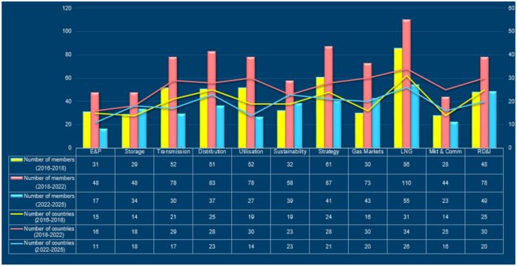
Comparison of Three Triennial Results

Slide 12
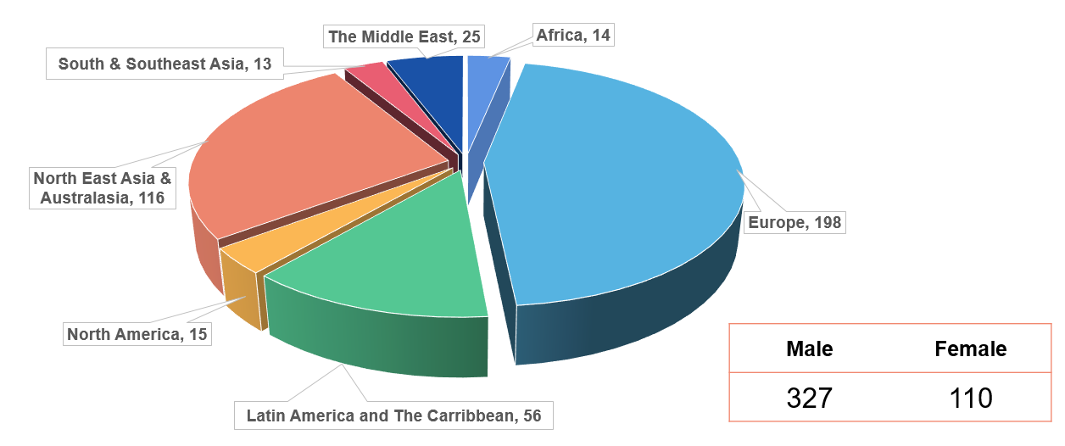
Analysis of Committee/TF Members
From 40 Countries

Slide 13
Results of IGU Members Portal Training
Five groups (ADMIN1 and ADMIN2) have already received and completed the training program.
R&D and Innovation
Storage
Strategy
Sustainability
Transmission
Marcela offers a bonus time to the attendees at the CC meeting in Lima - Oct. 25th from 16.00 to 18.00 in the IGU Secretariat Room at Swissotel, and continues the training program after Oct. 28th through online communication.

Slide 14
TWP 2022-2025
Revision of work plans
Strategy, RDI，Transmission and LNG Committees updated their work plans.
External relations
Waiting for Marketing & Communications Committee to complete the information.

Slide 15
First Meetings Schedule
E&P
Storage | Oct. 5-6 Bratislava, Slovakia
Transmission | Sept. 27-29 Sicilia, Italy
Distribution | Nov. 9-11 Essen, Germany
Utilisation | Nov. 3-5 Florianópolis/Santa Catarina/Brazil
Sustainability | Oct. 10-11 Barcelona, Spain
Strategy | Nov. 22-24 Warsaw, Poland
Gas Markets | Oct. 20 Online
LNG | Sept. 26 Online
Mkt & Comm
RDI | Sept. 20-22 Amsterdam, Netherlands & online
TFS
TFN | Oct. 7 online
TFD
* CC needs to keep a record of Committee meeting minutes.

Slide 16
Committees/TFs Personnel
Committee | Role | Mr/Ms | Name | Surname
E&P Committee | Chair | Mr | Emeka | Ene
 | Vice Chair | Mr | Aidid | Chee Tahir
 | Secretary
Storage Committee | Chair | Mr | Ladislav | Barkoci
 | Vice Chair | Dr | Amer | Abdel Haq
 | Secretary | Ms | Petra | Bocmanova
Transmission Committee | Chair | Mr | Vittorio | Musazzi
 | Vice Chair | Mr | Rudy | Van Beurden
 | Secretary | Mr | Marco | Fabbro
Distribution Committee | Chair | Dr | Jürgen | Grönner
 | Vice Chair | Mr | Stephane | Grit
 | Secretary | Mr | Klaas | Uwe
Utilisation Committee | Chair | Mr | Willian | Anderson Lehmkuhl
 | Vice Chair | Mr | Yong Shin | Kim
 | Secretary | Mr | Thais | Cunha
Sustainability Committee | Chair | Ms | Naiara | Ortiz de Mendibil
 | Vice Chair | Mr | Jon | Freeman
 | Secretary | Mr | Juan | Antonio Pérez
Strategy Committee | Chair | Mr | Amir | Foster
 | Vice Chair | Ms | Yan | Kang
 | Secretary | Dr | Eric | Semel
Gas Markets Committee | Chair | Mr | Mohd Khairuddin Ab |  | Khalik
 | Vice Chair | Mr | Rafael |  | Lamastra Junior
 | Secretary | Ms | Elinor |  | Bahrom
LNG Committee | Chair | Ms | Mi Jung |  | Nam
 | Vice Chair | Mr | Atsuo |  | Kanno
 | Secretary | Ms | Eun Ju |  | Lee
Marketing and Communications Committee | Chair | Mr | Akmal |  | Zaghloul
 | Vice Chair | Mr | Juraj |  | Adamica
 | Secretary
R&D and Innovation Committee | Chair | Dr | Gerard |  | Martinus
 | Vice Chair | Dr | Duncan |  | Robinson
 | Secretary | Mr | Bert-Jan |  | van Leeuwen
Task Forces | Role | Mr/Ms | Name | Surname
TFS | Chair | Ms | Luz | Stella Murgas Maya
 | Secretary
TFN | Chair | Mr | Jean-Marc | Leroy
 | Secretary
TFD | Chair | Dr | Yongping | Zhai
 | Secretary

Slide 17







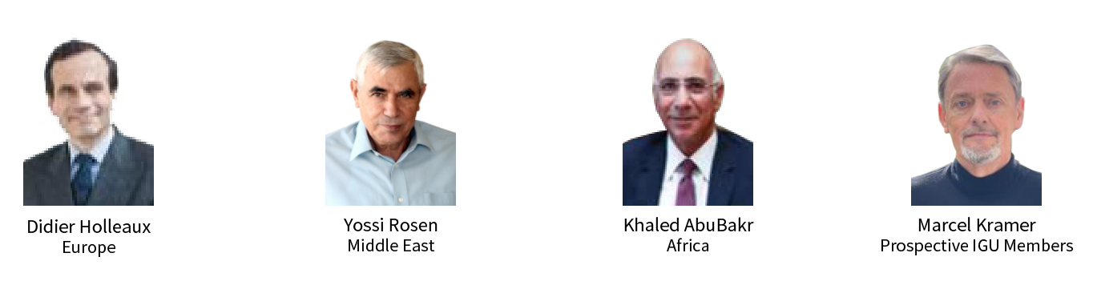

Regional Coordinators

Slide 18
Discussion Topic One
4
How to motivate members to join CC activities and stimulate individuals to contribute to committees and TFs they are nominated to?

Slide 19
Comments From Mr. Vittorio MUSAZZI
My current experience: Very few members appointed in TRACOM; some are onboard but not officially (I contacted them because they were in TRACOM in 2018/22 and they told me they will be part of TRACOM in this triennium as well but not yet officially (i.e. from Charter Members and then IGU) confirmed. How to deal with this?
Circulation of documents through the portal or mail
When possible: organising online meetings with members to clarify points
Strong link and work between Chair, Vice-Chair and Secretariat with SGs Leaders and Deputies (i.e. intermediate meetings between the official March/April & September/October meetings of the Committees & TFs)
  In TRACOM we appointed a “Management Team” composed by Chair/Vice Chair/Secretariat/SGs Leaders and Deputies to meet before each Committee meeting to
    Check SGs activities
    Potential new topics to address (from IGU from external world etc.)
Run another call for candidates through Charter Members and IGU Members: this together with the effort of Chair/V Chair/Secretariat and members of each COMM and TF could bring the necessary number of people to be directly involved in IGU activities to make final reports/deliverables and WGC 2025 a real success.

Slide 20
Comments From Mr. Vittorio MUSAZZI
Could be an idea to promote some actions from IGU in order to have in the LinkedIn IGU area a short report from all the meeting/webinars etc. in IGU so to attract attention and therefore participation to IGU activities from the external world? This should be a task for the Chair / V Chair / Secretariat of COMM/TF to prepare, submit to IGU for publication.
Anyhow, this IGU action should not avoid the company organizing the meeting to advertise the relevant IGU COM/ TF itself . Maybe in this case just the content to be similar, if not the same.
It maybe be useful to have (if not yet available) an area of the IGU website open to members only with the contacts information from the database.

Slide 21
Comments From Dr. Gerard Martinus
How can we unlock the ‘memory’ of IGU? As it stands now, each triennium seems to start with a blank sheet, and the results of the committees in previous triennium is not or hard to find. Is it possible that we recover that information? Or is that undesirable?

Slide 22
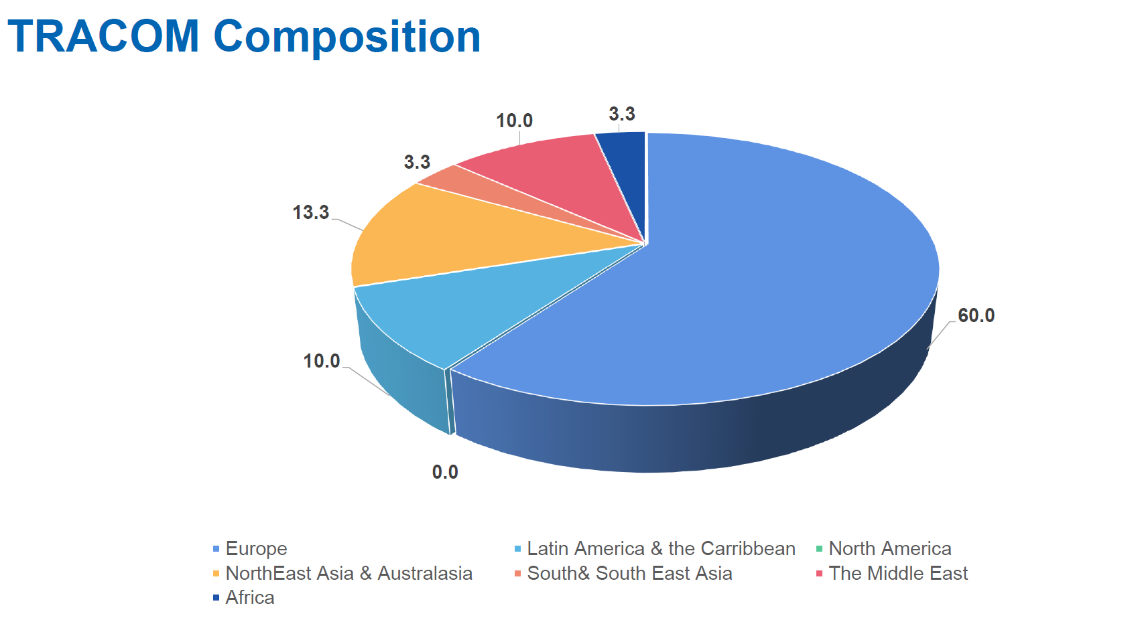
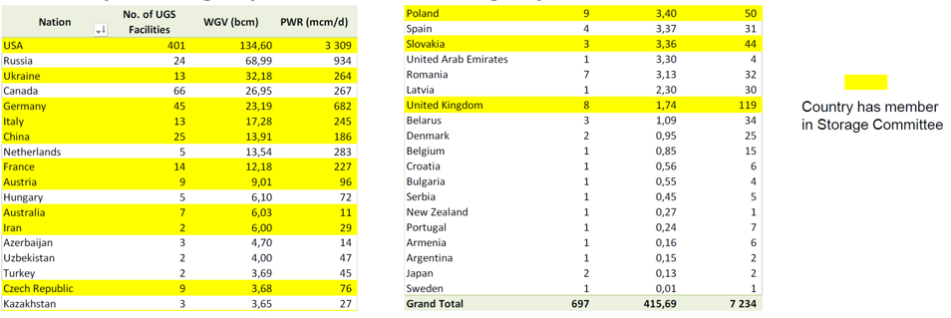
Comments From Zhu Kai
The official nomination of committee/TF individual members has lasted two months and ended in September. But the recruitment process is still going on. If you find some persons qualified, please let them find IGU members to nominate them. CC China Office will accept all nominations from IGU members. Chairs may have more focused regions/countries to develop new individual members – fill in the blanks.

Slide 23
Comments From Zhu Kai
A few Chairs lose contact with CC and with their individual members. If the Chairs are not mobilised, how can their individual members be motivated? Does CC have any power or means to push Chairs to work for the IGU?

Slide 24
Coffee Break

Slide 25
CC Meeting 2
Introduction to work progress of each Committee and TF
Including：work plan updates, triennial meetings schedule, first meeting, activities and periodical results, flagship reports, multi-tiered external relations development.
Introduction to updated SCOA

Slide 26
Work Progress of Each Committee & TF
5

Slide 27
Transmission Committee

Slide 28
In the information to the CC, TRACOM decided to deliver these following two topics within TRACOM & SGs
Organisational Chart: Chair/Vice Chair/ Secretariat/ SGs Leaders and Deputies, and their distribution in countries
Advocacy messages: we are going to ask each Study case to have a advocacy message at the end of the work so to enhance the coherence with the overall targets in Committee and in IGU

Slide 29
1
TRACOM TWP 2022-2025
2
TRACOM Study Groups Definition
3
First Meeting Highlights
4
Next meetings
5

Slide 30
TRACOM TWP 2022-2025
1

Slide 31
TRACOM TWP 2022 -2025
The work proposed for the triennium 2022-2025 takes into account the topics developed during last triennium and the conclusions of the Final Report delivered at WGC 2022 to ensure continuity and development of work.
The whole gas system is facing new challenges. Most of these challenges will be shared among the whole gas system industry and therefore there must be a great and fruitful connection between all the relevant Committees and Task Forces in the next triennium.
New technologies (Digitalization and Artificial Intelligence), security of supply and continuity granted by the gas systems and the possibility to accept new gases will also be crucial for the near future of the transmission system.
Moreover, the regulations schemes need to be reviewed to prepare all the countries for fair and well-developed rules and to include new gases.
Sustainability targets will also be very challenging in order to reach the expected environmental targets all over the world, making natural gas more accepted and in the vision of conversion to renewable gases. According to this, the existing gas infrastructure should be seen as an enabler for the decarbonisation.

Slide 32
Advocacy Messages
All the study cases will have a final message in line with the theme of the Triennium (Maximising Gas Benefits) and strictly related to the topic discussed/presented in the study case.
This message will be proposed by the author/s and discussed with the SG Leader and finally proposed for approval to the TRACOM Management Team.

Slide 33
TRACOM Study Groups Definition
2

Slide 34
TRACOM TWP 2022-2025
Study Groups 1, 2, 3 have been confirmed
SG1 – 5 participants
SG3 – 8 participants
Digitalization and Artificial Intelligence in Transmission Systems
Sector coupling and new gases for Transmission Systems
SG2 – 5 participants
SG4
Safety and environmental footprint of Transmission systems
Third Party Access
CANCELED
As there had been just few members signing up for SG4 Third Party Access, therefore MT has suggested to cancel such study group and to deal with its topics within SG3.
* Number of participants to SGs is referred to people attending the 1st meeting in Italy last September.

Slide 35
Study Group 1 - Digitalisation and Artificial Intelligence in Transmission Systems
Scope
Questions to be addressed
The following indicative and non-exhaustive areas will be included:
Analysis of the most updated Digitalization & AI technologies applicable for enhancing performance of transmission systems
Digitalization & AI contribution to optimization of activities, with a look at the existing examples and potential future applications.
Security to Digitalization & AI (Cyber attacks preventions policies)
Lessons learnt from COVID 19: organization & leadership and how Digitalization & AI helped during the period on that (e.g. remote work/home office and emergency response for crititcal infrastructures / maintenance, etc.)
How new technologies Digitalization & AI can help the optimization of transmission systems?
How new technologies can further develop and increase safety and efficiency during the operational activities?
How to improve further reliability and operations of gas transmission lines?
How to defend the transmission systems in the AI & Digitalization era?
Ensure that your computer/laptop is always powered and protected against unauthorized intrusion
Chapter Proposal
1
2
3
The most updated digital technologies and AI on enhancing integrity, reliability and performance of transmission gas system
How the new technologies regarding digitalization (processes, assets, …) enhance optimization and safety of on-field activities
Cybersecurity (and how did digitization and AI help during COVID 19 period)

Slide 36
Study Group 2 - Safety and Environmental Footprint of Transmission Systems
Scope
Questions to address
Analysis of the current technologies and reporting metrics for gas emission reductions
Analysis of the most important new technologies for the enhancement of safety for transmission systems
Analysis of how new technologies can improve the environmental footprint of the safety and emission reduction area
Lessons learnt from COVID 19 regarding the organization & management of transmission network infrastructure procedures (e.g. remote work / home office and emergency response and critical infrastructure / maintenance)
How to further reduce gas transmission emissions (fugitive leaks, maintenance & fuel gas)?
What are the public acceptance arguments in favor of pipelines (technical integrity, biodiversity preservation, archeological aspects, enabler of green industry) ?
How to further increase the safety of transmission systems through patrolling and safety criteria?
Chapter Proposal
Technologies and reporting metrics for gas emission reductions
1
Management of transmission system during Covid period: new best practices deployed and management models
2
New technologies for the enhancement of transmission systems safety
3

Slide 37
Study Group 3 - Sector Coupling and New Gases for Transmission Systems
Scope
Questions to address
Analysis of the updated technologies to enhance the cooperation between different systems (gas & power);
Analysis of the potential benefits of this cooperation amongst the two systems;
Analysis, challenges and tests of the conversion of infrastructures natural gas systems (pipelines/compressor stations etc.) to new gases (e.g. various levels of hydrogen and other new gases in the blend)
Regulatory framework stimulating new gases
How can gas systems helps the balancing of the power systems?
Which are the available technologies for transmission systems to increase the cooperation with power systems (P2G, power recovery from Pressure Reduction Stations etc.)?
How further allow the transmission of new gases in the current systems, which are the limitation (physical, standards availability etc.)?
What is necessary to do to have a real gas assets readiness for the transmission systems for new gases?
Chapter Proposal
Sector coupling – Examples of cooperation
1
Study cases in operating hydrogen grids and H2 readiness studies
2
New gases: best practices and study cases in operating transmission systems
3

Slide 38
Differences between TWP SG proposals and SG topics after first meeting
The main differences between the proposal done at the beginning of the triennium and the decisions made after discussion with the SG Leaders are the following ones:
SG3 will partially deal with regulations of new gases, covering some topics which were meant to be part of SG4;
SG3 decided to present study cases related to new gases in general in chapter 3, rather having a whole chapter for biomethane.

Slide 39
Organisational Chart
Vittorio MUSAZZI
CHAIRMAN
This chart reflects our will to have motivated and experienced people leading IGU Study Groups.
There’s a significative geographic distribution (four continents).
Rudy van BEURDEN
VICE CHAIRMAN
Marco FABBRO
SECRETARY
SG1
Digitalization and
Artificial Intelligence
in Transmission Systems
SG2
Safety and environmental
footprint
of Transmission systems
SG3
Sector coupling and new gases for Transmission Systems
SG4 (TBC)
Third Party Access
to Transmission Systems
Mio KOBAYASHI (Tokio Gas)
Marianella OJEDA (Promigas)
Michal SLABY (Net4Gas)
TBD
LEADER
LEADER
LEADER
LEADER
Fabrizio BORRI (Snam)
Mohd NAZMI (Petronas)
Nourreddine SAID (Sergaz)
TBD
DEPUTY LEADER
DEPUTY LEADER
DEPUTY LEADER
DEPUTY LEADER
TBD
TBD
TBD
TBD
CHAPTER LEADERS
CHAPTER LEADERS
CHAPTER LEADERS
CHAPTER LEADERS

Slide 40
4
First Meeting Highlights

Slide 41
First Meeting Highlights
Number of participants: 18 + Chair, Vice Chair and Secretary
Number of countries represented: 13; only 4 Non European countries
Number of proposed study cases for next meetings: 17 from 11 companies
Some topics discussed so far are possibly to be shared with TFD and Distribution Committee

Slide 42
TRACOM Composition

Slide 43
Considerations after First Meeting
At the time of the first TRACOM meeting only 29 people coming from 16 different countries were appointed.
Current number of members in TRACOM: 30
During last triennium, TRACOM members: 80
Low number of people registered to TRACOM: this could bring to few papers produced and reduce international representativeness
Actions taken during the first meeting:
To encourage the appointment by all the people attending the meeting to appoint as soon as possible to IGU through their company/Charter Member
To encourage TRACOM members to involve Colleagues in their companies to support each SG, even if they are not directly involved
To look for new study cases even via surveys
To urge a remind to all Charter Members to appoint people to TRACOM

Slide 44
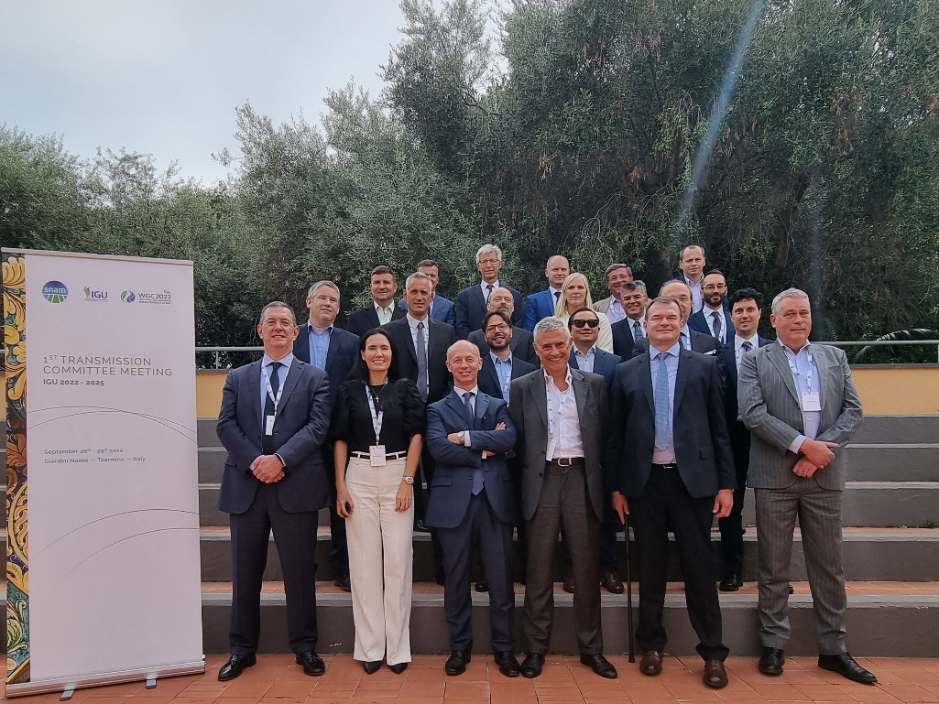
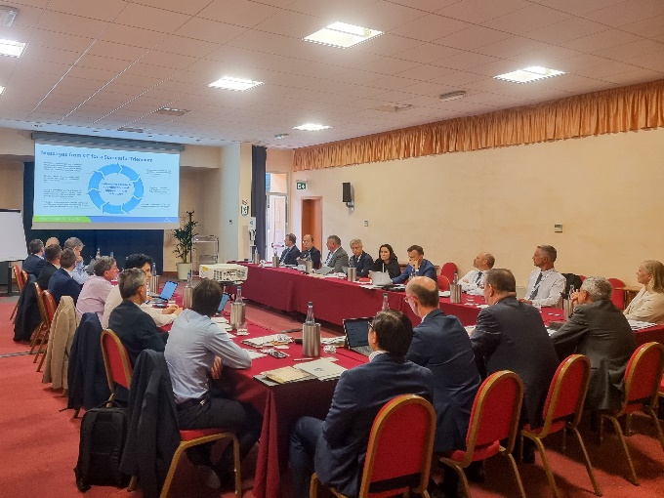

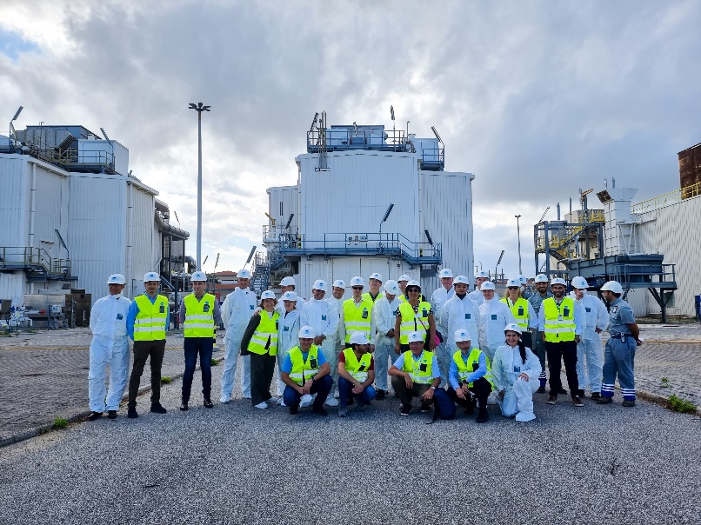
group and working sessions
Visit to Snam Messina’s compressor station
Gala dinner

Slide 45
Next Meetings
5

Slide 46
Next Meetings
The first meeting was held in Italy from September 27th to September 29th .
The second meeting will be held in Kuala Lumpur (Malaysia) mid of April 2023.
Meetings modes to be in person or fully remote (hybrid meetings possibly to be avoided).
Transmission Committee members have been invited for volunteering to host the next meetings, starting from September 2023.

Slide 47
Comments From Vittorio
In my opinion we have to strength the cooperation also between Committees and TFs in order to have an overall improvement of the activities of IGU.
In particular on transversal topics to be proposed as mid period targets (to be defined as soon as possible if deemed so)

Slide 48
Storage Committee

Slide 49
Triennial Work Plan Updates
1
2
First Meeting in Bratislava
3
Open Questions from First Meeting
4
Next Meetings
5
6

Slide 50
Storage Committee
SG1 – Gas Storage Database
  Leader: Petra Bocmanova
  Deputy Leader: Simon Sinsky
SG2 – Best Practices in UGS Design, Operations, and Maintenance
  Leader: Amer Abdel Haq
  Deputy Leader: TBC
SG3 – UGS to Todays Markets and Environment
  Leader: Carole Le-Henaff
  Deputy Leader: Anna Slavkovská

Slide 51
SG1 – Gas Storage Database
Focus of work:
Improved data consistency/Expanded data base
  Split db into 2 groups of countries – for countries „without reliable communication“ we will start searching for contacts/data immediately
  Doublecheck countries with no entry in database
Explore adding other storage sites/unconventional/Include projects of energy storage (hydrogen, biomethane, synthetic methane):
  Add additional parameter into db about hydrogen readiness ready 5%/ready 100%/under consideration/no/not available/confidential
  New hydrogen projects – not decided whether to include (we will decide after coordination with Sustainability Committee and RDI Committee
Outputs: Improving public awareness and access of the database:
  Produce and present Triennium db report
  Increase awareness by mentioning at conferences/articles (target: 3 presentations)
  Promote on IGU web site/social media
  Promote within Articles/Presentations of other Study Groups (2, 3)

Slide 52
SG2 - Best Practices in UGS Design, Operations, and Maintenance
Focus of work:
Technical and geological challenges of H2-storage (blended as well as pure). What are the important issues to be taken into account? What is important for defining a final possible concentration of H2 in CH4?
Gas emissions a) CH4, b) H2, and how to limit both or both to a possible lowest level?
Outputs:
Study on technical and geological challenges of H2-storage
Study on best practices to limit CH4 emissions in storage operations

Slide 53
SG3 – UGS to Todays Markets and Environment
Focus of work, prioritized topics for 2022-25:
Underground storage to be filled ahead of next winter – focus on security of supply value of storages
Decarbonized energy long-term storage
Key role of underground hydrogen storage – the essential bridge between variable RES and renewable H2 profiles
Outputs:
to prepare a short position paper/presentation regarding the IGU position, remarks and/or recommendations in order to fill the storages ahead of next winter – to be used also in discussions with national authorities – until the end of the year
to prepare a study on Evolving market conditions based on the development of renewables and stronger electrification
Promoting long-term and large-scale storage technologies, while supporting an integrated energy approach and sector coupling.
Via studies or other types of projects, developing a narrative in favour of storage capabilities in a decarbonized market (including market design, strategic behavior and performance to be achieved in a decarbonized market, underlying regulatory framework).
Via studies or other types of projects provide our view on the key role of hydrogen storages for electricity producers from variable RES, services H2 storages can provide for RES

Slide 54
First Meeting in Bratislava
Participants: 31 registered, of which 19 in person and 12 on-line
Topics:
  Inputs from Study Group leaders on current issues of underground gas storages
  Presentations related to hydrogen storage projects, requirements and regulation
  Overview of storage abandonment practises
  Methane emissions reduction – exchanging best practises
  Messages from CC Chair and presentation IGU program
  Discussions on TWP resulting in defining focal areas
  Outcomes: Definition of priority areas we will focus on, definition of Triennium work outcomes, best practises sharing, next meeting options established

Slide 55
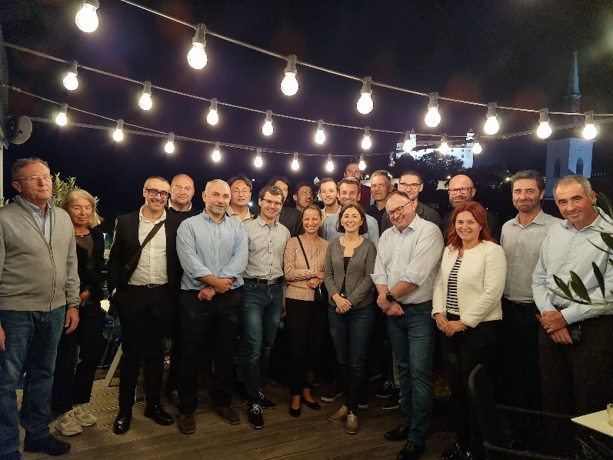
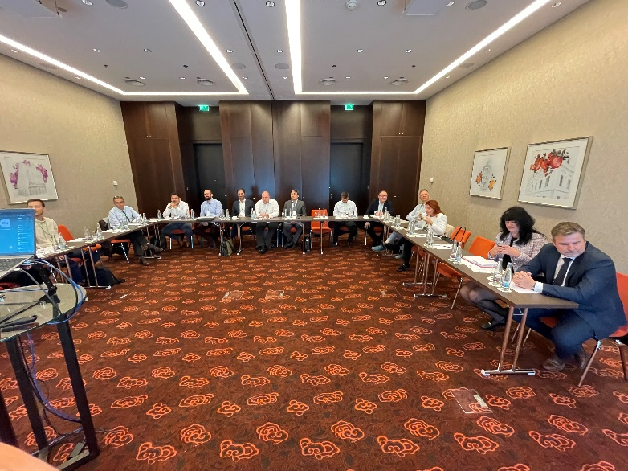
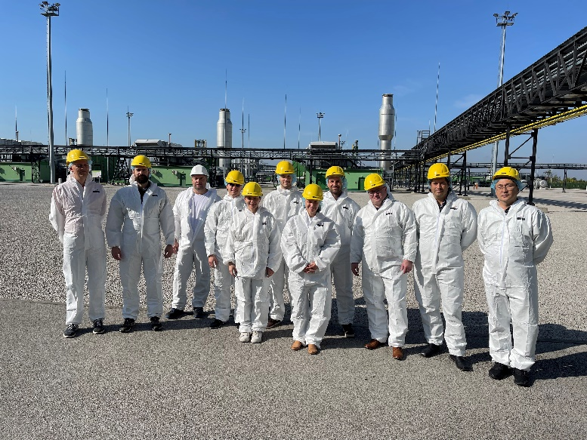
First Meeting in Bratislava
Site visit UGS Gajary
Dinner
Working session

Slide 56
Dissemination – what needs to be agreed
  Who shall approve the position paper/presentation as IGU position?
  Should we have a coordinated approach to dissemination? Or shall each group publish on its own?
  What are dissemination channels available?
  How to proceed with social media:
    What are the rules for publishing on social medias
    Which platforms are supported? LinkedIn, Twitter, Instagram, Facebook?
  Closer cooperation with other organizations (GIE,..)?

Slide 57
Other Points to Discuss
IGU web page functionalities/issues with access and uploading of group info (presentations, meeting info, members info etc.)
How to expand the group? How to activize the group?
Country has member in Storage Committee

Slide 58
Next Meetings (TBC)
Spring 2023 – Germany
Autumn 2023 – France
Spring 2024 – Poland
Autumn 2024 – TBD
Spring 2025 – TBD

Slide 59
RDI Committee

Slide 60
1. Triennial Work Plan Updates
2. Meetings Schedule and First Meeting
3. Activities and periodical results
4. Multi-tiered external relations development

Slide 61
Focus of the RDI Committee
From vertical segmentation to thematic approach in three study groups + task force
  SG1: Responsibly Sourced Gas
  SG2: Renewable and Low-Carbon Gasses
  SG3: Digital transformation
  TF: Cleantech Commericalisation
Important contributions are
  Annual Global Renewable & Low-Carbon Gas Report
  Program committee for IGRC
  Contributions to paper selection for WGC
  Technical papers and contributions to Global Voice of Gas

Slide 62
Study Group 1: Responsibly Sourced Gas
Vision: Responsibly Sourced Gas innovations can significantly contribute to energy reliability, sustainability, and affordability,
Topics for the TWP: methane emissions, affordability, environment, decarbonization,
Potential topics for IGRC: Methane emissions, CC(U)S, High carbon replacement, Reducing environmental impact, Environment Social Governance, Responsible Sourced Gasses, Efficient use of waste heat, Increased economical performance, Water efficiency, Reduction in land use, Air quality,
Outputs: Paper selection at IGRC and WGC, articles, Potentially a final report entitled“Global Framework for RSG”.

Slide 63
Study Group 2: Renewable and Low-Carbon Gasses
Vision: the gas industry is best positioned to lead towards a net zero emission energy system
Topics for the TWP : Hydrogen and bio-gasses, Technology, solutions and practices that accelerate the deployment towards a net zero goal.
Potential topics for IGRC: Bio-methane, Bio-gas, Hydrogen, SNG, Safety (in particular hydrogen), Gas quality, Fuel cells, Hybrid systems,
Outputs: Paper selection at IGRC and WGC, Flagship report “Global Renewable and Low-Carbon Gasses Report”, Articles.

Slide 64
Study Group 3: Digital Transformation
Vision: digital innovation to foster a sustainable gas industry,
Topics for the TWP: Energy systems integration and optimization, Digital tools for design, training, planning, operation, inspection, and maintenance in the gas industry, Digital transformation trends in the gas industry,
Potential topics for IGRC: Digital twins, Advanced analytics and artificial intelligence, Smart sensors and systems, Extended reality, Robots, drones or UAVs, Software, apps and digital platforms,
Outputs: Paper selection at IGRC and WGC, Articles (identified), survey providing input for final report.

Slide 65
Task Force: Cleantech Commercilisation
Vision: Commercialisation of cleantech solutions in the gas industry is key to environmental performance for the gas sector.
Topics for the TWP: Engagement strategy for cleantech companies and founders, Innovation awards for IGRC, Institution of (extended) NGIF (Natural Gas Innovation Fund and its processes)
Potential topics for IGRC: clean technology innovation for responsibly sourced gas, renewable gases, and digital transformation.
Outputs: Lessons learned by the task force, how cleantech has evolved in the triennium, a showcase of best cleantech startup solutions, recruit new members for the RDI Committee, report on a survey that assesses cleantech solutions.

Slide 66
RDI Committee Schedule
Tentative Dates (as of September 28st, 2022)
Period | Geography | Host | Other conferences
September 2022 | Amsterdam, The Netherlands, Europe | GasTerra
March 2023 | Cartagena, Colombia, South America | Promigas
October 2023 | Perth, Australia Pacific | AGIT | Council/CC meeting
May 2024 | Canada, North America | T.b.d. | May 2024 IGRC, Banff, Canada
September 2024 | North America / South America / East Asia / Southeast Asia / Pacific / Europe | T.b.d.
March 2025 | North America / South America / East Asia / Southeast Asia / Pacific / Europe | T.b.d.

Slide 67
First Meeting: Amsterdam
Participants: 29 registered, of which 18 in person and 11 on-line,
Topics:
  Presentations from local RDI professionals,
  Messages from CC Chair and presentation IGU program,
  Lively discussion on TWP, resulting in updated program,
  Development of first IGRC program outline,
  Technical visits (VR-tour, Gassification plant),
Outcomes: information exchanged/lessons learned, TWP to be finalised after meeting, steps towards IGRC Call for Abstracts, next meeting options established.

Slide 68
Activities and periodical results
The Global Renewable & Low-Carbon Gas Report is a common effort together with Oxford Institute for Energy Studies
Work on the report was initiated in 2021 following the realization that gasses play a crucial role in de-carbonization of the global energy system
First questionnaire has seen in-depth response from limited countries, leading to a report that as yet has to prove its value over other reports (e.g., IEA Global Hydrogen Review), see https://www.igu.org/resources/global-renewable-low-carbon-gas-report/,
This years questionnaire has been sent, response including draft country focus section is being processed; response has been limited
From next year onwards, the report will be embedded into regular Committee work

Slide 69
LNG Committee
Chair : Mi Jung Nam (Kogas)
Vice Chair : Atsuo Kanno (Osaka Gas)
Secretary : Eun Ju Lee (Kogas)

Slide 70
LNG Committee Meeting Summary
LNG Committee meeting held online on September 26, 2022 (31 members attended)
Leaders of each Study Group were selected and each SG held their 1st meeting in October
- SG 1 Leader : Mr. Kim Nak-Gyun (Kogas)
- SG2 Leader : Mr. Amine Yacef (Qatar Gas)
- SG3 Leader : Mr. Atsuo Kanno (Osaka Gas)
CNOOC presented the status and plan of IGU World LNG Report (PM : Mr. Wang Kai)
- 1st draft of the report will be out January 2023
Next Committee meeting planned to be held on 1Q of 2023 in the Republic of Korea

Slide 71
Study Group 1 : Theme and Objective
Theme
“Market Evolution – LNG Commoditization”
- LNG Market evolution – growing the LNG spot market and commoditization
- Establishment of potential LNG hubs, LNG Project’s strategies toward changing market
Background
LNG has been growing fast and is even expected to grow further.
Even in the era toward carbon neutrality, LNG is proving itself as indispensable fuel.
More flexibility and liquidity is needed to reach the world and become true global commodity.
Objective
SG1 will make suggestions of strategy to industry players and policy to policymakers, in order to ensure more flexibility and liquidity in LNG market toward commoditization.

Slide 72
Study Group 1 : Work Plan
Milestone and timing to be confirmed with Coordination committee.
STEP 1
Section 1: Problems in LNG market of each
Members review and summarize problems in LNG market of their own local market, which we know best.
Will provide us specific and in-depth understanding of current status.
2022.10～2023.3
Market 1
Market 2
Market 3
STEP 2
Section 2: Required solution in LNG market
2023.4～2024.3
STEP 3
Section 3: Strategy & Policy for LNG market
2024.4～2025.3
WGC 2025 Beijing

Slide 73
Study Group 2 : Theme and objective
Theme
Carbon Neutrality Trends Impact on LNG Business, LNG Demand and Opportunities for LNG
- Energy policies review and their impact on LNG market and value chain due to carbon neutrality
- Role of LNG towards carbon neutrality era
Objective
To review existing Energy and Climate policies in key LNG consuming regions
To identify carbon neutrality pathways and impact on energy mixes and LNG demand
To evaluate the role of LNG as a transition fuel to achieve carbon emissions targets
To identify LNG producers/consumers decarbonization efforts throughout the LNG value chain
To determine the future perspectives and opportunities for LNG as a substitution fuel
To showcase successful implementations of LNG as a transition fuel
To ascertain the challenges and hurdles for LNG as a transition fuel

Slide 74
Study Group 2 : Work Plan
Milestone and timing to be confirmed with Coordination committee.
STEP 1
Section 1: Energy Policy review in key LNG consumption regions
Members review and summarize Energy and Environmental policies.
2022.10～2023.9
EU
NE Asia
South Asia
SE Asia
STEP 2
Section 2: Carbon neutrality pathways and impact on LNG demand
How policy implementation has/will affected LNG demand
STEP 3
Section 3: Study cases of successful LNG as a transition fuel projects
2023.9～2024.3
STEP 4
Drafting final report
2024.4～2025.3
WGC 2025 Beijing

Slide 75
Study Group 3 : Theme and objective
Theme
“Create LNG demand with the development of a new utilization sector in Developing/Under-Developed Countries”.
Background
Importance of LNG has been increasing as the realistic transition fuel for low-carbonization.
While energy demand in developed countries is not significantly growing, there is potential for further LNG demand expansion in developing and under-developed countries where significant energy demand growth is expected.
Objective
SG3 will identify issues and strategies for LNG demand creation in these countries or area, which holds the key to future LNG demand.

Slide 76
Study Group 3 : Procedure of Study (Work plan)
Milestone and timing to be confirmed with Coordination committee.
STEP1
Topic 1: Current and future issues
Topic 2~4: Detailed work programme definition
2022.10～2023.3
Split into 3 sub-groups
Topic 2
Topic 3
Topic 4
STEP2
2023.4～2024.3
Study and discussion in each Topic group
Check progress and discussion in Regular Meeting (once every 2 month)
STEP3
Integration of SGs’ outcome and alignment
2024.3～2025.9
STEP4
Drafting final report
2024.10～2025.3
STEP5
WGC 2025 Beijing
2025.5

Slide 77
World LNG Report Status and Plan
Report Organizer
- World LNG Report Task Force (LNG Committee)
- Mr. Wang Kai (PM, CNOOC)
Main Contents of Report
State of the LNG Industry
LNG Trade
LNG and Gas Pricing
Liquefaction Plants
LNG Shipping
LNG Receiving Terminals
References
Special Topics
Impact of Ukraine Crisis on the LNG Industry
Chinese LNG Market
Timeline
Feb 2023 : First Draft
Apr 2023 : Update Data
May 2023 : Second Draft
Jun 2023 : Update Data
Jul 2023 : Publication
CNOOC Current Database : Rystad, IHS, Platts

Slide 78
Sustainability Committee

Slide 79
Sustainability Committee
  Chairman: Naiara Ortiz de Mendíbil (Sedigas, Spain)
  Vice-Chair: Jon Freeman (BP, UK)
  Secretary: Juan Antonio Pérez (Sedigas, Spain)
    Objective: provide an agenda and long strategic view of renewable gases to achieve the decarbonisation of the gas sector and other sectors that consume gas for their processes such as households, industry, transportation, and power generation, and to reduce GHG emissions with the objective of becoming emission neutral by 2050.

Slide 80
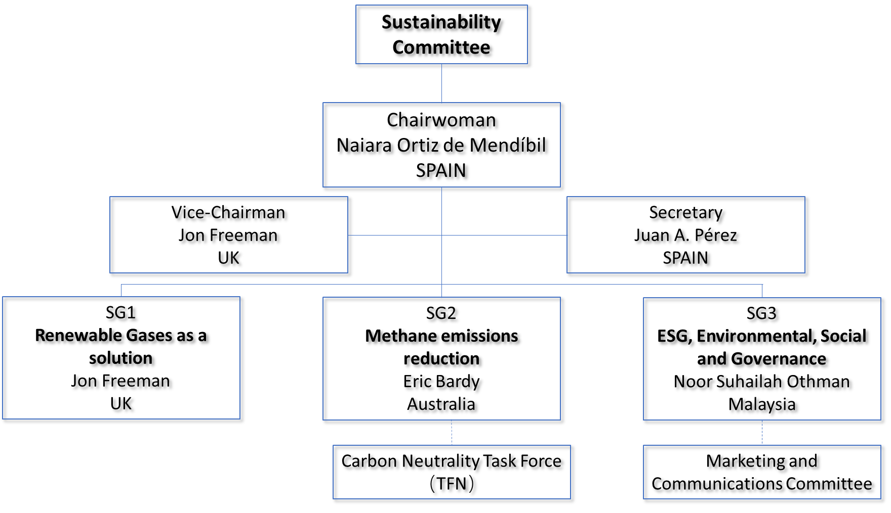
Team

Slide 81
Study Group 1: Renewable Gases as a solution
  Leader: Jon Freeman
    Objective
    Promote the development of renewable gases as a new key solution for the energy transition
Worldwide Benchmark study on the degree of implementation of renewable gases by collecting different data:
  Renewable gas potential by country and by feedstock.
  The regulatory framework, incentives or other mechanisms adopted in countries where the production and use of renewable gas is already advanced.
  Number of projects of each renewable gas by country and their main characteristics.
  Drivers for renewable gas penetration and key R&D projects around biomethane, hydrogen and syngas.
A report will be produced incorporating the information obtained from the benchmarking study and a summary of best practices for renewable gas development in different countries, both from an investor and policy maker standpoint.

Slide 82
Study Group 1: Renewable Gases as a solution
  Approach
  Focus, and slight change in the title: Renewable and low carbon gases as a solution. There was an appetite to follow regulations in some countries and allow options such as blue or pink hydrogen…but for the main focus to be on renewable gases such as biomethane and green hydrogen
  Timeframes is 2022, 2030 and 2050
  The potential, the projects, the policies for RLC gases…and how this feeds into decarbonisation objectives
  The demand and supply conditions needed for different gases in different sectors in different regions
  What the gaps look like between policies, technology and industrial realisation of the policies. Could include infrastructure, skills, R&D
  Mechanics of the team
  Teams call every 2 months
  Use the IGU collaboration platform
  Generate a final report and interim updates/reports if possible
    Year 1 - mapping where we are
    Year 2 - focussing on 2030, and what we need to put in place for 2050
    Year 3 - focussing on 2050 and preparing final report for WGC
  Focusing on IGU members, policymakers, and including case studies that help bring the message alive for any stakeholder including the general public

Slide 83
Study Group 2: Methane emissions reduction
  Leader: Eric Bardy
    Objective
    Collect best practice regarding methane emissions reduction in the gas industry and establishing the basis in the sector to obtain a reduction of at least 30%
The group will focus on:
Analyse Best Practice in the gas sector to reduce methane emissions.
Define and propose a standard methodology to measure methane emissions in the gas sector.
Define strategies aiming to reach the objectives of the Global Methane Pledge.
SG 2 will work and hold discussions with the Carbon Neutrality Task Force（TFN）to reduce overlaps and coordinate the work on this topic.

Slide 84
Study Group 2: Methane emissions reduction
  Approach to delivering the charter
  Year 1 : Measurement Review
  Collate methodologies from across members across all regions and sectors of the IGU
  Apply a confidence level to be judged based on available data
Year 2: Technology Review
  Review of technologies for reduction
  Collation and communication
Year 3: Reduction Confidence
  Determine if the available technologies deliver 30%
  Identify gaps and opportunities
  Mechanics of the team
  Meet again at the end of October with the full team to ensure alignment
  Meet quarterly : Dec/Mar/July/Oct
  6 monthly in person (if possible)
  Likely need to reach out to other sustainability committee members to ensure we cover all regions/sectors
  Collaboration platform

Slide 85
Study Group 3: Environmental, Social & Governance
  Leader: Noor Suhailah Othman
    Objective
    Promote and increase awareness of ESG in the energy sector as key solution for the energy transition
Main topics in this group will be:
Benchmarking ESG practices in the gas sector
Benchmarking ESG practices in other sectors applicable to our industry
A guide on ESG best practices for implementation in the global gas sector
SG 3 will work with the Marketing and Communications Committee to integrate ESG in the gas narrative considering stakeholder management and climate neutrality

Slide 86
Study Group 3: Environmental, Social & Governance
Scope: Natural gas & Renewable gas, i.e. hydrogen, biogas
Reporting indicators
  ESG indicators reporting (GRI, Dow Jones Sustainability Index, IPIECA Oil & Gas Reporting Guide, World Economic Forum Reporting).
  To benchmark on indicators an identify suitable indicators for renewables.
  Conduct opinion-poll survey among member companies.
ESG Governance
  Design and permitting requirements
  ESG risk and impact assessment
  Identification of stakeholder (internal & external)
  Stakeholder engagement including public participation
  Best practices on ESG governance (can be a compilation of ESG practices from study group members) or impact mitigation on local communities.
Benchmarking ESG practices in the gas sector
Benchmarking ESG practices in other sectors applicable to our industry
A guide on ESG best practices for implementation in the global gas sector

Slide 87
1st IGU Sustainability Meeting in BCN 10th-11th October
  9 members came to Barcelona meeting
  15 members connected on-line
Main topics of the meeting:
We visited a renewable gas landfill close to Barcelona
Presentations on ESG, methane emissions reduction, european policy framework and Biogas and biomethane situation in the Spain
Study groups had their kick off meeting and already started to work
Meeting calendar for the triennium is set

Slide 88
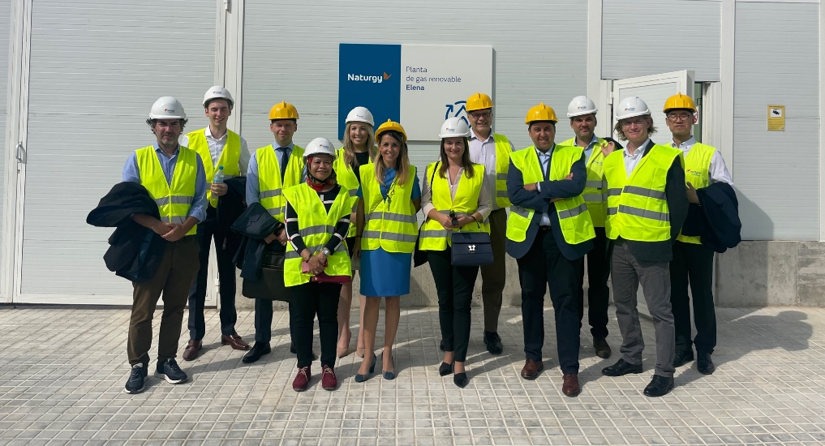
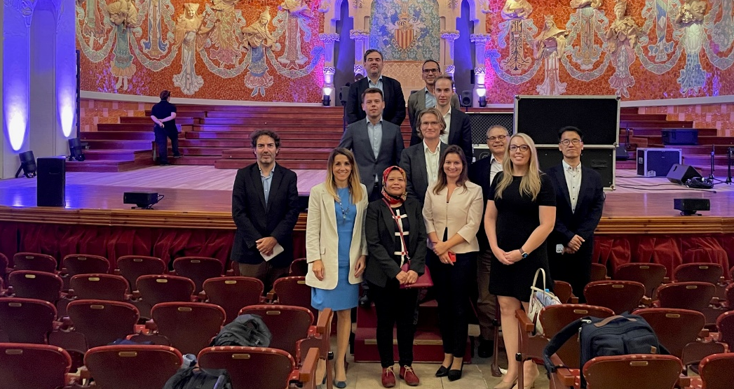
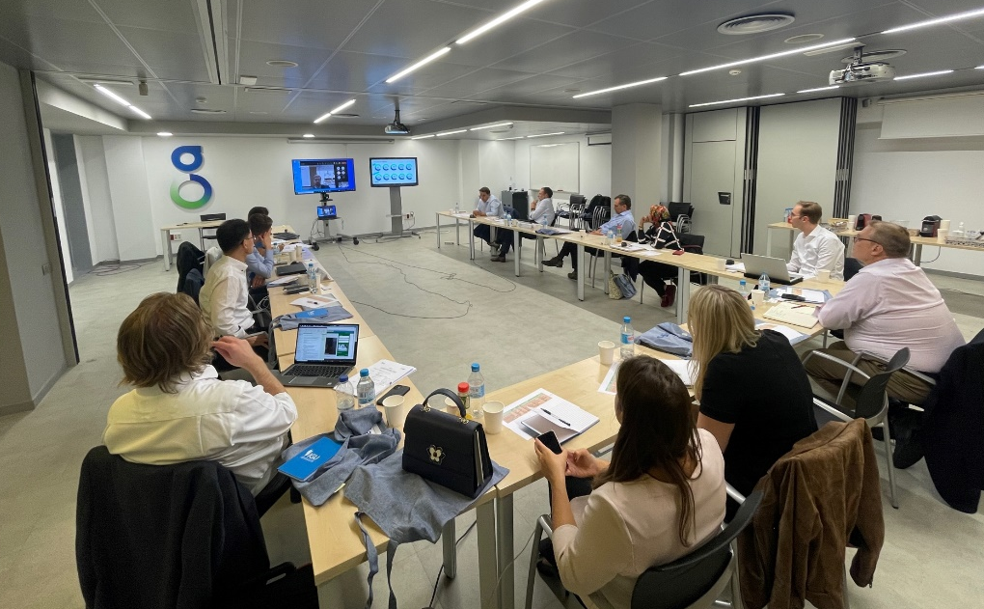
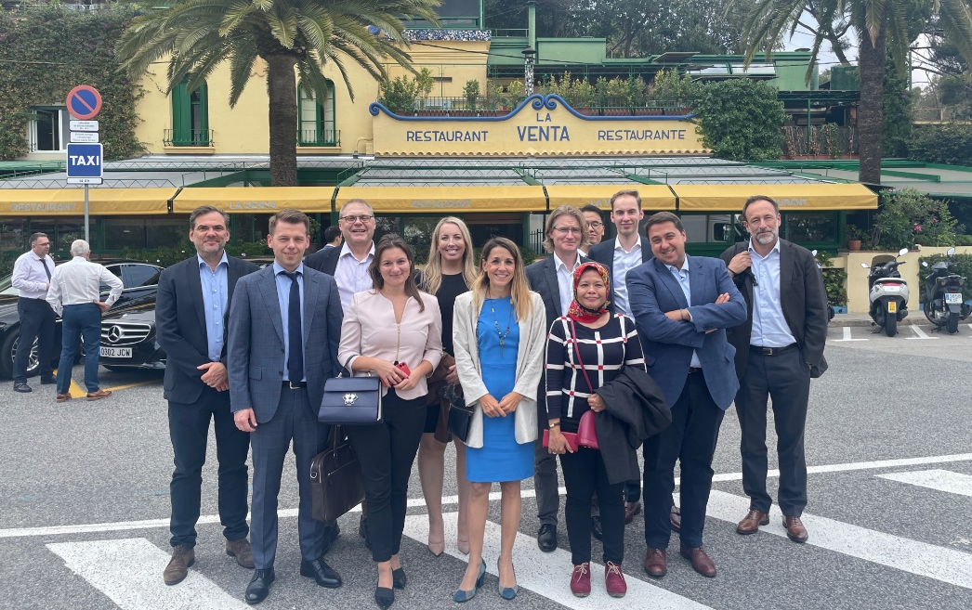
1st IGU Sustainability Meeting in BCN 10th-11th October

Slide 89
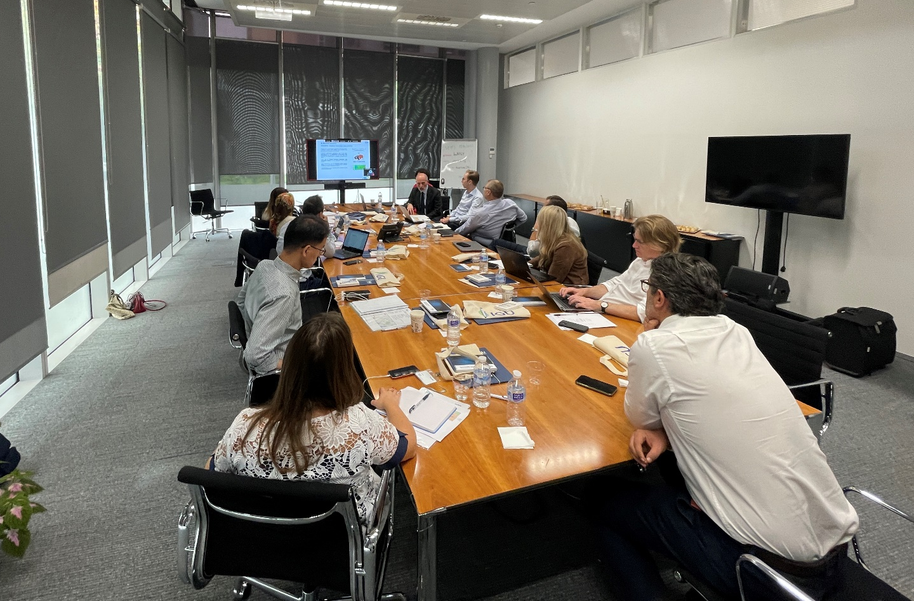
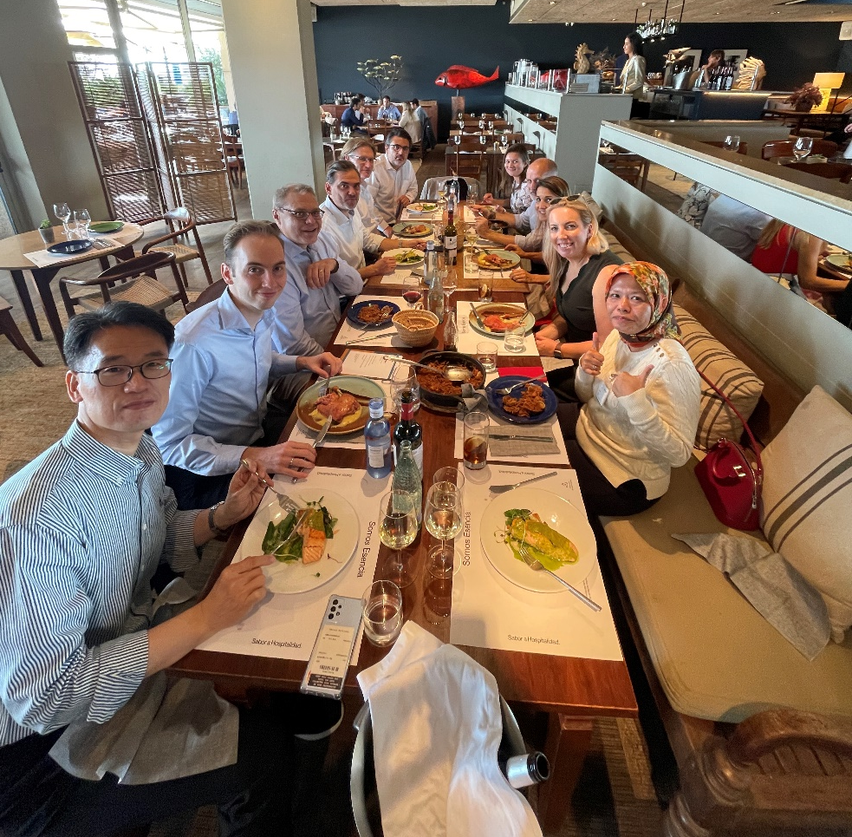
1st IGU Sustainability Meeting in BCN 10th-11th October

Slide 90
Sustainability Committee meetings
Sustainability meetings |  | CC meetings
10th, 11th October 2022 |  | October 2022
Barcelona, Spain |  | Lima, Perú
13th-15thMarch 2023 |  | March 2023
London, UK |  | Belgium
September 2023 |  | September 2023
Australia |  | Australia
March 2024 |  | March 2024
Hungary |  | Turkey
September 2024 |  | September 2024
USA / Brazil |  | Egypt
March 2025 |  | March 2025
Malaysia |  | Malaysia
  Committee meetings each semester, before the IGU council & CC meeting

Slide 91


London 13th -15th March 2023
Hosted by: BP
Next meeting !!!

Slide 92
Strategy Committee a
Chair: Amir Foster (Israel); Vice Chair: Yan Kang (China); Secretary: Eric Semel (Israel)

Slide 93
Strategy Committee – 42 Members

Slide 94
1. Triennial Work Plan Updates
2. Meetings Schedule and First Meeting
3. Activities and periodical results
4. Multi-tiered external relations development

Slide 95
Strategy Committee TWP Updates
SG1
Strategic Planning and Management in the Natural Gas Industry
SG2
Pricing for Natural Gas
SG3
Efficiency and Regulation of Regional Gas Markets
SG1
Strategic challenges: security of supply and environment commitments
SG2
Pricing for Natural Gas

Slide 96
SG1: Strategic challenges: security of supply and environment commitments
The group will study the area of strategic planning and strategic management and focus on the following:
      Define indicators for an integrated approach to the security of supply and the environmental impact of gas
      Compliance of company strategies with government policies in striking a balance of interests between business and society;
      Role of “alternative gases” (hydrogen, biogas, syngas…) in the worldwide energy transition and contribution of the natural gas infrastructures
      Regulatory environment, including Climate initiatives and The Paris Agreement, that strengthens strategic advantages of the gas industry;
The group should summarise the best corporate and government practices in strategic management worldwide, through a Report on Global gas policy for Regulation improvement and gas advocacy.

Slide 97
SG2: Pricing for Natural Gas
This group will study:
  The role of different pricing mechanisms for natural gas in making the industry attractive for investments;
  Regional differences in price formation mechanisms;
  Changes and future tendencies of price formation mechanisms
The group will continue to produce and improve the flagship report: The global Wholesale Gas Price Survey. This survey is essential to understand the evolution of pricing, approaches and mechanisms to price settings, and methods of government regulation of prices in different countries and regions worldwide.

Slide 98
Strategy Committee Meetings
November 2022
Warsaw, Poland
Spring 2023
Tel Aviv, Israel
Autumn 2023
Beijing, China
Spring 2024
Autumn 2024
T.B.D
T.B.D
Spring 2025
T.B.D
First Meeting – Nov 22-24
Host: GAZ-SYSTEM S.A
18 members have confirmed participation

Slide 99





External Relations Development - Partial List

Slide 100
Carbon Neutrality TF

Slide 101
Carbon Neutrality TF
Carbon neutrality will be obtained thanks to​
  massive renewable and low carbon production​
  drastic emissions reduction all along the value chain​
  carbon sinks to manage unabated fossil gas use​
  ​
One fits all will not be the case neither for the trajectory nor for the final result, depending on feedstock potential and regulations​

Slide 102
Carbon Neutrality TF
Main objectives​
  Concretely demonstrate the gas industry commitment to Carbon neutrality thanks to
    Innovative technologies​
    Circular economy offering new win/win solutions to territories ​
    First class operations all along the value chain​
    Valorise this commitment towards main high level stakeholders​
    Governments​
    World Bank​
    AIE​
    IRENA​
    WBA,
    ISWA, …

Slide 103
Carbon Neutrality TF
1st Step ​
  Tackling methane emissions​
  Inventory of technologies (existing, emerging, promissing)​ to produce​
    Biomethane​
    E-methane​
    Renewables gases​
    Low carbon gases​
    Green hydrogen​
    ...​
  To efficiently use these gases : Electricity production, heating, industrial uses and mobility​
  Carbon sinks : inventory of technologies ​

Slide 104
Carbon Neutrality TF
1st Step ​
  Methane emissions: refer to the great work already done by Mr Francisco de la Flor​ and add some local feedbacks
  Inventory of technologies (existing, emerging, promissing) : organize one or two joint workshops jointly with the R&D and Innovation Committee and one or two with the utilisation Commitee to tackle demand side issues​
1st draft of document : end of March 2023

Slide 105
Carbon Neutrality TF
  2nd Step : Regional demand / offer Assessment (2030, 2040, 2050 and 2060)​
  The principle : not to reinvent the wheel and reuse existing studies as much as possible​
  2023 : Starting with Europe (2nd quarter), North Asia & Australasia​ (linked with the Excom meeting to be held in Australia) and South America (4th quarter)​
  2024 : engage other parts of the world : Africa, Middle East, South Asia, North America
  Organise joint workshops for each Region with the support of Regional Coordinators when they exist.

Slide 106
Carbon Neutrality TF
In parallel engage discussions with key stakeholders such as:​
  World Bank​
  IEA​
  Irena​
  WBA
  ISWA
  ...​

Slide 107
Preliminary Joint-efforts with other Committees
Methane emissions : TFN will support the sustainability committee leadership initiative.
Ccs : TFN will contact the exploration and production chair in order to ensure the coordination. A contact with the global CCS institute and/ or CCSA with then been further considered.
High efficiency uses : TFN will contact the chair of the Utilization committee to consider the opportunity of developing common workshops.
CH4 Green and renewable production : Gerard will pick a date to discuss with Jon Freeman and myself to get things started. After that a meeting with all interested Committee members from the different committees would be organized.
H2 : the same process will be developed.

Slide 108
Gas Markets Committee 2022-2025
Open

Slide 109
Gas Markets Committee
Membership Demographics (N=43)
Bolivia
Bosnia and Herzegovina
Brazil
China
Colombia
Croatia
France
Hungary
Malaysia
Mozambique
Nigeria
Oman
Poland
Portugal
Trinidad and Tobago
Turkey
UK
USA
Members Representing 18 Countries
3
15
12
5
SG3
SG1
8
SG2
Open

Slide 110

Gas Markets Committee
High Level Roadmap
2025
Q1
Q2
29th WGC, Beijing
Finalization & submission of Committee TWP Report (Q1 2025)
Final preparation for WGC – Confirmation of presenters & moderators
2024
Q1
Q2
Q3
Q4
Physical Committee Meeting (TBD)
CC issue call for Papers
Virtual Committee Meeting
Physical Committee Meeting (TBD)
Closing of call for Papers
Abstract review and recommendation of presenters
Virtual Committee Meeting
Submission of TWP Report to Secretary for consolidation
2023
Q1
Q2
Q3
Q4
Physical Committee Meeting (Malaysia)
Virtual Committee Meeting
Physical Committee Meeting (TBD)
Virtual Committee Meeting
* Chairperson to seek confirmation of WGC Agenda from IGU CC - # of technical and industry insights sessions
Open

Slide 111
Gas Markets Committee
Study Group 1: Regional gas markets development
12
members
Regional gas markets development
Gas market developments are a result of critical interdependencies, and the study will focus on key drivers and enablers leading to where they are on the market maturity spectrum, and opportunities and challenges.
Provide an overview of key gas markets in selected regions and study the key drivers, enablers leading to where they are on the market maturity spectrum.
Identify key emerging opportunities and potential areas of leverage in terms of bilateral efforts.
Identify issues and challenges in developing gas markets in the region, including those relating to market integration, gas pricing, financing, and investment requirements.
Ascertain levels of activity and required investment on gas infrastructure and its scalability to support gas market growth.
Offer objective views and suggestions on strategic options and action plans to promote the development of gas markets from a more integrated perspective.
Member | Organization / Company | Country
Nathaniel Oyatogun (SG Leader) | Seplat Energy Plc | Nigeria
Titos Nhabomba | ENH | Mozambique
Ahmed Mroue | Cheniere Energy | USA
Weiguo Shan | CNPC | China
Sandino Rizvanović | Zenicagas Distribution Public Utility | Bosnia and Herzegovina
Vedran Špehar | PLINACRO Ltd. | Croatia
Daniel Golja | Energy Institute Hrvoje Pozar | Croatia
Grzegorz Bujnowski | PGNiG S.A. | Poland
César Álvarez | Ecopetrol | Colombia
Raja Ezwan Shafrizal Raja Safian | PETRONAS Energy & Gas Trading Sdn Bhd | Malaysia
Paartiban Paneerselvam | PETRONAS Energy & Gas Trading Sdn Bhd | Malaysia
Sun Hui Sun | Peking University | China
Shaik Mohamed Jamil Haja | Hibiscus Oil & Gas Malaysia | Malaysia
Tufan Can Sener | GAZBİR | Turkey
Xingjian LV | BP plc | China
Open

Slide 112
Gas Markets Committee
Study Group 2: Greening the gas markets
13
members
Greening the gas markets
Building on the work from the past triennium, the study will provide an overview of gas relative to other sources of fuel and how it is able to complement other clean energy sources in decarbonization efforts and their critical enablers.
Provide an overview of gas relative to other sources of fuel and how it can complement other clean energy sources in decarbonization efforts.
Assess what challenges and critical factors are required for the greening of gas, e.g., in terms of technology, cost and changes to demand.
Identify potential areas of leverage in terms of addressing how all hydrocarbon sources, particularly gas, can be used more efficiently (and less), given the growing dependence on renewables in the future.
Study and offer insights to the role of gas as a critical backstop and significant solution to renewable energy, given current challenges of adequate storage and transportation faced by the latter.
Offer views and suggestions on strategic options and action plans to promote the usage of gas in decarbonization effort.
Member | Organization / Company | Country
Matthew Shruhan | Cheniere Energy | USA
Xin He | CNPC | China
Aleksandra Czech | PGNiG S.A. | Poland
João Falcão | EDP Renováveis PT-PO | Portugal
Fabio Tarazona | Ecopetrol Group | Colombia
Farhaini Fasri | PETRONAS | Malaysia
Zane Mcdonald | GTI Energy | USA
Musa Cem Önal | GAZBİR | Turkey
Adejoke Ajaero | Seplat Energy Plc | Nigeria
Marcia Maynard | National Energy Corporation of Trinidad and Tobago | Trinidad and Tobago
Greg Silverman | BP plc | UK
Dinesh Cheryan | Hess Exploration and Production | Malaysia
Open

Slide 113
Gas Markets Committee
Study Group 3: Impact of pandemics on gas markets
14
members
Impact of pandemics on gas markets
The study will determine and highlight the key impact of pandemics to global gas markets and study the resilience of global gas systems and the markets they serve.
Determine and highlight the key impact of pandemics to global gas markets and study the resilience of global gas systems and the markets they serve.
Understand the role of gas during turbulent times to ensure energy security.
Identify and highlight gamechangers and market adaptations to the new norm, post-COVID-19, for both gas suppliers and consumers.
Understand whether such market implications disrupt the role of gas in the overall efforts of clean energy transition plans.
Offer objective views and suggestions on strategic options and action plans on how gas plays a role in economic recovery, post-pandemic.
Member | Organization / Company | Country
Gabor Orban | MVM CEEnergy | Hungary
Omar Al Balushi | Oman LNG | Oman
Ahmed Al Amri | Oman LNG | Oman
Elzbieta Kramek | GAZ-SYSTEM | Poland
Pawel Sek | GAZ-SYSTEM | Poland
Damian Fogel | PGNiG S.A. | Poland
Jerzy Dudek | PGNiG S.A. | Poland
Maia Marília | Petrobras | Brazil
Palhano Alexandre | Petrobras | Brazil
Marcelo Leite | Sulgás | Brazil
Bertelemy François | AFG | France
Oscar Claros Dulón | Company | Bolivia
Zahari Che Mi | PETRONAS Gas Berhad | Malaysia
Open

Slide 114
Distribution Committee

Slide 115
First Meeting Information
Objectives：
First of all, to get to know each other. Many of you have participated in the past activities of IGU committee "Distribution” and know each other, but some have been newly nominated by their gas associations or associate members of the IGU.
The second objective, namely to inform about IGU activities and organization in general and to talk about the committee's contributions in detail. Last but not least, we have to implement the three study groups of our committee according to the Triennial Work Program (TWP):
SG 1 Make grids smarter
SG 2 Support the Hydrogen Economy
SG 3 Expand Innovation System

Slide 116
First Meeting Agenda
Essen，Germany
Preliminary program:
Wednesday 9 November 2022
  Welcome evening 19:00
Thursday 10 November 2022
  Committee Meeting 9:00 – 18:00
  Lunch at 13:00 – 14:00
  SG meetings 14:00 – 16:30
  Dinner 17:30 – 22:00
Friday 11 November 2022
Study Group Meetings 9:00 – 12:00
  SG 1 Make grids smarter
  SG 2 Support the Hydrogen Economy
  SG 3 Expand Innovation System
Lunch at 13:00 – 14:00
Plenary meeting: wrap-up 1st meeting 14:00 – 15:00
Technical tour: 15:00 – approx.18:00

Slide 117
Utilisation Committee

Slide 118
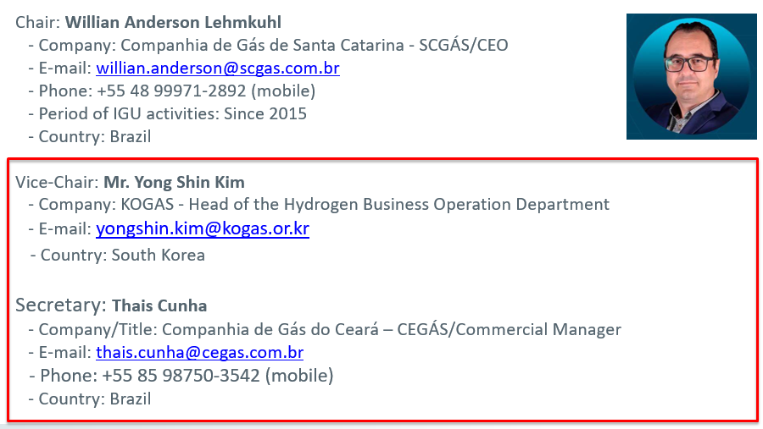
Committee Chair & Secretary Introduction

Slide 119
Committee work focus for 2022-2025
    Strengthen the committee by encouraging the entry of new members from WGC 2022, with a greater number of companies and associations represented.
    Establish cooperation with associations of equipment manufacturers and solution developers, INCLUDING THEIR PARTICIPATION WITHIN UTILIZATION STUDY GROUPS.
    Sustainable energy technologies. FOCUS ON THE ROLE OF RNG AND HYDROGEN AS ESSENTIAL TOOLS TO DECARBONIZE CONSUMER END USE ACROSS RESIDENITAL, COMMERICAL, INDUSTRIAL AND TRANSPORATION.
    Integration with the electricity sector. SHOWCASE CASE STUDIES WHERE NATURAL GAS/RNG/HYDROGEN ARE WORKING WITH ELECTRICITY TO MORE AFFORDABILITY MEET CONSUMER ENERGY NEEDS IN HOMES, INDUSTRIES AND MOBILITY.
    Synergy with other IGU committees AND OTHER ENERGY INDUSTRY STAKEHOLDERS. Promote joint meetings and cooperate in the exchange and generation of content. SOLICIT PRESENTATIONS FROM POLICY AND REGULATORY BODIES FROM AROUND THE WORLD ON KEY ENERGY RELATED ISSUES。
    Advocacy support publishing White Papers. A white paper is a report or guide that informs readers concisely about a complex issue and presents the issuing body's philosophy on the matter. It is meant to help readers understand an issue, solve a problem, or make a decision.

Slide 120
Specific measures to maximize gas benefits
1. Promoting the progress of global gas industry
1.1 Expand the application of natural gas in power generation, mobility, distributed energy and other fields to expand the market share of natural gas worldwide;
1.2 Improve the performance of the whole natural gas value chain in terms of technology, management, digitization, energy saving and emission reduction;
1.3 Advance the coupling of natural gas with renewables.
2. Promote the advantages of natural gas
2.1 Focus on coal replacement, emissions reduction, air pollution mitigation, energy efficiency, energy poverty reduction, and energy transformation;
2.2 Making a targeted advocacy.
3. Regionality
3.1 Showcasing the achievements and development needs of the gas industry in different regions of the world and promoting regional cooperation.

Slide 121
Working structure during 2022-2025
The Utilization Committee focus on the advocacy of clean solutions for either small- or large-scale usages of natural gas and as A MOBILITY fuel, for a sustainable future.
  Study Group 1: Industrial Gas Utilization
  Integration of renewables and NG for industrial use
  Power to gas
  Carbon footprint reduction and air emissions improvement
  Distributed power generation with NG as back up for intermittent renewables
  Enhancement of energy efficiency
Study Group 2: Domestic and Commercial
  Smart metering (INCLUDING FOR HYDROGEN), big data and IOT
  Safety, POLICY AND REGULATION FOR INTETRATION OF NEW GAS TECHNOLOGIES AND FUEL MIXES (E.G., H2)
  Gas appliances: CODES AND STANDARDS, GAS/ELECTRICTIY HEATING, New technologies
Study Group 3: Natural Gas for Mobility
  NG in urban mobility as key factor for quality of air improvement
  Biogas and RNG production for transportation
  New technologies for NG maritime uses
  Gas quality

Slide 122
Meeting Schedule
2022 | 2023 | 2024 | 2025
May | May | May | May
WGC Korea | Canada | Portugal | WGC China
November | October | October
Brazil | Asia | Colombia
Next triennium - main steps/warning points
  2023 LNG conference at Vancouver (July 10-13, Canada)
  2024 IGRC Conference at BANF/Alberta (May 13-16, Canada)
  2025 IGU WGC at Beijing (May 19-23, China)

Slide 123
First Meeting Information
The first face-to-face meeting is on November 3rd to 5th, 2022, Brazil.
There will be two different moments:
1st) Workshop – Open to the public. Please see: http://fairgastransition.com.br/
2nd) Utilization Committee meeting – Restricted to members
Some objectives of this first meeting:
Introduce and integrate new members;
Discuss the work plan with the insights of the Coordinating Committee;
Announce the Study Group leaders and the secretariat;
Share case studies;
Confirm the calendar of upcoming meetings and events.

Slide 124

Workshop: Fair Gas Transition and Energy Security
  Main Goals:
  Emphasize natural gas as a transition fuel and how to conduct the decarbonization process in a fair, fair and safe way.
  Discuss the role of natural gas in the fair energy transition and the prospects for diversifying gas sources, such as biomethane and hydrogen.
  Promote debate and exchange of experiences between IGU members and professional decision-makers in the Brazilian gas sector.

Slide 125
E&P Committee

Slide 126
Structure and Members of the E&P Committee
1
2
TWP Overview - E&P Committee
3
Study Groups Work Plan
4
Meeting Schedule
5
Next Steps

Slide 127
Opening Remarks by the Chairman E&P Committee
I want to seize the opportunity to welcome every member of the E&P committee to our very first meeting. I want to thank you for volunteering to serve at a time when the various global and regional challenges, particularly in the Energy industry threaten our very livelihood.
We recognize that the combination of the effects of the recent pandemic on well-being and global economies, coupled with regional conflicts, supply chain disruptions and climate change issues have created an unprecedented “Next-Normal” scenario for global economic recovery and growth in which Natural Gas has an important role to play as the hybrid-energy source of the future.
We live in interesting times. I look forward to working closely with you to deliver our collective targets. Thank you.
Emeka Ene

Slide 128
Structure and Members of the E&P Committee

Slide 129

E&P Committee Members
Emeka Ene
(Chairperson)
Aidid Chee Tahir
(Vice Chairperson)
TBA
Secretary
Sugaya Marcos
Cunha Marcello
Xiangwen KONG
Shiguo LIN
Omar Ceballos
Marko Živković
Ahmad Zamani
Muhamad Syafiq Mazlan
Paulinda Manhique
Rafał Wiśniowski
Stanisław Nagy
Jerzy Stopa
Gyoo Ho Lee
RODICA SASU
Nicolas Fernando
Vincenti Wadsworth
Sugaya Marcos
Cunha Marcello
Zhi GUO
Juan Manuel Lacayo
Ahmad Zamani
STUDY GROUP - 1
STUDY GROUP - 2

Slide 130
TWP Overview - E&P Committee
2

Slide 131
E&P Study Group Research Focus
STUDY GROUP - 1
Designing and implementing a Safe and Sustainable Energy Future
Natural Gas remains a viable source of energy for a sustainable future with greater emphasis on health and safety, sensitivity to global environmental and climate-change issues and attracting investment to the sector.
The International Energy Agency (IEA) forecasts that to achieve lower global emissions, natural gas production will need to grow to account for a quarter of energy demand by 2040.
STUDY GROUP - 2
Enabling Technologies for the “Next-Normal"
The emerging dominance of digital and alternative communication channels has impacted the way the industry communicates and interacts and is likely to form an integral part of the way business and operations are conducted.
It has therefore become imperative that the oil and gas industry aggressively adopts enabling digital technologies and best practices adapted to these new communication trends and improve well/field performance in an efficient and economical manner that also brings-to-market commercially sustainable technology solutions to difficult problems.

Slide 132
Study Groups Work Plan
3

Slide 133
SG1：Designing & implementing a Safe & Sustainable Energy future
Wellbeing, Health and Safety in the Upstream E&P Gas Industry: Sustainable operating models that ensure the wellbeing of personnel and the protection of operating environments；
Sustaining Investment Flows into the Gas Industry: Evaluate strategies and best practices for attracting capital flows to the industry in the midst of uncertainty, environmental considerations and anticipated demand growth.
Natural Gas as the preferred transition-Energy resource to a Carbon-Free future: Strategies and case histories on how natural gas is contributing to global economic recovery, energy security, sustainable food production, climate change and ongoing initiatives for de-carbonising energy supplies.

Slide 134
SG2: Enabling Technologies for the “Next-Normal”
Communication dynamics in the “Next-Normal”: Examine the digital tools, platforms and communication channels in the way people communicate and interact as it relates to the upstream E&P business.
“Megabytes to Molecules” - Key insights to a digital future: The digitization of the gas industry has become one of the most potent factors for transformation emerging on the heels of the Covid-19 pandemic. Global economic recovery, efficiency and sustainability of the natural gas industry will be emboldened through the successful implementation of digital enablers in the E&P sector.
Cutting-edge technologies for efficient E&P operations: The deployment of technology solutions targeted at the reduction of operating costs and productivity enhancement of conventional, unconventional and complex fields has become critical with the collapse of oil and gas prices in 2020, uncertainties in post-Covid-19 pandemic energy demand and associated environmental concerns.
Solving difficult problems: The industry still faces difficult and complex technology challenges to solve for unlocking access to significant gas reserves such as the extraction of Natural Gas hydrates, implementing novel environmentally sensitive carbon sequestration and dealing with sustainable permafrost gas production, and economically viable modular technology solutions that reduce or eliminate Methane flare emissions.

Slide 135
E&P Committee Meetings Schedule
4

Slide 136

E&P Committee Tentative Meetings Schedule - 2022-25
Proposed Date | Meeting Type | IGU Meeting | Location
October 2022 | Physical | Council Meeting | Peru
November 2022 | Virtual | E&P Committee Meeting
January 2023 | Virtual | E&P Committee Meeting
March 2023 | Virtual | E&P Committee Meeting
April 2023 | Hybrid | Executive Committee Meeting | Belgium
June 2023 | Virtual | E&P Committee Meeting
September 2023 | Virtual | E&P Committee Meeting
October 2023 | Physical | Council Meeting | Australia
November 2023 | Virtual | E&P Committee Meeting
March 2023 | Virtual | E&P Committee Meeting
April 2024 | Hybrid | Executive Committee Meeting | Turkey
June 2024 | Virtual | E&P Committee Meeting
September 2024 | Virtual | E&P Committee Meeting
October 2024 | Physical | Council Meeting | Egypt
November 2024 | Virtual | E&P Committee Meeting
January 2024 | Virtual | E&P Committee Meeting
March 2025 | Hybrid | Executive Committee Meeting | Malaysia
April 2024 | Virtual | E&P Committee Meeting
May 2025 | Physical | WGC2025 | China

Slide 137
Next Steps
5

Slide 138
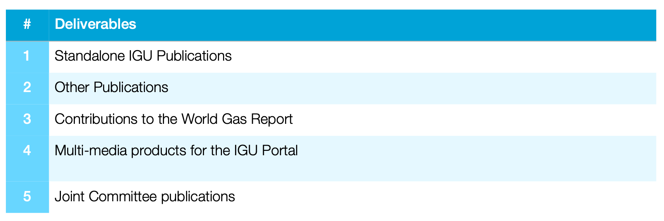
Key Deliverables

Slide 139
Next Steps
Assign specific research focal points.
Establish TWP and milestone delivery plan for each Study Group
First Virtual meeting of the E&P committee is scheduled for November 2022

Slide 140


Slide 141
Updated SCOA
SCMD, IGU Secretariat

Slide 142


Slide 143


Slide 144


Slide 145
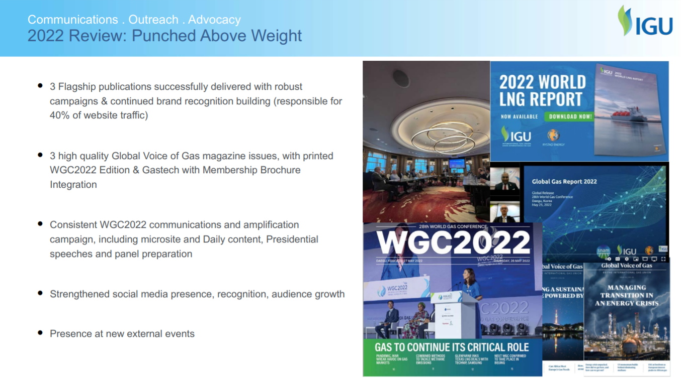

Slide 146
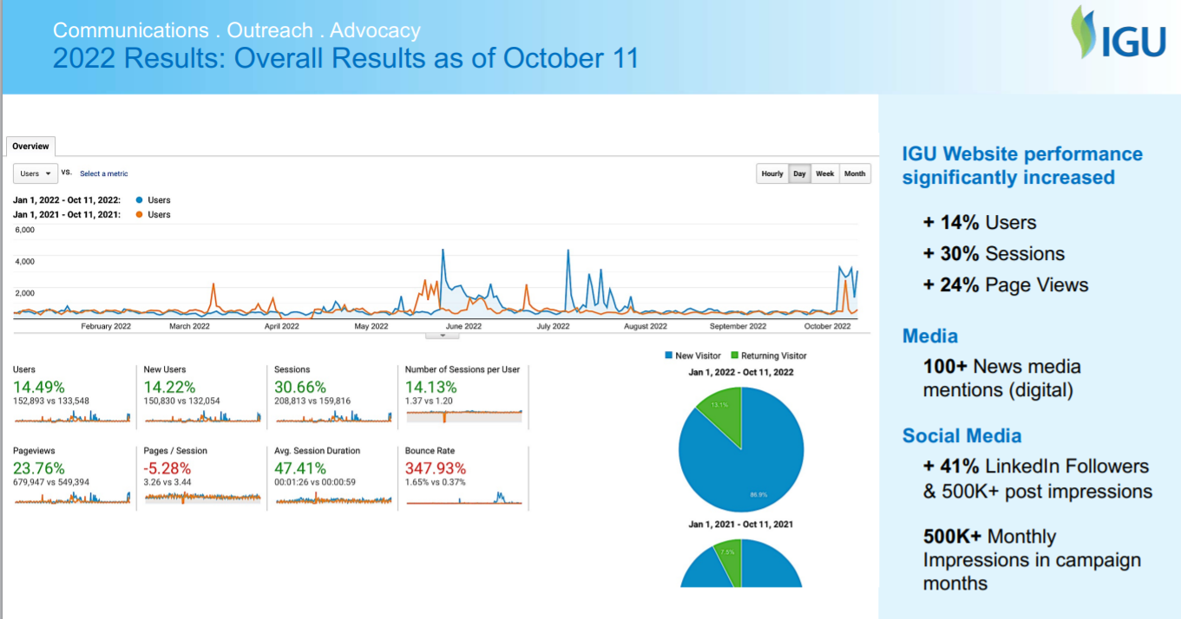

Slide 147
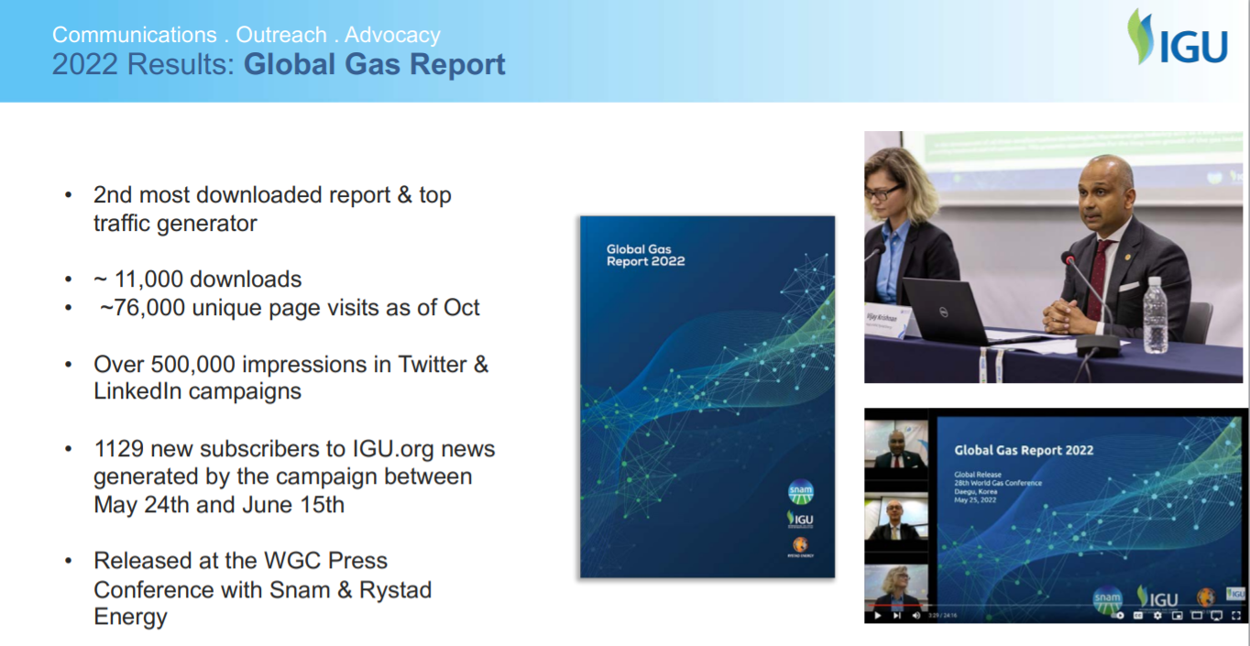

Slide 148
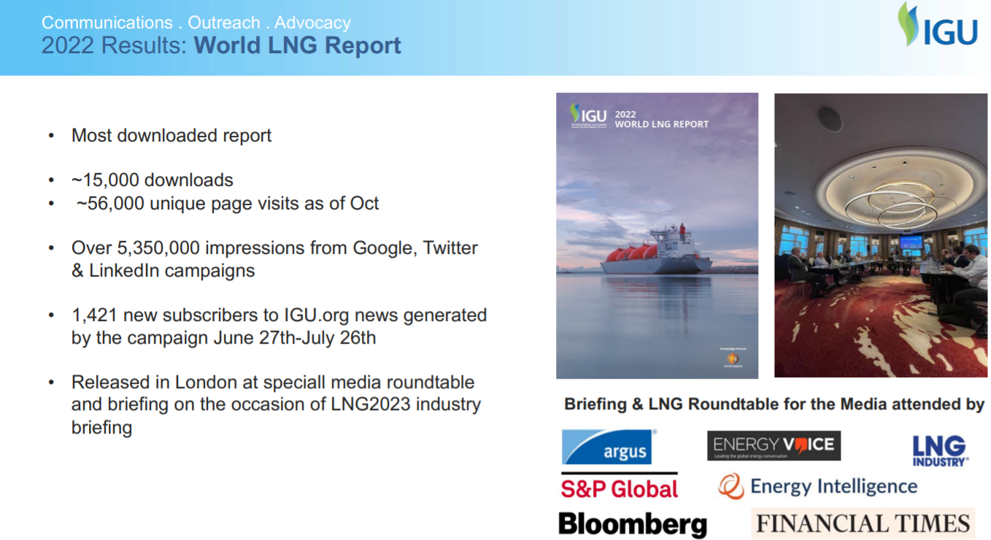

Slide 149
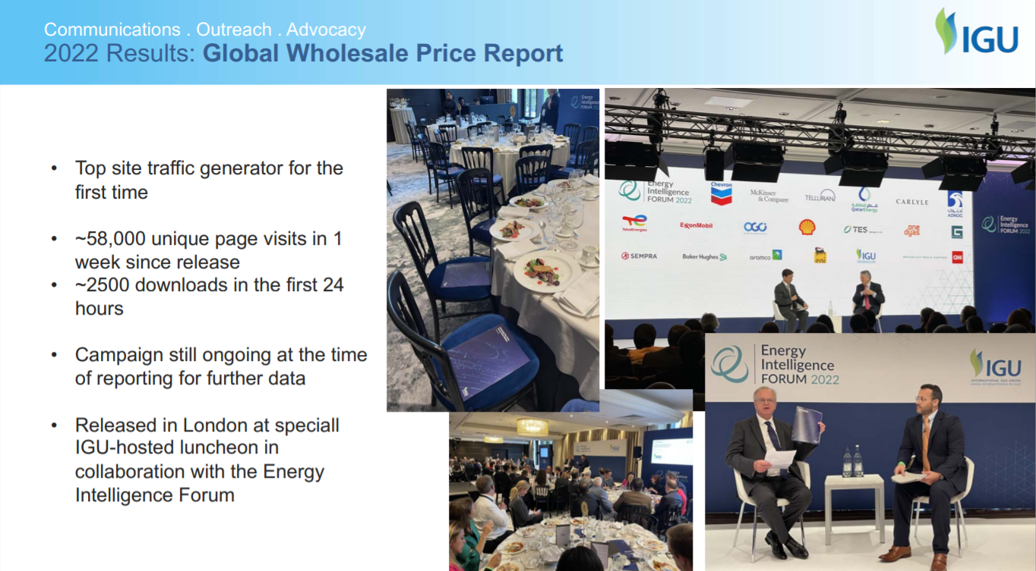

Slide 150


Slide 151
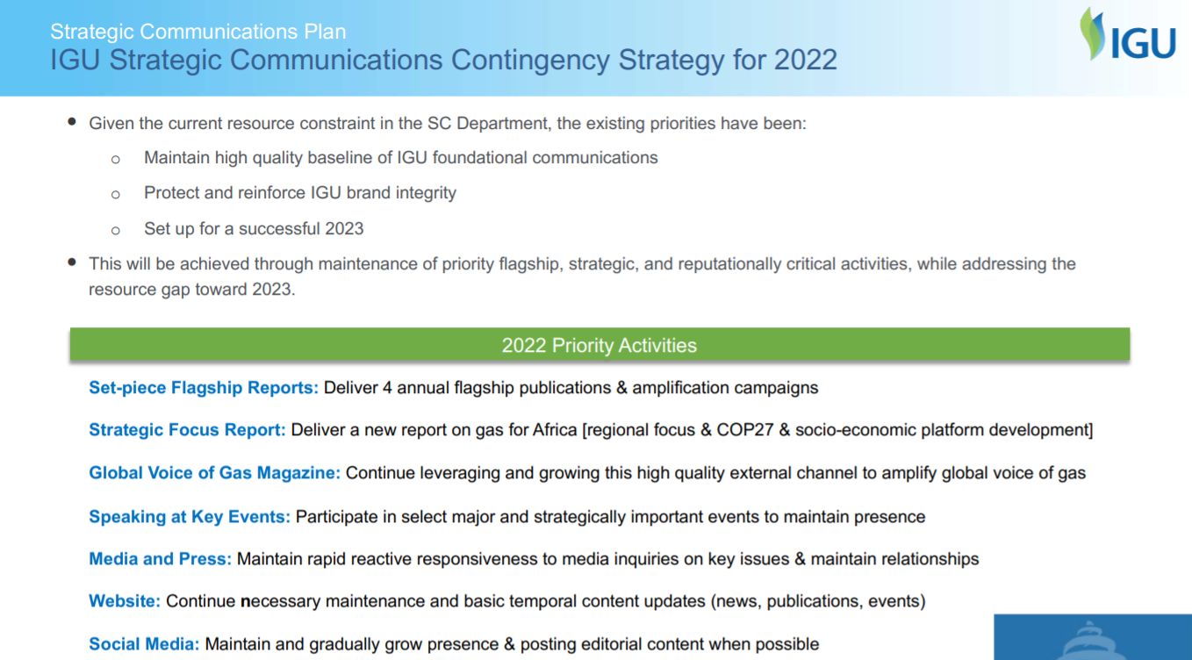

Slide 152
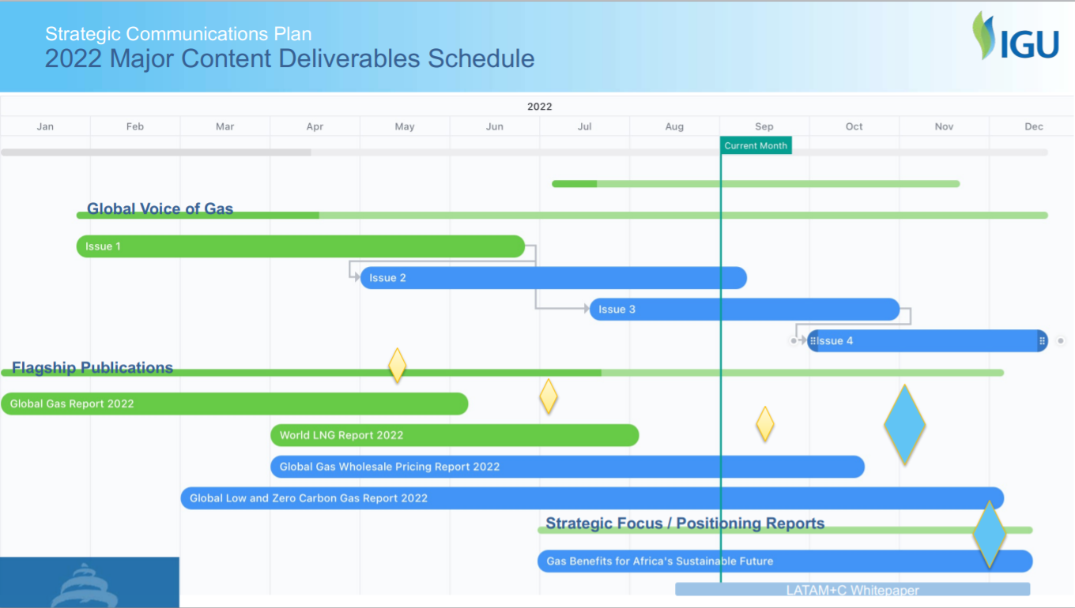

Slide 153
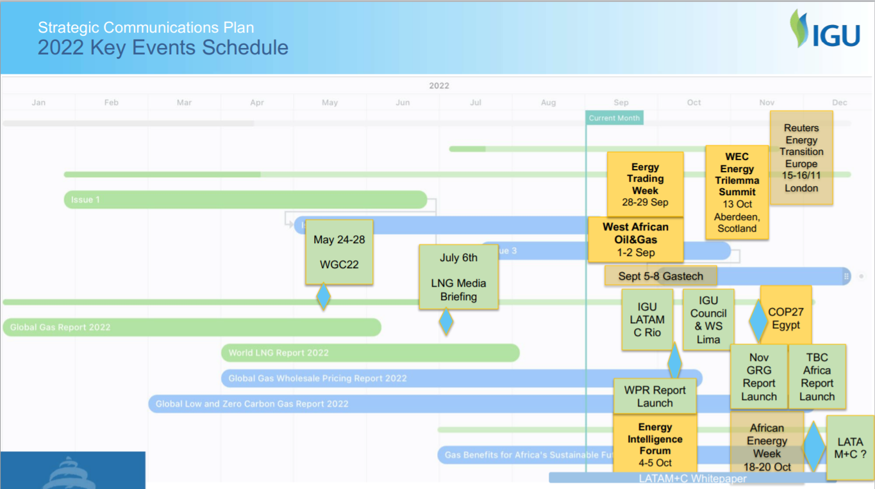

Slide 154
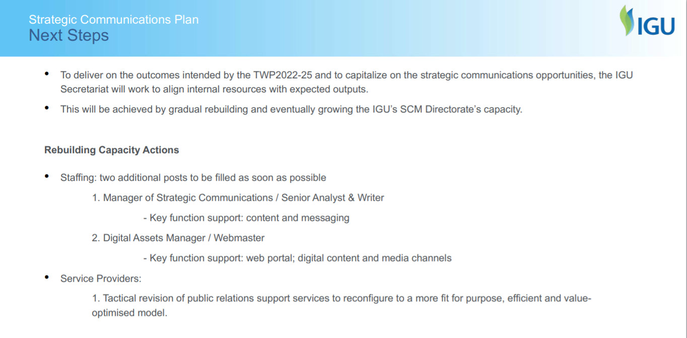

Slide 155


Slide 156
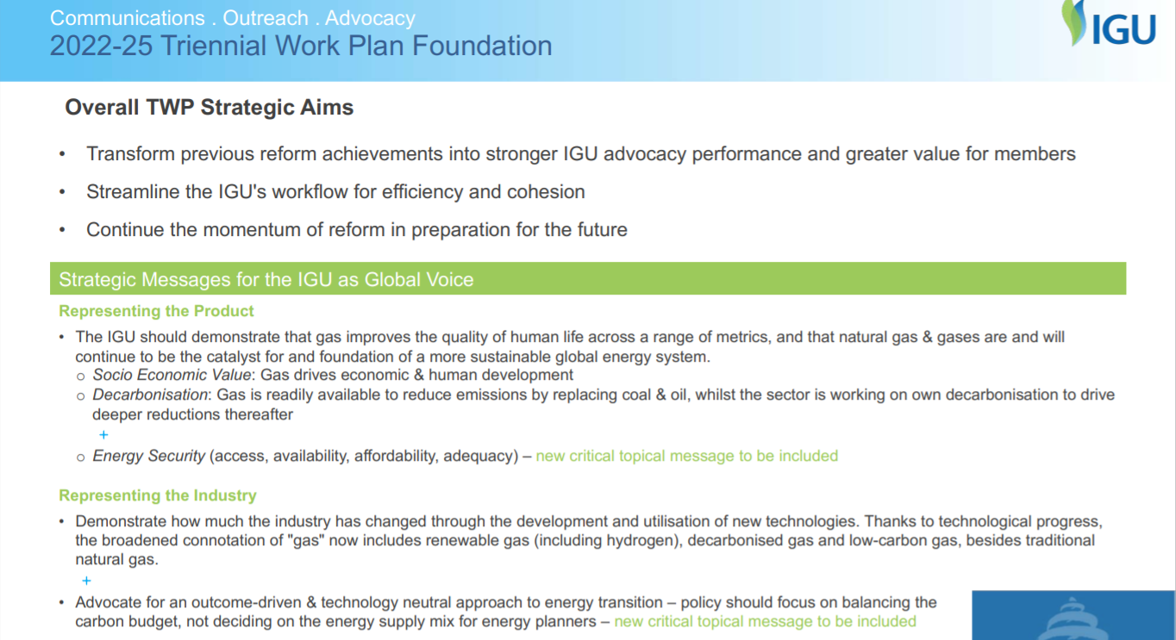

Slide 157
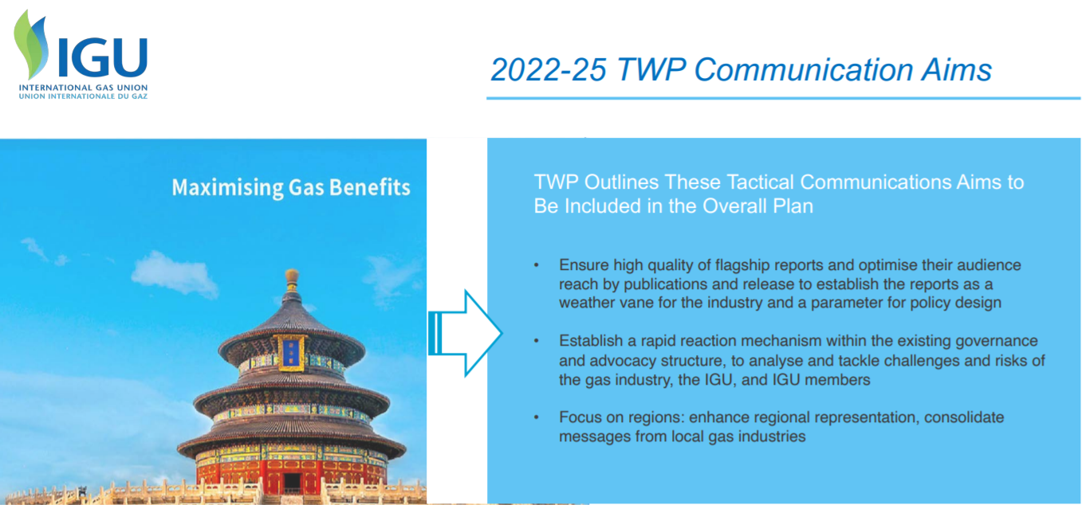

Slide 158
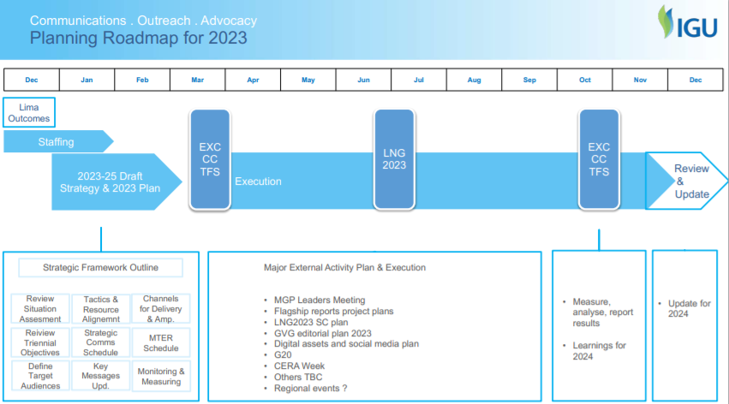

Slide 159
Luncheon

Slide 160
CC Meeting 3
Expected Activities to be organised: Online lectures by IGU experts, IGU Gas & Youth Actions (training young professionals)….
Sharing of the CC Personnel Database
Discussion Topic Two: Sessions and topics for WGC2025 to be discussed in 1H 2023 (60 mins)

Slide 161
Expected Activities to be Organised
Aim to vitalise the Committees/TFs through activities
Using IGU Members Portal to release information
  Committees/TFs are encouraged to release industry news, insights, summaries of meetings, research results, etc. on the platform of ‘Group’.
Online lectures / video clips by IGU experts
  Committees/TFs are encouraged to organise their experts to give online lectures or make video clips to share gas industry insights, advocate for gas and discuss energy transition. Results may be presented in the WGC2025.
IGU Gas & Youth Actions (training young professionals)
  Chinese members plan to invite IGU experts to give Online/offline training courses with IGU granted certificates to young professionals, as activity to support the Young Leaders Forum in WGC2025. Such training activities can be extended to members in other regions or other types of trainees (female professionals, managers in the industry, external stakeholders, etc.). Results may be presented in the WGC2025 (YPP).
Joint workshop among Committees/TFs and with external relations
  It is necessary for Committees/TFs to carry out the Open, concentrated and cooperative work through joint research with external organisations.

Slide 162
Sharing of the CC Personnel Database
According to the AoA, CC consists of CC Chair, CC Vice Chair, CC Secretary, Chairs of 11 IGU Committees. We extend the CC family to include Vice Chairs and Secretaries of IGU Committees, Secretaries of TFs and all individual members in Committees/TFs. This is the “CCfamily”we refer to in the daily operation，mainly for CC meetings.
We have collected mini CVs and brief resumes of CC and built the CC Personnel Database. Those who agree to share personal information while not yet submit materials need to send me mini CV/resume.
We would like to share the information within CC with your permission. If someone would not like to share, please email CC Secretary.

Slide 163
Discussion Topic Two
6
Sessions and topics for WGC2025.

Slide 164
Tasks for Next CC Meeting
Sessions and topics for WGC2025 to be discussed in 1H 2023 (based on Committees’ contributions)
Criteria for paper selection, awards and prizes（number, titles）
Timeline to be developed according to committees/TFs proposals and negotiated result with NOC. (Plan B is also necessary)
Launching the collection of sessions/ topics & awards
Deciding sessions/ topics & criteria and awards
Sessions/topics determined & Authors invitation
Authors’
papers received & speakers determined
Awards winner
fianlised
Start-up
CfA opens
CfA closes
CfP Opens
CfP closes
WGC
2025
Lima
Oct. 2023
Belgium
April, 2023
Australia
Oct, 2023
Dec. 2023
Turkey
April, 2024
May, 2024
Nov
2024
Dec. 2024
March
2025
May
2025

Slide 165
WGC2025 Program: A Draft
CC needs to prepare for >50 sessions of current debate, industry sights, technology & innovation (USA: about 100, Korea: about 50) . Each Committee/TF contributes ≥3 sessions.
Joint sessions are also to be planned.
Depending on the CfP results, we decide the final sessions.
Currently, the types of sessions are not determined.
Day 0 | Day 1 | Day 2 | Day 3 | Day 4 | Day 5
Registration | 9:00-10:30 Opening ceremony | 9:00 – 10:20 Plenary | 9:00 – 10:20 Plenary | 9:00 – 10:20 Plenary | 9:00 – 10:20 Plenary
 | Opening dialogue | 10:30 – 11:50 Current debate | 10:30 – 11:50 Current debate | 10:30 – 11:50 Industry insights | 10:30 – 11:50 Industry insights
 | 12:00 – 13:30 Luncheon | 12:00 – 13:30 Luncheon (?? forum) | 12:00 – 13:30 Luncheon (?? forum) | 12:00 – 13:30 Luncheon (?? forum) | 12:00 – 13:30 Luncheon
 | 14:00 – 15:30 Industry insights | 14:00 – 15:30 Industry insights | 14:00 – 15:30 Industry insights | 14:00 – 15:30 Industry insights | 13:00 – 14:30 TWP Release Conference
 | 15:50 – 17:20 Technology & innovation | 15:50 – 17:20 Technology & innovation | 15:50 – 17:20 Technology & innovation | 15:50 – 17:20 Members Portal training | 14:50 – 17:00 Closing ceremony
Welcome reception |  |  | YPP for ? days | Networking reception

Slide 166
WGC Programs
Sessions:
  Keynotes
  Keynote Luncheons
  Current Debates
  Industry Insights
  Technical & Innovation
Special Forums （Finance, female professionals, ...）
Young Professionals Program
Master Classes
Special training
To discuss: subjects/topics, formats
Organised by NOC, but CC helps design topics

Slide 167
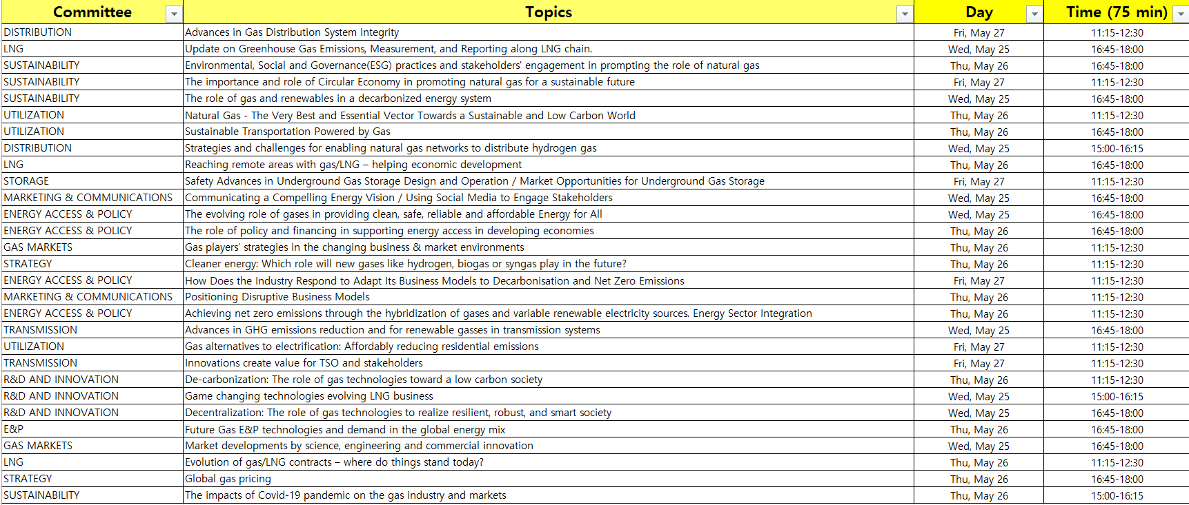
Example: Industry Insights of WGC2022

Slide 168
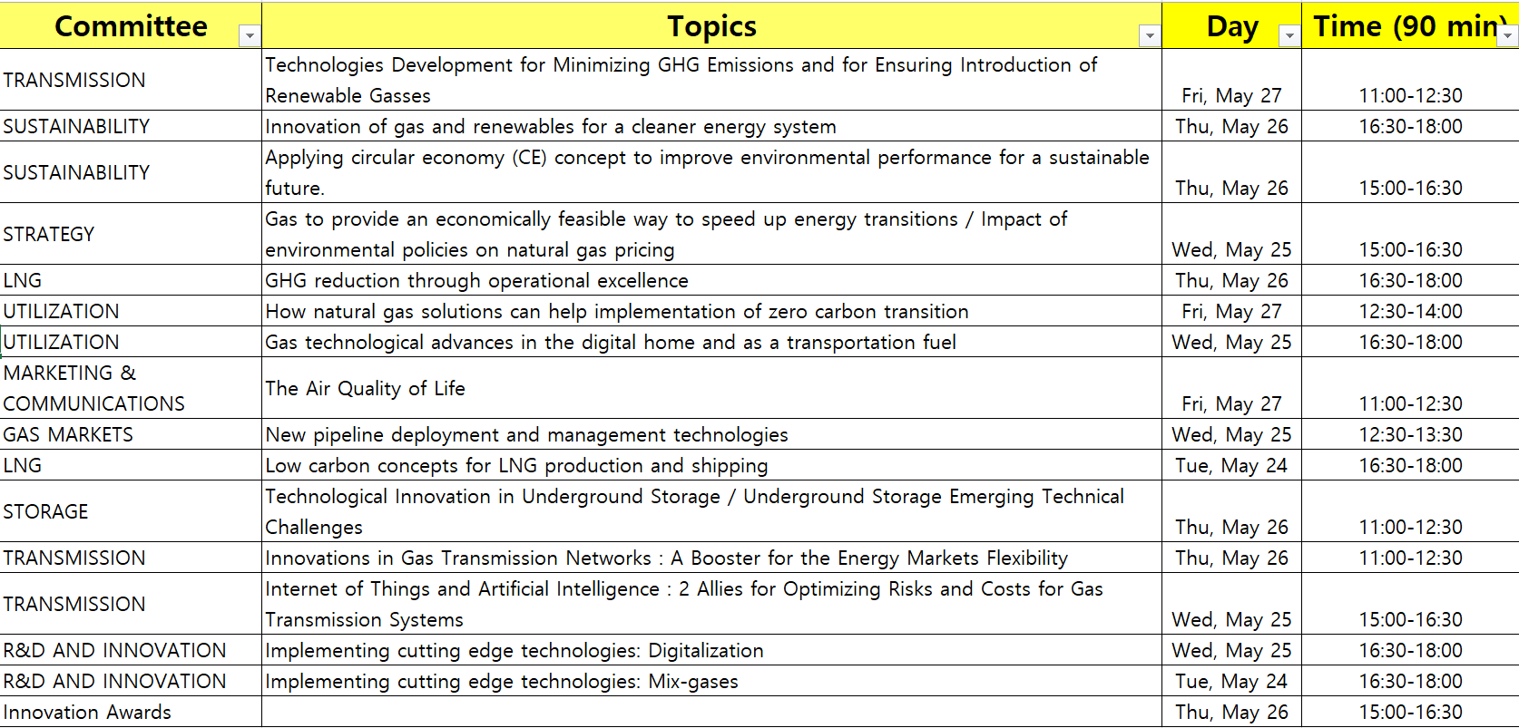
Example: Technology & Innovation of WGC2022

Slide 169


Innovation Awards
PRIZE
  Engraved glass plaque
  Presentation of award-winning project in a dedicated prize giving session in the Technology & Innovation Centre
  Feature in the WGC2022 app
  Announcement in the WGC2022 Newsletter
CATERGORY WINNERS (to discuss, comparing to design of Korea and USA below, number of winners, evaluation committee)
WGC2025 INDUSTRY CHOICE AWARD
The industry choice award winner will be announced at the ceremony award following the category winners’ presentations. How to do?

Slide 170
IGU Global Gas Award
The IGU Global Gas Award recognizes industry efforts that contribute to the progress of the gas industry. The best project should demonstrate an understanding of the challenges faced by the energy sector and provide pragmatic approaches that demonstrate how the adoption of natural gas can deliver positive societal benefit.
THEME FOR 2025
Maximising Gas Benefits.
EVALUATION COMMITTEE (to discuss)

Slide 171
Suggestion from Rodney
WGC2025- Supporting the Committees
Event Objective – 3Qs: Maximise the quantity & quality of qualified participants (delegates and speakers)
Event Strategies
Identify target audiences that match the programme topics and sessions
  Industry Sector; Job Title; Geography
    We need your input
The 1st most important goal of a great programme is to attract more delegates to register
  Detailed programme must be available to support delegate marketing campaign (begins in 2024)

Slide 172
Suggestions from Vittorio
I think it is necessary to deliver to all the COMMs & TFs common guidelines and criteria by which the selection of the papers for the WGC 2025 will be done. (I’m working on such a proposal and I will be happy to propose you some first ideas as soon as I finished drafting these. )
You have time to work on this but I think it is necessary to start thinking how to give guidelines for the papers selection for WGC 2025 very early.
In my previous experiences, it happened that a lot of papers were addressed to the wrong Committee by Authors: and this created some difficulties to the Committees for the selection and also some authors’ paper was rejected because not evaluated as interesting by the committee in charge.
We have to find a way to help the authors to fully understand the topics dealt by each Committee/TFs.

Slide 173
Suggestions From Vittorio
“Joint sessions for common topics are also to be planned.”
I think that the joint sessions have to be decided soon! It is necessary to work together with all the Committees to gather ideas to develop in the triennium and then to bring to WCG 2025.

Slide 174
Suggestions From Gerard
What lessons can be learned from WGC2022? Here is a brief summary of some discussions and exchanges I had with various people.
Challenging circumstances
  COVID-19 and delay by a year
  Invasion of Russia into Ukraine and subsequent responses
  Resulting lower attendance and gaps occuring in agenda
  BUT: given these circumstances, Korean Presidency, IGU Secretariat and CWC managed to provide an interesting conference

Slide 175
General lessons learned
WGC2022 showed an increased focus on what is relevant for the gas industry as well as for external stakeholders: at the time this meant low-carbon gas and methane emissions
The cancellations due to the aforementioned led to some thinly populated sessions; prepare a strategy accomodate more excellent speakers that were on the waiting list
The increased focus on high level discussions is good but comes at the expense of technical sessions, which is a main reason to participate to some of the delegates. We propose some technical session to be in parallel to the plenaries (and thus focus on target audiences)
Alternatively, bring more focus to WGC as high level and IGRC as technical conferences. This is a long term suggestion, that will have to take the outcome of IGRC2024 on board
Build on the functionality of the conference app, bringing more detail so as to facilitate the on-site choices in participating in specific program sessions

Slide 176
Lessons from the II and TI sessions
As mentioned before, consider increasing the time for these sessions by planning some in parallel with part of the high level discussions
Bring more coherence into the programming of the sessions, e.g. by cross checking between the Committees’ topic selections (see notes for more suggestions)
Ensure a stronger adherence to the session scheduling, to facilitate changing from one session to the other. We realize this puts a stress on the program, as delegates will need time to change from one to the other
For the TI sessions, maybe reconsider the appropriate location, as background noise may be impeding on the quality of the sessions
Pay more attention to the promotion of the Innovation Awards, or give these a more prominent role

