Slide 1
Coordination Committee 2022-2025
Kick-Off Meeting
2022.7.20

Slide 2
Objectives of CC Kick-off Meeting
Kick-off of CC, Committees and Task Forces
Current and long-term tasks
Facilitate communication among CC members, Chinese Presidency and Secretariat

Slide 3
Agenda
Moderated By CC Chair
Welcome by Mme. LI Yalan, IGU President
Self Introduction of Each Chair
Current and Long-Term Tasks by Dr. YANG lei
Updated Information of CC by Dr. ZHU Kai
Introduction to IGU Members Portal by Marcela
Introduction to SCOA by Secretariat Tatiana
Work Progress of Renewable Gases Database Report by Gerard Martinus
Work Progress of World LNG Report by LIANG Dong (CNOOC)
Other Issues to Discuss
Annex: Role of ADMIN-Training Session Overview

Slide 4
Welcome by IGU President
1

Slide 5
Self Introduction of Each Chair
2

Slide 6

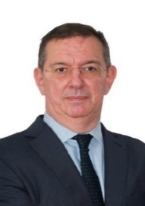
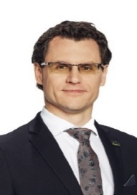
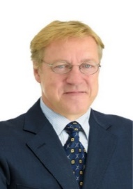
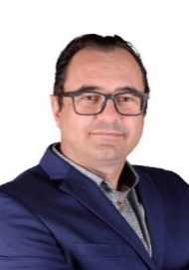
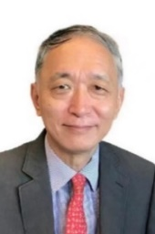







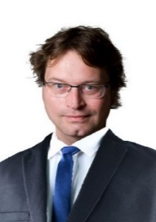
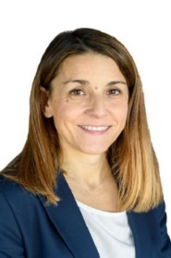
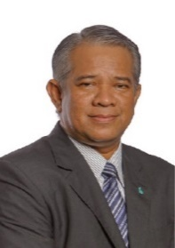
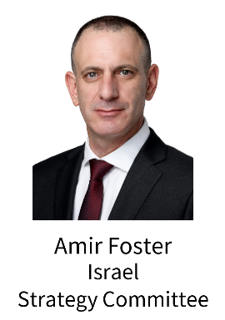
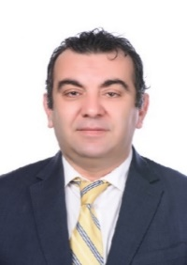




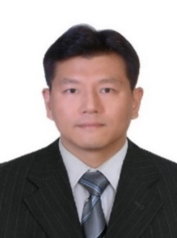

Chairs of Committees
Chairs of Task Forces
Photos to be added：TFS Chair - Ms. Luz Stella Murgas Maya
LNG Committee Chair is about to change.

Slide 7
Current and Long-Term Tasks
3

Slide 8
Member Recruitment for Committees and TFs
The committee member recruitment started on June 27th with an invitation letter jointly signed by IGU Secretary General and CC Chair.
The Secretariat has launched the IGU Members Portal. Marcela will give us a brief introduction to the management of "group”.
 | GasTerra (Netherland) | ENH (Mozambique) | Cheniere Energy (USA) | Beijing Gas Group (China) | CNOOC (China) | KVGN (Netherland) | ROMGAZ (Romania) | Total
Exploration & Production Committee |  | 1 |  |  |  |  | 1 | 2
Distribution Committee |  | 1 |  | 1 |  |  |  | 2
Transmission Committee |  |  |  |  |  |  |  | 0
Storage Committee |  |  |  |  |  |  |  | 0
Utilization Committee |  |  |  |  |  | 1 |  | 1
Strategy Committee | 1 |  | 1 |  |  |  |  | 2
R&D and Innovation Committee |  |  |  |  |  |  |  | 0
LNG Committee |  | 1 | 1 | 3 | 1 |  | 1 | 8
Marketing & Communications Committee |  | 1 |  |  |  |  |  | 0
Gas Markets Committee |  | 1 | 2 |  |  |  |  | 3
Sustainability Committee |  |  |  |  |  |  |  | 0
TFS: Strategic Communications and Outreach |  |  |  |  |  |  |  | 0
TFN: Carbon Neutrality |  |  |  | 1 |  |  |  | 1
TFD: Digitalisation |  |  |  | 4 |  |  |  | 4

Slide 9
Tasks to be Fulfilled Before CC Meeting in Peru
Update work plans
We need to adjust the work plans of Committees and TFs to better respond to the industrial context and the changing world through friendly communication with your members.
Meeting schedule in the triennium
We need to develop the meeting schedule with Committees and TFs, so that our members could better participate and support your activities.
Submission requirement
The new plan and schedule should be submitted to CC China Office by Sept. 10, 2022. Please feel free to contact Dr. YANG Lei, Chair of CC (yanglei@wgc2025.com) and Dr. ZHU Kai, Secretary of CC (zhukai@wgc2025.com).
Please don’t forget to nominate secretaries for your Committees and TFs.

Slide 10
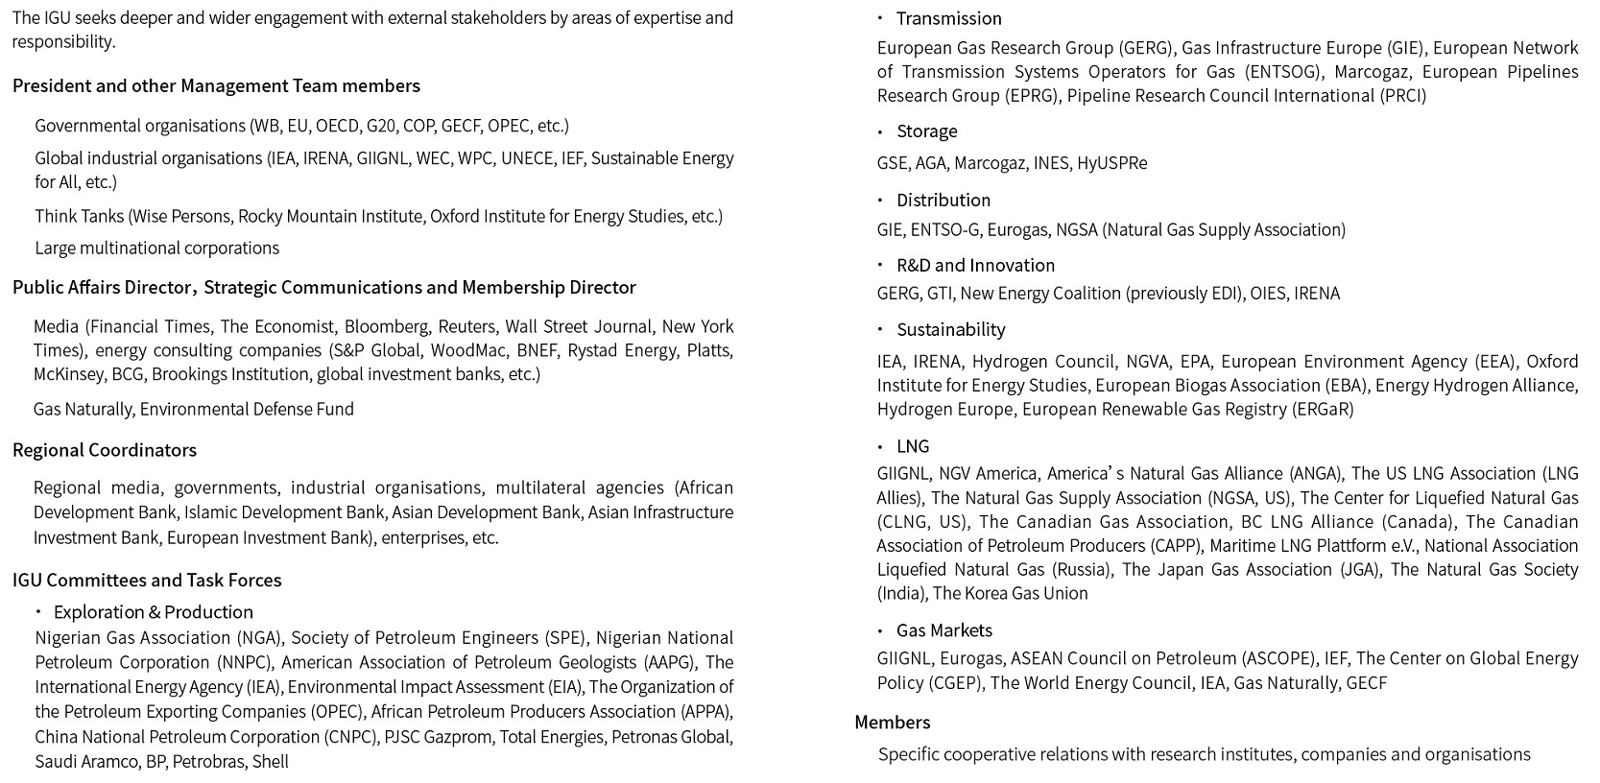
Multi-Tiered External Relations

Slide 11
Research Fields of Committees
Main research fields of the Committees | E&P | Trans-mission | Storage | Distri-bution | Utilisation | Strategy | RDI | Gas Markets | LNG | Marketing & Communication | Sustain-ability
Digitalisation | √ | √ | √ | √ | √ |  | √ |  | √
New Gases |  | √ | √ | √ | √ |  | √ | √ | √ |  | √
Best practices | √ | √ | √ | √ |  | √ | √ | √ | √ | √ | √
Technology | √ | √ |  | √ | √ |  | √ |  | √
Carbon neutrality | √ | √ | √ | √ | √ |  | √ | √ | √ | √ | √
Policy and regulation |  | √ | √ | √ |  | √ | √ | √ |  |  | √
Business competition | √ |  | √ |  |  | √ | √ | √ | √ | √ | √

Slide 12
Common Topics and Leading Committees/TFs
The 11 IGU Committees are clustered into a vertical value chain group and a horizontal industry-wide group, based on whether the Committee focuses on specific segments of the gas industry or topics cutting across all segments, such as strategy. Given that multiple topics are shared by Committees, five of them are chosen to be “common topics”. TFN, TFD, the Strategy Committee, the Gas Markets Committee, and the R&D and Innovation Committee (RDI) are selected to lead research activities of all Committees on the common topics—carbon neutrality, digitalisation, gas policy, differentiated development of gas markets, and innovation, in order to avoid duplication.
Research Unit | Common topic | Deliverable
TFD | Digitalisation | Gas Industry Digitalisation Report: “Digitalisation + Gas" for efficient operation, collaborative innovation and value promotion
TFN | Carbon neutrality | Carbon Neutrality in the Gas Industry: Accelerating the decarbonisation and emission reduction of natural gas with the coordinated development of new gases to achieve Paris Agreement goals
Gas Markets | Differentiated development | Global Gas Industry Differentiated Development and Best Practices Report
RDI | Innovation | Gas research, development and innovation to bring clean and affordable energy across the world
Strategy | Gas policy | Global Gas Policy Study for Regulation Improvement and Gas Advocacy

Slide 13
Long-Term Tasks
Deliverables
We need to pay close attention to deliverables to support the PA activities, rapid response mechanism and WGC2025.
Expertise
We need to motivate IGU experts to expand your team and develop external relations for better cooperation and results.
Advocacy
We need to use multiple digital platforms and channels to carry out activities, such as holding online and offline committee/TF meetings, releasing research achievement and holding webinars online, organising live dialogue with external wise persons, releasing video clips on IGU’s websites, in order to promote the vitality of the IGU and expand it influence across the globe.

Slide 14
Messages from CC for a Successful Triennium
Enhancing the management of research results and inheritance; establishing the archiving and sharing mechanism for the results of Committees and Task Forces
7
Encouraging Committees and Task Forces to hold workshops and joint meetings
1
Hosting two CC meetings every year to assess the work of committees and Task Forces
6
Enhancing research coordination and supporting gas advocacy
2
Mobilising Committees and Task Forces to support Regional Coordinators
Urging Committees and Task Forces to deliver research results, quickly share them within the IGU and release them through gas advocacy activities
5
Providing professional assistance to Secretariat and National Organising Committees to prepare topics and deliverables for WGC2025
3
Assisting Committees and Task Forces to cooperate with enterprises
4

Slide 15


Messages from CC for a Successful Triennium
Tapping into the full potential of IGU experts and help them bring more value to members and the IGU.
Exploring, cultivating and stimulating young practitioners, female talents and youth to contribute to the gas industry.
Human
Resource

Slide 16
Updated Information of CC
4

Slide 17
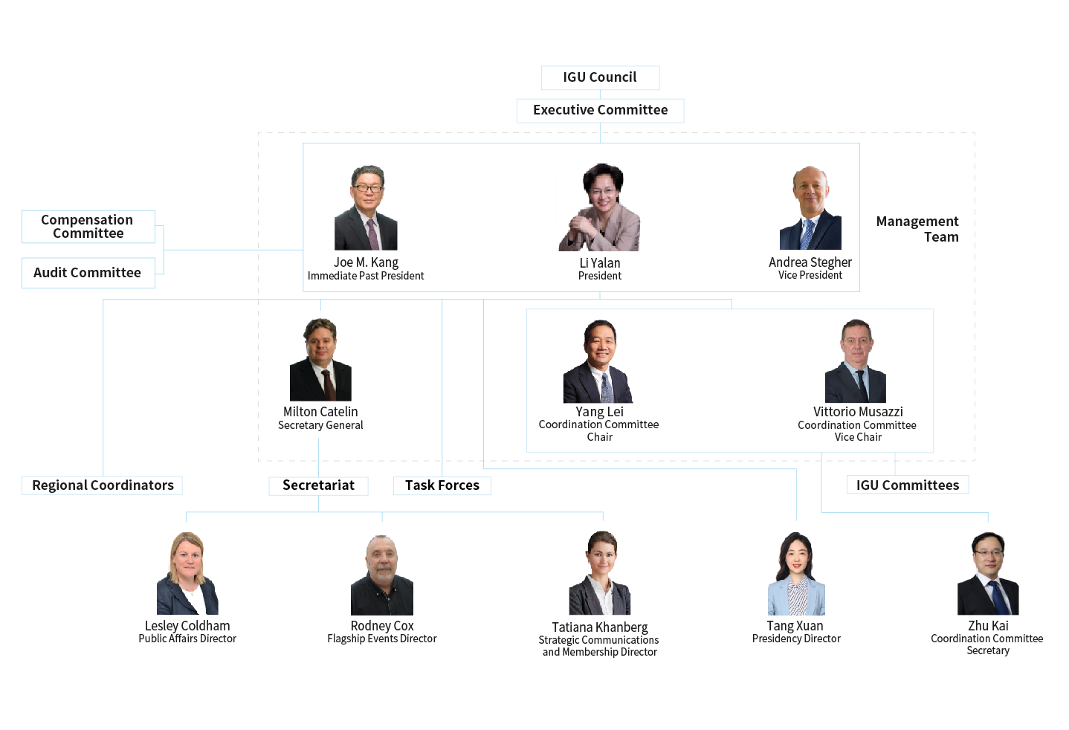
IGU Organisation Chart 2022-2025

Slide 18
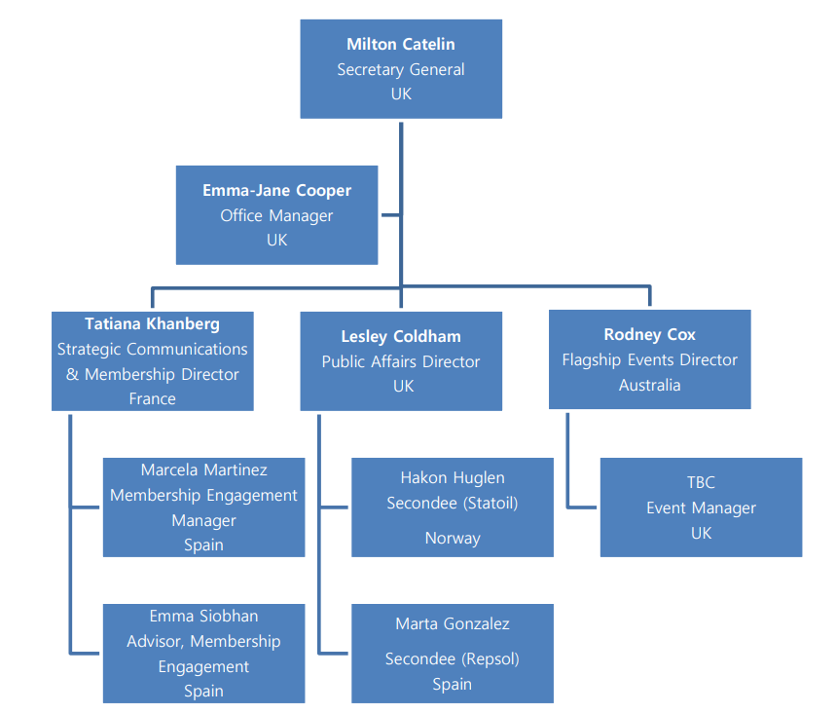
IGU Secretariat

Slide 19
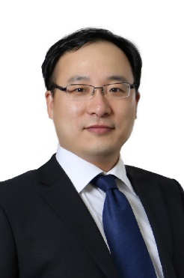
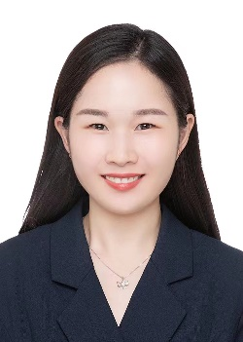
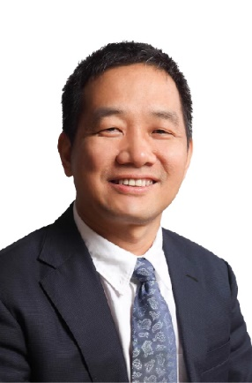
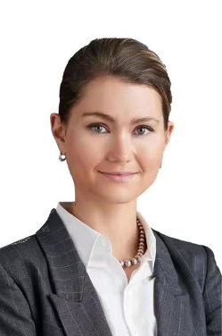
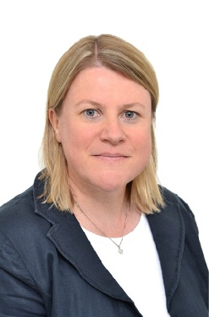
CC China Office 2022-2025
CC China Office:
CC Secretary： ZHU Kai | Manager： ZHANG Yuanhua
Liaison between Secretariat and CC:
SCMD：Tatiana KHANBERG | PAD：Lesley COLDHAM
CC Chair：YANG Lei

Slide 20
Key Actions in the Triennium
Establish a multi-tiered external relations system to magnify the global voice of gas.
Establish three task forces：
  Strategic Communications and Outreach Task Force (TFS) — provide guidance and supervision for the IGU’s strategic advocacy.
  Carbon Neutrality Task Force (TFN) — leading the IGU to engage in the global low carbon development and tackle climate change.
  Digitalisation Task Force (TFD) — respond to the digitalisation issue in the gas industry.
Enhance regional representation by empowering Regional Coordinators.
Restructure Committees and set common topics to improve research quality and efficiency.
Establish a rapid reaction mechanism to analyse and tackle challenges and risks facing the gas industry, the IGU, and the IGU members, and establish a rapid deliverable mechanism to release research progress to inform members and stakeholders and provide opportunities to contribution to the research.

Slide 21
Schedule of IGU Meetings 2022-2025
October 2022 | Council Meeting | Peru
April 2023 | Executive Committee Meeting | Belgium
October 2023 | Council Meeting | Australia
April 2024 | Executive Committee Meeting | Turkey
October 2024 | Council Meeting | Egypt
March 2025 | Executive Committee Meeting | Malaysia

Slide 22

Flagship Events
2023.7.10-14
2024.5.13-16
2025.5.19-23

Slide 23

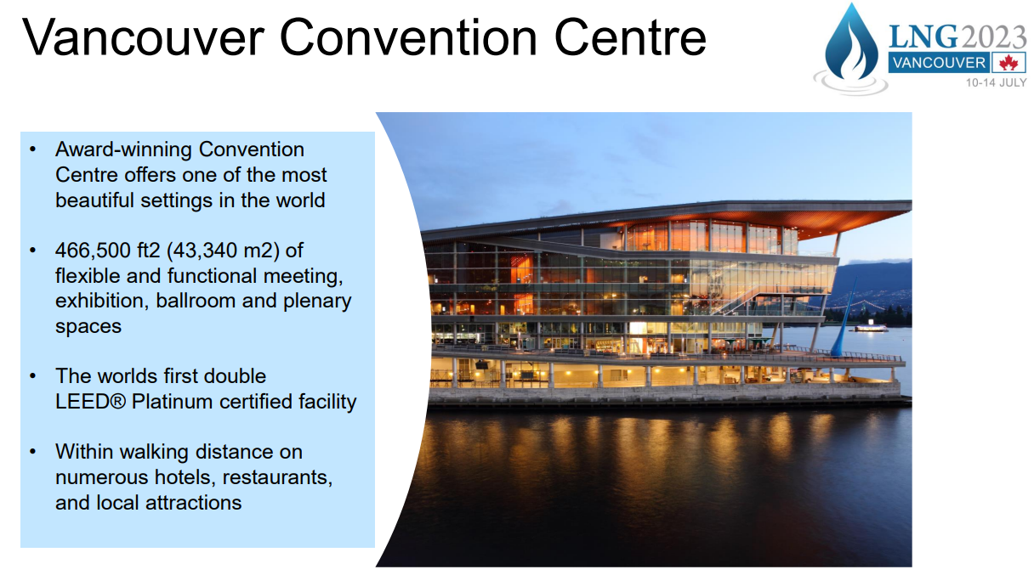
Exhibition & Sponsorship Inquiries: exhibition@lng2023.org
Call for Abstracts Inquiries: papers@lng2023.org
About Vancouver: www.destinationvancouver.com
About the Host: www.cga.ca

Slide 24

Steering Committee, March 2022. NOC’s project management met all requirements
Sponsorship commitments from 22 companies
www.igrc2024.com and quarterly webinar series focusing on Innovation both launched
Co-ordination with incoming IGU RD&I Committee Chair (IGRC Programme Committee Chair)
Canada Pavilion at WGC2022 is booth (5250)

Slide 25


70 countries
600 companies
6,000+ conference delegates
36,000+ visitors
80 sessions
600 speakers
360 exhibitors
42,000㎡ of exhibition floor
Contact us:
conference@wgc2025.com
exhibition@wgc2025.com
sponsor@wgc2025.com

Slide 26
Introduction to IGU Members Portal
5

Slide 27
To share a general view of Members Portal - Collaboration Hub and the role of the Admin of each group (Committees and Task Forces).
GOALS

Slide 28
What is the Members Portal - Collaboration Hub?
Is an open section to all members of the Members Portal where Committees and Task Forces have their own and private space/group to communicate themselves by :
  Publish content
  Organize meetings
  Share documents
How the Collaboration Hub works?
  Each Committee and Task Force assign one administrator (ADMIN) of the group.
  The ADMIN is able to manage the digital platform on the backend (CMS) of the Collaboration Hub.
  The ADMIN will be able to edit the group, manage members, create meetings and publish documents .
  The ADMIN will receive a personal training by the IGU Secretariat – in the following weeks - and technical support. During triennium.
How members of each Committee and TF can join groups on Collaboration Hub?
Members of each Committee and Task Force will join the group the belong by:
  Registration on the Members Portal
  Get into Collaboration Hub
  Registration on the group
IMPORTANT: The Collaboration Hub doesn´t replace the current process of nomination to recruit CC members.
Members who request Registration on a group of the Collaboration Hub, must be official members of a Committee or Task Force to be accepted by the ADMIN and join..
In case a member of the Members Portal requests to join a group he/she doesn't belong, the ADMIN will invite him/her to follow the nomination process in order to evaluate acceptance accordingly.

Slide 29
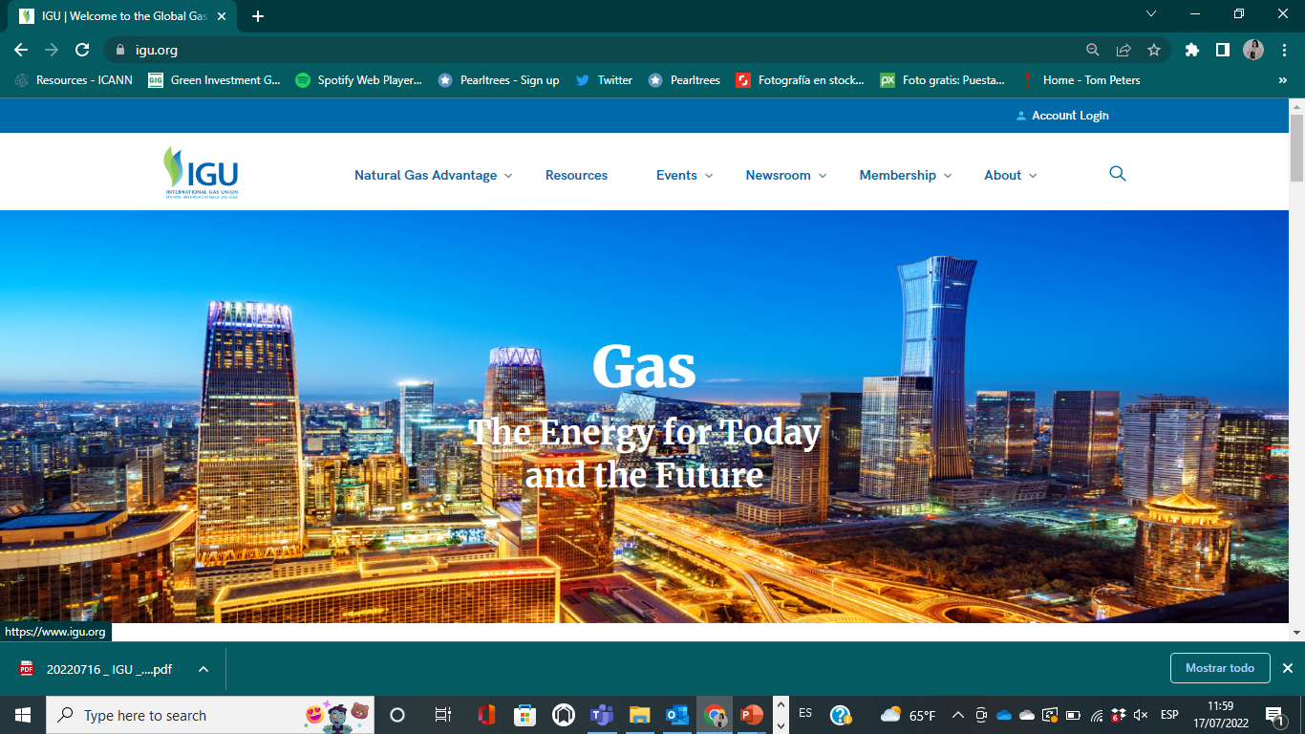

Slide 30
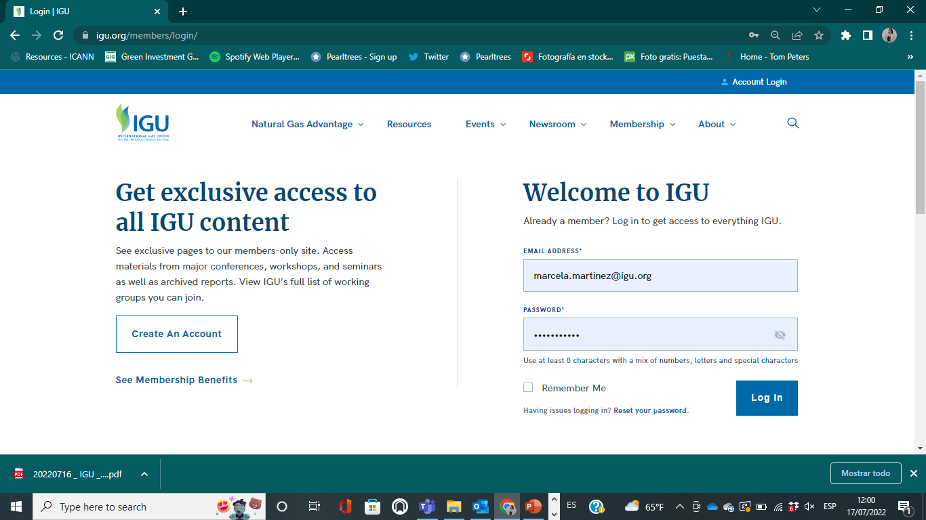

Slide 31
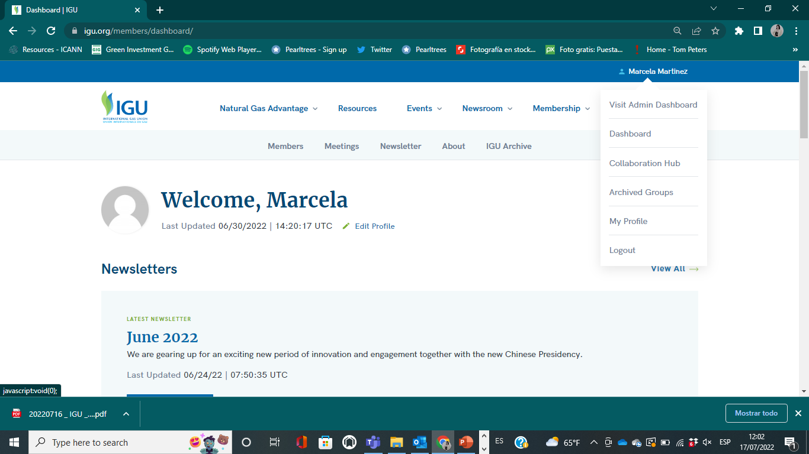

Slide 32
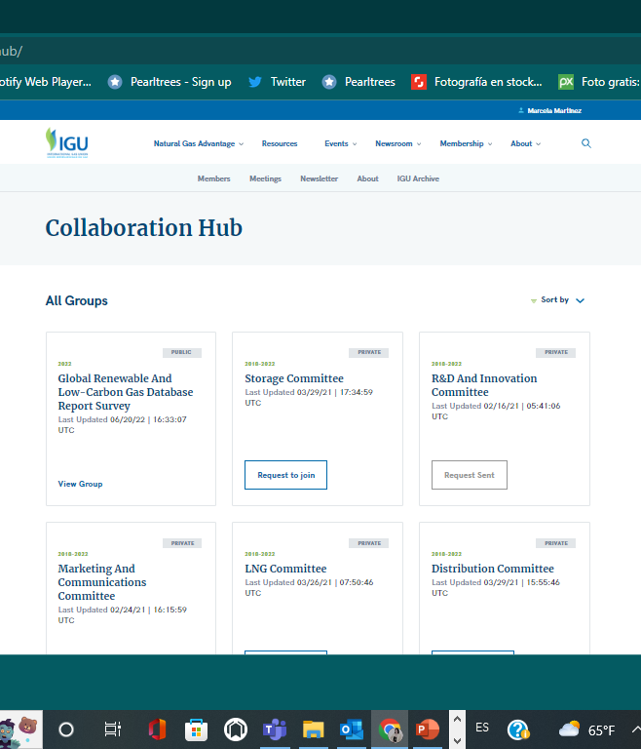
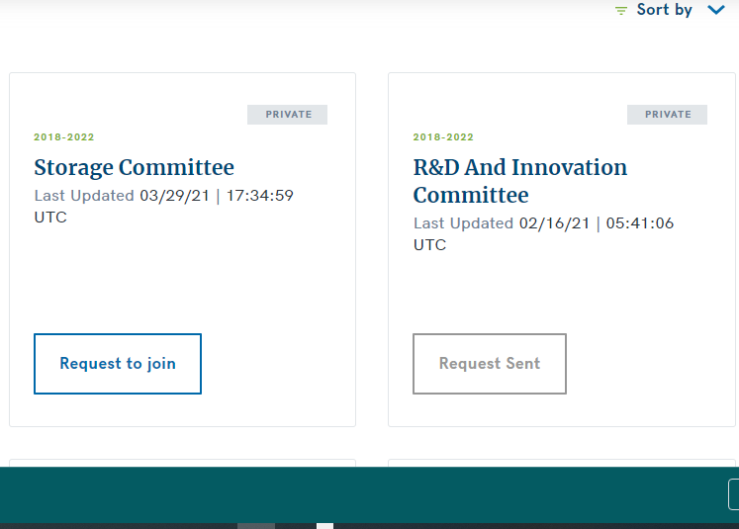

Slide 33
Existing Account
Official CC Member
ADMIN accept
CC or TF oficial Member
www.igu.org
Join Members Portal
Go to Collaboration Hub
Click on Request to Join
New Account
No Official Member
ADMIN deny
Registration process
ADMIN will follow recruitment process by email
Accepted (Only IGU members)
For not IGU members but oficial members of the CC, Chair should advise IGU Secretariat by email name and email to authorize Registration to the Members Portal.

Slide 34
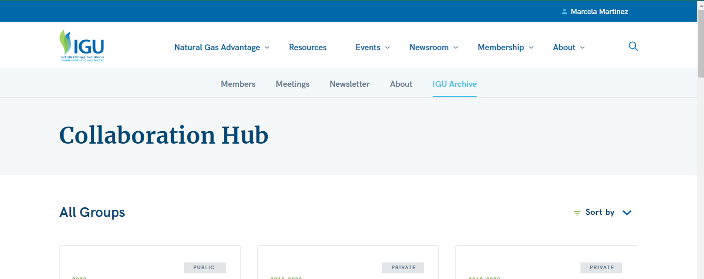
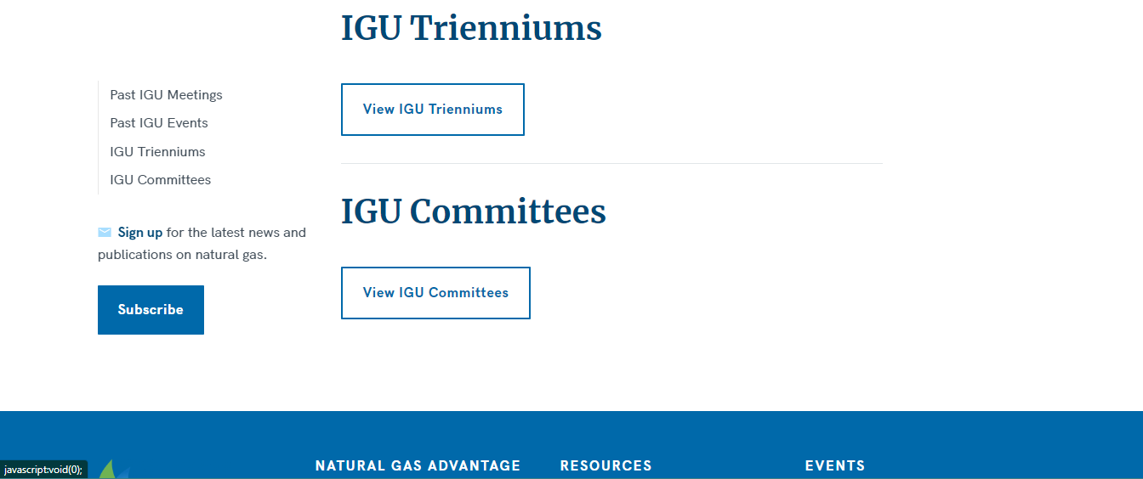
Transition from 2018-2022 to 2022-2025 Committees and Task Forces
Current Content and ADMIN permissions
Current groups belong Committees and TF 2018-2022
The chairs of the committees of the 2018-2022 triennium are working on backup their files until Friday 22nd at 12:00 GMT
ADMIN 2018- 2022 will lose rights to manage their groups on the platform.by next Saturday 23 ^{nd} July.
All current groups will be archived next Sunday 24th July
New Content and ADMIN permissions
Each chair of committees 2022-2025 must assign an official ADMIN to manage the group on Members Portal- Collaboration Hub
The CC Chair will share list of ADMIN´s (name and email) to marcela.martinez@igu.org before next Sunday 24th July
Groups of Committees and Task Forces 2022-2025 will be created by the IGU Secretariat next Sunday 24th July
The IGU Secretariat will give permissions to new ADMIN by next Sunday 24th July.
All new groups well be available next Monday 25th July.
Ready to schedule training sessions to ADMINS.

Slide 35
Timeline
Wed 20 Thu 21 Fri 22 Sat 23 Sun 24 Mon 25
Kick OFF Meeting
Deadline to backup files of CC groups 2018-2022
ADMIN 2018- 2022 will lose rights to manage their groups
2018-2022 CC groups will be archived
Deadline to CC send official ADMIN list of names and email to IGU Secretariat
New CC and Task Forces 2022-2025 will be created
Start schedule training sessions with ADMINS
Permissions to new ADMIN
New groups well be available next Monday 25th July.
Ready to start ADMIN training sessions
35

Slide 36
Introduction to SCOA
6

Slide 37
What is the COAP?
Secretariat: Develop a strategic communications, outreach and advocacy plan (COAP) and tactical programmes to submit to the Strategic Communication and Outreach Task Force for review and endorsement
SC&O Task Force:
  host one meeting to review the COAP before it is presented to the IGU Executive Committee
  Set up a ‘working group’ to work closely with the IGU’s Public Affairs Director and Strategic Communications & Membership Director to provide strategic inputs and support for
    the drafting and release of IGU messaging and IGU President’s presentations
    delivery of the COAP

Slide 38


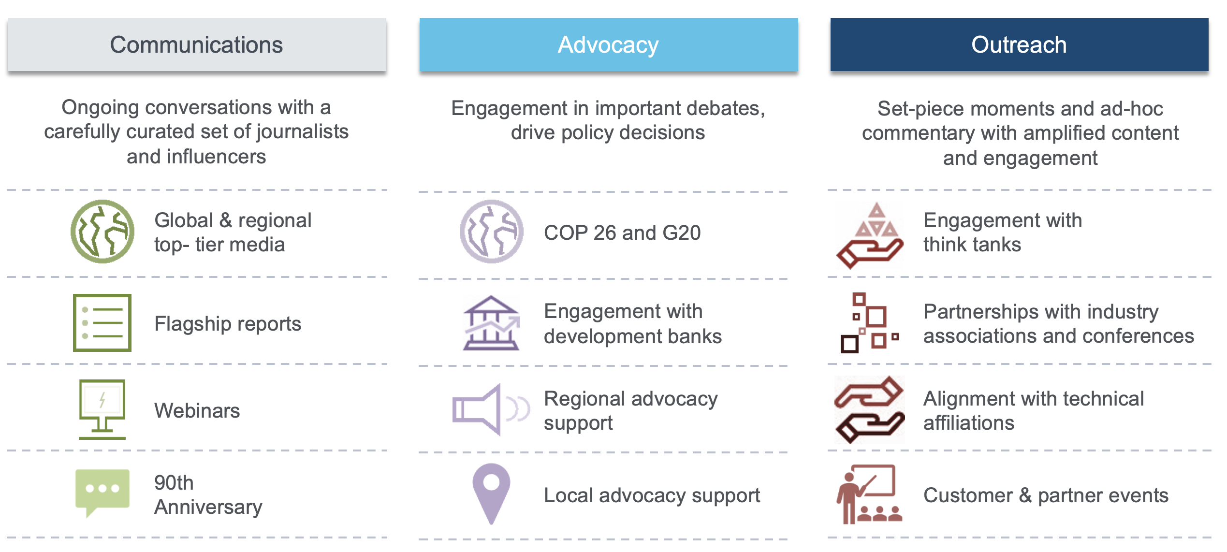
Where does the COAP fit in?
Articles of Association
PUBLIC DOCUMENT
IGU Website
Communication, Advocacy and Outreach Plan
INTERNAL DOCUMENT
Not on IGU Website
Public Communication, Advocacy, Outreach
Strategy, Objectives and Work Plan To be reviewed by TF1
REVIEW
Adopted Indonesia 2019
Includes Vision, Mission

Slide 39
Rapid Response Mechanism
Presidency: Establish a rapid reaction mechanism within the existing governance and advocacy structure to analyze and tackle challenges and risks of the gas industry, the IGU and IGU members
Secretariat: Enhance coordination and synergy between committees and other IGU working bodies to translate research results into a professional foundation for advocacy and decision-making, and enable rapid responses to external challenges
IGU Committees & Task Forces: Provide expertise and consultation to decision-makers to enable rapid responses by the IGU, with support from the CC and the Secretariat

Slide 40

Strategic Communications Key Outputs
Internal
Bi-Monthly Newsletter
Exclusive Briefings on Upcoming Events and Releases
External
Four Flagship Annual Reports:
  World LNG Report
  Wholesale Pricing Survey
  Global Gas Report
  Global Renewable and Low-Carbon Gas Report
Global Voice of Gas Magazine
  Produced quarterly in collaboration with NGW
  Thematic issues, with opportunity to contribute content & to advertise

Slide 41
Flagship Reports and External Comms Milestones
Flagship Report
Magazine
Global Gas Report 2022
Release
World LNG Report 2022
Release
Wholesale Price Report 2022
Release
Global Renewable Gas Report Release
Sustainable Future Powered by Gas
Managing Energy Transition in Crisis
GVG 3
GVG 4
Newsletter
Newsletter
Newsletter
May | Jun | Jul | Aug | Sep | Oct | Nov | Dec
Ongoing targeted media, social media and audience engagement

Slide 42
Work Progress of Renewable Gasses Database Report
7

Slide 43
RGDR Intro
Renewable Gasses Database Report is a common effort together with Oxford Institute for Energy Studies
Work on the report was initiated in 2021 the realization that gasses play a crucial role in de-carbonization of the global energy system
First questionnaire has seen in-depth response from limited countries, leading to a report that as yet has to prove its value over other reports (e.g., IEA Global Hydrogen Review)
This years questionnaire has been sent, feedback is coming in, including draft country focus section
From next year onwards, the report will be embedded into regular Committee work.

Slide 44
RGDR Plan
Compilation of Questionnaire (OIES) and Contact List (IGU), resulting in sending the questionnaire by IGU team: before 1st April
Collection of responses, sending reminders, and adding to the data set (IGU) leading to transfer of anonymized database to OIES: before 1st June
Parallel preparation of report outline (OIES): before 1st June
Analysis of data and writing of report (OIES), including country focus reports (OIES and IGU): before 1st August
Drafting of the report (OIES and IGU) with final draft before 15th September
Publication on 1st October

Slide 45
Work Progress of World LNG Report
8

Slide 46

We are
CNOOC Energy Economics Institute (EEI)
CNOOC Energy Economics Institute (EEI) was established on December 15, 2020.
We are responsible for advising the executive board on the drivers and trends in global energy.
We do
Energy Economics and Policies
Strategy and Management
Consulting and Evaluation
Carbon Neutrality
Our flagship report
China Offshore Energy Outlook is our flagship report, providing historic data and making projections on global energy markets.

Slide 47
Our Plan
4. Liquefaction Plants 液化工厂
4.1 Overview
4.2 Global Liquefaction Capacity and Utilisation
4.3 Liquefaction Capacity by Market
4.4 Liquefaction Technologies
4.5 Floating Liquefaction (LNG-FPSOS)
4.6 Risks to Project Development
4.7 Update on New Liquefaction Plays
1. State of the LNG Industry LNG产业现状
2. LNG Trade LNG贸易
2.1 Overview
2.2 LNG Exports by Market
2.3 LNG Imports by Market
2.4 LNG Interregional Trade
5. LNG Shipping LNG运输
5.1 Overview
5.2 LNG Carriers
5.3 Floating Storage and Regasification Unit Ownership (FSRUs)
5.4 2022 LNG Orderbook
5.5 Vessel Costs and Delivery Schedule
5.6 Charter Market
5.7 Fleet Voyages and Vessel Utilisation
5.8 Near Term Shipping Developments
3. LNG and Gas Pricing LNG及天然气价格趋势
3.1 Asia-Pacific LNG Market Price Trends
3.2 Atlantic LNG Market Price Trends
3.3 Crude Oil Market Price Trends

Slide 48
Our Plan
6. LNG Receiving Terminals LNG接收终端
6.1 Overview
6.2 Receiving Terminal Capacity and Global Utilisation
6.3 Receiving Terminal Capacity and Utilisation by Market
6.4 Receiving Terminal LNG Storage Capacity
6.5 Receiving Terminal Berthing Capacity
6.6 Floating and Offshore Regasification
6.7 Receiving Terminals with Reloading and Transshipment Capabilities
7. References List 参考文献
7.1 Data Collection
7.2 Definitions
7.3 Regions and Basins
7.4 Acronyms
7.5 Units
7.6 Conversion Factors
7.7 Discrepancies in Data vs. Previous IGU LNG Reports
Special Topic 特别专题
Impact of Ukraine Crisis on the LNG Industry
Chinese LNG Market

Slide 49

Timetable
September 2022
Complete the outline of the IGU report by referring to previous IGU
reports after confirming with the Leadership Group, IGU Secretariat, and LNG Committee.
October 2022 - January 2023
Complete the initial draft of the IGU report.
February 2023
Organise a team of experts and consultants to review the report, refine it accordingly, and submit it to the Leadership Group for a second round of review and revision.
March 2022
Submit the updated draft to the IGU Secretariat and the LNG Committee for consideration.
April 2023
Update data in English and Chinese versions and finalise the report.
May 2023 onwards
Release the report with the help of IGU.

Slide 50
Other Issues to Discuss
9

Slide 51
CC Meeting and Council Meeting in Peru
Free discussion:
Meeting agenda
Items to present/discuss：PPT to present in the Council meeting
Who are voluntary to present work progress?
Are there any local activities to participate in? (No CC member from Peru)

Slide 52
THANK YOU

Slide 53
Annex: Role of ADMIN-
Training Session Overview

Slide 54
LOGIN

Slide 55
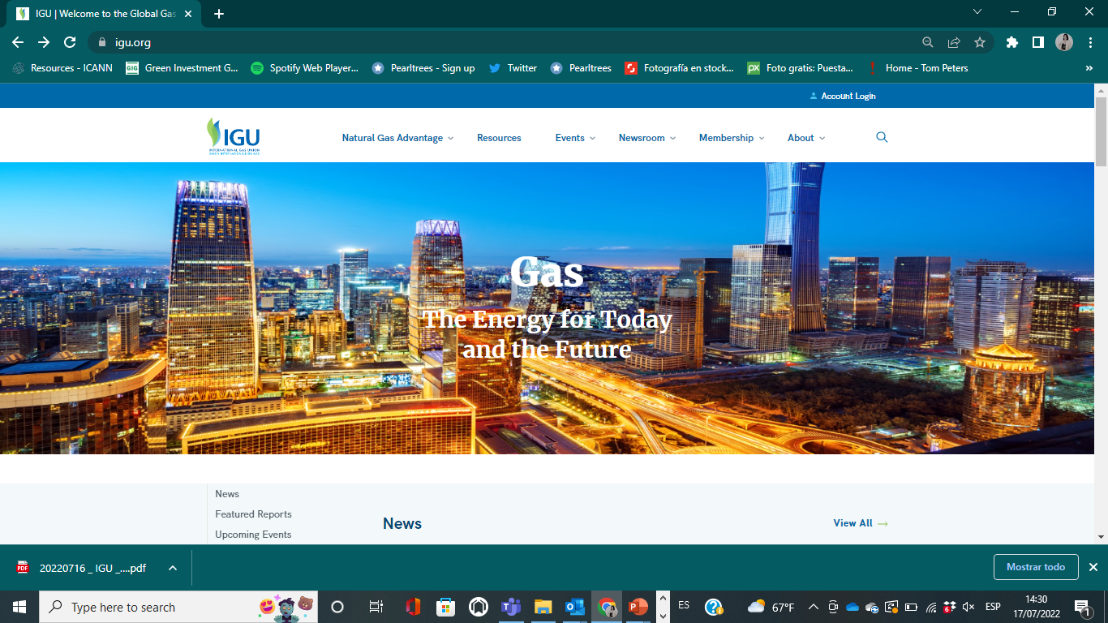
➔ Access the www.igu.org site

Slide 56
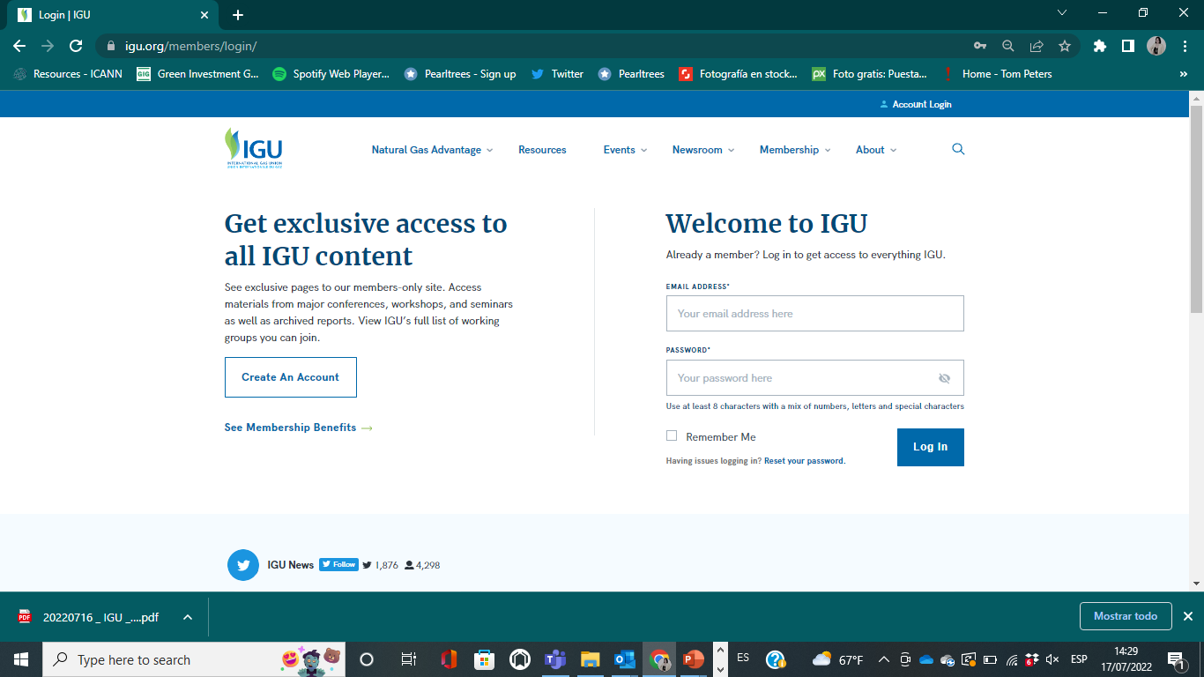
➔ Click Account Login on the top-right utility navigation

Slide 57
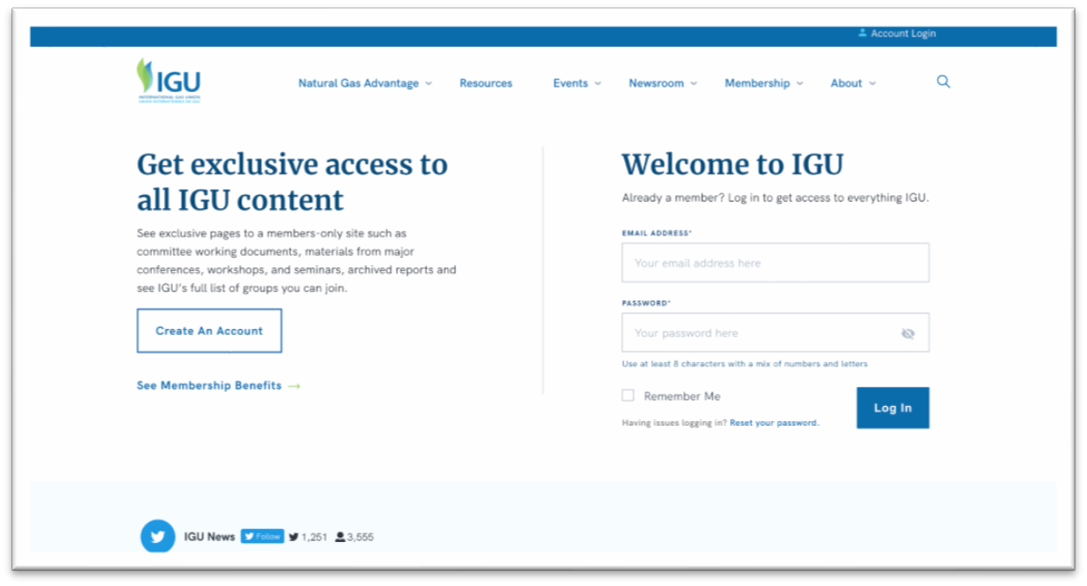
➔ Login to your IGU Account

Slide 58
ADMIN
DASHBOARD

Slide 59
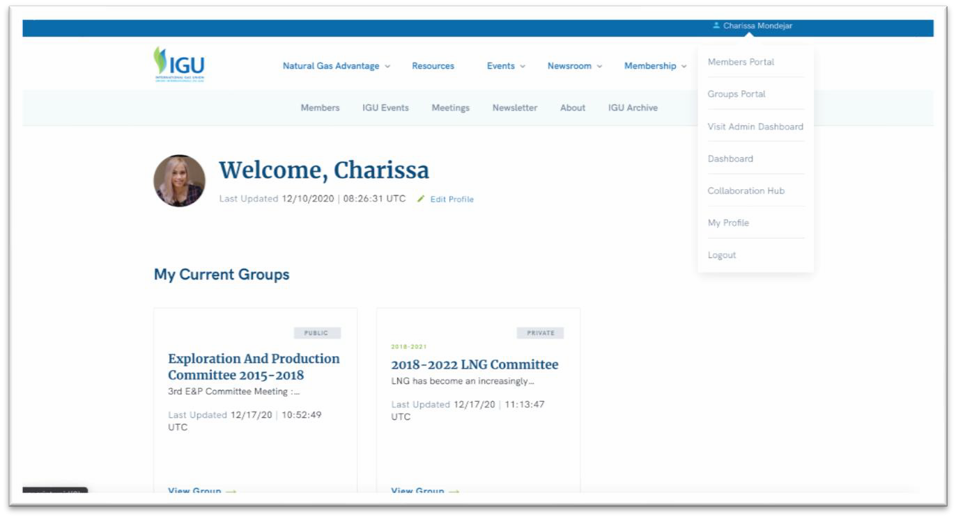
➔ On the dropdown, click Visit Admin Dashboard

Slide 60
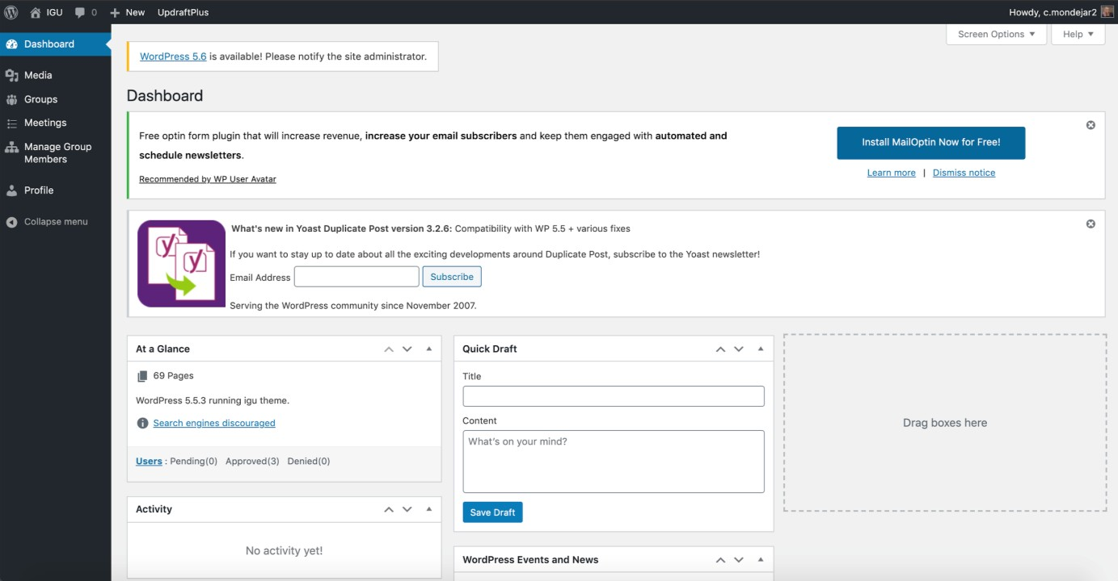

This will lead you to the Admin Dashboard (CMS)

Slide 61
CONTENT MANAGEMENT
A step-by-step process on how to manage and add content to your group

Slide 62
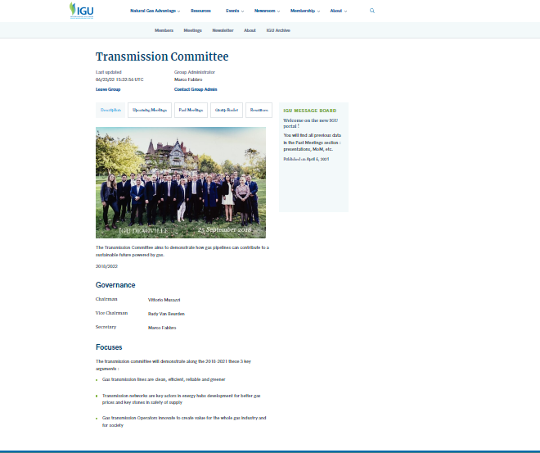
Group Structure & Content

Slide 63
EDIT GROUP
INFORMATION

Slide 64

➔ On the sidebar, click on Groups

Slide 65
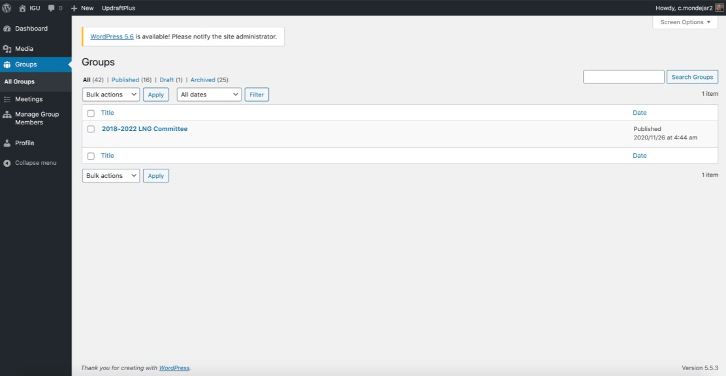
➔ Click on
your Group name

Slide 66
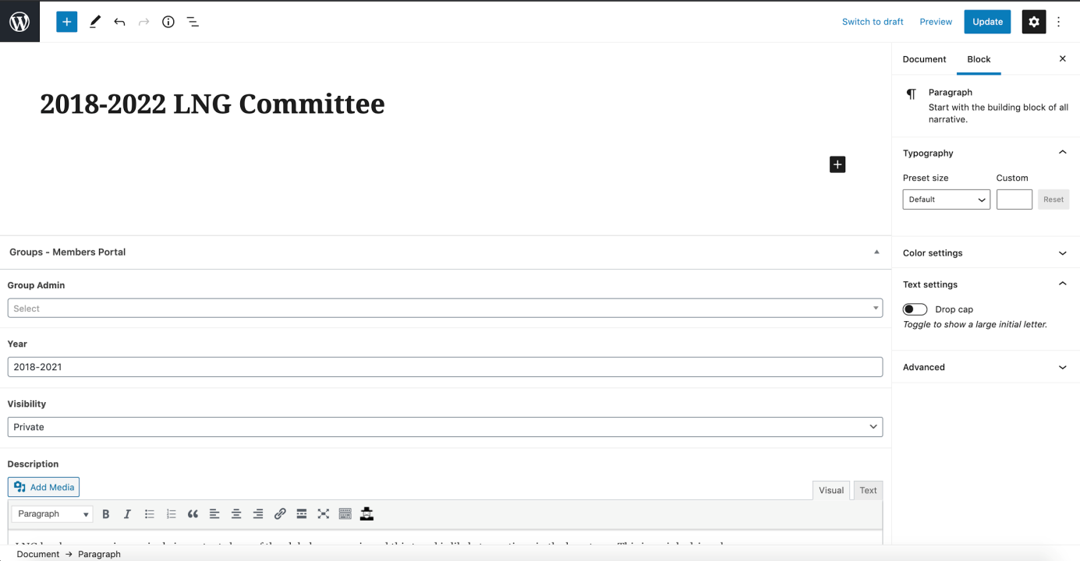

➔ Edit your Group information (Group admin, year, visibility)

Slide 67


➔ Click update, once done

Slide 68
EDIT
DESCRIPTION

Slide 69
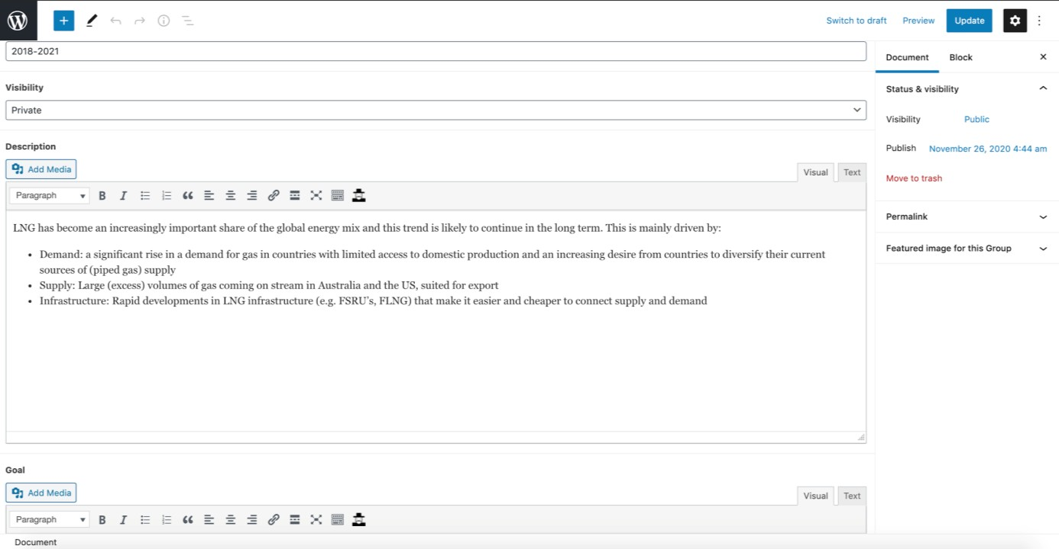

➔ Edit your Group description

Slide 70
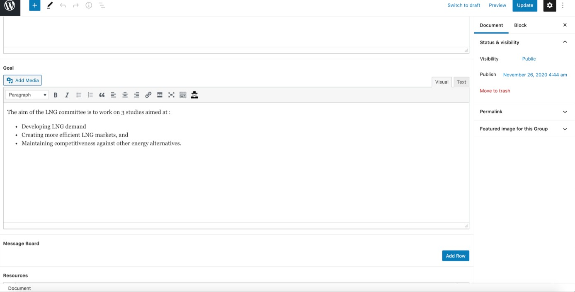

➔ Add/update your Group focuses

Slide 71
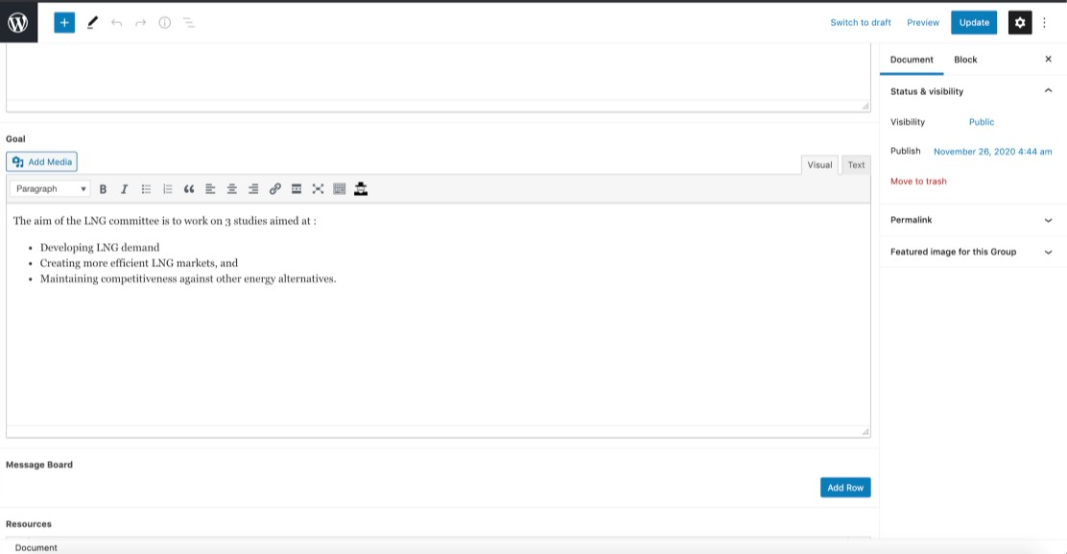

➔ Click update, once done

Slide 72
ADD MESSAGE BOARD

Slide 73
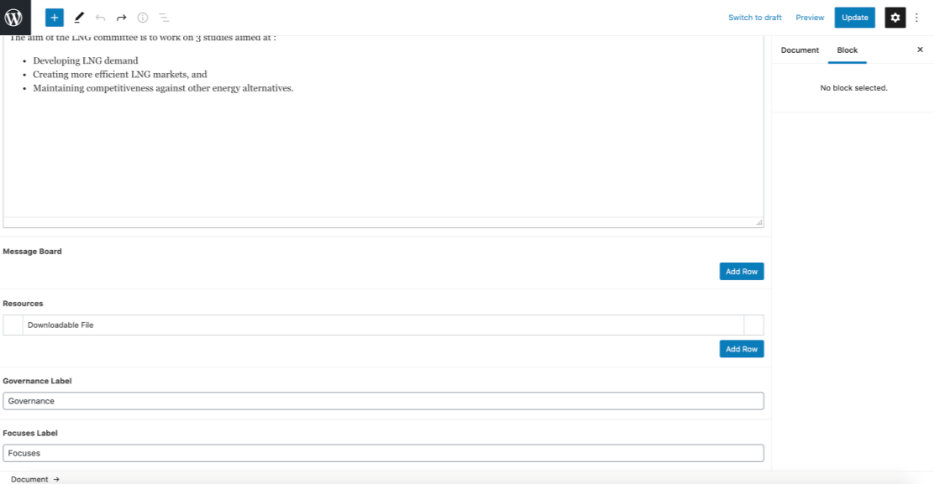

➔ Click on
Add Row

Slide 74
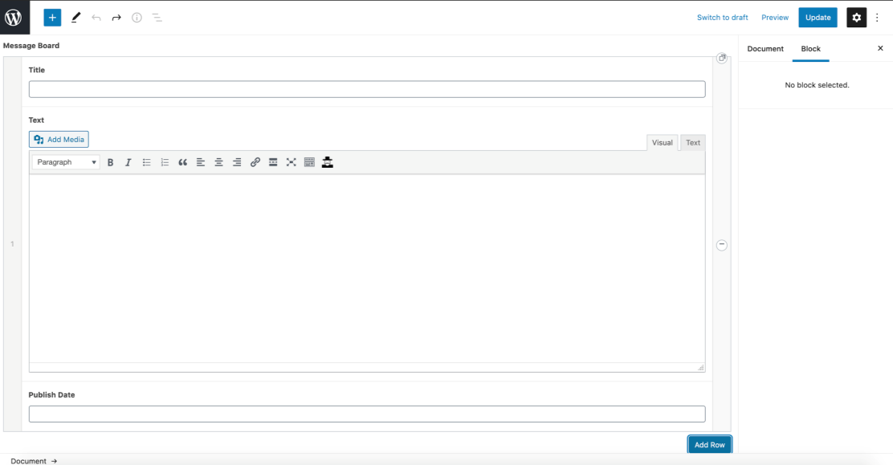
➔ Edit title,
text, publish date

Slide 75

➔ Click update, once done

Slide 76
ADD RESOURCES (DOWNLOADABLE FILES)

Slide 77
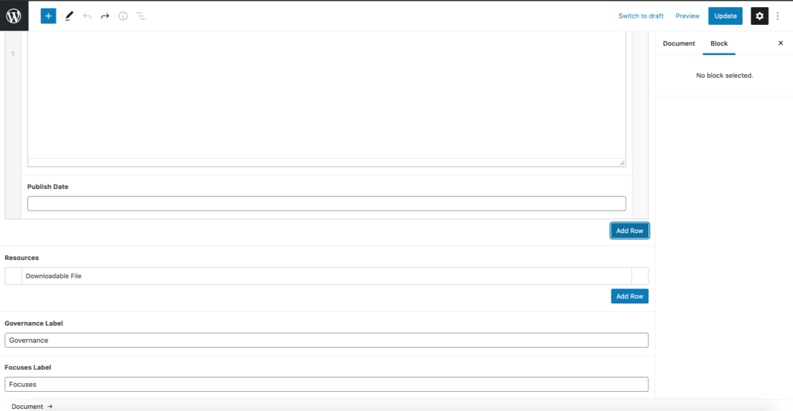

➔ Click on
Add Row

Slide 78
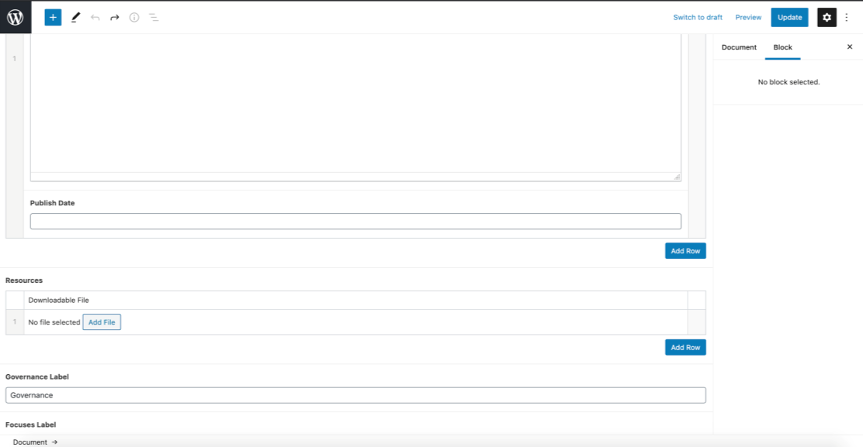
➔ Click on
Add File

Slide 79
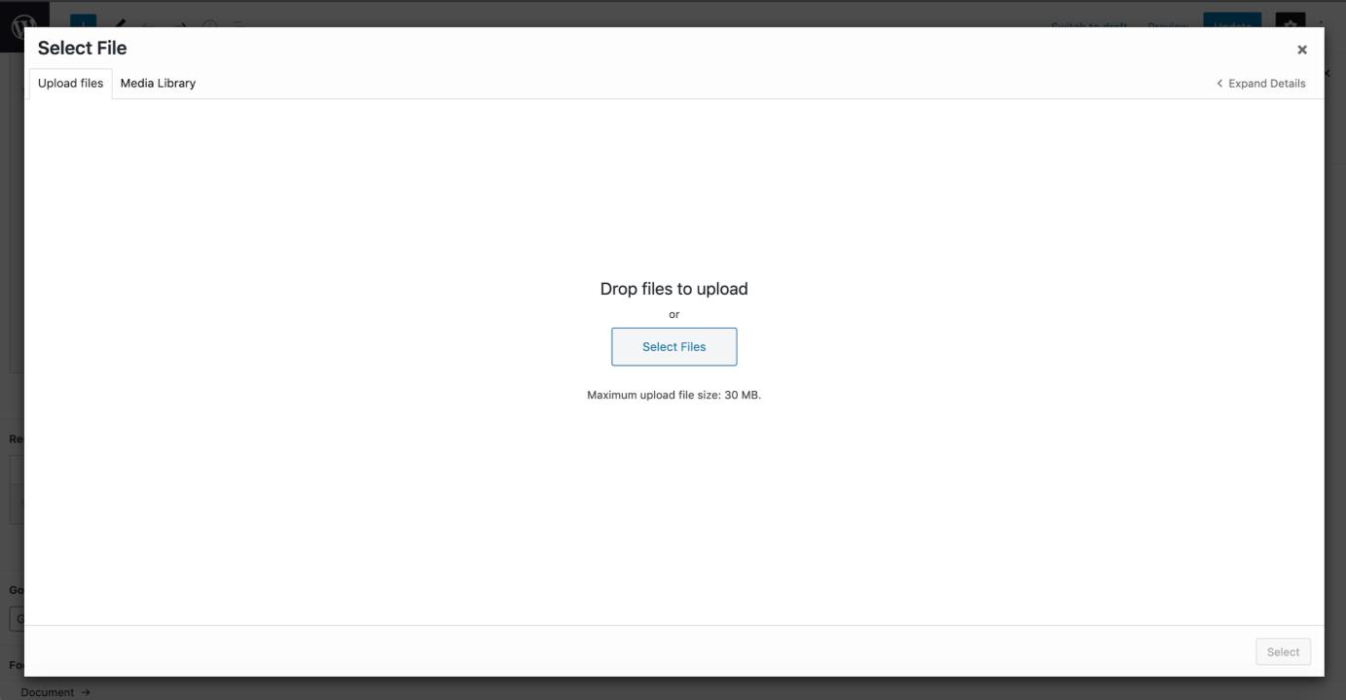
➔ Upload your file

Slide 80
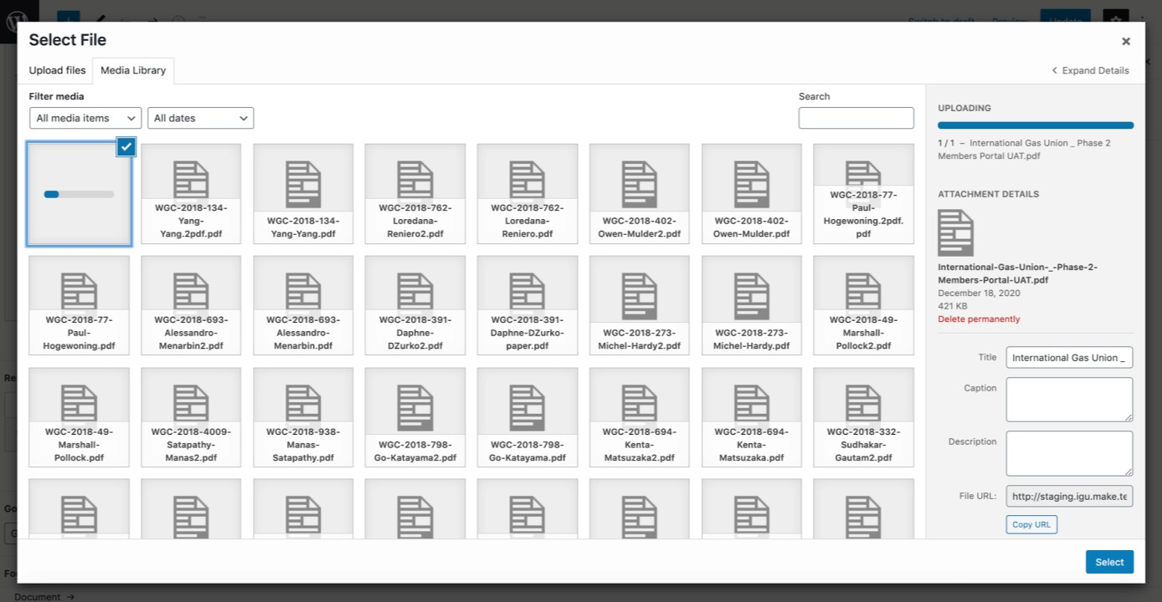
➔ Edit Title and click Select

Slide 81
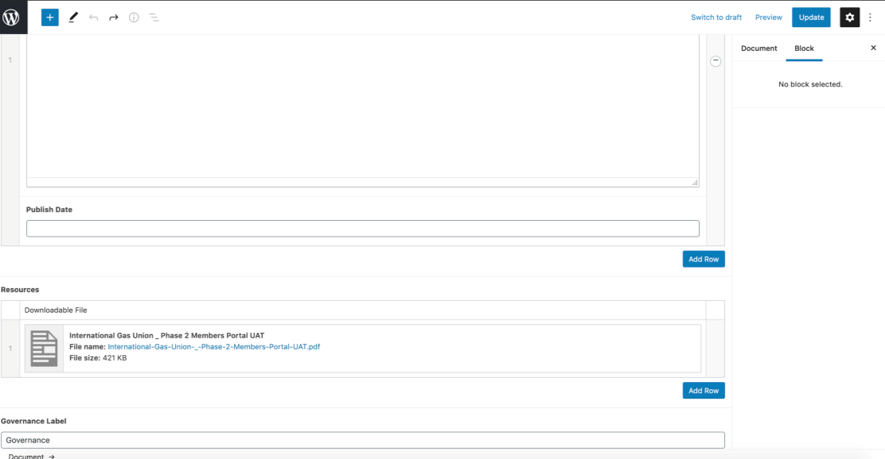

➔ Click update, once done

Slide 82
GROUP MEMBER APPROVAL

Slide 83

➔ On the sidebar, click on Manage Group Members

Slide 84
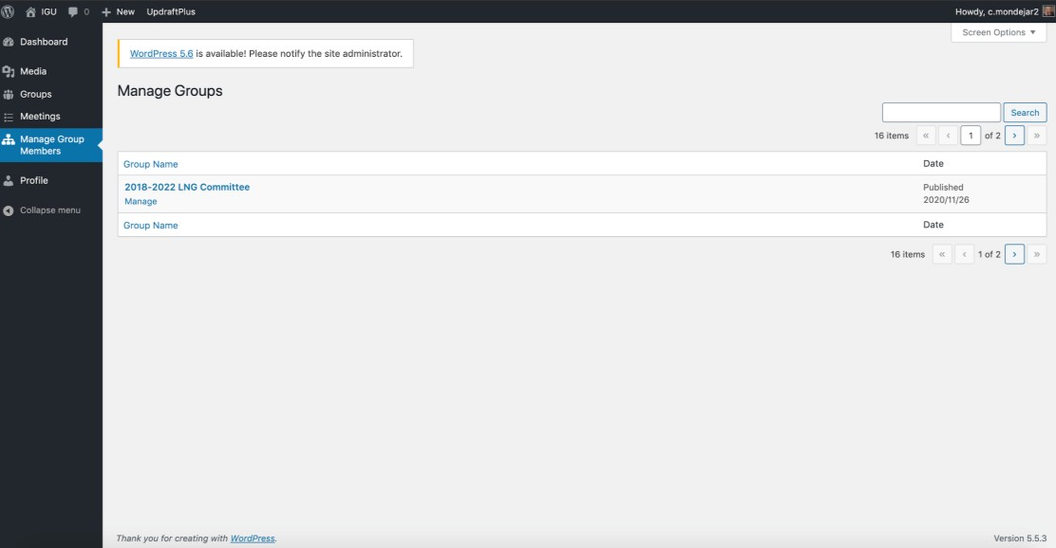
➔ Click on
your Group name

Slide 85
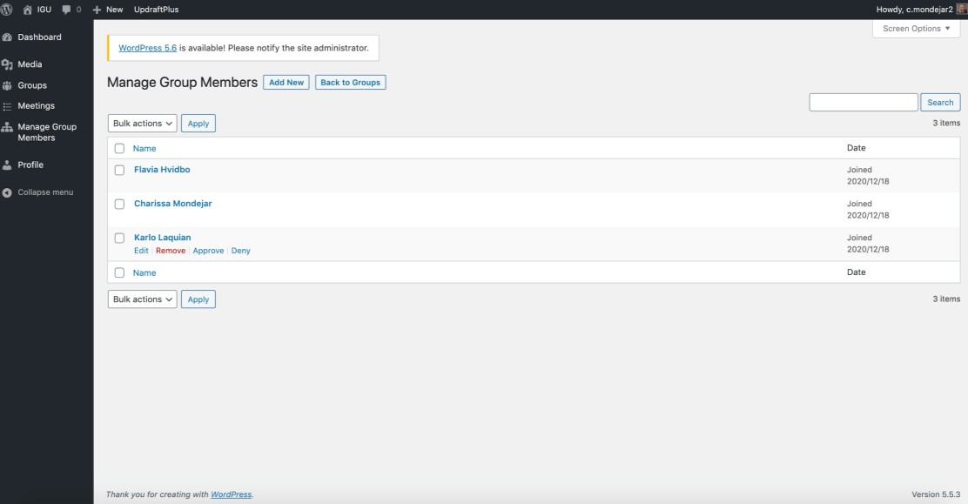
There are two ways to approve a member requesting to join your group

Slide 86

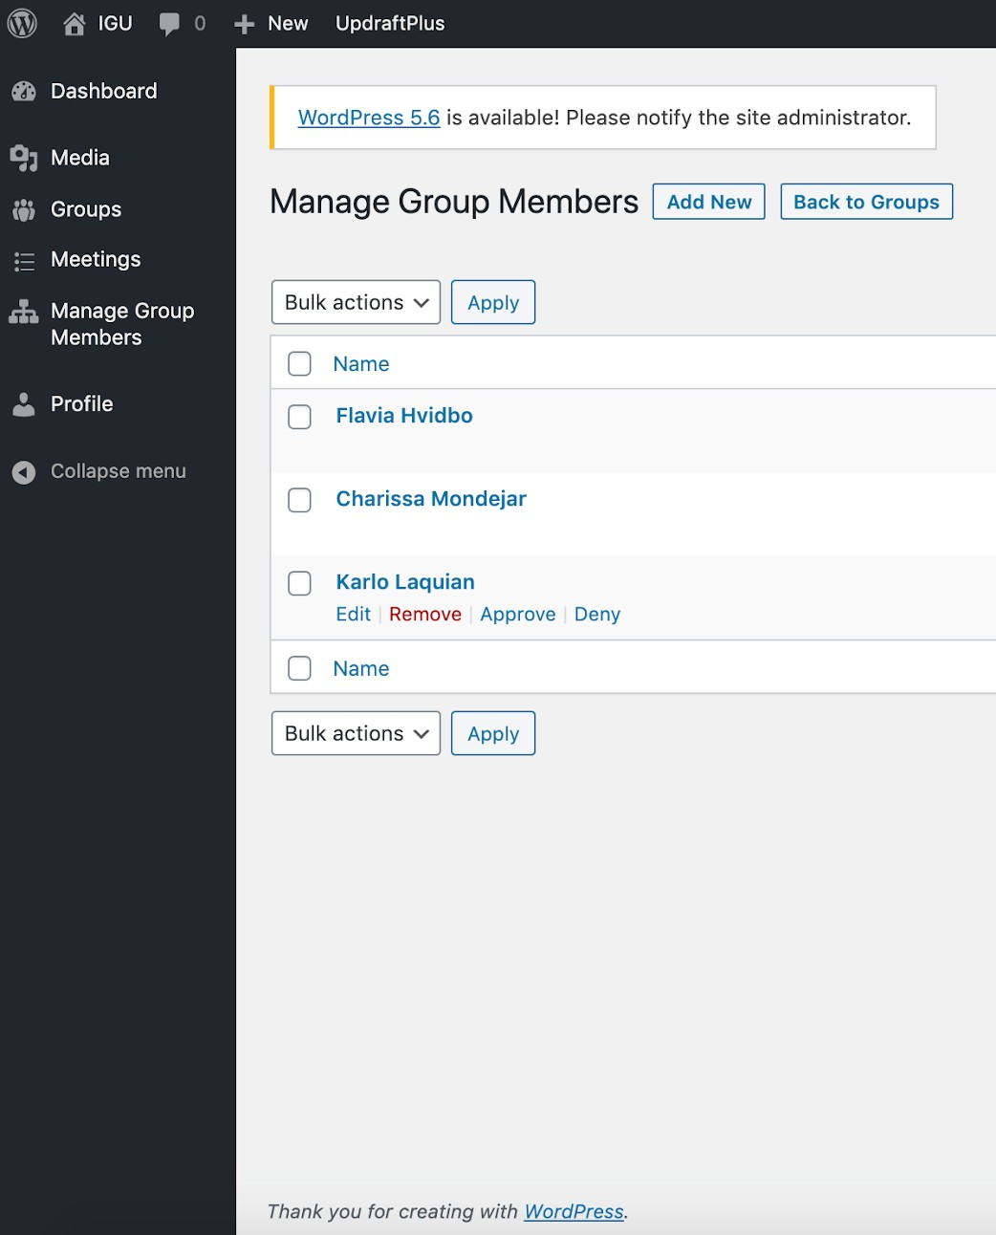
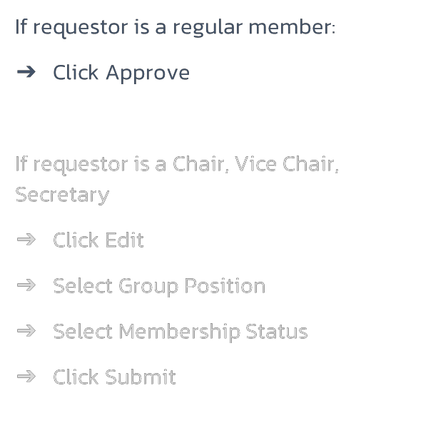
Group Member Approval

Slide 87



Group Member Approval

Slide 88



Group Member Approval

Slide 89



Group Member Approval

Slide 90



Group Member Approval

Slide 91



Group Member Approval

Slide 92


Group Member Approval

Slide 93


➔ If member is not allowed to join, click Deny

Slide 94
ADD/EDIT A
MEETING

Slide 95
➔ On the sidebar, click on Groups

Slide 96

➔ Click Add
New for new meetings

Slide 97


➔ Add Title (Meeting title)

Slide 98

➔ Add Start/End Date, Location, Description (short description)

Slide 99

➔ Add
Agenda

Slide 100
➔ Click
Add Row for Body Content

Slide 101

Add Body Content
for any Paragraph
/ Paragraph with image / Image with Caption / Pull Quote content

Slide 102

➔ Add Registration link for third-party registration

Slide 103
Leave registration
link in the field, if registration will be done using the Members Portal’s meeting registration

Slide 104

➔ Add
Downloadable Resources

Slide 105
➔ Add
Agenda
File

Slide 106

➔ Click
Publish

Slide 107
ADDING DOWNLOADABLE RESOURCES

Slide 108
➔ Drop/uploa d your file

Slide 109
➔ Click on
Add File

Slide 110
➔ Edit Title and click Select

Slide 111
GOING BACK TO THE MEMBERS PORTAL

Slide 112
➔ Click on Profile to go back to the Members
Portal

Slide 113
THANK YOU
Contact
Marcela Martínez Serret, Membership Engagement Manager
Marcela.martinez@igu.org

