Slide 1
IGU committee “Distribution”
1st meeting
Essen, Germany
2022.12. 09 - 11

Slide 2

hosted by:
kindly supported by:

Slide 3
Opening/Welcome
1
2
Introduction of participants
3
Agenda
4
Program
5
Schedule 2022 – 2025
6
Dates and places for next meeting(s)
7
Split into study groups
8
A.o.B./End of meeting

Slide 4
Moderated by
1. Jürgen Grönner (Chair)
2. All
3. Jürgen Grönner/Uwe Klaas
4. Jürgen Grönner
5. Uwe Klaas
6. Jürgen Grönner
7. Study group leaders
8. Jürgen Grönner

Slide 5
Opening/Welcome
1

Slide 6
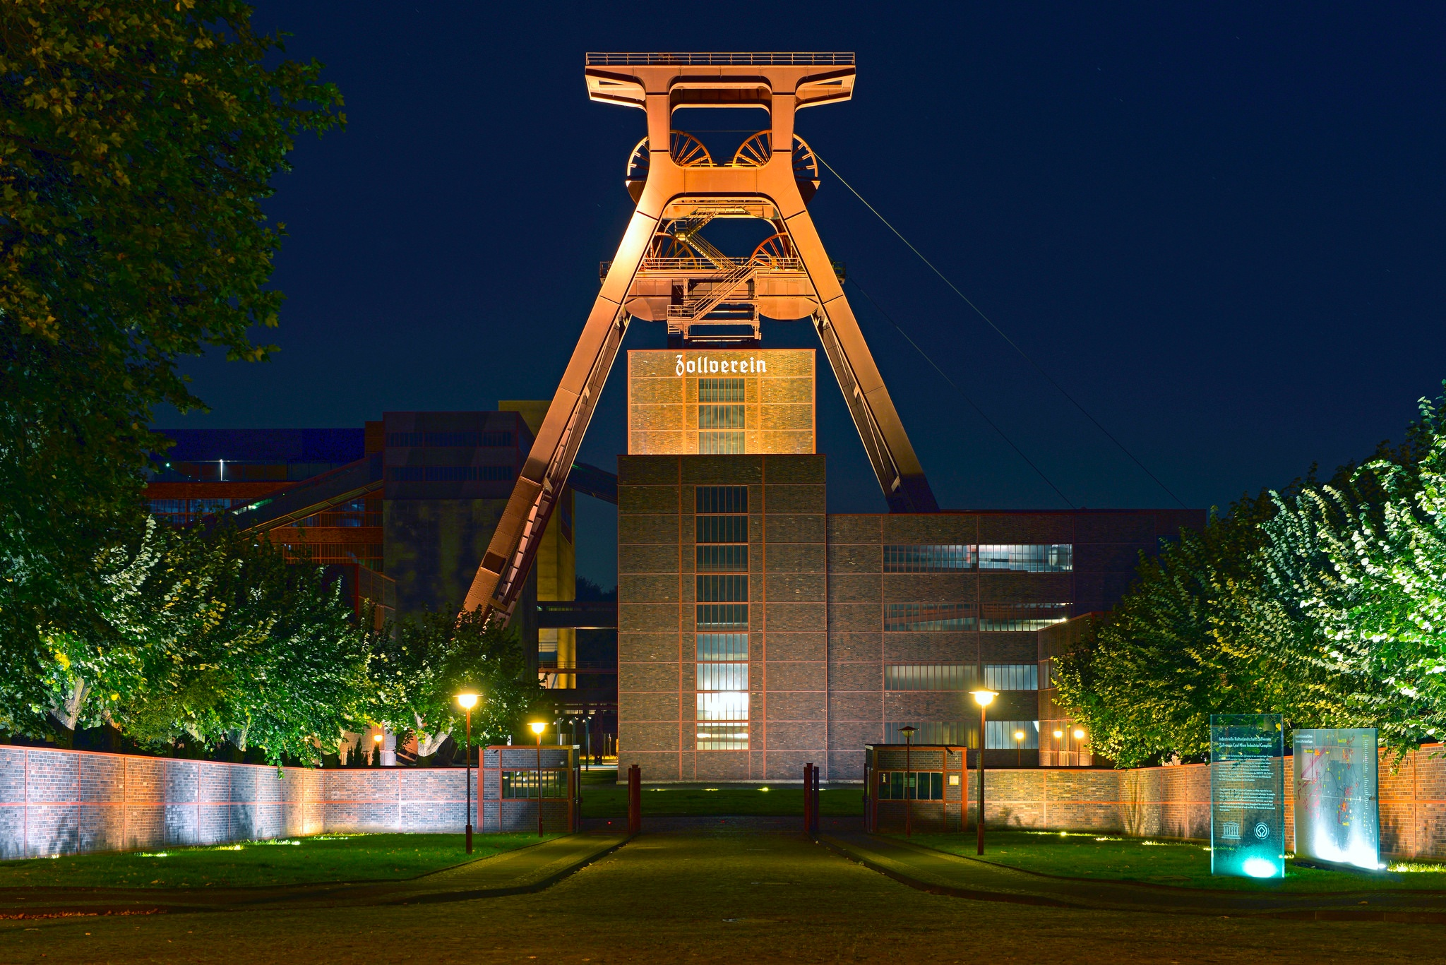
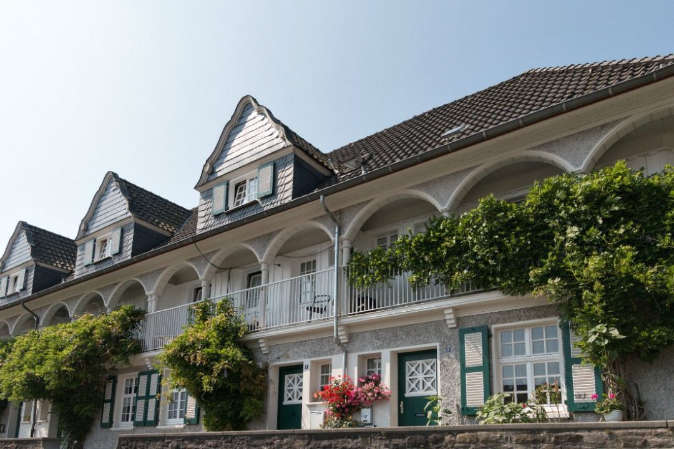

Welcome to Essen, the old industrial heart of Germany
Essen, once the heart of the German coal and steel industry, has a good quality of life these days, with some excellent museums, a large recreational area in its South, and far more to offer. Besides that, it is – and has always been – the centre of the German energy industry.

Slide 7
2
Introduction of participants

Slide 8
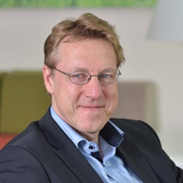
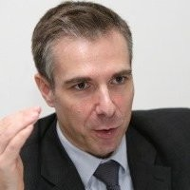
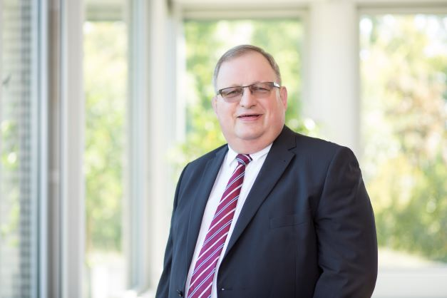
The management team of IGU committee Distribution 2022 - 2025
Chair:
Dr.-Ing. Jürgen Grönner
Westnetz GmbH
Managing Director Asset Management,
regional technique
Vice-chair:
Stéphane Grit
Inspecteur general for safety
CEO office
GrdF Gaz réseau Distribution France
Secretary:
Uwe Klaas
DVGW e.V.
Senior technical manager

Slide 9
IGU committee Distribution 2022 - 2025
Please introduce yourself:
Name
Country
Company
Job position
Study Group support (SG 1,2,3)

Slide 10
IGU committee Distribution 2022 – 2025
Present at 1st meeting
Surname | Name | Country
Čagala | Libor | Czech Republic
Chazykowski | Maciej | Poland
Elert | Marek | Poland
Feller | Florian | Germany
Grit | Stéphane | France
Grönner | Jürgen | Germany
Hakkoum | Mohammed | Algeria
Haudeville | Bertrand | France
Jarnecke | Dennis | United States
Klaas | Uwe | Germany
Pishbin | Iman | The Netherlands
Putman | Katelijn | Belgium
Simon | Cliff I. | United States
Sleuyter | Kevin | Belgium
Somers | Rory | Ireland
Song | Taekyoung | South Korea
Soresina | Alessandro | Italy
Sousa | Gabriel | Portugal
Tominaga | Naoto | Japan
Wehnert | Paul D. | United States
(Bin) Yaacob | Zulkeply | Malaysia

Slide 11
IGU committee Distribution 2022 – 2025: that‘s us!
Nominee Name | Nominee Surname | Mr/Ms | Organization / Company | Address | Phone | Mobile | E-mail | Country
Grönner | Jürgen | Mr. | Westnetz GmbH | Florianstr. 15-21, 44139 Dortmund | +49 231 438-1015 | +49 162 28 45 154 | juergen.groenner@westnetz.de | Germany
Grit | Stéphane | Mr. | Gaz réseau distribution France (GrdF) | 6 rue Concorcet, 75009 Paris | +33 1 71262123 | +33 675646307 | stephane.grit@grdf.fr | France
Klaas | Uwe | Mr. | DVGW e. V. | Josef-Wirmer-Straße 1 - 3, 53123 Bonn | +49 228 9188821 | +49 170 8644591 | uwe.klaas@dvgw.de | Germany
Michael | Gallagher | Mr | APA Group | 1 Wood St, Thomastown, Vic 3074, PO Box 111. Australia |  | 64 409 281 116 | michael.gallagher@apa.com.au | Australia
Manfred | Pachernegg | Mr. | Energienetze Steiermark GmbH | 8010 Graz, Leonhardgürtel 10 | 0043 316 90555 58830 | 0043 664 6168830 | manfred.pachernegg@e-netze.at | Austria
Sluyter | Kevin | Mr | Fluvius | Brusselsesteenweg 199, 9090 Melle | +32 9 263 46 20 | +32 475752732 | kevin.sleuyter@fluvius.be | Belgium
Putman | Katelijne | Ms | Fluvius | Brusselsesteenweg 199, 9090 Melle | +32 9 263 20 24 | + 32 473730905 | katelijn.putman@fluvius.be | Belgium
Adnan | Đugum | Mr. | Sarajevogas Distribution Public Utility | Trg Fadile Odžaković Žute 4, 71000 Sarajevo | 38733568101 | 38761302968 | djugum@gmail.com; adnan.djugum@sarajevogas.ba | Bosnia and Herzegovina
Coiradas | Luis | Mr. | Petrobras | Avenida Henrique Valadares, 28 , centro, Rio de Janeiro RJ 20231-030, Brazil |  |  | coiradas@petrobras.com.br | Brazil
Renato | Fontalva | Mr. | Commit Gas S.A. | Av. Brigadeiro Faria Lima 4100, 4o andar, 04538-132, Itaim Bibi, São Paulo/SP, Brazil | +55 11 98199-4219 | +55 11 98199-4219 | Renato.Fontalva@compassbr.com | Brazil
Yinghui | Zhang | Ms. | Beijing Gas Group Co., Ltd | No.22 Xizhimen South Street , Xicheng District，Beijing，China | +86-10-63913574 | +86 13621364575 | 364654177@qq.com | China
Qingxi | Chen | Mr | Beijing Gas Group Co., Ltd | No.22 Xizhimen South Street , Xicheng District，Beijing，China | +86-10-63913160 | +86 13366586721 | 382587474@qq.com | China
Yuan | Yu | Mrs. | Beijing Gas Group Co., Ltd | No. 22, Nan xiao jie, Xi Zhi Men, Xi Cheng District Beijing, China 100035 | +86 10 6391 3201 | + 86 15801631464 | yuyuan3434@163.com | China
Katherine | Orozco | Ms. | Ecopetrol | Cra. 13 No. 36-24 Principal Building Bogotá, Colombia |  | +57 310 231 8686 | katherine.orozco@ecopetrol.com.co | Colombia
Diego | Romero | Mr. | Ecopetrol | Cra. 13 No. 36-24 Principal Building Bogotá, Colombia |  | +57 3133336060 | diego.romero@ecopetrol.com.co | Colombia
Libor | Čagala | Mr. | GasNet, s.r.o. | Klíšská 940/96, Klíše, 400 01 Ústí nad Labem | 420.602.527.498 | 420.602.527.498 | libor.cagala@gasnet.cz | Czech Republic
Peter | Kristensen | Mr. | Evida | Vognmagervej 14, 8800 Viborg, Denmark | 4520464587 | 4520464587 | pkr@evida.dk | Denmark
Haudeville | Bertrand | Mr. | GRDF | 9 place de la Pucelle, 76000 Rouen |  | 33647052545 | bertrand.haudeville@grdf.fr | France
Seyyed Mahdi | Alavinia | Mr. | National Iranian Gas Company (NIGC) | No. 29, NIGC Main Building, Shouth Shahid Azodi Street, Karimkhan Zand Ave. Tehran, Iran | 0098 (21) 88912864 | 0098(914)3131654 | alavinia@nigc.ir | Iran
Rory | Somers | Mr | Gas Networks Ireland | NSC, St. Margarets Road, Finglas, Dublin 11, Ireland. | +353 1 89 26221 | +353 87 6358427 | Rory.Somers@gasnetworks.ie | Ireland
Alessandro | Soresina | Mr | CIG | via Ponte Nuovo, 100 - Milano - Italy |  | +39 3487775176 | alessandro.soresina@unareti.it | Italy
Natsuki | Kitagawa | Mr. | Toho Gas Network Co., Ltd. | 19-18 Sakuradacho Atsutaku Nagoya Japan |  | +81-80-8667-5760 | nkitagawa@tohogas.co.jp | Japan
Ryou | Yamashita | Mr | Staff / Network Planning Dept. | 4-1-2 Hirano-machi, Chuo-ku, Osaka, 541-0046, Japan | +81-6-6205-2328 | +81-80-2473-3197 | ry-yamashita@osakagas.co.jp | Japan
Takayuki | Sakurai | Mr. | Osaka Gas Network Co., Ltd. | 4-1-2 Hirano-machi, Chuo-ku, Osaka | +81-6-6205-4622 | +81-80-9944-7270 | tak-sakurai@osakagas.co.jp | Japan
Kohei | ABE | Mr. | Tokyo Gas Network Co.,Ltd. | 1-5-20, Kaigan, Minato-ku, Tokyo, 105-8527 | +81-80-8441-1832 | +81-80-8441-1832 | kohei.abe@tokyo-gas.co.jp | Japan
Naoto | TOMINAGA | Mr. | Tokyo Gas Network Co.,Ltd. | 1-5-20, Kaigan, Minato-ku, Tokyo, 105-8527 | +81-80-2142-1507 | +81-80-2142-1507 | nao_tomi@tokyo-gas.co.jp | Japan
Amni Hidayah | Mohd Tauffick | Ms. | Gas Malaysia Distribution Sdn Bhd | Ground Floor, No. 5, Jalan Serendah 26/17, Seksyen 26, Peti Surat 7901, 40732, Shah Alam,Selangor, Malaysia | +603-5101 4400 | - | amnihidayah@gasmalaysia.com | Malaysia
Nelson | Cossa | Mr. | ENH | Maputo,Mozambique | (+258) 21 87 82 86 | (+258) 84 522 5586 | nelson.cossa@enh.co.mz | Mozambique
Marek | Elert | Mr. | GAZ-SYSTEM | Mszczonowska 4, 02-337 Warsaw | (+) 48 22 220 15 43 | 48.885.890.553 | marek.elert@gaz-system.pl | Poland
Maciej | Chaczykowski | Mr. | PW Technical University of Warsaw | Nowowiejska 20, 00-653 Warsaw |  |  | maciej.chaczykowski@pw.edu.pl | Poland
Gabriel | Sousa | Mr. | GALP GAS NATURAL DISTRIBUIÇÃO | Rua Tomás da Fonseca, Torre C - 6º | 1600-209 Lisboa | (351) 21 003 93 34 | (351) 918 391 060 | gabriel.sousa@ggnd.pt | Portugal
Mariana | Paiva | Mrs. | GALP GAS NATURAL DISTRIBUIÇÃO | Rua Tomás da Fonseca, Torre C - 6º | 1600-209 Lisboa |  | (351) 961 921 574 | mariana.paiva@ggnd.pt | Portugal
Ricardo | Moreira | Mr. | REN PORTGÁS DISTRIBUIÇÃO, SA | Rua Linhas de torres 41, 4350-214 Porto |  | (351) 933 990 805 | ricardo.moreira@ren.pt | Portugal
Marek | Smatana | Mr. | SPP- Distribution, a.s. | Plátennícka 2,82109, Bratislava, Slovakia |  |  | marek.smatana@spp-distribucia.sk | Slovakia
Taekyong | Song | Mr. | Korea Gas Corporation | 120, Cheomdan-ro, Dong-gu, Daegu, Republic of Korea | +82-32-810-+82-325 | +82-10-5199-6259 | tysong@kogas.or.kr | Republic of Korea
Iman | Pishbin | Mr. | Stedin | Blaak 8, 3011 TA Rotterdam | 088 896 3963 |  | iman.pishbin2@stedin.net | The Netherlands
Musa Cem | Önal | Mr. | GAZBİR | Tepe Prime Avenue B-Block Office 47 Mustafa Kemal-Cankaya-Ankara-Turkey | 90-312-2666769 | 90-533-4091902 | conal@gazbir.org.tr | Turkey
Tufan Can | Sener | Mr. | GAZBİR | Tepe Prime Avenue B-Block Office 47 Mustafa Kemal-Cankaya-Ankara-Turkey | 90-312-2666769 | 90-533-6159995 | tsener@gazbir.org.tr | Turkey
Dennis | Jarnecke | Mr. | GTI Energy | 1700 S Mount Prospect Road, Des Plaines, IL 60018 | +1 847-768-0943 | +1. 847-561-2954 | djarnecke@gti.energy | USA
Paul D. | Wehnert | Mr. | Heath Conuktants Inc. | 9030 MonHouston, Texas 77061 | +1 713 8441391 | +1 713 2080411 | P.Wehnert@heathus.com | USA

Slide 12
3
Agenda

Slide 13
Agenda 1st meeting IGU committee Distribution 2022 – 12 – 10
09.00 – 13.00 | Committee Meeting – room „Philharmonie“ I & II 09.00 – 09.10 Welcome and Opening (Jürgen) 09.10 – 09.20 Introductory round by members 09.20 – 09.40 Introductory Vice chair speech (Stéphane) 09.40 – 10.00 WGC 2025-Preparation Technical Program (Jürgen, Uwe) 10.00 – 10.20 DVGW – The German Challenge and Chance to replace Gas by Hydrogen 10.20 – 10.40 Coffee break 10.40 – 11.00 Gas supply in difficult times (Jürgen) 11.00 – 11.20 Methane emissions – a problem for the industry? (Klaus Peters, Westnetz) 11.20 – 11.40 Innovative odorization techniques (Klaus Peters, Westnetz) 11.40 – 12.00 Schedule IGU Committee Distribution, IGU-CC 12.00 – 13.00 SG leaders overview (3x10 mins.) SG 1 - Make Grid Smarter SG 2 - Support Hydrogen Economy SG 3 - Expand Innovation Ecosystem
13.00 – 14.00 | Buffet Lunch
14.00 – 14.20 | Product presentation: innovative valve techniques (Alexander Schneider, Böhmer Valves Company)
14.00 – 16.30 | DC Study Groups – rooms - Philharmonie I & II (largest study group) - Philharmonie III - Executive Boardroom

Slide 14
Agenda 1st meeting IGU committee Distribution 2022 – 12 – 11
2022-11-11 9.00 – 13.00 | DC Study Groups – rooms - Philharmonie I & II (largest study group) - Philharmonie III - Executive Boardroom
13.00 – 14.00 | Buffet Lunch
14.00 – 14.30 | Plenary meeting: Wrap up, presentation of study group results
14.30 | End of meeting, transfer to technical visit

Slide 15
4
Program

Slide 16
2022-11-09, 17:40 h: Departure for welcome dinner from Sheraton hotel by taxi
2022-11-09, 18:00 h: Welcome dinner at restaurant “Dampfe Essen-Borbeck”, Heinrich-Brauns-Str. 9 – 15, 45355 Essen-Borbeck
2022-11-10, 9:00 – 13:00 h: Committee meeting
2022-11-10, 13:00 – 14:00 h: Lunch
2022-11-10, 14:00 – 16:30 h: Study group meetings
2022-11-10, 17:15 – 18:15 h: Visit to Folkwang museum, Museumsplatz 1, 45128 Essen
(fine weather: short walk, bad weather: taxi from hotel)
2022-10-11, 18:30 h: Dinner at restaurant “Tablo”, Huyssenallee 5, 45128 Essen
(fine weather: short walk, bad weather: taxi from hotel)
2022-11-11, 9:00 – 12:00 h: Work in study groups
2022-11-11, 12:00 – 13:00 h: Product presentations
2022-11-11, 13:00 – 14:00 h: Lunch
2022-11-11, 14:00 – 14:30 h: Committee meeting: Wrap-up
2022-11-11, 15:00 – 18:00 h: Technical visit to “Gaswärme-Institut”, Hafenstraße 101, 45356 Essen-Borbeck

Slide 17
IGU committee Distribution 2022 – 2025: the study groups
SG 1 - Make Grid Smarter
Leader:
Objective:
SG 2 - Support Hydrogen Economy
Leader:
Objective:
SG 3 - Expand Innovation Ecosystem
Leader:
Objective:

Slide 18
Presentation: The German Challenge and Chance to replace Gas by Hydrogen

Slide 19

Coffee break
"Dieses Foto" von Unbekannter Autor ist lizenziert gemäß CC BY

Slide 20
Product presentation: Innovative Valve Techniques
Alexander Schneider

Slide 21
Presentation: Gas supply in difficult times
Jürgen Grönner

Slide 22
Presentation: Methane emissions – a problem for the industry?
Klaus Peters

Slide 23
Presentation: Innovative odorization techniques
Klaus Peters

Slide 24
5
Schedule 2022 – 2025

Slide 25
Meetings of the Distribution Committee
Year | CC Meeting |  | DC Meeting
 | Date | Place | Date | Place (tbc)
2022 | 25 Oct | Lima, Peru | 09 – 11 November | Essen, Germany
2023 | April | Brussels, Belgium | March | Lisboa, Portugal
 | October | Australia | September
2024 | April | Turkey | March
 | October | Egypt | September
2025 | March | Malaysia | February
 | May WGC 2025 | Beijing, China

Slide 26
7
Split into study groups

Slide 27
Wrap up, presentation of study group results

Slide 28
8
A.o.B./End of meeting

