Slide 1
Well engineering and P&A Standards
Ing. Peter Hudec

Slide 2
AGENDA
1 NAFTA WELL ENGINEERING
2 P&A STANDARDS
3 CONCLUSIONS AND RECOMMMENDATIONS

Slide 3
1
NAFTA WELL ENGINEERING

Slide 4
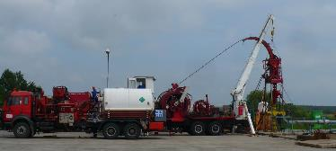
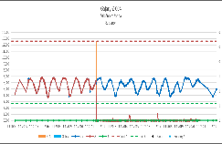
NAFTA well engineering
  COMPETENCE CENTRE
  Nafta has own competence center and prepare and provide:
  Workover, P&A Drilling and well intervention organizing and supervising
  Well integrity management
  Mining rescue services
  Slickline/wireline services
  Laboratory
  Consultancy
Coiled Tubing

Slide 5
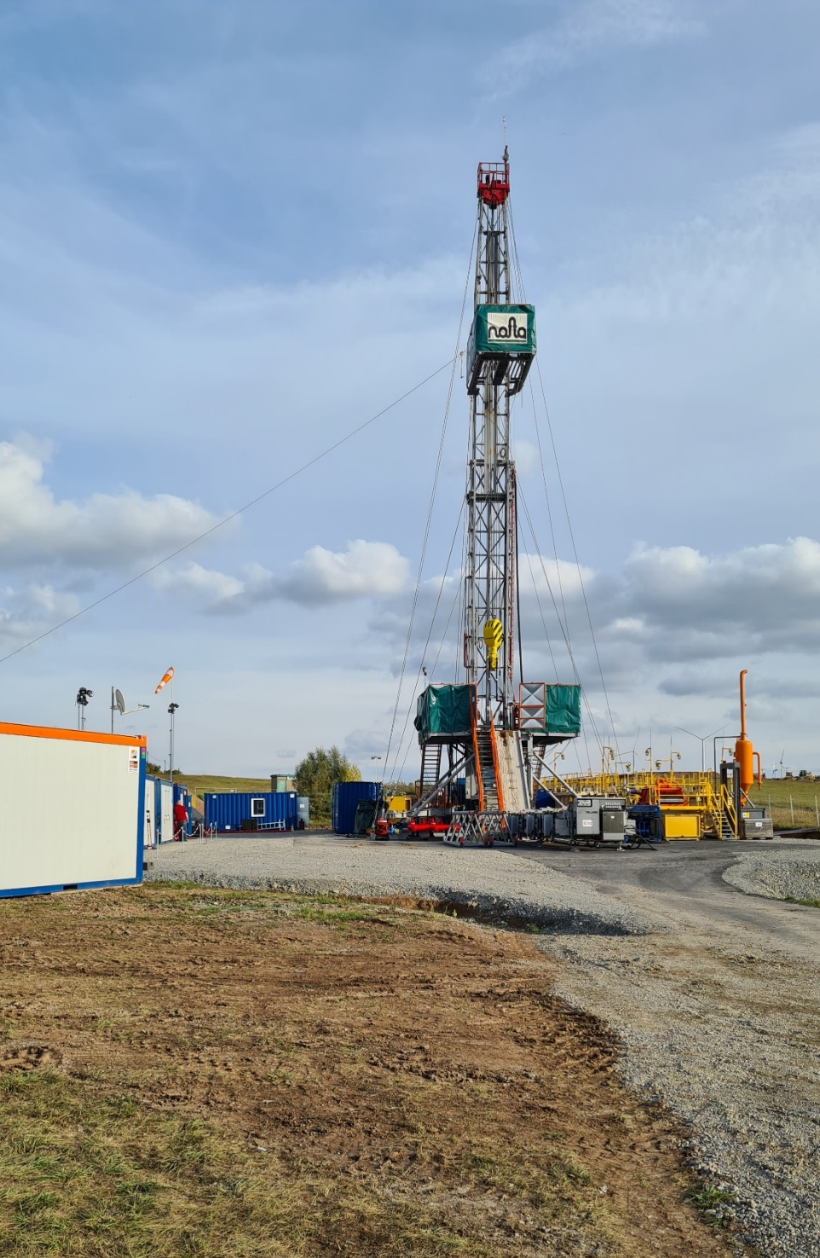
P&A / Workover
  Nafta has 2 own crews and rigs for P&A/Workover/Drilling:
P&A 2021:
  NAFTA group: 3 wells (SK)
  Ext. Companies: 4 wells (D)
  Ext. Companies: 4 wells (CZ) re-abandonment
  Workover 2021:
  NAFTA group: 24 wells (SK)
  Ext. Companies: 13 wells (CZ)
P&A in Germany 2021-2022:
  NAFTA abandoned wells 4 in 2021 and 4 wells in 2022
  Wells has integrity issues and on most of them were milled out casings.
  The presence of NAFTA engineers on the well helped to solving many issues during the P&A process.
RIGS:
GVS 3070 70t
MR 4000 90t
BIR 8000 140t
MR 4000

Slide 6
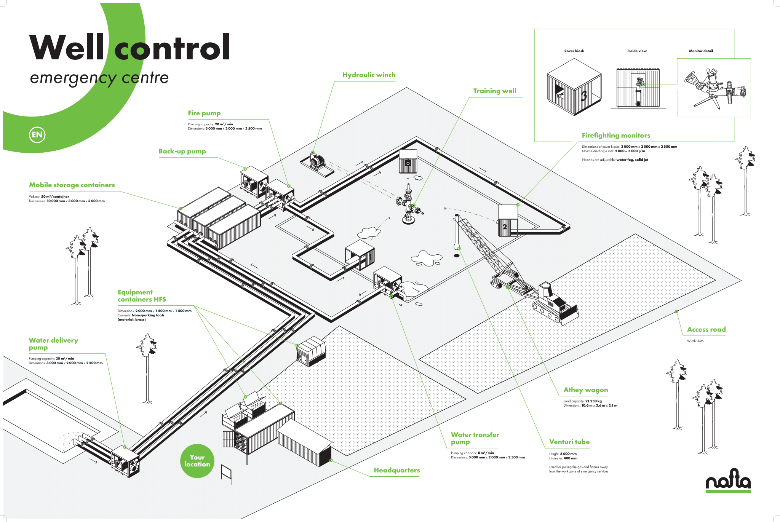
NAFTA / Mining RESCUE services
structure
15 professional rescuers
65 voluntary rescuers
facilities
Training centre with training well
Special equipment
Athey wagon
2 Pumps 20 m³/min
6“ hoses – 2 500 m
Firefighting equipment
self-contained breathing apparatus (SCBA)
Measuring instruments
Training well which allows simulate blowout and well control operations
Training room for intervention in unbreathable environment

Slide 7
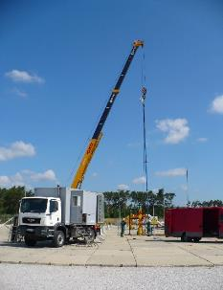
NAFTA / wireline and slickline services
Structure and facilities
Services
2 operating crews
2 slickline/wireline trucks
Downhole dynamic pressure and temperature measuring, online production tests
Downhole memory B&W camera
Spinner downhole measuring, flow profile of completions and producing zones
CCL, Thermometry
Downhole samples
Setting / Pulling plugs, Shifting sliding sleeves
Sand bailing
Acoustic and temperature measuring with GESO
Slickline operation

Slide 8
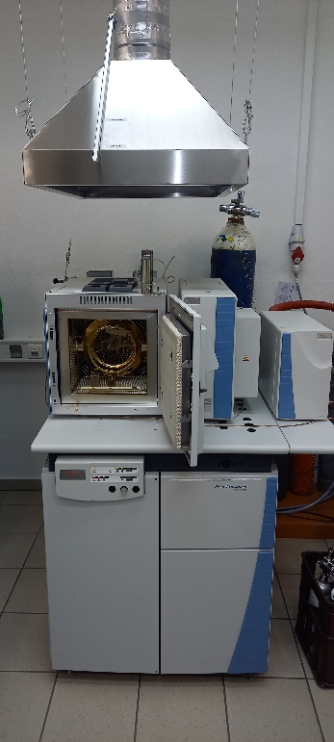
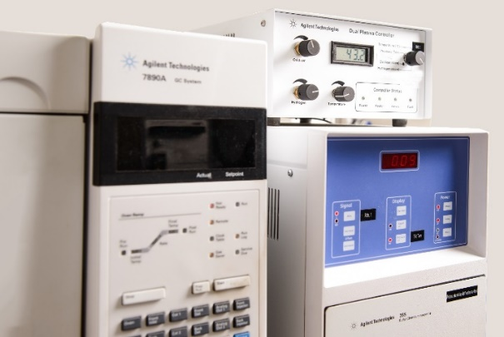
NAFTA / Laboratory services
Structure and facilities
Services
1 head of laboratory
5 laboratory technician
Isotopic composition of hydrocarbons
Gas composition of hydrocarbons
Water and HC Dew Point measuring
HC Dew Point calculations
Water Content Calculations
High/Low pressure gas samples
Calorific Calculations
Isotopic analyser
Chromatograph

Slide 9
2
P&A STANDARDS

Slide 10
P&A Standards – Nafta Group
SLOVAK REPUBLIC
The Slovak Republic legislation does not specify exactly how to P&A wells. NAFTA submits to the Slovak Mining Authority a plan for the P&A and the Mining Authority makes a statement. NAFTA have internal standard for P&A wells.
CZECH REPUBLIC
The P&A process is determined by Ordinance No. 239/1998 Coll. § 71b.
GERMANY
The P&A process is determined by Guideline of the Mining Authority in Clausthal-Zellerfeld
UK
The P&A process is determined by Guidelines for the Abandonment of Wells (Oil & Gas UK)

Slide 11
P&A Standards - NAFTA
Revision of general conditions of the well before P&A
  Head of cement behind the casing
  Well integrity issues (Sustain Casing Pressure, Casing corrosion, ...)
  Hydrocarbon saturated horizons
  Hydrocarbon saturated horizons with H₂S or CO₂
Possible ways of gas migration
Ways of gas
Way of gas
UGS horizon
Impermeable barriers in both horizontal and vertical directions.

Slide 12
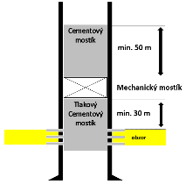
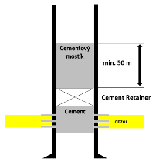
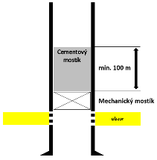
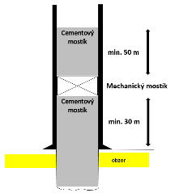
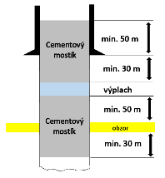
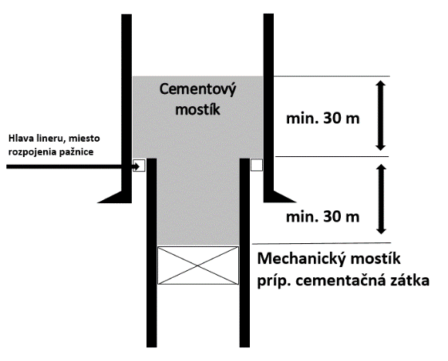
P&A Standards - NAFTA
Cement bridge plug
Cement bridge plug
Cement bridge plug
Mechanical bridge plug
Cement bridge plug
Cement retainer
Mechanical bridge plug
Cement bridge plug
Isolation through perforation
Isolation through perforation
Isolation above perforation (in case of impassable perforation)
Cement bridge plug
Cement bridge plug
Cement bridge plug
Mechanical bridge plug
Liner head or Casing head
Cement bridge plug
Drilling mud
Cement bridge plug
Mechanical bridge plug
Open-hole isolation
Open-hole isolation
Lier head/cut casing head isolation

Slide 13
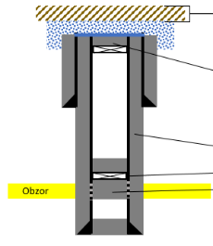
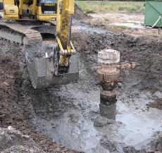
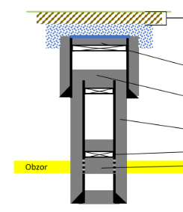
P&A Standards - NAFTA
The casing strings are cut and welded 2m under surface with concreate block on top.
Mechanical plug and 50m of cement bridge plug.
Good cement in annulus confirmed by CBL and VDL logging
Mechanical plug and 50m of cement bridge plug.
Cement plug squeezed to perforation
The casing strings are cut and welded 2m under surface with concreate block on top.
Mechanical plug and 50m of cement bridge plug.
Mechanical plug and 60m of cement bridge plug.
Good cement in annulus confirmed by CBL and VDL logging
Mechanical plug and 50m of cement bridge plug.
Cement plug squeezed to perforation

Slide 14
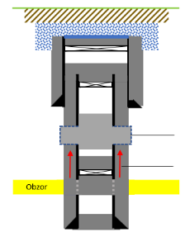
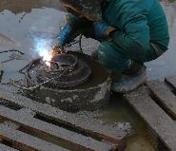
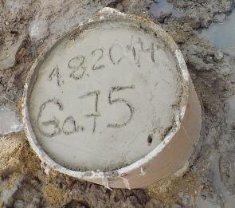
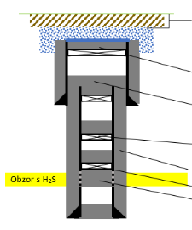
P&A Standards - NAFTA
30 m of milled and underreamed section with cement bridge plug or 30m of DYNASLOT perforation with squeezed resin
Gas migration behind the casing
The casing strings are cut and welded 2m under surface with concreate block on top.
Mechanical plug and 50m of cement bridge plug.
Mechanical plug and 60m of cement bridge plug.
Mechanical plug and 50m of cement bridge plug.
Good cement in annulus confirmed by CBL and VDL logging
Mechanical plug and 50m of cement bridge plug.
Cement plug squeezed to perforation

Slide 15
3
CONCLUSIONS AND RECOMMMENDATIONS

Slide 16
Conclusions and recommendations
KEY POINTS
  Individual approach
  Well history
  Current well integrity status
  Special temperature and ultrasound logging
  P&A standards knowledge
  Know how
  Observing and monitoring well area after P&A

Slide 17
Contact
Ing. Peter Hudec
Head of Subsurface dept
Tel: +421 917 728 058
Email: peter.hudec@nafta.sk

