Slide 1
Tackling methane emissions in UGS Division in Nafta
JAn MrAz

Slide 2
SUMMARY
Introduction
Categorization of methane emissions
Methods of reducing emissions in Nafta
Emission reduction strategy and next steps

Slide 3
1. Introduction

Slide 4

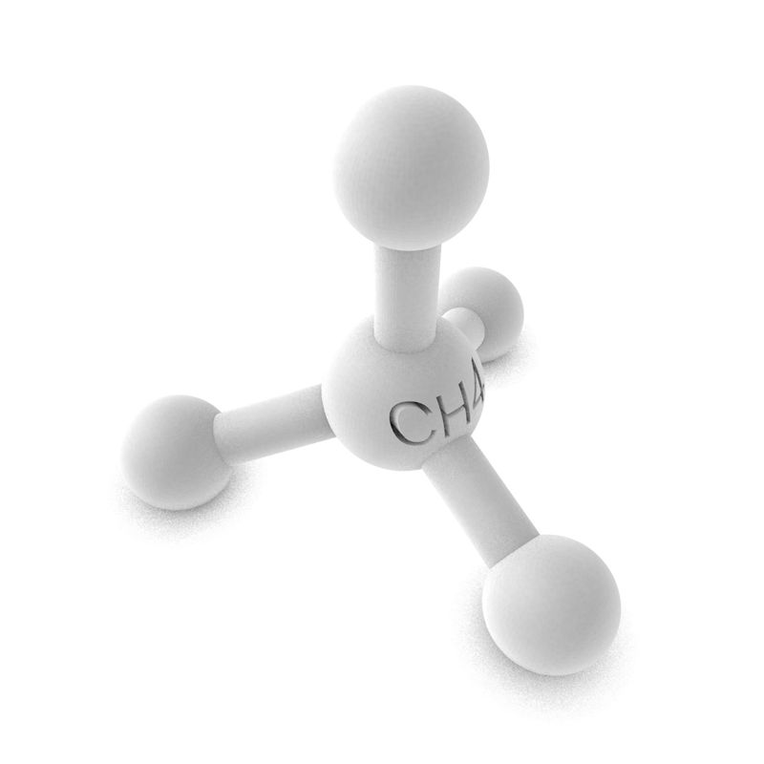


Why reduce methane emissions?
Climete change, GWP100=28, Social license
The European Green Deal, Preparation of new European Commission legislation
Safety risk (fire, explosion)
Financial losses

Slide 5
2.Categorization of methane emissions

Slide 6
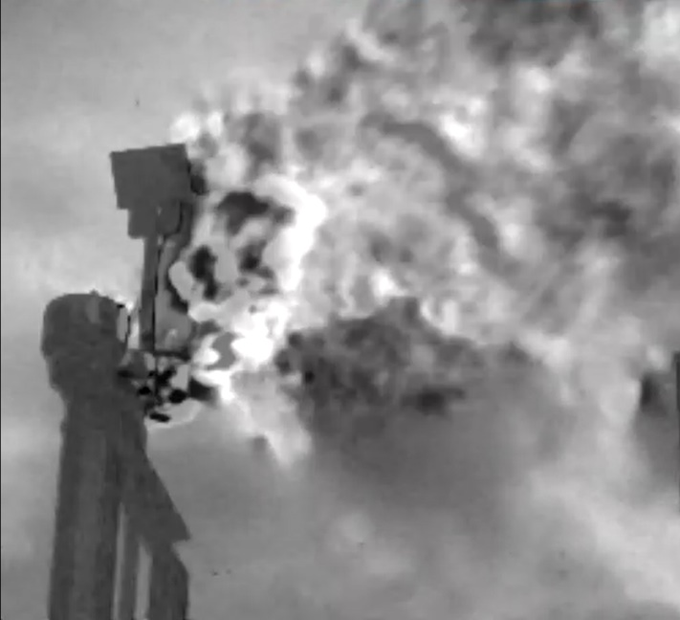
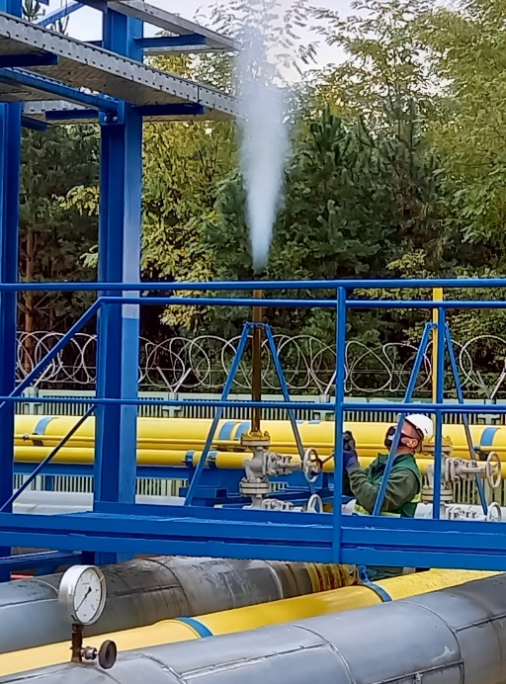
Categorization of methane emissions by source
Operational emissions
Fugitive emissions
Emissions during safety depressurization
Methane emissions from Incomplete combustion

Slide 7
Emissions with potential for reduction

Slide 8
3. Methods of reducing emissions in Nafta

Slide 9
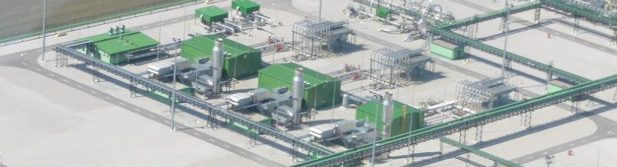
1. Projects to reduce operational emissions
Capture and recompression of natural gas emissions at TKG1-3
Source of compressor emissions:
  Purging of the compressor with natural gas at start-up
  Venting gas leaks from compressor gas dry seals
  Depressurization of the compressor when it is shut down
TKG1
TKG2
TKG3

Slide 10
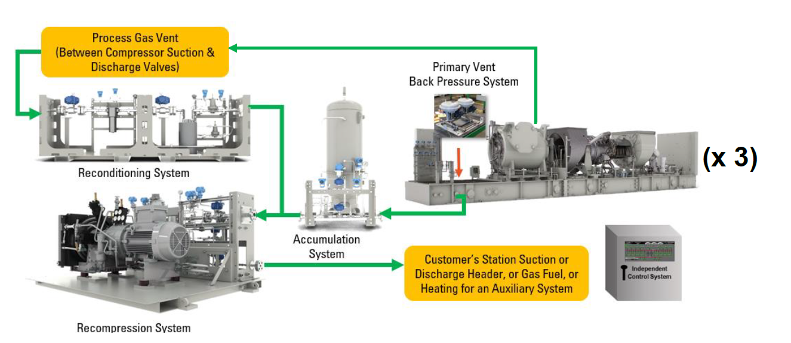
Proposed solution
Installation of a recompression system for the collection of natural gas emissions during the operation of compressors TKG1,2,3
99% reduction of methane emissions
Minimize the costs of project - grants, the NPV is negative

Slide 11
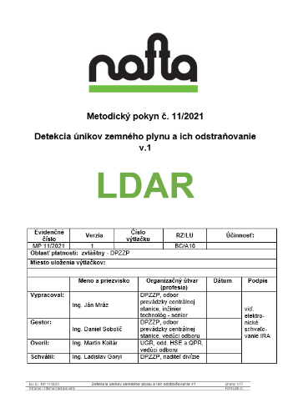
2. Fugitive emissions
Detection and quantification of methane emissions is a challenge
Instructions for detecting and quantifying fugitive emissions – LDAR
  Purchase of a detection camera and quantificator
  Gaining experience with detection and quantification
  Publication of LDAR instructions
  Screening of UGS stations and identification of all leaks
  Calculation of the amount of emissions
  Increased interest in performing leaks detection within Nafta Group storage facilities

Slide 12
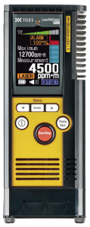
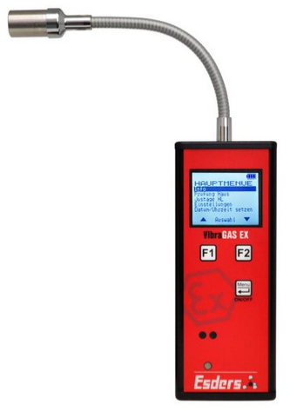
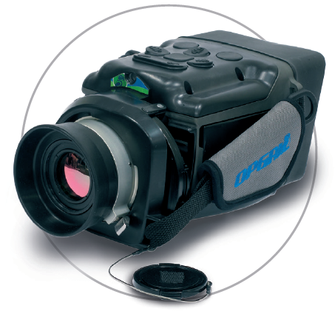
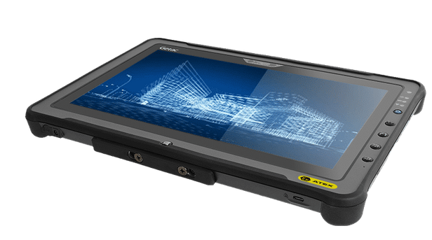
Measurement of concentration CH4 with laser beam on the target
+ measurement on long distance
+ measurement speed
+ real time data
- measurement only in ppmm
- exact source of leakage
- necessary reflection
Used detection equipment
From 2016
From 2019
From 2021
Laser Detector
Gas leak Detector
Camera + Quantificator
Measurement of concentration CH4 with air compresor
+ accuracy
+ sensitivity
+ Range: 0 - 10 000ppm
- measurement only in ppm,
- sensor damage (higher concentrations)
Infrared camera – take video leak site
+ accurate leak detection
+ speed of detection,
+ harder to reach places
+ measurement in kg/h
- minimum sensitivity (>500ppm)
- depand on weather conditions
Notes:
At the moment we have 3 diferent detection equipment

Slide 13
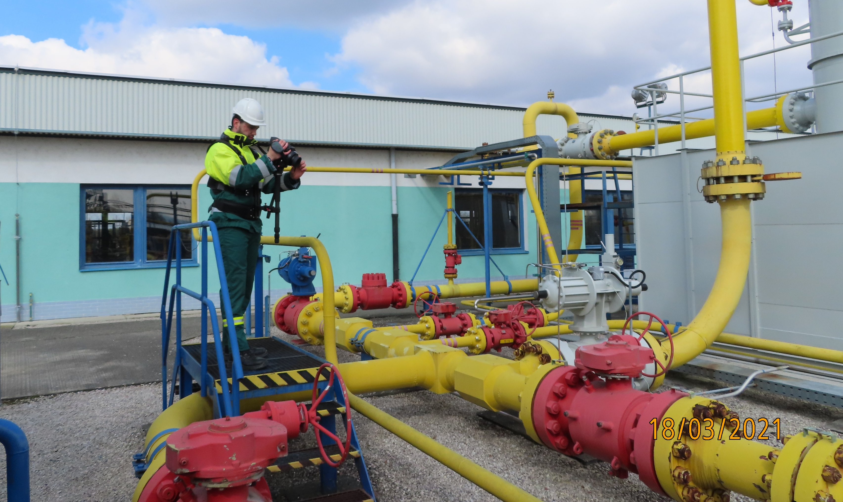
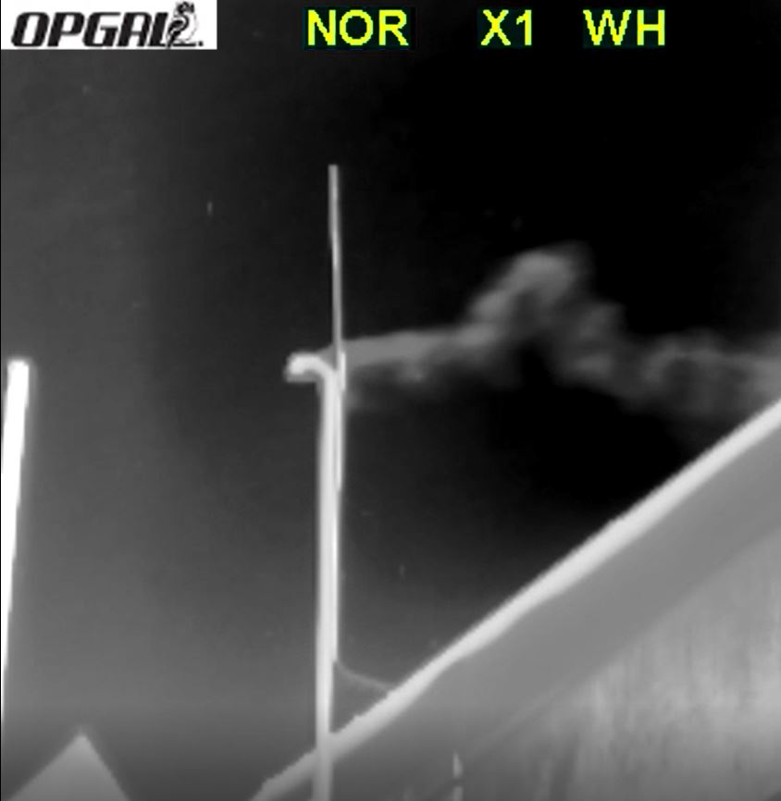
Detection and quantification – 1 step

Slide 14
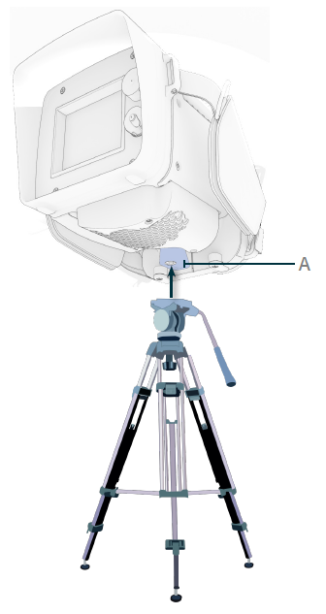
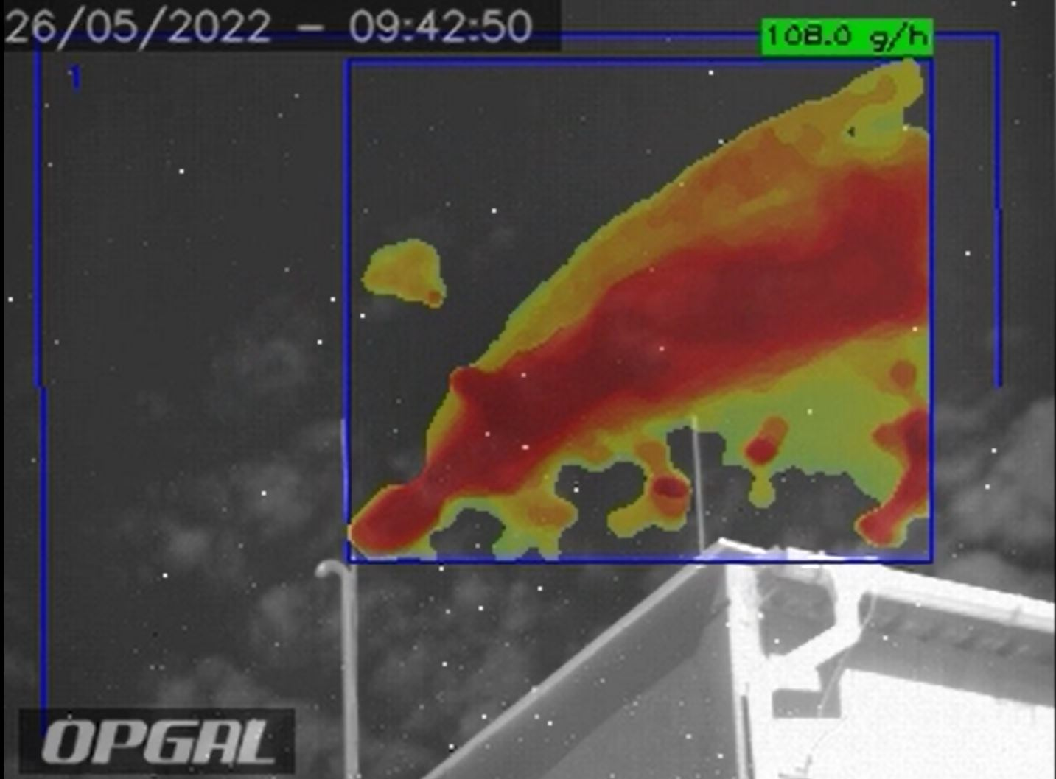
Detection and quantification – 2 step
WIFI Connect
ATEX Tablet (with EYECSite aplication)

Slide 15



Categorisation and Repair planning
Level of leakage | Volume of leakage – in kg/h | Leakage concentration - in ppmv | Deadline for leak repair
I. | In process | 10.000 ppmv and more | 3 days
II. | In process | 500-9.999 ppmv | 14 days
III. | In process | 0 - 499 ppmv | 3 months
  Each leak has its own ID
  Marking label card at the point of leak
III
II
I
Notes:
Doplniť proces ako potom v ISu a vetvy pre okamžité riešenie a potom ako postupne nahodiť do ISU
Riešiť všetko do EK kvoly evidencii + proces na riešenie výnimiek

Slide 16
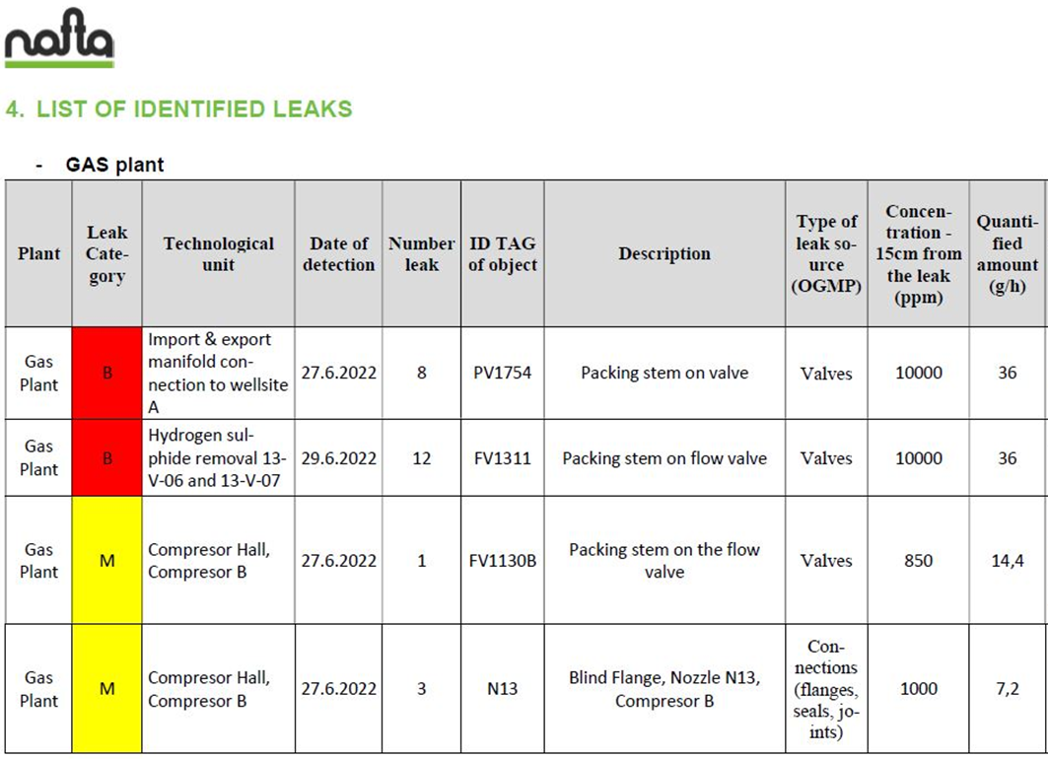
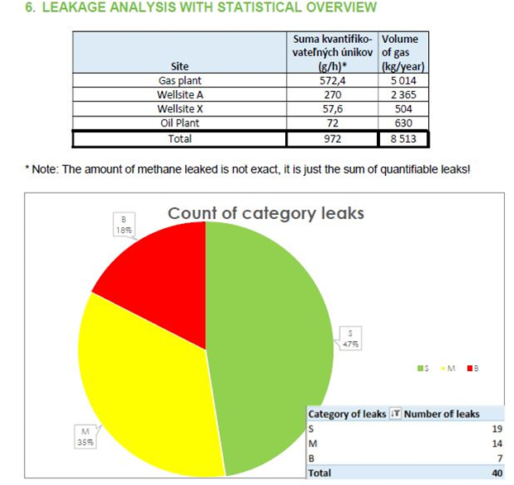
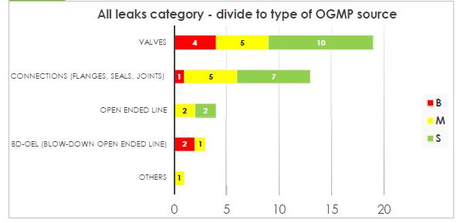
Final report from inspection
Wellsite B
Wellsite C

Slide 17
Implementation of the Final report into the maintenance system (ISU)
DB
List of gas leaks from the Gas plant
Creation of the final report and record in the ISU
ISU + M-Files
Automatic import of each leak with data - work order generation
Linking the ISU leak to the M-Files leak video
Realization
Automatic assignment of the task for the worker to repair the leak + tracking KPI
Online overview of repair status in ISU by category

Slide 18
4. Emission reduction strategy and next steps

Slide 19


Setting a target for CH4 reduction
GreenDeal:
Reduction by 55% by 2030 (base year 1990)
Zero carbon emissions in 2050 (need to reduce CO2 emissions as well)=> offsetting
Global Methane Pledge of COP26 Glasgow:
Reduction by at least 30% by 2030 (base year 2020)

Slide 20
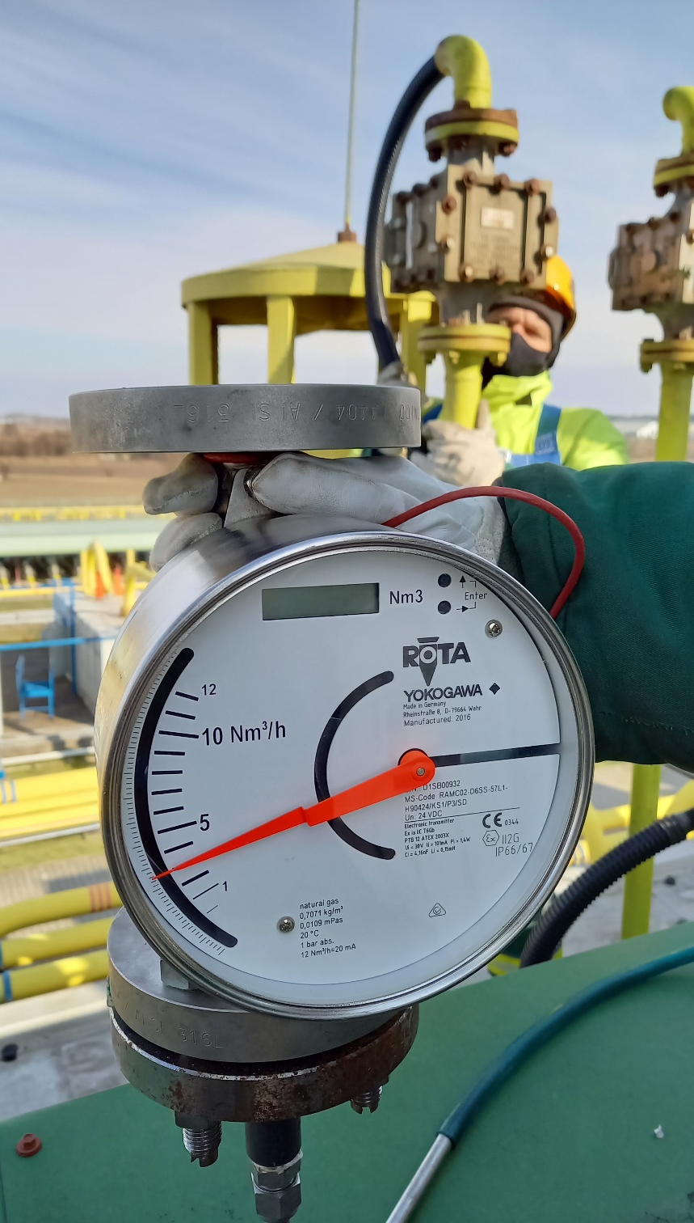
Plans for the next years
Increasing the accuracy of reporting methane emissions
Routine inspection every 6 months within the entire Nafta Group
Raising awareness of the identification of fugitive emissions among Nafta workers and the importance of reducing fugitive emissions
Implementation of technical solutions to meet emission reduction targets

Slide 21
THANK YOU

