Slide 1
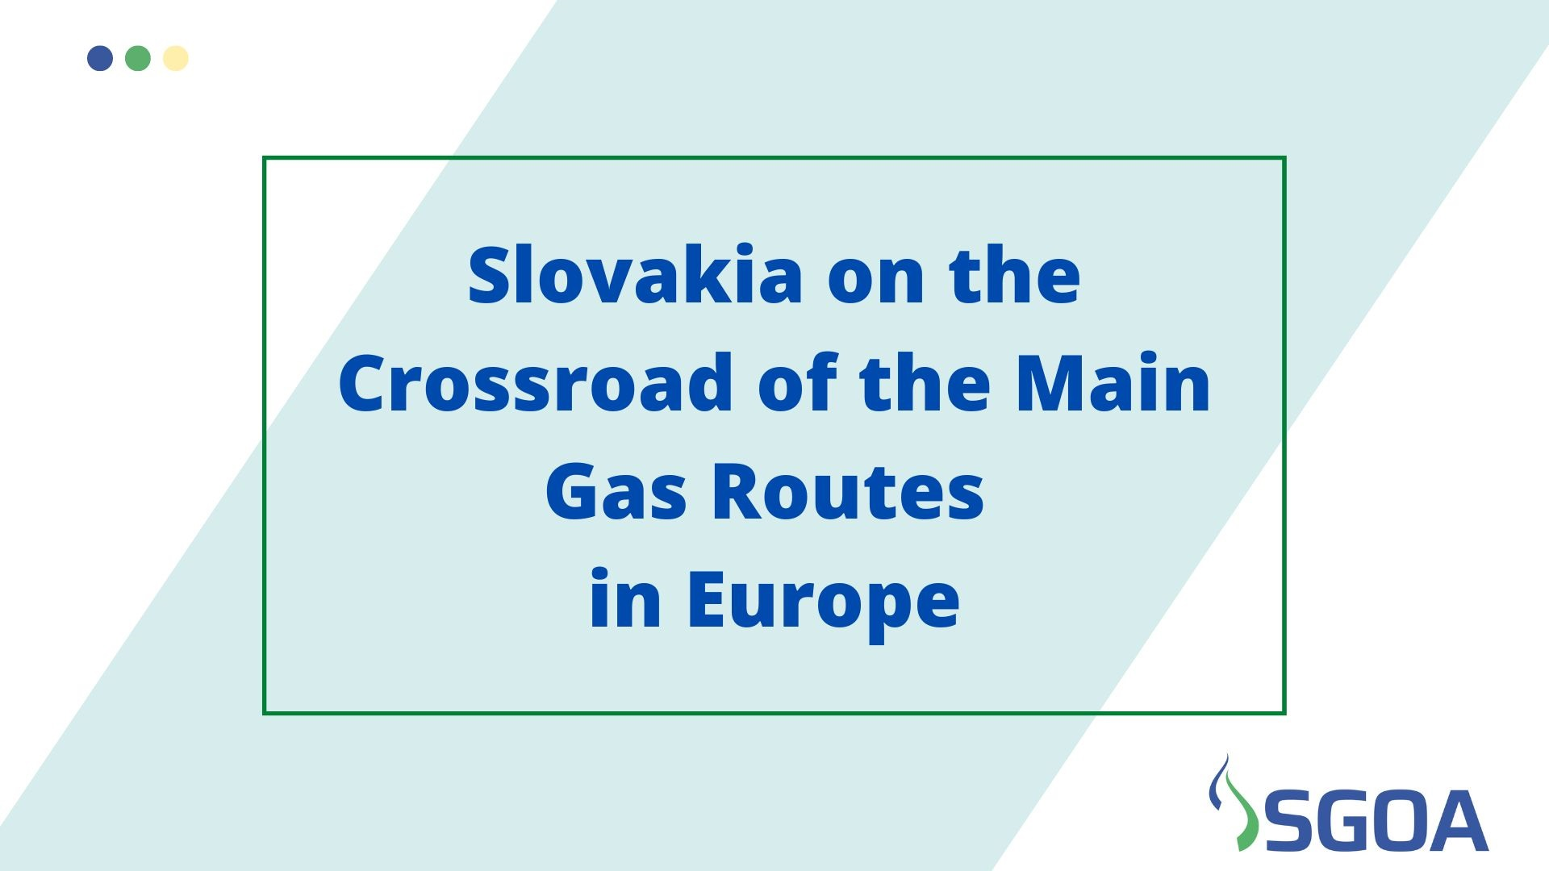
Richard Kvasňovský, Slovak Gas and Oil Association (SGOA)

Slide 2


Slide 3
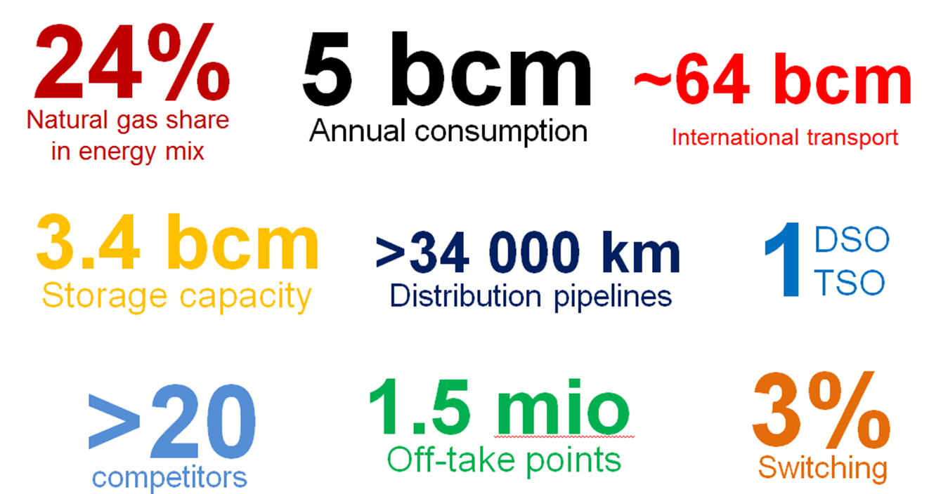
SLOVAK NATURAL GAS MARKET KEY FIGURES

Slide 4
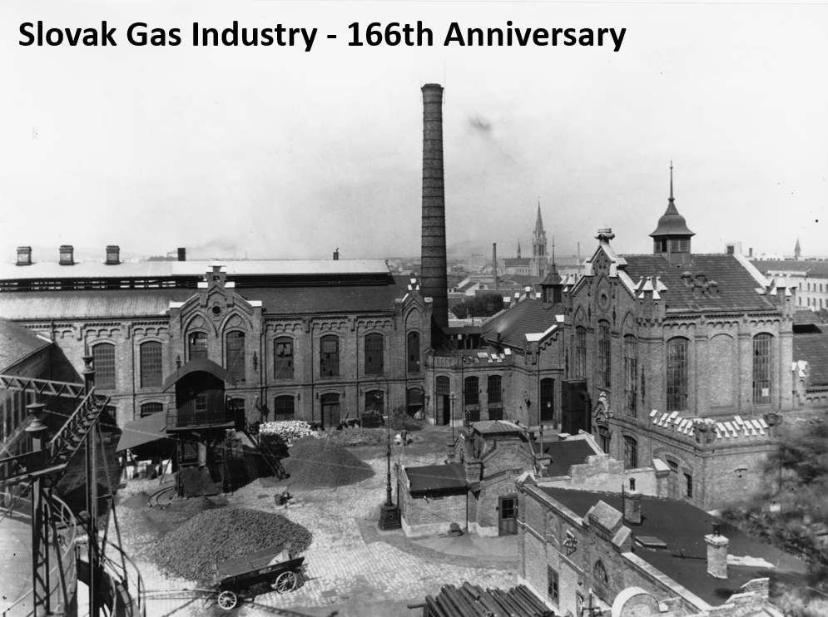

Slide 5
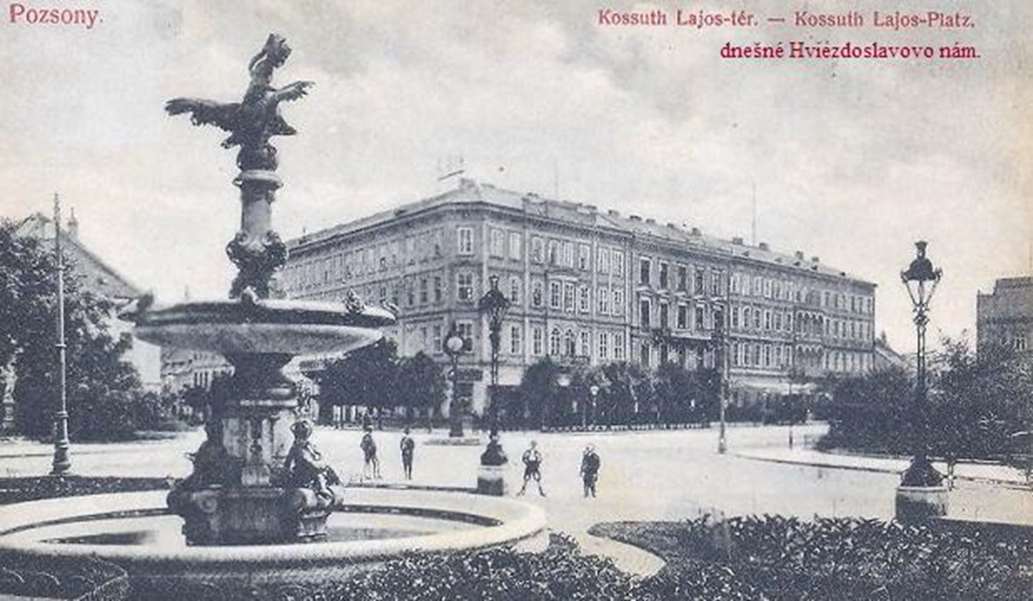
19th March 1856 - 209 gas lamps were lit in Pressburg / Pozsony (Bratislava). This day is recognised as the beginning of the Gas industry in Slovakia

Slide 6
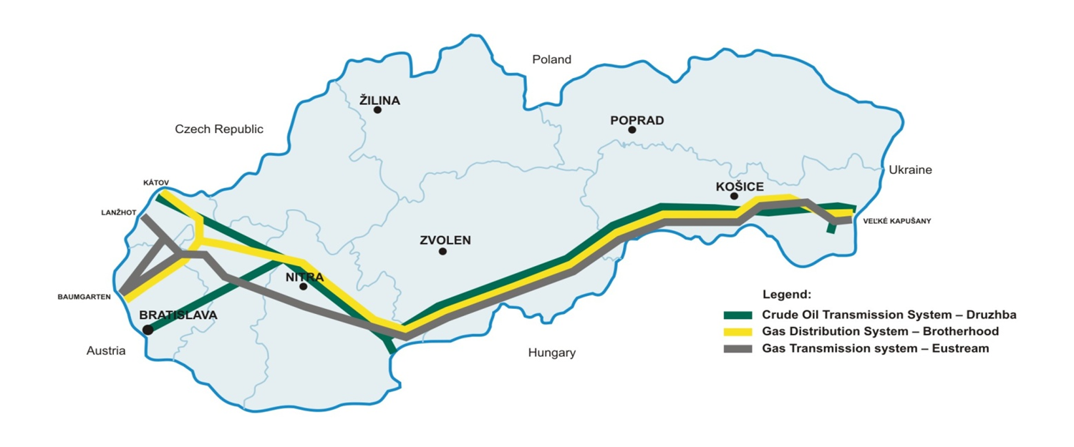
Slovakia is important transport corridor of Russian natural gas and oil to Europe
History
1962 put into operation the first International crude oil transmission pipeline Friendship
1967 put into operation the first International natural gas transmission pipeline Brotherhood
1972 put into operation transcontinental transmission gas system (in Slovakia Eustream)
consists of four pipelines Ø1200 mm and Ø1400mm, total transport capacity 94 bcm

Slide 7
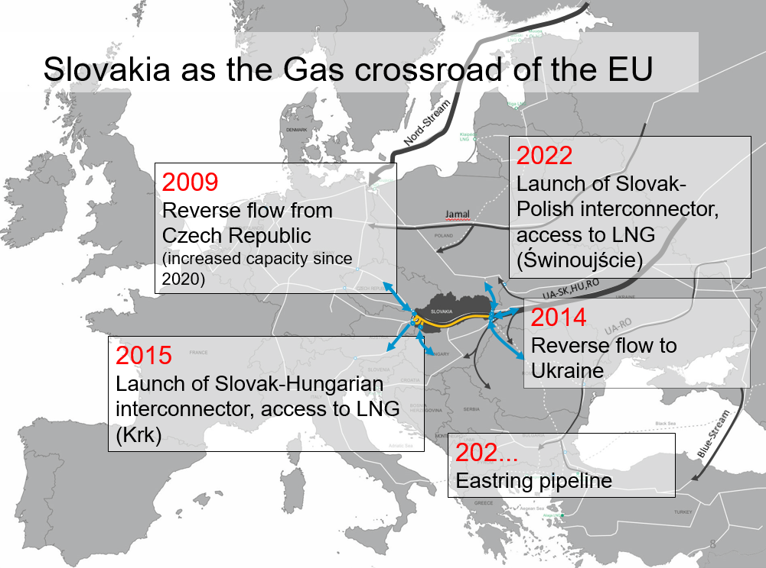

Slide 8
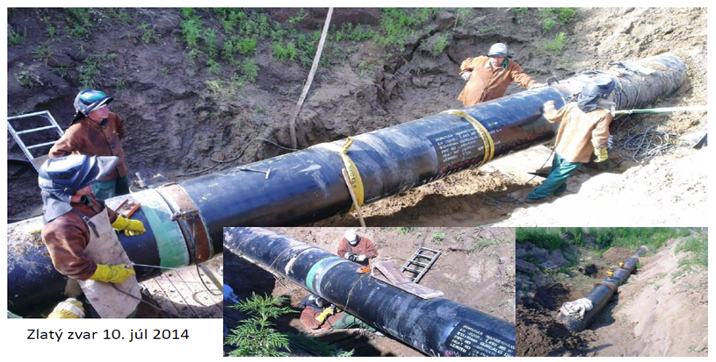
Interconnector SK - HU
the length of pipeline 113 km (19 km Slovakia, 94km Hungary)
the overall capacity 5 bcm / year
since 2015 in the operation
successful project- second line of interconnector was included in the PCI
projects

Slide 9
Interconnector SK - PL
total length of 164 km (Slovakia 106 km, Poland 58 km)
total investment 534 mil. EUR
PCI project
completion 2022
access to LNG for Slovakia and Ukraine
After completion - Slovakia is an excellent example of the diversification of natural gas supply sources and their routes with a high level of energy security

Slide 10
Helping Ukraine Reverse Flow SK – UA 2014
Slovak aid to solving of Russian - Ukrainian crisis
Exit point Budince
The overall capacity 42 mil m3/daily
Ukraine – second biggest export gas market for Slovakia after Austria

Slide 11
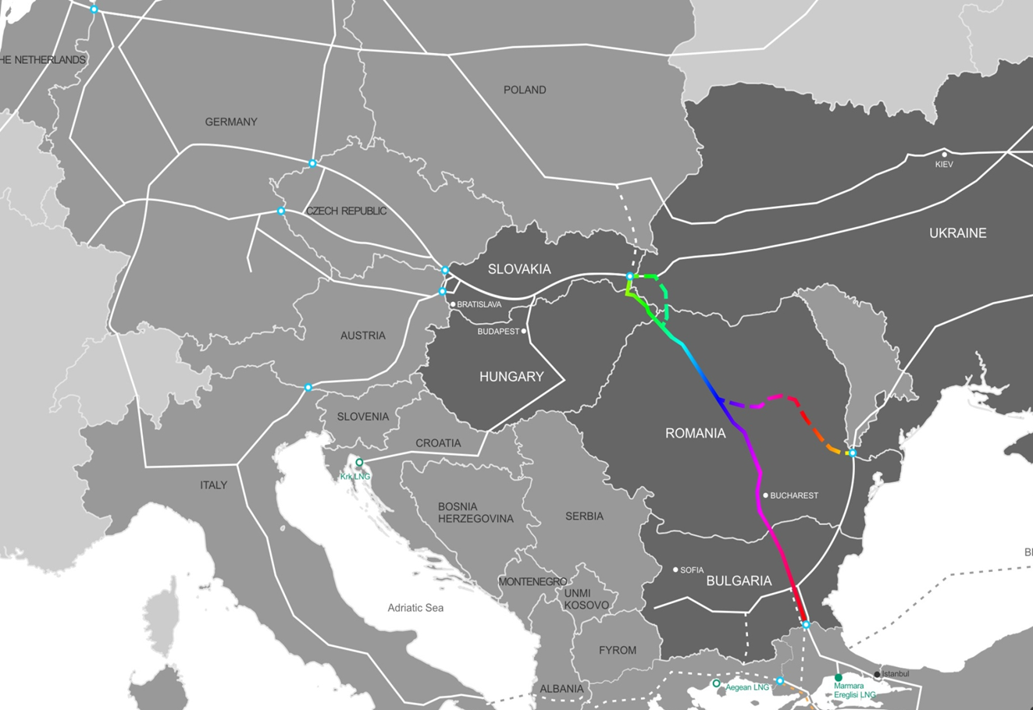
EASTRING – Main facts
Capacity: up to 40 bcm/year
Length of pipeline: 832 – 1,015 km
Expected costs: 1,850 – 2,205 bil. EUR
Current status: on hold, waiting for potential consumers, route for a higher demand for gas in Southeastern Europe or route for the gas from new fields in Mediterranean or Black Sea

Slide 12
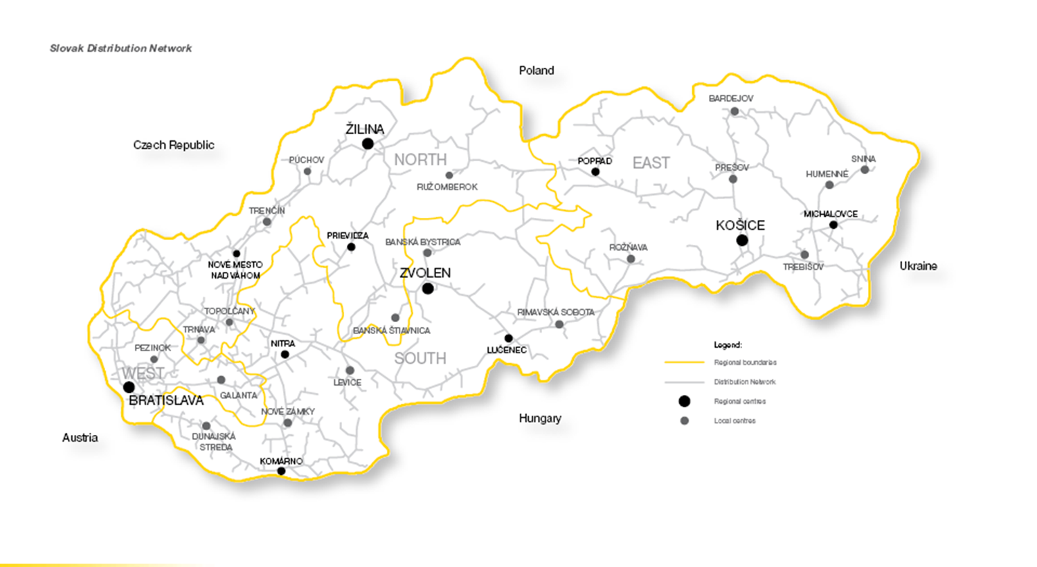

Slovak DSO
In Slovakia, there are 34,525 kilometres of distribution pipelines leading to 77 % of towns and villages, in which 94 % of the population lives, within Europe only in the Netherlands is gas penetration higher. Number of 1,518,019 end consumers are connected to the gas grid

Slide 13
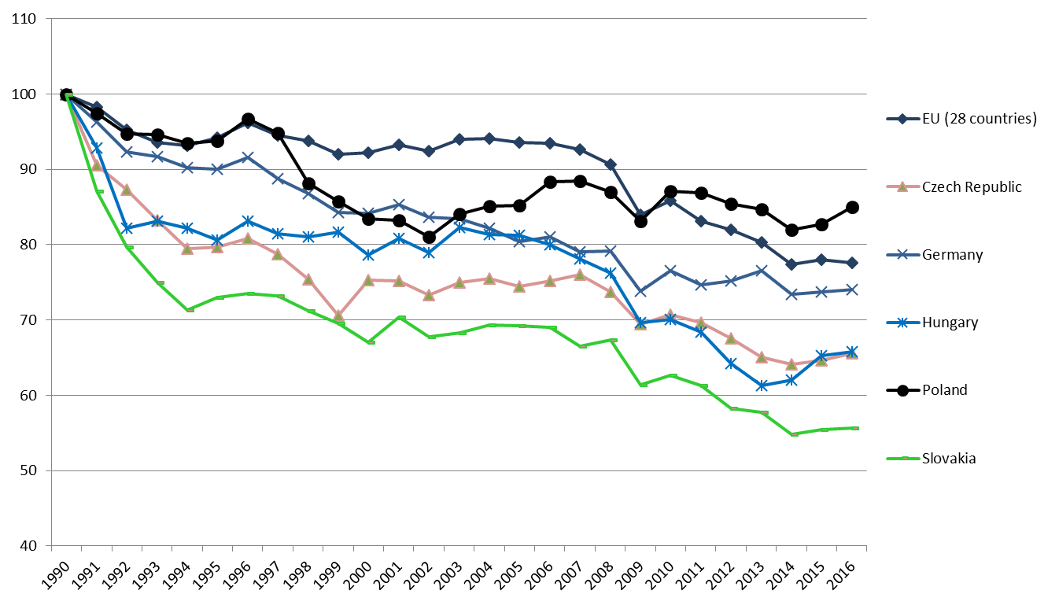
Slovakia has achieved one of the larges reductions in greenhouse gas emissions within the EU since 1990 in Energy sector
Evolution of CO2 emissions since 1990
Source: eurostat

Slide 14
Slovakia´s energy sector has one of the best emission profiles within the EU

Slide 15
