Slide 1
Subject proposal : Storage abandonment Is it time to update the 2003 IGU Study?
P. Egermann, E. Kermarrec (Storengy)

Slide 2
Agenda
Context of porous UGS abandonment / operations
Reminders of the last IGU works on the subject in 2003
Is it time to update the 2003 IGU guideline on abandonment ?

Slide 3
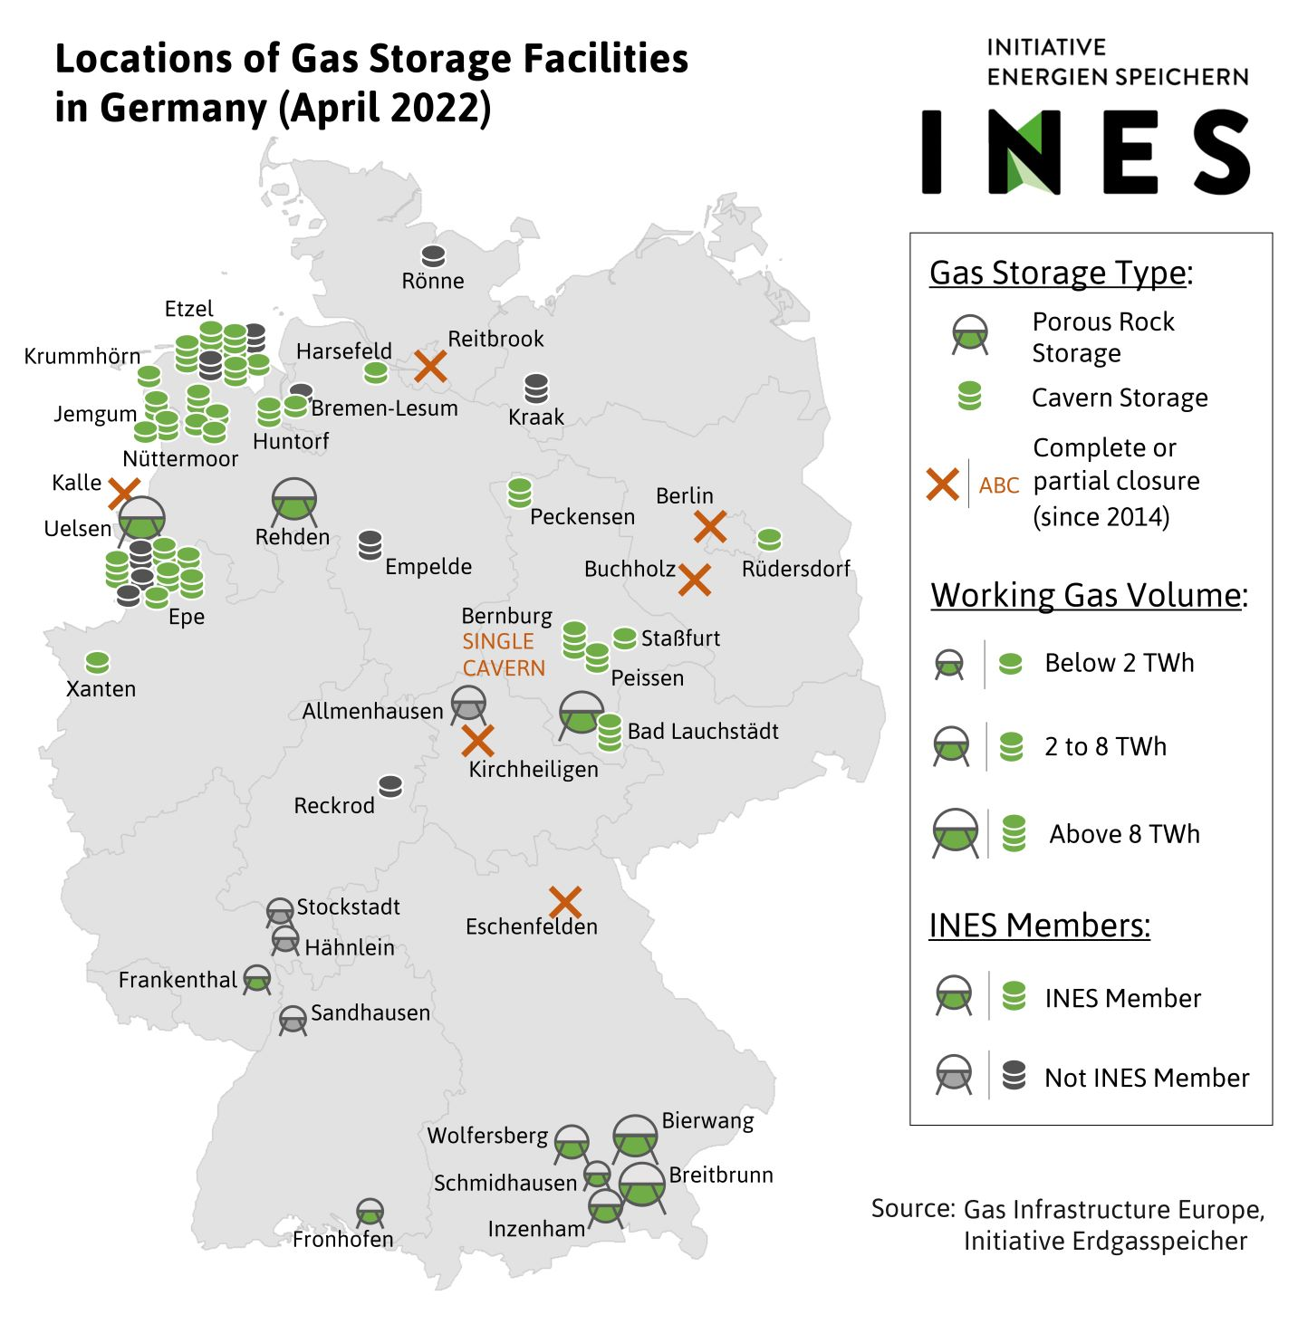
Recent quick look study on porous UGS closure operations
Focus on the porous UGS
Various sources of informations in public domain
Associations in the gas domain : IGU, GIE, INES, BVEG, ..
Federal and states sites (FERC, LBEG, LBGR, ..)
Reports / books, guidelines, peer reviews, …
Scientific publications
Public documents on the UGS
Local & national press
Some direct contacts
Overview on the porous UGS abandonment operations

Slide 4
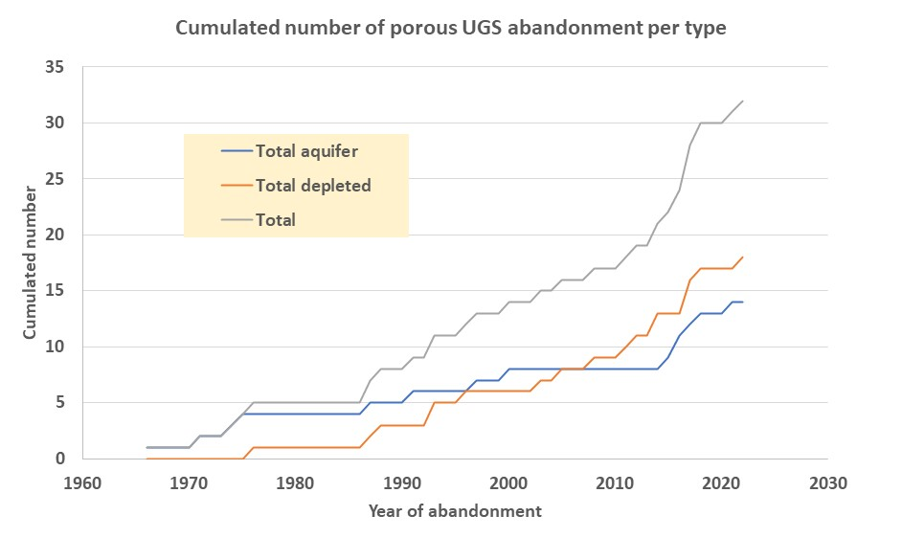
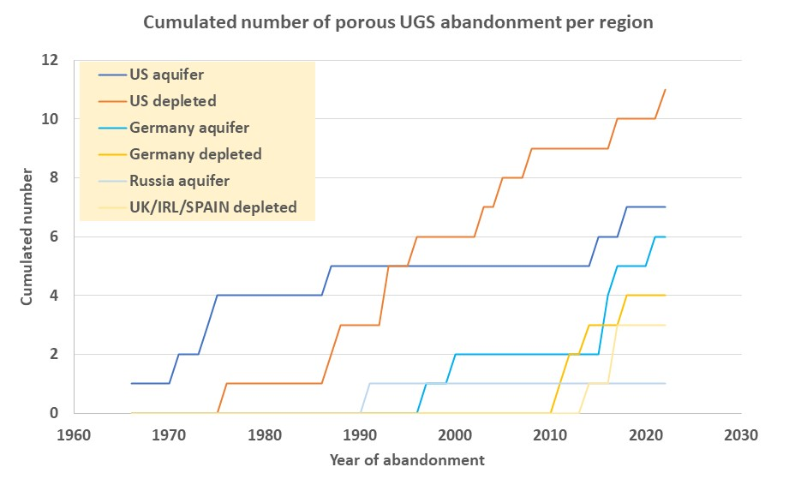
Porous UGS abandonments per type and region
32 sites including 14 aquifers (6 very recent)
Abandonment acceleration after 2010 for different reasons
US : increase of domestic production leading to less storage needs / more constrains for the UGS operators on well integrity following Aliso Canyon accident
Germany : Storage needs reduction due to renewables share increase
Of course this picture recently evolved …. (example : Rough re-opening)
Recent acceleration
Closures following unsuccessfull initial tests
Closures in California

Slide 5
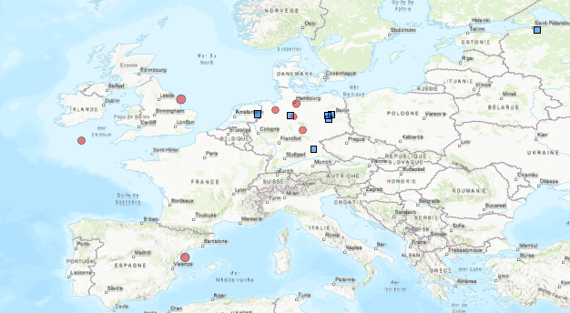
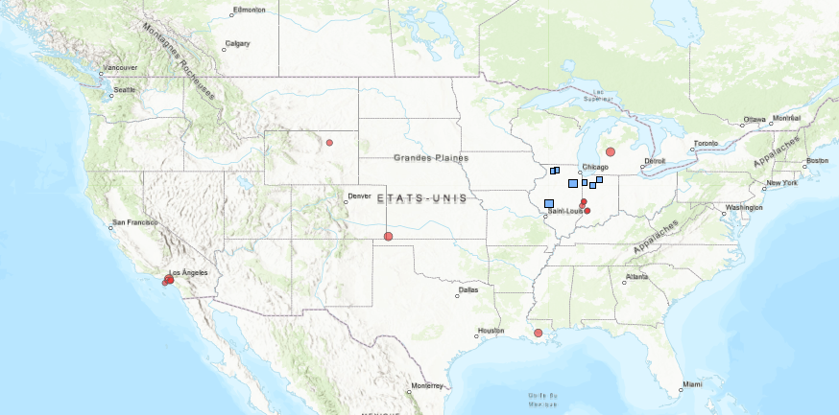
Porous UGS abandonments per type and region
US and Germany are the champions

Slide 6
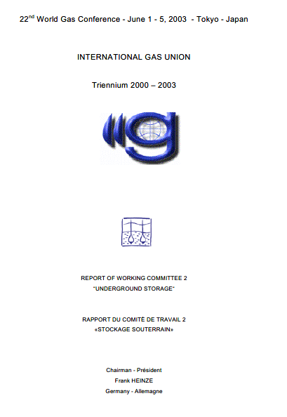
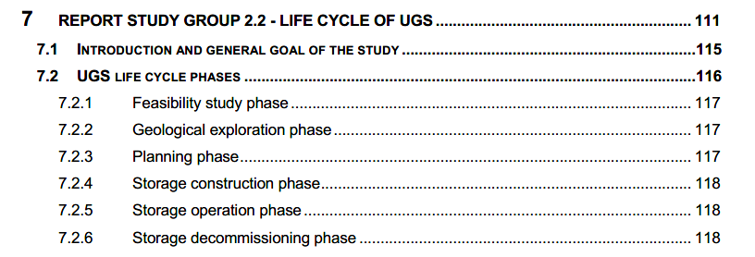
IGU worked on abandonment during 2000-2003 Triennium

Slide 7
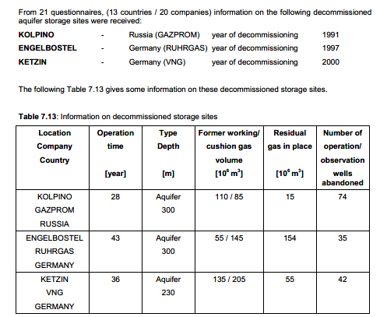
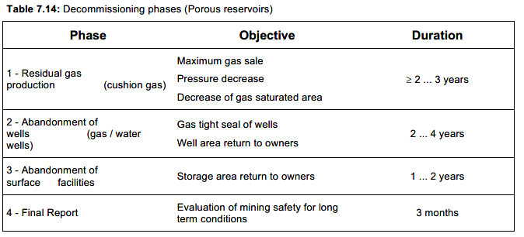
2003 IGU report
Questionnaires / surveys approach
Main phases of abandonment with typical duration
3 documented examples

Slide 8
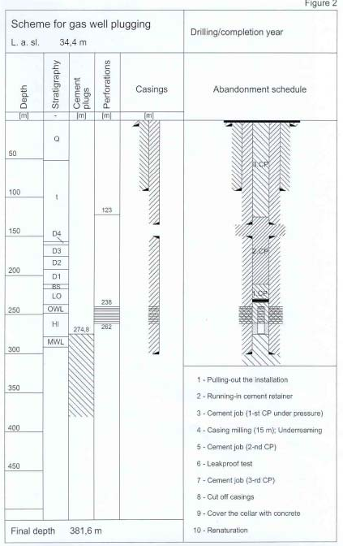
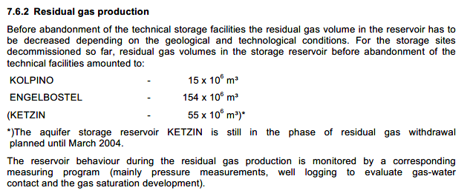
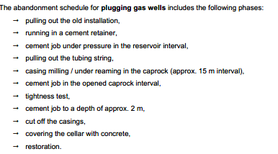
2003 IGU report
Details level was not homogeneous
Some parts are well covered
Some are very short
No surveillance phase mentionned as such

Slide 9
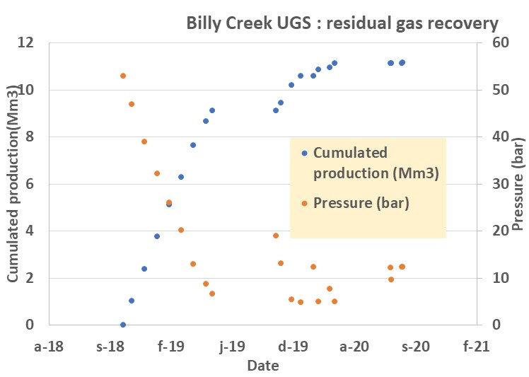
Is it time to update the 2003 IGU report ?
The quicklook analysis revealed
The possibility to include much more examples with a variability of contexts
Few technical data are available in the public domain
NB : Counter example = Billy Creek
Surveillance does not seem systematic but is implemented in some particular cases
Times adressed to abandon wells can vary significantly from one region to another
….
A significant amount of new informations potentially available through a survey
Your views and ideas about taking this opportunity to update the 2003 IGU document ?
Option 1 : Recovery using one existing compressor with the lowest aspiration pressure. First continuous production then stop & go.
Option 2 : new compressor with the lowest pressure limit
Option 3 : new wells to reach undrained areas
Not retained as non economical

Slide 10
Thank you

