Slide 1
Subject proposal :
Framework / guideline for UHS (conversion from UGS or new)
P. Egermann, E. Kermarrec, J. Breton (Storengy)

Slide 2
Agenda
Why UHS (blended or pure) matters ?
Storengy & UHS related topics , an old story
Some current/recent initiatives on UHS
Toward a framework / guideline ?

Slide 3





















ENGIE ambitions on hydrogen set the framework
End user targets
2030 Ambition
Industry
    4 GW
    Green H2 production
Transformation e-CH4 / LH2
LNG Export / Import terminal
Transport
Storage
Distribution
Uses
Mobility
    >100 H₂ filling stations
H₂
Infrastructures
    700 km
Green power &
H2 production
    H2 pipeline
1 TWh
H2 storage

Slide 4






Large-scale H2 infrastructures are needed to support market growth
Insurance Value
Production disruption, continuous supply despite variable production
Feedstock
> large industrials & mobility uses
Market & Arbitrage value
Hedge against market prices & challenge H2 suppliers
Peak solution
> power grid operators
-30% green H2 cost for end-users
System value
Sector coupling avoids over-investments in power grid reinforcements
Long-term & large-scale storage
> REN power producers
> Large-scale H2 producers
Environmental & kick-start value
Avoid REN power curtailment & increase load factors
Source : Guidehouse 2021 study, Artelys 2022 study Icons Source : Flaticon, Nueng_wana, Smachicons

Slide 5
Europe ambitious H2 plan drives infrastructure requirements
Storage Capacity (TWh)
RePowerEU 2030 : 20 Mt - 780 TWh
New H2 storages projects are already required to cover H2 demand in 2030
200
100 – high assumption
H2 demand is expected to increase faster than gas demand decline
Repurposed assets are unproductive during conversion process (several years)
75 – Average assumption
50
Salt caverns are the best solution (TRL 9) for short term needs
Max storage assumption : 15%
Average storage assumption : 10%
But role also to play porous storages where suitable salt is not present
Low H2% blend in NG grid likely in parallel
EU27 + UK UGS existing + planned capacity (caverns)
Conversion UGS -> UHS
Storage required in 2030
Projects would need to start between now and 2025 to be ready by the beginning of the 2030s
H2 demand in 2030 : 20 Mt (RePower EU Strategy)
Energy density factor H2 / CH4 : 3.8
Storage capacity required : 20% of demand if mainly Green H2 /-/ 10% if mainly blue H2 /-/ 24% for NG
Medium size cavern : 0,275 TWh
Source : GIE Storage Database, based on existing UGS in caverns (WGV considered)
Notes:
Salt caverns => ideal compromise between costs & maturity (only short term solution available in 2030)

Slide 6
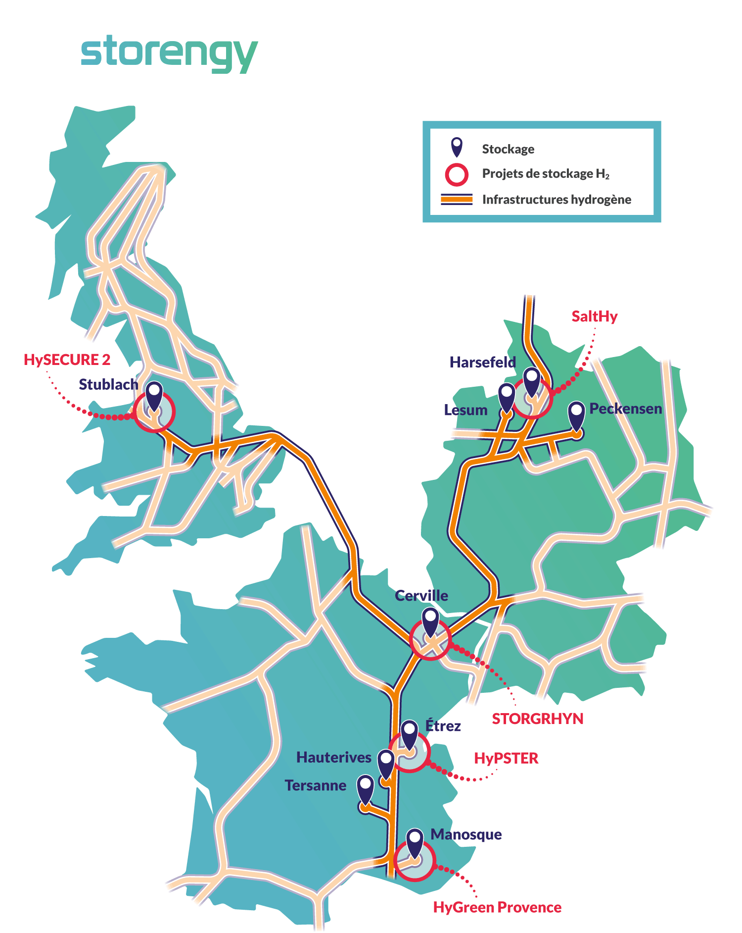

First STORENGY’s projects in salt caverns along the European Hydrogen Backbone and industrial hubs
Foreseen hydrogen backbone by 2040
Various initiatives already launched and in progress

Slide 7
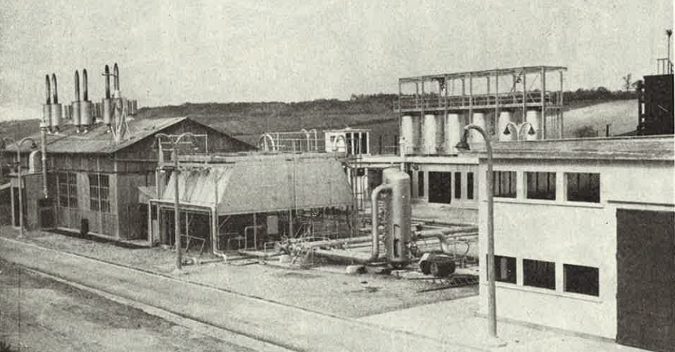
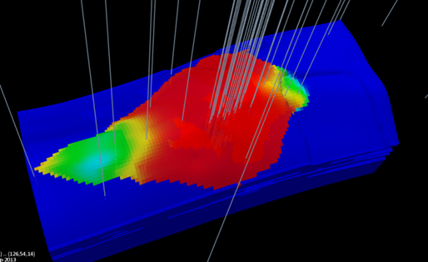
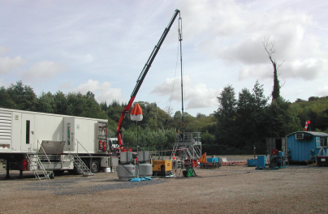


Storengy and UHS related topics …. a long story
1950-60
1970-90
2000
2012
2016
2022
Town gas storage at the Beynes site (40-50% H2)
Several H-gas – L-gas UGS conversions + cushion gas replacement with inter gas => mixing processes
Bacteria bioattenuation processes & sampling & testing & modelling
Dedicated experimental device for lab assessment of new gases => RINGS
Porous UGS
Position paper Marcogaz (2016)
Internal program on H2 & biomethane in UGS
All UGS
Third party services
+ specific studies on H2
Salt caverns UGS
Several studies
STOPIL-H2 (FR-2018)
Centurion (UK-2018)
HySecure (UK-2019)
Fast cycling in 2023
SaltHy (DE))
Hygreen, STOGRHyn (FR)
HySecure2 (UK)

Slide 8






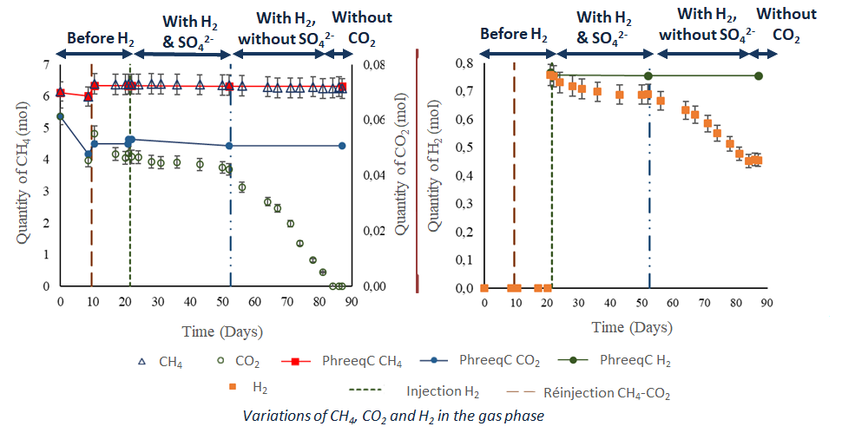
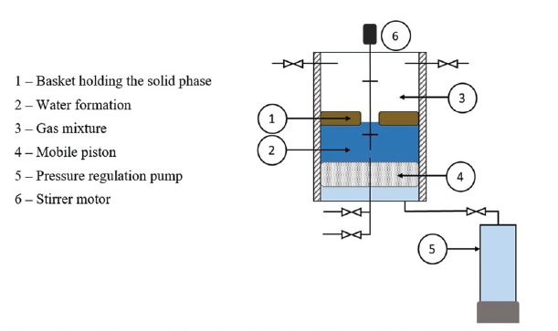
Example : RINGS : Research on the Injection of New Gases into Storages
A collaborative work
+
as advisory board members
2017
2018
2019
2020
2021
2022
Start of the project RINGS-I, involving 5 laboratories of UPPA University, led by LaTEP and IPREM.
1 experiment with O2
1 experiment with H₂
Start of RINGS-II
(for 3 years with a phD student)
1 experiment with H₂
End of RINGS-I
Design of the experimental reactor - Start of pHD thesis
1 experiment with O2
1 experiment with H₂
Addad et al. (2022)
Example of sulfato-reduction and methanation reactions detected under full representative reservoir conditions

Slide 9
RINGS one key step but not the only one …
Constitutive Laws
(Chemical and physical effects)
Upscaling at reservoir scale
Understanding actual subsurface equilibrum in UGS
Study the impact of new gases (biomethane, H₂) on UGS
Get ready for new gases
Current microbiological diversity
Microbiological and chemical equilibria after decades of UGS operation with natural gas
Impact on microbiological diversity
Impact on aquifer
Porosity/permeability change
Change in well injectivity
Water quality
Impact on gas quality
Acidification (H₂S, CO₂)
Loss of H₂
Simulate injection scenarios
Define admissible H₂ concentrations (and O₂)
Anticipating necessary change in gas infrastructures

Slide 10
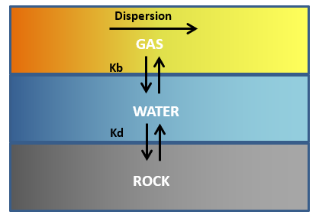
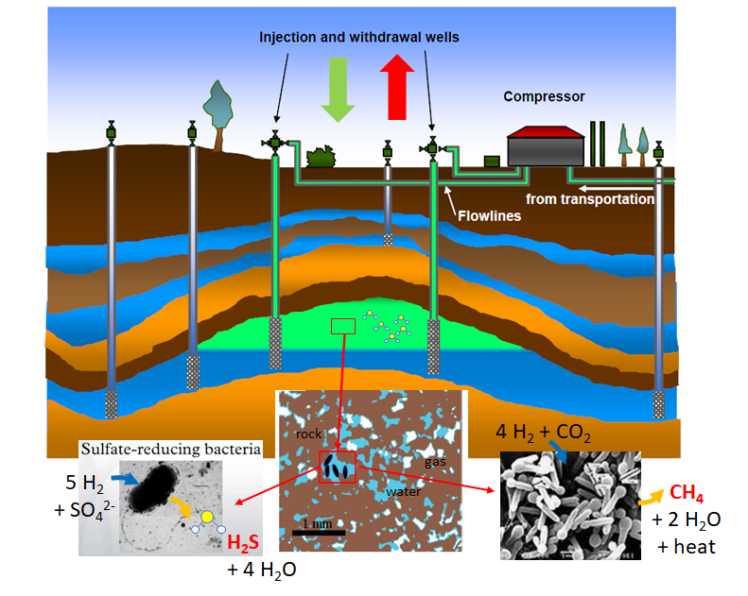
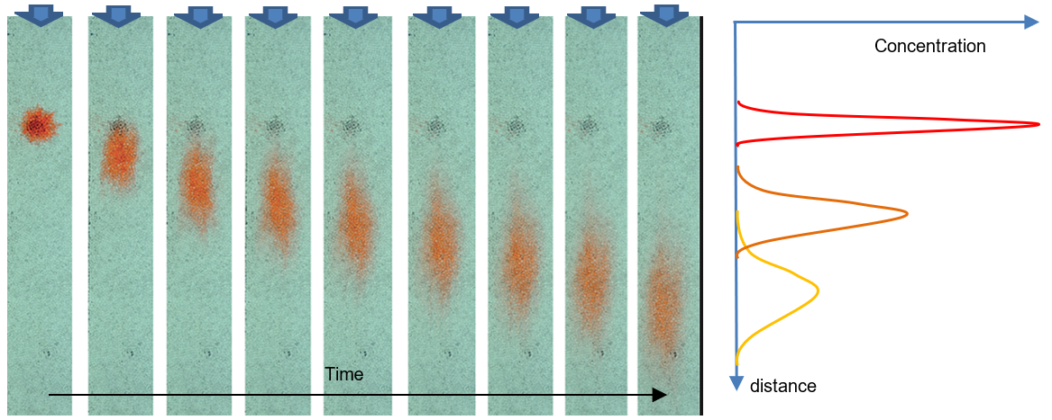
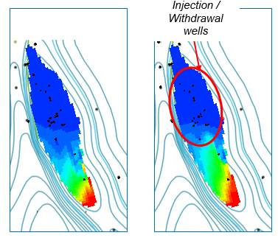
…. mechanisms affecting the gas composition
Dissolution / absorption
Water composition, P&T cdts, rock composition (TOC)
Dispersion
Mixing process with in-situ gas (reservoir heterogeneities, gas velocities)
Reactions
Abiotic and biotic (RINGS)
Compositional and reactional reservoir model
History match
process
Upscaling process
Historical compositional data, tracer tests, pilot tests, ..
Reliable forecasts

Slide 11



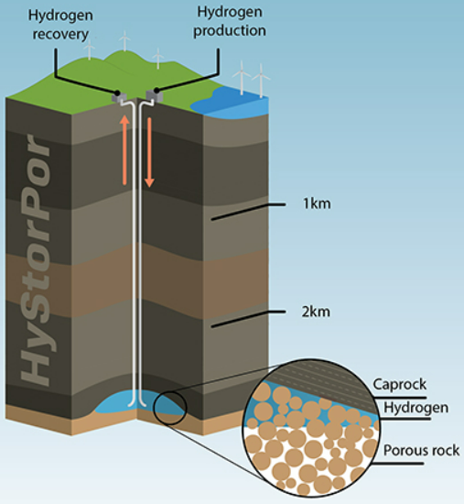







Some current/recent initiatives on UHS (1)
Learnings, rules and feed backs for hydrogen (various%) storages
Porous and salt caverns
Wells and surface facilities
Hydrogen Pilot STorage for large Ecosystem Replication
…. and much more

Slide 12
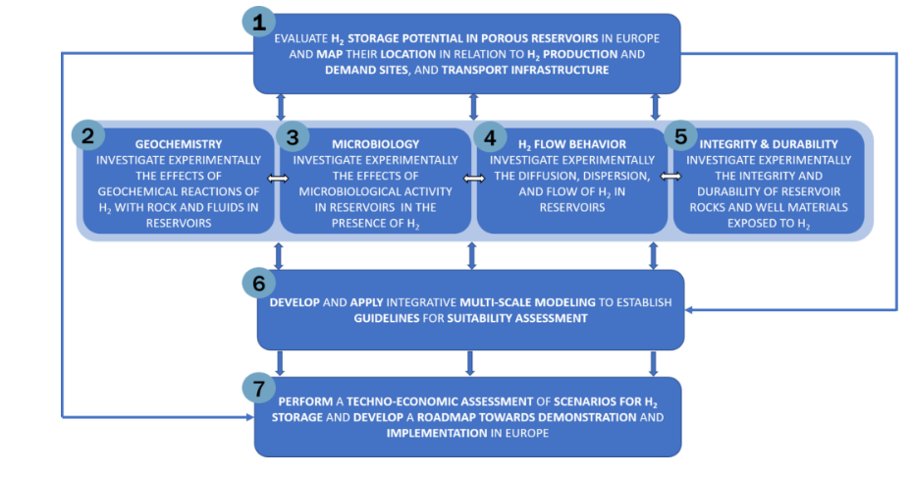
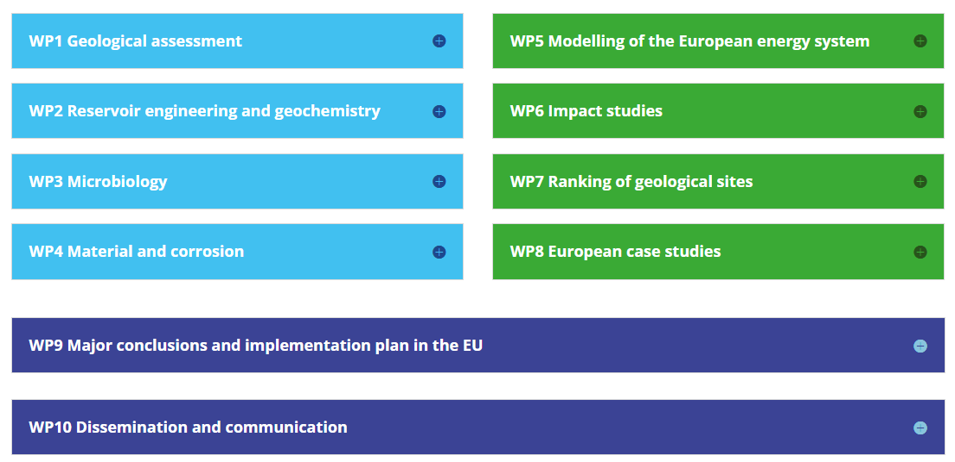
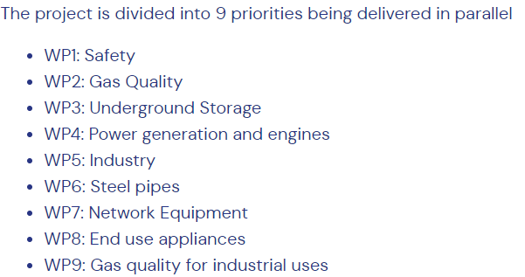
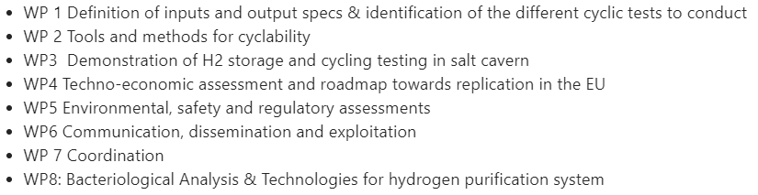
Some current/recent initiatives on UHS (2)
Some examples of project scope / deliverables … A lot to capitalize

Slide 13
Toward a framework / guideline ?
Project Phases
PRE-DEV
DEV
EXECUTION
O&M
decommissioning
Key Objectives
Identify opportunity – Exploration / appraisal
Narrow geological uncertainties / drilling targets / Process / Permitting
FEED
Start construction
Enhance/maintain performances
Monitoring
Abandonment
GO / NOGO
GO / NOGO
FID
A framework / guideline should provide recos for all the possible stages of a project
  Conversion of UHS or new UHS
For a given technical topic
  The approach can differ significantly depending on the objectives followed
    From screening card with simple rules / threshold ….
    …. to detailed studies
  Spend the time and money where the risks or/and rewards are the most important

Slide 14
Toward a framework / guideline ? (2)
Pragmatism
Operators inputs to achieve an applicable methodology with an adequate merit order on relevant topics
Efficiency / Clarity
Common vision which integrates the works and feed backs from past / current initiatives
Framework / guideline on UHS ((conversion UGS or new)
Sharing / visibility
Put available a useful reference for storage operators but also the stakeholders and project developers
Sustainability
Avoid issues of any kind (safety, performance, etc …) especially for the first projects to prevent a domino effect on the next ones

Slide 15
Toward a framework / guideline ? (3)
Not easy and significant work ….
Possible format
  Appropriate level of details as some aspects are case dependent
  Recipe approach with decision tree if necessary
  References to key projects/pilots, norms, other guidelines, publications, … practical rules, domains remaining uncertain, …
  ….
Your views, ideas on both the content and way to do it or not ? Is it the right time to initiate something in that direction or not ?
THANK YOU !

