Slide 1
NAFTA WELCOMES IGU
Ladislav Barkoci

Slide 2
GREETIngs from NAFTA General Director
„This winter is very important and it will check the performance of every storage. We need to show to world our value, they count on us now“

Slide 3
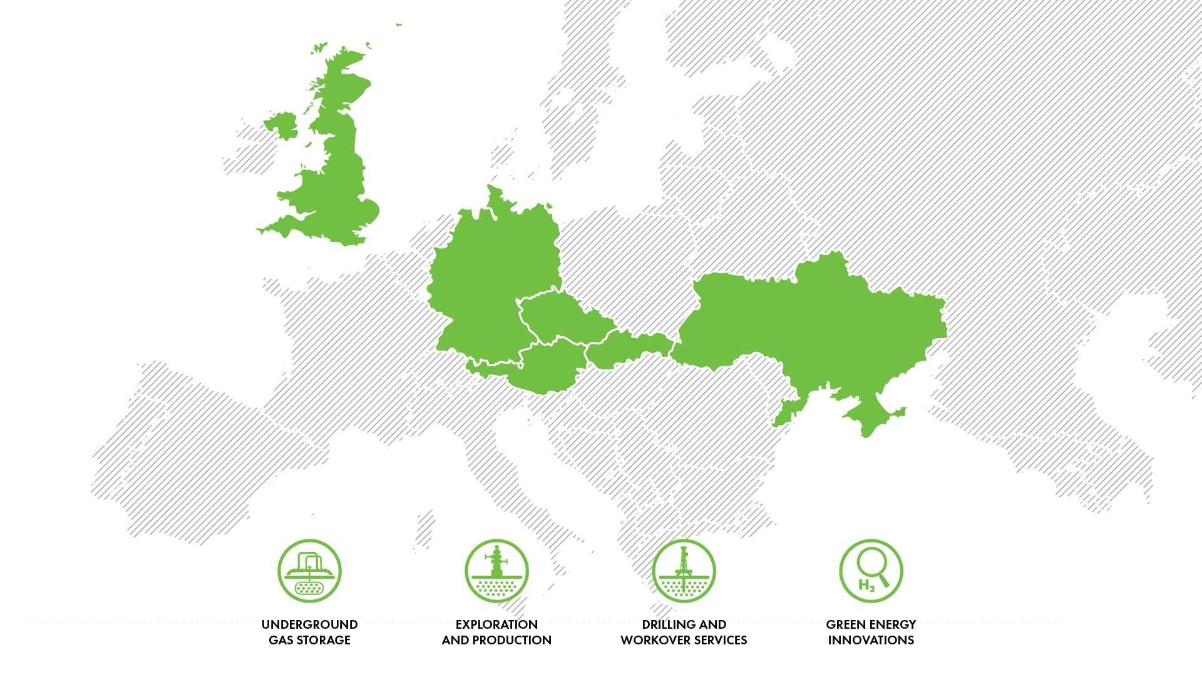
NAFTA in europe

Slide 4
Drilling cRew
Photograph from the year 1959

Slide 5
NAFTA / ugs operations in europe

Slide 6
NAFTA / ugs operations in central europe
Gas Storage | NAFTA Technical Operator | NAFTA Storage System Operator | NAFTA Technical & Advisory Services | Working Gas Volume (TWh)
UGS Complex Lab | ● | ● |  | 27.7
UGS Pozagas |  |  | ● | 6.9
UGS Dolni Bojanovice |  |  | ● | 6.1
WGV
40.7 TWh
Withdrawal Rate
418.9 GWh/d
Injection Rate
338 GWh/d

Slide 7
CS GAJARY
Central Station UGS in Gajary

Slide 8
LEADING GAS STORAGE OPERATOR IN EUROPE
N. | Technical Operator | Max. Storage Capacity
1 | STOGIT | 179.95
2 | Storengy | 121.22
3 | NAM | 83.19
4 | RAG Energy Storage | 70.26
5 | Uniper Energy Storage | 62.77
6 | NAFTA group | 61.58
7 | TAQA Gas Storage | 53.15
8 | Astora | 51.81
9 | Hungarian Gas Storage | 47.59
10 | RWE Gas Storage | 46.65
N. | SSO | Max. Storage Capacity
1 | STOGIT | 179.95
2 | Storengy | 121.22
3 | Uniper Energy Storage | 80.67
4 | Astora | 70.41
5 | TAQA Gas Storage | 53.15
6 | Hungarian Gas Storage | 47.59
7 | NAFTA group | 46.75
8 | RWE Gas Storage | 46.65
9 | Gas Storage Poland | 36.41
10 | RAG Energy Storage | 34.18

Slide 9
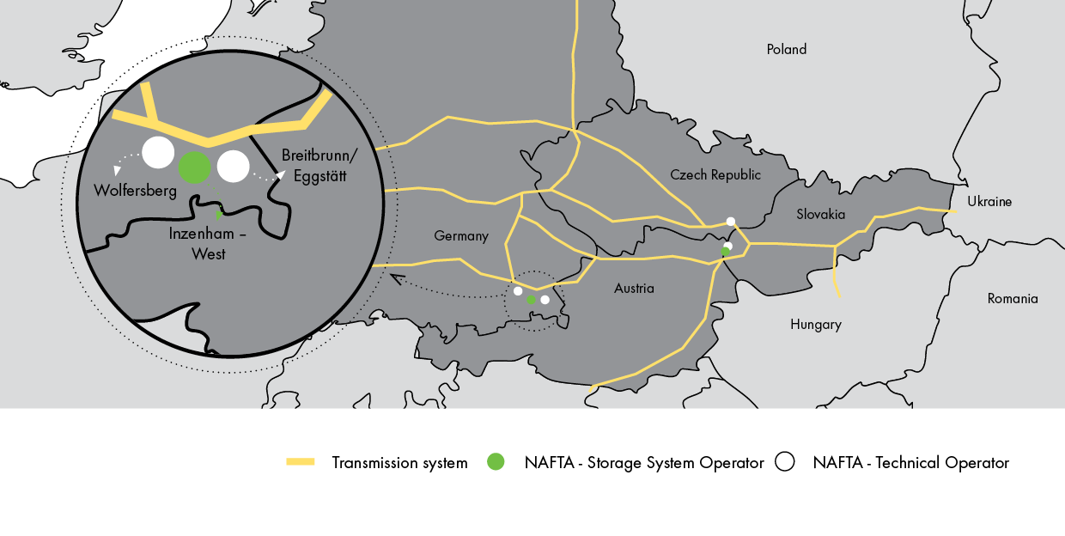
NAFTA / ugs operations in germany

Slide 10
NAFTA / ugs operations in germany
Gas Storage | NAFTA Technical Operator | NAFTA Storage System Operator | Working Gas Volume (TWh)
UGS Breitbrunn/Eggstätt | ● | Uniper Energy Storage | 11.1
UGS Inzenham-West | ● | NAFTA Speicher Inzenham | 4.8
UGS Wolfersberg | ● | Bayernugs | 4.1
WGV
20 TWh
Withdrawal Rate
286 GWh/d
Injection Rate
149 GWh/d

Slide 11
UGS Inzenham-west
UGS of NAFTA Speicher in Germany

Slide 12
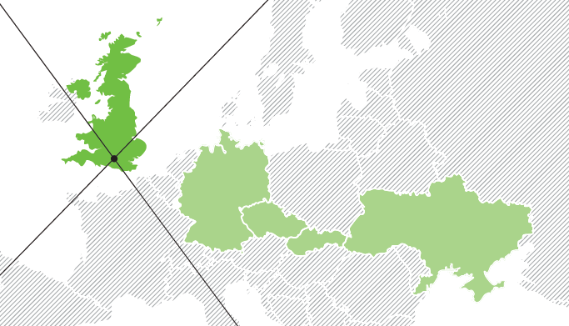
NAFTA / technical & advisory services in UK
WGV
2.6 TWh
Withdrawal Rate
79 GWh/d
Injection Rate
89 GWh/d

Slide 13
UGS humbly grove
UGS in United Kingdom

Slide 14
www.nafta.sk

