Slide 1
Gas Storage Value in Europe
2022.10.05

Slide 2
Underground gas storage value

Slide 3
Spread development
Source: NCG, THE

Slide 4
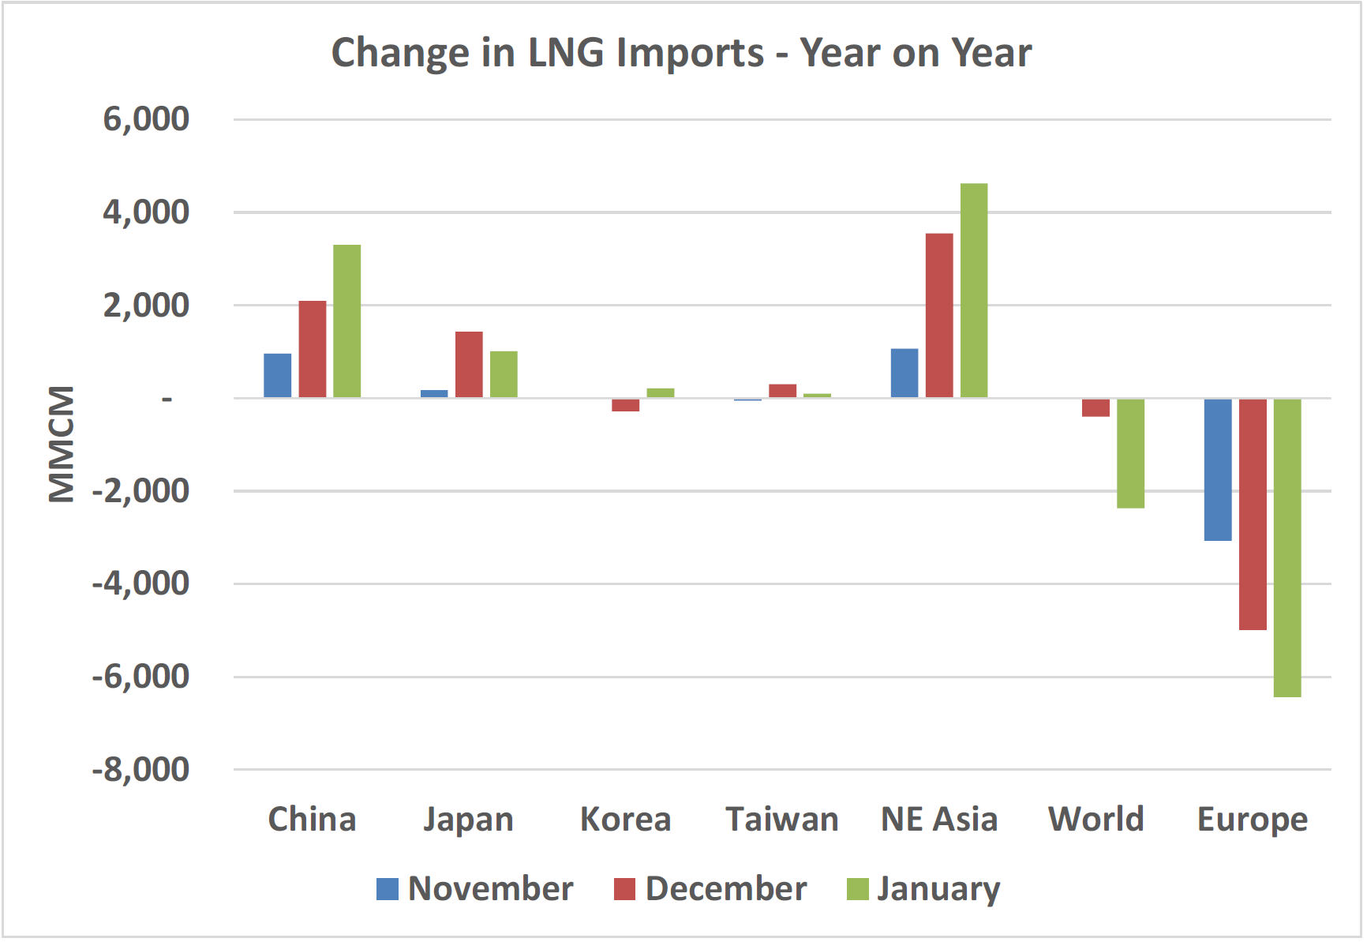
Winter 2020 case study
LNG flows to Asia instead of Europe
Source: https://www.oxfordenergy.org/wpcms/wp-content/uploads/2021/02/Asia-LNG-Price-Spike.pdf

Slide 5
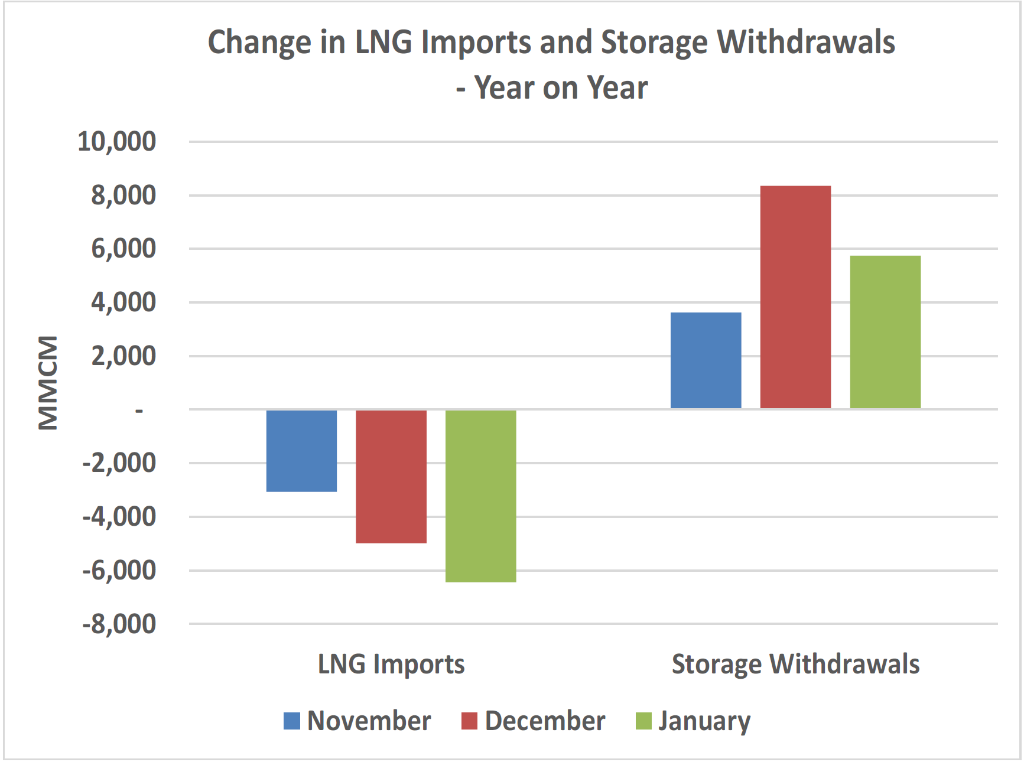
Winter 2020 case study
Missing LNG import is covered by storage withdrawals
Source: https://www.oxfordenergy.org/wpcms/wp-content/uploads/2021/02/Asia-LNG-Price-Spike.pdf

Slide 6
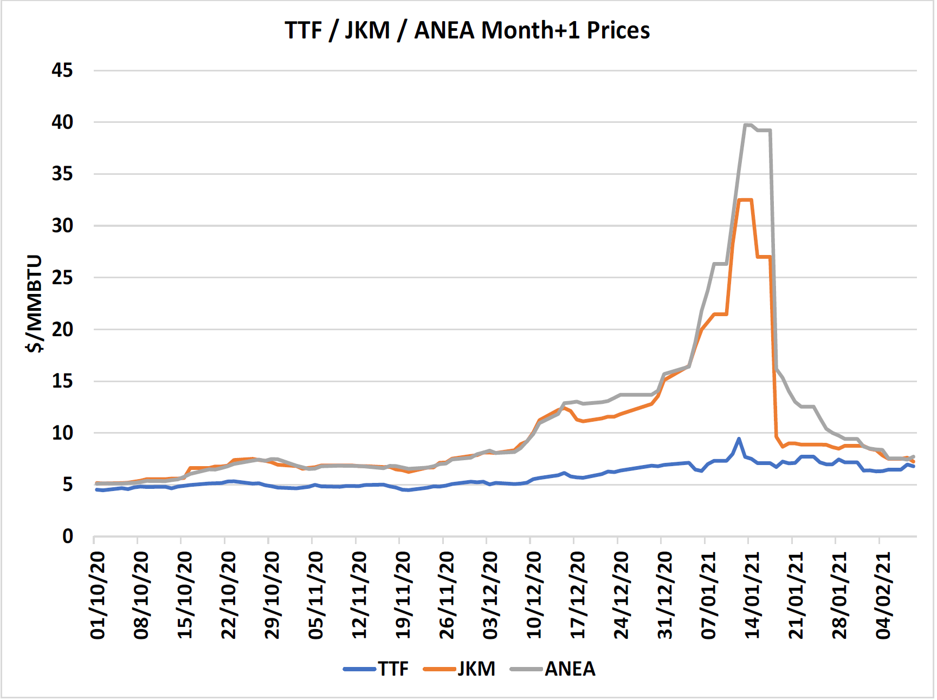
Winter 2020 – demonstration of system value of storage
Storages help Europe to avoid high price of gas, flexibility export to Asia
Source: https://www.oxfordenergy.org/wpcms/wp-content/uploads/2021/02/Asia-LNG-Price-Spike.pdf

Slide 7
Spread development

Slide 8
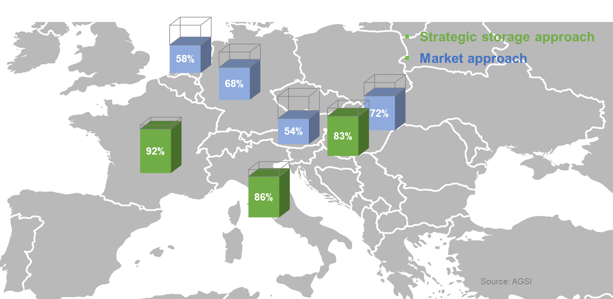
UGS regulation influence

