Slide 1
Implications of regulation
2022.10.05

Slide 2
Storages and legislation
1
2
Security of supply
Transition to decarbonized world
3
4
5
6

Slide 3
Storages and legislation
1

Slide 4
Storages and legislation
storages legislation
We ARE in the FOCUS – security of supply
We HAVE to FOCUS – transition to new green world

Slide 5
Security of supply
3

Slide 6
Storages and security of supply
March 2022 EC published a proposal for amendment of Security of supply Regulation:
Gas storages in the spotlight (effective from 01/07/22):
Obligatory Filling targets (MS shall ensure filling level of storages on their territory):
on 1/11/22 at least 80%,
On 1/11/23 at least 90%
( max. 35% of the average annual gas consumption over the preceding five years for that Member State)
Obligatory Filling trajectories - intermediate target in % on 1/08, 1/09, 1/10, 1/11 (2022) and
1/02, 1/05, 1/07 and 1/09 (2023 to be adopted)
How to achieve it is on each MS:
national legislations are adopted
lot of differences between MS
lot of application questions - legislation is often approved without understanding of storage business

Slide 7
Storages and security of supply
Burden sharing mechanism:
MS without storages – shall make arrangements with market participants or storages to provide for use of at least 15% of their gas consumption or
MS without storages – shall develop a burden sharing mechanism with MS with storages
Obligatory certification of storage system operators:
Storages over 3,5 TWh filled less than 30 % on 31/03/21 and 31/03/22 by 1 February 2023, others until 02 January 2024
Considering risk to security of supply (e.g. ownership, supply or other commercial relationships that could negatively affect the filling level of storages...)
Conditions for ceasing operation of storage facilities:
Technical and safety requirements are not met
Would not weaken SoS at Union and national level (approval of NRA and consultation w. ENTSOG)

Slide 8
Transition to decarbonized world
3

Slide 9
Transition to decarbonized world
until 2015 (2019) - relatively low regulatory requirements for storages in EU:
Lowest unbundling requirements from infrastructure operators
Mostly negotiated access with no strict rules
in 2015 UN - Paris Agreement on climate change
in 2019 EU - European Green Deal= EU strategy to reach climate neutrality by 2050 into law by Fit for 55
NEW GREEN WORLD

Slide 10
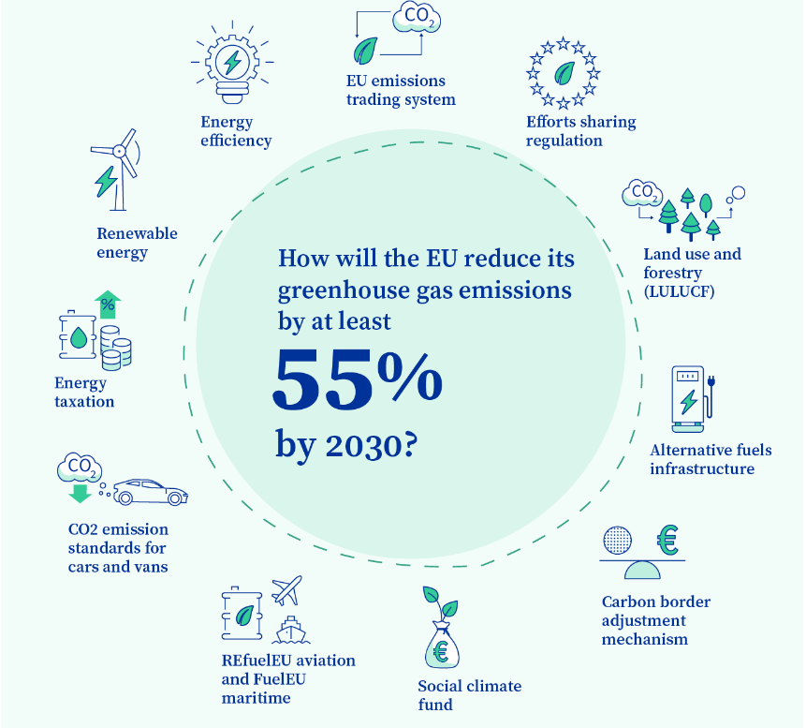
Fit for 55
to cut emissions at least by 55% by 2030 and climate neutral by 2050
Is there a place for storages in the new green world?
Source: EU Commission, https://www.consilium.europa.eu/

Slide 11
Fit for 55 into REPowerEU
Includes proposals for revision of climate, energy and transport related legislation, e.g.:
a revision of the EU emissions trading system (EU ETS)
a revision of the effort sharing regulation on member states’ reduction targets in sectors outside the EU ETS
a revision of the renewable energy directive
a recast of the energy efficiency directive
a revision of the energy tax directive
a carbon border adjustment mechanism
reducing methane emissions in the energy sector
a revision of the third energy package for gas
May 2022 – REPowerEU – accelerate and enhance targets under Fit for 55

Slide 12
Revision of the third energy package for gas
revision of „Gas Directive“ and „Gas Regulation“ now including H2:
definition of hydrogen storage
unbundling rules for hydrogen
blending of hydrogen
gas quality, hydrogen quality....
revision of „Security of supply Regulation“
new Regulation on Methane emissions reduction in the energy sector
Is there a feasible place for our storages?

Slide 13
Final remarks
This is the situation in Europe
What is the situation in other countries?
The world is globalized...we need to cooperate to be prepared

