Slide 1
Messages From Coordination Committee 2022-2025
2022.09

Slide 2
1
Introduction to the IGU
2
Introduction to CC
3
Introduction to the TWP2022-2025
4
IGU Committees and Task Forces

Slide 3
Introduction to the IGU
1

Slide 4
IGU Representing over 90% of the Global Gas Market
As of May 2022, the IGU has 80 Charter members, 14 Premium Associate Members and 59 Associate Members in 5 Continents.
The IGU is a unique organisation because its work and membership cover the entire gas value chain, supporting its vision of being the most influential, effective and independent not-for-profit serving the global gas industry.
IGU Presidency 2022-2025: China
IGU Secretariat: London, UK

Slide 5
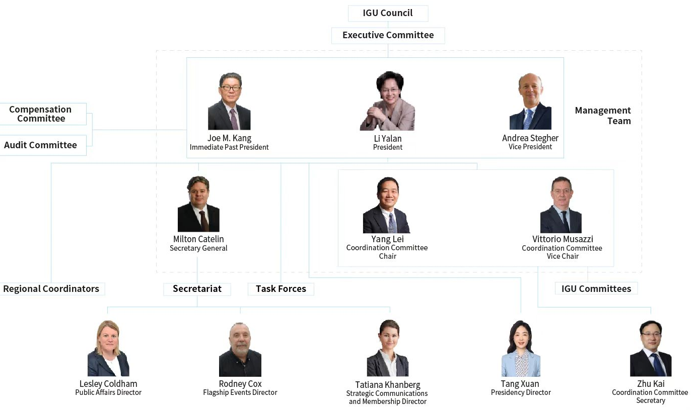
IGU Organisation Chart 2022-2025

Slide 6
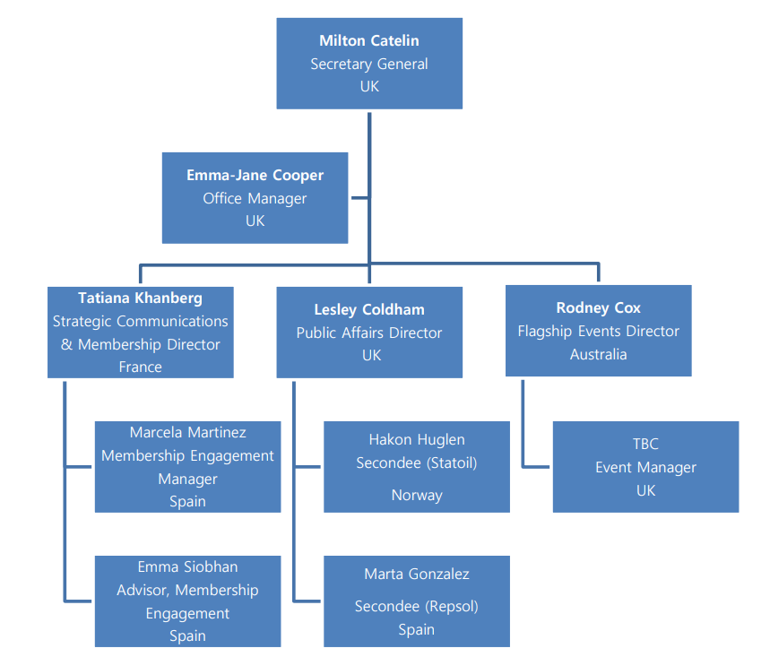
IGU Secretariat

Slide 7
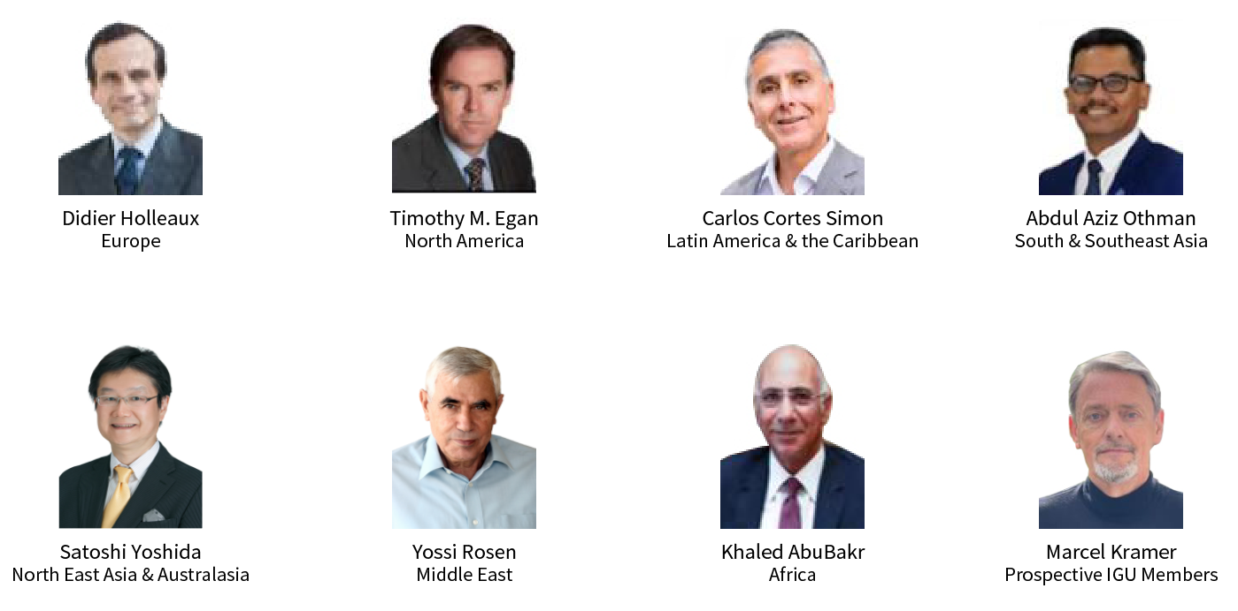
Regional Coordinators

Slide 8
Schedule of IGU Meetings 2022-2025
October 2022 | Council Meeting | Peru
April 2023 | Executive Committee Meeting | Belgium
October 2023 | Council Meeting | Australia
April 2024 | Executive Committee Meeting | Turkey
October 2024 | Council Meeting | Egypt
March 2025 | Executive Committee Meeting | Malaysia
May 2025 | WGC2025 | China

Slide 9
Introduction to CC
2

Slide 10
Messages from CC for a Successful Triennium
Enhancing the management of research results and inheritance; establishing the archiving and sharing mechanism for the results of Committees and Task Forces
7
Encouraging Committees and Task Forces to hold workshops and joint meetings
1
Hosting two CC meetings every year to assess the work of committees and Task Forces
6
Enhancing research coordination and supporting gas advocacy
2
Mobilising Committees and Task Forces to support Regional Coordinators
Urging Committees and Task Forces to deliver research results, quickly share them within the IGU and release them through gas advocacy activities
5
Providing professional assistance to Secretariat and National Organising Committees to prepare topics and deliverables for WGC2025
3
Assisting Committees and Task Forces to cooperate with enterprises
4

Slide 11
Messages from CC for a Successful Triennium
Tapping into the full potential of IGU experts and help them bring more value to members and the IGU.
Exploring, cultivating and stimulating young practitioners, female talents and youth to contribute to the gas industry.
Human
Resource

Slide 12
Triennial Tasks
Deliverables
We need to pay close attention to deliverables to support the PA activities, rapid response mechanism and WGC2025.
Expertise
We need to motivate IGU experts to expand team and develop external relations for better cooperation and results.
Advocacy
We need to use multiple digital platforms and channels to carry out activities, such as holding online and offline committee/TF meetings, releasing research achievement and holding webinars online, organising live dialogue with external wise persons, releasing video clips on IGU’s websites, in order to promote the vitality of the IGU and expand it influence across the globe.

Slide 13
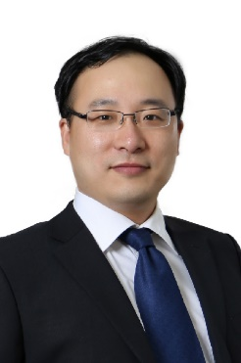
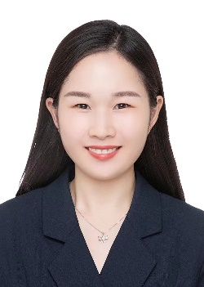
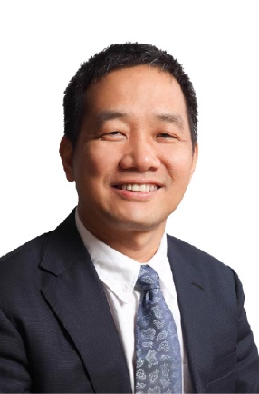
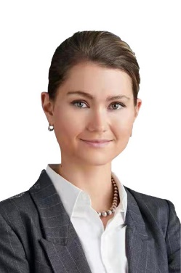
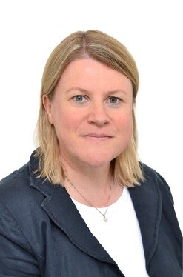
CC China Office 2022-2025
CC China Office:
CC Secretary： ZHU Kai | Manager： ZHANG Yuanhua
Liaison between Secretariat and CC:
SCMD：Tatiana KHANBERG | PAD：Lesley Coldham
CC Chair：YANG Lei

Slide 14
Work Scope of CC China office
 | Category | Description | Contents
1 | Multi-tiered external relations | Follow through the multi-tiered external relations plan. | Urge the committees to reach and liaison with agreed international organisations. Work with the Presidency’s office and IGU Secretariat to follow through the multi-tiered external relations plan.
2 | Management on the work of committees and task forces | Management on the meeting and research plan of committees and task forces. | Assist the committees to recruit members and appoint secretaries; set close ties with all committees. Attend committees meetings. Follow up the research activities on the common topics and urge the publication of flagship reports. Annual assessment of the committees’ work. Organise CC meetings.
3 | WGC2025 session topics design | Assist the NOC to design and develop session topics and activities. | Study and analyse the session design of previous WGCs. Develop and finalise the session topics for WGC2025 in view of the committees and TFs’ work.
4 | Research results sharing and China’s engagement | Share the Committees and Task Forces’ work progress and results within the IGU and with potential stakeholders, together with IGU Secretariat. | Collect and categorize the research results of the committees and TFs, and share them within the Committees and TFs. Organise together with IGU Secretariat for the distribution of these results to all IGU members and potential stakeholders (e.g. China’s gas industry players). Mobilise China’s gas industry players to participate in the committees and task forces.

Slide 15
Introduction to the TWP2022-2025
3

Slide 16
Theme and Aims of the TWP2022–2025
The IGU has seen significant changes in the past years — changes driven by energy transition, climate change and net zero targets, which resulted in shifting of the IGU members’ focus and evolving into a broader concept of gases.
Themed Maximising Gas Benefits, the Triennial Work Programme 2022–2025 has been designed to reflect such changes, and to facilitate the delivery of the IGU’s core missions in a future-oriented manner.
Through the TWP, we aim to:
Transform previous reform achievements into stronger IGU advocacy performance and greater value for members;
Streamline the IGU’s workflow for efficiency and cohesion;
Continue the momentum of reform in preparation for the future.

Slide 17
TWP2022–2025: A Single and Integrated Plan for the IGU
The TWP 2022–2025 is the first single and integral work plan for the IGU. The IGU needs such an overall work program to guide its work in the triennium, in order to best represent the voice of gas in the new context.
By engaging all the IGU working units to draft the TWP, the document attempts to enhance the cohesion and coordination in the three-year work and tap the union’s potential to the maximum.
Internally, enable information flow and enhance cooperation, facilitate members’ participation;
Externally, bridge IGU and external stakeholders.

Slide 18
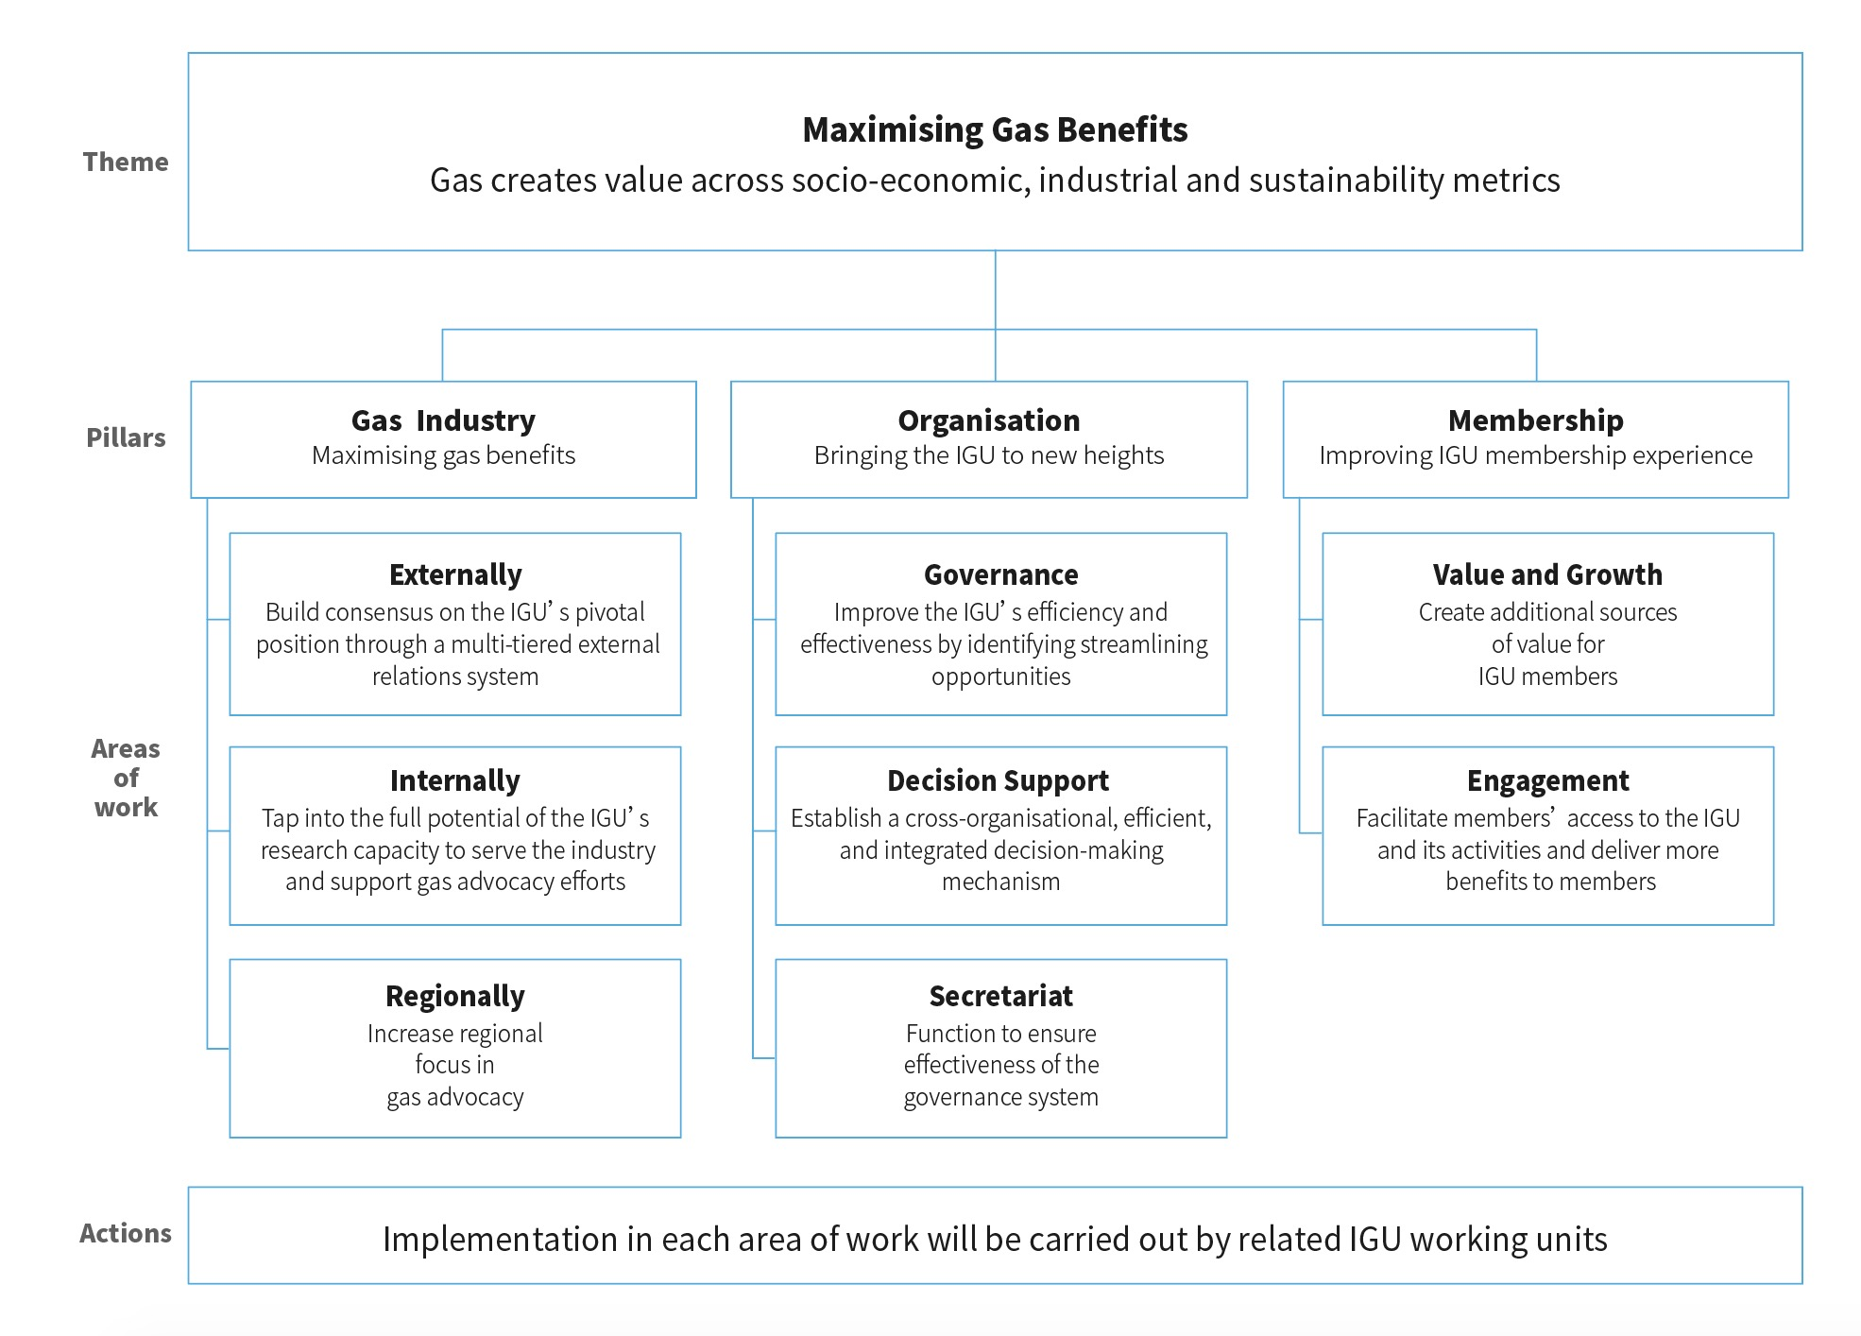
Strategic Guidelines

Slide 19
Key Actions in the Triennium
Establish a multi-tiered external relations system to magnify the global voice of gas.
Establish three task forces：
Strategic Communications and Outreach Task Force (TFS) — provide guidance and supervision for the IGU’s strategic advocacy.
Carbon Neutrality Task Force (TFN) — leading the IGU to engage in the global low carbon development and tackle climate change.
Digitalisation Task Force (TFD) — respond to the digitalisation issue in the gas industry.
Enhance regional representation by empowering Regional Coordinators.
Restructure Committees and set common topics to improve research quality and efficiency.
Establish a rapid reaction mechanism to analyse and tackle challenges and risks facing the gas industry, the IGU, and the IGU members, and establish a rapid deliverable mechanism to release research progress to inform members and stakeholders and provide opportunities to contribution to the research.

Slide 21
Flagship Events

Slide 22
Exhibition & Sponsorship Inquiries: exhibition@lng2023.org
Call for Abstracts Inquiries: papers@lng2023.org
About Vancouver: www.destinationvancouver.com
About the Host: www.cga.ca

Slide 23
Steering Committee, March 2022. NOC’s project management met all requirements
Sponsorship commitments from 22 companies
www.igrc2024.com and quarterly webinar series focusing on Innovation both launched
Co-ordination with IGU RD&I Committee Chair (IGRC Programme Committee Chair)

Slide 24
70 countries
600 companies
6,000+ conference delegates
36,000+ visitors
80 sessions
600 speakers
360 exhibitors
42,000㎡ of exhibition floor
Contact us:
conference@wgc2025.com
exhibition@wgc2025.com
sponsor@wgc2025.com

Slide 25
IGU Committees and Task Forces
4

Slide 26
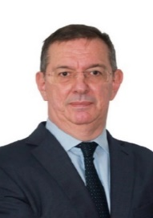
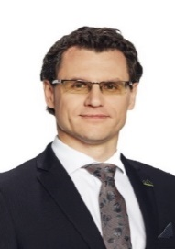
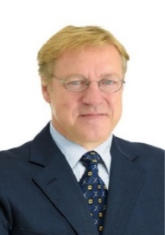
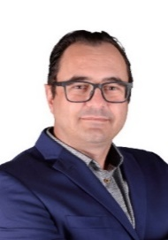
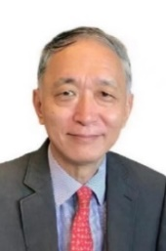
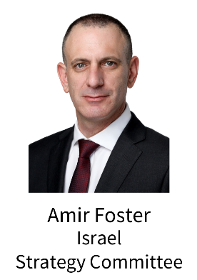
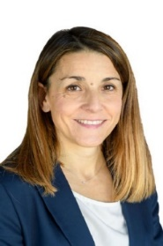
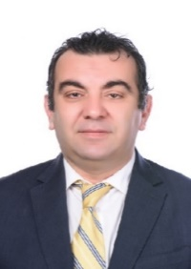
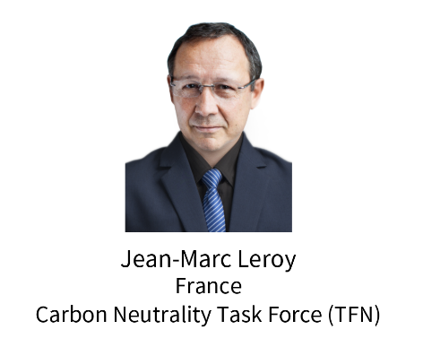
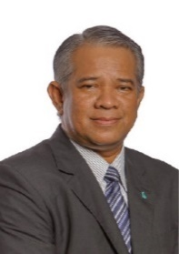
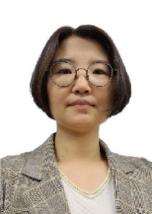
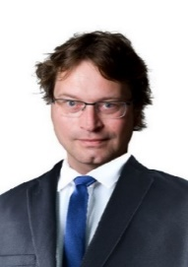
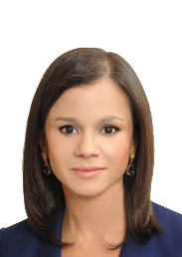
Chairs of Committees
Chairs of Task Forces
Mi Jung Nam
Korea
LNG Committee

Slide 27
Vice Chairs of IGU Committees
Committee | Members Entrusted | Vice Chairs
Exploration & Production | Malaysia | Mr. Aidid Chee Tahir
Storage | Germany | Mr. Amel Abdel Haq
Transmission | Belgium | Mr. Rudy Van Beurden
Distribution | France | Mr. Stéphane Grit
Utilisation | KOGAS | Mr. Yong Shin KIM
R&D and Innovation | USA | Dr. Duncan Robinson
Sustainability | UK | Mr. Jon Freeman
Strategy | China | Ms. KANG Yan
Gas Markets | Brazil | Mr. Rafael Lamastra Junior
LNG | Japan | Mr. Atsuo Kanno
Marketing & Communications | Slovakia | Mr. Juraj Adamica

Slide 28
Results of members recruitment
Unit | Number of member | Number of Country
E&P | 16 | 10
Storage | 32 | 16
Transmission | 29 | 16
Distribution | 40 | 23
Utilisation | 27 | 14
Sustainability | 39 | 23
Strategy | 42 | 21
Gas Markets | 41 | 20
LNG | 54 | 25
Marketing & Communications | 23 | 16
RD&I | 49 | 20
TFS | 12 | 8
TFN | 18 | 7
TFD | 11 | 5
Total | 433

Slide 29
Research Fields of Committees
Main research fields of the Committees | E&P | Trans-mission | Storage | Distri-bution | Utilisation | Strategy | RDI | Gas Markets | LNG | Marketing & Communications | Sustain-ability
Digitalisation | √ | √ | √ | √ | √ |  | √ |  | √
New Gases |  | √ | √ | √ | √ |  | √ | √ | √ |  | √
Best practices | √ | √ | √ | √ |  | √ | √ | √ | √ | √ | √
Technology | √ | √ |  | √ | √ |  | √ |  | √
Carbon neutrality | √ | √ | √ | √ | √ |  | √ | √ | √ | √ | √
Policy and regulation |  | √ | √ | √ |  | √ | √ | √ |  |  | √
Business competition | √ |  | √ |  |  | √ | √ | √ | √ | √ | √

