Slide 1
Innovations projects in NAFTA
5.10.2022
IGU Delegate meeting – Bratislava 5.10.2022

Slide 2
AGENDA
1
Introduction
2
Energy storage
3
Actual projects
4
Summary
IGU Delegate meeting – Bratislava 5.10.2022

Slide 3
Introduction
IGU Delegate meeting – Bratislava 5.10.2022

Slide 4
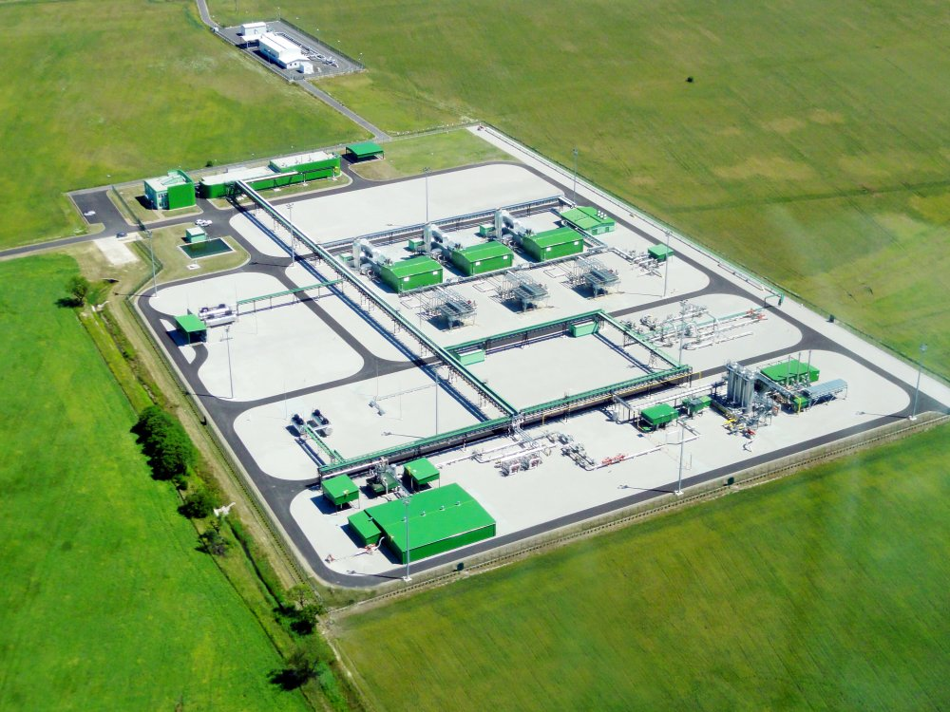
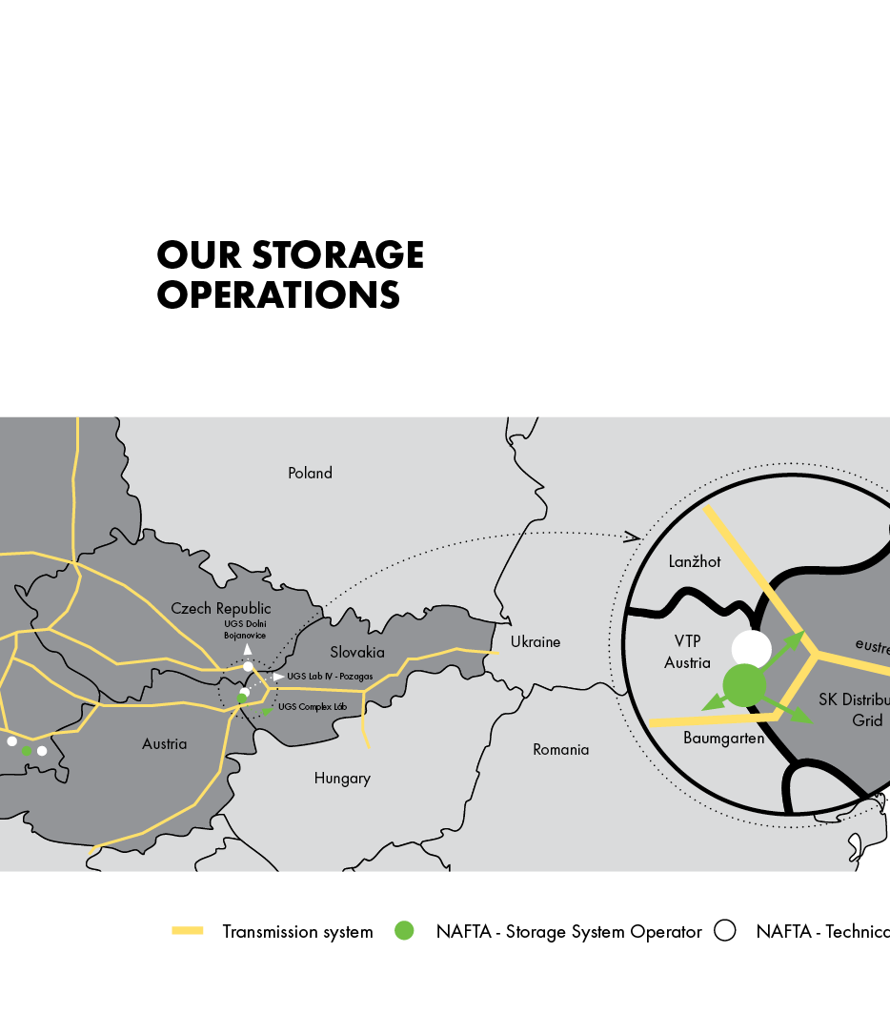
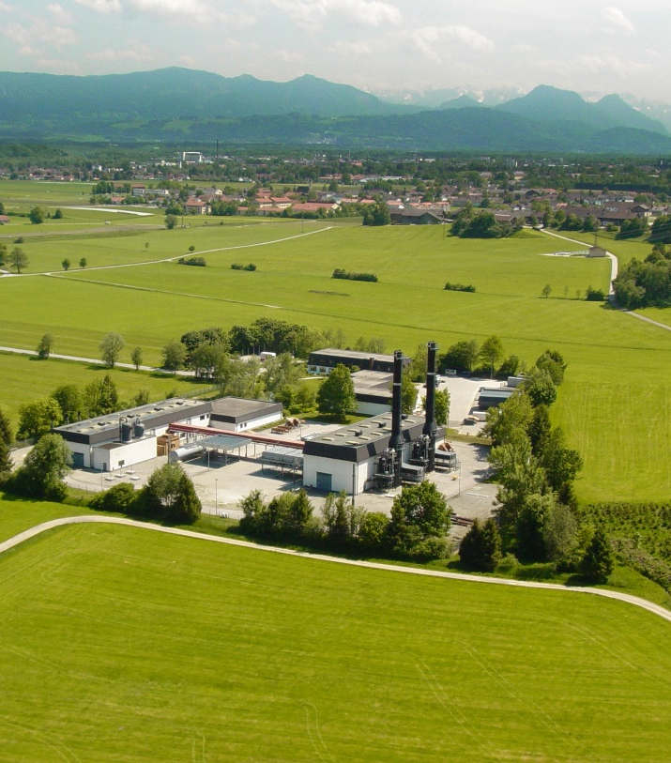
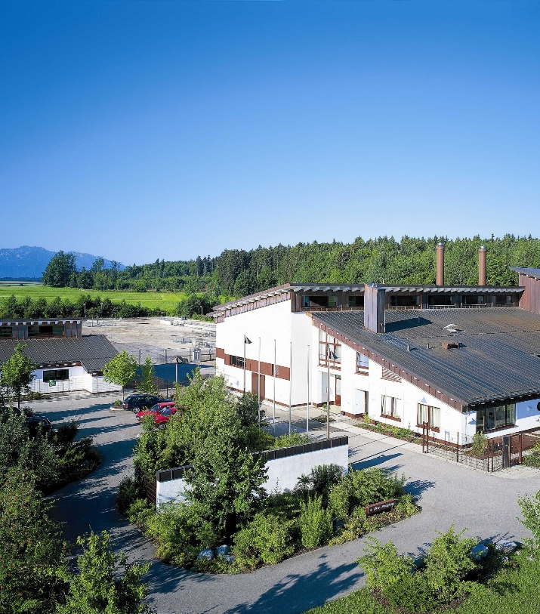
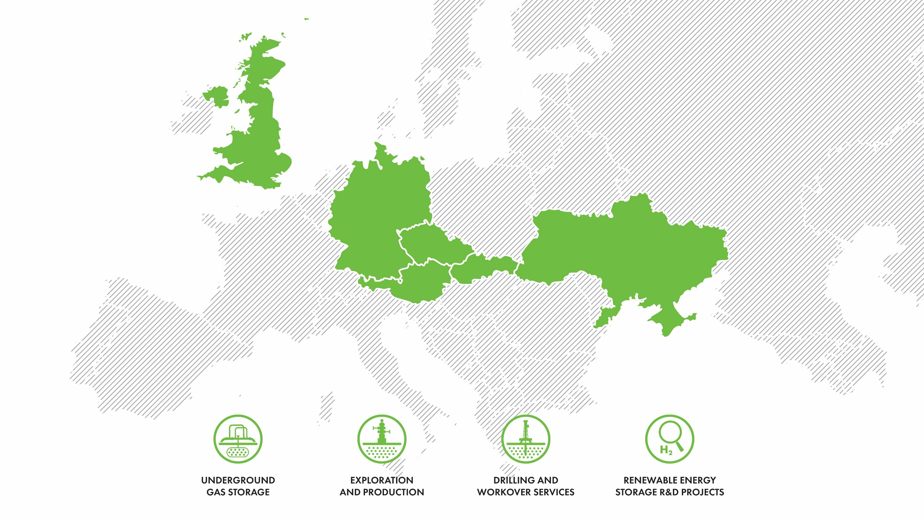
NAFTAS introduction
NAFTAs Introduction
NAFTA the 6th biggest underground storage operator in Europe with total capacity of approx. 60 TWh
IGU Delegate meeting – Bratislava 5.10.2022

Slide 5
02
Energy storage
IGU Delegate meeting – Bratislava 5.10.2022

Slide 6
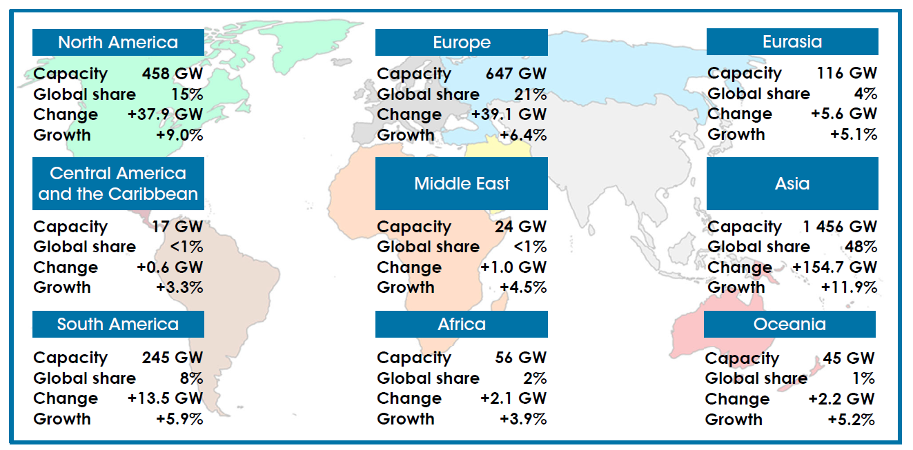
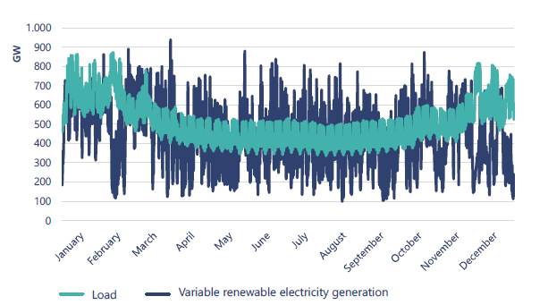
Energy storage
Why we will need an energy storage ?
Hourly variable renewable electricity generation and load, EU27 and UK, 2050²
Renewable generation capacity by the region¹⁾
GROWTH of RE generation capacity
Differences between the consumption & production during the winter / summer – seasonal storage is needed
Increasing of time with excess of the energy
Increasing of time with lack of energy
¹⁾ IRENA renewable capacity Highlights (11.4.2022)
²⁾ GIE 6/2021 - Picturing the value of underground gas storage to the European hydrogen system
IGU Delegate meeting – Bratislava 5.10.2022

Slide 7
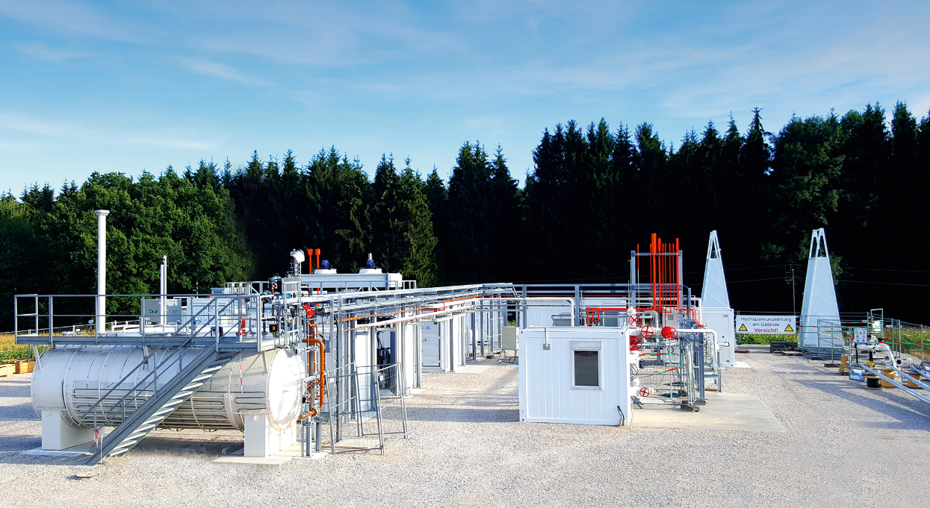
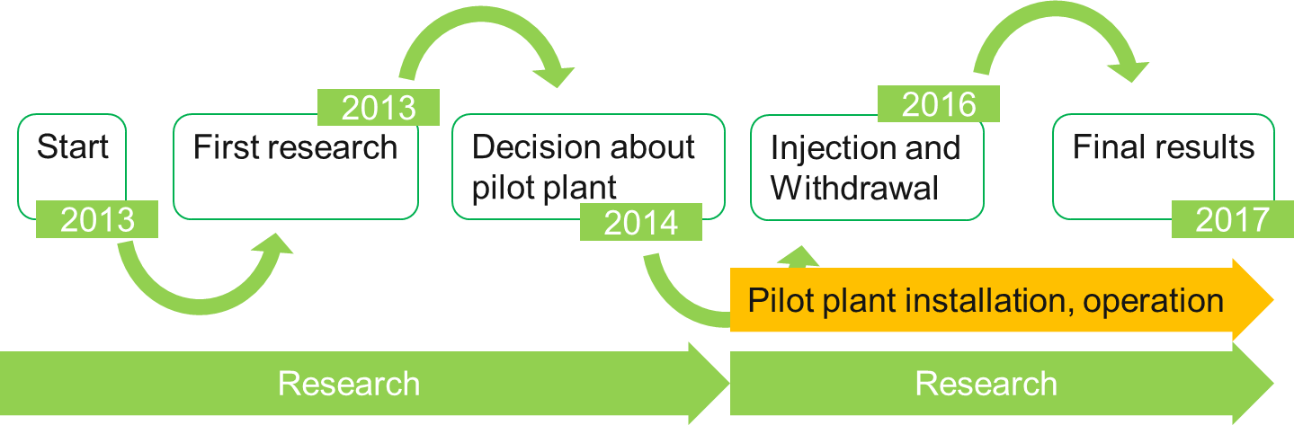

Energy storage & NAFTA
Demonstration of Storability of the renewable gases in Gas Storage facilities
Research of effects of hydrogen admixtures in existing Gas Storage Facilities
IGU Delegate meeting – Bratislava 5.10.2022

Slide 8
03
Actual projects
IGU Delegate meeting – Bratislava 5.10.2022

Slide 9
Actual projects
Future system
Blended gas
Pure H2
Synthetic methane / biomethane
Current situation
Storing of natural gas
The future is an integrated & resilient infrastructure comprising modified existing gas infrastructure with renewable power sources & storage green gases
IGU Delegate meeting – Bratislava 5.10.2022

Slide 10
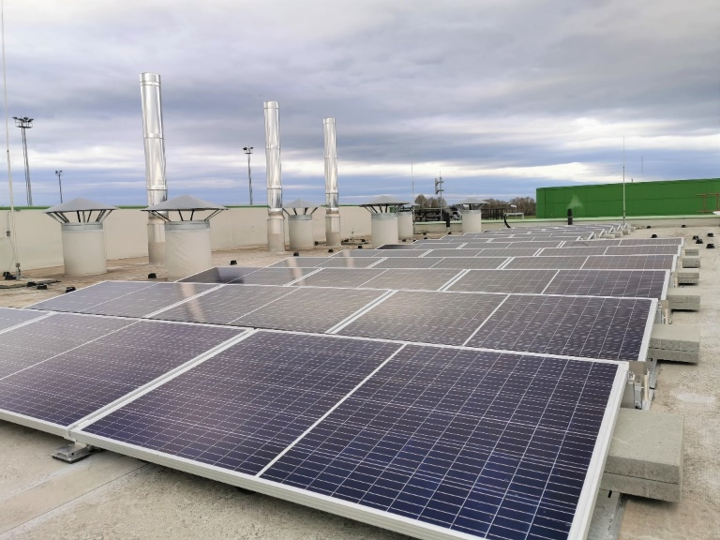

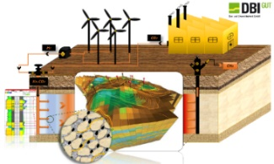
Where we are now?
Development pathways
Blending of H₂
into the NG
Pure H₂
Synthetic methane
PV plant
HyUSPRe
Project BIO-UGS
Assessment of 5% H₂
Impact to UGS
Project H2I-S&D
Project H2EU+Store
IGU Delegate meeting – Bratislava 5.10.2022

Slide 11
Assessment of 5% H2 - Impact to UGS
Internal methodology for UGS assessment created
Reservoir
Wells
Surface technology
Created checklist
H₂ impact on the performance parameters (e.g. WGV)
H₂ impact to the geochemical reaction
H₂ impact to the microbial reaction
Other test defined
In realisation via cooperation with research institution and university
Based on the existing data, storing of 5% H₂ in the mixture with natural gas is feasible
IGU Delegate meeting – Bratislava 5.10.2022

Slide 12
Assessment of 5% H2 - Impact to UGS
Internal methodology for UGS assessment created
Reservoir
Wells
Surface technology
Created checklist
H₂ impact on the well integrity
H₂ impact to the materials
H₂ impact to the cement
H₂ impact to the well equipment
Based on the existing data, storing of 5% H₂ in the mixture with natural gas is feasible
IGU Delegate meeting – Bratislava 5.10.2022

Slide 13

Assessment of 5% H2 - Impact to UGS
Summary
Based on the existing data, storing of 5% H₂ in the mixture with natural gas is feasible without the huge investment
With higher H₂ concentration the investments will increase
From certain H₂ concentration level there is no difference between the investment cost to store pure H₂ and mixture of H₂ with natural gas
In case of storing pure H₂ in depleted gas field – the separation technology for purification of H₂ will be crucial
IGU Delegate meeting – Bratislava 5.10.2022

Slide 14

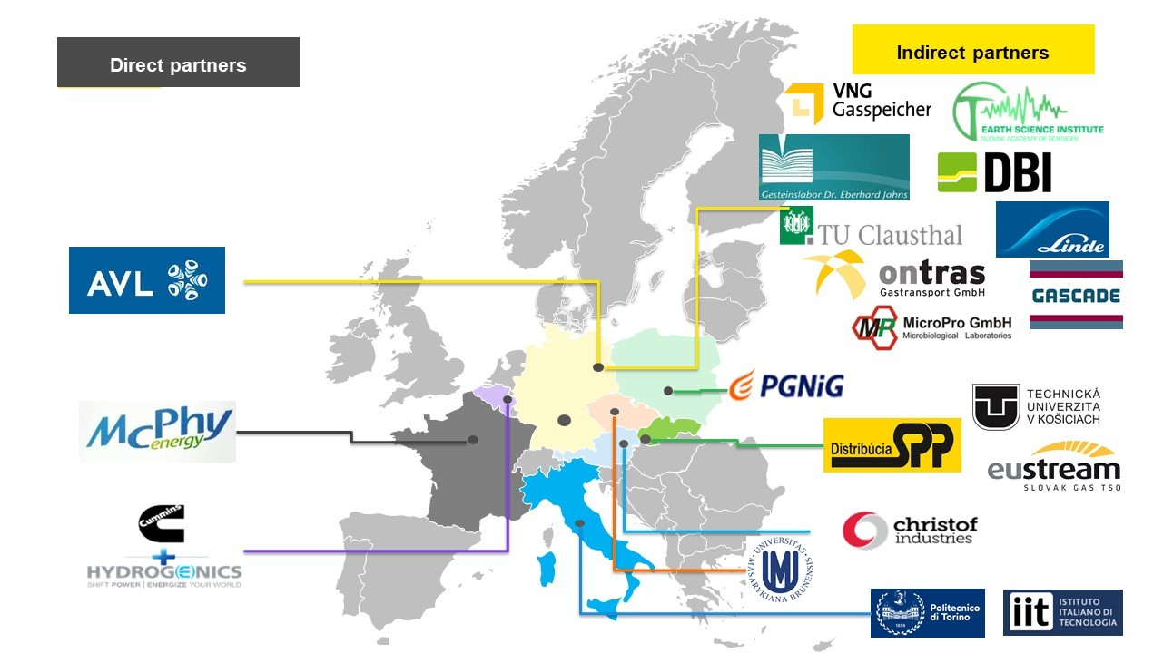



Project H2I-S&D
  Identification of suitable structure for storing of H₂ in Slovakia
  Definition of methodology for reservoir assessment
  Based on R&D phase definition the max suitable H₂ storing concentration
Project received status IPCEI based on EC decision
  Pilot technology for confirmation the research at real condition
IGU Delegate meeting – Bratislava 5.10.2022

Slide 15
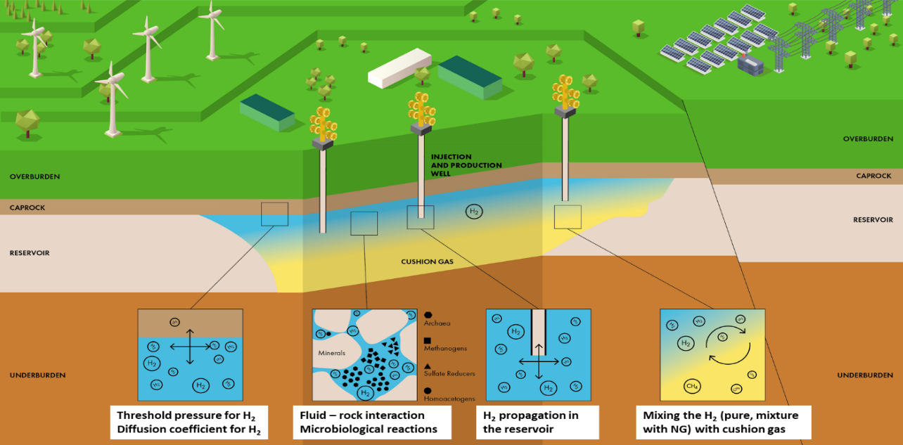
Project H2I-S&D
Project Duration: 2022 – 2029 (based on call)
R&D phase
FID phase
Laboratory experiments
  Geochemical interaction
  Microbial interaction
  Testing of materials
Modelling of the reservoir
Building the technology for H₂ production and related storing technology
Testing the H₂ purification technology
IGU Delegate meeting – Bratislava 5.10.2022

Slide 16
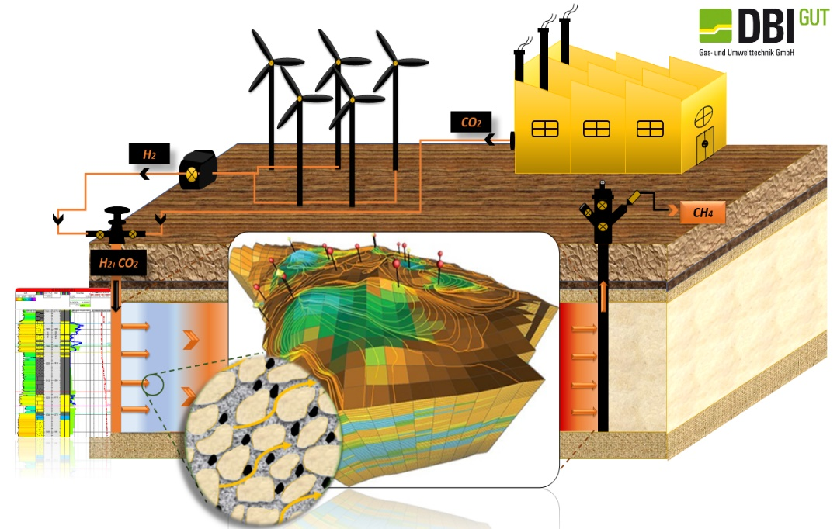
Project BIO-UGS
  Identification of possibility to use UGS in Germany for microbial production of synthetic methane
Collection of materials
Research
Outcomes
Project timeline: 2020 – 2023
Project leader: DBI-GUT
Role in project: NAFTA – partner
Preliminary results
At least one from our UGS in Germany seems to be feasible for methanation process
IGU Delegate meeting – Bratislava 5.10.2022

Slide 17

PV plant
1. step
  Small installation – top of the building – already finished and in operation
  2. step
  Installation in MW scale – under preparation
IGU Delegate meeting – Bratislava 5.10.2022

Slide 18
04
Summary
IGU Delegate meeting – Bratislava 5.10.2022

Slide 19

Summary
Storing of 5% H₂ is realistic without the large investment cost
R&D and pilot projects are needed to confirm feasibility for storing of higher % of H₂
The legislation in Europe is missing, however seems that the process is starting – EU gas package 12/2021
Microbial methanation could be feasible – using methane in existing infrastructure is proofed and well known
UGS is part of the transition and will be definitely needed in the future energy system
IGU Delegate meeting – Bratislava 5.10.2022

Slide 20
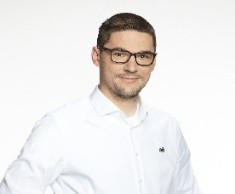
Thank you
Contact:
Roman Zavada
Head of Innovation Unit
roman.zavada@naft.sk
IGU Delegate meeting – Bratislava 5.10.2022

