Slide 1
Progress on the IGU’s Triennium Strategic Plan
Coordination Committee
Sept-Nov 2017 Update
Mel Ydreos – Executive Director, Public Affairs and
Chair, Coordination Committee
Rod Rinholm – Acting Chair, Coordination Committee
Anette Sorum Nordal – Secretary, Coordination Committee
Terence Thorn – Sr. Advisor, USA Presidency

Slide 2
Agenda
General IGU Updates
Update on the Triennium Strategic Objectives
WGC 2018 Progress and Committee Guidelines
Call for papers and Committee Sessions
  review of papers (guidelines from CWC)
  important dates
  committee session preparations
Committee Reports
  Final templates
  Executive Summary: content, aim
  Timeline
Upcoming Events
  CC Meeting – Tokyo, Japan
  Safety Summit – Washington DC, USA

Slide 3
General IGU Updates

Slide 4

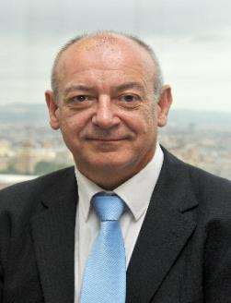



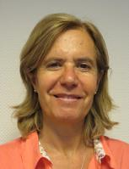

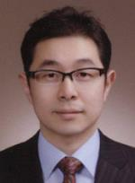
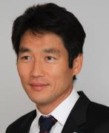


IGU Secretariat
Secretary General
Luis Bertrán
IGU Director
Rafael Huarte
Chief Advisor
Antonia
Fernández
Corrales
Executive
Assistant
Luisa Peris
Administration
Consultant
Emma
Siobhan Paños
Advisor
Hyunchang Kim
Senior Advisor
Taeksang Kwon
CC Secretary/
Information
Consultant
Anette Sørum Nordal
Event Director
Rodney Cox

Slide 5
Update on the
Triennium Strategic Objectives

Slide 6
IGU Strategic Direction 2015-2018 Triennium
AREAS OF TRIENNIUM STRATEGIC FOCUS
Access Markets Social License
TRIENNIUM OBJECTIVES
Grow the global gas
market share
Key decision, policy makers and global agencies accept gas as an ally for their global/regional/local development and growth
Credible global Voice of Gas by being an advocate towards political, technical and economic progress of the gas industry
Support and facilitate innovation and industry best practices while delivering member value
TRIENNIUM GOALS
Effectively differentiate gas from the other fossil fuels
Advocate policies that support the greater use of gas including the key role in mitigating climate change and improving air quality
Advocate for the removal of market barriers that would result in greater use of gas
Effectively operationalize MOU’s with Strategic Partners
Engage in major events/opportunities to raise support for natural gas
Become active in relevant and important evolving developments
Increase profile of IGU reports, visitors to the Global Gas Portal and LinkedIn
Become relevant to key international journalists
Deliver an outstanding IGRC & WGC 2018
Effective communications and access to IGU’s leadership
Integrated Triennial work plan
Global focus; Regional impact
Increase member engagement in IGU related activities
Strive for “100”

Slide 7






Grow the Global Gas Market Share
Participated on the G20 ESWG and tabled the Clean Marine Transport report. Excellent reference to natural gas in the Summit Communique.
Group of Experts on Methane Emissions meets regularly. Excellent engagement within the group and with the IEA
Released the 2017 editions of the LNG and Wholesale Price Reports. Excellent media pick up and website traffic relating to these reports.
Greater engagement with Strategic Partners on key industry issues. Planning for participation at COP 23.

Slide 8



Gas Accepted as an Ally
New Case Studies reports on the Methane Challenge and 3rd Edition of the Clean Air report
First IGU Media day held on September 20th in London UK
Revised Strategic Partnerships approach to effectively operationalize our work with strategic partners under way and well focused. First execution of strategy: UNEP-IGU event, mid-September.
IGU Diplomatic Gas Forum to be held at the Canadian Embassy in Washington D.C. and in the Gas Natural Fenosa offices in Madrid
Notes:
First execution of strategy: UNEP-IGU event MID-SEPT
in order to present the role of the gas in achieving the sust. Dev. Goals and sharing criteria and sharing next steps for deeper collaboration. AFTER THIS MEETING: EXTEND TO ALL OUR PARTNERS. Incoming committee chairs to participate.

Slide 9

Communications and Outreach Plan 2018

Slide 10





Credible Global Voice of Gas
Updated and modernized the website
Launched the 1st Edition of the Global Gas Insights pocketbook
Continued presence on Twitter and LinkedIn with over 3500 followers
Continuing to reach out and build relationships with the major global media outlets and journalists. Frequent contact from global journalists.
Strong progress on the organization of WGC 2018 with input from the National Organizing Committee, host partners and the Financial Advisory Board

Slide 11






Deliver Member Value
Continue to evolve the monthly newsletter. Committee contributions are required. Increased the frequency of communications with the Executive Committee and Council
Facts and Figures section on igu.org has been completely redesigned, research has been completed and expect to launch new section in January, 2018
Developed a new Membership Brochure in support of the IGU Marketing Plan
IGU members discount for LNG 2019

Slide 12

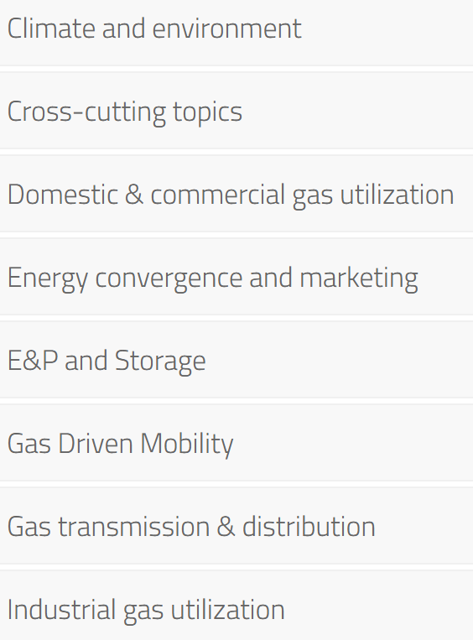
Conference Topics
Successful event held
  300+ attendees
  400+ approved papers and presentations
Plenary sessions
  Natural Gas and Renewable Energy
  Innovations in the Gas Value Chain
  The Brazilian Gas Industry
Major themes and messages
  Critical role of technology and innovation across gas value chain
  Environmental/methane emissions
  Integration and cooperation with renewables
May 24-26 2017

Slide 13
WGC 2018 Progress and Committee Guidelines

Slide 14

Update on WGC 2018 Program

Slide 15
WGC 2018 Status Report
Exhibition – 90% of space allocated
  Numerous specialized pavilions
Sponsorship – Hosts/Principals/Globals/Diamonds confirmed
Conference
  Keynote sessions
  Luncheon sessions
  Current Issues Debates sessions
  Industry Insights Sessions – Call for Abstracts
  Technical and Innovation Center – conducted on floor of exhibit hall
Social Events
Engagement with outside audiences
  Diplomatic Corps
  Washington, DC based policy makers
  Customer Groups
  Regulatory Authorities
  Financial Community
  LPG
  Young Professionals
  STEM
Ongoing and Upcoming Marketing Activities wgc2018.com
  Newsletters, global events, USA events, CWC events
Notes:
A. Exhibition coming along very nicely, with over 90 percent of the space allocated. Numerous specialized pavilions including Showcase America — over 50 companies; Gas for Transportation; Robotics and Automation (copy of latest floorplan attached);
B. 43 Keynote Speakers confirmed — all at CEO or Ministerial level (copy of latest listing is attached)
C. Social events well in hand — Presidents Dinner at National Air and Space Museum; Opening Reception at Union Station
D. Very strong engagement with outside organizations — Sept. 26 event at the Canadian Embassy; Over 30 Members of US Congress and Senators have signed on as Honorary Members of the National Organizing Committee.

Slide 16
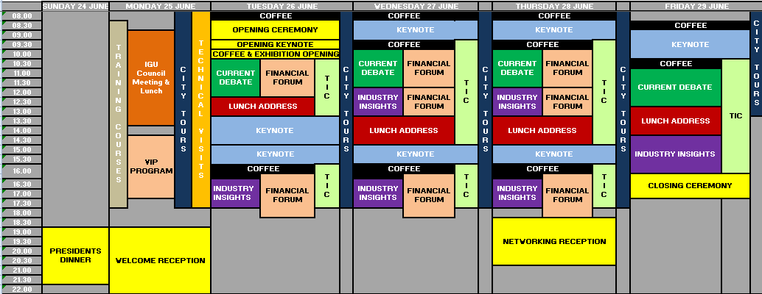
Program Overview
NB: Timings subject to change

Slide 17
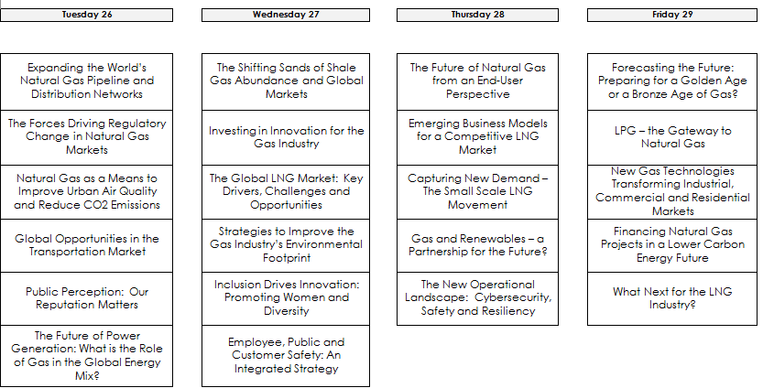
Current Debate Sessions
Notes:
The 22 Current Debate sessions represent the most timely and topical strategic, commercial and technical issues facing the global gas industry. We are currently populating all of these sessions with very senior level speakers from throughout the gas value chain, from government, from consulting firms, from the financial community, from customer groups, from NGOs and a wide variety of constituencies. We expect this speaker group to be very diverse, and from across the globe.

Slide 18
Committee Sessions at WGC2018
68+ sessions currently defined by committees and task forces
  Industry Insight Sessions
  Technical and Innovation Center (TIC) Sessions
1000 abstracts received
Opportunity for additional II and TIC sessions based on Call for Abstracts results

Slide 19
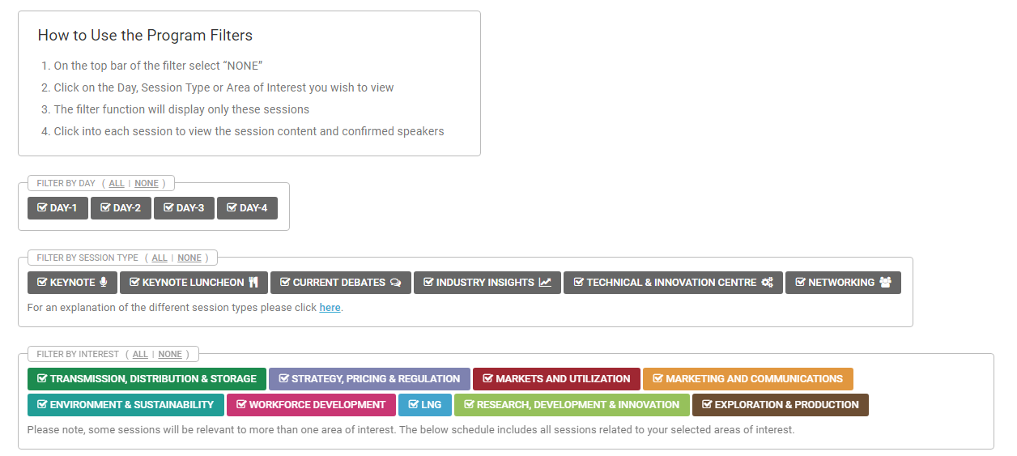
How to use the Program filter function
Notes:
We are particularly excited about the program filter function on the WGC website. Simply by clicking on the type of session you are looking for, you will be able to plan out your entire week. For example (SLIDE 21), if you are interested in all sessions relating to LNG, by using the program filter function, you can see how you would spend your week attending the various LNG sessions, and this cuts across the keynotes, the luncheons, the Current Debates, the Industry Insights and the Technical and Innovation Center.

Slide 20
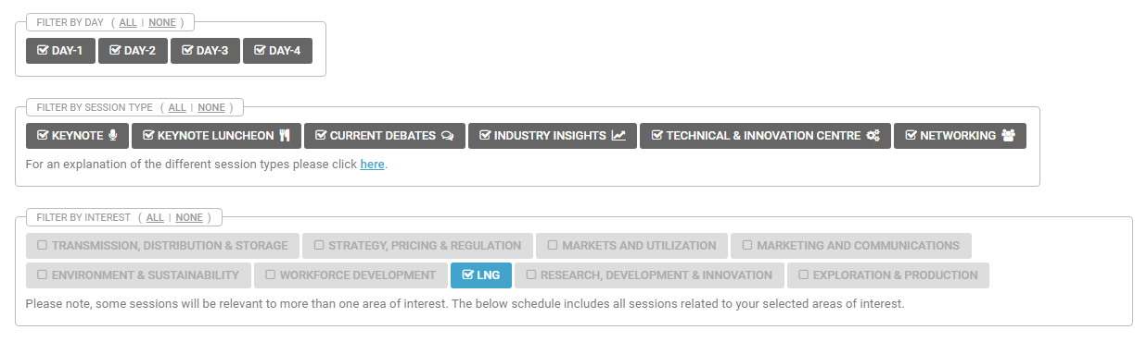
Example: Searching for LNG Sessions
Leave all boxes ticked
Select “NONE”
Select “LNG”

Slide 21
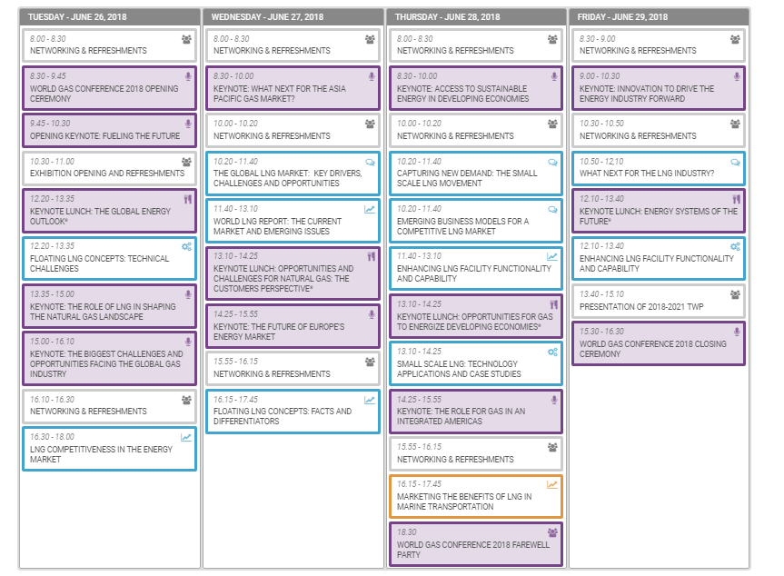
“LNG” Filter Results
Notes:
Concluding remarks:
Most importantly, we would encourage all committee members to register as soon as possible. The IGU headquarters hotel is the three year old JW Marriott; it is physically connected to the Convention Center, and will be the site of all meetings. While we have 1,100 rooms at this hotel, they are going fast and we would hope that all IGU members will be staying in this hotel. But, to do so, you will need to register for the conference as soon as possible (to take advantage of the early bird rate — which closes on Jan. 31 — but, waiting until then does not guarantee that you will get into the Marriott).

Slide 22
WGC 2018
Call for Abstracts - Reviewing Process

Slide 23
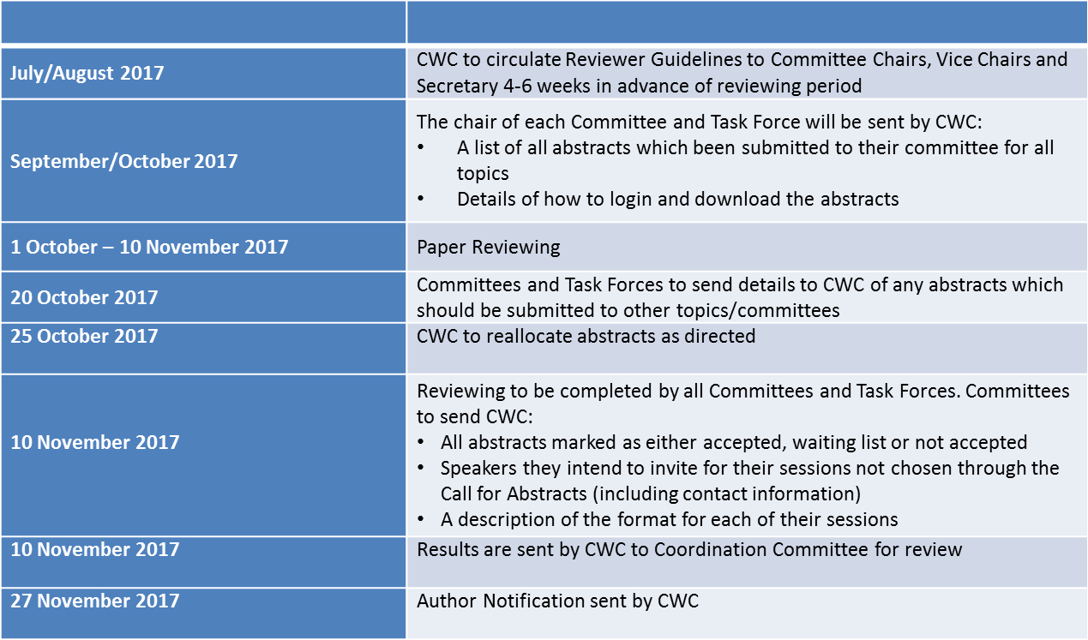
KEY DATES

Slide 24

REVIEW PERIOD
When will committees be given details on the reviewing process?
4-6 weeks in advance of the reviewing period
This will include the criteria for scoring and log in details for the online portal
When can committees view the abstracts that have been submitted?
Committees will be provided access to the online portal on October 1, 2017
CWC working with committees who have meetings scheduled in advance of this date to provide them with the abstracts in time for their meetings
How will committees review the abstracts?
You will be able to access the abstracts via the online portal
Through the portal you will be able to view, download and score submissions
What format do the abstracts take?
Either text (maximum 1,000 words) or video (maximum two minutes)

Slide 25
WGC 2018
How to Use the Reviewer Portal

Slide 26
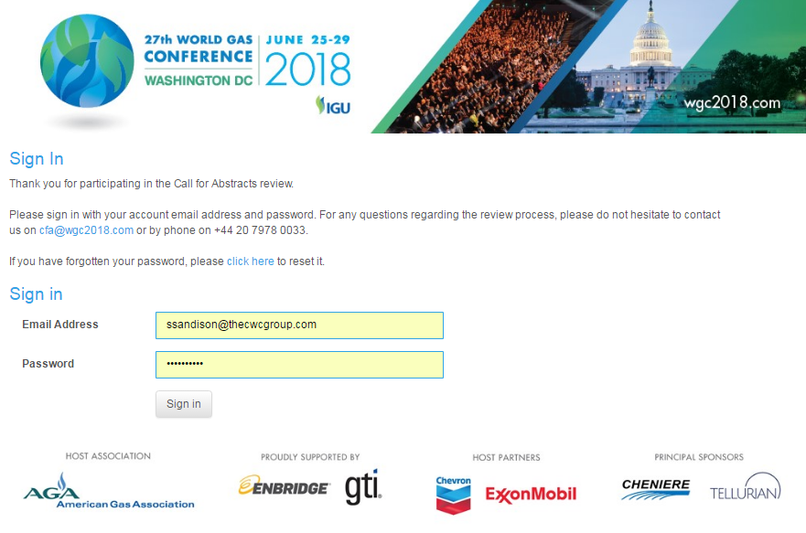
Sign in Page
1. To enter the Reviewer Portal and access the abstracts, please use the following link: https://cwc.eventsair.com/wgc-2018/review-portal
2. Enter your username and password. This will be sent to you by email on the date reviewing for your committee opens.

Slide 27
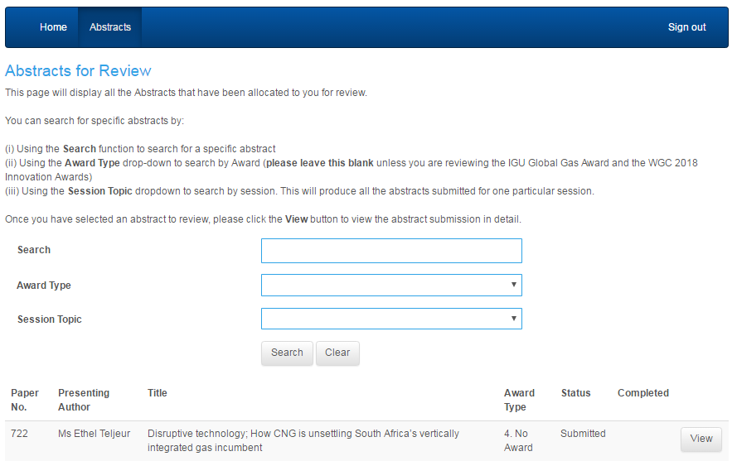
Searching for Abstracts by Session
3. On entering the Reviewer Portal you will be to see the full list of abstracts which have been allocated to your committee . Instructions for how to search for each session are included in the web page and in the Reviewer Guidelines.
Please leave this section blank
Click View
Please select the session topic you wish to view from the drop down menu

Slide 28
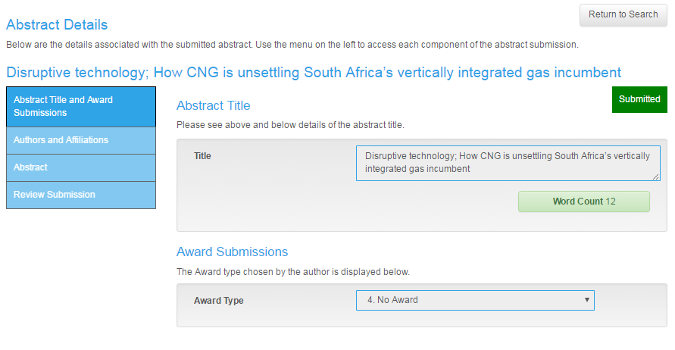
Viewing the Abstract
4. Once you have opened the abstract, you will see four tabs to the left hand side of the page:
The Abstract Title and Award Submissions tab contains details of the abstract title.
The Authors and Affiliations tab contains the name of all abstract authors, their company and their biography.
The Abstract tab contains the abstract.
The Review Submission tab is the section in which you can score the abstract.

Slide 29
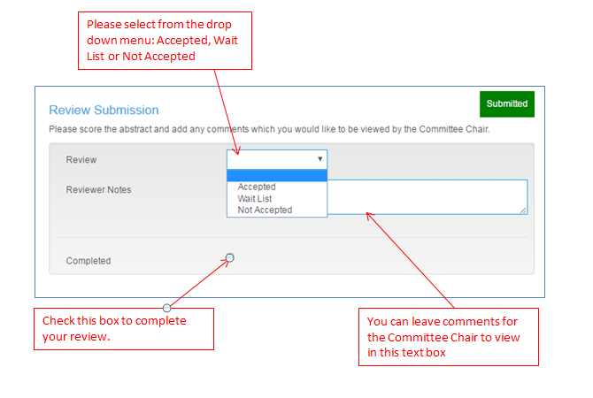
Scoring the abstracts
5. Once you have read the abstract, please select from the following options in the Review Submission tab: “Accepted”, “Wait List” or “Not Accepted”. If you have any additional comments for the Committee Chair please leave these in the “Reviewer Notes” section.
All scores and comments submitted through the Review Portal will be made accessible to the Committee Chair to download and view.

Slide 30
Additional Information
In addition to viewing the abstracts in the Reviewer Portal, you will also be sent:
    A PDF booklet containing all the abstracts submitted to your committee session; these will be sub-divided by session topic.
    An excel document with a list of all the authors who have submitted their abstract, author information and a link to each of the abstracts. This will be sub-divided by session topic.
Contact Us
If you cannot view the abstracts properly or need further assistance, please do not hesitate to contact Zeinab El-Sayed, Speaker Manager WCG 2018, by email on cfa@wgc2018.com or by phone on + 44 20 7978 0074.

Slide 31
Outcome of Committee Review
Accepted Abstracts | 4 - 5 abstracts to be marked as Accepted for each committee session
Wait List Abstracts | A minimum of 3 abstracts to be marked as Wait List for each committee session Note: In the instance an accepted author is unable to attend, the Committee Chair will be contacted to confirm who on the Wait List they wish to invite as a replacement.
Not Accepted Abstracts | All remaining abstracts to be marked as Not Accepted
Session Format | Industry Insight Sessions Committee must choose from: o Presentations and Q&A o Panel Discussion with Q&A
 | Technical and Innovation Center Sessions Committee must choose from: o Presentations and Q&A o Panel Discussion with Q&A o Live Demonstration o Poster Display

Slide 32
Outcome of Committee Review
Moderator | Each session must be assigned a moderator. Please provide contact Information.
Session Titles | Committees to confirm any changes they wish to make to session titles following the review of your abstracts.
Additional Sessions | Committees to indicate if there are any additional sessions they wish to add to the conference following the review of your abstracts.
Other speakers | Committees to provide contact Information for any speakers who have been selected to present that have not been chosen through the Call for Abstracts and indicate which session they are to be invited to speak in.
Speaker waivers | Each Committee is allocated two Complimentary One Day Speaker Waivers if needed. Committees to provide the names of the two speakers who will be offered your Committee’s Complimentary One Day Speaker Waivers. Please note, the allocation is for two speakers per Committee and not two speakers per session.

Slide 33
SESSION FORMAT: INDUSTRY INSIGHTS
90 minute sessions
Committee Chair to choose the most fitting format to present session topic:
FORMAT | DESCRIPTION
Presentations | 15 minute PowerPoint Presentation per speaker Question & Answers from audience following Presentations
Panel Discussion | Speakers given 5 minutes to position themselves within session topic No PowerPoint slides are required for this session Dynamic debate and discussion facilitated by the session moderator Question & Answers from audience

Slide 34
SESSION FORMAT: TECHNICAL & INNOVATION CENTER
90 minute sessions
Committee Chair to choose most fitting format to present their session topic:
FORMAT | DESCRIPTION
Presentations | As in previous slide
Panel Discussion | As in previous slide
Digital Poster | Digital poster displayed on plasma screen Questions & Answers from audience
Demonstration Sessions | 15 Minute interactive demonstration of new technology Opportunity for Speaker to show audience how new technology looks, feels and works. Questions & Answers from audience

Slide 35
Awards at WGC2018
Nominees and selections in parallel with Call for Papers
  Global Gas Industry Award
    Awarded at WGC since 2008
    Objective of contributing to the progress of the gas industry through promoting innovation and sustainability
    Theme for 2018: The Role of Natural Gas in enhancing the quality of life, today and in the future
    Winner given monetary award, WGC2018 registration and travel expense coverage
  IGU Innovation Awards
    New award series defined and selected by Research Development and Innovation (RD&I) Committee
    Showcases the latest available technologies furthering the continued growth of the global gas industry

Slide 36
Innovation Awards
Showcases the next big innovations in natural gas
Administered by RD&I Committee
Awards offered in 10 categories
  Exploration and Production (E&P)
  Liquefied Natural Gas (LNG)
  Transmission, Processing and Storage
  Gas Distribution
  Domestic Utilization
Winners will present and receive certificates in dedicated Technical and Innovation Center sessions
Dedicated area near TIC theaters for showcasing winners equipment or innovative processes
  Commercial and Industrial Utilization
  Transportation Driven by Gas
  Digital and Smart Solutions
  Gas and Renewables
  Emissions Detection and Mitigation

Slide 37
Triennium Work Program Reports

Slide 38
Triennium Summary
Brief two-page summary
Gathered in one compendium, printed and distributed at WGC 2018
Should include:
Short description of the committee and its scope of work, incl. study themes, relevance, highlights and insights
Description of the study groups: scope of work, themes of studies, why relevant, study methods, findings and what remains to be done. Any special activities?
See template and guidance document for further guidance
The Marketing and Communications committee to assist in summary review in order to ensure consistent style and language.

Slide 39
Committee Reports
Triennium Study Reports
  Unless committees have made other arrangements, available electronically.
  Should include an abstract max. 2 pages.
See report template and guidance document for further explanations on expectations
In addition, articles of 200-300 words based on study report abstract. Will be used in newsletter/magazine and online channels.

Slide 40
Timeline – Triennium Summaries
TRIENNIUM SUMMARIES:
1 Feb 2018 | Draft triennium summaries to CC leadership
23 Feb 2018 | Review by CC leadership and sent to M&C committee
16 Mar 2018 | Updated summaries to CC leadership and committees
6 Apr 2018 | Final summaries complete and approved for print

Slide 41
Timeline – Committee Reports
COMMITTEE REPORTS:
As soon as possible and at least after Committee meeting second half of 2017 | Share report draft outline
1 Feb 2018 | Share complete draft of report (including abstract) to CC Secretary
28 Feb 2018 | Feedback provided to committee
31 Mar 2018 | Submit final report electronically to CC Secretary

Slide 42
Upcoming meetings

Slide 43
Schedule of CC, EXC & Council meetings
IGU meetings 2015-2018 Triennium | Meeting periods and places | Coordination Committee meetings | Executive Committee and Council meetings | Council workshop
2017 | 24-26 October, Tokyo, Japan | 24 October | 25-26 October | 26 October
2018 | 17-19 April, Cairo, Egypt | 17 April | 18 April
 | 25-29 June, Washington D.C., USA WGC2018 | 24 June |  | 25 June

