Slide 1
Marketing & Communications Committee
Toronto, Canada
October 10-13, Westin Harbour Castle Hotel

Slide 2
Key deliverables and outcomes from Toronto meeting # 5
Committee report: agree on key messages and confirm final actions. Completed
WGC2018 papers: review papers and select for: Completed
3 x Industry Insight speakers
Current Issues session
TIC speakers
Reserve speakers
World gas conference sessions: finalise format, speakers, guest invitations. Completed
Engage Canadian energy stakeholders. Completed
Host *first* IGU podcast Thu am. Completed
How to market our key messages before and during WGC2018. How else can we market/share/broadcast these? Discussed, completed

Slide 3
Key dates for MCC
10-13 Oct 2017 Toronto | MCC meeting #5
Oct 1 – Nov 10 | Paper Reviewing
10 Nov | MCC to send final list to CC
20 Nov | Keith/Tracy/Marcel deliver their part of report to Dimitri
Nov 27 | Author Notification
End Dec/early Jan | Prepare executive summary (2 pages)
1 Feb | Draft Triennium Summary + Draft Report
23 Feb | Summary reviewed by IGU and sent back to ctees
28 Feb | Draft reports reviewed by IGU and sent back to ctees
28 Feb - 2 Mar 2018 | MCC meeting #6 final, IGU office, BARCELONA
Mar 9 | Author Final Paper Deadline
16 March | Updated summary to IGU
31 March | Submit final report electronically to CC secretary
6 April | Final summaries complete and approved for print
 | Rehearsals?
FUELING THE FUTURE

Slide 4
Marketing our report
Report & Toolkit
Full report
Executive summary for full report (1 Feb 2018)
Study Group Leaders to write short article on each specific topic & with one image > for IGU Magazine (3 articles)
One or two PowerPoint slides for the overarching message for all 3 sessions
Hard copies of the report summaries (limited)
3 podcast interviews with SG leaders (in Barca)
Media
Press kit for magazine w interview options, visuals, photo…
Raise media or conference newspaper interest at WGC
Distribute report via existing channels of the IGU
WGC flyer and twitter feed
WGC / IGU Channels
LinkedIn posts
Articles on IGU.org
Twitter feed
CWC distribution list (via Tracy)
Our Network
Send e-mail report and summary
Send promo link and report to speakers, MCC members, MCC former members etc..
Every member to pitch in 10 important contacts
Booth on the trade floor for members
Suggest ‘triggering’ pre-cooked tweets (preferably with photo or video)
Promote joining MCC next triennium

Slide 5
Agenda Barcelona
Confirm marketing campaign
Confirm session content
Confirm overarching ‘story’ for Barbara’s intro (prep Dimitri/Hansch)
Insight session: calls with the panel
Do podcasts with IGU Secretariat and SG leaders on their topic

Slide 6
Reminder of the initial goals
FUELING THE FUTURE

Slide 7
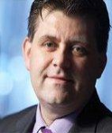
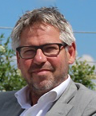
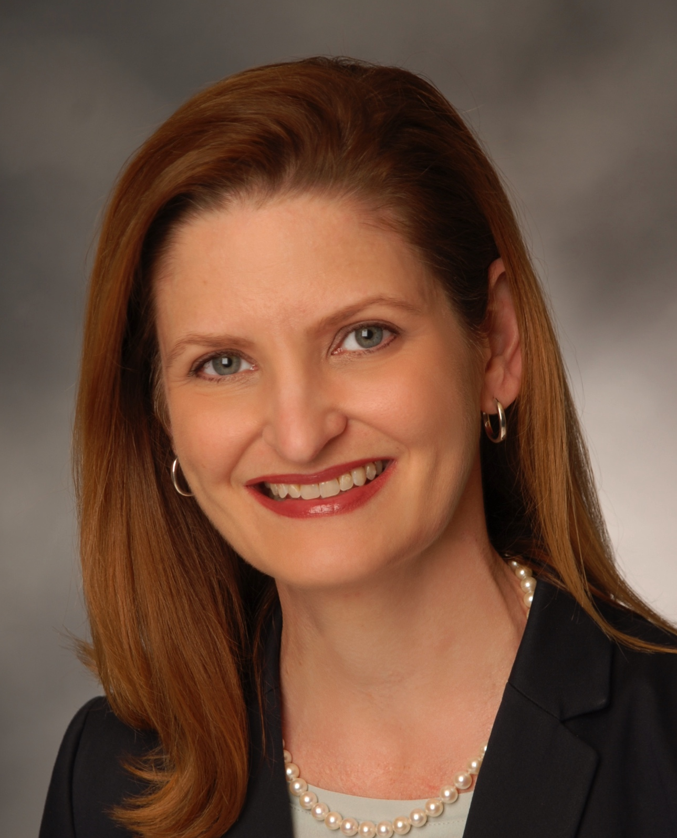
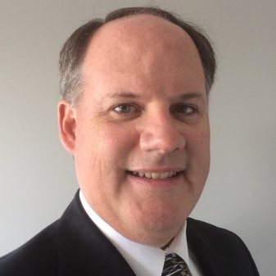
Chair
Barbara Jinks (Australia)
Director LNG18
Vice Chair Hansch van der Velden (Netherlands)
VP Corporate Communications, Gasunie
Study Group 1 – The role of public acceptance in business decisions. Lead: Marcel Hoenderdos (Netherlands), Manager Communications and Public Affairs at EBN
Study Group 2 - Marketing the benefits of LNG in marine transportation. Lead: Tracy Burleson (USA), Director Communications, AGA.
Study Group 3 – Marketing innovation and innovations in marketing. Lead: Keith Boulton (Canada)
OVERALL: about 20 members from Europe, Australia, Africa and North America

Slide 8
MCC @WGC 2018: One key message, three "insight" sessions
Key message: “Effective communications opens minds and markets”
Combining forces:
One message, one report, with every study group contributing
Preparing three WGC Insights Sessions and one TIC session
Three distinct parts:
Recommendation on new ways of public and local stakeholder engagement strategies
Recommendations on best practice for communications on clean air in marine transport and role natural gas plays in this.
Recommendations on more effective marketing of new innovative products & services of the gas market, as well as on how to communicate on innovation as a sector.
Call for papers on all three topics.
FUELING THE FUTURE

Slide 9
Working on a new dialogue for gas.
The IGU Marketing & Communications Committee contribution to the ‘global voice for gas’
Dialogue with society is central to the role of natural gas in the future.
Natural gas: old tree looking for new roots
But what are new, creative and more effective ways to engage in this dialogue?
Soundbites
“If you do something for me - without involving me, you do it against me.“ Marcel
“Communicate in question marks, not just exclamation marks.” Hansch
“Communication is a contact sport.” Dimitri
And how can we apply these to key themes for our sector:
Public acceptance of gas projects
Sustainability
Clean air
Innovation
FUELING THE FUTURE

Slide 10
The IGU stakeholder engagement model is at the heart of our approach to dialogue.

Slide 11
Podcast & webcast series continues…
Live from Berlin (March 2016)
Paul Rasmussen on IGU vision and COP21
Marcel Hoenderdos on multi-stakeholder approach
Alex Burnett on IGU advocacy
Live from Amsterdam (October 2016)
Mel Ydreos on IGU and clean air
Tjerk Wagenaar on NGO and gas collaboration
Coby van der Linden on gas and clean air and collaboration
Podcast from Toronto (October 2017)
Paula Dunlop, VP Corp &Strategic Affairs, CGA
Susan Waller, VP Stakeholder Eng & Enterprise Public Awareness Programs
Next one in Barcelona?
FUELING THE FUTURE

Slide 12
MCC at the World Gas Conference
Sessions
FUELING THE FUTURE

Slide 13
What is important in our WGC sessions?
Have insights from in & outside of the industry
Find diversity in speakers
Work with speakers to ensure content and delivery works for us.
Make sure it is interactive session – with plenty of input from the audience. We push dialogue – so let’s ensure dialogue.
Dare to be different in your approach.
Format:
Intro 2 minutes (Barbara)
Kick-off 5 minutes (Moderator = study group leader)
7 minute per speaker + couple questions for the speaker
Open up for questions and panel discussion
FUELING THE FUTURE WITH GAS

Slide 14
MCC in Washington
Current Issues Debate Tue 26 Jun 1100-1220 | IGU | Public perception: our reputation matters
Industry Insights Session Tue 26 Jun 1610 hrs | Run, Marcel | Power of the people
Technical & Innovation Center Wed 27 Jun 1020 hrs | Run, Barbara | Best practice in gas industry marketing & comms
Industry Insights Session Thu 28 Jun 1615 hrs | Run, Tracy | LNG and marine transportation
Current Issues Debate Fri 28 Jun 1050 hrs | IGU | Forecasting the future
Industry Insights Session Fri 29 Jun 1340 hrs | Run, Keith | Marketing innovation and innovations in marketing.
FUELING THE FUTURE WITH GAS

Slide 15
Industry Insight Sessions MCC
FORMAT | DESCRIPTION
Panel Discussion | Speakers given 7 minutes to position themselves within session topic No PowerPoint slides are required for this session – but 2 recommended (more allowed). Dynamic debate and discussion facilitated by the session moderator(s) Question & Answers from audience
FUELING THE FUTURE

Slide 16
Technical and Innovation Center
FORMAT | DESCRIPTION
Presentations | 10 minute PowerPoint Presentation per speaker Question & Answers from audience following Presentations
Panel Discussion | Speakers given 5 minutes to position themselves within session topic No PowerPoint slides are required for this session Dynamic debate and discussion facilitated by the session moderator Question & Answers from audience
Demo Sessions [applies to New Technology sessions only] | 15 Minute interactive demonstration of new technology Opportunity for Speaker to actually show audience how new technology looks, feels and works. Questions & Answers from the audience facilitated by the Moderator
FUELING THE FUTURE

Slide 17
Industry Insight: Power of the People
Monica Gattinger, University of Ottowa
Jan Willem van Hoogstraten, EBN
Susan Waller, Enbridge
Olav Skalmeraas, VP, Statoil, Norway Statoil *
Mrs Sarah Sandberg,
Colorado Oil & Gas Association, Denver *
Moderator(s): Marcel & Dimitri
Reserve speakers: Hansch, Dimitri, Keith, Marcel
Authors of papers selected:
Adam Zrodlowski, EDI >> for TIC session
Amandeep Singh, Corporate Communication, Indraprastha Gas Limited >> TIC session
*Confirmed by CWC

Slide 18
Industry Insight: LNG in Marine Transportation
??, USA CLNG
Ulco Vermeulen, Gasunie
UN Environment and/or Mike Utsler
(via Barbara)
Kamil Sobczak, SSLNG, Russia*
Minjie Wu, CNPC, China*
Moderator(s): Tracy
Reserve: Hansch
?? Women speakers
* Confirmed by CWC

Slide 19
Industry Insight: Marketing innovation & innovations in marketing
Gerald Linke DVGW – Energy Impulse
Sarah van der Paelt, Union Gas*
Barbara Pichayrou, GRTgaz*
Kimball Chem, WLPGA?
Dennis Puyvelde, ENA
Moderator (s): Keith
Reserve: Barbara on ERIG / ENA, Keith (and replace moderator)
* Confirmed by CWC

Slide 20
TIC: Best Practice in Gas Industry Marketing & Comms
Adam Zrodlowsk, Uni Groningen/EDI*
Cameron Madgwick,
CEO, Petroleum Expl. & Production Association of NZ
Frank Graf , Director gas technology, Englert-bunte- Institut des KIT
Amandeep Singh Narang, Indraprastha Gas Ltd*
Ana Stanic (UK),
Energy Advsior,
E&A Law Ltd
Ying Luo (Australia),
Markets Analyst,
Santos Ltd
Moderator: Barbara Jinks
Speaker:+ Women speakers
+ Not selected for session
* Confirmed by CWC

Slide 21
WGC2018 paper submissions

Slide 22
Lists of picked papers
Marketing & Communication: 1. (Industry Insights) Power of the people: the role of public acceptance in business decisions
Revisions to Session Title (if applicable):
ID | Presenting Author Name | Organization | Abstract Title
256 | Mr Olav Skalmeraas | Statoil | PUBLIC PERCEPTION AND KNOWLEDGE - KEY FOR THE FUTURE OF NATURAL GAS
811 | Mr Amandeep Singh Narang | Indraprastha Gas Limited | USE OF STRATEGIC COMMUNICATION TO OVERCOME THE CHALLENGE OF ODD – EVEN
856 | Mr Adam Zrodlowski | University of Groningen/ Energy Academy Europe | THE ROLE OF PUBLIC ACCEPTANCE IN BUSINESS DECISIONS: THE CASE OF THE NETHERLANDS
1012 | Mrs Sarah Sandberg | Colorado Oil & Gas Association | BEYOND THE FRACKING DEBATE: CURRENT DYNAMICS OF ACTIVISM AND ENGAGEMENT
Marketing & Communication: 2. (Industry Insights) Marketing the benefits of LNG in marine transportation
Revisions to Session Title (if applicable):
ID | Presenting Author Name | Organization | Abstract Title
288 | Mr Minjie Wu | CNPC Economics&technology Research Institute | STATUS AND PROSPECT OF LNG FUELED SHIP IN CHINA
335 | Mr Kamil Sobczak | SSLNG Initiative | HOW TO INCREASE DEMAND FOR SSLNG BY USING COMMUNICATION STRATEGY?
Marketing & Communication: 3. (Industry Insights) Marketing innovation and innovations in marketing
Revisions to Session Title (if applicable):
ID | Presenting Author Name | Organization | Abstract Title
71 | Ms Barbara Pichayrou | GRTgaz | GAME OF FLOWS, THE SERIOUS GAME TO CO-BUILD THE FUTURE FRENCH MARKET PLACE WITH THE CUSTOMERS
727 | Dr Volker Bartsch | DVGW | HOW TO PLACE NATURAL GAS SOLUTIONS IN CLIMATE NEUTRAL ENERGY SYSTEMS OF THE FUTURE
879 | Ms Sarah Van Der Paelt | Union Gas | GAINING MARKET ACCEPTANCE OF CNG LONG HAUL TRACTORS – ONE TRUCK AT A TIME

Slide 23
MCC Report “Open Minds and Markets”
Outline and next steps
FUELING THE FUTURE

Slide 24
Executive summary
5 Trends in Comms
Issues global
Audience assertive & equal
Audience decide on channel and timing
Audience can mobilize
A multipolar world / polarized
Authentic engagement over scripted PR
The context for natural gas companies is changing fast.
The natural gas sector has every opportunity to play a major role in the energy future if we accept expectations change and we act to meet society’s needs.
Open minds and markets talks to our belief that first we have to get stakeholders to have an open mind towards NG – before we can open their minds to commercial solutions that NG brings.
It will need dialogue and communications for this to happen… for stakeholder to accept our premise.
For public acceptance this means XXX
Message 1 - 3
For marketing LNG in shipping
Message 1 - 3
For innovation in marketing communications
Message 1-3

Slide 25
DRAFT key messages public acceptance
Public acceptance starts wit accepting the public
Start early, dedicate people and don’t let anyone slide under the table
Every audience needs its own approach
The only reliable source is your neighbour / friend

Slide 26
Clean air and marine – draft messages
Messages:
Opportunities: By adding LNG fueled international shipping vessels, emissions can be lowered and air quality will be improved.
Communications: It is key to communicate the opportunities for the gas industry and the capabilities of LNG as a safe, cleaner maritime fuel.
Benefits: LNG provides environmental advantages and it is a global commodity.
Reflect:
The case studies demonstrate how the entire value chain working together can provide a solution to reduce emissions and improve air quality.

Slide 27
DRAFT – key messages innovation
Top Three Key Messages:
The use of innovative marketing techniques can significantly advance the adoption (demand creation) of natural gas uses and/or position natural gas/renewable gas for the future. In many areas around the globe, positioning natural gas within the energy mix for the future can benefit from innovative marketing approaches to create awareness of the many advantages of natural gas.
The use of traditional media, social media and B2B marketing techniques can be an effective tool in opening up the minds of policy makers, customers and stakeholders. To support and advance climate objectives, natural gas proponents must be willing to try new approaches, invest in new marketing approaches; traditional benefits of price and reliability are insufficient advantages when issues of CO2 and clean air are top of mind
Audiences must see a compelling vision of the future where NG plays a central role in their lives - strong visual demonstration of our world with natural gas, in a sustainable, lower carbon world is required to influence outcomes. To truly open minds and in turn markets, the NG industry must shift from relying solely on a technical argument to win an emotional battle. (hearts and minds)

Slide 28
Actions
Barbara ensures speakers are invited by WGC team (CWC)
Keith/Tracy/Marcel send update report to Dimitri <27 November
Hans and Dimitri to draft executive summary in January and prepare overaching message for all 3 sessions
Arrange interview with Barbara on first day WGC
Barbara to write an article for IGU newsletter on topics @WGC
Dimitri & Hansch will draft a mini press kit
Keith/Tracy/Marcel to prepare 3 short articles on each SG/topic
Tracy to check if podcasts are possible during WGC
Tracy to check if Toronto podcast can be used for article in IGU magazine
Dimitri to check if podcast can be shared through link in newsletter

