Slide 1
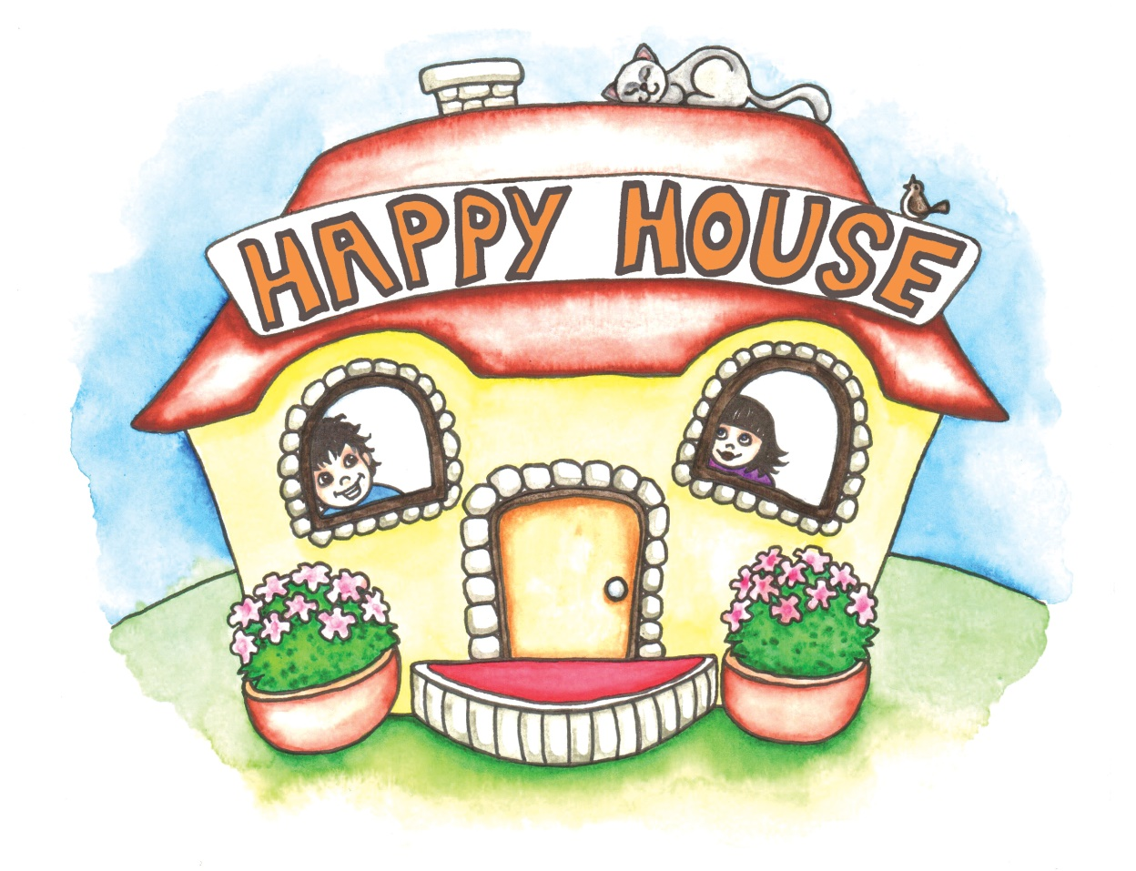
Local joy for global happiness

Slide 2
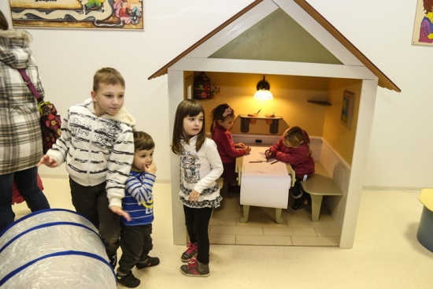
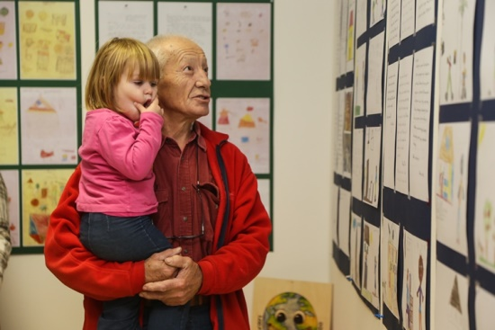
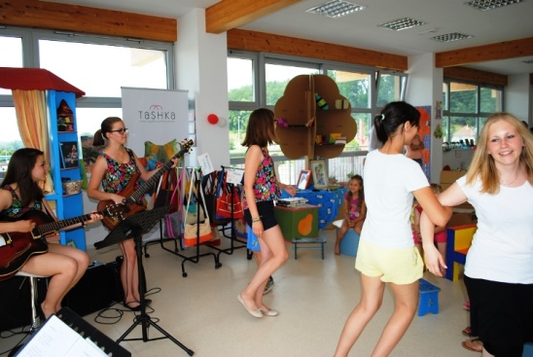
THE OBJECTIVE OF THE PROJECT is to show through social events and responsible projects/activities how locally initiated joy can promote global happiness. From local to global!
Local joy for global happiness

Slide 3
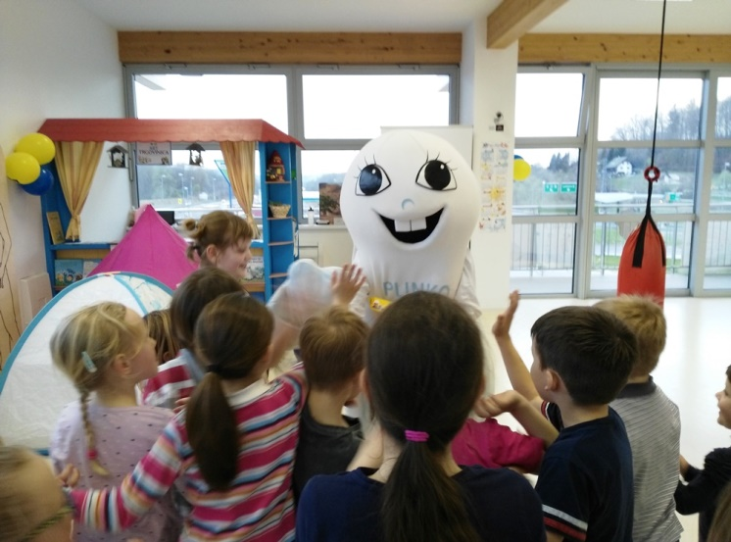
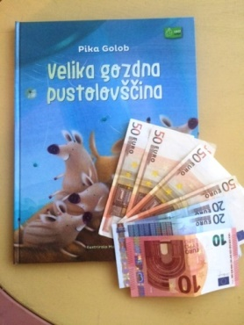
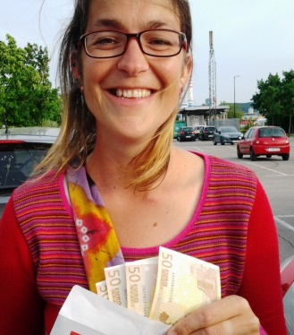
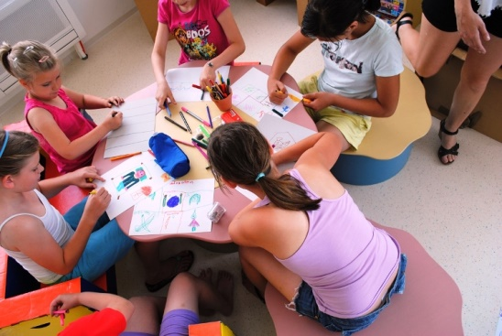
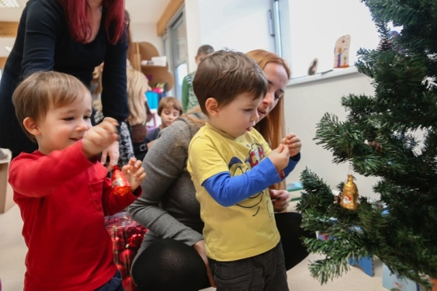
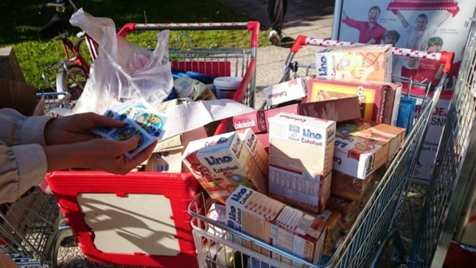
Excellent offer:
Local joy for global happiness
ECO playrooms for the little ones
Reading and study corners for pupils and students
Responsible events
Learning help for pupils
ART shop with local products

Slide 4
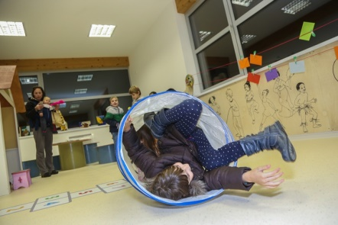
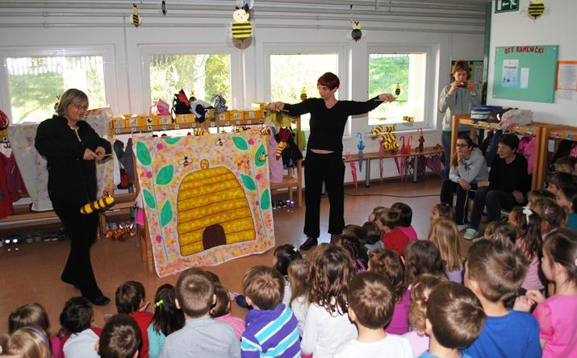
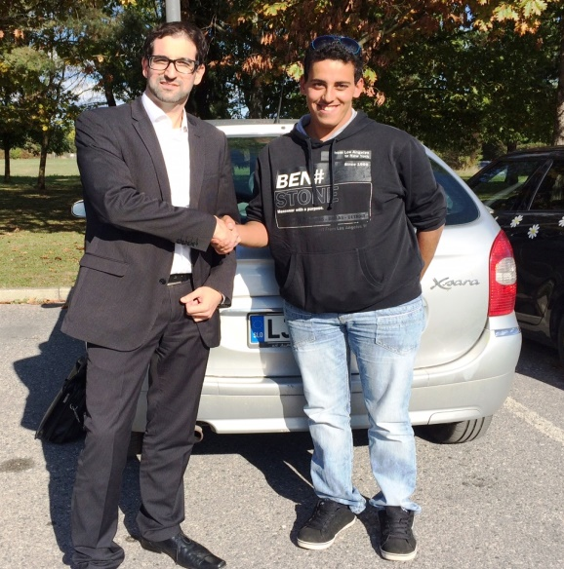
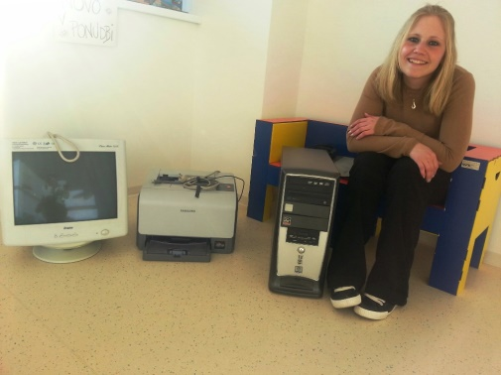
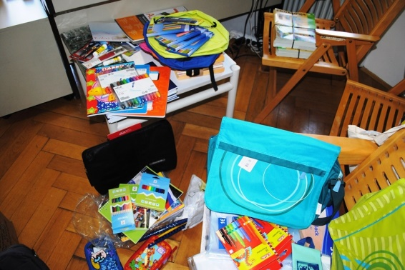
ECO playroom
Local joy for global happiness
Playroom with wooden ECO toys and walls covered in
illustrations by Nina Meglič and Ajda Erznožnik
Book & study corner
A library (eco books) and learning assistance (pedagogue)
Responsible events
Kids‘ theater, book presentations and various worshops for all target groups
ART shop
Jewellery and crafts products of local artists

Slide 5
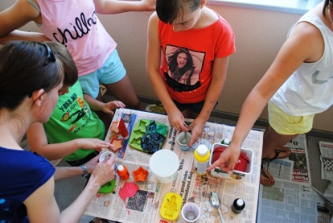
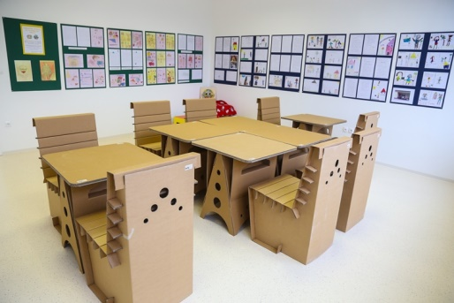
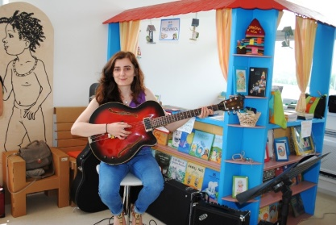
Social services and community
Local joy for global happiness
Job creation, workshops and lectures, summer schools, day care during vacation
Creativity and art
Workshops for children – drawing with Nina, Little Green Fingers with Jerneja, music and multimedia art, ECO contests
Responsibility and economy
Raising money through events for the needy (Social Work Centre Domžale, families from Lukovica, Ana’s Little Star, etc.)
Ecology and sustainable living
Healthy lifestyle, contests and awards,
integration and cooperation

Slide 6
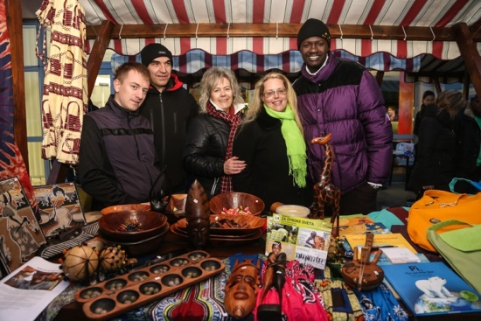
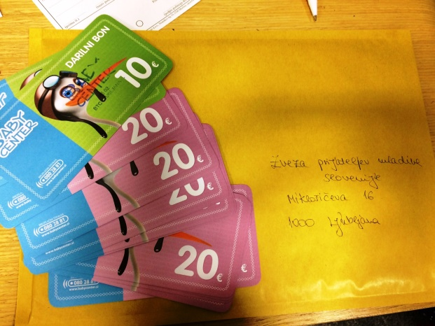
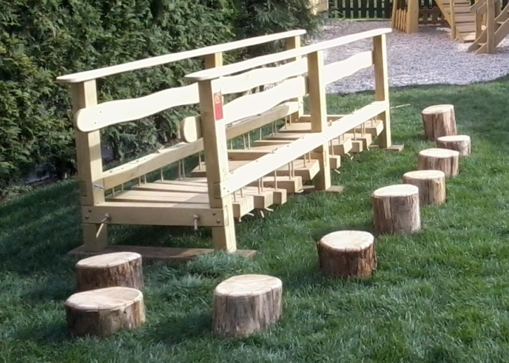
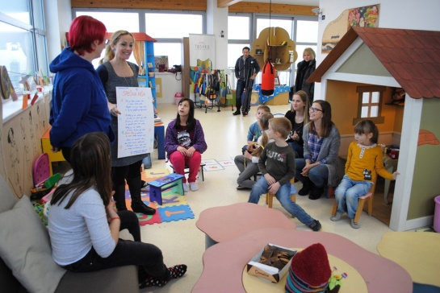
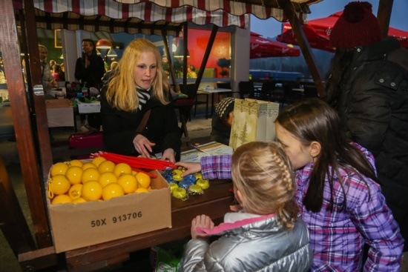
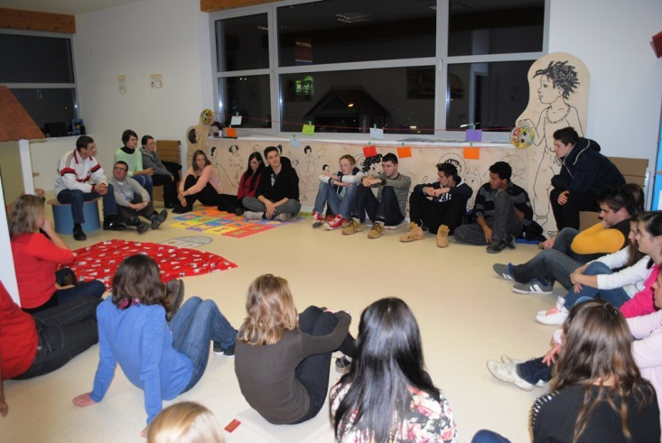
Caring for the others…
Local joy for global happiness

Slide 7
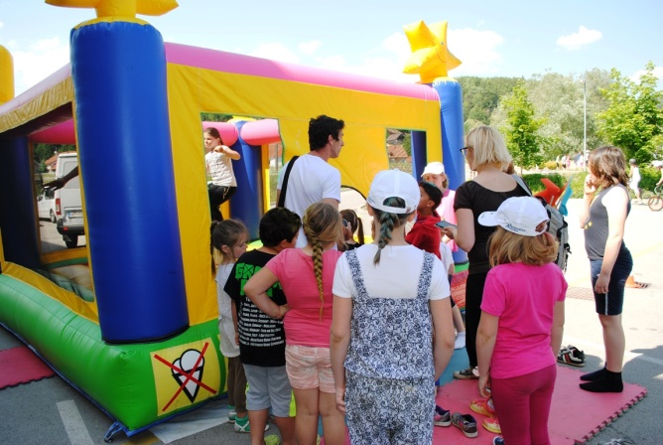
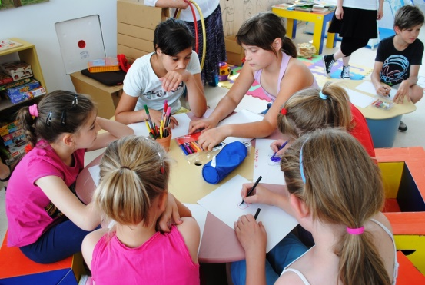
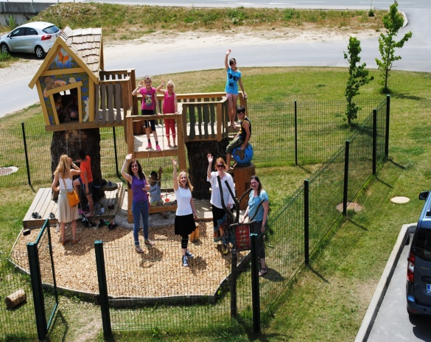
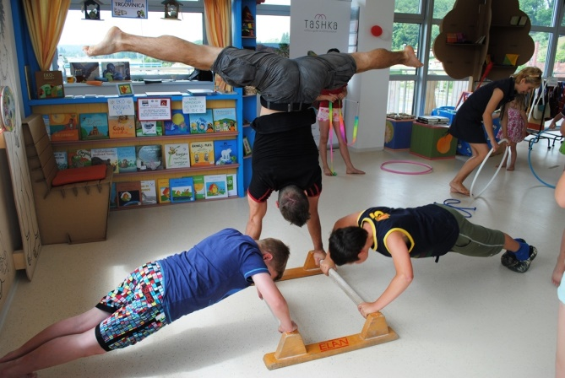
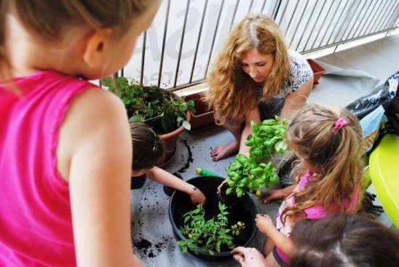
We support local joy for global happiness!
Local joy for global happiness
More info:
alenka@srecnahisa.si
00386 031 673 236
http://www.srecnahisa.si/en

